Slide 1
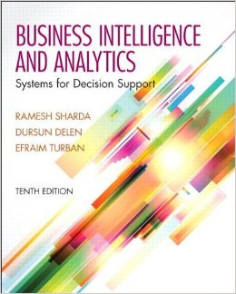
Business Intelligence and Analytics: Systems for Decision Support
(10th Edition)
Chapter 14:
Business Analytics: Emerging Trends and Future Impacts

Slide 2
Location-Based Analytics
Geospatial Analytics
Geocoding
Visual maps
Postal codes
Latitude & Longitude
Enables aggregate view of a large geographic area
Integrate “where” into customer view

Slide 3
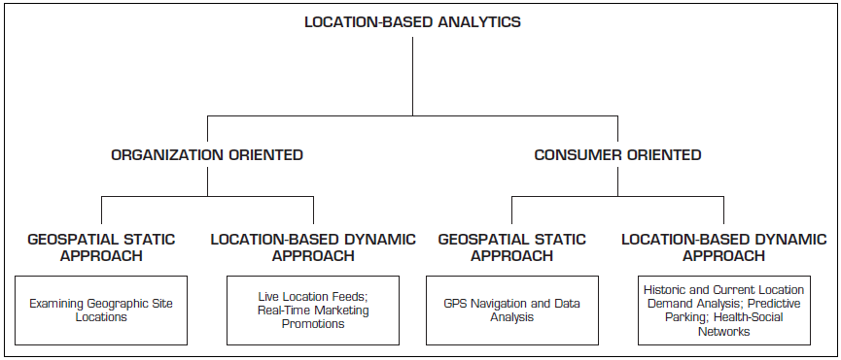
Location-Based Analytics

Slide 4
Location-Based Analytics
Location-based databases
Geographic Information System (GIS)
Used to capture, store, analyze, and manage the data linked to a location
Combined with integrated sensor technologies and global positioning systems (GPS)
Location Intelligence (LI)?
Interactive maps that further drill down to details about any location

Slide 5
Use of Location-Based Analytics
Retailers – location + demographic details combined with other transactional data can help …
determine how sales vary by population level
assess locational proximity to other competitors and their offerings
assess the demand variations and efficiency of supply chain operations
analyze customer needs and complaints
better target different customer segments

Slide 6
Use of Location-Based Analytics
Global Intelligence
U.S. Transportation Command (USTRANSCOM)
track the information about the type of aircraft
maintenance history
complete list of crew
equipment and supplies on the aircraft
location of the aircraft
→ well-informed decisions for global operations
Overlaying weather and environmental data
Teradata, NAVTEQ, Tele Atlas …

Slide 7
Geospatial Analytics Examples
Sabre Airline Solutions’ application
Traveler Security
Geospatial-enabled dashboard
Assess risks across global hotspots
Interactive maps
Find current travelers
Respond quickly in the event of any travel disruption
Telecommunication companies
Analysis of failed connections
See the Multimedia Exercise, next

Slide 8
Real-Time Location Intelligence
Many devices are constantly sending out their location information
Cars, airplanes, ships, mobile phones, cameras, navigation systems, …
GPS, Wi-Fi, RFID, cell tower triangulation
Reality mining?
Real-time location information = real-time insight
Path Intelligence (pathintelligence.com)
Footpath – movement patterns within a city or store
How to use such movement information

Slide 9
Real-Time Location Intelligence
Targeting right customer based on their behavior over geographic locations
Example Radii app
Collects information about the user’s favorite locations, habits, interests, spending patterns, …
Radii uses the Gimbal Context Awareness SDK
Combines time + place + duration + action + …
Assigns Location Personality → Recommendation
New members receive 10 “Radii” to spend
Radii can be earned and spent on those locations
For more info, search for radii app on the Internet

Slide 10
Real-Time Location Intelligence
Augmented reality
Cachetown - augmented reality-based game
Encourage users to claim offers from select geographic locations
User can start anywhere in a city and follow markers on the Cachetown app to reach a coupon, discount, or offer from a business
User can point a phone’s camera toward the virtual item through the Cachetown app to claim it
Claims → free good/discount/offer from a nearby business
For more info, go to cachetown.com/press

Slide 11
Analytics Applications for Consumers
Explosive growth of the apps industry
iOS, Android, Windows, Blackberry, Amazon, …
Directly used by consumers (not businesses)
Enabling consumers to become more efficient
Interesting Examples
CabSense – finding a taxi in New York City
Rating of street corners; interactive maps, …
ParkPGH – finding a parking spot
Downtown Pittsburgh, Pennsylvania
For a related example, see Application Case 14.3, next

Slide 12
Recommendation Engines
People rely on recommendations by others
Success for retailer line Amazon.com
Recommender systems
Web-based information filtering system that takes the inputs from users and then aggregates the inputs to provide recommendations for other users in their product or service selection choices
Data
Structured → ratings/rankings
Unstructured → textual comments

Slide 13
Recommendation Engines
Two main approaches for recommendation systems
Collaborative filtering
Based on previous users’ purchase/view/rating data
Collectively deriving user ⬄ item profiling
Use this knowledge for item recommendations
Techniques include user-item rating matrix, kNN, correlation, …
Disadvantage – requires huge amount of historic data
Content filtering
Based on specifications/characteristics of items (not just ratings)
First, characteristics of an item are profiled, and then the content-based individual user profiles are built
Recommendations are made if there are similarities found in the item characteristics
Techniques include decision trees, ANN, Bayesian classifiers

Slide 14
The Web 2.0 Revolution and Online Social Networking
Web 2.0?
Advanced Web - blogs, wikis, RSS, mashups, user-generated content, and social networks
Objective – enhance creativity, information sharing, and collaboration
Changing the Web from passive to active
Consumer is the one that creates the content
Redefining what is on the Web as well as how it works
Companies are adopting and benefiting from it

Slide 15
Representative Characteristics of Web 2.0
Allows tapping into the collective intelligence of users
Data is made available in new or never-intended ways
Relies on user-generated/user-controlled content/data
Lightweight programming tools for wider access
The virtual elimination of software-upgrade cycles
Users can access applications entirely through a browser
An architecture of participation and digital democracy
A major emphasis is on social networks and computing
Strong support for information sharing and collaboration
Fosters rapid and continuous creation of new business models

Slide 16
Social Networking
Social networking gives people the power to share, making the world open/connected
Facebook, LinkedIn, Google+, Orkut, …
Wikipedia, YouTube, …
A social network is a place where people create their own space, or homepage, on which they write blogs (Web logs); post pictures, videos, or music; share ideas; and link to other Web locations they find interesting
Mobile social networking

Slide 17
Social Networks - Implications of Business and Enterprise
Enhancing marketing and sales in public social networks
Using Twitter to Get a Pulse of the Market
Listening to the public for opinions/sentiments
Product/service brand management
Text mining, sentiment analysis
How – built in-house or outsource
reputation.com
Share content in a messaging ecosystem
WhatsApp, Draw Something, SnapChat, …

Slide 18
Cloud Computing and BI
A style of computing in which dynamically scalable and often virtualized resources are provided over the Internet.
Users need not have knowledge of, experience in, or control over the technology infrastructures in the cloud that supports them.
Cloud computing = utility computing, application service provider grid computing, on-demand computing, software-as-a-service (SaaS), …
Cloud = Internet
Related “-as-a-services”: infrastructure-as-a-service (IaaS), platforms-as-a-service (PaaS)

Slide 19
Cloud Computing Example
Web-based email → cloud computing application
Stores the data (e-mail messages)
Stores the software (e-mail programs)
Centralized hardware/software/infrastructure
Centralized updates/upgrades
Access from anywhere via a Web browser
e.g., Gmail
Web-based general application = cloud application
Google Docs, Google Spreadsheets, Google Drive,…
Amazon.com’s Web Services

Slide 20
Cloud Computing Example
Cloud computing is used in
e-commerce, BI, CRM, SCM, …
Business model
Pay-per-use
Subscribe/pay-as-you-go
Companies that offer cloud-computing services
Google, Yahoo!, Salesforce.com
IBM, Microsoft (Azure)
Sun Microsystems/Oracle

Slide 21
Cloud Computing and BI
Cloud-based data warehouse
1010data, LogiXML, Lucid Era
Cloud-based ERP+DW+BI
SAP, Oracle
Elastra and Rightscale
Amazon.com and Go Grid
SaaS
DaaS
SaaS
DaaS
+ IaaS

Slide 22
Cloud Computing and Service-Oriented Thinking
Service-oriented thinking is one of the fastest-growing paradigms today
Toward building agile data, information, and analytics capabilities as services
Service orientation + DSS/BI
Component-based service orientation fosters
Reusability, Substitutability, Extensibility, Scalability, Customizability, Reliability, Low Cost of Ownership, Economy of Scale,…

Slide 23
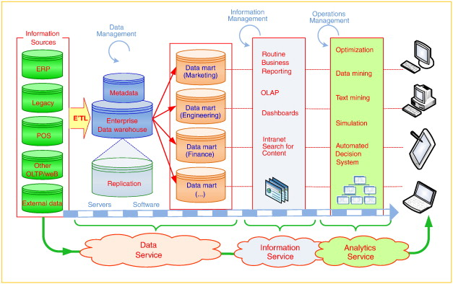
Service-Oriented DSS/BI

Slide 24
Major Components of Service-Oriented DSS/BI
Data-as-a-Service (DaaS)
Accessing data “where it lives”
Enriching data quality with centralization
Better MDM, CDI
Access the data via open standards such as SQL, XQuery, and XML
NoSQL type data storage and processing
Amazon’s SimpleDB
Google’s BigTable

Slide 25
Major Components of Service-Oriented DSS/BI
Information-as-a-Service (IaaS)
“Information on Demand”
Goal is to make information available quickly to people, processes, and applications across the business (agility)
Provides a “single version of the truth,” make it available 24/7, and by doing so, reduce proliferating redundant data and the time it takes to build and deploy new information services
SOA, flexible data integration, MDM, …

Slide 26
Major Components of Service-Oriented DSS/BI
Analytics-as-a-Service (AaaS)
“Agile Analytics”
AaaS in the cloud has economies of scale, better scalability, and higher cost savings
Data/Text Mining + Big Data → Cloud Computing
Storage and access to Big Data
Massively Parallel Processing
In-memory processing
In-database processing
Resource polling, scaling, cost and time saving, …

Slide 27
Impacts of Analytics in Organizations: An Overview
New Organizational Units
Analytics departments
Chief Analytics Officer, Chief Knowledge Officer
Restructuring Business Processes and Virtual Teams
Reengineering and BPR
Job Satisfaction
Job Stress and Anxiety
Impact on Managers’ Activities/Performance

Slide 28
Issues of Legality, Privacy, and Ethics
Legal issues to consider
What is the value of an expert opinion in court when the expertise is encoded in a computer?
Who is liable for wrong advice (or information) provided by an intelligent application?
What happens if a manager enters an incorrect judgment value into an analytic application?
Who owns the knowledge in a knowledge base?
Can management force experts to contribute their expertise?

Slide 29
Issues of Legality, Privacy, and Ethics
Privacy
“the right to be left alone and the right to be free from unreasonable personal intrusions”
Collecting Information About Individuals
How much is too much?
Mobile User Privacy
Location-based analysis/profiling
Homeland Security and Individual Privacy
Recent Issues in Privacy and Analytics
“What They Know” about you (wsj.com/wtk)
Rapleaf (rapleaf.com), X + 1 (xplusone.com), Bluecava (bluecava.com), reputation.com, sociometric.com...

Slide 30
Issues of Legality, Privacy, and Ethics
Ethics in Decision Making and Support
Electronic surveillance
Software piracy
Invasion of individuals’ privacy
Use of proprietary databases
Use of knowledge and expertise
Accessibility for workers with disabilities
Accuracy of data, information, and knowledge
Protection of the rights of users
Accessibility to information
Personal use of corporate computing resources
… more in the book

Slide 31
An Overview of The Analytics Ecosystem
Analytics Industry Clusters
Data Infrastructure Data Warehouse Providers
Middleware/BI Platform Industry
Data Aggregators/Distributors
Analytics-Focused Software Developers
Application Developers or System Integrators
Analytics User Organizations
Analytics Industry Analysts and Influencers
Academic Providers and Certification Agencies

Slide 32
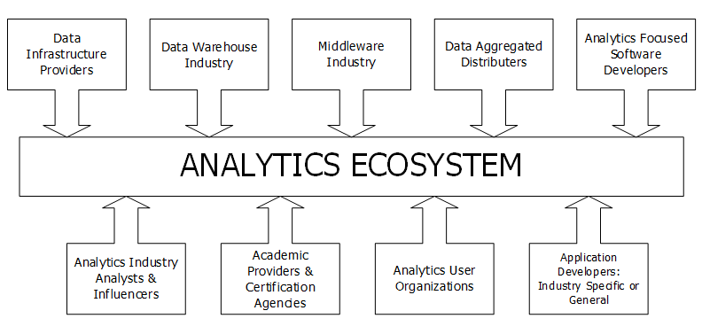
Analytics Ecosystem

Slide 33
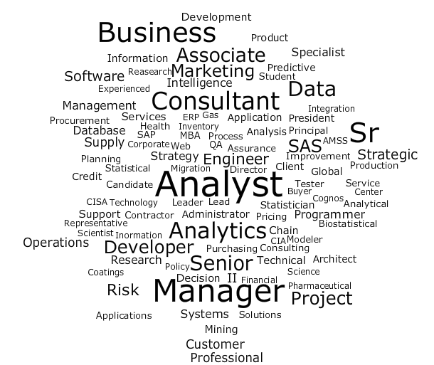
Analytics Ecosystem - Titles of Analytics Program Graduates
Masters Degrees
UG Degrees
Certificate Programs
…
Data Scientist
…
Decision Science
Marketing Analytics
Management Science
…

Slide 34
End of the Chapter
Questions, comments

