Slide 1
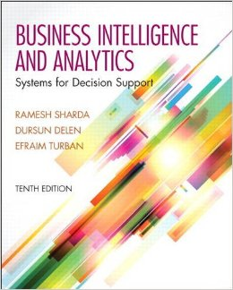
Business Intelligence and Analytics: Systems for Decision Support
(10th Edition)
Chapter 13:
Big Data Analytics

Slide 2
Learning Objectives
Learn what Big Data is and how it is changing the world of analytics
Understand the motivation for and business drivers of Big Data analytics
Become familiar with the wide range of enabling technologies for Big Data analytics
Learn about Hadoop, MapReduce, and NoSQL as they relate to Big Data analytics
Understand the role of and capabilities/ skills for data scientist as a new analytics profession
(Continued…)

Slide 3
Learning Objectives
Compare and contrast the complementary uses of data warehousing and Big Data
Become familiar with the vendors of Big Data tools and services
Understand the need for and appreciate the capabilities of stream analytics
Learn about the applications of stream analytics

Slide 4


Opening Vignette…
Big Data Meets Big Science at CERN
Situation
Problem
Solution
Results
Answer & discuss the case questions.

Slide 5
Questions for the Opening Vignette
What is CERN, and why is it important to the world of science?
How does the Large Hadron Collider work? What does it produce?
What is the essence of the data challenge at CERN? How significant is it?
What was the solution? How were the Big Data challenges addressed with this solution?
What were the results? Do you think the current solution is sufficient?

Slide 6
Big Data -
Definition and Concepts
Big [volume] Data is not new!
Big Data means different things to people with different backgrounds and interests
Traditionally, “Big Data” = massive volumes of data
  E.g., volume of data at CERN, NASA, Google, …
Where does the Big Data come from?
  Everywhere! Web logs, RFID, GPS systems, sensor networks, social networks, Internet-based text documents, Internet search indexes, detail call records, astronomy, atmospheric science, biology, genomics, nuclear physics, biochemical experiments, medical records, scientific research, military surveillance, multimedia archives, …

Slide 7
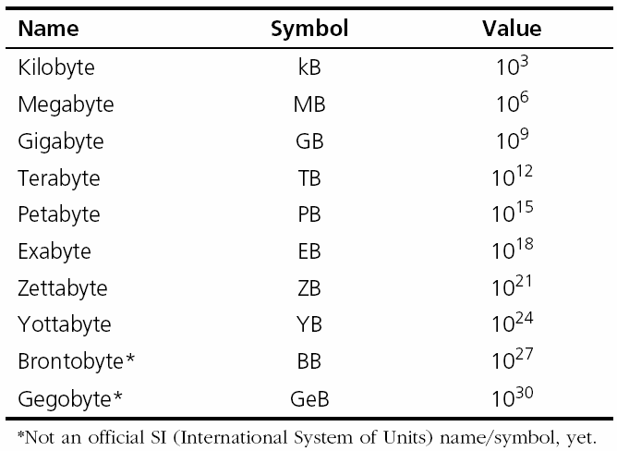
Technology Insights 6.1
The Data Size Is Getting Big, Bigger…
Hadron Collider - 1 PB/sec
Boeing jet - 20 TB/hr
Facebook - 500 TB/day.
YouTube – 1 TB/4 min.
The proposed Square Kilometer Array telescope (the world’s proposed biggest telescope) – 1 EB/day
Names for Big Data Sizes

Slide 8

Big Data -
Definition and Concepts
Big Data is a misnomer!
Big Data is more than just “big”
The Vs that define Big Data
  Volume
  Variety
  Velocity
  Veracity
  Variability
  Value
  …

Slide 9
A High-level Conceptual Architecture for Big Data Solutions
(by AsterData / Teradata)

Slide 10
Application Case 13.1
BigData Analytics Helps Luxottica Improvement its Marketing Effectiveness
Questions for Discussion
What does “big data” mean to Luxottica?
What were their main challenges?
What were the proposed solution and the obtained results?

Slide 11
Fundamentals of
Big Data Analytics
Big Data by itself, regardless of the size, type, or speed, is worthless
Big Data + “big” analytics = value
With the value proposition, Big Data also brought about big challenges
  Effectively and efficiently capturing, storing, and analyzing Big Data
  New breed of technologies needed (developed (or purchased or hired or outsourced …)

Slide 12
Big Data Considerations
You can’t process the amount of data that you want to because of the limitations of your current platform.
You can’t include new/contemporary data sources (e.g., social media, RFID, Sensory, Web, GPS, textual data) because it does not comply with the data schema.
You need to (or want to) integrate data as quickly as possible to be current on your analysis.
You want to work with a schema-on-demand data storage paradigm because the variety of data types.
The data is arriving so fast at your organization’s doorstep that your analytics platform cannot handle it.
…

Slide 13
Critical Success Factors for
Big Data Analytics
A clear business need (alignment with the vision and the strategy)
Strong, committed sponsorship (executive champion)
Alignment between the business and IT strategy
A fact-based decision-making culture
A strong data infrastructure
The right analytics tools
Right people with right skills

Slide 14
Critical Success Factors for
Big Data Analytics

Slide 15
Enablers of Big Data Analytics
In-memory analytics
  Storing and processing the complete data set in RAM
In-database analytics
  Placing analytic procedures close to where data is stored
Grid computing & MPP
  Use of many machines and processors in parallel (MPP- massively parallel processing)
Appliances
  Combining hardware, software and storage in a single unit for performance and scalability

Slide 16
Challenges of Big Data Analytics
Data volume
  The ability to capture, store, and process the huge volume of data in a timely manner
Data integration
  The ability to combine data quickly/cost effectively
Processing capabilities
  The ability to process the data quickly, as it is captured (i.e., stream analytics)
Data governance (… security, privacy, access)
Skill availability (… data scientist)
Solution cost (ROI)

Slide 17
Business Problems Addressed by
Big Data Analytics
Process efficiency and cost reduction
Brand management
Revenue maximization, cross-selling/up-selling
Enhanced customer experience
Churn identification, customer recruiting
Improved customer service
Identifying new products and market opportunities
Risk management
Regulatory compliance
Enhanced security capabilities
…

Slide 18
Application Case 13.2
Top 5 Investment Bank Achieves Single Source of the Truth
Questions for Discussion
How can Big Data benefit large-scale trading banks?
How did MarkLogic infrastructure help ease the leveraging of Big Data?
What were the challenges, the proposed solution, and the obtained results?

Slide 19
Application Case 13.2
Moving from many old systems to a unified new system

Slide 20



Big Data Technologies
MapReduce …
Hadoop …
Hive
Pig
Hbase
Flume
Oozie
Ambari
Avro
Mahout, Sqoop, Hcatalog, ….

Slide 21
Big Data Technologies
- MapReduce
MapReduce distributes the processing of very large multi-structured data files across a large cluster of ordinary machines/processors
Goal - achieving high performance with “simple” computers
Developed and popularized by Google
Good at processing and analyzing large volumes of multi-structured data in a timely manner
Example tasks: indexing the Web for seearch, graph analysis, text analysis, machine learning, …

Slide 22
Big Data Technologies
- MapReduce
How does
MapReduce
work?

Slide 23

Big Data Technologies
- Hadoop
Hadoop is an open source framework for storing and analyzing massive amounts of distributed, unstructured data
Originally created by Doug Cutting at Yahoo!
Hadoop clusters run on inexpensive commodity hardware so projects can scale-out inexpensively
Hadoop is now part of Apache Software Foundation
Open source - hundreds of contributors continuously improve the core technology
MapReduce + Hadoop = Big Data core technology

Slide 24
Big Data Technologies
- Hadoop
How Does Hadoop Work?
  Access unstructured and semi-structured data (e.g., log files, social media feeds, other data sources)
  Break the data up into “parts,” which are then loaded into a file system made up of multiple nodes running on commodity hardware using HDFS
  Each “part” is replicated multiple times and loaded into the file system for replication and failsafe processing
  A node acts as the Facilitator and another as Job Tracker
  Jobs are distributed to the clients, and once completed the results are collected and aggregated using MapReduce

Slide 25
Big Data Technologies
- Hadoop
Hadoop Technical Components
  Hadoop Distributed File System (HDFS)
  Name Node (primary facilitator)
  Secondary Node (backup to Name Node)
  Job Tracker
  Slave Nodes (the grunts of any Hadoop cluster)
  Additionally, Hadoop ecosystem is made-up of a number of complementary sub-projects: NoSQL (Cassandra, Hbase), DW (Hive), …
    NoSQL = not only SQL

Slide 26
Big Data Technologies
Hadoop - Demystifying Facts
Hadoop consists of multiple products
Hadoop is open source but available from vendors, too
Hadoop is an ecosystem, not a single product
HDFS is a file system, not a DBMS
Hive resembles SQL but is not standard SQL
Hadoop and MapReduce are related but not the same
MapReduce provides control for analytics, not analytics
Hadoop is about data diversity, not just data volume.
Hadoop complements a DW; it’s rarely a replacement.
Hadoop enables many types of analytics, not just Web analytics.

Slide 27
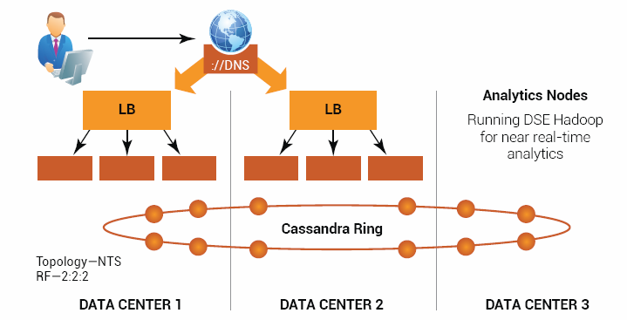
Application Case 13.3
EBay’s Multi Data-Center Deployment
eBay’s
Big Data
Solution
Questions for Discussion
Why did eBay need a Big Data solution?
What were the challenges, the proposed solution, and the obtained results?

Slide 28
Data Scientist
“The Sexiest Job of the 21st Century”
Thomas H. Davenport and D. J. Patil
Harvard Business Review, October 2012
Data Scientist = Big Data guru
  One with skills to investigate Big Data
Very high salaries, very high expectations
Where do Data Scientist come from?
  M.S./Ph.D. in MIS, CS, IE,… and/or Analytics
  There is not a specific degree program for DS!
  PE, PML, … DSP (Data Sceice Professional)

Slide 29
Skills That Define a Data Scientist

Slide 30
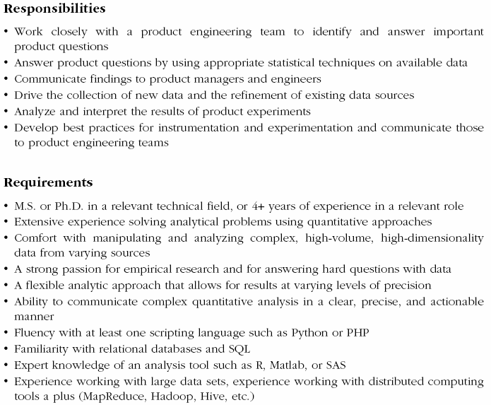
A Typical Job Post for Data Scientist

Slide 31
Application Case 13.4
Big Data and Analytics in Politics
Questions for Discussion
What is the role of analytics and Big Data in modern day politics?
Do you think Big Data analytics could change the outcome of an election?
What do you think are the challenges, the potential solution, and the probable results of the use of Big Data analytics in politics?

Slide 32
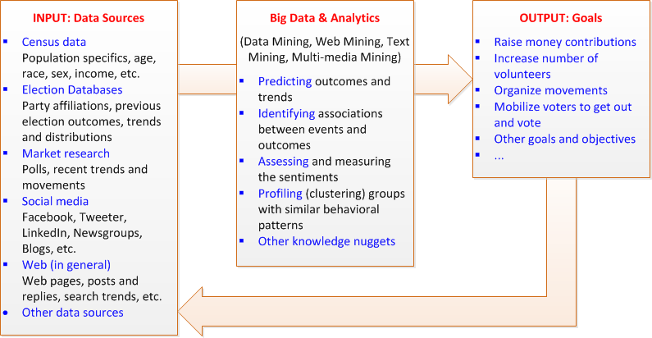
Application Case 13.4
Big Data and Analytics in Politics

Slide 33
Big Data And Data Warehousing
What is the impact of Big Data on DW?
  Big Data and RDBMS do not go nicely together
  Will Hadoop replace data warehousing/RDBMS?
Use Cases for Hadoop
  Hadoop as the repository and refinery
  Hadoop as the active archive
Use Cases for Data Warehousing
  Data warehouse performance
  Integrating data that provides business value
  Interactive BI tools

Slide 34
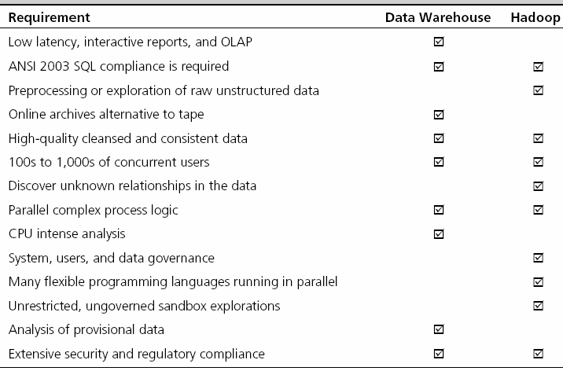
Hadoop versus Data Warehouse
When to Use Which Platform

Slide 35
Coexistence of Hadoop and DW
Use Hadoop for storing and archiving multi-structured data
Use Hadoop for filtering, transforming, and/or consolidating multi-structured data
Use Hadoop to analyze large volumes of multi-structured data and publish the analytical results
Use a relational DBMS that provides MapReduce capabilities as an investigative computing platform
Use a front-end query tool to access and analyze data

Slide 36
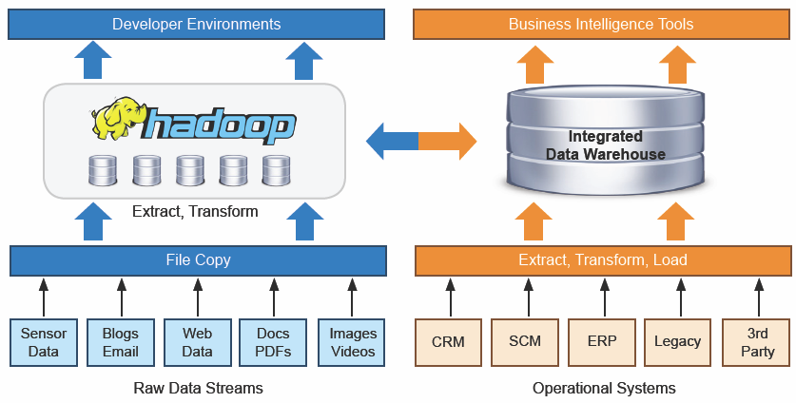
Coexistence of Hadoop and DW
Source: Teradata

Slide 37
Big Data Vendors
Big Data vendor landscape is developing very rapidly
A representative list would include
  Cloudera - cloudera.com
  MapR – mapr.com
  Hortonworks - hortonworks.com
  Also, IBM (Netezza, InfoSphere), Oracle (Exadata, Exalogic), Microsoft, Amazon, Google, …
Software,
Hardware,
Service, …

Slide 38
Top 10 Big Data Vendors with Primary Focus on Hadoop

Slide 39
Application Case 13.5
Dublin City Council Is Leveraging Big Data to Reduce Traffic Congestion
Questions for Discussion
Is there a strong case to make for large cities to use Big Data Analytics and related information technologies? Identify and discuss examples of what can be done with analytics beyond what is portrayed in this application case.
How can a big data analytics help ease the traffic problem in large cities?
What were the challenges Dublin City was facing; what were the proposed solution, initial results, and future plans?

Slide 40

Technology Insights 13.4
How to Succeed with Big Data
Simplify
Coexist
Visualize
Empower
Integrate
Govern
Evangelize

Slide 41
Application Case 13.6
Creditreform Boosts Credit Rating Quality with Big Data Visual Analytics
Questions for Discussion
How did Creditreform boost credit rating quality with Big Data and visual analytics?
What were the challenges, proposed solution, and initial results?

Slide 42
Big Data And Stream Analytics
Data-in-motion analytics and real-time data analytics
One of the Vs in Big Data = Velocity
Analytic process of extracting actionable information from continuously flowing/streaming data
Why Stream Analytics?
  It may not be feasible to store the data
  It may loose its value if not processed immediately
Stream Analytics Versus Perpetual Analytics
Critical Event Processing?

Slide 43
Stream Analytics
A Use Case in Energy Industry

Slide 44
Stream Analytics Applications
e-Commerce
Telecommunication
Law Enforcement and Cyber Security
Power Industry
Financial Services
Health Services
Government

Slide 45
Application Case 13.7
Turning Machine-Generated Streaming Data into Valuable Business Insights
Questions for Discussion
Why is stream analytics becoming more popular?
How did the telecommunication company in this case use stream analytics for better business outcomes? What additional benefits can you foresee?
What were the challenges, proposed solution, and initial results?

Slide 46
End of the Chapter
Questions, comments

Slide 47

All rights reserved. No part of this publication may be reproduced, stored in a retrieval system, or transmitted, in any form or by any means, electronic, mechanical, photocopying, recording, or otherwise, without the prior written permission of the publisher. Printed in the United States of America.
Copyright © 2014 Pearson Education, Inc.

