Slide 1

Business Intelligence and Analytics: Systems for Decision Support
(10th Edition)
Chapter 12:
Knowledge Management and Collaborative Systems

Slide 2
Learning Objectives
Define knowledge and describe the different types of knowledge
Describe the characteristics of KM
Describe the KM cycle
Describe the technologies that can be used in a knowledge management system (KMS)
Describe different approaches to KM
Understand the basic concepts and processes of groupwork, communication, and collaboration
…
(Continued…)

Slide 3
Learning Objectives
Describe how computer systems facilitate communication and collaboration in an enterprise
Explain the concepts and importance of the time/place framework
Explain the underlying principles and capabilities of groupware (group support systems—GSS)
Understand how the Web enables collaborative computing and group support of virtual meetings
Describe the role of emerging technologies in supporting collaboration

Slide 4
Opening Vignette
Expertise Transfer System to Train Future Army Personnel
Background
Problem description
Proposed solution
Results
Answer & discuss the case questions...

Slide 5
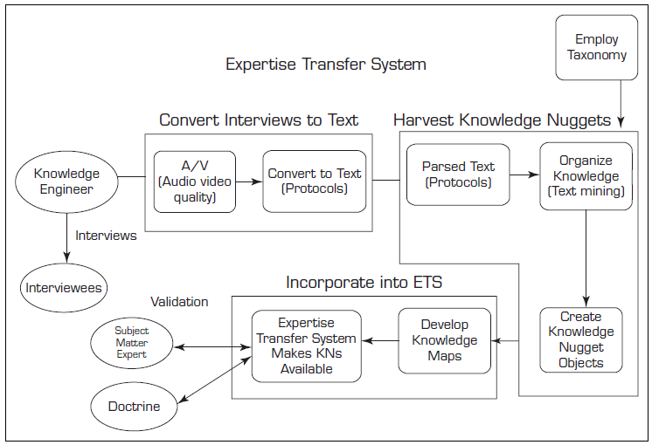
Opening Vignette…

Slide 6
Questions for the Opening Vignette
What are the key impediments to the use of knowledge in a knowledge management system?
What features are incorporated in a knowledge nugget in this implementation?
Where else could such a system be implemented?

Slide 7
Introduction to
Knowledge Management
Knowledge management concepts and definitions
  Knowledge management
  The active management of the expertise in an organization. It involves collecting, categorizing, and disseminating knowledge
  Intellectual capital
  The invaluable knowledge of an organization’s employees

Slide 8
Introduction to
Knowledge Management
Knowledge is
  information that is contextual, relevant, and actionable
  understanding, awareness, or familiarity acquired through education or experience
  anything that has been learned, perceived, discovered, inferred, or understood.
  In a knowledge management system, “knowledge is information in action”

Slide 9
Introduction to
Knowledge Management

Slide 10
Introduction to
Knowledge Management
Characteristics of knowledge
  Extraordinary leverage and increasing returns
  Fragmentation, leakage, and the need to refresh
  Uncertain value
  Uncertain value of sharing
Knowledge-based economy
The economic shift from natural resources to intellectual assets

Slide 11
Introduction to
Knowledge Management
Explicit and tacit knowledge
  Explicit (leaky) knowledge
  Knowledge that deals with objective, rational, and technical material (data, policies, procedures, software, documents, etc.)
  Easily documented, transferred, taught, and learned
  Examples…

Slide 12
Introduction to
Knowledge Management
Explicit and tacit knowledge
  Tacit (embedded) knowledge
  Knowledge that is usually in the domain of subjective, cognitive, and experiential learning.
  It is highly personal and hard to formalize.
  Hard to document, transfer, teach, & learn
  Involves a lot of human interpretation
  Examples…

Slide 13
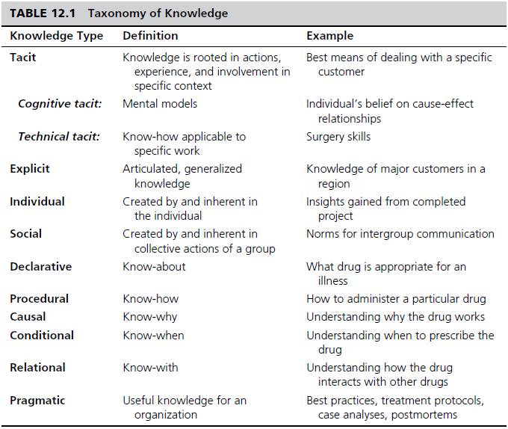
Taxonomy of Knowledge

Slide 14
Organizational Knowledge -
Learning and Transformation
Learning organization
An organization capable of learning from its past experience, implying the existence of an organizational memory and a means to save, represent, and share it through its personnel
Organizational memory
Repository of what the organization knows

Slide 15
Organizational Knowledge -
Learning and Transformation
Organizational culture
The aggregate attitudes in an organization concerning a certain issue (e.g., technology, computers, DSS)
  How do people learn the “culture”?
  Is it explicit or implicit?
  Can culture be changed? How?
  Give some examples of corporate culture: Microsoft, Google, Apple, HP, GM, …

Slide 16
Approaches to
Knowledge Management
Process approach to knowledge management attempts to codify organizational knowledge through formalized controls, processes and technologies
  Focuses on explicit knowledge and IT
Practice approach focuses on building the social environments or communities of practice necessary to facilitate the sharing of tacit understanding
  Focuses on tacit knowledge and socialization

Slide 17
Approaches to
Knowledge Management
Hybrid approaches to knowledge management
  The practice approach is used so that a repository stores only explicit knowledge that is relatively easy to document
  Tacit knowledge initially stored in the repository is contact information about experts and their areas of expertise
  Increasing the amount of tacit knowledge over time eventually leads to the attainment of a true process approach
Hybrid at
80/20
to
50/50

Slide 18
Approaches to
Knowledge Management
Best practices
In an organization, the best methods for solving problems. These are often stored in the knowledge repository of a knowledge management system
Knowledge repository is the actual storage location of knowledge in a knowledge management system. Similar in nature to a database, but generally text-oriented

Slide 19
Approaches to
Knowledge Management
A Comprehensive View to Knowledge Repository

Slide 20
Information Technology (IT) in Knowledge Management
The KMS cycle
  KMS usually follow a six-step cycle:
    Create knowledge
    Capture knowledge
    Refine knowledge
    Store knowledge
    Manage knowledge
    Disseminate knowledge

Slide 21
Information Technology (IT) in Knowledge Management
The Cyclic Model of Knowledge Management

Slide 22
Information Technology (IT) in Knowledge Management
Components of KMS
  KMS are developed using three sets of core technologies:
    Communication
    Collaboration
    Storage and retrieval
  Technologies that support KM
    Artificial intelligence
    Intelligent agents
    Knowledge discovery in databases
    Web 2.0, …

Slide 23
Characteristics of Groupwork
Groupwork → the work done by two or more people together
A group performs a task
Members may be located in different places
Group members may work at different times
Group members may work for the same organization or for different organizations
A group can be permanent or temporary
A group can be at one managerial level or span several levels …

Slide 24
Why Groupwork/Collaborate?
Make Decisions
Review
Build Trust
Synergy
Share the Vision
Share Information
Share Work
Solve Problems
Build Consensus
Socialize

Slide 25
Group Decision-Making Process
Why? Because no one has all the
    Experience
    Knowledge
    Resources
    Insight, and
    Inspiration
  … to do the job alone.
Difficult decisions require group of people
Virtual teams?

Slide 26
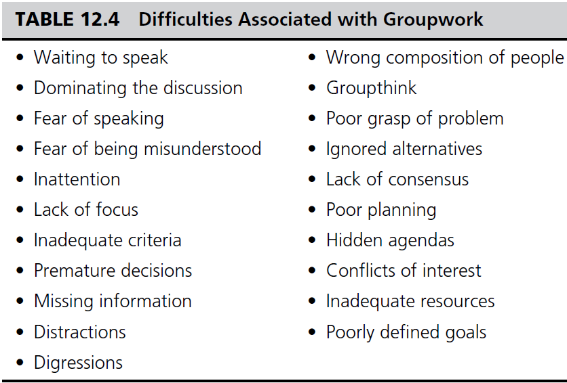
Groupwork

Slide 27
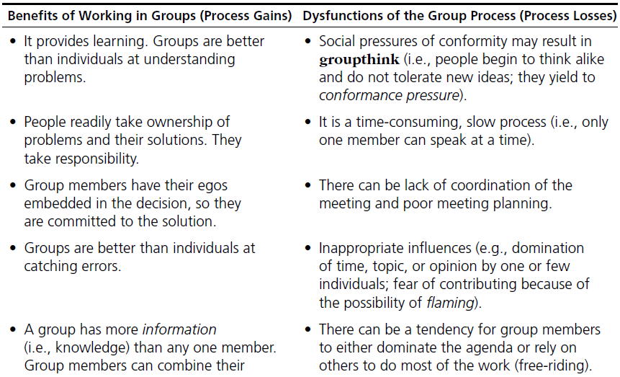
Groupwork –
Process Gains and Losses

Slide 28
Supporting Groupwork –
Group Support Systems
Goal: to support groupwork
Increase benefits / decrease losses
Based on traditional methods
  Nominal Group Technique
  “Individuals work alone to generate ideas which are pooled under guidance of a trained facilitator”
  Delphi Method
  “A structured process for collecting and distilling knowledge from a group of experts by means of questionnaires”
Electronic Meeting System (EMS)

Slide 29
Groupware
Lotus Notes / Domino Server
  Includes Learning Space
Netscape Collabra Server
Microsoft NetMeeting
Novell Groupwise
GroupSystems
TCBWorks
WebEx

Slide 30
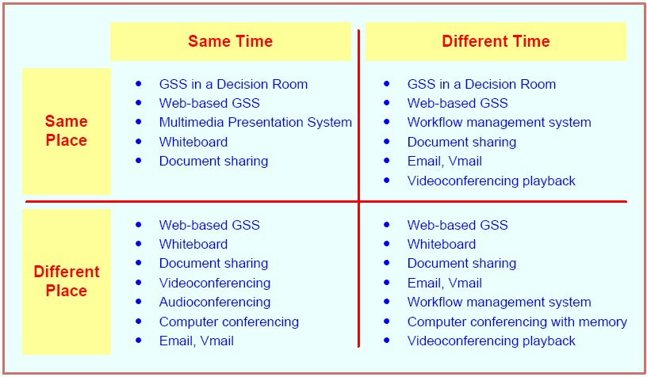
A Time/Place Communication Framework for Groupwork

Slide 31
Tools for Indirect Support of Decision Making
Groupware products provide a way for groups to share resources and opinions
Synchronous or Asynchronous
Examples
  dropbox.com
  drive.google.com
  office.microsoft.com
  …
See Table 12.5 for a list of examples

Slide 32
Groupware…
Virtual Meeting Systems
  webex.com, gotomeeting.com, Skype.com, …
GroupSystems (Groupsystems.com)
Collaborative Workflow
Web 2.0
  Search, links, authoring, tags, extensions, signals
Wikis
Collaborative Networks

Slide 33
Group Decision Support Systems
It is an interactive computer-based system that facilitates the solution of semistructured or unstructured problems by a group of decision makers
Goal – support group decision making
A specially designed IS to enhance collaborative decision processes
It encourages generation of ideas, freedom of expression, and resolution of conflicts

Slide 34
GDSS – Pros and Cons
Gains:
Parallelism
Anonymity →
Triggering
Synergy
Structure
Record keeping
Loses:
Free-riding
Flaming

Slide 35
Facilities for GDSS
Decision room
Multiple-use facility
Web based

Slide 36
The Decision Room
12 to 30 networked personal computers
Usually recessed into the desktop
Server PC
Large-screen projection system
Breakout rooms
Need a trained facilitator for success

Slide 37

Cool Decision Rooms
IBM Corp.

Slide 38

Cooler Decision Rooms
US Air Force

Slide 39
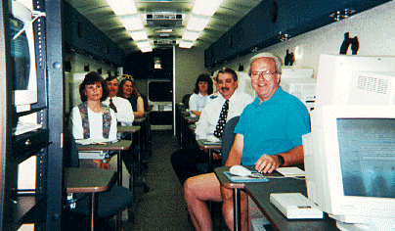
Mobile Decision Rooms
Murraysville School District Bus

Slide 40
On-Demand Decision Rooms

Slide 41
Very Few Organizations Use Decision Rooms
High Cost
Need for a Trained Facilitator
Requires Specific Software Support for Different Cooperative Tasks
Infrequent Use
Different Place / Different Time Needs
May Need More Than One

Slide 42
End-of-Chapter Application Case
Solving Crimes by Sharing Digital Forensic Knowledge
Background
Problem description
Proposed solution
Results

Slide 43
End of the Chapter
Questions, comments

Slide 44
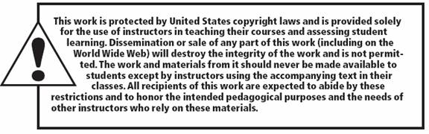
All rights reserved. No part of this publication may be reproduced, stored in a retrieval system, or transmitted, in any form or by any means, electronic, mechanical, photocopying, recording, or otherwise, without the prior written permission of the publisher. Printed in the United States of America.

