Slide 1

Business Intelligence and Analytics: Systems for Decision Support
(10th Edition)
Chapter 8:
Web Analytics, Web Mining, and Social Analytics

Slide 2
Learning Objectives
Define Web mining and understand its taxonomy and its application areas
Differentiate between Web content mining and Web structure mining
Understand the internals of Web search engines
Learn the details about search engine optimization
Define Web usage mining and learn its business application
(Continued…)

Slide 3
Learning Objectives
Describe the Web analytics maturity model and its use cases
Understand social networks and social analytics and their practical applications
Define social network analysis and become familiar with its application areas
Understand social media analytics and its use for better customer engagement

Slide 4
Opening Vignette…
Security First Insurance Deepens Connection with Policyholders
Situation
Problem
Solution
Results
Answer & discuss the case questions.

Slide 5
Questions for the Opening Vignette
What does Security First do?
What were the main challenges Security First was facing?
What was the proposed solution approach? What types of analytics were integrated in the solution?
Based on what you learn from the vignette, what do you think are the relationships between Web analytics, text mining, and sentiment analysis?
What were the results Security First obtained? Were any surprising benefits realized?

Slide 6
Web Mining Overview
Web is the largest repository of data
Data is in HTML, XML, text format
Challenges (of processing Web data)
  The Web is too big for effective data mining
  The Web is too complex
  The Web is too dynamic
  The Web is not specific to a domain
  The Web has everything
Opportunities and challenges are great!

Slide 7
Web Mining
Web mining (or Web data mining) is the process of discovering intrinsic relationships from Web data (textual, linkage, or usage)
Is it the same as data mining on data generated on the Internet?
Web data?
  Content, Link, Log, …
Web Mining versus Web Analytics
  Look at the simple taxonomy on the next slide

Slide 8
Web Mining

Slide 9
Web Content/Structure Mining
Mining the textual content on the Web
Data collection via Web Crawlers/Spiders
Web pages include hyperlinks
  Authoritative pages
  Hubs
  hyperlink-induced topic search (HITS) alg.

Slide 10
Application Case 8.1
Identifying Extremist Groups with Web Link and Content Analysis
Questions for Discussion
How can Web link/content analysis be used to identify extremist groups?
What do you think are the challenges and the potential solution to such intelligence gathering activities?

Slide 11
Search Engines
Google, Bing, Yahoo, …
For what reason do you use search engines?
Search engine is a software program that searches for documents (Internet sites or files) based on the keywords (individual words, multi-word terms, or a complete sentence) that users have provided that have to do with the subject of their inquiry
They are the workhorses of the Internet

Slide 12
Structure of a
Typical Internet Search Engine

Slide 13
Anatomy of a Search Engine
Development Cycle
  Web Crawler
  Document Indexer
  Steps
    Step 1 – Pre-Processing the Documents
      Collecting, organizing, and storing
    Step 2 – Parsing the Documents
    Step 3 – Creating the Term-by-Document Matrix
      How to represent the values (numeric, binary, …)
      Term Frequency / Inverse Document Frequency

Slide 14
Anatomy of a Search Engine
Response Cycle
  Query Analyzer
  Document Matcher/Ranker
How does Google do it?
  Googlebot
  Google indexer
  Google Query Processor

Slide 15
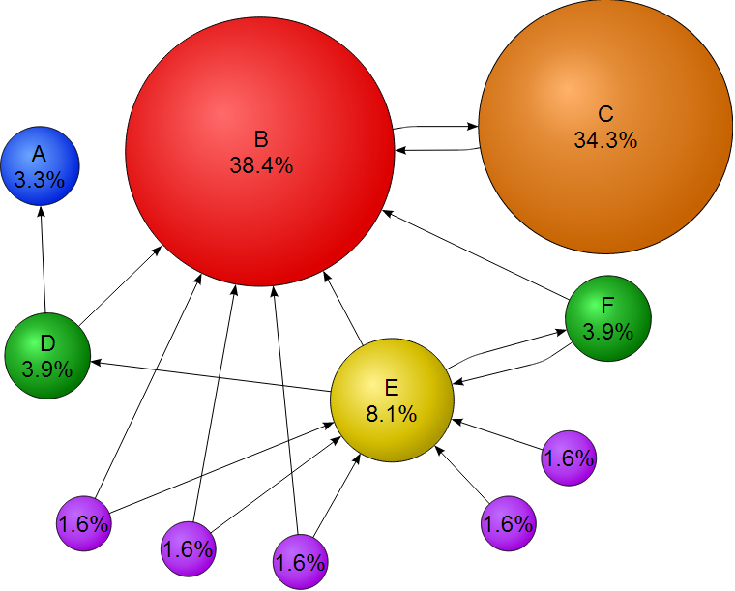

Technology Insights 8.1
PageRank Algorithm
PageRank is a link analysis algorithm
  → Larry Page
Outcome of a research project at Stanford University in 1996
The “secret sauce” in Google

Slide 16
Application Case 8.2
IGN Increases Search Traffic by 1500 Percent with SEO
Questions for Discussion
How did IGN dramatically increase search traffic to its Web portals?
What were the challenges, the proposed solution, and the obtained results?

Slide 17
Search Engine Optimization (SEO)
It is the intentional activity of affecting the visibility of an e-commerce site or a Web site in a search engine’s natural (unpaid or organic) search results
Part of an Internet marketing strategy
Based on knowing how a search engine works
  Content, HTML, keywords, external links, …
Indexing based on …
  Webmaster submission of URL
  Proactively and continuously crawling the Web

Slide 18
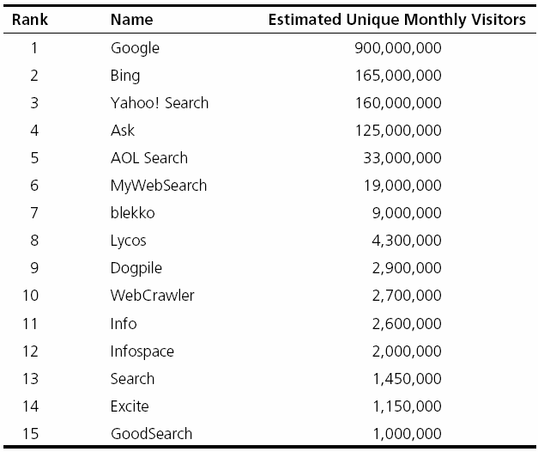
Top 15 Most Popular Search Engines (by eBizMBA, March 2013)

Slide 19
Methods for
Search Engine Optimization
Search engine recommended techniques (White-Hat SEO)
  Producing results based on good site design, accurate content (for users, not engines)
Search engine disapproved techniques (Black-Hat SEO)
  Spamdexing? (search spam, search engine spam, or search engine poisoning)
  Deception (what is shown is different to human and machine/spider)

Slide 20
Application Case 8.3
Understanding Why Customers Abandon Shopping Carts Results in $10 Million Sales Increase
Situation
Problem
Solution
Results

Slide 21
Web Usage Mining
→ Web Analytics!
Extraction of information from data generated through Web page visits and transactions…
  data stored in server access logs, referrer logs, agent logs, and client-side cookies
  user characteristics and usage profiles
  metadata, such as page attributes, content attributes, and usage data
Clickstream data, clickstream analysis

Slide 22
Web Usage Mining
Web usage mining applications
  Determine the lifetime value of clients
  Design cross-marketing strategies across products
  Evaluate promotional campaigns
  Target electronic ads and coupons at user groups based on user access patterns
  Predict user behavior based on previously learned rules and users' profiles
  Present dynamic information to users based on their interests and profiles
  …

Slide 23
Web Usage Mining
(Clickstream Analysis)

Slide 24
Application Case 8.4
Allegro Boosts Online Click-Thru Rates by 500 Percent with Web Analysis
Questions for Discussion
How did Allegro significantly improve clickthrough rates with Web analytics?
What were the challenges, the proposed solution, and the obtained results?

Slide 25
Web Analytics Metrics
Provides near-real-time data to deliver invaluable information to …
  Improve site usability
  Manage marketing efforts
  Better document ROI, …
Web analytics metric categories:
  Web site usability: How were they using my Web site?
  Traffic sources: Where did they come from?
  Visitor profiles: What do my visitors look like?
  Conversion statistics: What does all this mean for the business?

Slide 26
Web Analytics Metrics
- Web Site Usability
Web Site Usability
Page views
Time on site
Downloads
Click map
Click paths
Traffic Source
Referral Web sites
Search engines
Direct
Offline campaigns
Online campaigns

Slide 27
Web Analytics Metrics
- Web Site Usability
Visitor Profiles
Keywords
Content groupings
Geography
Time of day
Landing page
Conversion Statistics
New visitors
Returning visitors
Leads
Sales/conversions
Abandonment rates

Slide 28
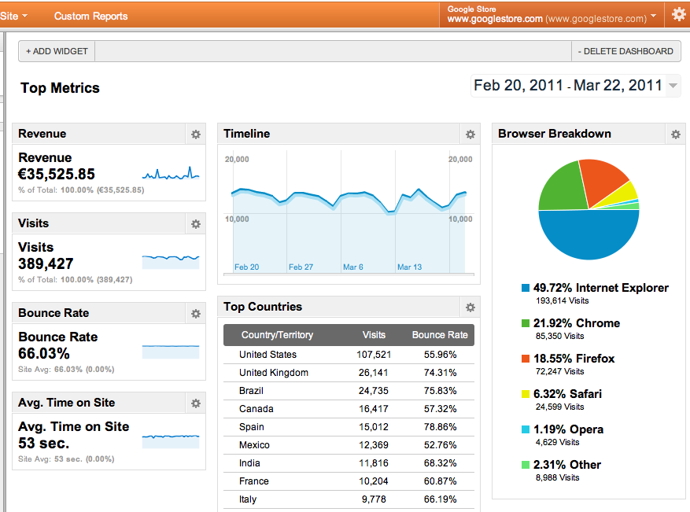
A Web Analytics Dashboard

Slide 29
Web Analytics Maturity Model
Maturity → degree of proficiency, formality, and optimization of business models
Business Intelligence Maturity Model (TDWI)
  Management Reporting ➔ Spreadmarts ➔ Data Marts ➔ Data Warehouse ➔ Enterprise Data Warehouse ➔ BI Services
Business Analytics Maturity Model (INFORMS)
  Descriptive Analytics ➔ Predictive Analytics ➔ Prescriptive Analytics
Web analytics maturity model → next slide…

Slide 30
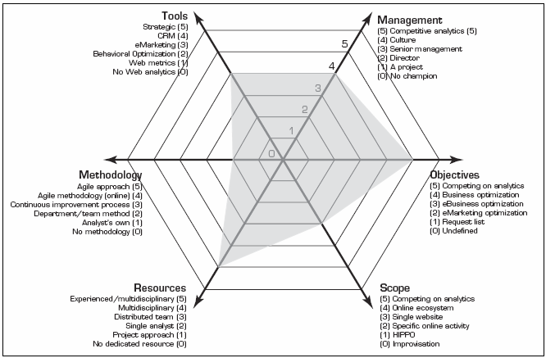
Web Analytics Maturity Model

Slide 31
Web Analytics Tools
Plenty of them exist, and numbers are increasing (Web-based versus downloadable)
  Google Web Analytics (google.com/analytics)
  Yahoo! Web Analytics (web.analytics.yahoo.com)
  Open Web Analytics (openwebanalytics.com)
  Piwik (PIWIK.ORG)
  FireStats (firestats.cc)
  Site Meter (sitemeter.com)
  Woopra (woopra.com)
  AWStats (awstats.org)
  Snoop (reinvigorate.net) …

Slide 32
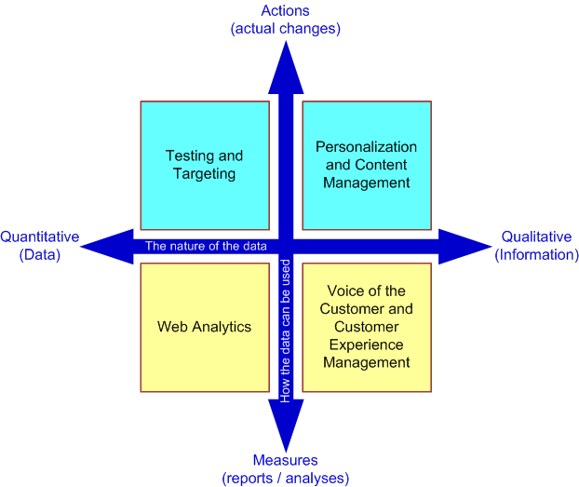
Putting It All Together—A Web Site Optimization Ecosystem
Two-Dimensional View of the Inputs for Web Site Optimization
Goal:
Customer Experience Management (CEM)
Voice of Customer (VOC)

Slide 33
Web Mining Success Stories
Amazon.com, Ask.com, Scholastic.com, …
A Process View of the Web Site Optimization Ecosystem

Slide 34
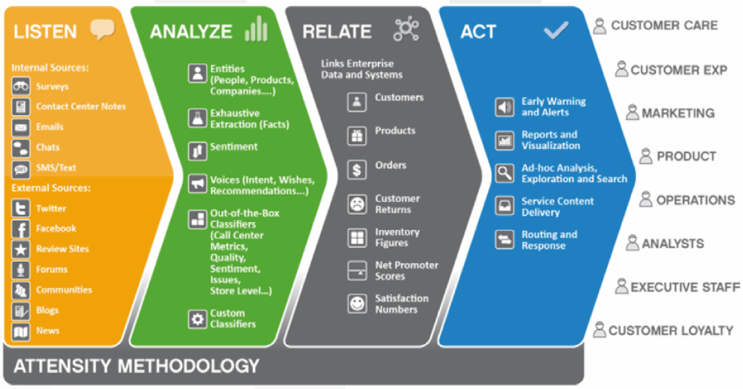
Voice of the Customer Strategy Framework (Attensity.com)

Slide 35
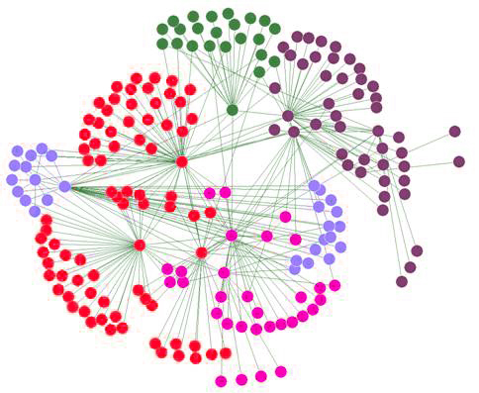
Social Analytics
Social Network Analysis
Social Network - social structure composed of individuals linked to each other
Analysis of social dynamics
Interdisciplinary field
  Social psychology
  Sociology
  Statistics
  Graph theory

Slide 36
Social Analytics
Social Network Analysis
Social Networks help study relationships between individuals, groups, organizations, societies
  Self organizing
  Emergent
  Complex
Typical social network types
  Communication networks, community networks, criminal networks, innovation networks, …

Slide 37
Application Case 8.5
Social Network Analysis Helps Telecommunication Firms (TELCOs)
Questions for Discussion
How can social network analysis be used in the telecommunications industry?
What do you think are the key challenges, potential solution, and probable results in applying SNA in telecommunications firms?

Slide 38
Social Analytics
Social Network Analysis Metrics
Connections
  Homophily
  Multiplexity
  Network closure
  Propinquity
Segmentation
  Cliques and social circles
  Clustering coefficient
  Cohesion
Distribution
  Bridge
  Centrality
  Density
  Structural holes
  Tie strength

Slide 39
Social Media
Definitions and Concepts
Enabling technologies of social interactions among people
Relies on enabling technologies of Web 2.0
Takes on many different forms
  Internet forums, Web logs, social blogs, microblogging, wikis, social networks, podcasts, pictures, video, and product reviews
Different types of social media
  Based on media research and social process

Slide 40
Different Types of Social Media
Collaborative projects (e.g., Wikipedia)
Blogs and microblogs (e.g., Twitter)
Content communities (e.g., YouTube)
Social networking sites (e.g., Facebook)
Virtual game worlds (e.g., World of Warcraft), and
Virtual social worlds (e.g., Second Life)
--Kaplan and Haenlein (2010)

Slide 41
Social versus Industrial Media
Web-based social media are different from traditional/industrial media, such as newspapers, television, and film
Differentiating characteristics
  Quality
  Reach
  Frequency
  Accessibility
  Usability
  Immediacy
  Updatability

Slide 42
How Do People Use Social Media?
Different engagement levels

Slide 43
Application Case 8.6
Measuring the Impact of Social Media at Lollapalooza
Questions for Discussion
How did C3 Presents use social media analytics to improve its business?
What were the challenges, the proposed solution, and the obtained results?

Slide 44
Social Media Analytics
It is the systematic and scientific ways to consume the vast amount of content created by Web-based social media outlets, tools, and techniques for the betterment of an organization’s competitiveness
Fastest growing movement in analytics
Social Media
Tweeter
Facebook
LinlkedIn
…
Insights
Solutions
Course of Actions
…

Slide 45
Social Media Analytics
HBR Analytic Services survey (HBR, 2010)
  75% of the companies did not know where their customers are talking about them
  31% do not measure effectiveness of social media
  only 23% are using social media analytics tools
  7% are able to integrate social media into marketing
Measuring the Social Media Impact
  Descriptive analytics – simple counts/statistics
  Social network analysis
  Advanced analytics – predictive analytics, text mining

Slide 46
Best Practices in
Social Media Analytics
Think of measurement as a guidance system, not a rating system
Track the elusive sentiment
Continuously improve the accuracy of text analysis
Look at the ripple effect
Look beyond the brand
Identify your most powerful influencers
Look closely at the accuracy of your analytic tool
Incorporate social media intelligence into planning

Slide 47

Application Case 8.7
eHarmony Uses Social Media to Help Take the Mystery Out of Online Dating
Questions for Discussion
How did eHarmony use social media to enhance online dating?
What were the challenges, the proposed solution, and the obtained results?

Slide 48
Social Media Analytics
Tools and Vendors
Attensity360
Radian6/Salesforce Cloud
Sysomos
Collective Intellect
Webtrends
Crimson Hexagon
Converseon
SproutSocial …
Twitter
Facebook
YouTube
LinkedIn
Flickr
…

Slide 49
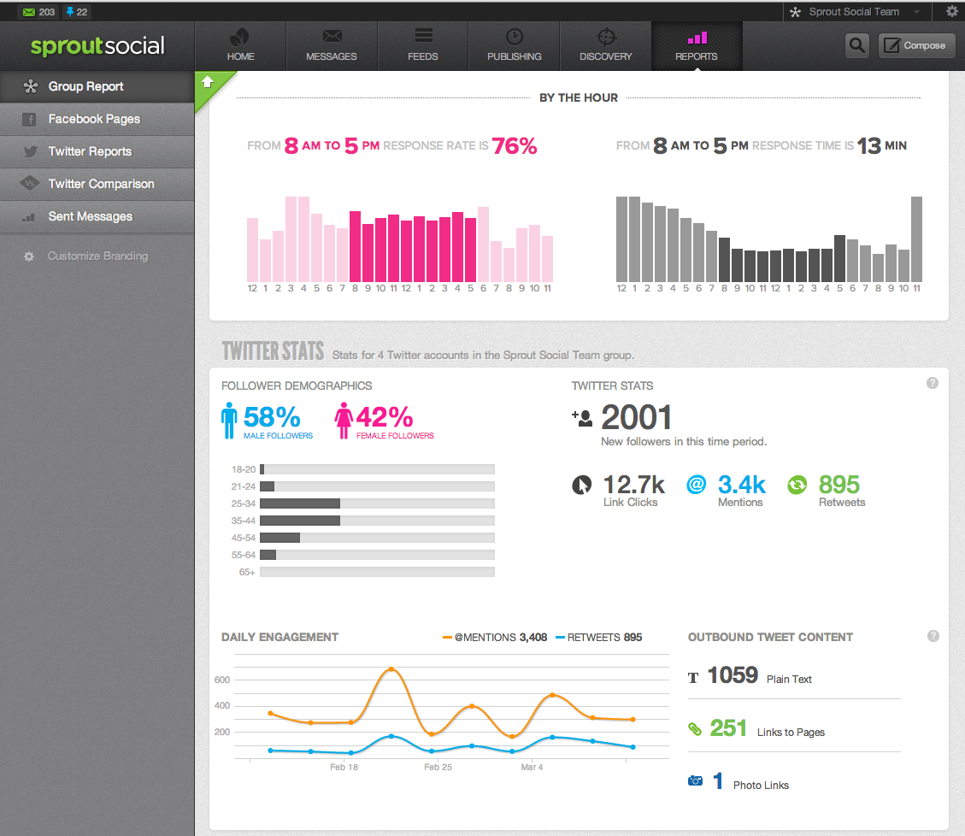
Social Media Analytics

Slide 50
End of the Chapter
Questions, comments

Slide 51

All rights reserved. No part of this publication may be reproduced, stored in a retrieval system, or transmitted, in any form or by any means, electronic, mechanical, photocopying, recording, or otherwise, without the prior written permission of the publisher. Printed in the United States of America.

