Slide 1
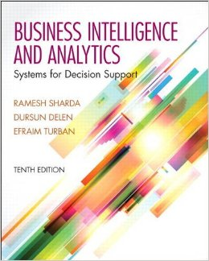
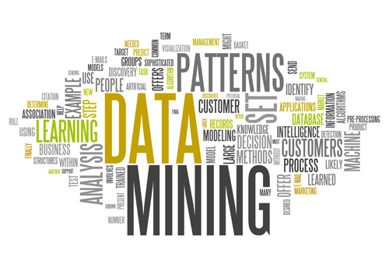
Business Intelligence and Analytics: Systems for Decision Support
(10th Edition)
Chapter 5:
Data Mining

Slide 2
Learning Objectives
Define data mining as an enabling technology for business intelligence
Understand the objectives and benefits of business analytics and data mining
Recognize the wide range of applications of data mining
Learn the standardized data mining processes
  CRISP-DM
  SEMMA
  KDD
(Continued…)

Slide 3
Learning Objectives
Understand the steps involved in data preprocessing for data mining
Learn different methods and algorithms of data mining
Build awareness of the existing data mining software tools
  Commercial versus free/open source
Understand the pitfalls and myths of data mining

Slide 4

Opening Vignette…
Cabela’s Reels in More Customers with Advanced Analytics and Data Mining
Decision situation
Problem
Proposed solution
Results
Answer & discuss the case questions.

Slide 5
Questions for the
Opening Vignette
Why should retailers, especially omni-channel retailers, pay extra attention to advanced analytics and data mining?
What are the top challenges for multi-channel retailers? Can you think of other industry segments that face similar problems/challenges?
What are the sources of data that retailers such as Cabela’s use for their data mining projects?
What does it mean to have a “single view of the customer”? How can it be accomplished?

Slide 6
Data Mining Concepts/Definitions
Why Data Mining?
More intense competition at the global scale.
Recognition of the value in data sources.
Availability of quality data on customers, vendors, transactions, Web, etc.
Consolidation and integration of data repositories into data warehouses.
The exponential increase in data processing and storage capabilities; and decrease in cost.
Movement toward conversion of information resources into nonphysical form.

Slide 7
Definition of Data Mining
The nontrivial process of identifying valid, novel, potentially useful, and ultimately understandable patterns in data stored in structured databases. - Fayyad et al., (1996)
Keywords in this definition: Process, nontrivial, valid, novel, potentially useful, understandable.
Data mining: a misnomer?
Other names: knowledge extraction, pattern analysis, knowledge discovery, information harvesting, pattern searching, data dredging,…

Slide 8
Data Mining is at the Intersection of Many Disciplines

Slide 9
Data Mining Characteristics/Objectives
Source of data for DM is often a consolidated data warehouse (not always!).
DM environment is usually a client-server or a Web-based information systems architecture.
Data is the most critical ingredient for DM which may include soft/unstructured data.
The miner is often an end user
Striking it rich requires creative thinking
Data mining tools’ capabilities and ease of use are essential (Web, Parallel processing, etc.)

Slide 10
Application Case 5.1
Smarter Insurance: Infinity P&C Improves Customer Service and Combats Fraud with Predictive Analytics
Questions For Discussion
How did Infinity P&C improve customer service with data mining?
What were the challenges, the proposed solution, and the obtained results?
What was their implementation strategy? Why is it important to produce results as early as possible in data mining studies?

Slide 11
Data in Data Mining
Data: a collection of facts usually obtained as the result of experiences, observations, or experiments.
Data may consist of numbers, words, images, …
Data: lowest level of abstraction (from which information and knowledge are derived).

Slide 12
What Does DM Do?
How Does it Work?
DM extract patterns from data
  Pattern? A mathematical (numeric and/or symbolic) relationship among data items
Types of patterns
  Association
  Prediction
  Cluster (segmentation)
  Sequential (or time series) relationships

Slide 13
Application Case 5.2
Harnessing Analytics to Combat Crime: Predictive Analytics Helps Memphis Police Department Pinpoint Crime and Focus Police Resources
Questions For Discussion
How did the Memphis Police Department used data mining to better combat crime?
What were the challenges, the proposed solution, and the obtained results?

Slide 14
A Taxonomy for
Data Mining Tasks

Slide 15
Data Mining Tasks (cont.)
Time-series forecasting
  Part of sequence or link analysis?
Visualization
  Another data mining task?
Types of DM
  Hypothesis-driven data mining
  Discovery-driven data mining

Slide 16
Data Mining Applications
Customer Relationship Management
  Maximize return on marketing campaigns
  Improve customer retention (churn analysis)
  Maximize customer value (cross-, up-selling)
  Identify and treat most valued customers
Banking & Other Financial
  Automate the loan application process
  Detecting fraudulent transactions
  Maximize customer value (cross-, up-selling)
  Optimizing cash reserves with forecasting

Slide 17
Data Mining Applications (cont.)
Retailing and Logistics
  Optimize inventory levels at different locations
  Improve the store layout and sales promotions
  Optimize logistics by predicting seasonal effects
  Minimize losses due to limited shelf life
Manufacturing and Maintenance
  Predict/prevent machinery failures
  Identify anomalies in production systems to optimize the use manufacturing capacity
  Discover novel patterns to improve product quality

Slide 18
Data Mining Applications (cont.)
Brokerage and Securities Trading
  Predict changes on certain bond prices
  Forecast the direction of stock fluctuations
  Assess the effect of events on market movements
  Identify and prevent fraudulent activities in trading
Insurance
  Forecast claim costs for better business planning
  Determine optimal rate plans
  Optimize marketing to specific customers
  Identify and prevent fraudulent claim activities

Slide 19
Data Mining Applications (cont.)
Computer hardware and software
Science and engineering
Government and defense
Homeland security and law enforcement
Travel industry
Healthcare
Medicine
Entertainment industry
Sports
Etc.
Increasingly more popular application areas for data mining

Slide 20
Application Case 5.3
A Mine on Terrorist Funding
Questions For Discussion
How can data mining be used to fight terrorism? Comment on what else can be done beyond what is covered in this short application case.
Do you think data mining, while essential for fighting terrorist cells, also jeopardizes individuals’ rights of privacy?

Slide 21
Data Mining Process
A manifestation of best practices
A systematic way to conduct DM projects
Different groups has different versions
Most common standard processes:
  CRISP-DM (Cross-Industry Standard Process for Data Mining)
  SEMMA (Sample, Explore, Modify, Model, and Assess)
  KDD (Knowledge Discovery in Databases)

Slide 22
Data Mining Process
Source: KDNuggets.com

Slide 23
Data Mining Process: CRISP-DM

Slide 24
Data Mining Process: CRISP-DM
Step 1: Business Understanding
Step 2: Data Understanding
Step 3: Data Preparation (!)
Step 4: Model Building
Step 5: Testing and Evaluation
Step 6: Deployment
The process is highly repetitive and experimental (DM: art versus science?)
Accounts for ~85% of total project time

Slide 25
Data Preparation – A Critical DM Task

Slide 26
Data Mining Process: SEMMA

Slide 27
Application Case 5.4
Data Mining in Cancer Research
Questions For Discussion
How can data mining be used for ultimately curing illnesses like cancer?
What do you think are the promises and major challenges for data miners in contributing to medical and biological research endeavors?

Slide 28
Data Mining Methods: Classification
Most frequently used DM method
Part of the machine-learning family
Employ supervised learning
Learn from past data, classify new data
The output variable is categorical (nominal or ordinal) in nature
Classification versus regression?
Classification versus clustering?

Slide 29
Assessment Methods for Classification
Predictive accuracy
  Hit rate
Speed
  Model building; predicting
Robustness
Scalability
Interpretability
  Transparency, explainability

Slide 30
Accuracy of Classification Models
In classification problems, the primary source for accuracy estimation is the confusion matrix

Slide 31
Estimation Methodologies for Classification
Simple split (or holdout or test sample estimation)
  Split the data into 2 mutually exclusive sets training (~70%) and testing (30%)
  For ANN, the data is split into three sub-sets (training [~60%], validation [~20%], testing [~20%])

Slide 32
Estimation Methodologies for Classification
k-Fold Cross Validation (rotation estimation)
  Split the data into k mutually exclusive subsets
  Use each subset as testing while using the rest of the subsets as training
  Repeat the experimentation for k times
  Aggregate the test results for true estimation of prediction accuracy training
Other estimation methodologies
  Leave-one-out, bootstrapping, jackknifing
  Area under the ROC curve

Slide 33
Estimation Methodologies for Classification – ROC Curve

Slide 34
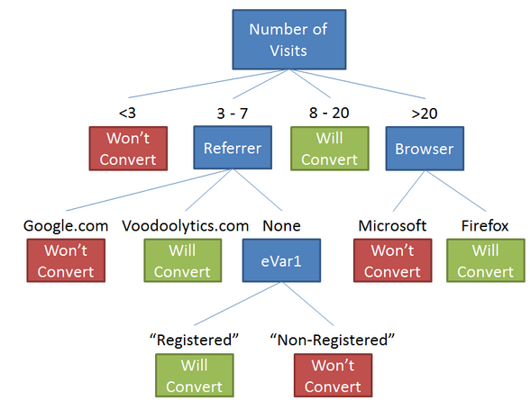
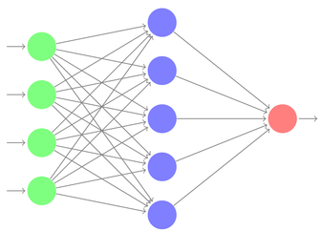
Classification Techniques
Decision tree analysis
Statistical analysis
Neural networks
Support vector machines
Case-based reasoning
Bayesian classifiers
Genetic algorithms
Rough sets

Slide 35
Decision Trees
Employs the divide and conquer method
Recursively divides a training set until each division consists of examples from one class
  Create a root node and assign all of the training data to it.
  Select the best splitting attribute.
  Add a branch to the root node for each value of the split. Split the data into mutually exclusive subsets along the lines of the specific split.
  Repeat the steps 2 and 3 for each and every leaf node until the stopping criteria is reached.
A general algorithm for decision tree building

Slide 36
Decision Trees
DT algorithms mainly differ on
  Splitting criteria
    Which variable, what value, etc.
  Stopping criteria
    When to stop building the tree
  Pruning (generalization method)
    Pre-pruning versus post-pruning
Most popular DT algorithms include
  ID3, C4.5, C5; CART; CHAID; M5

Slide 37
Decision Trees
Alternative splitting criteria
  Gini index determines the purity of a specific class as a result of a decision to branch along a particular attribute/value
    Used in CART
  Information gain uses entropy to measure the extent of uncertainty or randomness of a particular attribute/value split
    Used in ID3, C4.5, C5
  Chi-square statistics (used in CHAID)

Slide 38
Application Case 5.5
2degrees Gets a 1275 Percent Boost in Churn Identification
Questions For Discussion
What does 2degrees do? Why is it important for 2degrees to accurately identify churn?
What were the challenges, the proposed solution, and the obtained results?
How can data mining help in identifying customer churn? How do some companies do it without using data mining tools and techniques?
Why is it important for Delta Lloyd Group to comply with industry regulations?

Slide 39
Cluster Analysis for Data Mining
Used for automatic identification of natural groupings of things
Part of the machine-learning family
Employ unsupervised learning
Learns the clusters of things from past data, then assigns new instances
There is not an output variable
Also known as segmentation

Slide 40
Cluster Analysis for Data Mining
Clustering results may be used to
  Identify natural groupings of customers
  Identify rules for assigning new cases to classes for targeting/diagnostic purposes
  Provide characterization, definition, labeling of populations
  Decrease the size and complexity of problems for other data mining methods
  Identify outliers in a specific domain (e.g., rare-event detection)

Slide 41
Cluster Analysis for Data Mining
Analysis methods
  Statistical methods (including both hierarchical and nonhierarchical), such as k-means, k-modes, and so on.
  Neural networks (adaptive resonance theory [ART], self-organizing map [SOM])
  Fuzzy logic (e.g., fuzzy c-means algorithm)
  Genetic algorithms

Slide 42
Cluster Analysis for Data Mining
How many clusters?
  There is not a “truly optimal” way to calculate it
  Heuristics are often used
Most cluster analysis methods involve the use of a distance measure to calculate the closeness between pairs of items.
  Euclidian versus Manhattan/Rectilinear distance

Slide 43
Cluster Analysis for Data Mining
k-Means Clustering Algorithm
  k : pre-determined number of clusters
  Algorithm (Step 0: determine value of k)
  Step 1: Randomly generate k random points as initial cluster centers.
  Step 2: Assign each point to the nearest cluster center.
  Step 3: Re-compute the new cluster centers.
  Repetition step: Repeat steps 3 and 4 until some convergence criterion is met (usually that the assignment of points to clusters becomes stable).

Slide 44
Cluster Analysis for Data Mining - k-Means Clustering Algorithm

Slide 45
Association Rule Mining
A very popular DM method in business
Finds interesting relationships (affinities) between variables (items or events)
Part of machine learning family
Employs unsupervised learning
There is no output variable
Also known as market basket analysis
Often used as an example to describe DM to ordinary people, such as the famous “relationship between diapers and beers!”

Slide 46
Association Rule Mining
Input: the simple point-of-sale transaction data
Output: Most frequent affinities among items
Example: according to the transaction data…
“Customer who bought a lap-top computer and a virus protection software, also bought extended service plan 70 percent of the time."
How do you use such a pattern/knowledge?
  Put the items next to each other
  Promote the items as a package
  Place items far apart from each other!

Slide 47
Association Rule Mining
A representative applications of association rule mining include
  In business: cross-marketing, cross-selling, store design, catalog design, e-commerce site design, optimization of online advertising, product pricing, and sales/promotion configuration
  In medicine: relationships between symptoms and illnesses; diagnosis and patient characteristics and treatments (to be used in medical DSS); and genes and their functions (to be used in genomics projects)
  …

Slide 48
Association Rule Mining
Are all association rules interesting and useful?
  A Generic Rule: X ⇒ Y [S%, C%]
  X, Y: products and/or services
  X: Left-hand-side (LHS)
  Y: Right-hand-side (RHS)
  S: Support: how often X and Y go together
  C: Confidence: how often Y go together with the X
  Example: {Laptop Computer, Antivirus Software} ⇒ {Extended Service Plan} [30%, 70%]

Slide 49
Association Rule Mining
Algorithms are available for generating association rules
  Apriori
  Eclat
  FP-Growth
  + Derivatives and hybrids of the three
The algorithms help identify the frequent item sets, which are, then converted to association rules

Slide 50
Association Rule Mining
Apriori Algorithm
  Finds subsets that are common to at least a minimum number of the itemsets
  Uses a bottom-up approach
    frequent subsets are extended one item at a time (the size of frequent subsets increases from one-item subsets to two-item subsets, then three-item subsets, and so on), and
    groups of candidates at each level are tested against the data for minimum support.
    (see the figure) → --

Slide 51
Association Rule Mining
Apriori Algorithm

Slide 52
Data Mining
Software
Commercial
  IBM SPSS Modeler (formerly Clementine)
  SAS - Enterprise Miner
  IBM - Intelligent Miner
  StatSoft – Statistica Data Miner
  … many more
Free and/or Open Source
  R
  RapidMiner
  Weka…
Source: KDNuggets.com

Slide 53
Big Data Software Tools and Platforms

Slide 54

Application Case 5.6
Data Mining Goes to Hollywood: Predicting Financial Success of Movies
Questions For Discussion
Decision situation
Problem
Proposed solution
Results
Answer & discuss the case questions.

Slide 55
Application Case 5.6
Data Mining Goes to Hollywood!
Dependent Variable
Independent Variables
A Typical Classification Problem

Slide 56
Application Case 5.6
Data Mining Goes to Hollywood!
The DM Process Map in IBM SPSS Modeler

Slide 57
Application Case 5.6
Data Mining Goes to Hollywood!

Slide 58

Application Case 5.7
Data Mining & Privacy Issues
Predicting Customer Buying Patterns—
The Target Story
Questions For Discussion
What do you think about data mining and its implication for privacy? What is the threshold between discovery of knowledge and infringement of privacy?
Did Target go too far? Did it do anything illegal? What do you think Target should have done? What do you think Target should do next (quit these types of practices)?

Slide 59
Data Mining Myths
Data mining …
  provides instant solutions/predictions
  is not yet viable for business applications
  requires a separate, dedicated database
  can only be done by those with advanced degrees
  is only for large firms that have lots of customer data
  is another name for the good-old statistics

Slide 60
Common Data Mining Blunders
Selecting the wrong problem for data mining
Ignoring what your sponsor thinks data mining is and what it really can/cannot do
Not leaving insufficient time for data acquisition, selection and preparation
Looking only at aggregated results and not at individual records/predictions
Being sloppy about keeping track of the data mining procedure and results
…more in the book

Slide 61
End of the Chapter
Questions, comments

Slide 62
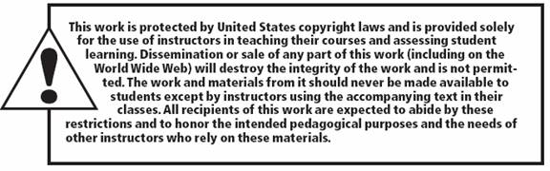
All rights reserved. No part of this publication may be reproduced, stored in a retrieval system, or transmitted, in any form or by any means, electronic, mechanical, photocopying, recording, or otherwise, without the prior written permission of the publisher. Printed in the United States of America.
Copyright © 2014 Pearson Education, Inc.

