Slide 1
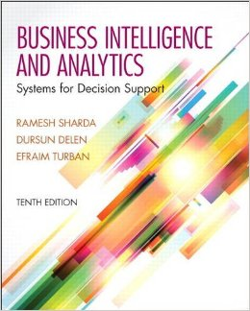
Business Intelligence and Analytics: Systems for Decision Support
(10th Edition)
Chapter 4:
Business Reporting,
Visual Analytics, and Business
Performance Management

Slide 2
Learning Objectives
Define business reporting and understand its historical evolution
Recognize the need for and the power of business reporting
Understand the importance of data/information visualization
Learn different types of visualization techniques
Appreciate the value that visual analytics brings to BI/BA
…
(Continued…)

Slide 3
Learning Objectives
Know the capabilities and limitations of dashboards
Understand the nature of business performance management (BPM)
Learn the closed-loop BPM methodology
Describe the basic elements of balanced scorecards

Slide 4
Opening Vignette…
Self-Service Reporting Environment Saves Millions For Corporate Customers
Background
Business Challenge
Solution
Results
Answer & discuss the case questions.

Slide 5
Questions for the
Opening Vignette
What does Travel and Transport, Inc., do?
Describe the complexity and the competitive nature of the business environment in which Travel and Transport, Inc., functions.
What were the main business challenges?
What was the solution? Implementation?
Why do you think a multi-vendor, multi-tool solution was implemented?
List and comment on three main benefits of the implemented system.

Slide 6
Business Reporting
Definitions and Concepts
Report = Information → Decision
Report?
  Any communication artifact prepared to convey specific information
A report can fulfill many functions
  To ensure proper departmental functioning
  To provide information
  To provide the results of an analysis
  To persuade others to act
  To create an organizational memory…

Slide 7
What is a Business Report?
A written document that contains information regarding business matters.
Purpose: to improve managerial decisions
Source: data from inside and outside the organization (via the use of ETL)
Format: text + tables + graphs/charts
Distribution: in-print, email, portal/intranet
Data acquisition → Information generation → Decision making → Process management

Slide 8
Business Reporting

Slide 9
Key to Any Successful Report
Clarity …
Brevity …
Completeness …
Correctness …
Report types (in terms of content and format)
  Informal – a single letter or a memo
  Formal – 10-100 pages; cover + summary + text
  Short report – periodic, informative, investigative

Slide 10
Application Case 4.1
Delta Lloyd Group Ensures Accuracy and Efficiency in Financial Reporting
Questions for Discussion
How did Delta Lloyd Group improve accuracy and efficiency in financial reporting?
What were the challenges, the proposed solution, and the obtained results?
Why is it important for Delta Lloyd Group to comply with industry regulations?

Slide 11
Types of Business Reports
Metric Management Reports
  Help manage business performance through metrics (SLAs for externals; KPIs for internals)
  Can be used as part of Six Sigma and/or TQM
Dashboard-Type Reports
  Graphical presentation of several performance indicators in a single page using dials/gauges
Balanced Scorecard-Type Reports
  Include financial, customer, business process, and learning & growth indicators

Slide 12
Components of
Business Reporting Systems
Common characteristics
  OLTP (online transaction processing)
    ERP, POS, SCM, RFID, Sensors, Web, …
  Data supply (volume, variety, velocity, …)
  ETL
  Data storage
  Business logic
  Publication medium
  Assurance

Slide 13
Application Case 4.2
Flood of Paper Ends at FEMA
Questions for Discussion
What is FEMA and what does it do?
What are the main challenges that FEMA faces in delivering its services?
How did FEMA improve its inefficient reporting practices?

Slide 14
Data and Information Visualization
  “The use of visual representations to explore, make sense of, and communicate data.”
Data visualization vs. Information visualization
Information = aggregation, summarization, and contextualization of data
Related to information graphics, scientific visualization, and statistical graphics
Often includes charts, graphs, illustrations, …

Slide 15
Application Case 4.3
Tableau Saves Blastrac
Thousands of Dollars with
Simplified Information Sharing
Questions for Discussion
How did Blastrac achieve significant cost saving in reporting and information sharing?
What were the challenge, the proposed solution, and the obtained results?

Slide 16
A Brief History of
Data Visualization
Data visualization can date back to the second century AD
Most developments have occurred in the last two and a half centuries
Until recently it was not recognized as a discipline
Today’s most popular visual forms date back a few centuries

Slide 17
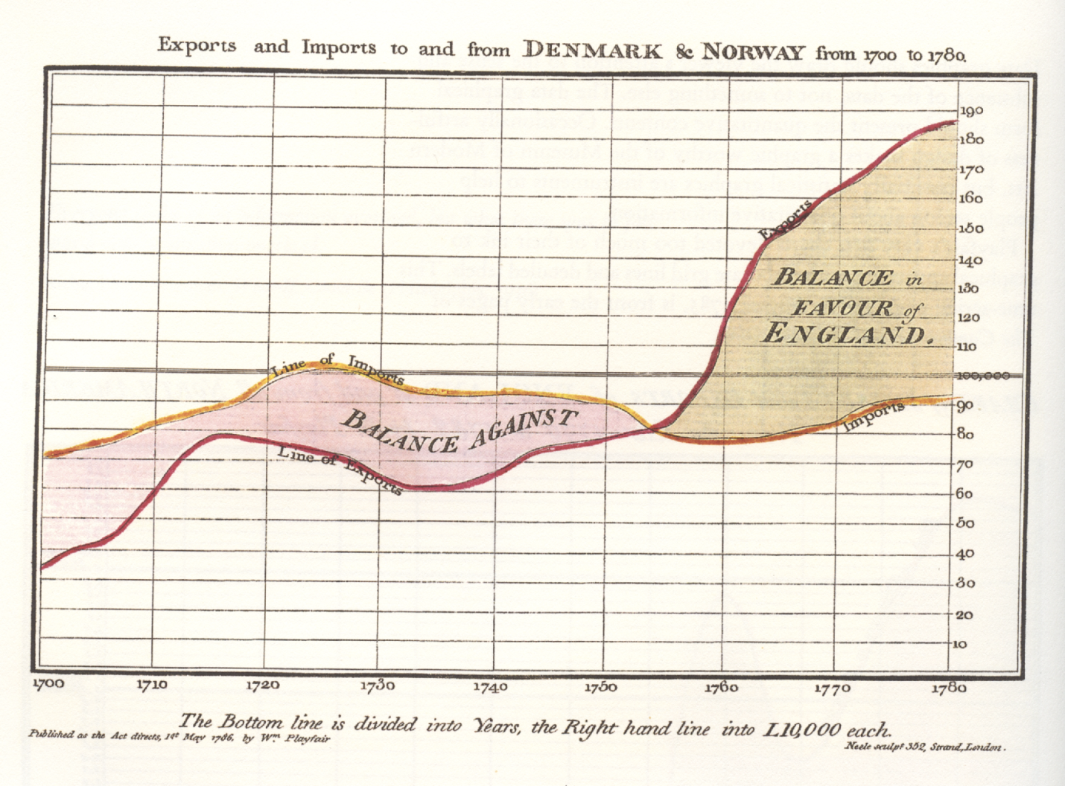
The First Pie Chart
Created by William Playfair in 1801
William Playfair is widely credited as the inventor of the modern chart, having created the first line and pie charts.

Slide 18
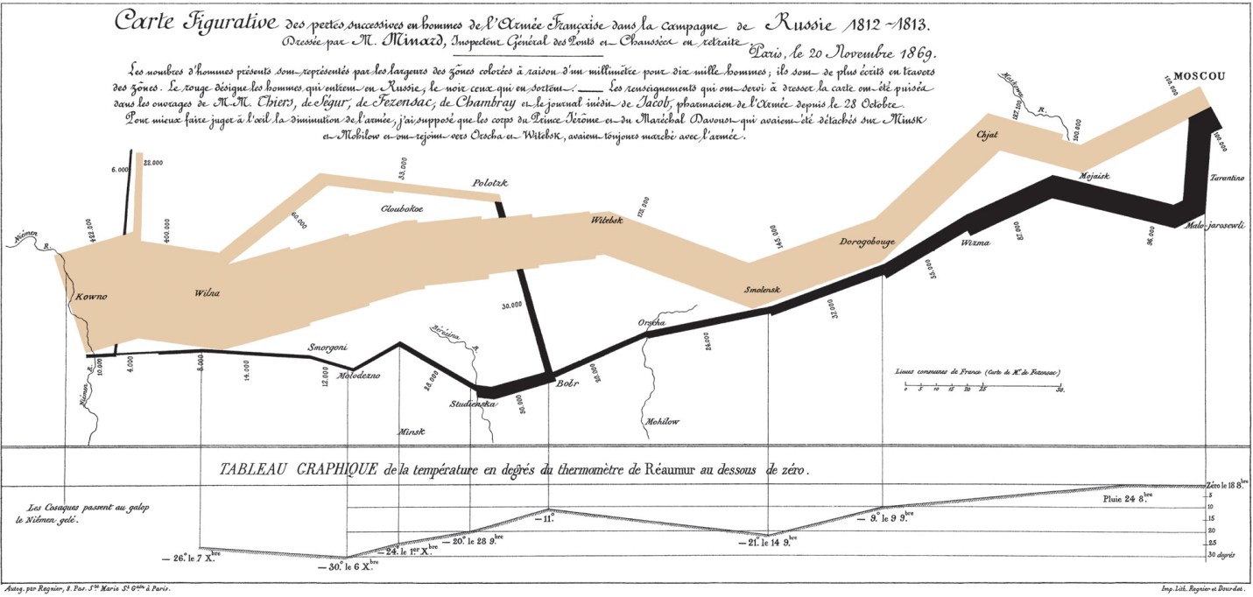
Decimation of Napoleon’s Army During the 1812 Russian Campaign
By Charles Joseph Minard
Arguably the most popular multi-dimensional chart

Slide 19
A Brief History of Data Visualization
1900s –
  more formal attitude toward visualization
  focus on color, value scales, and labeling
  Publication of the book Semiologie Graphique
2000s –
  Emergence of Internet as the medium for information visualization → raising visual literacy
  Incorporate interaction, animation, 3D graphics-rendering, virtual worlds, real-time data feed
2010s and beyond – ?

Slide 20
Application Case 4.4
TIBCO Spotfire Provides Dana-Farber Cancer Institute with Unprecedented Insight into Cancer Vaccine Clinical Trials
Questions for Discussion
How did Dana-Farber Cancer Institute use TIBCO Spotfire to enhance information reporting and visualization?
What were the challenges, the proposed solution, and the obtained results?

Slide 21
Different Types of
Charts and Graphs
Which one to use? Where and when?
Basic Charts and Graphs
  Line Chart
  Bar Chart
  Pie Chart
  Scatter Plot
  Bubble Chart
Specialized Charts and Graphs
  Histogram
  Gantt Chart
  PERT Chart
  Geographic Map
  Bullet Graph
  Heat Map / Tree Map
  Highlight Table

Slide 22
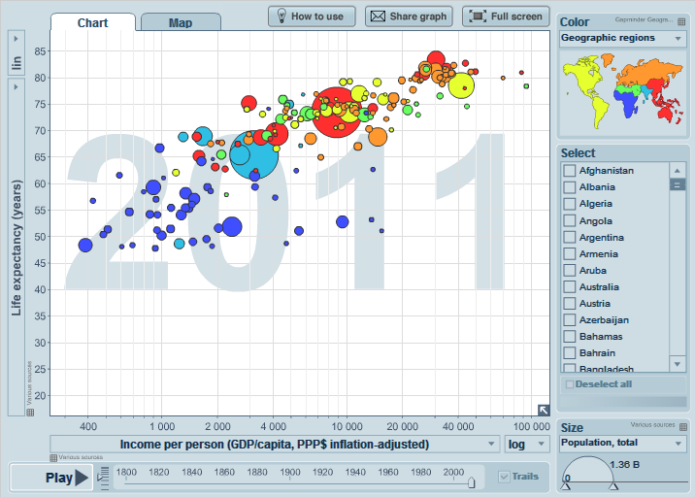
A Gapminder Chart
Wealth and Health of Nations
See gapminder.org for
interesting animated examples

Slide 23
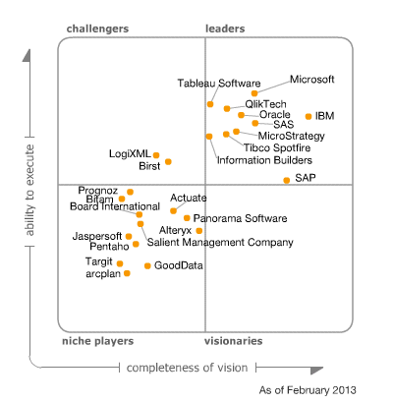
The Emergence of Data Visualization And Visual Analytics
Magic Quadrant for Business Intelligence and Analytics Platforms (Source: Gartner.com)
Many data visualization companies are in the 4th quadrant
There is a move toward visualization

Slide 24
The Emergence of Data Visualization And Visual Analytics
Emergence of new companies
  Tableau, Spotfire, QlikView, …
Increased focus by the big players
  MicroStrategy improved Visual Insight
  SAP launched Visual Intelligence
  SAS launched Visual Analytics
  Microsoft bolstered PowerPivot with Power View
  IBM launched Cognos Insight
  Oracle acquired Endeca

Slide 25
Visual Analytics
A recently coined term
  Information visualization + predictive analytics
Information visualization
  Descriptive, backward focused
  “what happened” “what is happening”
Predictive analytics
  Predictive, future focused
  “what will happen” “why will it happen”
There is a strong move toward visual analytics

Slide 26
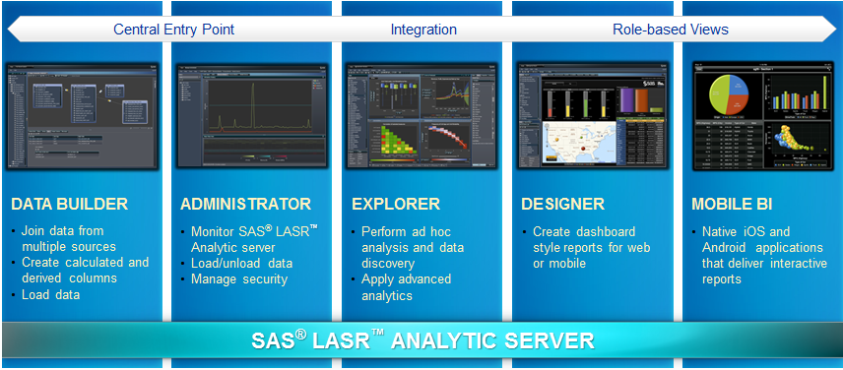
Visual Analytics by SAS Institute
SAS Visual Analytics Architecture
  Big data + In memory + Massively parallel processing + ..

Slide 27
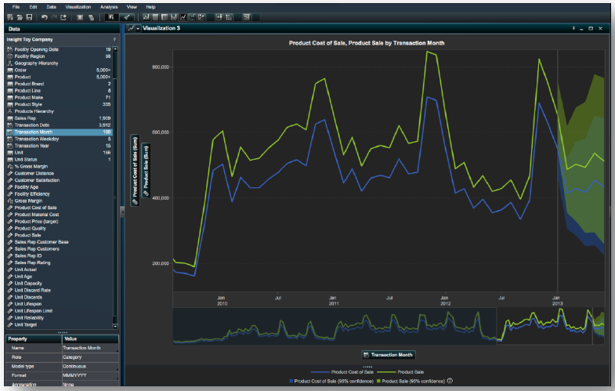
Visual Analytics by SAS Institute
At teradatauniversitynetwork.com, you can learn more about SAS VA, experiment with the tool

Slide 28
Performance Dashboards
Performance dashboards are commonly used in BPM software suites and BI platforms
Dashboards provide visual displays of important information that is consolidated and arranged on a single screen so that information can be digested at a single glance and easily drilled in and further explored

Slide 29
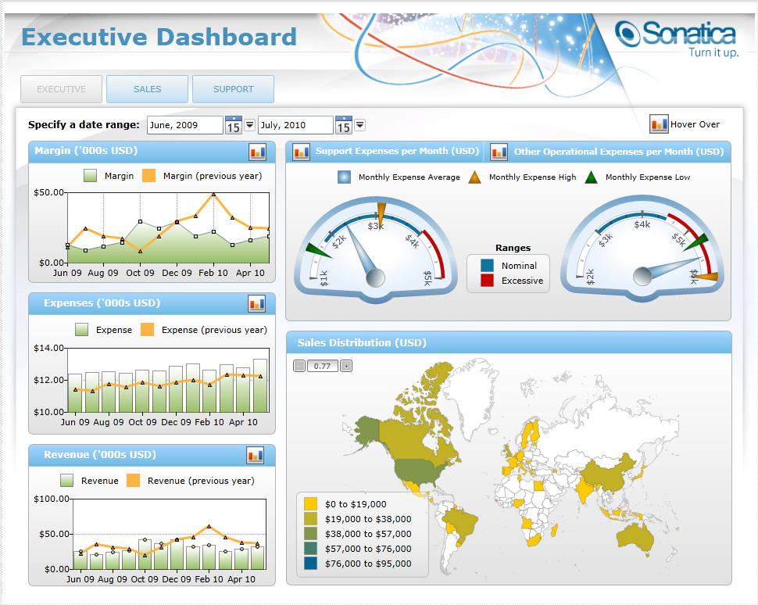
Performance Dashboards

Slide 30
Performance Dashboards
Dashboard design
  The fundamental challenge of dashboard design is to display all the required information on a single screen, clearly and without distraction, in a manner that can be assimilated quickly
Three layer of information
  Monitoring
  Analysis
  Management

Slide 31
Application Case 4.6
Saudi Telecom Company Excels with Information Visualization
Questions for Discussion
Why do you think telecommunication companies are among the prime users of information visualization tools?
How did Saudi Telecom use information visualization?
What were their challenges, the proposed solution, and the obtained results?

Slide 32
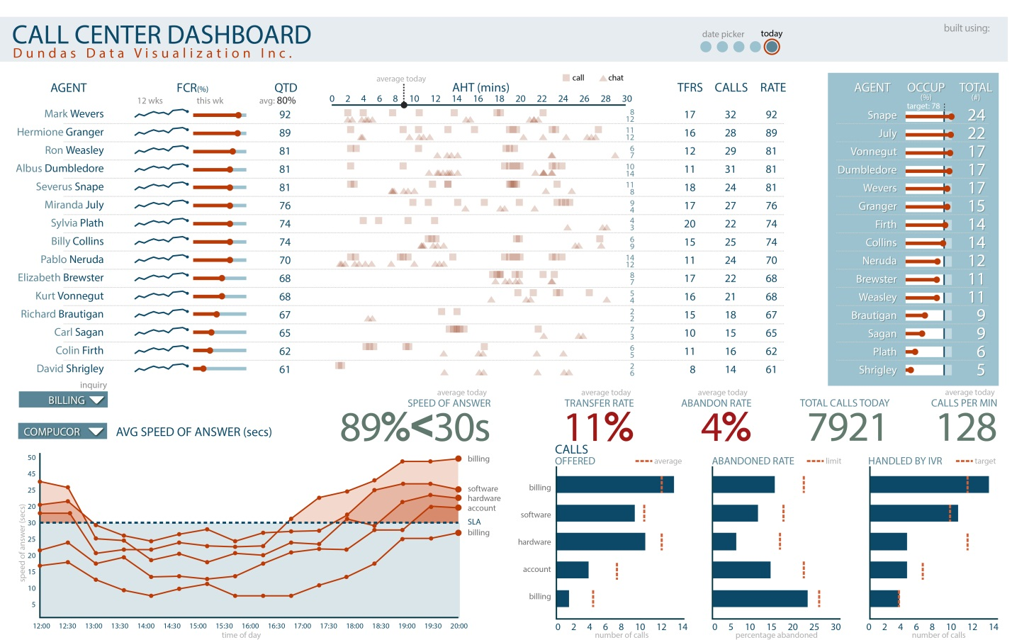
Application Case 4.6

Slide 33
Performance Dashboards
What to look for in a dashboard
  Use of visual components to highlight data and exceptions that require action.
  Transparent to the user, meaning that they require minimal training and are extremely easy to use
  Combine data from a variety of systems into a single, summarized, unified view of the business
  Enable drill-down or drill-through to underlying data sources or reports
  Present a dynamic, real-world view with timely data
  Require little coding to implement/deploy/maintain

Slide 34
Best Practices in
Dashboard Design
Benchmark KPIs with Industry Standards
Wrap the Metrics with Contextual Metadata
Validate the Design by a Usability Specialist
Prioritize and Rank Alerts and Exceptions
Enrich Dashboard with Business-User Comments
Present Information in Three Different Levels
Pick the Right Visual Constructs
Provide for Guided Analytics

Slide 35
Business Performance Management (BPM)
Business Performance Management (BPM) is…
A real-time system that alerts managers to potential opportunities, impending problems and threats, and then empowers them to react through models and collaboration.
Also called corporate performance management (CPM by Gartner Group), enterprise performance management (EPM by Oracle), strategic enterprise management (SEM by SAP)

Slide 36
Business Performance Management (BPM)
BPM refers to the business processes, methodologies, metrics, and technologies used by enterprises to measure, monitor, and manage business performance.
BPM encompasses three key components
  A set of integrated, closed-loop management and analytic processes, supported by technology …
  Tools for businesses to define strategic goals and then measure/manage performance against them
  Methods and tools for monitoring key performance indicators (KPIs), linked to organizational strategy

Slide 37
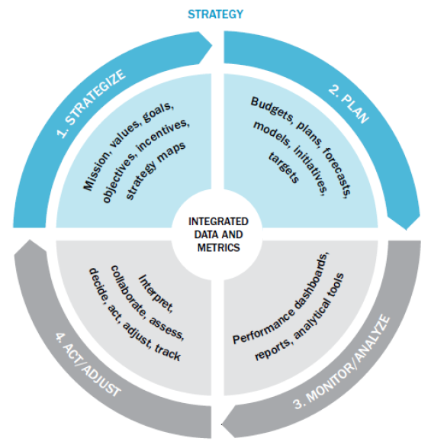
A Closed-Loop Process to Optimize Business Performance
Process Steps
  Strategize
  Plan
  Monitor/analyze
  Act/adjust
  Each with its own process steps

Slide 38
Strategize:
Where Do We Want to Go?
Strategic planning
  Common tasks for the strategic planning process:
    Conduct a current situation analysis
    Determine the planning horizon
    Conduct an environment scan
    Identify critical success factors
    Complete a gap analysis
    Create a strategic vision
    Develop a business strategy
    Identify strategic objectives and goals

Slide 39
Plan:
How Do We Get There?
Operational planning
  Operational plan: plan that translates an organization’s strategic objectives and goals into a set of well-defined tactics and initiatives, resources requirements, and expected results for some future time period (usually a year).
Operational planning can be
    Tactic-centric (operationally focused)
    Budget-centric plan (financially focused)

Slide 40
Monitor/Analyze:
How Are We Doing?
A comprehensive framework for monitoring performance should address two key issues:
  What to monitor?
    Critical success factors
    Strategic goals and targets
    …
  How to monitor?
    …

Slide 41
Act and Adjust: What Do We Need to Do Differently?
Success (or mere survival) depends on new projects: creating new products, entering new markets, acquiring new customers (or businesses), or streamlining some process.
Many new projects and ventures fail!
What is the chance of failure?
  60% of Hollywood movies fail
  70% of large IT projects fail, …

Slide 42
Application Case 4.7
IBM Cognos Express Helps Mace for Faster and Better Business Reporting
Questions for Discussion
What was the reporting challenge Mace was facing? Do you think this is an unusual challenge specific to Mace?
What was the approach for a potential solution?
What were the results obtained in the short term, and what were the future plans?

Slide 43
Performance Measurement
Performance measurement system
A system that assists managers in tracking the implementations of business strategy by comparing actual results against strategic goals and objectives
  Comprises systematic comparative methods that indicate progress (or lack thereof) against goals

Slide 44
KPIs and Operational Metrics
Key performance indicator (KPI)
A KPI represents a strategic objective and metrics that measure performance against a goal
Distinguishing features of KPIs
Strategy
Targets
Ranges
Encodings
Time frames
Benchmarks

Slide 45
Performance Measurement
Key performance indicator (KBI)
Outcome KPIs vs. Driver KPIs
(lagging indicators (leading indicators
e.g., revenues) e.g., sales leads)
Operational areas covered by driver KPIs
  Customer performance
  Service performance
  Sales operations
  Sales plan/forecast

Slide 46
Performance Measurement System
Balanced Scorecard (BSC)
A performance measurement and management methodology that helps translate an organization’s financial, customer, internal process, and learning and growth objectives and targets into a set of actionable initiatives
"The Balanced Scorecard: Measures That Drive Performance” (HBR, 1992)

Slide 47
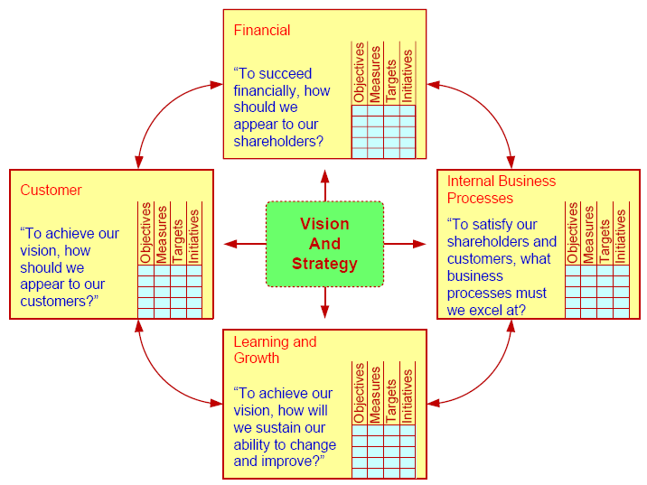
Balanced Scorecard
The meaning of “balance” ?

Slide 48
Six Sigma as a Performance Measurement System
Six Sigma
A performance management methodology aimed at reducing the number of defects in a business process to as close to zero defects per million opportunities (DPMO) as possible

Slide 49
Six Sigma as a Performance Measurement System
The DMAIC performance model
A closed-loop business improvement model that encompasses the steps of defining, measuring, analyzing, improving, and controlling a process
Lean Six Sigma
  Lean manufacturing / lean production
  Lean production versus six sigma?

Slide 50
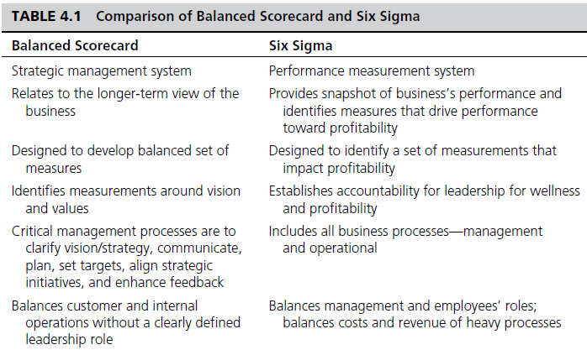
Comparison of Balanced Scorecard and Six Sigma

Slide 51
Application Case 4.8
Expedia.com’s Customer Satisfaction Scorecard
Questions for Discussion
Who are the customers for Expedia.com? Why is customer satisfaction a very important part of their business?
How did Expedia.com improve customer satisfaction with scorecards?
What were the challenges, the proposed solution, and the obtained results?

Slide 52
End of the Chapter
Questions, comments

Slide 53

All rights reserved. No part of this publication may be reproduced, stored in a retrieval system, or transmitted, in any form or by any means, electronic, mechanical, photocopying, recording, or otherwise, without the prior written permission of the publisher. Printed in the United States of America.

