Slide 1
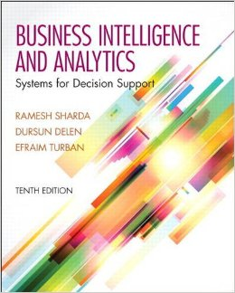
Business Intelligence and Analytics: Systems for Decision Support
(10th Edition)
Chapter 3:
Data Warehousing

Slide 2
Learning Objectives
Understand the basic definitions and concepts of data warehouses
Learn different types of data warehousing architectures; their comparative advantages and disadvantages
Describe the processes used in developing and managing data warehouses
Explain data warehousing operations
…
(Continued…)

Slide 3
Learning Objectives
Explain the role of data warehouses in decision support
Explain data integration and the extraction, transformation, and load (ETL) processes
Describe real-time (a.k.a. right-time and/or active) data warehousing
Understand data warehouse administration and security issues

Slide 4
Opening Vignette…
“Isle of Capri Casinos Is Winning with Enterprise Data Warehouse”
Company background
Problem description
Proposed solution
Results
Answer & discuss the case questions.

Slide 5
Questions for the
Opening Vignette
Why is it important for Isle to have an EDW?
What were the business challenges or opportunities that Isle was facing?
What was the process Isle followed to realize EDW? Comment on the potential challenges Isle might have had going through the process of EDW development.
What were the benefits of implementing an EDW at Isle? Can you think of other potential benefits that were not listed in the case?
Why do you think large enterprises like Isle in the gaming industry can succeed without having a capable data warehouse/business intelligence infrastructure?

Slide 6
Main Data Warehousing Topics
DW definition
Characteristics of DW
Data Marts
ODS, EDW, Metadata
DW Framework
DW Architecture & ETL Process
DW Development
DW Issues

Slide 7
What is a Data Warehouse?
A physical repository where relational data are specially organized to provide enterprise-wide, cleansed data in a standardized format
“The data warehouse is a collection of integrated, subject-oriented databases designed to support DSS functions, where each unit of data is non-volatile and relevant to some moment in time”

Slide 8
A Historical Perspective to
Data Warehousing

Slide 9
Characteristics of DWs
Subject oriented
Integrated
Time-variant (time series)
Nonvolatile
Summarized
Not normalized
Metadata
Web based, relational/multi-dimensional
Client/server, real-time/right-time/active...

Slide 10
Data Mart
A departmental small-scale “DW” that stores only limited/relevant data
  Dependent data mart
  A subset that is created directly from a data warehouse
  Independent data mart
  A small data warehouse designed for a strategic business unit or a department

Slide 11
Other DW Components
Operational data stores (ODS)
A type of database often used as an interim area for a data warehouse
Oper marts - an operational data mart.
Enterprise data warehouse (EDW)
A data warehouse for the enterprise.
Metadata: Data about data.
In a data warehouse, metadata describe the contents of a data warehouse and the manner of its acquisition and use

Slide 12
Application Case 3.1
A Better Data Plan: Well-Established TELCOs Leverage Data Warehousing and Analytics to Stay on Top in a Competitive Industry
Questions for Discussion
What are the main challenges for TELCOs?
How can data warehousing and data analytics help TELCOs in overcoming their challenges?
Why do you think TELCOs are well suited to take full advantage of data analytics?

Slide 13
A Generic DW Framework

Slide 14
Application Case 3.2
Data Warehousing Helps MultiCare Save More Lives
Questions for Discussion
What do you think is the role of data warehousing in healthcare systems?
How did MultiCare use data warehousing to improve health outcomes?

Slide 15
DW Architecture
Three-tier architecture
  Data acquisition software (back-end)
  The data warehouse that contains the data & software
  Client (front-end) software that allows users to access and analyze data from the warehouse
Two-tier architecture
  First two tiers in three-tier architecture is combined into one
… sometimes there is only one tier?

Slide 16
DW Architectures
3-tier
architecture
2-tier
architecture
1-tier
Architecture
?

Slide 17
Data Warehousing Architectures
Issues to consider when deciding which architecture to use:
  Which database management system (DBMS) should be used?
  Will parallel processing and/or partitioning be used?
  Will data migration tools be used to load the data warehouse?
  What tools will be used to support data retrieval and analysis?

Slide 18
A Web-Based DW Architecture

Slide 19
Alternative DW Architectures

Slide 20
Alternative DW Architectures
Each architecture has advantages and disadvantages!
Which architecture is the best?

Slide 21
Ten factors that potentially affect the architecture selection decision
Information interdependence between organizational units
Upper management’s information needs
Urgency of need for a data warehouse
Nature of end-user tasks
Constraints on resources
Strategic view of the data warehouse prior to implementation
Compatibility with existing systems
Perceived ability of the in-house IT staff
Technical issues
Social/political factors

Slide 22
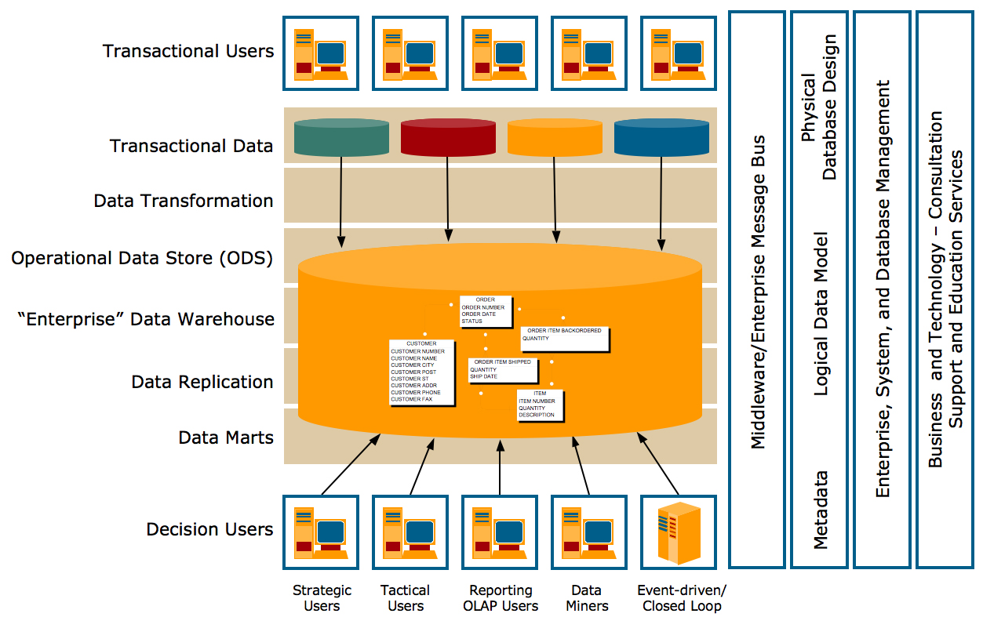
Teradata Corp. DW Architecture

Slide 23
Data Integration and the Extraction, Transformation, and Load Process
ETL = Extract Transform Load
Data integration
Integration that comprises three major processes: data access, data federation, and change capture.
Enterprise application integration (EAI)
A technology that provides a vehicle for pushing data from source systems into a data warehouse
Enterprise information integration (EII)
An evolving tool space that promises real-time data integration from a variety of sources, such as relational or multidimensional databases, Web services, etc.

Slide 24
Data Integration and the Extraction, Transformation, and Load Process

Slide 25
ETL (Extract, Transform, Load)
Issues affecting the purchase of an ETL tool
  Data transformation tools are expensive
  Data transformation tools may have a long learning curve
Important criteria in selecting an ETL tool
  Ability to read from and write to an unlimited number of data sources/architectures
  Automatic capturing and delivery of metadata
  A history of conforming to open standards
  An easy-to-use interface for the developer and the functional user

Slide 26
Data Warehouse Development
Data warehouse development approaches
  Inmon Model: EDW approach (top-down)
  Kimball Model: Data mart approach (bottom-up)
  Which model is best?
Table 3.3 provides a comparative analysis between EDW and Data Mart approach
One alternative is the hosted warehouse

Slide 27
Application Case 3.5
Starwood Hotels & Resorts Manages Hotel Profitability with Data Warehousing
Questions for Discussion
How big and complex are the business operations of Starwood Hotels & Resorts?
How did Starwood Hotels & Resorts use data warehousing for better profitability?
What were the challenges, the proposed solution, and the obtained results?

Slide 28
Additional DW Considerations Hosted Data Warehouses
Benefits:
  Requires minimal investment in infrastructure
  Frees up capacity on in-house systems
  Frees up cash flow
  Makes powerful solutions affordable
  Enables solutions that provide for growth
  Offers better quality equipment and software
  Provides faster connections
  … more in the book

Slide 29
Representation of Data in DW
Dimensional Modeling
  A retrieval-based system that supports high-volume query access
Star schema
  The most commonly used and the simplest style of dimensional modeling
  Contain a fact table surrounded by and connected to several dimension tables
Snowflakes schema
  An extension of star schema where the diagram resembles a snowflake in shape

Slide 30
Multidimensionality
The ability to organize, present, and analyze data by several dimensions, such as sales by region, by product, by salesperson, and by time (four dimensions)
Multidimensional presentation
  Dimensions: products, salespeople, market segments, business units, geographical locations, distribution channels, country, or industry
  Measures: money, sales volume, head count, inventory profit, actual versus forecast
  Time: daily, weekly, monthly, quarterly, or yearly

Slide 31
Star versus Snowflake Schema

Slide 32
Analysis of Data in DW
OLTP vs. OLAP…
OLTP (online transaction processing)
  Capturing and storing data from ERP, CRM, POS, …
  The main focus is on efficiency of routine tasks
OLAP (Online analytical processing)
  Converting data into information for decision support
  Data cubes, drill-down / rollup, slice & dice, …
  Requesting ad hoc reports
  Conducting statistical and other analyses
  Developing multimedia-based applications
  …more in the book

Slide 33
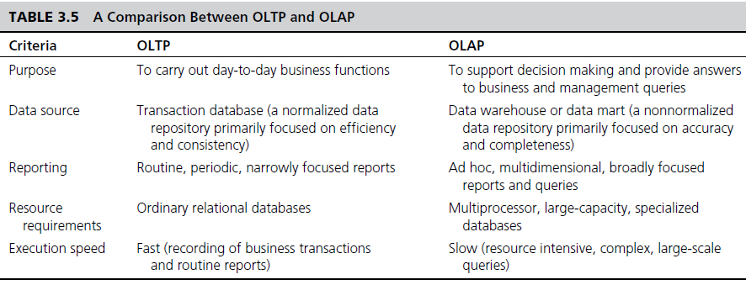
OLAP vs. OLTP

Slide 34
OLAP Operations
Slice - a subset of a multidimensional array
Dice - a slice on more than two dimensions
Drill Down/Up - navigating among levels of data ranging from the most summarized (up) to the most detailed (down)
Roll Up - computing all of the data relationships for one or more dimensions
Pivot - used to change the dimensional orientation of a report or an ad hoc query-page display

Slide 35
OLAP
Slicing Operations on a Simple Tree-Dimensional
Data Cube

Slide 36
Variations of OLAP
Multidimensional OLAP (MOLAP)
OLAP implemented via a specialized multidimensional database (or data store) that summarizes transactions into multidimensional views ahead of time
Relational OLAP (ROLAP)
The implementation of an OLAP database on top of an existing relational database
Database OLAP and Web OLAP (DOLAP and WOLAP); Desktop OLAP,…

Slide 37
Technology Insights 3.2
Hands-On DW with MicroStrategy
A wealth of teaching and learning resources can be found at TUN portal
www.teradatauniversitynetwork.com
The available resource includes scripted demonstrations, assignments, white papers, etc…

Slide 38
DW Implementation Issues
Identification of data sources and governance
Data quality planning, data model design
ETL tool selection
Establishment of service-level agreements
Data transport, data conversion
Reconciliation process
End-user support
Political issues
… more in the book

Slide 39
Successful DW Implementation
Things to Avoid
Starting with the wrong sponsorship chain
Setting expectations that you cannot meet
Engaging in politically naive behavior
Loading the data warehouse with information just because it is available
Believing that data warehousing database design is the same as transactional database design
Choosing a data warehouse manager who is technology oriented rather than user oriented
… more in the book

Slide 40
Failure Factors in DW Projects
Lack of executive sponsorship
Unclear business objectives
Cultural issues being ignored
  Change management
Unrealistic expectations
Inappropriate architecture
Low data quality / missing information
Loading data just because it is available

Slide 41
Massive DW and Scalability
Scalability
  The main issues pertaining to scalability:
    The amount of data in the warehouse
    How quickly the warehouse is expected to grow
    The number of concurrent users
    The complexity of user queries
  Good scalability means that queries and other data-access functions will grow linearly with the size of the warehouse

Slide 42
Real-Time/Active DW/BI
Enabling real-time data updates for real-time analysis and real-time decision making is growing rapidly
  Push vs. Pull (of data)
Concerns about real-time BI
  Not all data should be updated continuously
  Mismatch of reports generated minutes apart
  May be cost prohibitive
  May also be infeasible

Slide 43
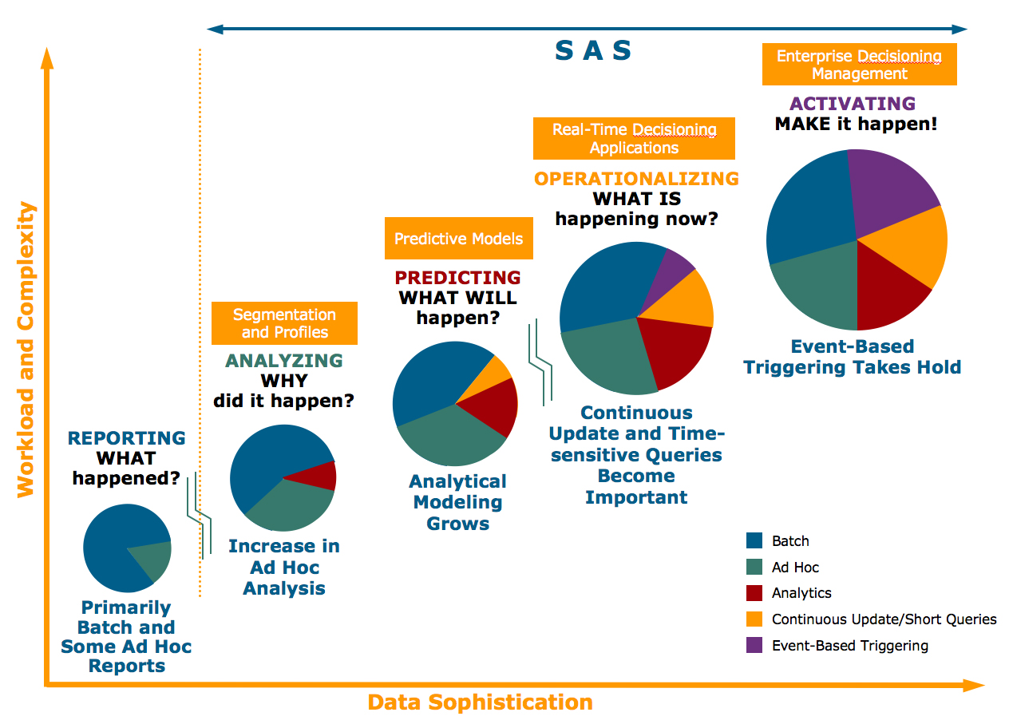
Enterprise Decision Evolution and Data Warehousing

Slide 44
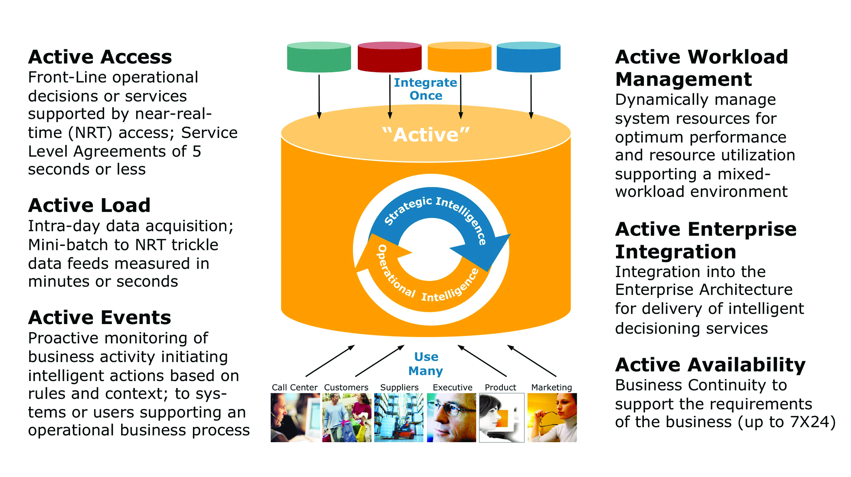
Real-Time/Active DW at Teradata

Slide 45
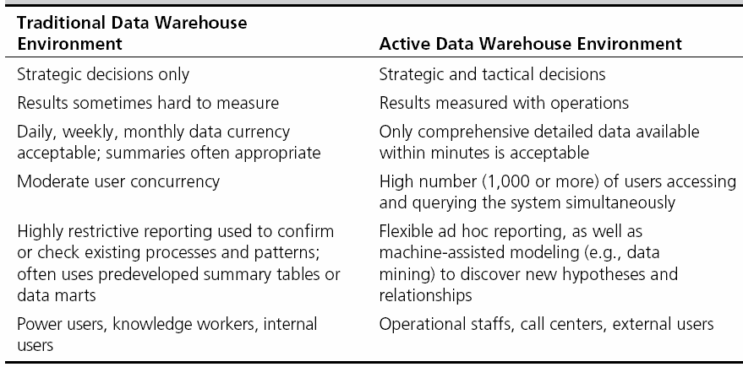
Traditional versus Active DW

Slide 46
DW Administration and Security
Data warehouse administrator (DWA)
  DWA should…
    have the knowledge of high-performance software, hardware and networking technologies
    possess solid business knowledge and insight
    be familiar with the decision-making processes so as to suitably design/maintain the data warehouse structure
    possess excellent communications skills
Security and privacy is a pressing issue in DW
  Safeguarding the most valuable assets
  Government regulations (HIPAA, etc.)
  Must be explicitly planned and executed

Slide 47
The Future of DW
Sourcing…
  Web, social media, and Big Data
  Open source software
  SaaS (software as a service)
  Cloud computing
Infrastructure…
  Columnar
  Real-time DW
  Data warehouse appliances
  Data management practices/technologies
  In-database & In-memory processing New DBMS
  Advanced analytics
  …

Slide 48
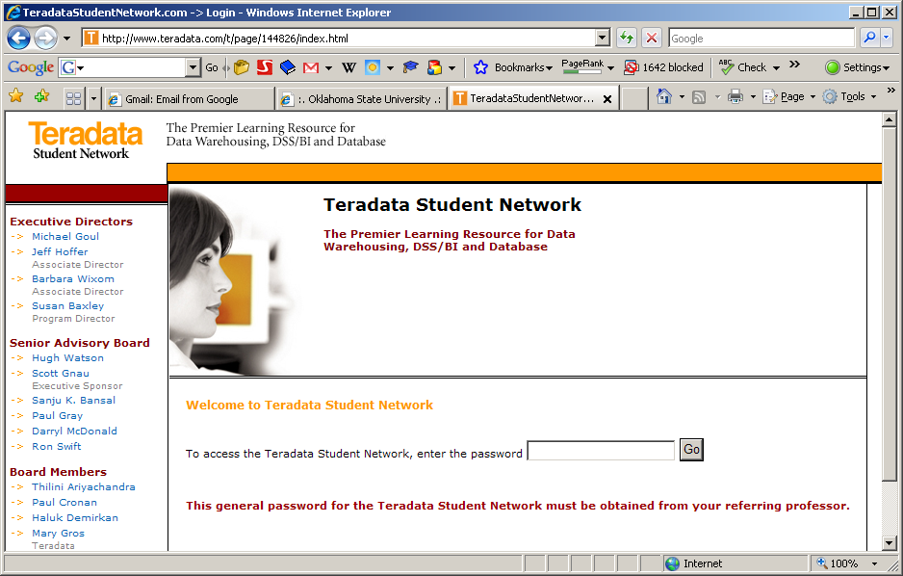
Free of Charge DW Portal for Teaching & Learning
www.TeradataStudentNetwork.com
Password to signup: <check with your instructor>

Slide 49
End of the Chapter
Questions, comments

Slide 50
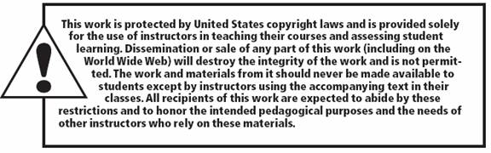
All rights reserved. No part of this publication may be reproduced, stored in a retrieval system, or transmitted, in any form or by any means, electronic, mechanical, photocopying, recording, or otherwise, without the prior written permission of the publisher. Printed in the United States of America.

