Slide 1
Business Intelligence and Analytics: Systems for Decision Support
(10th Edition)
Chapter 2:
Foundations and Technologies
for Decision Making

Slide 2
Learning Objectives
Understand the conceptual foundations of decision making
Understand Simon’s four phases of decision making: intelligence, design, choice, and implementation
Understand the essential definition of decision support systems (DSS)
Understand different types of DSS classifications
(Continued…)

Slide 3
Learning Objectives
Learn the capabilities and limitations of DSS in supporting managerial decisions
Learn how DSS support for decision making can be provided in practice
Understand DSS components and how they integrate

Slide 4
Opening Vignette
Decision Modeling at HP Using Spreadsheets
Background
Problem description
Proposed solution
Results
Answer & discuss the case questions...

Slide 5
Questions for the Opening Vignette
What are some of the key questions to be asked in supporting decision making through DSS?
What guidelines can be learned from this vignette about developing DSS?
What lessons should be kept in mind for successful model implementation?

Slide 6
Characteristics of Decision Making
Groupthink
Evaluating what-if scenarios
Experimentation with a real system!
Changes in the decision-making environment may occur continuously
Time pressure on the decision maker
Analyzing a problem takes time/money
Insufficient or too much information

Slide 7
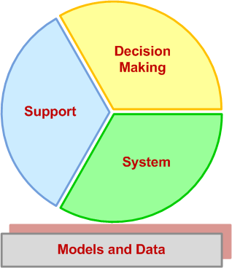
Characteristics of Decision Making Decision Support Systems (DSS)
Dissecting DSS into its main concepts →
Building successful DSS requires a thorough understanding of these concepts

Slide 8
Decision Making
A process of choosing among two or more alternative courses of action for the purpose of attaining a goal(s)
Managerial decision making is synonymous with the entire management process - Simon (1977)
Example: Planning
What should be done? When? Where? Why? How? By whom?

Slide 9
Decision-Making Disciplines
Behavioral: anthropology, law, philosophy, political science, psychology, social psychology, and sociology
Scientific: computer science, decision analysis, economics, engineering, the hard sciences (e.g., biology, chemistry, physics), management science/operations research, mathematics, and statistics
Each discipline has its own set of assumptions and each contributes a unique, valid view of how people make decisions

Slide 10
Decision-Making Disciplines
Better decisions
Tradeoff: accuracy versus speed
Fast decision may be detrimental
Many areas suffer from fast decisions
Effectiveness versus Efficiency
Effectiveness → “goodness” “accuracy”
Efficiency → “speed” “less resources”
A fine balance is what is needed!

Slide 11
Decision Style
The manner by which decision makers think and react to problems
perceive a problem
cognitive response
values and beliefs
When making decisions, people…
follow different steps/sequence
give different emphasis, time allotment, and priority to each step

Slide 12
Decision Style
Personality temperament tests are often used to determine decision styles
There are many such tests
Meyers/Briggs,
True Colors (Birkman),
Keirsey Temperament Theory, …
Various tests measure somewhat different aspects of personality
They cannot be equated!

Slide 13
Decision Style
Decision-making styles
Heuristic versus Analytic
Autocratic versus Democratic
Consultative (with individuals or groups)
A successful computerized system should fit the decision style and the decision situation
Should be flexible and adaptable to different users (individuals vs. groups)

Slide 14
Decision Makers
Small organizations
Individuals
Conflicting objectives
Medium-to-large organizations
Groups
Different styles, backgrounds, expectations
Conflicting objectives
Consensus is often difficult to reach
Help: Computer support, GSS, …

Slide 15
Phases of Decision-Making Process
Humans consciously or subconsciously follow a systematic decision-making process - Simon (1977)
Intelligence
Design
Choice
Implementation
(?) Monitoring (a part of intelligence?)

Slide 16
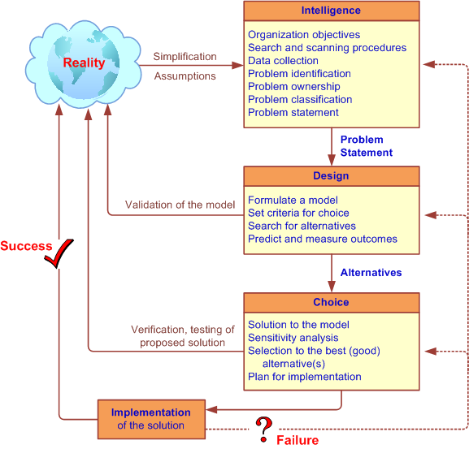
Simon’s Decision-Making Process

Slide 17
Decision Making: Intelligence Phase
Scan the environment, either intermittently or continuously
Identify problem situations or opportunities
Monitor the results of the implementation
Problem is the difference between what people desire (or expect) and what is actually occurring
Symptom versus Problem
Timely identification of opportunities is as important as identification of problems

Slide 18
Decision Making: Intelligence Phase
Potential issues in data/information collection and estimation
Lack of data
Cost of data collection
Inaccurate and/or imprecise data
Data estimation is often subjective
Data may be insecure
Key data may be qualitative
Data change over time (time-dependence)

Slide 19
Application Case 2.1
Making Elevators Go Faster!
Background
Problem description
Proposed solution
Results

Slide 20
Decision Making: Intelligence Phase
Problem Classification
Classification of problems according to the degree of structuredness
Problem Decomposition
Often solving the simpler subproblems may help in solving a complex problem.
Information/data can improve the structuredness of a problem situation
Problem Ownership
Outcome of intelligence phase →
A Formal Problem
Statement

Slide 21
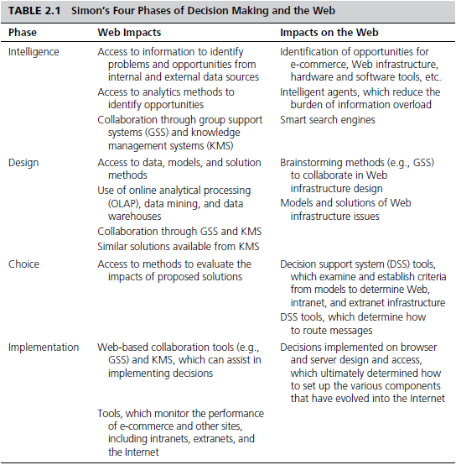
Web and the Decision-Making Process

Slide 22
Decision Making: The Design Phase
Finding/developing and analyzing possible courses of actions
A model of the decision-making problem is constructed, tested, and validated
Modeling: conceptualizing a problem and abstracting it into a quantitative and/or qualitative form (i.e., using symbols/variables)
Abstraction: making assumptions for simplification
Tradeoff (cost/benefit): more or less abstraction
Modeling: both an art and a science

Slide 23
Decision Making: The Design Phase
Selection of a Principle of Choice
It is a criterion that describes the acceptability of a solution approach
Reflection of decision-making objective(s)
In a model, it is the result variable
Choosing and validating against
High-risk versus low-risk
Optimize versus satisfice
Criterion is not a constraint!
See Technology Insight 2.1

Slide 24
Decision Making: The Design Phase
Normative models (= optimization)
the chosen alternative is demonstrably the best of all possible alternatives
Assumptions of rational decision makers
Humans are economic beings whose objective is to maximize the attainment of goals
For a decision-making situation, all alternative courses of action and consequences are known
Decision makers have an order or preference that enables them to rank the desirability of all consequences

Slide 25
Decision Making: The Design Phase
Heuristic models (= suboptimization)
The chosen alternative is the best of only a subset of possible alternatives
Often, it is not feasible to optimize realistic (size/complexity) problems
Suboptimization may also help relax unrealistic assumptions in models
Help reach a good enough solution faster

Slide 26
Decision Making: The Design Phase
Descriptive models
Describe things as they are or as they are believed to be (mathematically based)
They do not provide a solution but information that may lead to a solution
Simulation - most common descriptive modeling method (mathematical depiction of systems in a computer environment)
Allows experimentation with the descriptive model of a system

Slide 27
Decision Making: The Design Phase
Good Enough, or Satisficing
“something less than the best”
A form of suboptimization
Seeking to achieve a desired level of performance as opposed to the “best”
Benefit: time saving
Simon’s idea of bounded rationality

Slide 28
Decision Making: The Design Phase
Developing (Generating) Alternatives
In optimization models (such as linear programming), the alternatives may be generated automatically
In most MSS situations, however, it is necessary to generate alternatives manually
Use of GSS helps generate alternatives
Measuring/ranking the outcomes
Using the principle of choice

Slide 29
Decision Making: The Design Phase
Risk
Lack of precise knowledge (uncertainty)
Risk can be measured with probability
Scenario (what-if case)
A statement of assumptions about the operating environment (variables) of a particular system at a given time
Possible scenarios: best, worst, most likely, average (and custom intervals)

Slide 30
Decision Making: The Choice Phase
The actual decision and the commitment to follow a certain course of action are made here
The boundary between the design and choice is often unclear (partially overlapping phases)
Generate alternatives while performing evaluations
Includes the search, evaluation, and recommendation of an appropriate solution to the model
Solving the model versus solving the problem!

Slide 31
Decision Making: The Choice Phase
Search approaches
Analytic techniques (solving with a formula)
Algorithms (step-by-step procedures)
Heuristics (rule of thumb)
Blind search (truly random search)
Additional activities
Sensitivity analysis
What-if analysis
Goal seeking

Slide 32
Decision Making: The Implementation Phase
“Nothing more difficult to carry out, nor more doubtful of success, nor more dangerous to handle, than to initiate a new order of things.”
- The Prince, Machiavelli 1500s
Solution to a problem → Change
Change management ?..
Implementation: putting a recommended solution to work

Slide 33
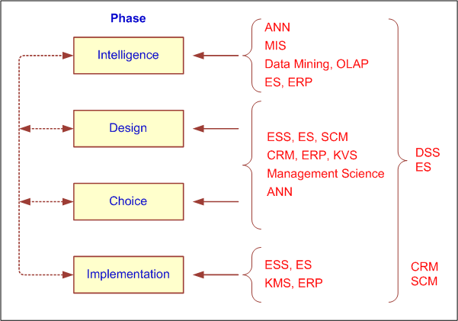
How Decisions are Supported

Slide 34
How Decisions are Supported
Support for the Intelligence Phase
Enabling continuous scanning of external and internal information sources to identify problems and/or opportunities
Resources/technologies: Web; ES, OLAP, data warehousing, data/text/Web mining, EIS/Dashboards, KMS, GSS, GIS,…
Business activity monitoring (BAM)
Business process management (BPM)
Product life-cycle management (PLM)

Slide 35
How Decisions are Supported
Support for the Design Phase
Enabling generating alternative courses of action, determining the criteria for choice
Generating alternatives
Structured/simple problems: standard and/or special models
Unstructured/complex problems: human experts, ES, KMS, brainstorming/GSS, OLAP, data/text mining
A good “criteria for choice” is critical!

Slide 36
How Decisions are Supported
Support for the Choice Phase
Enabling selection of the best alternative given a complex constraint structure
Use sensitivity analyses, what-if analyses, goal seeking
Resources
KMS
CRM, ERP, and SCM
Simulation and other descriptive models

Slide 37
How Decisions are Supported
Support for the Implementation Phase
Enabling implementation/deployment of the selected solution to the system
Decision communication, explanation and justification to reduce resistance to change
Resources
Corporate portals, Web 2.0/Wikis
Brainstorming/GSS
KMS, ES

Slide 38
DSS Capabilities
DSS early definition: it is a system intended to support managerial decisions in semistructured and unstructured decision situations
DSS were meant to be adjuncts to decision makers → extending their capabilities
They are computer based and would operate interactively online, and preferably would have graphical output capabilities
Nowadays, simplified via Web browsers and mobile devices

Slide 39
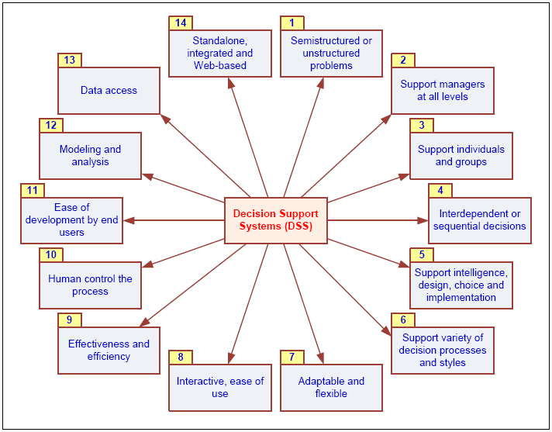
DSS Capabilities

Slide 40
DSS Classifications
AIS SIGDSS Classification
Communication-driven and group DSS
Data-driven DSS
Document-driven DSS
Knowledge-driven DSS
Model-driven DSS
Often DSS is a hybrid of many classes

Slide 41
DSS Classifications
Other DSS Categories
Institutional and ad-hoc DSS
Custom-made systems versus ready-made systems
Personal, group, and organizational support
Individual support system versus group support system (GSS)…

Slide 42
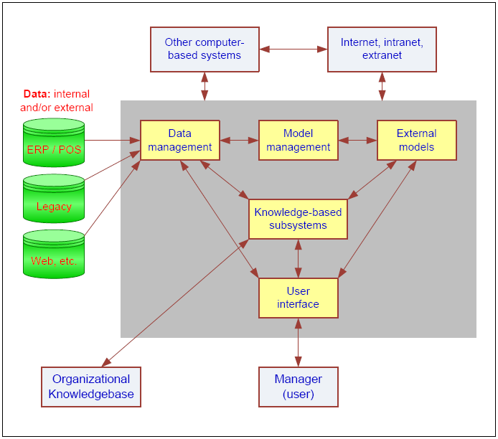
Components of DSS

Slide 43
Components of DSS
Data Management Subsystem
Includes the database that contains the data
Database management system (DBMS)
Can be connected to a data warehouse
Model Management Subsystem
Model base management system (MBMS)
User Interface Subsystem
Knowledgebase Management Subsystem
Organizational knowledge base

Slide 44
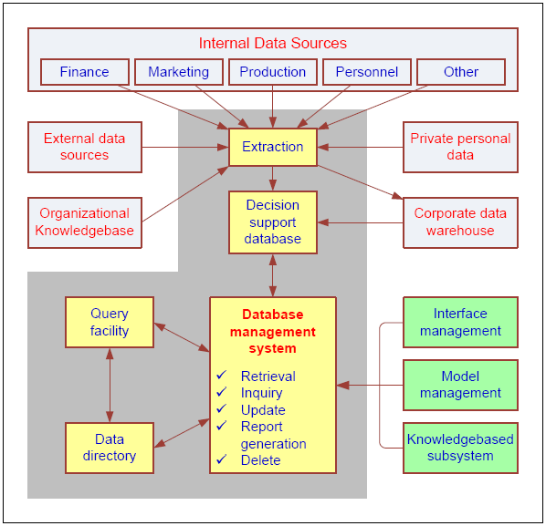
DSS Components: Data Management Subsystem
DSS database
DBMS
Data directory
Query facility

Slide 45
Application Case 2.2
Station Casinos Wins by Building Customer Relationships Using Its Data
Questions for Discussion
Why is this decision support system classified as a data-focused DSS?
What were some of the benefits from implementing this solution?

Slide 46
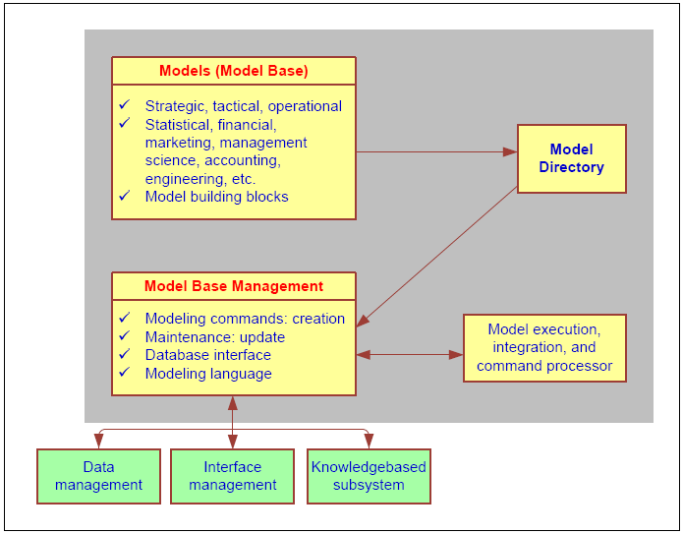
DSS Components: Model Management Subsystem
Model base
MBMS
Modeling language
Model directory
Model execution, integration, and command processor

Slide 47
Application Case 2.3
SNAP DSS Helps OneNet Make Telecommunications Rate Decisions
Background
Problem description
Proposed solution
Results

Slide 48
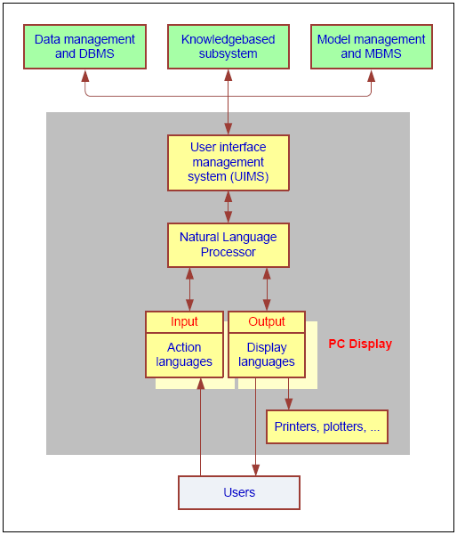
DSS Components: User Interface Subsystem
Interface
Application interface
User Interface (GUI?)
DSS User Interface
Portal
Graphical icons
Dashboard
Color coding
Interfacing with PDAs, cell phones, etc.
See Technology Insight 2.2 for next gen devices

Slide 49
End of the Chapter
Questions, comments

Slide 50
All rights reserved. No part of this publication may be reproduced, stored in a retrieval system, or transmitted, in any form or by any means, electronic, mechanical, photocopying, recording, or otherwise, without the prior written permission of the publisher. Printed in the United States of America.

