Slide 1
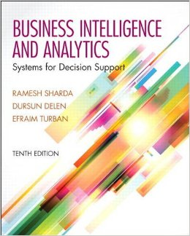
Business Intelligence and Analytics: Systems for Decision Support
(10th Edition)
Chapter 1:
An Overview of Business Intelligence, Analytics, and Decision Support
Notes:
<number>

Slide 2
Plan of the Book
Part I - Decision Making and Analytics: An Overview
  (Chapters 1 & 2)
Part II - Descriptive Analytics
  (Chapters 3 & 4)
Part III - Predictive Analytics
  Chapters 5 - 8
Part IV - Prescriptive Analytics
  Chapter 9 - 12
Part V - Big Data and Future Directions for Business Analytics
  Chapters 13 & 14
PLUS - Online Supplements
  …

Slide 3
Learning Objectives
Understand today’s turbulent business environment and describe how organizations survive and even excel in such an environment (solving problems and exploiting opportunities)
Understand the need for computerized support of managerial decision making
Understand an early framework for managerial decision making
...
(Continued…)

Slide 4
Learning Objectives
Learn the conceptual foundations of the DSS methodology
Describe the BI methodology and concepts and relate them to DSS
Understand the various types of analytics
List the major tools of computerized decision support

Slide 5
Opening Vignette…
Magpie Sensing Employs Analytics to Manage a Vaccine Supply Chain Effectively and Safely
Company background
Problem
Proposed solution and results
Answer & discuss the case questions...
Notes:
<number>

Slide 6
Opening Vignette…
Questions for the Opening Vignette
What information is provided by the descriptive analytics employed at Magpie Sensing?
What type of support is provided by the predictive analytics employed at Magpie Sensing?
How does prescriptive analytics help in business decision making?
In what ways can actionable information be reported in real time to concerned users of the system?
In what other situations might real-time monitoring applications be needed?
Notes:
<number>

Slide 7
Changing Business Environment & Computerized Decision Support
Companies are moving aggressively to computerized support of their operations ⇨ Business Intelligence
Business Pressures–Responses–Support Model
  Business pressures result of today's competitive business climate
  Responses to counter the pressures
  Support to better facilitate the process
Notes:
<number>

Slide 8
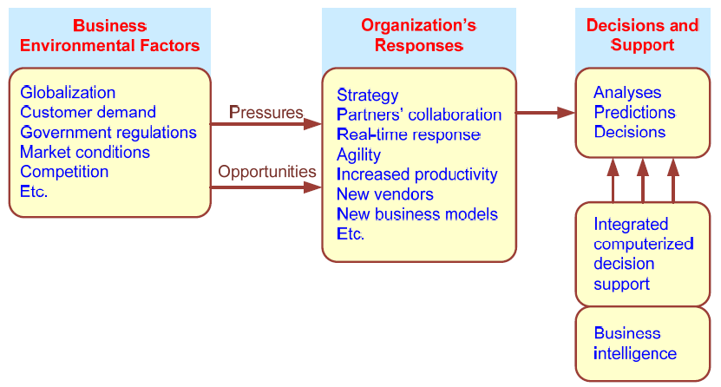
Business Pressures–Responses–Support Model
Notes:
<number>

Slide 9
The Business Environment
The environment in which organizations operate today is becoming more and more complex, creating
  opportunities, and
  problems.
  Example: globalization.
Business environment factors:
  markets, consumer demands, technology, and societal…
Notes:
<number>

Slide 10
Business Environment Factors
FACTOR DESCRIPTION
Markets Strong competition
Expanding global markets
Blooming electronic markets on the Internet
Innovative marketing methods
Opportunities for outsourcing with IT support
Need for real-time, on-demand transactions
Consumer Desire for customization
demand Desire for quality, diversity of products, and speed of delivery
Customers getting powerful and less loyal
Technology More innovations, new products, and new services
Increasing obsolescence rate
Increasing information overload
Social networking, Web 2.0 and beyond
Societal Growing government regulations and deregulation
Workforce more diversified, older, and composed of more women Prime concerns of homeland security and terrorist attacks
Necessity of Sarbanes-Oxley Act and other reporting-related legislation Increasing social responsibility of companies
Greater emphasis on sustainability
Notes:
<number>

Slide 11
Organizational Responses
Be Reactive, Anticipative, Adaptive, and Proactive
Managers may take actions, such as
  Employ strategic planning.
  Use new and innovative business models.
  Restructure business processes.
  Participate in business alliances.
  Improve corporate information systems.
  … more [in your book]
Notes:
<number>

Slide 12
Closing the Strategy Gap
One of the major objectives of computerized decision support is to facilitate closing the gap between the current performance of an organization and its desired performance, as expressed in its mission, objectives, and goals, and the strategy to achieve them.
Notes:
<number>

Slide 13
Managerial Decision Making
Management is a process by which organizational goals are achieved by using resources.
  Inputs: resources
  Output: attainment of goals
  Measure of success: outputs / inputs
Management ≅ Decision Making
Decision making: selecting the best solution from two or more alternatives
Notes:
<number>

Slide 14
The Nature of Managers’ Work
Mintzberg's 10 Managerial Roles
Interpersonal
1. Figurehead
2. Leader
3. Liaison
Informational
4. Monitor
5. Disseminator
6. Spokesperson
Decisional
7. Entrepreneur
8. Disturbance handler
9. Resource allocator
10. Negotiator
Notes:
<number>

Slide 15
Decision-Making Process
Managers usually make decisions by following a four-step process (a.k.a. the scientific approach)
  Define the problem (or opportunity)
  Construct a model that describes the real-world problem.
  Identify possible solutions to the modeled problem and evaluate the solutions.
  Compare, choose, and recommend a potential solution to the problem.
Notes:
<number>

Slide 16
Information Systems Support
for Decision Making
Group communication and collaboration
Improved data management
Managing data warehouses and Big Data
Analytical support
Overcoming cognitive limits in processing and storing information
Knowledge management
Anywhere, anytime support
Notes:
<number>

Slide 17
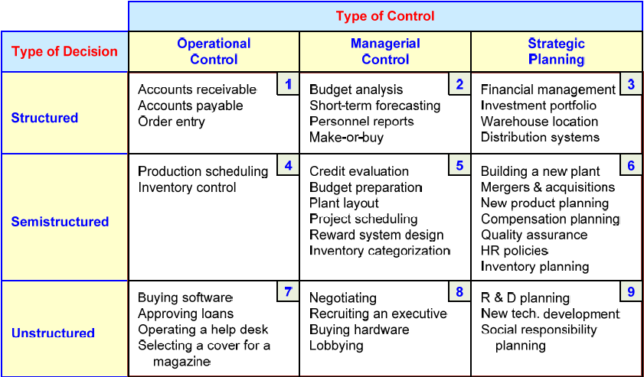
An Early Decision Support Framework (by Gory and Scott-Morten, 1971)
Notes:
<number>

Slide 18
An Early Decision Support Framework
Degree of Structuredness (Simon, 1977)
  Decisions are classified as
    Highly structured (a.k.a. programmed)
    Semi-structured
    Highly unstructured (i.e., nonprogrammed)
Types of Control (Anthony, 1965)
  Strategic planning (top-level, long-range)
  Management control (tactical planning)
  Operational control
Notes:
<number>

Slide 19
The Concept of DSS
DSS - interactive computer-based systems, which help decision makers utilize data and models to solve unstructured problems
(Gorry and Scott-Morton, 1971)
Decision support systems couple the intellectual resources of individuals with the capabilities of the computer to improve the quality of decisions.
DS as an Umbrella Term
Evolution of DS into Business Intelligence

Slide 20
A Framework for
Business Intelligence (BI)
BI is an evolution of decision support concepts over time
    Then: Executive Information System
    Now: Everybody’s Information System (BI)
BI systems are enhanced with additional visualizations, alerts, and performance measurement capabilities
The term BI emerged from industry
Notes:
<number>

Slide 21
Definition of BI
BI is an umbrella term that combines architectures, tools, databases, analytical tools, applications, and methodologies
BI is a content-free expression, so it means different things to different people
BI's major objective is to enable easy access to data (and models) to provide business managers with the ability to conduct analysis
BI helps transform data, to information (and knowledge), to decisions, and finally to action
Notes:
<number>

Slide 22
A Brief History of BI
The term BI was coined by the Gartner Group in the mid-1990s
However, the concept is much older
  1970s - MIS reporting - static/periodic reports
  1980s - Executive Information Systems (EIS)
  1990s - OLAP, dynamic, multidimensional, ad-hoc reporting -> coining of the term “BI”
  2010s - Inclusion of AI and Data/Text Mining capabilities; Web-based Portals/Dashboards, Big Data, Social Media, Analytics
  2020s - yet to be seen
Notes:
<number>

Slide 23
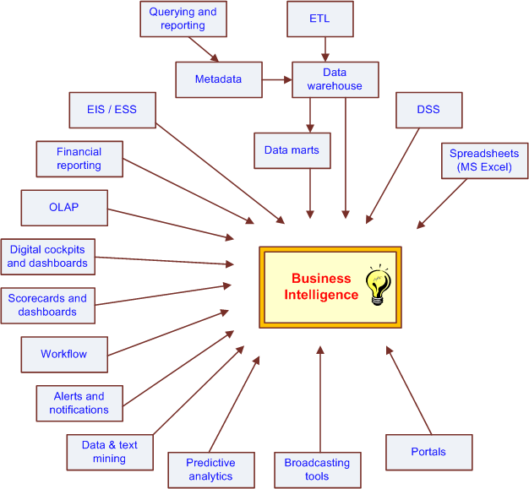
The Evolution of BI Capabilities
Notes:
<number>

Slide 24
The Architecture of BI
A BI system has four major components
  a data warehouse, with its source data
  business analytics, a collection of tools for manipulating, mining, and analyzing the data in the data warehouse
  business performance management (BPM) for monitoring and analyzing performance
  a user interface (e.g., dashboard)
Notes:
<number>

Slide 25
A High-Level Architecture of BI
Notes:
<number>

Slide 26

Business Value of BI Analytical Applications
Customer segmentation
Propensity to buy
Customer profitability
Fraud detection
Customer attrition
Channel optimization

Slide 27
Application Case 1.1
Sabre Helps Its Clients Through Dashboards and Analytics
Questions for Discussion
  What is traditional reporting? How is it used in the organization?
  How can analytics be used to transform the traditional reporting?
  How can interactive reporting assist organizations in decision making?
Notes:
<number>

Slide 28
A Multimedia Exercise
in Business Intelligence
Teradata University Network (TUN)
www.teradatauniversitynetwork.com
BSI Videos (Business Scenario Investigations)
www.youtube.com/watch?v=NXEL5F4_aKA
Also look for other BSI Videos at TUN

Slide 29
DSS-BI Connections
Similarities and differences?
  Similar architectures, data focus, …
Direct vs. indirect support
Different target audiences
Commercially available systems versus in-house development of solutions
Origination – Industry vs. Academia
So, is DSS = BI ?

Slide 30
Analytics Overview
Analytics?
  Something new or just a new name for …
A Simple Taxonomy of Analytics (proposed by INFORMS)
  Descriptive Analytics
  Predictive Analytics
  Prescriptive Analytics
Analytics or Data Science?

Slide 31
Analytics Overview

Slide 32
Application Case 1.2
Eliminating Inefficiencies at Seattle Children’s Hospital
Questions for Discussion
Who are the users of the tool?
What is a dashboard?
How does visualization help in decision making?
What are the significant results achieved by the use of Tableau?

Slide 33
Application Case 1.3
Analysis at the Speed of Thought
Questions for Discussion
What are the desired functionalities of a reporting tool?
What advantages were derived by using a reporting tool in the case?

Slide 34
Application Case 1.4
Moneyball: Analytics in Sports and Movies
Questions for Discussion
How is predictive analytics applied in Moneyball?
What is the difference between objective and subjective approaches in decision making?

Slide 35
Application Case 1.5
Analyzing Athletic Injuries
Questions for Discussion
What types of analytics are applied in the injury analysis?
How do visualizations aid in understanding the data and delivering insights into the data?
What is a classification problem?
What can be derived by performing sequence analysis?

Slide 36
Application Case 1.6
Industrial and Commercial Bank of China (ICBC) Employs Models to Reconfigure Its Branch Networks
Questions for Discussion
How can analytical techniques help organizations to retain competitive advantage?
How can descriptive and predictive analytics help in pursuing prescriptive analytics?
What kind of prescriptive analytic techniques are employed in the case study?
Are the prescriptive models once built good forever?

Slide 37
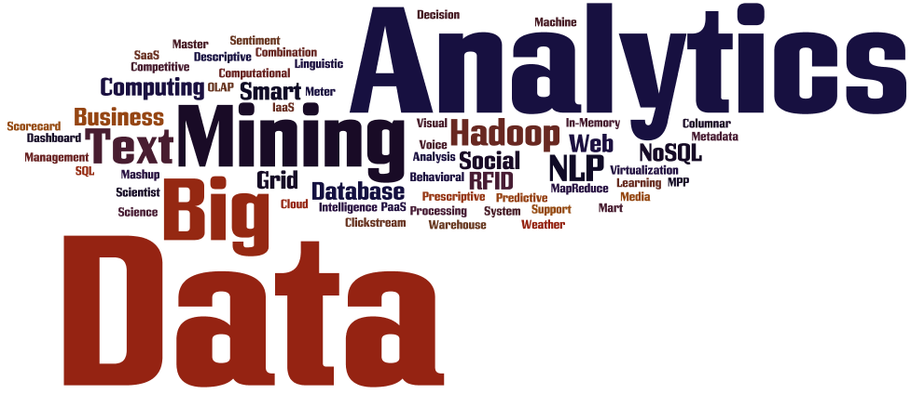
Introduction to Big Data Analytics
Big Data?
  Not just big!
  Volume
  Variety
  Velocity
More of Big Data and related analytics tools and techniques are covered in Chapter 13.

Slide 38
Application Case 1.7
Gilt Groupe’s Flash Sales Streamlined by Big Data Analytics
Questions for Discussion
What makes this case study an example of Big Data analytics?
What types of decisions does Gilt Groupe have to make?

Slide 39
End-of-Chapter Application Case
Nationwide Insurance Used BI to Enhance Customer Service
Questions for Discussion
Why did Nationwide need an enterprise-wide data warehouse?
How did integrated data drive the business value?
What forms of analytics are employed at Nationwide?
With integrated data available in an enterprise data warehouse, what other applications could Nationwide potentially develop?

Slide 40
End of the Chapter
Questions / Comments…
Notes:
<number>

Slide 41
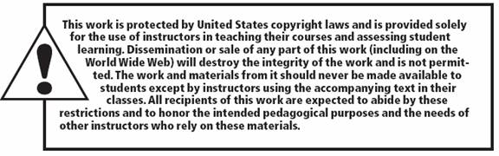
All rights reserved. No part of this publication may be reproduced, stored in a retrieval system, or transmitted, in any form or by any means, electronic, mechanical, photocopying, recording, or otherwise, without the prior written permission of the publisher. Printed in the United States of America.
Notes:
<number>

