Slide 1

CHAPTER ELEVEN
MULTIMEDIA DEVELOPMENT

Slide 2
CHAPTER HIGHLIGHTS
Multimedia development requires a team and a development plan.
Team members provide specialized knowledge of media creation.
Plan defines the set of tasks and procedures needed for successful project development.
Notes:
Instructional tip: the DVD for Shrek and Toy Story contain supporting video segments on the development process. These are good illustrations of a team, the process, and the iterative nature of development.

Slide 3
DEVELOPMENT TEAM
Team of experts is important for project.
  They produce high quality media.
  They contribute to the development of ideas in the project cycle.
Development is both:
  Interactive—team members share expertise and ideas during the development cycle.
  Iterative—revisions result from development feedback.
Notes:
Not all development will have the array of team members we identify here. In some cases one person may do all the development, but in many cases a variety of expertise is part of a production staff. Rather than consider the individual persons on a team, it may be more realistic to consider the required skill sets that are part of the process. Some staff members may handle multiple roles because they have a wide range of skill sets.

Slide 4
TEAM MEMBERS
Project manager
  Responsible for delivering the product with promised features, on time, and on budget.
  Oversees the business aspects of the development process.
  Must be organized, focused, and task oriented.
Project designer
  Responsible for overall structure of content, the look, feel, and functionality of user interface.
Notes:
Not all development will have the array of team members we identify here. In some cases one person may do all the development, but in many cases a variety of expertise is part of a production staff. Rather than consider the individual persons on a team, it may be more realistic to consider the required skill sets that are part of the process. Some staff members may handle multiple roles because they have a wide range of skill sets.

Slide 5
TEAM MEMBERS
Content expert
  Has detailed understanding of the topic.
  Some projects may rely on the client to provide content for project.
Writers
  Create original text for the project.
  Provide written requirements of the project such as documentation, contracts, help screens.
  Technical writing skills are useful.

Slide 6
MEDIA SPECIALISTS
Responsible for preparation of individual elements in a multimedia application.
  Graphics specialist
    Artists skilled in design principles and most current digital technology.
  Sound specialist
    Trained in traditional sound production and has a working knowledge of a sound studio.
    Familiar with digital tools for creating and editing sounds.

Slide 7
MEDIA SPECIALISTS
  Animation artist
    Understands the principles of composition and color and can produce drawings.
    Understands the elements of motion and can envision action sequences.
    Knows computer animation programs and techniques.
  Video specialist
    Videographers who have knowledge of film techniques, writing, sound, and digital video production and editing.

Slide 8
MEDIA SPECIALISTS
  Programmer
    Responsible for computer code that unites the media elements and provides the product's functionality.
  Acquisitions Specialist
    Knowledgeable about sources for copyright-protected content and process of securing permissions.
    Establishes agreements to protect the creative work of the project developers.

Slide 9
DEVELOPMENT PLAN
Addresses three essential tasks:
    Definition
    Design
    Production.
Progress markers or rewards are identified at each stage.
Deliverables are sent to the client as project takes shape.
Payment schedules often tied to deliverables.
Development is an iterative process: earlier stages are re-shaped as development progresses.

Slide 10
STAGE 1: DEFINITION
Identify project goal or purpose.
  What should the application accomplish?
Identify the audience.
  Who are the intended users?
Identify role of multimedia in this project.
    Advantages of multimedia to accomplish goal.
    Media elements it requires.
    Forms of interactivity to provide.
    Delivery method and cost estimate.

Slide 11
KEY DOCUMENTS IN STAGE 1
Preliminary Proposal
  Short description of the proposed application.
    Includes project goal, audience, outcomes, description of media, types and uses of interactivity, preliminary cost estimate.
  Often includes a flowchart.
    A simple box diagram with brief descriptions of product contents.

Slide 12
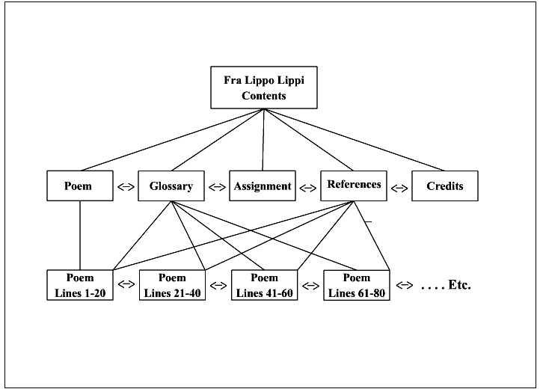
SAMPLE FLOWCHART
Created for a multimedia application based on the poem Fra Lippo Lippi developed by Savage and Vogel.

Slide 13
KEY DOCUMENTS IN STAGE 1
Storyboard
  Series of sketches of major screens.
  Rough drawings of media elements such as photos, animations, or videos are sketched in.
  Navigational aides are identified.
  Used to:
    Communicate with the client during the definition stage
    Communicate project goals and requirements to the development team.

Slide 14
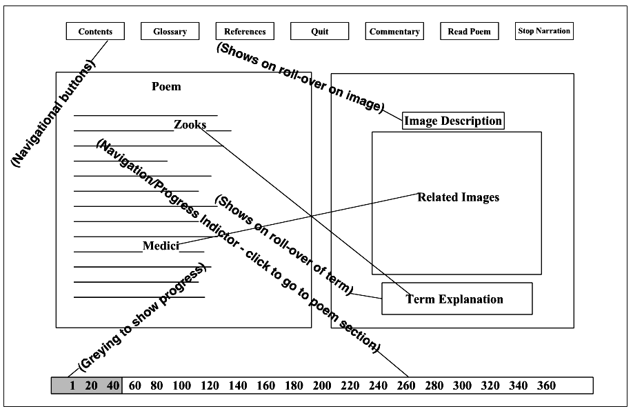
SAMPLE STORYBOARD
Storyboard used in Fra Lippo Lippi application with key elements identified.
Check the storyboard process for ToyStory.
Notes:
An extensive set of online video tutorials on Storyboarding can be found at:
http://www.youtube.com/user/StoryboardSecrets?feature=relchannel

Slide 15
KEY DOCUMENTS IN STAGE 1
Functional specification
  Detailed description of the elements and performance of multimedia project.
  Basis of a detailed business contract.
    Developer and client understanding of what has been promised and the procedures to follow if changes are made in specifications.

Slide 16
STAGE 2: DESIGN
Purpose is to create an incomplete working model of the project—prototype.
  First media elements are created.
  Interface is designed.
  Elements are combined to create the prototype.
Media Creation
  Required media identified in a content inventory list.
  Media preproduction, production, postproduction are carried out.
Notes:
Students should identify the uses for a content inventory list.
Identify the tasks done in each stage of media creation.

Slide 17
INTERFACE DESIGN
User interface defines how user experiences the content on the screen.
Goal of interface design is to engage the user.
  Must support the project goals, match the expectations and abilities of audience.
  Should establish appropriate tone determined by style of media elements and controls.

Slide 18
INTERFACE DESIGN
Features of user interface
  Intuitive.
    Immediately understood by the user.
    Common strategy is to use a metaphor.
  Consistent.
    Common backgrounds and consistent location of user controls.
  Predictable and reliable.
    Similar actions should produce similar results.
    Identical actions produce identical results.

Slide 19
SAMPLE INTERFACE DESIGN
One navigation interface for the multimedia application, Exploring Fra Lippo Lippi. User can randomly access segments of the poem by clicking on a line number. Gray bar provides visual feedback on their progress through the poem. Other means of navigating the poem are presented in the overall design.

Slide 20
PROTOTYPE
An incomplete working model of the final product.
Functions of prototype:
  Refine the definition of the product
  Test proposed features
  Guide further work of team members.
Generally built in the authoring application that will produce final project.

Slide 21
PROTOTYPE (cont.)
Used to test the product itself.
  Test proposals.
  Test assumptions of definition and design stage.
  Test product to see if it performs as anticipated.
  Test navigation of product.
  Obtain internal and external product review.
Guides subsequent work to complete the project.

Slide 22
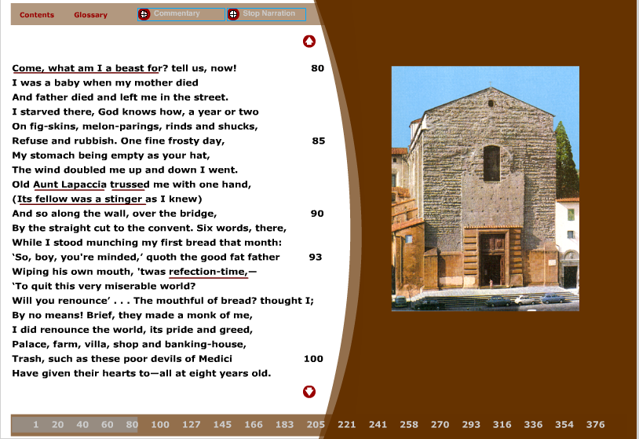
SAMPLE PROTOTYPE
Prototype created in Flash MX, includes media, design, user interface and provides an incomplete working model to test the product's functionality.

Slide 23
STAGE 3: PRODUCTION
Remaining elements of product are created and integrated into the application.
Includes quality assurance testing with bug reports and corrective measures.
  Alpha version: includes most media elements but also many "bugs."
  Beta version: includes all media but still has a few bugs.
  Gold master: complete, bug-free application.

Slide 24
STAGE 3: PRODUCTION (cont.)
Completion of release notes, manuals, and packaging.
Project materials are systematically archived.
  Archived files may resolve disputes between client and developers.
  Project may need revisions that use archived files.
  Copyrighted materials may be used in future projects.

Slide 25
WRAP UP
Multimedia development is a team effort.
  Team members provide expertise in the varied disciplines needed to complete the project.
  Process is interactive and iterative.
Development plan guides the process to keep production on task and on time.
  Follows three major stages: Definition, Design, Production

Slide 26
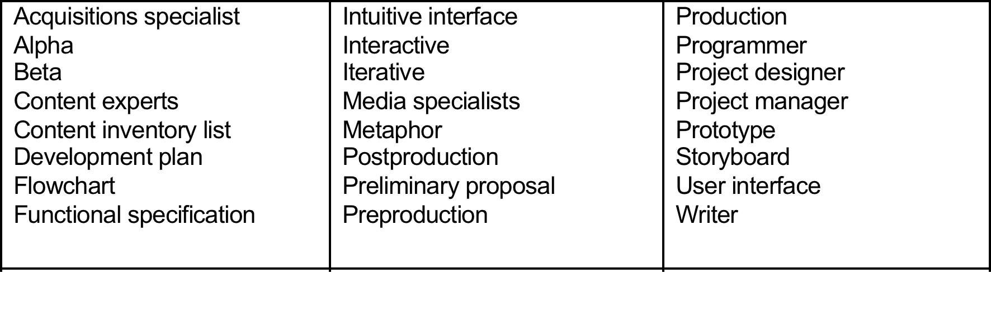
KEY TERM CHECK UP

