Slide 1
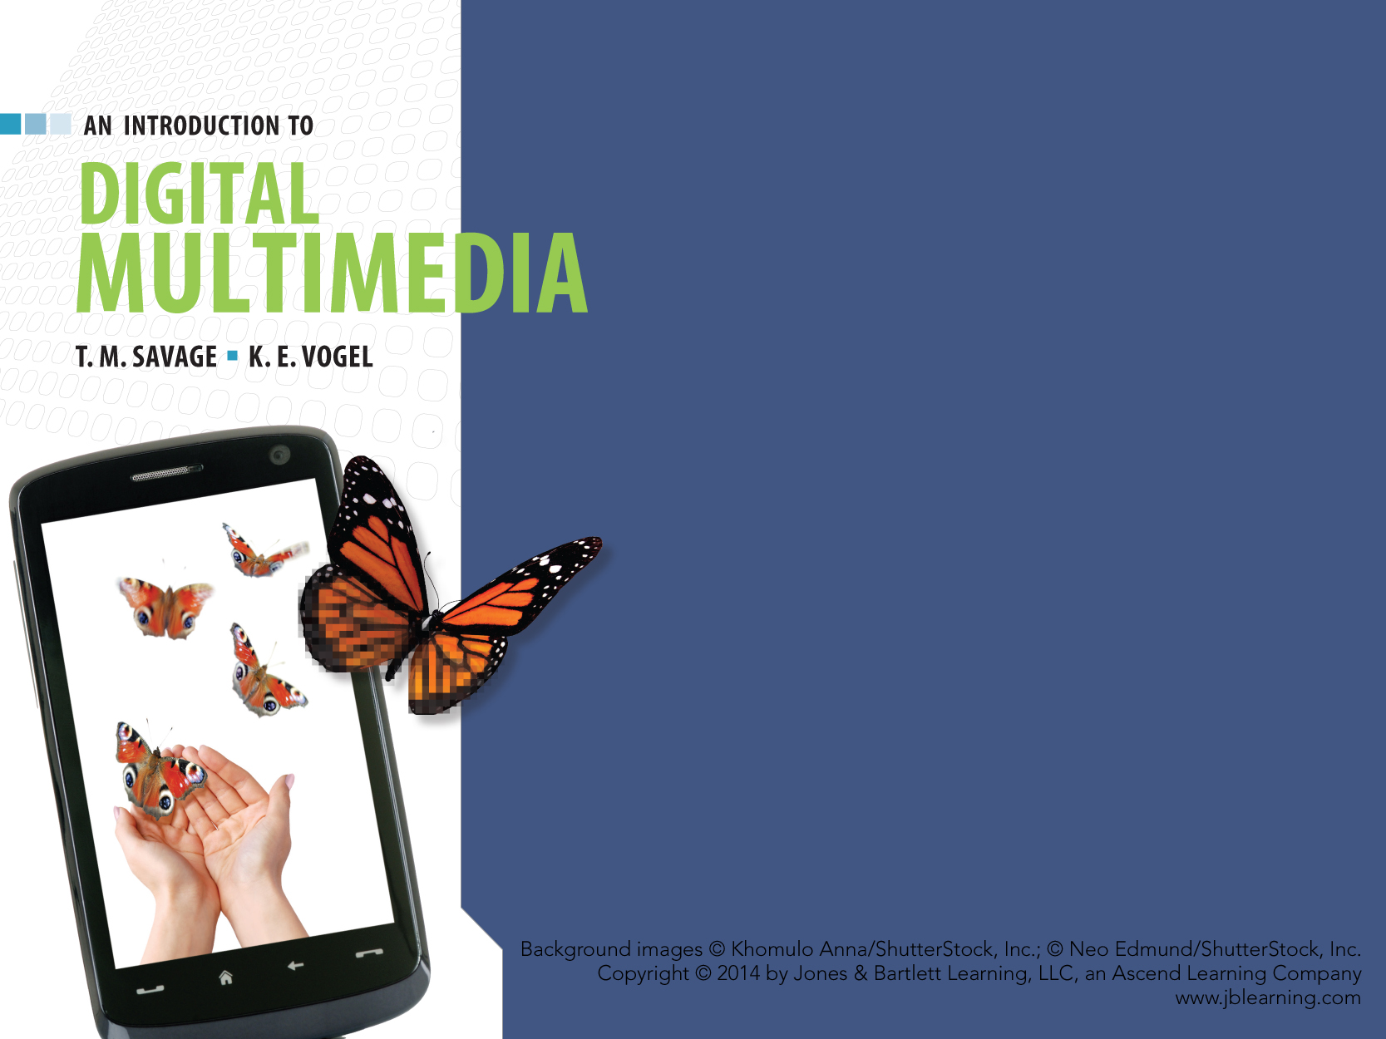
CHAPTER ONE
MULTIMEDIA REVOLUTION

Slide 2
Chapter Highlights
Nature of a revolution.
Definition of modern multimedia.
  Forms of multimedia.
Origins of multimedia.
Visionaries of multimedia.
Potential of digital media.
Notes:
Use topics and questions to engage students with the reading in Chapter one.

Slide 3
MULTIMEDIA DEFINED
Contemporary Multimedia is the development, integration, and delivery of any combination of text, graphics, animation, sound or video through a digital processing device.

Slide 4
FORMS OF MULTIMEDIA
Non-interactive
  User is a observer of information.
Interactive
  User is a participant in the flow of information.

Slide 5
FORMS OF MULTIMEDIA
Non-Interactive
  User has no control over the flow of information.
  Developer establishes the sequence of media elements and how they are presented.
  Examples include:
    Information kiosks
    Digital animations.

Slide 6
INTERACTIVE MULTIMEDIA
Basic interactivity
  Includes menu and button options to access content.
Adaptive or Intellimedia
  Adapt the information flow to the needs or interests of the users.
Immersive
  Draws users into an alternate world.

Slide 7
MULTIMEDIA VISIONARIES
FROM ANALOG TO DIGITAL: VISIONS OF THE FUTURE.
Notes:
What early expressions of multimedia were part of human communication?

Slide 8
VANNEVAR BUSH (1890 - 1974)
Memex I 1945
  A hypothetical machine to make the work of scientists more effective and efficient in grasping the “growing mountain of research.” (As We May Think, 1945)

Slide 9
MEMEX I — FEATURES
Massive storage capacity.
Multimedia input devices such as “vocoder” and “cyclops camera.”
Automatic mathematical calculations and logical reasoning.
New method to store and access information by associations.
Notes:
Method of storage is distinctive from sequential methods traditionally used.
Used a system of “trails” to preserve links between data.
More intuitive system of organization than alphabetical or numerical order of data.
Operational features to review include:
Levers to advance pages, keys to return to first page, ability to annotate sources.
Have students draw parallels to using today’s computers and the web.
Is the web organized “As we may think” ?

Slide 10
MEMEX II 1959
Extended the original proposals of Memex I by considering new technical developments such as:
  Magnetic tape
  Transistor
  Digital computer.
Notes:
Compare the proposed features of the Memex II to current computer systems, particularly expert systems.
Have class survey the status of computer technology that existed in 1959 to understand how Bush’s vision was based on contemporary technical developments.
Have students search the Web for illustrations of the proposed Memex I or Memex II and compare the sketches to modern computer devices.
Full discussion of Memex I and Memex II can be developed by reading the source articles by Vannevar Bush: “As We May Think” is readily available on web sites and “Memex II” is reported in From Memex to Hypertext by James Nyce and Paul Kahn, Academic Press 1991.

Slide 11
MEMEX II — FEATURES
Professionally maintained associational databases delivered by tape or facsimile.
Trails would be color-coded to reflect age and reinforced by repetitive use.
Combined with a digital computer, Bush believed the Memex II could learn from experience and even demonstrate a form of judgment.

Slide 12
ALAN TURING (1912-1954)
Proposed an abstract machine known as the “Turing Machine.”
  The “machine” was a means of defining an “effective procedure.”
  The imaginary device had three components:
    An infinitely long tape consisting of single row of squares
    A read/write head that moved along the tape one square at a time
    A set of instructions.

Slide 13
TURING MACHINES
Single Purpose “Turing Machine.”
  Can carry out a specific set of instructions or “effective procedure.”
“Universal Turing Machine” (UTM).
  Can accept a description of a single purpose machine and imitate it’s behavior.
  Implication of the UTM:
  If we can think of a way to do something, the computer can do it.
Notes:
Have class discuss how the UTM
Predicts the power of a general purpose computer.
Software embodies the effective procedure to perform any behavior.
Class discussion on the implications of the UTM for potential of multimedia applications and the power of imagineering.

Slide 14
DOUGLAS ENGELBART
Proposed practical applications of computers beyond the normal mathematical and sorting functions.
Developed innovations for human-computer interactivity in the NLS (oNLineSystem). These included:
  Mouse
  Multiple screen areas for text editing
  Email.

Slide 15
THEODORE NELSON
Coined terms hypertext and hypermedia.
  Hypertext: interactive text linked to other textual information.
  Hypermedia: extends interactive linking to other media
Initiated Xanadu Project:
  A dynamic, expanding, hypertext library available to everyone.
  Supported collaborative editing, tracking changes, crediting, and rewarding contributors.
Notes:
Discussion topics:
What aspects of Nelson’s Xanadu resemble the web?
What Web2 service contains several elements of Xanadu? (Wikipedia)
How does Xanadu relate to vision of Bush and MemexI? How is it different?

Slide 16
ALAN KAY
Proposed a computer design that supported the ways people perceive, learn, and create.
Dynabook: designed as a personal computer.
  Tied to the mind and interests of the user.
  A “modeless” multimedia computer.
    Users could move between graphics, sound, text, animation seamlessly.
Introduced Graphical User Interface (GUI) as an intuitive interface for the Dynabook.
Notes:
Have class research Dynabook to determine influence it may have had on development of Apple computers.
Dynabook was model for intuitive, accessible multimedia computing, though never produced.
Research Alan Kay to learn what other contributions he made to computing and where he is working now.

Slide 17
STEVE JOBS (1955-2011)
Founded Apple in 1976 with Steve Wozniak.
Macintosh computer introduced in 1984.
  Graphical desktop and Icons provide user interface.
  First mass produced computer with built in sound support.
  Multimedia computing became the standard for modern computers.
Notes:
Class discussion on influence of Alan Kay, Douglas Engelbart on the development of Apple and Macintosh computers.

Slide 18
TIM BERNERS-LEE
Developed a decentralized information system of “nodes” linked together for easy access across a network.
  Nodes could be any form of media.
  Anyone could add nodes.
  No centralized control over servers, documents or links.
Notes:
Compare the vision of Bush, with the proposal of Nelson’s Xanadu and implementation of Berners-Lee’s WWW.

Slide 19
WORLD WIDE WEB
Basic components of WWW:
  Server computer
  Client computer
  Browser software
  HTML scripting language.
Notes:
Students should be able to identify the purpose of each component.

Slide 20
WWW & MULTIMEDIA COMPUTING
Solved cross-platform compatibility problem.
Supported distribution of media beyond the capacity of CD-ROM storage.
Allowed instant distribution and inexpensive media creation.
Notes:
Class discussion on each of these benefits to multimedia. Contrast to desktop multimedia where standards of media were tied to computer platforms, distribution was via CD's, and with network access everyone can distribute media.
Consider the explosion of multimedia introduced by high speed internet, powerful browsers, and consumer based development software such as iPhoto and iMovie.

Slide 21
MULTIMEDIA VISIONARIES
First Generation
  Alan Turing
  Vannevar Bush
Second Generation
  Douglas Engelbart
  Theodore Nelson
  Alan Kay
  Steve Jobs
  Tim Berners-Lee
Next Generation
  Current innovators of multimedia
Notes:
Have students research who represents the next generation. Answers might include animators at Pixar, game developers, neighbor with a camcorder.

Slide 22
THE REVOLUTION CONTINUES
Factors influencing the revolution:
  Technical breakthroughs in hardware and software.
  Integration of computers with other devices.
  Digital merger of disparate technologies and industries.
  Further development of wireless communications & mobile devices.
  Expansion of creative opportunity.
Notes:
Have students research each of these factors contributing to the Revolution. Identify examples for each factor.
What additional factors can students offer?

Slide 23
WRAP UP
Definition of contemporary multimedia.
Expressions of multimedia.
Visionaries who contributed to development of digital multimedia.
Potential of digital media.
The analog-to-digital revolution.

Slide 24
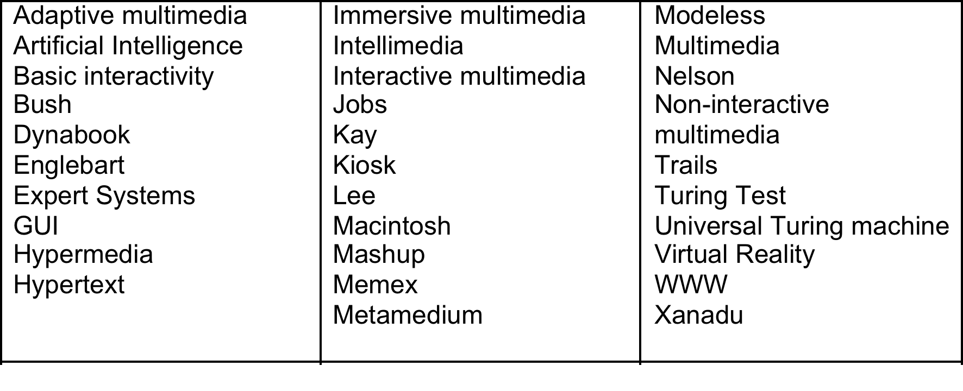
KEY TERM CHECK UP

