Slide 1
Security Program and Policies Principles and Practices
by Sari Stern Greene
Updated 02/2018
Chapter 1: Understanding Policy
Notes:
1

Slide 2
Objectives
Describe the significance of policies
Evaluate the role policy plays in corporate culture and civil society
Discuss information security policy
Identity the characteristics of a successful policy
Discuss Information Security Policy lifecycle
Copyright 2014 Pearson Education, Inc.
2
Notes:
2

Slide 3
Introduction
Policy: “A definite course of action or procedure selected from among alternatives and in light of given conditions to guide and determine present and future decisions”**
(** per www.merriamwebster.com)
Copyright 2014 Pearson Education, Inc.
3
Notes:
3

Slide 4
Looking at Policy Through the Ages
The role of the Torah and Bible as written policy
3000-year old documents include business rules still in practice today
First documented attempt at creating a code to preserve order
Copyright 2014 Pearson Education, Inc.
4
Notes:
4

Slide 5
Looking at Policy Through the Ages Cont.
The U.S. Constitution as a Policy Revolution
A collection of articles and amendments that codify all aspects of American government along with citizens’ rights and responsibilities
A rule set with a built-in mechanism for change
Both the Constitution and the Torah have a similar goal:
Serve as rules that guide behavior
Copyright 2014 Pearson Education, Inc.
5
Notes:
5

Slide 6
Policy Today
Corporate culture
Shared attitudes, values, goals, and practices that characterize a company
Three classifications
Negative
Neutral
Positive
Guiding principles
Reflect the corporate culture
Copyright 2014 Pearson Education, Inc.
6

Slide 7
Information Security Policy
A document that states how an organization plans to protect its information assets and information systems and ensure compliance with legal and regulatory requirements
Asset
Resource with a value
Information asset
Any information item, regardless of storage format, that represents value to the organization
Customer data, employee records, IT information, reputation, and brand
Copyright 2014 Pearson Education, Inc.
7
Notes:
7

Slide 8
Successful Policy Characteristics
Endorsed
Management supports the policy
Relevant
The policy is applicable and supports the goals of the organization
Realistic
The policy makes sense
Attainable
The policy can be successfully implemented
Adaptable
The policy can be changed
Enforceable
Controls that can be used to support and enforce the policy exist
Inclusive
The policy scope includes all relevant parties
Copyright 2014 Pearson Education, Inc.
8

Slide 9
Defining the Role of Policy in Government
Government regulation is required to protect its critical infrastructure and citizens
Two major information security-related legislations were introduced in Saudi Arabia
Anti-Cyber Crime ACT.
http://www.citc.gov.sa/en/RulesandSystems/CITCSystem/Pages/CybercrimesAct.aspx
Electronic Transactions ACT
http://www.citc.gov.sa/en/RulesandSystems/CITCSystem/Pages/ElectronicTransactionsLaw.aspx
Copyright 2014 Pearson Education, Inc.
9
Notes:
9

Slide 10
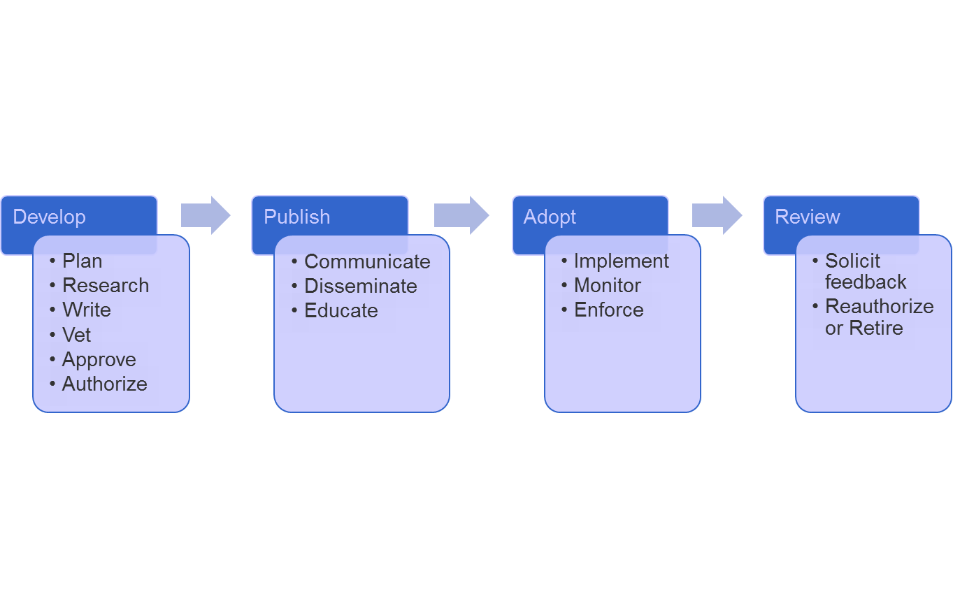
Information Security Policy Lifecycle
Copyright 2014 Pearson Education, Inc.
10

Slide 11
Information Security Policy Lifecycle continued
Regardless of the type of policy, its success depends on how the organization approaches the process of development, publishing, adopting and reviewing the policy.
1.Policy development: There are six main tasks involved in policy development: 1. planning – identifying the need and context of the policy, 2. researching –defining legal, regulatory requirements ,3.writing – making a document according to the audience, 4. vetting- examining, 5. approving – by all concerned department, and 6. authorizing- approval from the management.
2.Policy Publication: Policies should be communicated and made available to all parties they apply to. The company should provide training to reinforce the policies. Creating a culture of compliance can ensure all parties understand the importance of the policy and actively support it.
3.Policy Adoption: The policy is implemented, monitored, and enforced.
4.Policy Review: Policies are reviewed annually and outdated policies are updated or retired.

Slide 12
Summary
Policies apply to governments as well as to business organizations.
When people are grouped to achieve a common goal, policies provide a framework that guides the company and protects the assets of that company.
The policy lifecycle spans four phases: develop, publish, adopt, and review.
Copyright 2014 Pearson Education, Inc.
12
Notes:
12

