Slide 1
Systems Design: Physical Requirements

Slide 2
Physical Requirements
Physical Design
The results of logical data design require that you make some key decisions, such as:
Choosing storage format for each attribute from the logical database model
Grouping attributes from the logical database model into physical records
Arranging related records in secondary memory (hard disks and magnetic tapes) so that records can be stored, retrieved, and updated rapidly
Selecting media and structures for storing data to make access more efficient

Slide 3
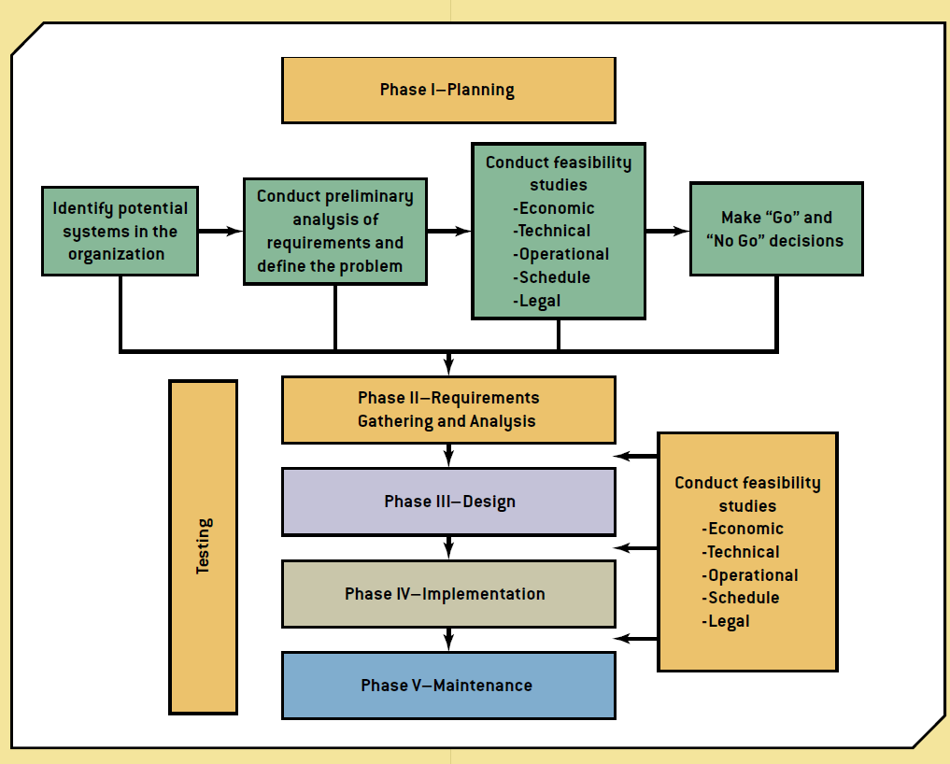
Physical Requirements
Recall this Methodology?
Source: Bidgoli, H. (2014). Building Successful Information Systems. In MIS⁴ ([4th ed., p. 336). Boston: Course Technology

Slide 4
Physical Requirements
Another important decision to make:
Will you be storing your data in-house or using a cloud host service?
Do you have a server on-site?
How will you protect your data?

