Slide 1
Systems Analysis: Conceptual Modeling

Slide 2
Conceptual Modeling
The data flow diagram captured the data requirements and flow.
However, it does not capture the detailed relationship between the data elements flowing through the system or software.

Slide 3
Conceptual Modeling
The conceptual data model will eventually be translated into a physical design.
One of the key deliverables at this stage is the entity-relationship diagram.

Slide 4
Conceptual Modeling
The conceptual data model shows the relationship between the data flows from one entity to another.
The conceptual data model can be easily created using Microsoft Visio as a tool.

Slide 5
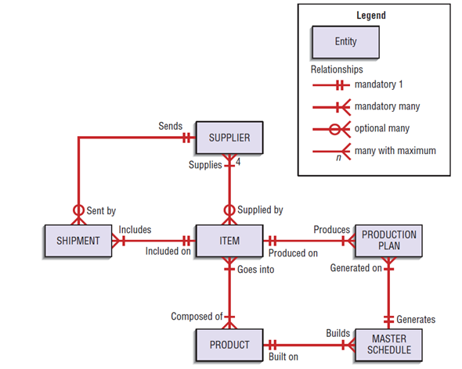
Conceptual Modeling
A sample Conceptual data model:
Source: Valacich, J., George, J., & Hoffer, J. (2015). Systems Planning and Selection. In Essentials of Systems Analysis and Design (6th ed., p. 418). New Jersey: Pearson.

Slide 6
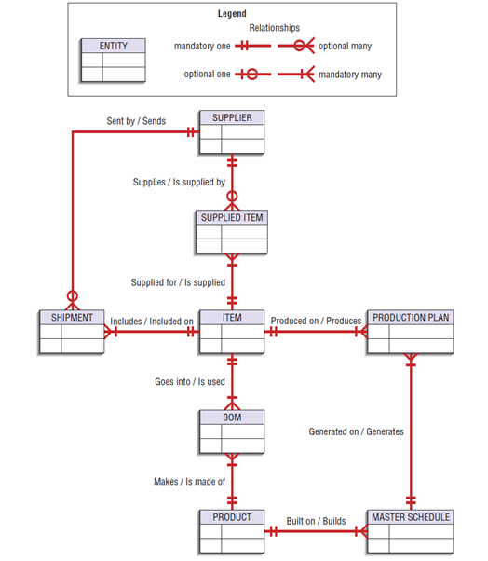
Conceptual Modeling
A sample Conceptual data model:
Source: Valacich, J., George, J., & Hoffer, J. (2015). Systems Planning and Selection. In Essentials of Systems Analysis and Design (6th ed., p. 418). New Jersey: Pearson.

