Slide 1
Systems Analysis: Workflows

Slide 2
Systems Analysis: Workflows
  Workflows allow you to present key requirements of your new software based on:
    Inputs
    Processes
    Outputs

Slide 3
Systems Analysis: Workflows
  The software inputs data which is often processed into information.
  Understanding data requirements and mapping this using a Unified Modeling Language (UML) is necessary.

Slide 4
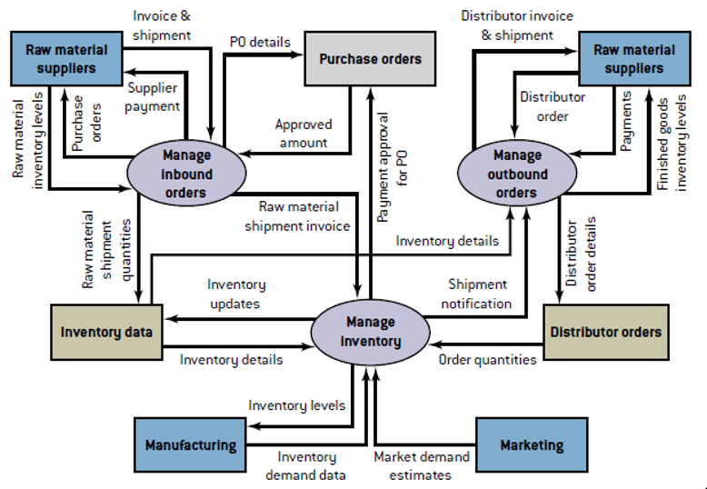
Systems Analysis: Workflows
Example of a data flow diagram capturing data in an inventory management system:
        Source: Bidgoli, H. (2014). Building Successful Information Systems. In MIS⁴ ([4th ed., p. 336). Boston: Course Technology
Source: Bidgoli, H. (2014). Building Successful Information Systems. In MIS⁴ ([4th ed., p. 336). Boston: Course Technology

Slide 5
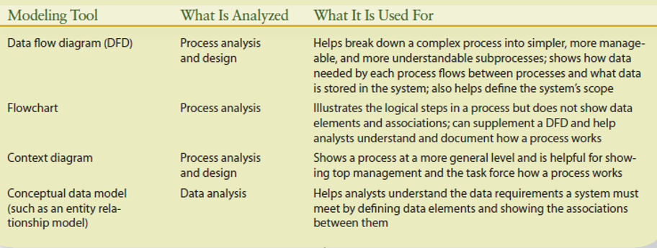
Systems Analysis: Workflows
Examples of tools used can be seen in the diagram below:
        Source: Bidgoli, H. (2014). Building Successful Information Systems. In MIS⁴ ([4th ed., p. 336). Boston: Course Technology.

