Slide 1

Mobile Application Development
Chapter 7
[Location Sensors, Maps, and Fragments]

Slide 2
Contents
Location Sensors, Maps, and Fragments
Setting Up your Maps
Finding Your Location
Displaying your Contacts’ Locations

Slide 3
Location Sensors, Maps, and Fragments
Location and maps are important components of many apps
Knowing how to capture and display location information can help you build powerful apps.
Location sensors can be accessed and used directly through the Android SDK. However maps require more work.
Sensors are hardware built in to the mobile device to allow an app to capture environmental data.
Maps are used to display data that can be enhanced by a visual representation of its location.
To include a map into your project, you must use fragments.

Slide 4
Location Sensors, Maps, and Fragments
Location Sensors
Android devices typically have two location sensors:
Network Sensor | GPS Sensor
based on the cell towers and/or the Wi-Fi access points your device is connected to. | based on a built-in Global Positioning System (GPS) receiver.
provides the approximate location of the device | can provide position information accurate to within a few meters, depending on conditions.
Fast in detecting device location. | GPS sensor is much slower in acquiring its position information than the network sensor
Most of the devices have a Network Sensor | not all devices have a GPS sensor.

Slide 5
Location Sensors, Maps, and Fragments
Maps
Maps are implemented using the GoogleMap object and a MapFragment in the layout file
These objects are not a part of the standard Android SDK but rather the Google Play Services SDK.
This SDK must be installed on your development machine to implement maps in your app.
Using Google Maps requires an API key. This key associates your app with an attempt to access the GoogleMap API.
This is how you and Google, can track how often your users access the map portion of your app. The API key is free.
Maps are implemented as a MapFragment widget in a layout. The Activity that implements the code to provide the map’s behavior must be a FragmentActivity .

Slide 6
Location Sensors, Maps, and Fragments
Fragments
The FragmentActivity is a subclass of the Activity class.
An Activity that needs to implement a map must extend the FragmentActivity class rather than the Activity class.
This is required because maps are encapsulated in a MapFragment .
This allows a map to be a part of a layout rather than the only thing in a layout.

Slide 7
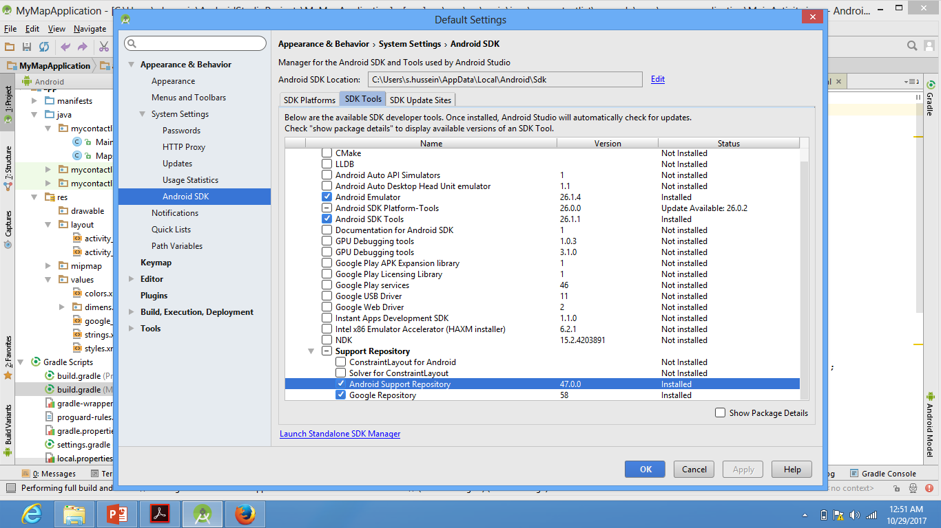
Setting Up for Maps in Android Studio
1. Install the Google Play services SDK
Start Android Studio.
On the Tools menu, click Android > SDK Manager.
Update the Android Studio SDK Manager: click SDK Tools, expand Support Repository, select Google Repository, and then click OK.

Slide 8
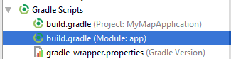
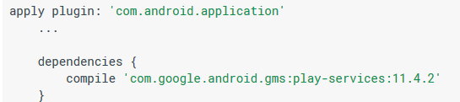
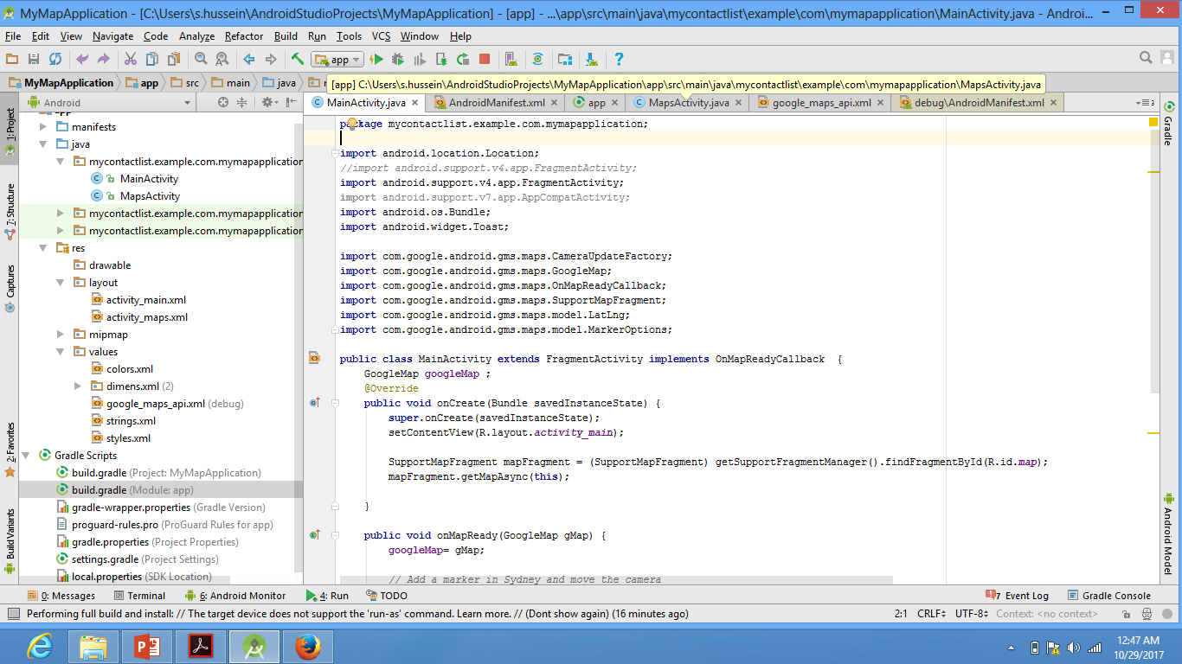
Setting Up for Maps in Android Studio
2. Add Google Play Services to Your Project
Open build.gradle file inside your application module directory
Add a new build rule under dependencies for the latest version of play services
To know the version of the Google Play services installed in your Android Studio
  Go to File -> Project Structure.
  Select 'Project Settings'
  Select 'Dependencies' Tab.
  Click '+' and select '1.Library Dependencies'
  Search for : com.google.android.gms:play-services.
  Select the latest version and click 'OK‘
Save the changes and click Sync Project with Gradle Files in the toolbar.
Make sure you put the right version of google play services installed on your machine

Slide 9
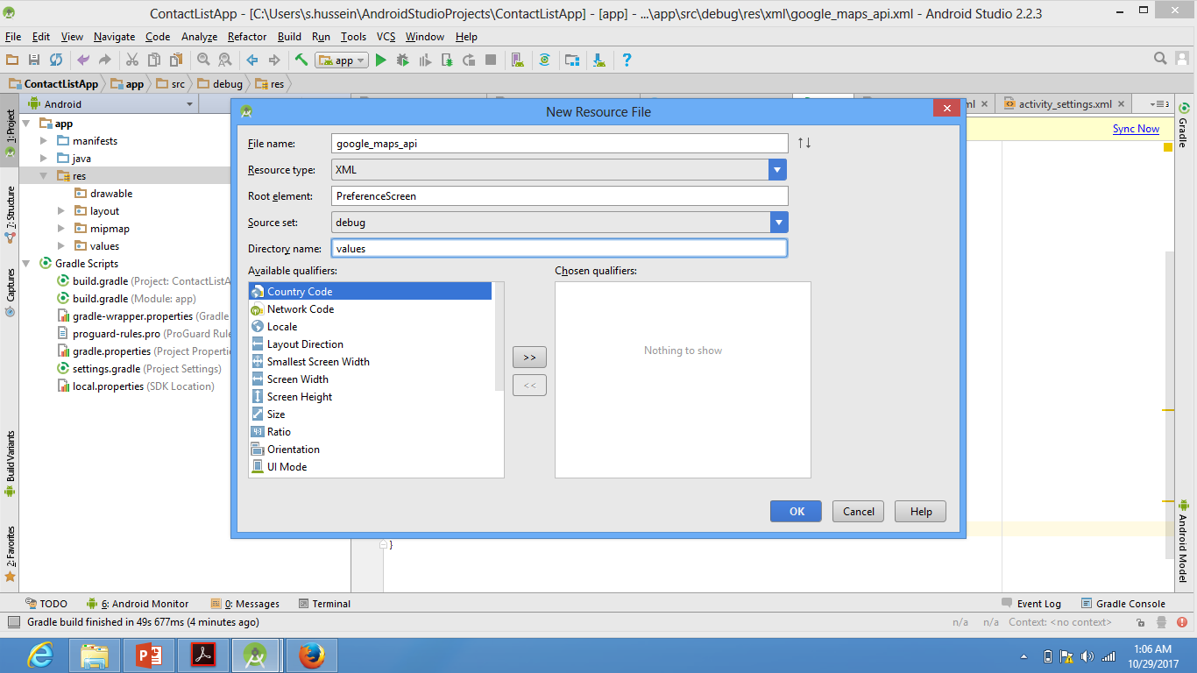
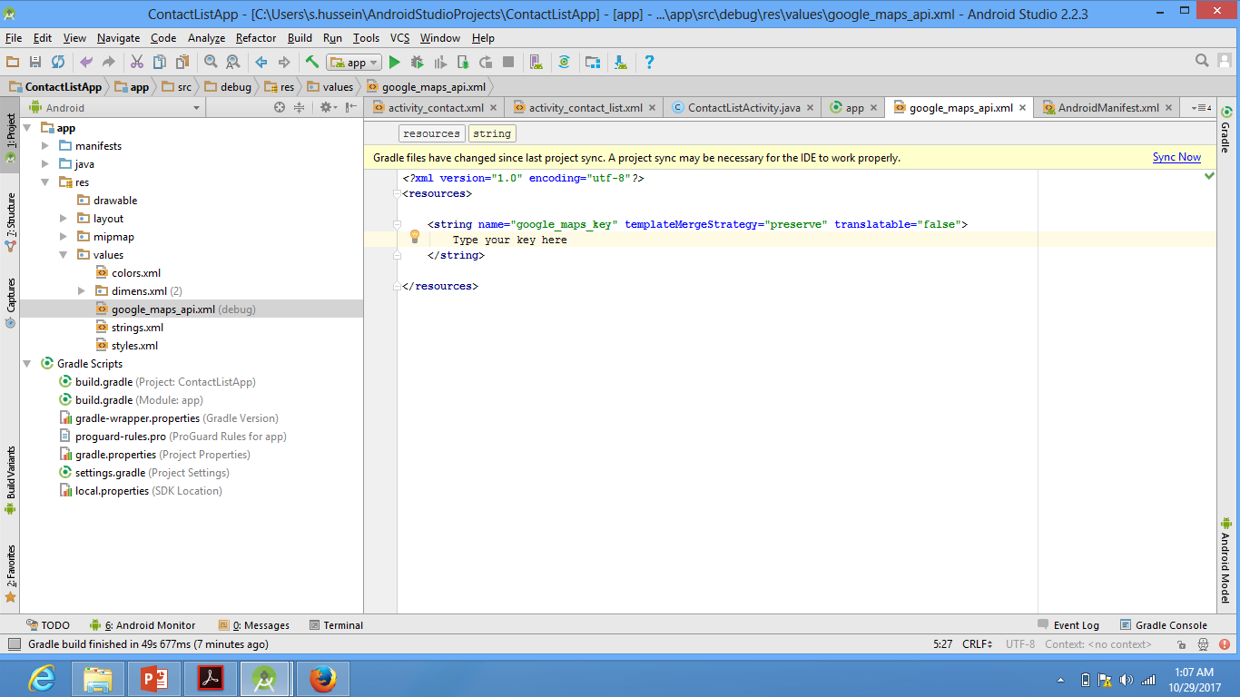
Setting Up for Maps in Android Studio
https://developers.google.com/maps/documentation/android/start#get-key
  3. Get a Google Maps API key
  Your application needs an API key to access the Google Maps servers. The type of key you need is an API key with restriction for Android apps. The key is free. You can use it with any of your applications that call the Google Maps Android API, and it supports an unlimited number of users. To get the key and use it into your project:
  Create a new resource file, with the following features as shown in the print screen
  The file should contain the following code:
To get your key, go to : https://developers.google.com/maps/documentation/android/start#get-key
And press the GetKey button at the top of the page.

Slide 10
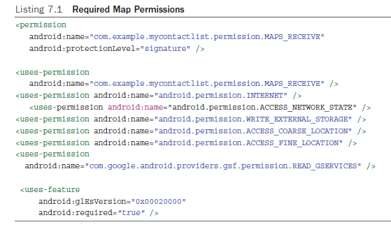
Passing Data Between Controllers
To use maps in your app, you have to give the app permission to use certain device features.
These permissions are used to alert the user during installation or upgrade what the app is allowed to access on the device.
The user permits that app to use those devices, services, or data by choosing to install the app after reviewing the permissions.
Permissions are set in the Android manifest file. If a permission is required by what you are trying to do but is not in the manifest, the app will crash.
Put these permissions in the Android manifest file after the version number

Slide 11
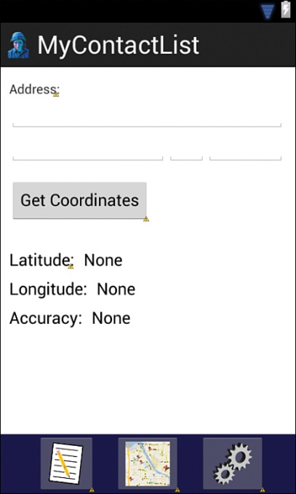
Finding Your Location
Geocoding: Get Coordinates from an Address
Find your location: use the map’s getMyLocation ( ) method to get the device’s current GPS coordinates.
After layout creation open the ContactMapActivity.java file to write the code for the behavior for the Get Location button.
  Code the call to the initialization method in the onCreate method
  The proper format for a call is required i.e. street address method.
  A List object variable parameterized to hold an Address object is declared.
  A Geocode variable is declared and assigned a new Geocoder object.
  The getFromLocationName method is used as a parameter.
  The latitude and longitude of the first address in the returned list are displayed.

Slide 12
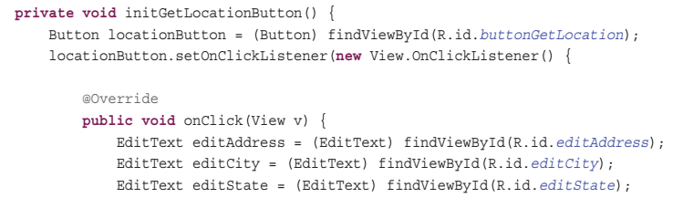
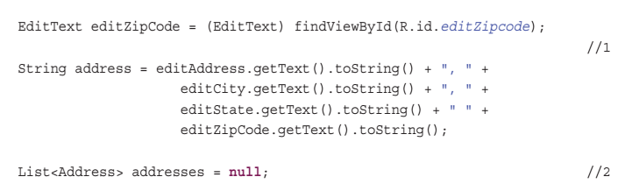
Finding Your Location
Geocoding: Get Coordinates from an Address

Slide 13
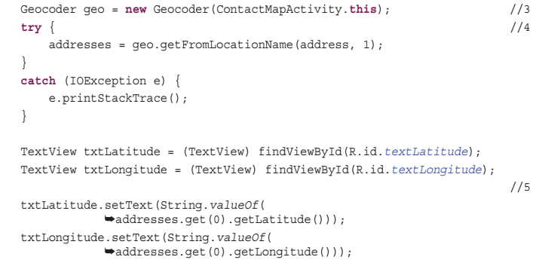
Finding Your Location
Geocoding: Get Coordinates from an Address
method getFromLocationName method is passed the address to look up as a
parameter. The parameter 1 tells the service that you want one response, If the service cannot find the
exact location, it will return several locations with the best guess as the first entry.
The latitude and longitude of the first address in the returned list are displayed in the
appropriate TextView widgets

Slide 14
Finding Your Location
Get Coordinates from the GPS Sensor
To use the GPS sensor:
  replace the Geocoding code in the Get Location button with GPS listener code
  add a method to turn off the location sensing when the app enters the Paused life cycle state.
First, go to ContactMapsActivity and add the following variable declarations just after the class declaration:
  LocationManager locationManager;
  LocationListener gpsListener;
Next, go to the initGetLocationButton method and replace all the code in the onClick method with the code in Listing 7.3 .
You will have to import these classes. Use the android.location option, not the com.google.android.gms one.

Slide 15
Finding Your Location
Get Coordinates from the GPS Sensor
reference to the LocationManager object is assigned to the locationManager variable. The getSystemService method is sent to the activity’s context with a parameter that tells the context that you want the location service manager.
A new LocationListener is instantiated and assigned to the gpsListener variable. A LocationListener requires the implementation of four methods.
However, only the onLocationChanged method is needed for the purpose of reporting location
String.valueOf method to convert values into strings
LocationManager is sent the message requestLocationUpdates to begin listening for location changes.
Note: The minimum time is set in milliseconds, and Minimum distance is set in meters.
A Toast is displayed if there is an error.
Toast: object that displays a short
message for a limited period of time on the user’s display.

Slide 16
Finding Your Location
Get Coordinates from the GPS Sensor
When the user presses the button, the button gets a reference to the system’s location manager and instantiates a location listener to get the GPS coordinates and accuracy from a location object each time the sensor detects a location change.
After the changes to the initGetLocationButton have been made, you need to add a method to stop the sensors if the Activity’s life cycle state changes. To do that:
  you need to override the Activity’s onPause method.
  Create a new method using the code in Listing 7.4.

Slide 17
Finding Your Location
Get Coordinates from the GPS Sensor
LocationManager object is sent the message removeUpdates to end listening to the gpsListener.
This code is within a try and catch block because it is possible that the activity could pause before the user presses the Get Location button.
In that case, neither the locationManager nor the gpsListener variables would have values, and the code would crash the app.
The final code calls the overridden method to execute the standard onPause routine for the activity.

Slide 18
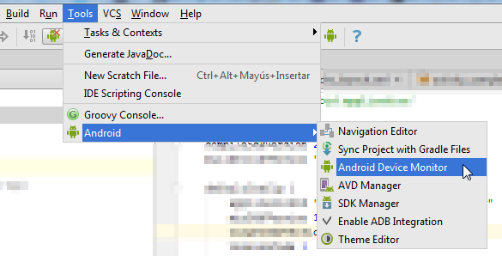
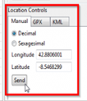
Finding Your Location
Get Coordinates from the GPS Sensor –Setting Up Emulator
If you develop an Android app with Android Studio you can send one GPS position using the Android Device Emulator.
Once you have launched the app you are developing in the Android emulator, you have to launch the Android Device Emulator, insert both location points (longitude and latitude) and press the “Send” button. Then your app will receive this coordinate, simulating the Android GPS

Slide 19
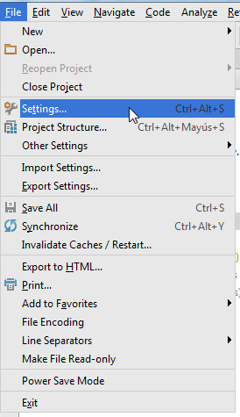
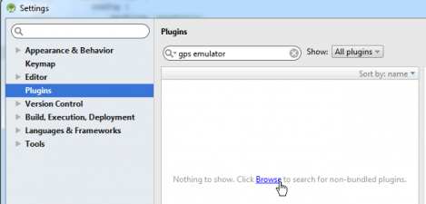
Finding Your Location
Get Coordinates from the GPS Sensor –Setting Up Emulator
But if you want to simulate a route made with your device, with a lot of coordinates, you have to install one plugin, in particular the “Mock Location Plugin” for Android Studio.
First, you have to install the plugin in Android Studio. You have to go to “Settings…”
Then you have to click on “Plugins”, insert the text “gps emulator” in the search box and click on the “Browse” link.

Slide 20
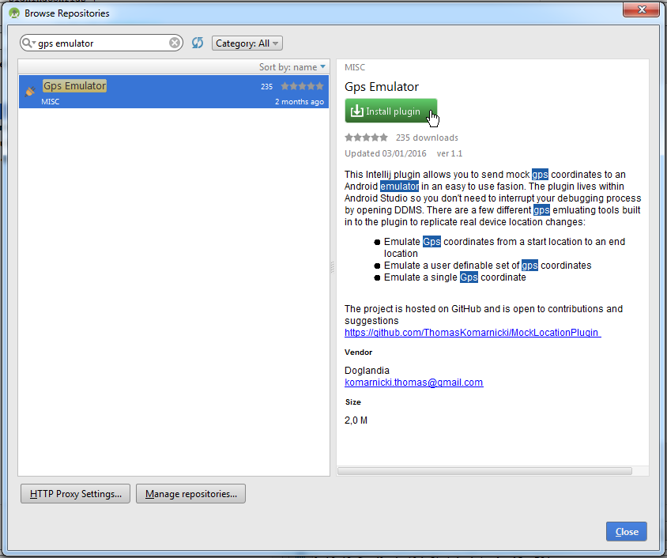
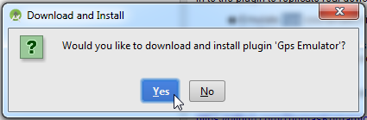
Finding Your Location
Get Coordinates from the GPS Sensor –Setting Up Emulator
Then you have to click on the “Gps Emulator” plugin and click on the “Install plugin” button.
You have to confirm the download and installation process.
And then you have to restart the “Android Studio” clicking on the “Restart Android Studio” button.

Slide 21
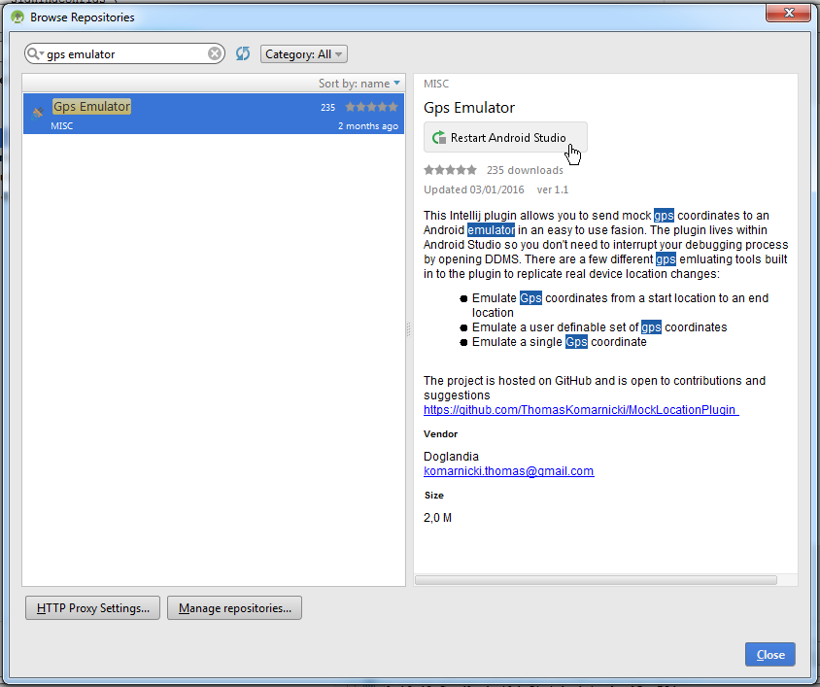
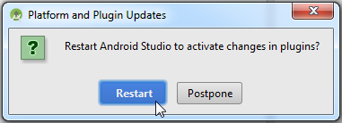
Finding Your Location
Get Coordinates from the GPS Sensor –Setting Up Emulator
You have to confirm the restart by clicking on the “Restart” button.
Now you have the plugin installed in the Android Studio.
Once you have launched the app you are developing in the Android emulator, you have to launch the “Gps Emulator”.

Slide 22
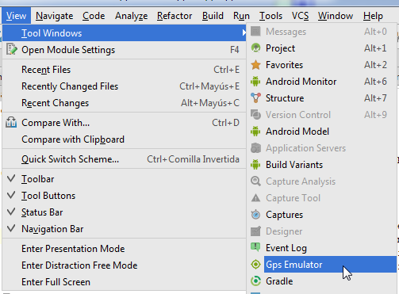
Finding Your Location
Get Coordinates from the GPS Sensor –Setting Up Emulator
Then you have to configure:
The “Start Location” (latitude and longitude).
The “End Location” (latitude and longitude).
The “Steps”: the number of emulated coordinates that the plugin will send to your app.
The “Time Between Steps”.
And you have to click in the “Start GPS Emulation” button to start sending the emulated coordinates.

Slide 23
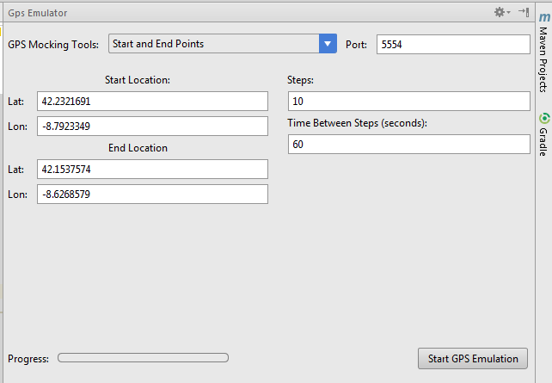
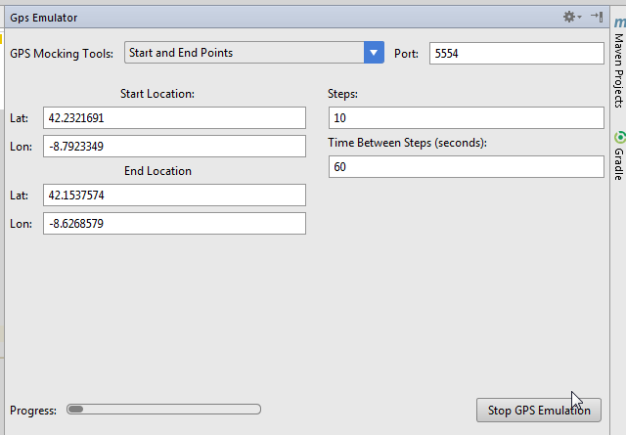
Finding Your Location
Get Coordinates from the GPS Sensor –Setting Up Emulator

Slide 24
Finding Your Location
Get Coordinates from Network Sensor
A sensor network that can provide access to information anytime, anywhere by collecting, processing, analyzing and disseminating data.
Add the following declaration after the gpsListener declaration:
LocationListener networkListener;
Copy the code that begins with gpsListener = and ends just before the locationManager.requestLocationUpdates line, and paste it back into the method just before the locationManager.requestLocationUpdates line.

Slide 25
Finding Your Location
Get Coordinates from Network Sensor
Change all the gpsListener variables in the code you just pasted to networkListener and then add another requestUpdates message after the one that is used to request GPS updates.
locationManager.requestLocationUpdates(LocationManager.NETWORK_PROVIDER,0, 0, networkListener);
The only real change we made was to request updates from the network sensor rather than the GPS sensor.

Slide 26
Finding Your Location
Android Vs iOS: Location Sensors
Working with location data on iOS is similar to Android. However, although iOS devices also have both GPS and network sensors, iOS developers don’t have access to the specific sensors. Instead, the developer specifies a desired accuracy of the location data, and the system chooses the appropriate sensor to provide the data. This allows the system to optimize the sensor usage for battery and performance of the device.

Slide 27
Finding Your Location
Get Coordinates from the Map
The Map object is used to get GPS coordinates of our device’s location.
It has built-in methods that access the sensors without writing any code to access the sensors.
All sensor management is handled by the map.
Drawback:
  must display a map in the layout to use these features

Slide 28
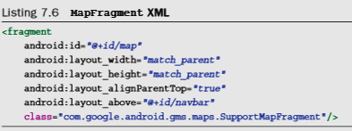
Finding Your Location
Get Coordinates from the Map
The map object is not coded as a standard widget.
A fragment is added to the layout with the standard set of attributes for size and positioning.
SupportMapFragment is used to make the map object compatible with the earlier versions of Android targeted in this app.

Slide 29
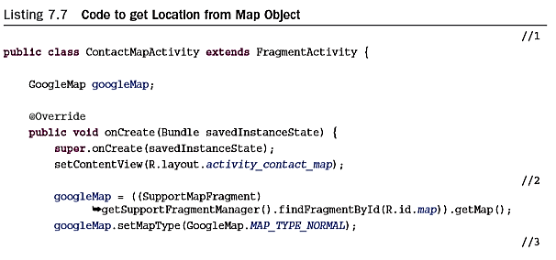
!!!! This code will work only, in case you have play-services below 9.2.
After 9.2 update, the getMap() has been deprecated➔ see following slide
Finding Your Location
Get Coordinates from the Map
//1 GoogleMap object is held within a fragment. To use a fragment, the super class of ContactMapActivity must be changed to FragmentActivity.
//2 An instance of a GoogleMap is assigned to the googleMap variable. SupportMapFragment need to be imported manually.
The map type of normal is a standard highway map.
//3 enables the map to find the device location

Slide 30
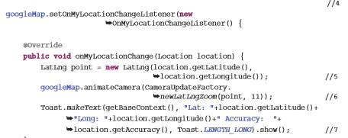
Finding Your Location
Get Coordinates from the Map
//4 onMyLocationChanged listener is added to the map with a method, onMyLocationChanged , executed when a location change is detected.
//5. location object is used to create a point on the map.
//6 The map is zoomed to the location received by the onMyLocationChanged method. The integer 11 represents the zoom level.
//7. A Toast is used to display the GPS coordinates and accuracy to the user.

Slide 31
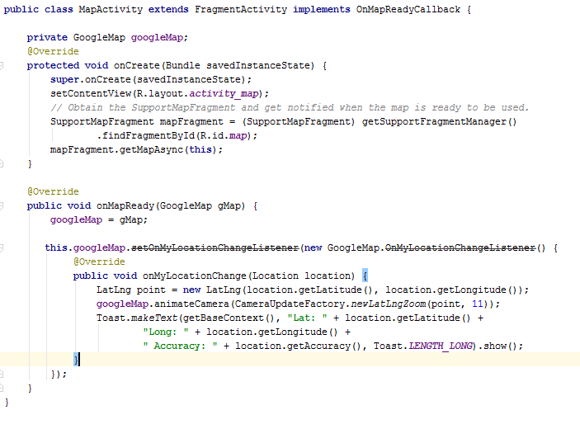
!!!! This is the updated map methods for play-services above 9.2
Finding Your Location
Get Coordinates from the Map
The getMap() method has been replaced by getMapAsync(). To use this method, you have to implement the OnMapReadyCallback interface
This callback is triggered when the map is ready to be used. This is where we can add markers or lines, add listeners or move the camera.

Slide 32
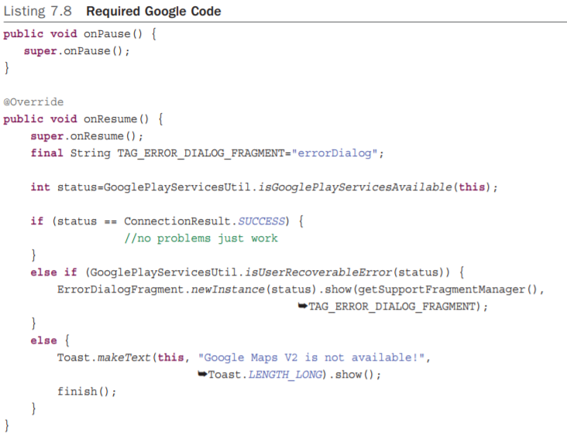
Finding Your Location
Get Coordinates from the Map
To use a map in an Android app, Google requires that some specific code is included in the activity. Listing 7.8 has this code. Enter it after the onCreate method

Slide 33
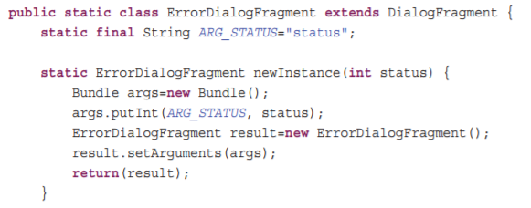
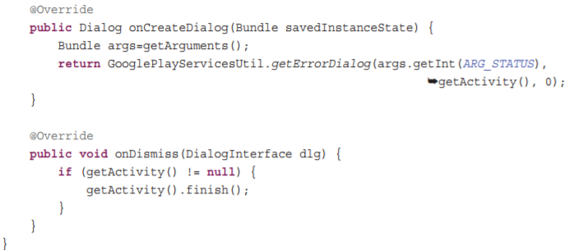
Finding Your Location
Get Coordinates from the Map

Slide 34
Displaying Your Contacts’ Locations
The map can be accessed from any of the three other activities through the navigation bar.
If the user accesses the map from either the contact list or the settings activities, the map should display all the contacts in the database on the map.
If the user accesses the map from the contact activity, the map should display only that contact.
This requires coding the ContactActivity to pass the current contact’s ID to the map as shown in Listing 7.9

Slide 35
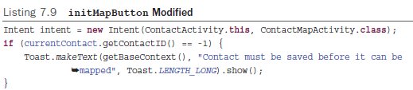
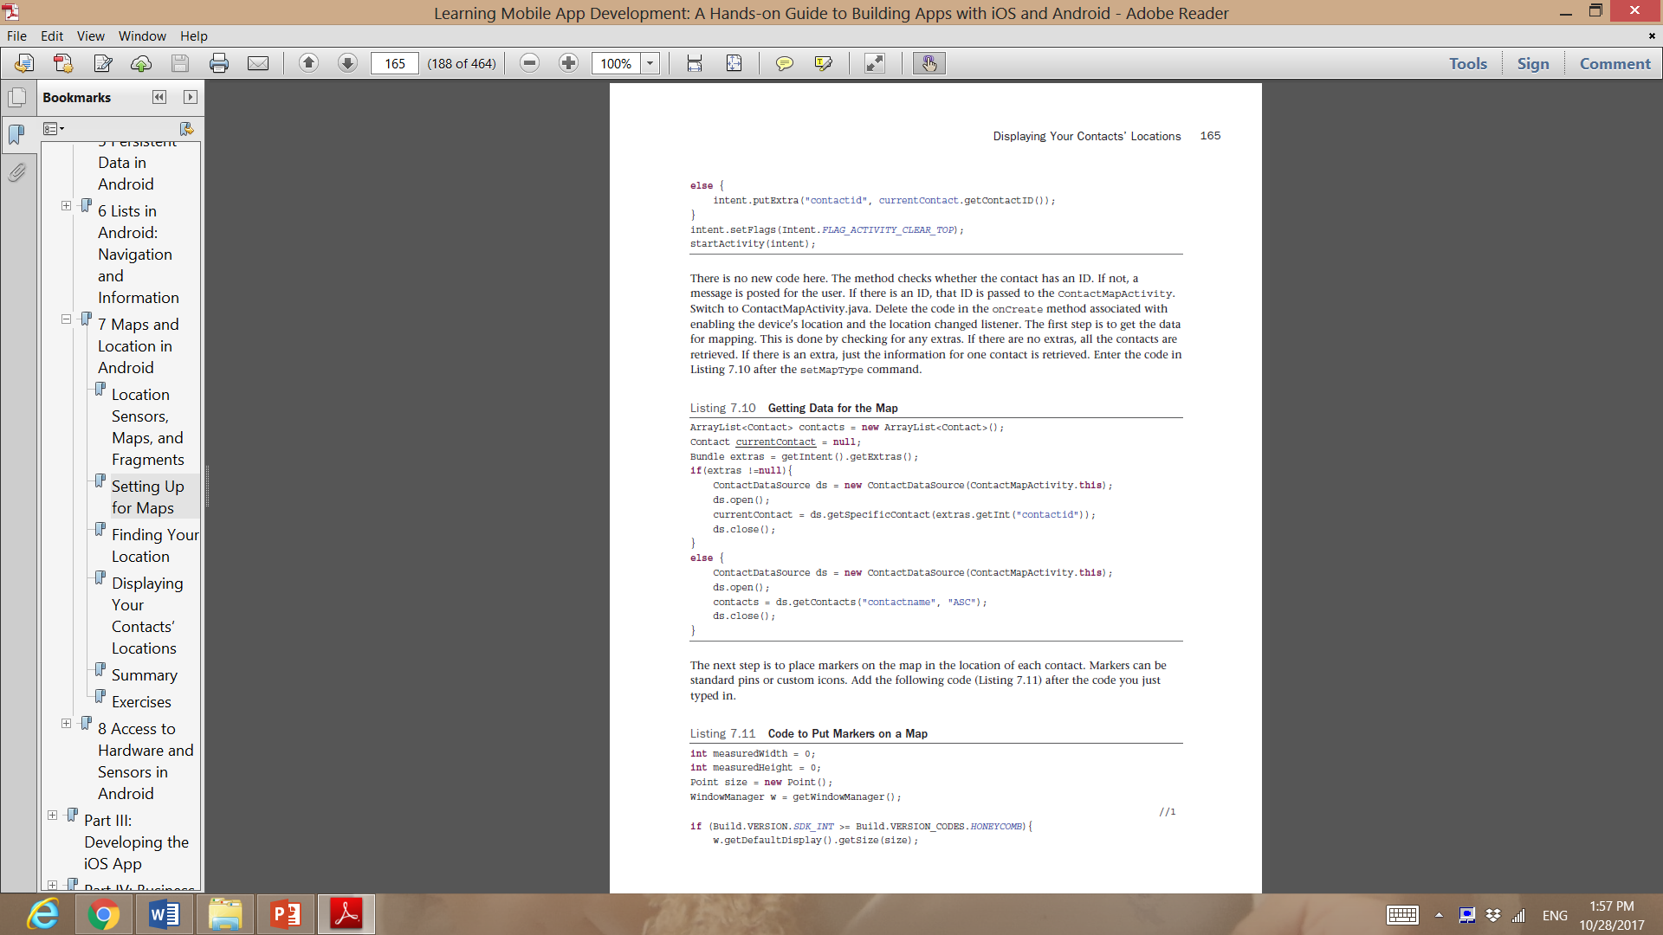
Displaying Your Contacts’ Locations
Open ContactActivity.java and locate the initMapButton method. This method is modified to pass the contact’s ID with the intent. Modify the code in the onClick method to match Listing 7.9 .
The method checks whether the contact has an ID. If not, a message is posted for the user. If there is an ID, that ID is passed to the ContactMapActivity .

Slide 36
Displaying Your Contacts’ Locations
Switch to ContactMapActivity.java. Delete the code in the onCreate method associated with enabling the device’s location and the location changed listener.
The first step is to get the data for mapping. This is done by checking for any extras. If there are no extras, all the contacts are retrieved. If there is an extra, just the information for one contact is retrieved. Enter the code in Listing 7.10 after the setMapType command

Slide 37
Displaying Your Contacts’ Locations
The next step is to place markers on the map in the location of each contact
Markers can be standard pins or custom icons
Add the following code
Code continues in next slide……

Slide 38
To properly bound a group of points, the app needs to know the size of the display
A LatLngBounds.Builder is used to construct the geographic boundaries of a set of GPS coordinates
The contacts ArrayList contains Contact objects, the Activity loops through them, adding each one to the map
A LatLng object is instantiated with the GPS coordinates returned from the Geocoding service
The LatLng object is a point on a map
A Marker is added to the map
The message animateCamera is sent to the map to tell it to zoom in to the location of the markers. A CameraUpdateFactory is the object used to set the zoom level. It is passed the boundaries of the zoom through the LatLngBounds.Builder , the measured sized of the device display, and the amount of padding to put around the bounds.

Slide 39
If the contacts ArrayList does not contain any objects
the code checks whether there is a single Contact object to map
If no contacts are available either in the ArrayList or the Contact object, the app displays an error message.
An AlertDialog displays the commonly used dialog with a title, message, and a button to acknowledge that the user saw the message
➔ Now Test the app on a device. Make sure you have entered valid addresses for contacts prior to testing the mapping function

Slide 40
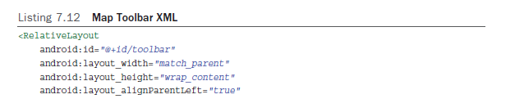
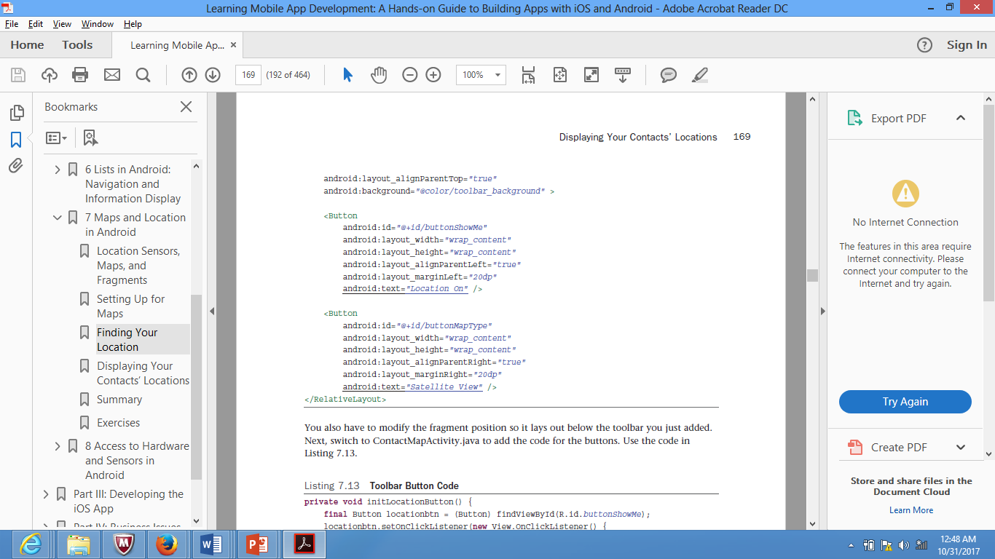
Displaying Your Contacts’ Locations
The map is almost complete. The final touch is to add a toolbar that allows the user to select the type of map to display and to show the user’s present location. Open the activity_contact_map.xml and add a toolbar using the following xml.
You also have to modify the fragment position so it lays out below the toolbar you just added.

Slide 41
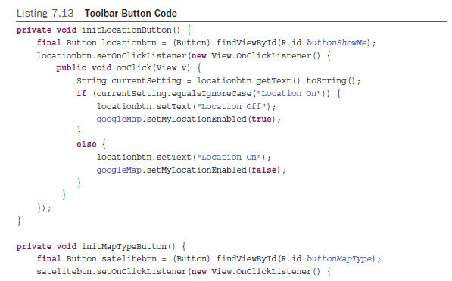
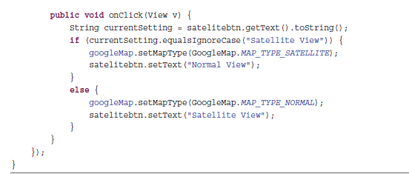
Displaying Your Contacts’ Locations
Now open ContactMapActivity.java to add the code for the buttons (Listing 7.13)
The code is very simple.
When the user taps the Location button, the code tests to see what the text for the button is. If it is Location On, myLocation is enabled and the button’s text is changed to Location Off. If the text is Location Off, myLocation is disabled and the button text is set to Location On.
The Map Type button operates in essentially the same manner, except that it changes the map type from normal to satellite and back again
Remember to call these methods in the onCreate method.

Slide 42
Thank You !

Slide 43
Extra Resources
Building dynamic UI with Fragments:
https://developer.android.com/training/basics/fragments/index.html
Maps Android API
https://developers.google.com/maps/documentation/android-api/start#get-key

