Slide 1

Mobile Application Development
Chapter 6
[Lists in Android: Navigation and Information Display]

Slide 2
Contents
Lists and Adapters
Simple Lists
Complex Lists
Complete the ContactList Activity

Slide 3
Lists and Adapters
“Lists are very useful tools and have become ubiquitous in mobile computing” (Iversen, 2014).
Two components are required for any list implementation in Android: a ListView widget and an adapter.
The ListView widget is an object that can display a vertical list of items that can be scrolled through.
The adapter provides access to the underlying data source for the list.
An AdapterView is the super class of all views that are bound to an underlying data source.

Slide 4
Lists and Adapters
Lists
The visible component of a list is implemented with a ListView widget in an XML layout file.
The widget has attributes that allow the user to configure some aspects of the display. In many ways, a ListView is a standard widget.
However, if given the special ID of @id/android:list and a special subclass of Activity, many of the tasks of list implementation are easier because the developer can take advantage of many built-in features of the SDK.
To take advantage of these features, the Activity associated with the layout containing the ListView must be a subclass of ListActivity rather than Activity. You don’t have to use the ListActivity subclass, but that requires more coding

Slide 5
Lists and Adapters
Adapters
The super class for all adapters is BaseAdapter, which is an abstract class. The BaseAdapter class has three subclasses, ArrayAdapter, CursorAdapter, and SimpleAdapter.
The ArrayAdapter is used to bind an Array or ArrayList to a view. An ArrayAdapter is always parameterized. That means it must be told what kind of data it is going to bind to a view. This data can be simple, such as String, or more complex.
The CursorAdapter is an abstract class that binds data from a database cursor to a view. It has a concrete subclass, SimpleCursorAdapter, that is used to map a row layout to fields in a cursor.
The SimpleAdapter class is used to bind static data to a view.

Slide 6
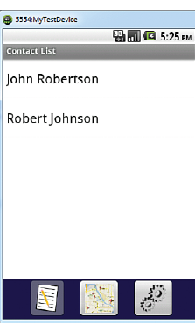
Simple Lists
The simple list implementation displays only the contact name of each contact in the user’s contact database.
The user will be able to scroll through this list and click any list item (contact) to open the ContactActivity screen

Slide 7
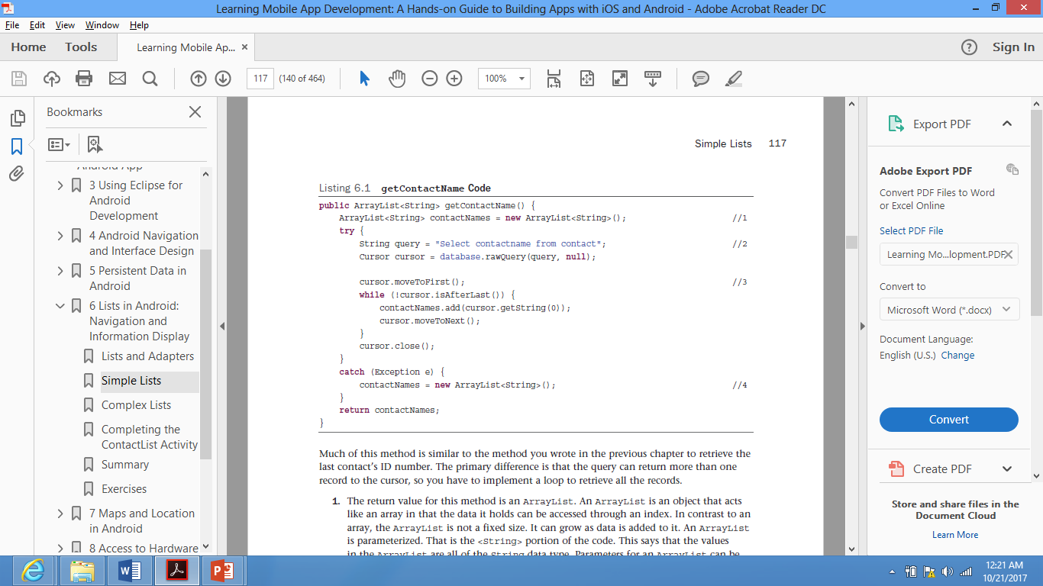
Simple Lists
Create the Data Source Method
To fill the Simple list with data, create the method getContactName() in the ContactDataSource class.
The SQL query is set up to return the contactname field for all records in the contact table. The retrieved contact names are filled in a <String> ArrayList, which is returned by the method .

Slide 8
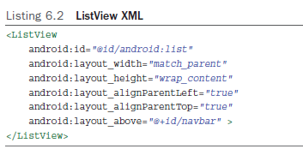
Simple Lists
Create the Layout
The layout of the Simple List is created in the activity_contact_ list.xml
This is done by dragging a ListView widget from the Pallette. The xml of the ListView should be as follows:
Notice that the id value is not a +id . It is @id/android:list . This identifies this widget as using an Android-supplied ID. You use this to get access to the built-in behaviors in ListActivity .

Slide 9
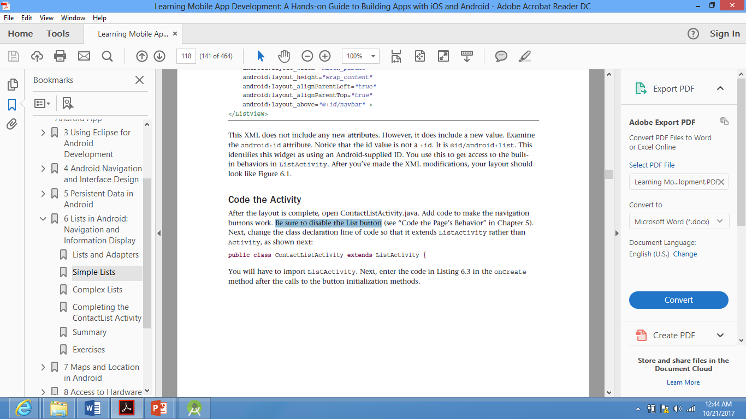
Simple Lists
Code the Activity
Open ContactListActivity.java file. Be sure to disable the List button in the Navigation Bar as shown in the previous chapter.
Make the ContactListActivity class inherit from the ListActivity. The ListActivity must be imported. This way, the ContactListActivity will have built-in List methods that can be directly called.

Slide 10
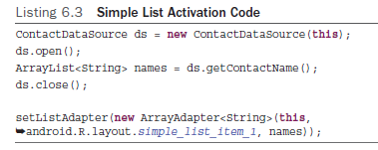
Simple Lists
Code the Activity
Add the following code in the onCreate Method of the ContactListActivity class
  The first four lines create a new ContactDataSource object, open the database, retrieve the contact names using the method you created, and close the database.
  The last line associates the ListView widget with the Adapter that has the data to be displayed. This is done by instantiating a new ArrayAdapter that
    holds String data: <String>
    Has the context : this
    Has the list item layout: android.R.layout.simple_list_item_1
    Has an ArrayList filled the data to be displayed: names
Note that the list item layout is provided by the Android SDK, which is why the reference to the layout begins with android rather than R .
Note that you did not have to get a reference to the ListView widget like you have done every other time
you accessed a widget in a layout. This is because of the use of android:list ID and the ListActivity . All that work is built in to the Activity .

Slide 11
Complex Lists
The ContactListActivity needs to have more functionality than can be coded in a simple list.
In this activity, the list displays the contact’s name in a large blue font and the contact’s phone number in a smaller black font below the name.
The list item also displays an arrow indicating that tapping the contact will open the ContactActivity and the contact’s data is displayed.
The list also allows the deletion of one or more contacts. To get this functionality, you need to create data source methods, create your own list item layout, and create your own adapter.

Slide 12
Complex Lists
Create the Data Source Method
The complex list displays and uses several bits of data about a contact. To function properly, it needs all the data for a contact.
This requires a method to retrieve contact data for all contacts from the database.
Open the ContactDataSource.java to create a new method that returns that data as Contact objects in an ArrayList as shown in Listing 6.5 .

Slide 13
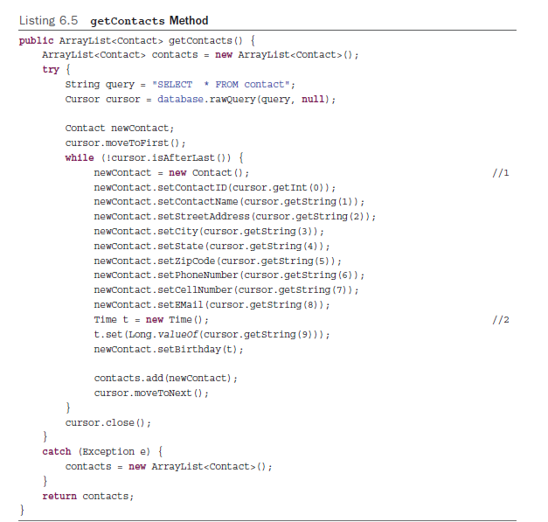
Complex Lists
Create the Data Source Method
This code is very similar to the method used to retrieve the contact name. The primary difference is that it retrieves all the data for each contact and places that data in a Contact object before it adds it to the ArrayList (which is now parameterized to hold Contact objects).

Slide 14
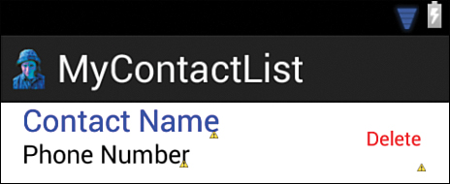
Complex Lists
Create the Layout
A complex list relies on the ListView widget, but also requires a custom list item layout. It typically contains significantly fewer widgets than an activity’s layout and is organized in a row-like manner.
There are several steps you need to take to create the list item layout
  Add some colors to the color.xml value file.
  Create a new XML layout file named list_item.
  Change the root layout of the list_item.xml from LinearLayout to RelativeLayout .
  Drag two large TextViews , one medium TextView , and one small Button to anywhere on the layout and configure it as shown in Listing 6.6

Slide 15
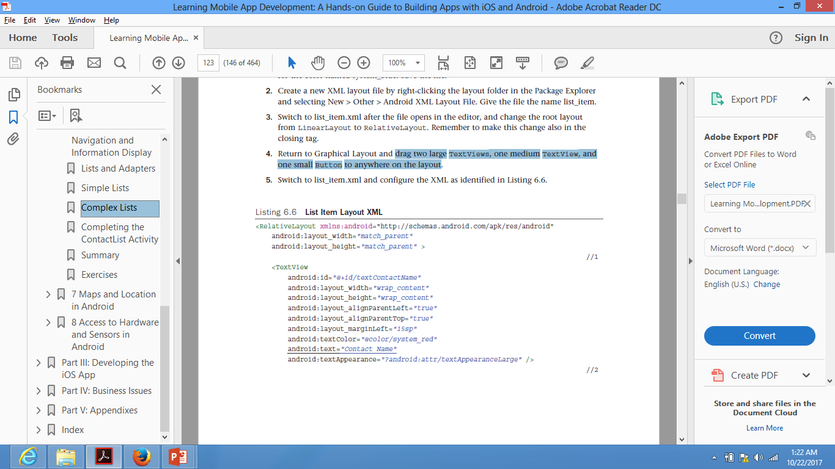
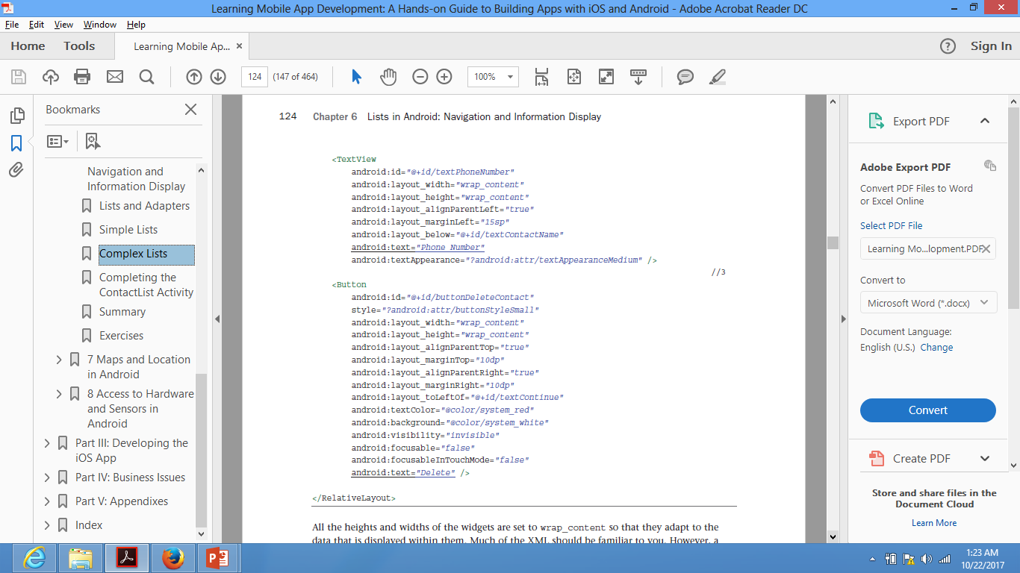
Complex Lists
Create the Layout

Slide 16
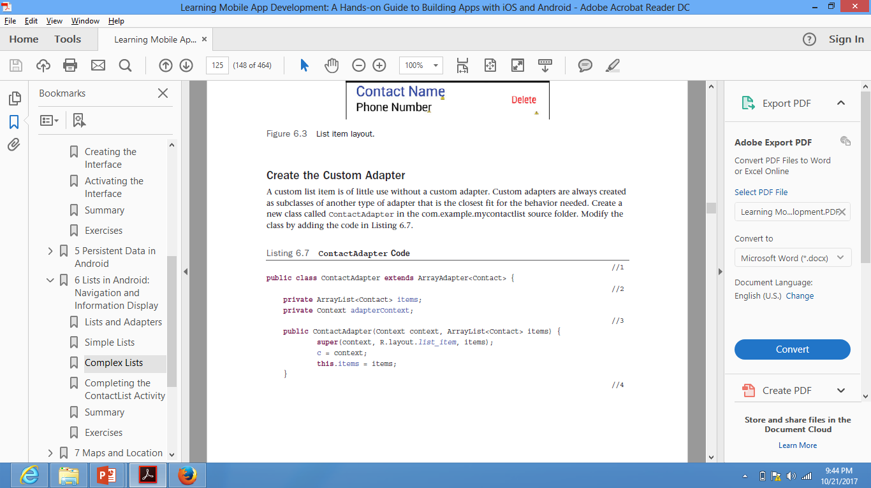
Complex Lists
Create the Custom Adapter
A custom list item is of little use without a custom adapter. Custom adapters are always created as subclasses of another type of adapter that would provide the desired behavior.
Create a new class called ContactAdapter.java
The ContactAdapter class is declared as a subclass of ArrayAdapter that has been parameterized to hold only Contact objects.
The items variable holds the ArrayList of
Contact objects retrieved from the database.
The adapterContext variable holds a reference to the context, in this case the ContactListActivity , where the list is being displayed.
adapterContext

Slide 17
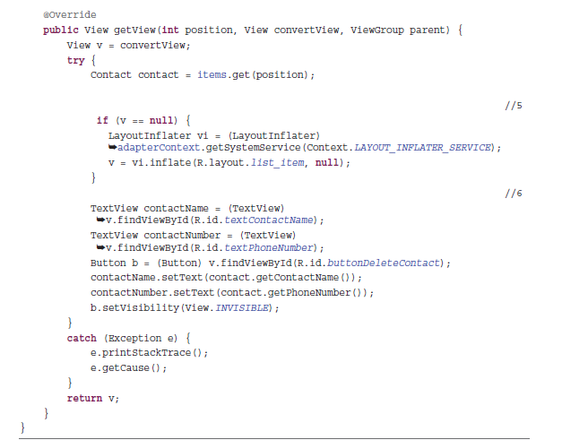
Complex Lists
Create the Custom Adapter
This method is called for every item
in the underlying data source up to the number of list items that can be displayed in the ListView .
As the user scrolls through the list, this method is called to display contacts in the ArrayList as they are scrolled into view.
The ListView passes the index of the item to be displayed and the View , which is the list item layout if it exists, null if it does not.
This is done so that list item views can be reused as they scroll off the screen rather than re-creating a new view. This saves system resources.

Slide 18
Complex Lists
Code the Activity
You need to do the following changes to be able to test the custom adapter:
  change the ContactListActivity code to retrieve contact objects rather than contact names,
    change “ArrayList<String> names = ds.getContactName();”
    to “final ArrayList<Contact> contacts = ds.getContacts();”
  set the ListView to use the custom adapter
    change “setListAdapter( new ArrayAdapter<String>( this , android.R.layout. simple_list_item_1 , names));”
    to “setListAdapter( new ContactAdapter( this , contacts));”
  code the onItemClick method to pass the selected contact’s ID to ContactActivity as shown in Listing 6.8

Slide 19
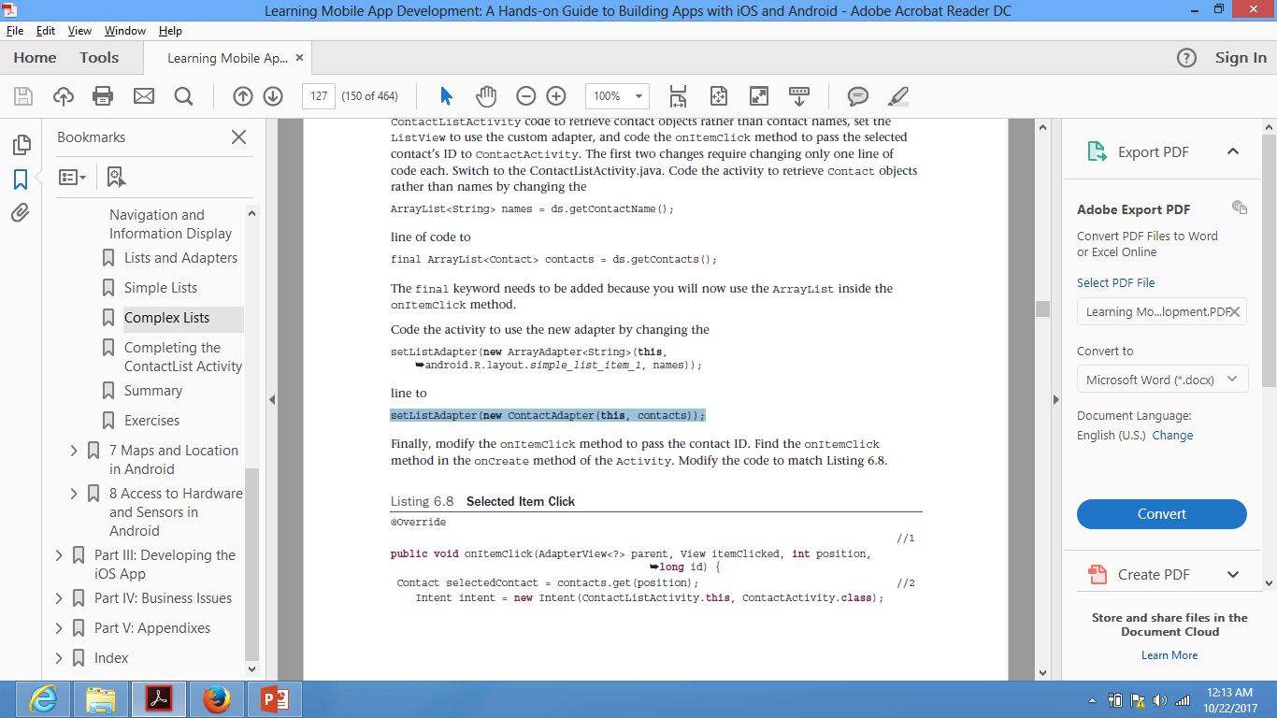
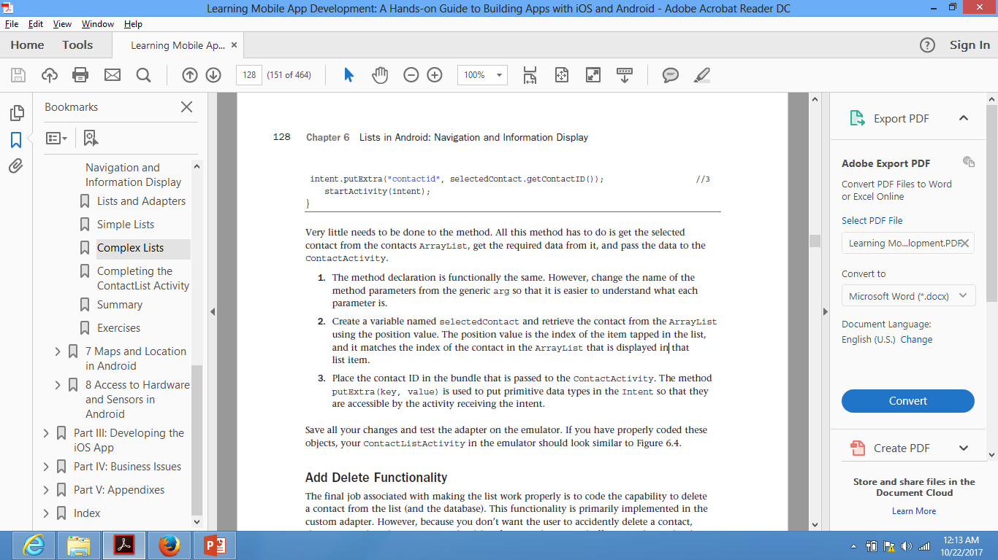
Complex Lists
Code the Activity
The selectedContact varaible holds the retrieved contact from the ArrayList at a certain position value.
The position value is the index of the item tapped in the list, and it matches the index of the contact in the ArrayList that is displayed in that list item.
Note to place the contact ID in the bundle that is passed to the ContactActivity.
The method putExtra(key, value) is used to put primitive data types in the Intent so that they are accessible by the activity receiving the intent.

Slide 20
Complex Lists
Add Delete Functionality
To make list work properly is to code the capability to delete a contact from the list (and the database)
Four tasks need to be completed to implement the delete function:
  Add a button to the activity contact_list layout.
  Code a method to delete a contact from the database in ContactDataSource
  Code the custom adapter to delete a contact from the list and database.
  Code the ContactListActivity to use the delete function of the adapter.

Slide 21
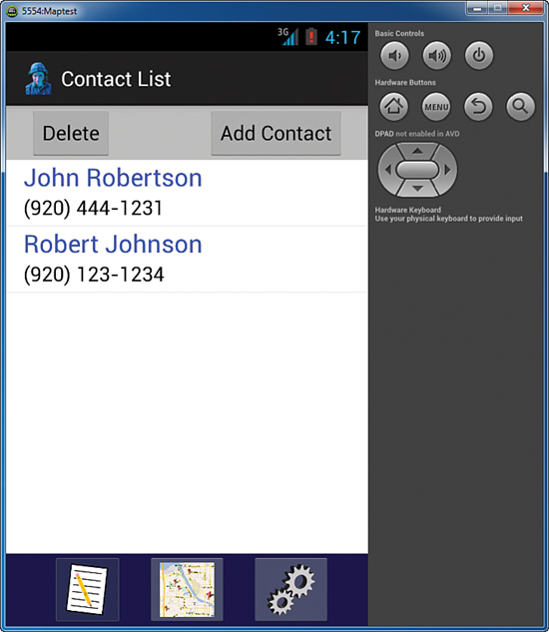
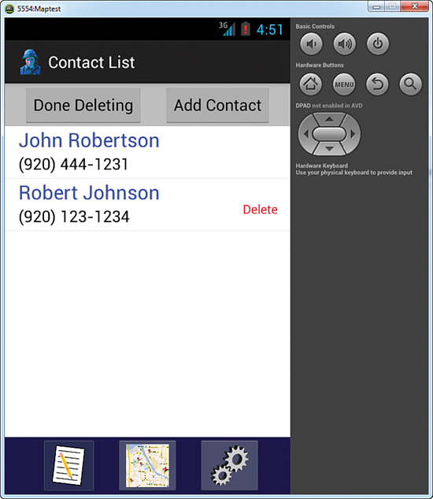
Complex Lists
Add Delete Functionality

Slide 22
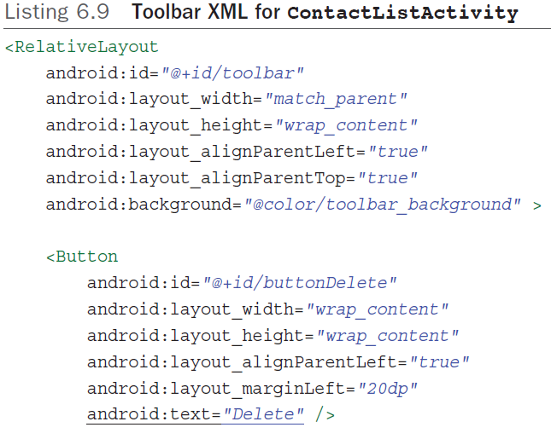
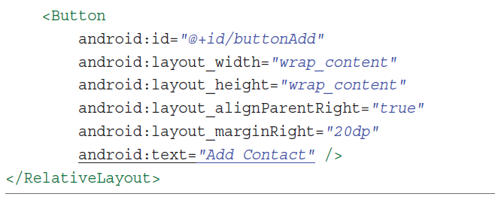
Complex Lists
Add Delete Functionality (task 1)
If you copied the XML, make sure you change the ToggleButton to a Button .
The XML for the list widget also needs to be modified.
In the ListView's attributes, delete the line that aligns the ListView with the top of the parent, and add the following line in its place:
android:layout_below = "@+id/toolbar"

Slide 23
Complex Lists
Add Delete Functionality (task 2)
Open ContactDataSource to add a method to delete a contact
Method will be passed the ID number of the contact to delete

Slide 24
Complex Lists
Add Delete Functionality (task 3)
The showDelete method checks if the Delete button is visible on the list item layout passed to it.
If it is, it calls the hideDelete method. If it is not, it displays the buttonand enables the button click event to remove the contact from the ArrayList and the
database.
The deleteOption method is code standard for calling a method to access the database.
The notifyDataSetChanged() method tells the adapter that the underlying data source has changed so that the list display will be changed to reflect the deletion.
The hideDelete method changes the button from visible to invisible and disables the
button’s onClick event.

Slide 25
Complex Lists
Add Delete Functionality (task 4)
The final step in coding the delete functionality is to modify the ContactListActivity by:
Adding a method to initiate the Delete button (Listing 6.12)
Modifying the onItemClick method to handle deleting. (Listing 6.13)

Slide 26
Completing the ContactList Activity
There are a few things left to complete the ContactList Activity.
These things include:
  Populating the ContactActivity Screen with data of the contact id passed to it
  Adding an Add Contact button
  Sorting the list using user preferences
  Making the app open the ContactList as the default activity instead of the blank ContactActivity.
  Set the ContactActivity as the default activity, if there are no contacts saved in the database.

Slide 27
Completing the ContactList Activity 1.Populating the ContactActivity Screen
In this step, the ContactActivity is modified to use the contact ID passed to it, in order to retrieve and display the specific contact’s data. To do that:
First create the GetSpecificContact method in the ContactDataSource.java file. This method retrieves a specific contact data based on the passed contact’s ID parameter.
Note that:
1. this code is essentially the same as the getContacts method, except that it returns a single contact rather than an ArrayList of all the contacts.
2. there is no loop because only one contact is returned.
3. A Contact object is the return value rather than an ArrayList.

Slide 28
Completing the ContactList Activity
1.Populating the ContactActivity Screen
Next, a new method needs to be added to ContactActivity and its onCreate method must be modified.
  The new method, called initContact , is used to Load a Contact (retrieve the contact and populate the layout with the values of the retrieved contact).
  The onCreate method is modified to get the passed ID and call the initContact method to retrieve and display the contact.
Note that: this code is similar to the methods used to set the ContactActivity for editing or viewing

Slide 29
Completing the ContactList Activity
1.Populating the ContactActivity Screen
To modify the onCreate, delete the currentContact = new Contact() line.
    Before the setForViewing() line, add the code in Listing 6.16.
When a name in the contact list is tapped, the ContactActivity will open with all the contact’s data displayed.
Note that this code checks the intent for extras.
- if it finds an extra, it gets the contact ID, retrieves the contact from the database, and displays the data in the layout.
- else if there is no extra, it assigns a new contact object to currentContact , effectively setting the currentContact ID to -1.
extras - is a Bundle of any additional information. This can be used to provide extended information to the component.

Slide 30
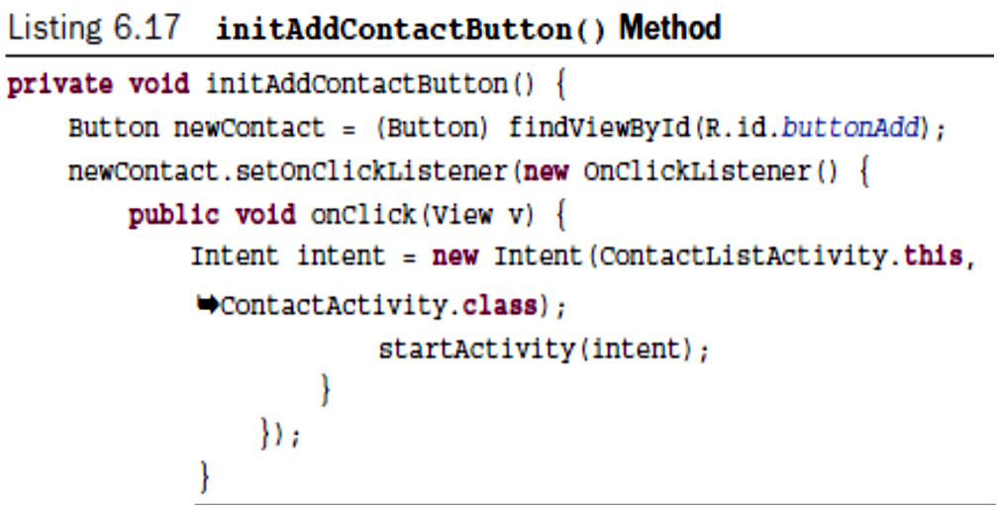
Completing the ContactList Activity
2.Coding the Add Button
Coding the Add button is just reusing code that you used before
Remember to call the initAddContactButton() method in the onCreate method.

Slide 31
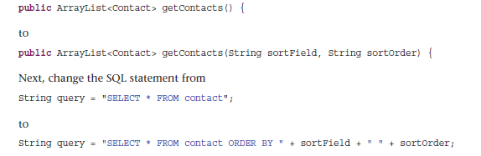
Completing the ContactList Activity
3.Sort the Contacts List
To sort the Contacts List according to the preferences set by the user, the following steps must be done:
Modify the getContacts method in the ContactDataSoure class. The method must take now two parameters: the sort field and the sort order, which will be used in SQL to perform the actual sort.
Change

Slide 32
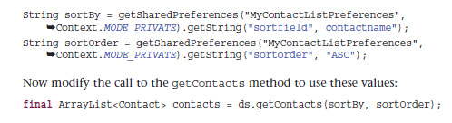
Completing the ContactList Activity
3.Sort the Contacts List
Modify the ContactListActivity to retrieve the user sorting preferences and pass them to the modified getContacts method. Enter the following two lines before the line that creates a new ContactDataSource object:
You can now run your app, change the preferences on the settings screen
and open the ContactListActivity to see the sorted contacts.

Slide 33
Completing the ContactList Activity
3. Sort the Contacts List
The sorting is executed correctly as long as you access the ContactList Activity from the list ImageButton. However, if you use the Back button on your device, the sorting is not executed.
This is because, the flag you set intent.setFlags(Intent. FLAG_ACTIVITY_ CLEAR TOP ); causes the old ContactActivityList activity to be destroyed and a new one is created so the onCreate method is executed. However, When you use the Back button, the Activity still exists, so the onCreate method is not executed and the sort order is thus never changed.
The solution to this is to place the code that populates the list in the onResume() method. This method will be executed every time the user navigates to the activity.
  After the onCreate method, create the onResume method.
  Cut the code from the onCreate method that gets the preferences, retrieves the contacts, and sets up the list, and paste it into the onResume method.

Slide 34
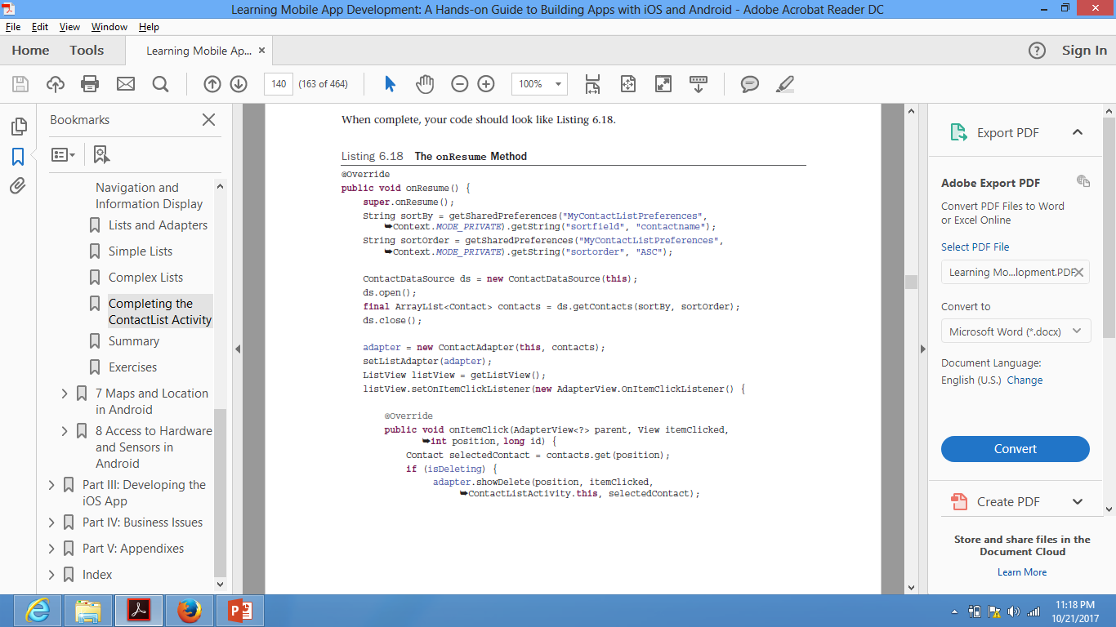
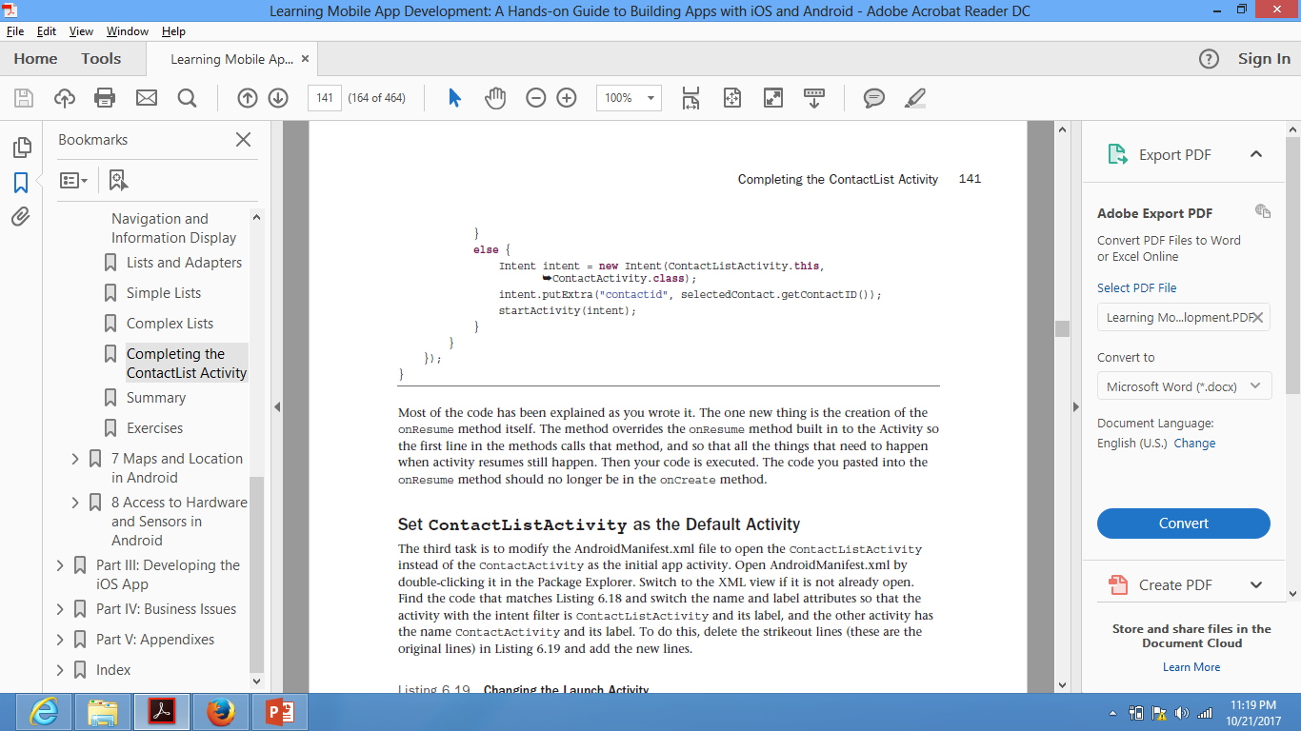
Completing the ContactList Activity
3.Sort the Contacts List

Slide 35
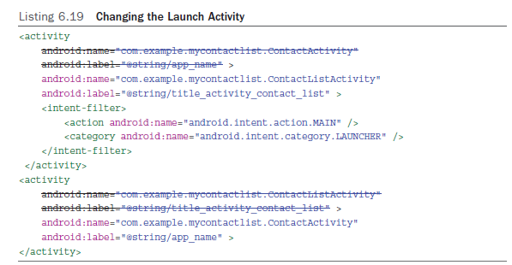
Completing the ContactList Activity 4.Set ContactListActivity as the Default Activity
In this task you need to modify the AndroidManifest.xml file to open the ContactListActivity instead of the ContactActivity as the initial app activity
To do that, you need to change the AndroidManifest.xml as shown below.

Slide 36
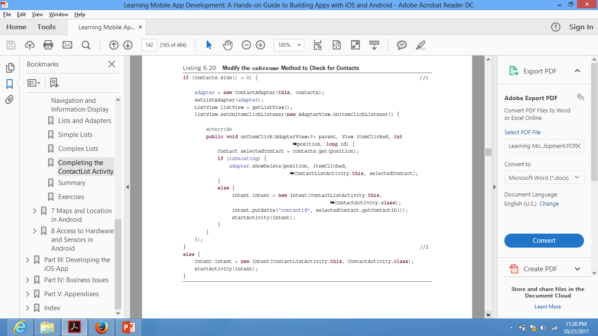
Completing the ContactList Activity 5. Set ContactListActivity as the Default Activity in case no contacts in the DB
The final task is to modify the onResume method of the ContactListActivity to check if there are any contacts in the database. If there are not, the app should open the ContactActivity .

Slide 37
Extra Resources
Building dynamic UI with Fragments:
https://developer.android.com/training/basics/fragments/index.html

Slide 38
Thank You !

