Slide 1

Mobile Application Development
Chapter 11
[Persistent Data in iOS]

Slide 2
Contents
File Data Storage
User Defaults
Core Data
Setting Up Core Data
Storing Settings

Slide 3
File Data Storage
Like most other operating systems, iOS enables saving data in files, either in regular text files or by archiving (what’s known as serialization in Java and C#).
It’s worth noting that on iOS, apps are sandboxed, which means that each app is isolated from the other apps and from the operating system.
  One of the consequences is that each app has only a very simple file system that by default consists of a few standard directories: Documents, Library, and tmp.
As a developer, you can store files in the Documents and tmp directories. The Documents folder is backed up when the device is backed up. The tmp folder is not.
By storing data in files, you can quickly store user data and can even take advantage of Apple’s iCloud to allow the user to sync documents between their devices. This is a powerful service, but it works only between devices for a single user. iCloud will not allow you to let your users exchange data.

Slide 4
User Defaults
When you need to save a little bit of data in your app, the NSUserDefaults object is a very simple and easy way to do so.
NSUserDefaults is a front-end to a key-value file (often referred to as Plist files because of the .plist extension) that is stored in the app’s Preferences directory.
There’s only one file, but in this file you can store as many values as you want.
When storing values in the file, you have to supply a key string to identify the value when retrieving it later.
You can store many data types in NSUserDefaults , including all scalar types as well as NSData , NSString , NSNumber , NSDate , NSDictionary , and NSArray .
Other data types can be archived and stored as an NSData object.

Slide 5
Core Data
Core Data is a powerful data persistence solution developed by Apple to provide object-oriented storage.
Core Data is an object-wrapper on top of a data store—typically a SQLite database.
This allows the developer to work with objects that map to entities in the database without worrying too much about the underlying database design and queries.
For apps that need business data stored, Core Data is a strong solution to meet this need.
Figure 11.1 shows an overview of the Core Data framework.

Slide 6
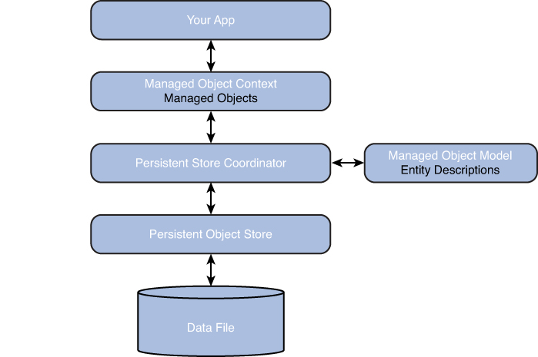
Core Data
The framework stores data in files. The default is SQLite database, but you can also choose to use XML or binary data.
The Persistent Object Store wraps around the data file and presents a common interface to the rest of the stack. You will not need to interact with the Persistent Object Store except to choose which file format to store the data in.
The Persistent Store Coordinator allows for having multiple data stores in the same app, and will then coordinate access to those stores. This is very rare for iOS apps, and you will never directly interact with the Persistent Store Coordinator.
The Managed Object Model is the description of the layout of the data. This is where you describe the structure of your data. The design of the data structure is similar to relational database design
When you need to access the data, you will not directly interact with the data store. Instead, you will work with the Managed Object Context, which allows you to access the objects that are stored in the data file. The Managed Object Context can keep track of multiple changes to the objects, and will periodically, or when instructed, save the changes to the persistent store.
Figure 11.1 Overview of the Core Data framework.

Slide 7
Setting Up Core Data
Creating the Project
Start by creating a new project in Xcode
Choose the Empty Application template and click Next.
Fill in the settings on the next screen as shown in Figure 11.2 .
Make sure the Use Core Data check box is selected, then click Next and choose a place to save the new project.
Figure 11.2 Setting up the project to support Core Data.

Slide 8
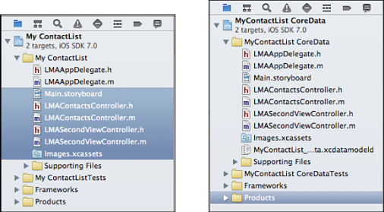
Setting Up Core Data
Creating the Project
After you have created the project,
Open the new project and delete images.xcassets. Then click Move to Trash in the dialog that pops up.
Open both projects side by side and select all the files in the MyContactList folder of the original project except LMAAppDelegate.h and LMAAppDelegate.m, because these files contain important setup for Core Data (see the left side of Figure 11.3 ).
Figure 11.2 Setting up the project to support Core Data.
Figure 11.3 Selecting files to copy to the new project on the left. The result of the copy is shown on the right

Slide 9
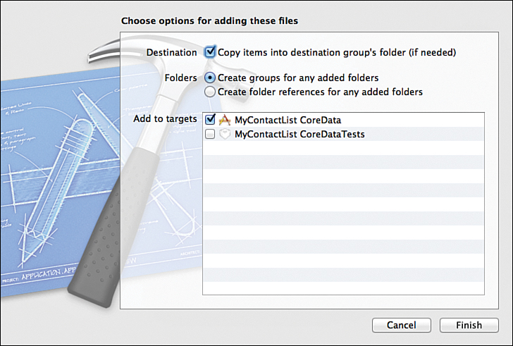
Setting Up Core Data
Creating the Project
After you have created the project,
Drag all the selected files into the new project (see the right side of Figure 11.3 for the end result).
In the dialog that comes up, check Copy Items into Destination Group’s Folder, as shown in Figure 11.4 .
Figure 11.4 Copying files to the new project.

Slide 10
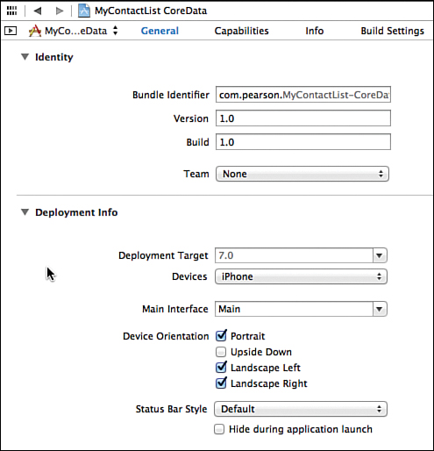
Setting Up Core Data
Creating the Project
Next, you will need to modify the app delegate to have the correct View Controller show up when launching the app.
First, open the Project Summary and change the Main Interface to Main.storyboard. After making the selection, the chosen text will change to Main, as shown in Figure 11.5 .
Figure 11.5 Setting the Main storyboard.

Slide 11
Setting Up Core Data
Creating the Project
If you look through LMAAppDelegate you will see a lot of code that manages the Core Data functionality.
There are references to the Managed Object Context, the Managed Object Model, and the Persistent Store Coordinator.
Further down in the file, you will see a method, saveContext , which can be called whenever changes to the managed objects need to be saved to disk.
You don’t really need to understand the functionality of all the Core Data methods.
All you need to access is the managedObjectContext and saveContext methods

Slide 12
Setting Up Core Data
Designing Data Structure
While creating the project a new file, MyContactList_CoreData.xcdatamodeld, has been added to the project.
This is a representation of the Data Model and is where you can design the data structure for the MyContactList app.
The data structure for the app is very simple with just a single entity. Refer to Figure 11.6 .

Slide 13
Setting Up Core Data
Designing Data Structure
1. Open the data model file.
2. Click Add Entity and name the entity Contact (entity names must begin with as
uppercase letter) by double-clicking the word Entity and typing Contact .
3. Click Add Attribute and name the first attribute contactName and give it the type
String .
4. Add the remaining attributes as shown in Figure 11.7 . Each of the attributes are of
type String except birthday, which is Date .
Figure 11.6 Using the Core Data Model editor

Slide 14
Setting Up Core Data
Designing Data Structure
Figure 11.7 Attributes of the Contact entity.

Slide 15
Setting Up Core Data
Designing Data Structure
After setting up the data design, you will need to create an Objective-C class that represents the data design.
Select the Contact entity and select Editor > Create NSManagedObject Subclass.
2. Choose the data model and click Next.
3. Select the Contact entity and click Next.
4. Make sure you have the MyContactList CoreData target selected and click Create.
This adds two files to your project, Contact.h and Contact.m. The content of the two files is very simple, with a property for each of the attributes in the data model. The Contact class is a subclass of NSManagedObject, which means it inherits the capability to be managed and stored by the Managed Object Context.

Slide 16
Setting Up Core Data
Passing Data Between Controllers
The Birthday label on the Contacts screen is changed on the Date screen. When the user taps
the Change button next to the birthday, the Date screen is opened with a Date Picker, where
the user can choose the desired date. Tapping the Save button brings the user back to the
Contact screen and changes the Birthday label to what was chosen in the Date Picker.
The standard way to pass data back from a View Controller is to use the delegate pattern. With
this pattern, you will have a reference in the Date Controller back to whatever controller
called it (allowing for the Date Controller to be used in many contexts)
The delegate pattern is used widely in iOS.
This pattern of using a delegate is similar to using listeners in Android
There are several steps to set up this pattern:
1. Define a delegate protocol in the .h file of the subview controller (LMADateController.h)
2. Set up a property called delegate in the .h file of the subview Controller to hold a
reference to the main view controller (LMAContactController.h.)
3. Specify in the @interface declaration of the main controller (LMAContactController.m.)
that it should implement the delegate protocol.
4. Implement the methods specified in the protocol in the .m file of the main controller
5. Set up the main view as a delegate of the subview.
6. Call the delegate methods from the subview in the main view (LMAContactController.m.)

Slide 17
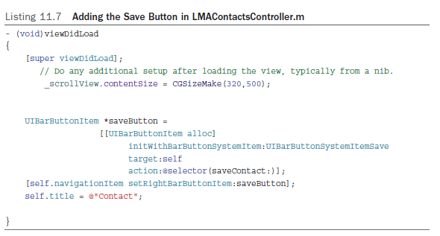
Setting Up Core Data
Saving Data to Core Data
To save the contact info to core data, the user interface on the Contacts screen needs to be changed to add a Save button in the navigation bar
Open LMAContactsController.m and update the viewDidLoad : method to match Listing 11.7 .
you’ll need to implement the method specified in the @selector . This method is the one that will do the saving of data from the form ( Listing 11.8 ).

Slide 18
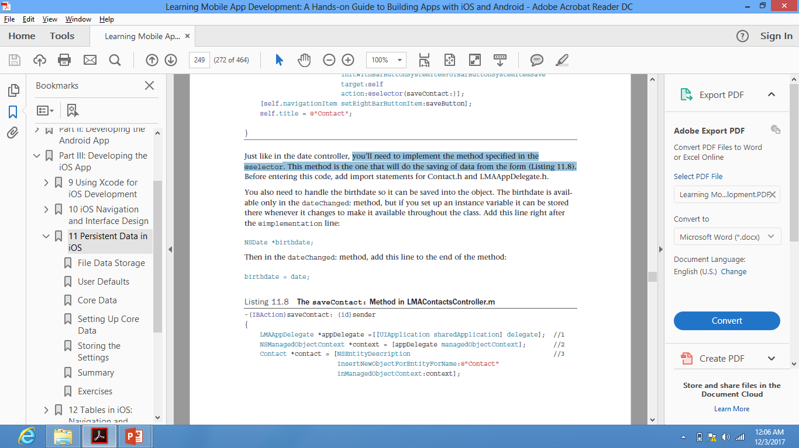
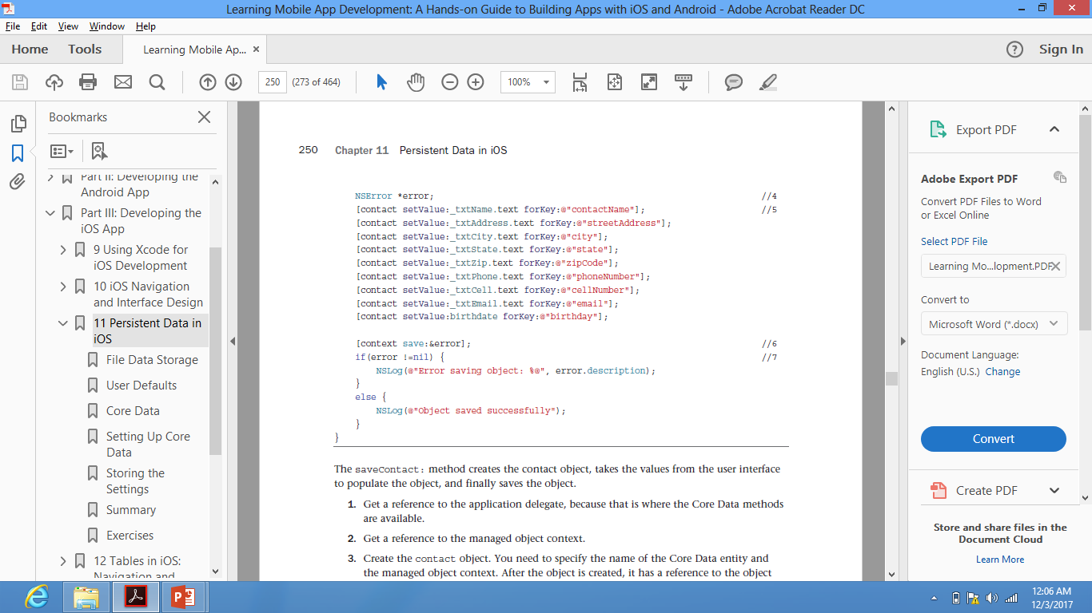
Setting Up Core Data
Saving Data to Core Data
The saveContact: method creates the contact object, takes the values from the user interface to populate the object, and finally saves the object.
1. Get a reference to the application delegate, because that is where the Core Data methods are available.
2. Get a reference to the managed object context.
3. Create the contact object. You need to specify the name of the Core Data entity and the managed object context. After the object is created, it has a reference to the object context and knows which entity it is defined by.
4. The error variable will contain any errors that occur during the saving of the object.
5. This set of statements populates the object with the values from the user interface by calling the setValue:forKey: method on the contact object passing in the text property from each of the text fields and the name of the Core Data attribute.
6. This statement forces the context to save any changes, and will record any errors. If you
don’t call the save method, the data will be saved, but you will not know when, so your app may behave erratically.
7. Print out any errors to NSLog . These messages will not show up to the user but will
appear in Xcode in the bottom-right part of the debug section.

Slide 19
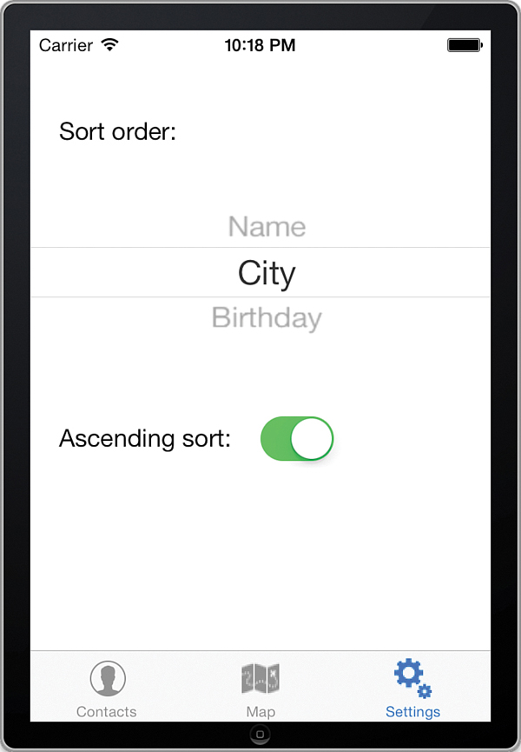
Storing the Settings
In the settings part of the app, the user is able to change the sort order of the displayed contacts. The contacts can be sorted in either ascending or descending order by Name, City, or Birthday. Two controls are being used: the Picker View and the Switch. ( Figure 11.11 ).
Note: Implementation of these controls can be viewed in the textbook but is not required

Slide 20
Storing the Settings
The user’s preference for sorting will be stored in an NSUserDefaults object.
The NSUserDefaults object is used to store data values for an app in a key-value list on the disk.
Working with NSUserDefaults is very simple. You start by getting a reference to the standard NSUserDefaults object with this line of code:
NSUserDefaults *settings = [NSUserDefaults standardUserDefaults];
To store a value in the settings object, you use code like this:
[settings setObject:@"City" forKey:@"sortField"];
This saves the value “City” with the key “sortField”.
Every value must have a unique key. In addition to the setObject:forKey : method, there are also methods that can be used to store scalar values such as BOOL and int . Here’s an example:
      [settings setBool: YES forKey:@"sortDirectionAscending"];

Slide 21
Storing the Settings
Retrieving the data is equally simple. Using the reference called settings to the NSUserDefaults object, you would retrieve an object using this call:
NSString *sortField = [settings objectForKey: @"sortField" ];
The data is periodically saved, but to force saving, you can call the synchronize method:
[settings synchronize];
This will save any changes you’ve made to the Plist file.
The functionality provided by NSUserDefaults in iOS is provided by SharedPreferences in Android.
In both cases, these objects are used to store single bits of information. However, whereas Android can store only simple data types in SharedPreferences , iOS has the capability to store more complex objects.

Slide 22
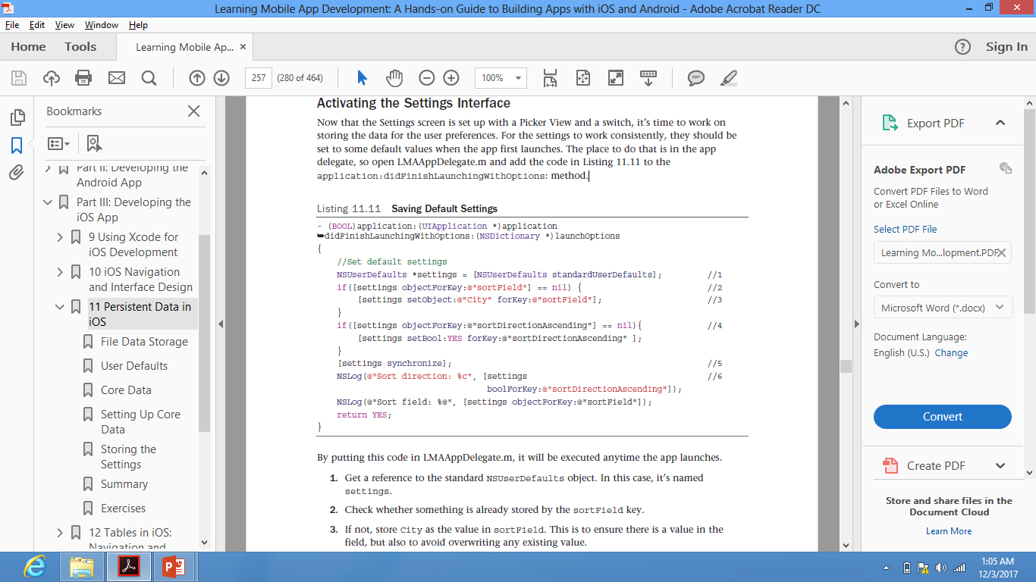
Storing the Settings
For the settings to work consistently, they should be set to some default values when the app first launches. The place to do that is in the app delegate, so open LMAAppDelegate.m and add the code in Listing 11.11 to the application:didFinishLaunchingWithOptions : method. By putting this code in LMAAppDelegate.m, it will be executed anytime the app launches.
1. Get a reference to the standard NSUserDefaults object. In this case, it’s named settings .
2. Check whether something is already stored by the sortField key.
3. If not, store City as the value in sortField . This is to ensure there is a value in the
field, but also to avoid overwriting any existing value.
4. Repeat the same check for the sort direction. If no value is stored, it defaults to YES.
5. Save any changes back to the settings file.
6. Write the values of the two settings fields to NSLog . This shows how to retrieve a Boolean value using the boolForKey : method and retrieving a string by using objectForKey :

Slide 23
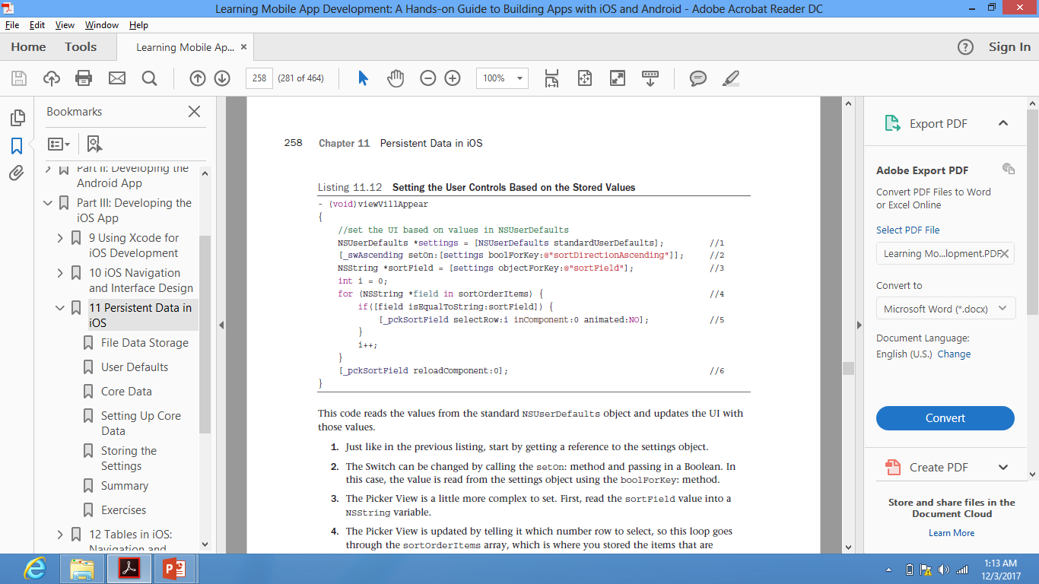
Storing the Settings
Next, we need to make sure the UI controls on the Settings screen get updated when the view is loaded. Implement viewWillAppear : in LMASettingsController.m, as shown in Listing 11.12. This code reads the values from the standard NSUserDefaults object and updates the UI with those values.
1. Start by getting a reference to the settings object.
2. The Switch can be changed by calling the setOn : method and passing in a Boolean. In this case, the value is read from the settings object using the boolForKey : method.
3. The Picker View is a little more complex to set. First, read the sortField value into a NSString variable.
4. The Picker View is updated by telling it which number row to select, so this loop goes through the sortOrderItems array, which is where you stored the items that are displayed in the Picker View.
5. If a match is found, the Picker View is told to select that row. There’s only one component, or column, so that is set to 0. The selection can be animated so the Picker View spins to the selection, but this is not appropriate here because the selection is
already made before the user opens the Selection screen, so we set animated to NO .
6. To have the Picker View change, you call reloadComponent

Slide 24
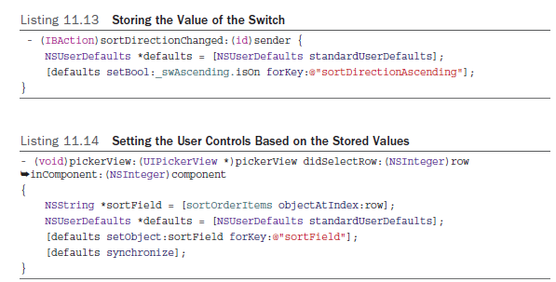
Storing the Settings
To store the values chosen by the user, implement sortDirectionChanged : as shown in Listing 11.1 to store the value of the switch, and to update the implementation of PickerView: didSelectRow:inComponent: as shown in Listing 11.14 .

Slide 25
Thank You !

