Slide 1
Apps are made available to users by publishing them to their target audience.
Apple and Google provide a marketplace where developers can sell their apps.
Developers configure the app and conform to the sponsors requirements.
Google and Apple have requirements and guidelines for app.
Developers must adhere to these requirements for Apple as every app is reviewed before it is published.

Slide 2
If developers apps do not conform, it will be rejected by Apple.
Google publishes apps that do not meet its store requirements, but will remove it later if the app violates its rules.
When an app meets publication requirements of the target market the process of publishing requires several steps.
Prepare an icon for the app.
Prepare screen shots of the app.
Determine price.
Establish category.
Determine countries for app.
Licensing Library and copyrights.
Compile app and sign into application.
Debug code.
Set a private key.

Slide 3
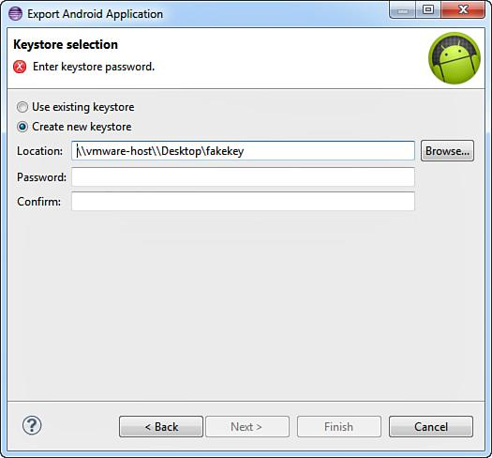
To create a signed APK (which is required by the Play Store) you need to set a private key. Fortunately, you can do this using the Export Wizard at the same time you are creating the APK.
Figure 16.1 Creating a new keystore.
Notes:
No figures in Ch. 15

Slide 4
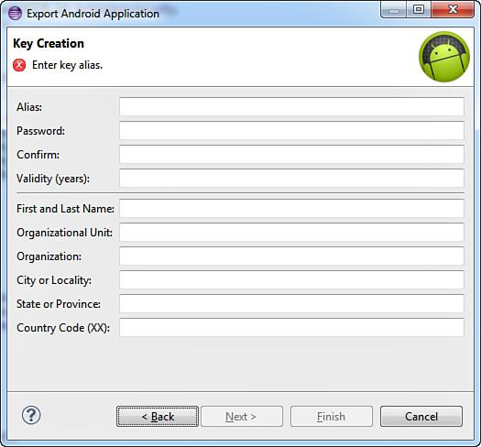
Fill in any company information you want and click Next (Figure 16.2)
The signed APK will be created and stored in the specified location. This
APK will be uploaded to the Play Store.
Figure 16.2 Key configuration.
Notes:
Figure:

Slide 5
iOS App Store Distribution
Set up your Distribution Certificate and Distribution Provisioning Profile.
Set up an entry for your app in iTunes Connect.
Provide information about the app: pricing, and screenshots prior to uploading the app.
Select the default language of the app.
Enter the app name, SKU number, and Bundle ID.
Link the year of publication, the number of the app in stock, and the version number.
Provide an app description, screenshots, icon, rating and categorization, and review information.
Verify app, click save and get ready to upload.
When the app is open in Xcode change the active scheme from the simulator to iOS Device.
Figure 16.3 Changed scheme to iOS Device.
Notes:
Figure:

Slide 6
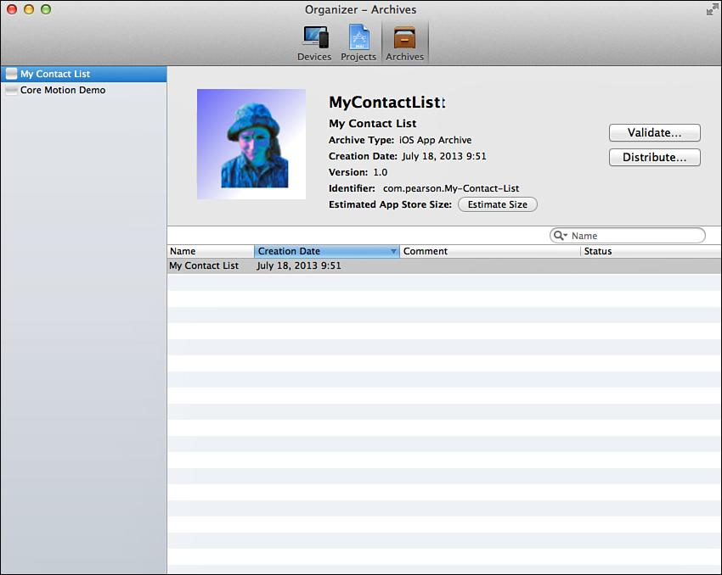
Select Product > Archive from the menu. An archive file will be compiled and the Organizer opens (Figure 16.4 ).
In the Organizer, make sure the latest archive file is selected and click the Validate button.
Click the Distribute button. Click the Submit to App Store option button. Click Next.
Enter your developer login information. Select an identity.
You will get a message “Your application is being uploaded.”
You will get a success message. Your app is now waiting to be reviewed by Apple.
Figure 16.4 Xcode Archive Organizer.
Notes:
Figure:

Slide 7
App distribution within an organization differs between iOS and Android.
Android:
Prepare an APK and give it to your users.
Send users an email with the APK attached.
Device automatically asks if they want to install it.
Users must have set their device to accept apps from unknown sources.
Go to the Settings app on the Android device and check the box next to Unknown Sources.

Slide 8
Set up an internal website to distribute the app.
Accepting apps from unknown sources must be checked.
Remember, you can choose the method that works for the organization.
Organizations implement Mobile Device Management (MDM) solutions.

Slide 9
iOS Enterprise Distribution
Get an iOS Enterprise Developer license.
Allows unlimited distribution of apps within the organization.
You cannot sell apps in the App Store with this license.
Organizations that do internal and public development need an Enterprise Developer license and an iOS Developer license.
Set up an enterprise distribution certificate and an enterprise distribution provisioning profile.
Packaged with the app using Xcode.
Do not need to need to use iTunes Connect with in-house apps.
The provisioning profile expires after a year.
Prior to expiration, a new profile must be created, packaged with the app, and redistributed, or the app will stop working.
After an app is compiled with the appropriate certificate and profile, it can be distributed through iTunes, using the iPhone Configuration Utility, or wirelessly from a secure server.

Slide 10
Testing and Fragmentation
Testing is a critical component of app development.
apps developed on either platform must be tested on real devices prior to release.
A comprehensive test plan must be established and followed.
A comprehensive test plan should include thorough black box unit testing, including equivalence partitioning, boundary value analysis, and cause-effect graphing.
The organization of apps into individual screens makes it easy to test each screen as a unit.
To use equivalence partitioning in a screen, identify all the possible outcomes of the user interaction with the screen and identify the input or other data that would lead to that outcome.

Slide 11
Testing and Fragmentation (contd.)
Testing should also be performed by individuals outside the development team.
The testing can initially be performed on the Android Emulator or the iOS Simulator, but it should then be performed on a device.
After all the unit tests have been passed the app is tested for usability.
The final set of tests requires access to a variety of devices which is more difficult for Android than for iOS.
Keep up with platform changes and update accordingly.

