Slide 1
Data Mining:
Concepts and Techniques
(3rd ed.)
— Chapter 3 —
Jiawei Han, Micheline Kamber, and Jian Pei
University of Illinois at Urbana-Champaign &
Simon Fraser University
©2013 Han, Kamber & Pei. All rights reserved.
1
Notes:
1

Slide 2
Chapter 3: Data Preprocessing
Data Preprocessing: An Overview
  Data Quality
  Major Tasks in Data Preprocessing
Data Cleaning
Data Integration
Data Reduction
Data Transformation and Data Discretization
Summary
2
2
Notes:
2

Slide 3
Data Quality: Why Preprocess the Data?
Measures for data quality: A multidimensional view
  Accuracy: correct or wrong, accurate or not
  Completeness: not recorded, unavailable, …
  Consistency: some modified but some not, dangling, …
  Timeliness: timely update?
  Believability: how trustable the data are correct?
  Interpretability: how easily the data can be understood?
3
Notes:
3

Slide 4
Major Tasks in Data Preprocessing
Data cleaning
  Fill in missing values, smooth noisy data, identify or remove outliers, and resolve inconsistencies
Data integration
  Integration of multiple databases, data cubes, or files
Data reduction
  Dimensionality reduction
  Numerosity reduction
  Data compression
Data transformation and data discretization
  Normalization
  Concept hierarchy generation
4
Notes:
4

Slide 5
Chapter 3: Data Preprocessing
Data Preprocessing: An Overview
  Data Quality
  Major Tasks in Data Preprocessing
Data Cleaning
Data Integration
Data Reduction
Data Transformation and Data Discretization
Summary
5
5
Notes:
5

Slide 6
Data Cleaning
Data in the Real World Is Dirty: Lots of potentially incorrect data, e.g., instrument faulty, human or computer error, transmission error
  incomplete: lacking attribute values, lacking certain attributes of interest, or containing only aggregate data
    e.g., Occupation = “ ” (missing data)
  noisy: containing noise, errors, or outliers
    e.g., Salary = “−10” (an error)
  inconsistent: containing discrepancies in codes or names, e.g.,
    Age = “42”, Birthday = “03/07/2010”
    Was rating “1, 2, 3”, now rating “A, B, C”
    discrepancy between duplicate records
  Intentional (e.g., disguised missing data)
    Jan. 1 as everyone’s birthday?
6
Notes:
6

Slide 7
Incomplete (Missing) Data
Data is not always available
  E.g., many tuples have no recorded value for several attributes, such as customer income in sales data
Missing data may be due to
  equipment malfunction
  inconsistent with other recorded data and thus deleted
  data not entered due to misunderstanding
  certain data may not be considered important at the time of entry
  not register history or changes of the data
Missing data may need to be inferred
7
Notes:
7

Slide 8
How to Handle Missing Data?
Ignore the tuple: usually done when class label is missing (when doing classification)—not effective when the % of missing values per attribute varies considerably
Fill in the missing value manually: tedious + infeasible?
Fill in it automatically with
  a global constant : e.g., “unknown”, a new class?!
  the attribute mean
  the attribute mean for all samples belonging to the same class: smarter
  the most probable value: inference-based such as Bayesian formula or decision tree
8
Notes:
8

Slide 9
Noisy Data
Noise: random error or variance in a measured variable
Incorrect attribute values may be due to
  faulty data collection instruments
  data entry problems
  data transmission problems
  technology limitation
  inconsistency in naming convention
Other data problems which require data cleaning
  duplicate records
  incomplete data
  inconsistent data
9
Notes:
9

Slide 10
How to Handle Noisy Data?
Binning
  first sort data and partition into (equal-frequency) bins
  then one can smooth by bin means, smooth by bin median, smooth by bin boundaries, etc.
Regression
  smooth by fitting the data into regression functions
Clustering
  detect and remove outliers
Combined computer and human inspection
  detect suspicious values and check by human (e.g., deal with possible outliers)
10
Notes:
10
Enrich using data integration research!!

Slide 11
Data Cleaning as a Process
Data discrepancy detection
  Use metadata (e.g., domain, range, dependency, distribution)
  Check field overloading
  Check uniqueness rule, consecutive rule and null rule
  Use commercial tools
    Data scrubbing: use simple domain knowledge (e.g., postal code, spell-check) to detect errors and make corrections
    Data auditing: by analyzing data to discover rules and relationship to detect violators (e.g., correlation and clustering to find outliers)
Data migration and integration
  Data migration tools: allow transformations to be specified
  ETL (Extraction/Transformation/Loading) tools: allow users to specify transformations through a graphical user interface
Integration of the two processes
  Iterative and interactive (e.g., Potter’s Wheels)
11
Notes:
11

Slide 12
Chapter 3: Data Preprocessing
Data Preprocessing: An Overview
  Data Quality
  Major Tasks in Data Preprocessing
Data Cleaning
Data Integration
Data Reduction
Data Transformation and Data Discretization
Summary
12
12
Notes:
12

Slide 13
Data Integration
Data integration:
  Combines data from multiple sources into a coherent store
Schema integration: e.g., A.cust-id ≡ B.cust-#
  Integrate metadata from different sources
Entity identification problem:
  Identify real world entities from multiple data sources, e.g., Bill Clinton = William Clinton
Detecting and resolving data value conflicts
  For the same real world entity, attribute values from different sources are different
  Possible reasons: different representations, different scales, e.g., metric vs. British units
13
13
Notes:
13
Should ask students to do some survey on data integration. -JH

Slide 14
Handling Redundancy in Data Integration
Redundant data occur often when integration of multiple databases
  Object identification: The same attribute or object may have different names in different databases
  Derivable data: One attribute may be a “derived” attribute in another table, e.g., annual revenue
Redundant attributes may be able to be detected by correlation analysis and covariance analysis
Careful integration of the data from multiple sources may help reduce/avoid redundancies and inconsistencies and improve mining speed and quality
14
14
Notes:
14

Slide 15
Chapter 3: Data Preprocessing
Data Preprocessing: An Overview
  Data Quality
  Major Tasks in Data Preprocessing
Data Cleaning
Data Integration
Data Reduction
Data Transformation and Data Discretization
Summary
15
15
Notes:
15

Slide 16
Data Reduction Strategies
Data reduction: Obtain a reduced representation of the data set that is much smaller in volume but yet produces the same (or almost the same) analytical results
Why data reduction? — A database/data warehouse may store terabytes of data. Complex data analysis may take a very long time to run on the complete data set.
Data reduction strategies
  Dimensionality reduction, e.g., remove unimportant attributes
    Wavelet transforms
    Principal Components Analysis (PCA)
    Feature subset selection, feature creation
  Numerosity reduction (some simply call it: Data Reduction)
    Regression and Log-Linear Models
    Histograms, clustering, sampling
    Data cube aggregation
  Data compression
16
Notes:
16
MK 09/09/05: Wiki has dimensionality reduction as feature extraction (PCA) and feature subset selection. It states both wavelet transforms and PCA as forms of data compression. It does not have any pages for "numerosity reduction". We claim there are many different ways to organize data reduction strategies, which is true, so this presentation below should be OK. Let’s discuss.

Slide 17
Data Reduction 1: Dimensionality Reduction
Curse of dimensionality
  When dimensionality increases, data becomes increasingly sparse
  Density and distance between points, which is critical to clustering, outlier analysis, becomes less meaningful
  The possible combinations of subspaces will grow exponentially
Dimensionality reduction
  Avoid the curse of dimensionality
  Help eliminate irrelevant features and reduce noise
  Reduce time and space required in data mining
  Allow easier visualization
Dimensionality reduction techniques
  Wavelet transforms
  Principal Component Analysis
  Supervised and nonlinear techniques (e.g., feature selection)
17
Notes:
17
JH: put SVD at clustering high-D reduction.

Slide 18
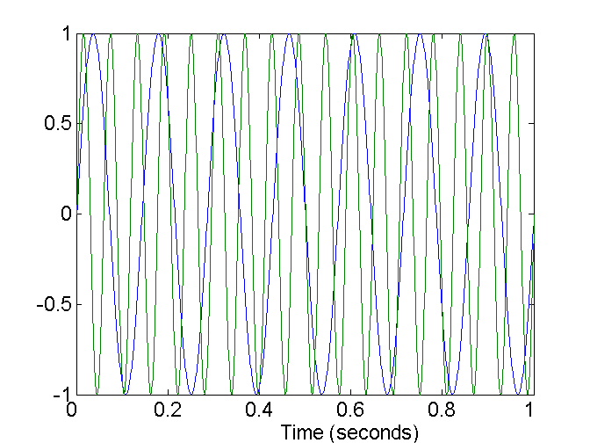
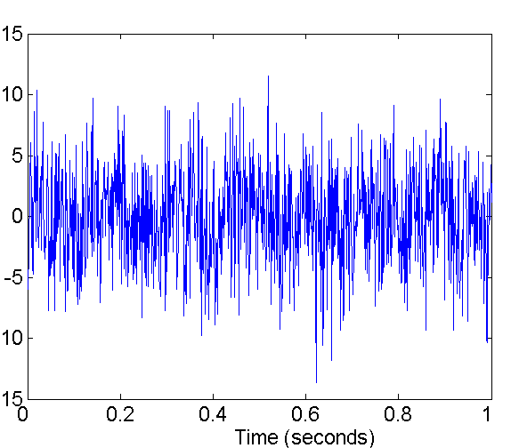
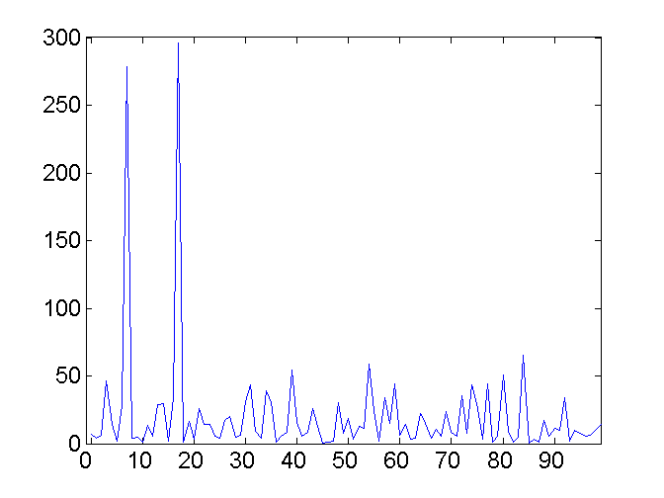
Mapping Data to a New Space
Fourier transform
Wavelet transform
Two Sine Waves
Two Sine Waves + Noise
Frequency
18
Notes:
18

Slide 19
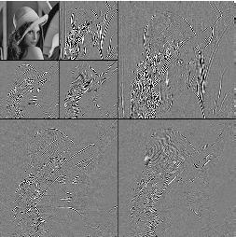
What Is Wavelet Transform?
Decomposes a signal into different frequency subbands
  Applicable to n-dimensional signals
Data are transformed to preserve relative distance between objects at different levels of resolution
Allow natural clusters to become more distinguishable
Used for image compression
19
Notes:
19

Slide 20
Principal Component Analysis (PCA)
Find a projection that captures the largest amount of variation in data
The original data are projected onto a much smaller space, resulting in dimensionality reduction. We find the eigenvectors of the covariance matrix, and these eigenvectors define the new space
x₂
e
x₁
20
Notes:
20

Slide 21
Principal Component Analysis (Steps)
Given N data vectors from n-dimensions, find k ≤ n orthogonal vectors (principal components) that can be best used to represent data
  Normalize input data: Each attribute falls within the same range
  Compute k orthonormal (unit) vectors, i.e., principal components
  Each input data (vector) is a linear combination of the k principal component vectors
  The principal components are sorted in order of decreasing “significance” or strength
  Since the components are sorted, the size of the data can be reduced by eliminating the weak components, i.e., those with low variance (i.e., using the strongest principal components, it is possible to reconstruct a good approximation of the original data)
Works for numeric data only
21
Notes:
21

Slide 22
Attribute Subset Selection
Another way to reduce dimensionality of data
Redundant attributes
  Duplicate much or all of the information contained in one or more other attributes
  E.g., purchase price of a product and the amount of sales tax paid
Irrelevant attributes
  Contain no information that is useful for the data mining task at hand
  E.g., students' ID is often irrelevant to the task of predicting students' GPA
22
Notes:
22

Slide 23
Heuristic Search in Attribute Selection
There are 2^{d} possible attribute combinations of d attributes
Typical heuristic attribute selection methods:
  Best single attribute under the attribute independence assumption: choose by significance tests
  Best step-wise feature selection:
    The best single-attribute is picked first
    Then next best attribute condition to the first, ...
  Step-wise attribute elimination:
    Repeatedly eliminate the worst attribute
  Best combined attribute selection and elimination
  Optimal branch and bound:
    Use attribute elimination and backtracking
23
Notes:
23

Slide 24
Attribute Creation (Feature Generation)
Create new attributes (features) that can capture the important information in a data set more effectively than the original ones
Three general methodologies
  Attribute extraction
    Domain-specific
  Mapping data to new space (see: data reduction)
    E.g., Fourier transformation, wavelet transformation, manifold approaches (not covered)
  Attribute construction
    Combining features (see: discriminative frequent patterns in Chapter on “Advanced Classification”)
    Data discretization
24
Notes:
24

Slide 25
Similarity and Dissimilarity
Similarity
  Numerical measure of how alike two data objects are.
  Is higher when objects are more alike.
  Often falls in the range [0,1]
Dissimilarity
  Numerical measure of how different are two data objects
  Lower when objects are more alike
  Minimum dissimilarity is often 0
  Upper limit varies
Proximity refers to a similarity or dissimilarity

Slide 26
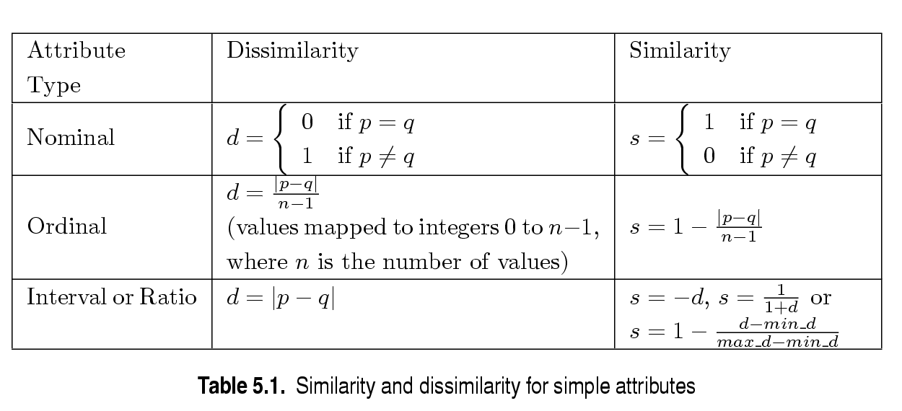
Similarity/Dissimilarity for Simple Attributes
p and q are the attribute values for two data objects.

Slide 27
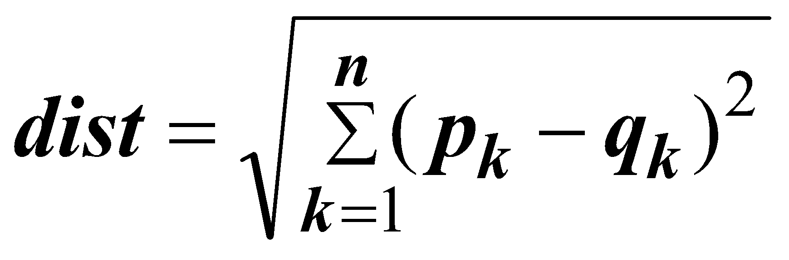
Euclidean Distance
Euclidean Distance
  Where n is the number of dimensions (attributes) and p_{k} and q_{k} are, respectively, the k^{th} attributes (components) or data objects p and q.
Standardization is necessary, if scales differ.

Slide 28
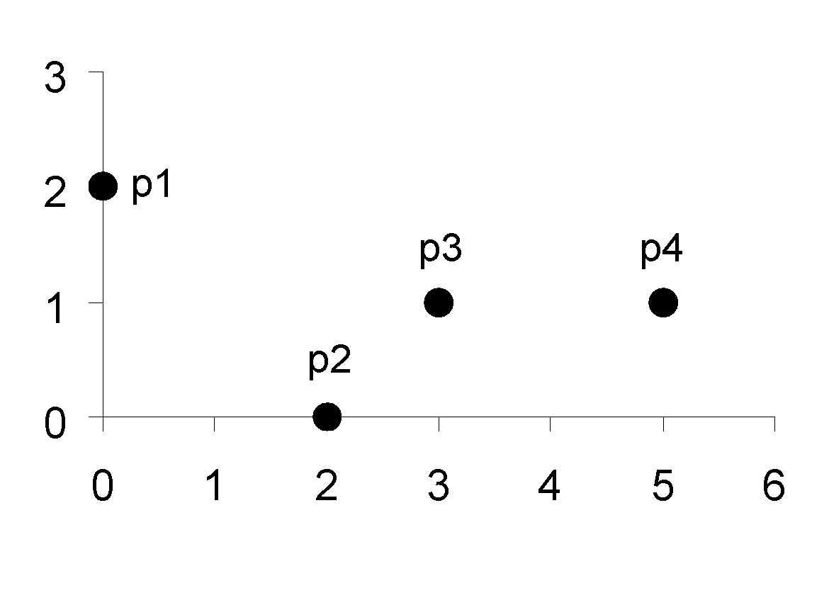
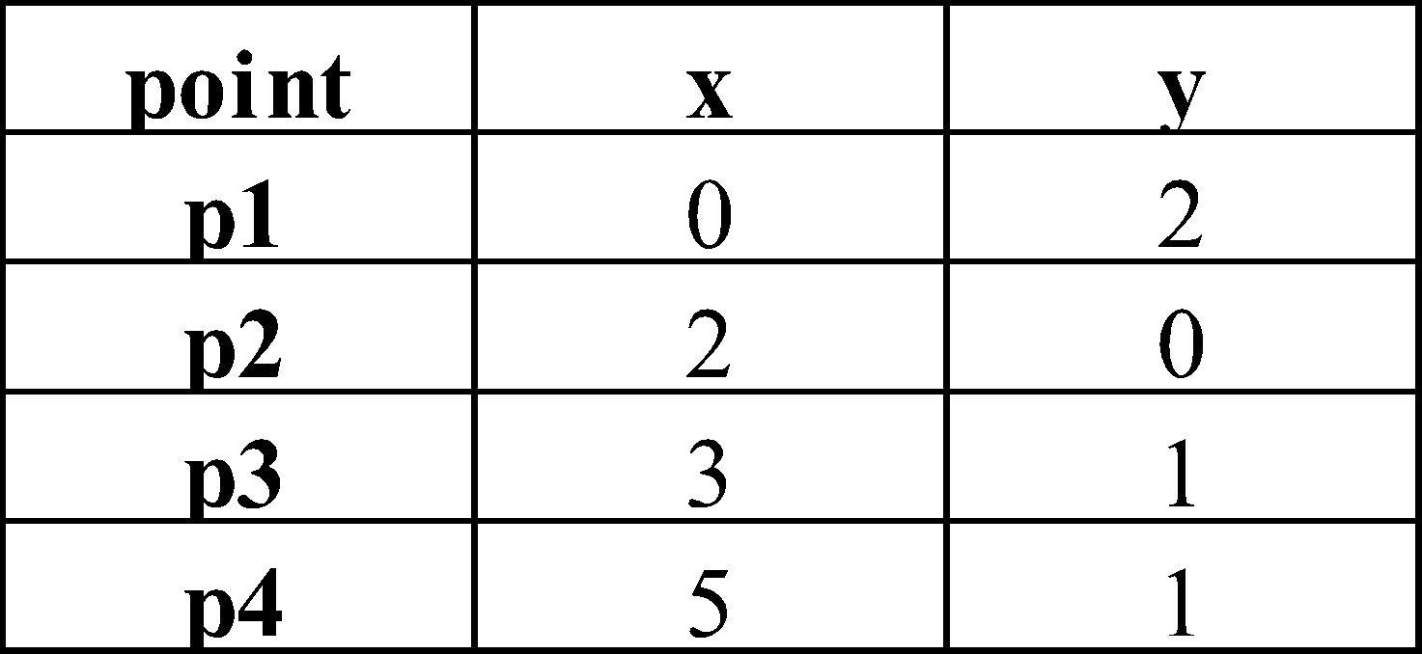
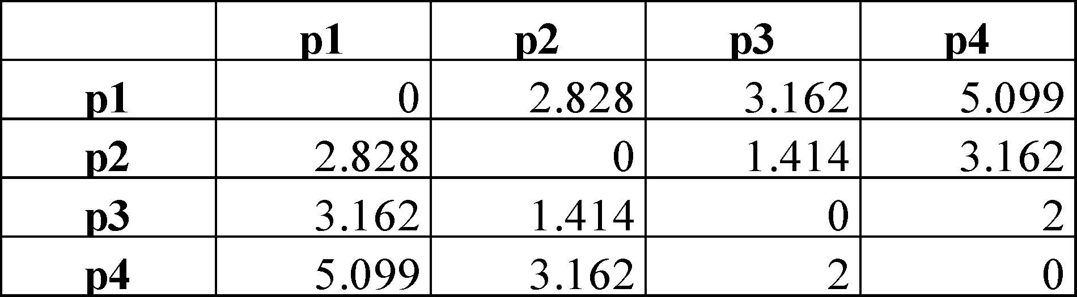
Euclidean Distance
Distance Matrix

Slide 29
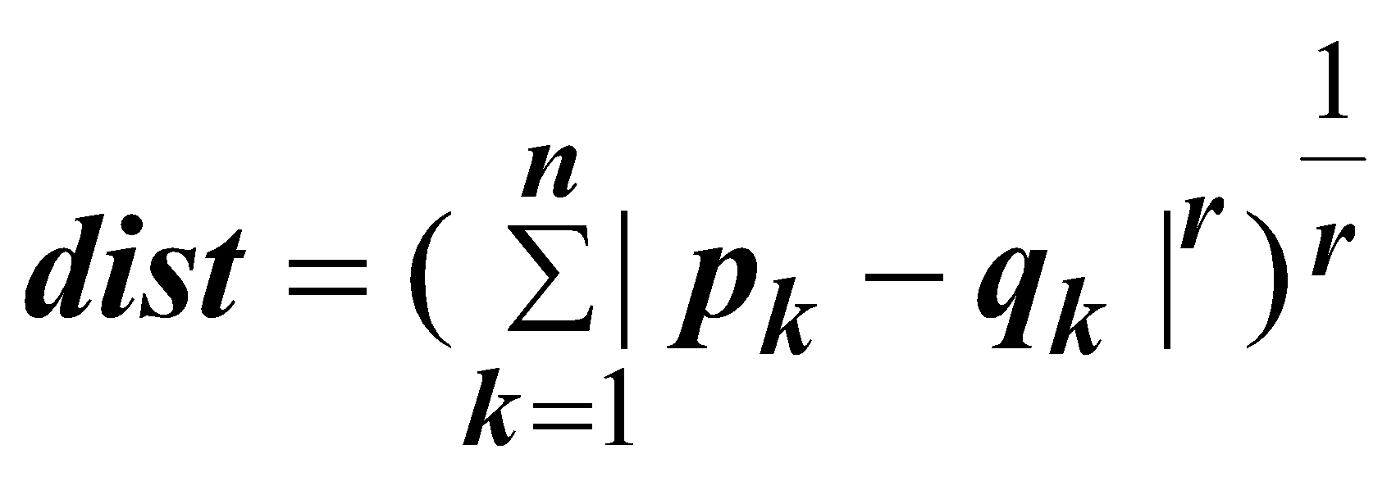
Minkowski Distance
Minkowski Distance is a generalization of Euclidean Distance
  Where r is a parameter, n is the number of dimensions (attributes) and p_{k} and q_{k} are, respectively, the kth attributes (components) or data objects p and q.

Slide 30
Minkowski Distance: Examples
r = 1. City block (Manhattan, taxicab, L₁ norm) distance.
  A common example of this is the Hamming distance, which is just the number of bits that are different between two binary vectors
r = 2. Euclidean distance
r → ∞. “supremum” (L_{max} norm, L∞ norm) distance.
  This is the maximum difference between any component of the vectors
Do not confuse r with n, i.e., all these distances are defined for all numbers of dimensions.

Slide 31
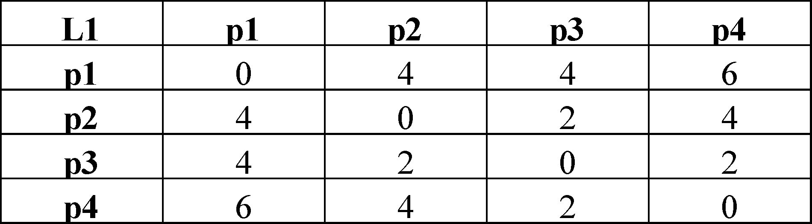
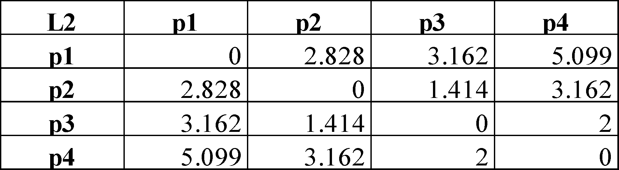
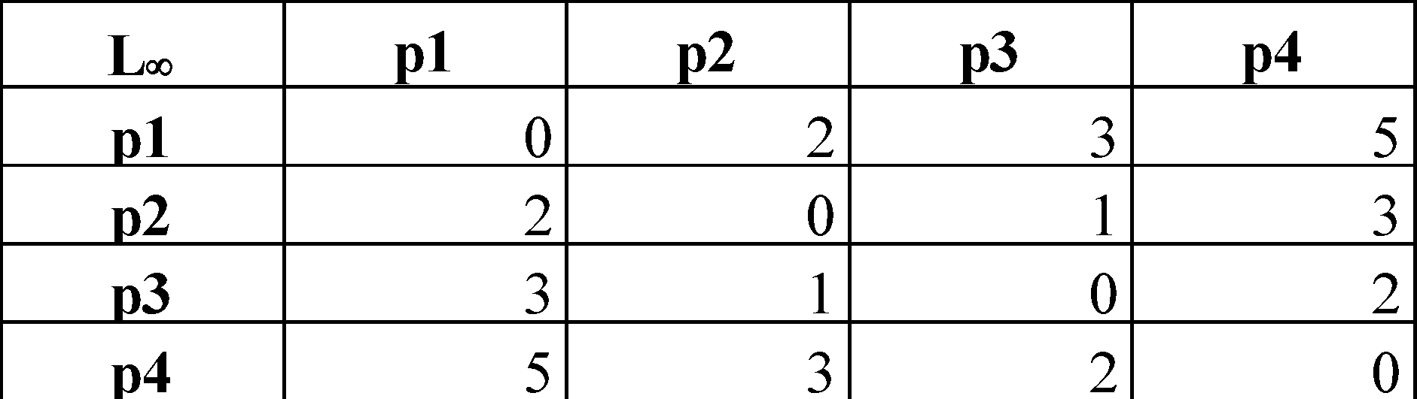
Minkowski Distance
Distance Matrix

Slide 32
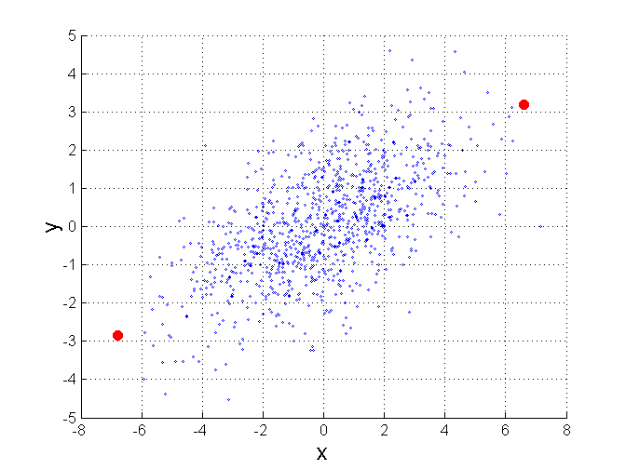
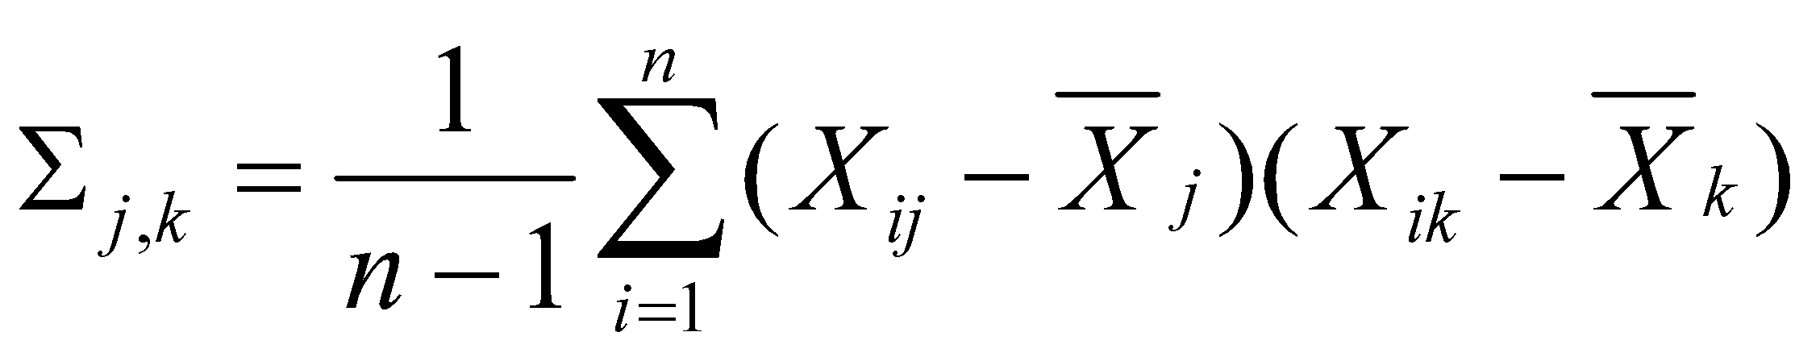
Mahalanobis Distance
Σ is the covariance matrix of the input data X
For red points, the Euclidean distance is 14.7, Mahalanobis distance is 6.

Slide 33
Common Properties of a Distance
Distances, such as the Euclidean distance, have some well known properties.
  d(p, q) ≥ 0 for all p and q and d(p, q) = 0 only if
  p = q. (Positive definiteness)
  d(p, q) = d(q, p) for all p and q. (Symmetry)
  d(p, r) ≤ d(p, q) + d(q, r) for all points p, q, and r.
  (Triangle Inequality)
where d(p, q) is the distance (dissimilarity) between points (data objects), p and q.
A distance that satisfies these properties is a metric

Slide 34
Common Properties of a Similarity
Similarities, also have some well known properties.
  s(p, q) = 1 (or maximum similarity) only if p = q.
  s(p, q) = s(q, p) for all p and q. (Symmetry)
where s(p, q) is the similarity between points (data objects), p and q.

Slide 35
Similarity Between Binary Vectors
Common situation is that objects, p and q, have only binary attributes
Compute similarities using the following quantities
M₀₁ = the number of attributes where p was 0 and q was 1
M₁₀ = the number of attributes where p was 1 and q was 0
M₀₀ = the number of attributes where p was 0 and q was 0
M₁₁ = the number of attributes where p was 1 and q was 1
Simple Matching and Jaccard Coefficients
SMC = number of matches / number of attributes
= (M₁₁ + M₀₀) / (M₀₁ + M₁₀ + M₁₁ + M₀₀)
J = number of 11 matches / number of not-both-zero attributes values
= (M₁₁) / (M₀₁ + M₁₀ + M₁₁)

Slide 36
SMC versus Jaccard: Example
p = 1 0 0 0 0 0 0 0 0 0
q = 0 0 0 0 0 0 1 0 0 1
M₀₁ = 2 (the number of attributes where p was 0 and q was 1)
M₁₀ = 1 (the number of attributes where p was 1 and q was 0)
M₀₀ = 7 (the number of attributes where p was 0 and q was 0)
M₁₁ = 0 (the number of attributes where p was 1 and q was 1)
SMC = (M₁₁ + M₀₀)/(M₀₁ + M₁₀ + M₁₁ + M₀₀) = (0+7) / (2+1+0+7) = 0.7
J = (M₁₁) / (M₀₁ + M₁₀ + M₁₁) = 0 / (2 + 1 + 0) = 0

Slide 37
Cosine Similarity
If d₁ and d₂ are two document vectors, then
cos( d₁, d₂ ) = (d₁ ∙ d₂) / ||d₁|| ||d₂|| ,
where ∙ indicates vector dot product and || d || is the length of vector d.
Example:
d₁ = 3 2 0 5 0 0 0 2 0 0
d₂ = 1 0 0 0 0 0 0 1 0 2
d₁ ∙ d₂= 3*1 + 2*0 + 0*0 + 5*0 + 0*0 + 0*0 + 0*0 + 2*1 + 0*0 + 0*2 = 5
||d₁|| = (3*3+2*2+0*0+5*5+0*0+0*0+0*0+2*2+0*0+0*0)^{0.5} = (42) ^{0.5} = 6.481
||d₂|| = (1*1+0*0+0*0+0*0+0*0+0*0+0*0+1*1+0*0+2*2) ^{0.5} = (6) ^{0.5} = 2.245
cos( d₁, d₂ ) = .3150

Slide 38
Data Reduction 2: Numerosity Reduction
Reduce data volume by choosing alternative, smaller forms of data representation
Parametric methods (e.g., regression)
  Assume the data fits some model, estimate model parameters, store only the parameters, and discard the data (except possible outliers)
  Ex.: Log-linear models—obtain value at a point in m-D space as the product on appropriate marginal subspaces
Non-parametric methods
  Do not assume models
  Major families: histograms, clustering, sampling, …
38
Notes:
38

Slide 39
Parametric Data Reduction: Regression and Log-Linear Models
Linear regression
  Data modeled to fit a straight line
  Often uses the least-square method to fit the line
Multiple regression
  Allows a response variable Y to be modeled as a linear function of multidimensional feature vector
Log-linear model
  Approximates discrete multidimensional probability distributions
39
Notes:
39

Slide 40
Regression Analysis
y
Y1
Regression analysis: A collective name for techniques for the modeling and analysis of numerical data consisting of values of a dependent variable (also called response variable or measurement) and of one or more independent variables (aka. explanatory variables or predictors)
The parameters are estimated so as to give a "best fit" of the data
Most commonly the best fit is evaluated by using the least squares method, but other criteria have also been used
Y1’
y = x + 1
X1
x
Used for prediction (including forecasting of time-series data), inference, hypothesis testing, and modeling of causal relationships
40
Notes:
40

Slide 41
Regress Analysis and Log-Linear Models
Linear regression: Y = w X + b
  Two regression coefficients, w and b, specify the line and are to be estimated by using the data at hand
  Using the least squares criterion to the known values of Y₁, Y₂, …, X₁, X₂, ….
Multiple regression: Y = b₀ + b₁ X₁ + b₂ X₂
  Many nonlinear functions can be transformed into the above
Log-linear models:
  Approximate discrete multidimensional probability distributions
  Estimate the probability of each point (tuple) in a multi-dimensional space for a set of discretized attributes, based on a smaller subset of dimensional combinations
  Useful for dimensionality reduction and data smoothing
41
Notes:
41

Slide 42
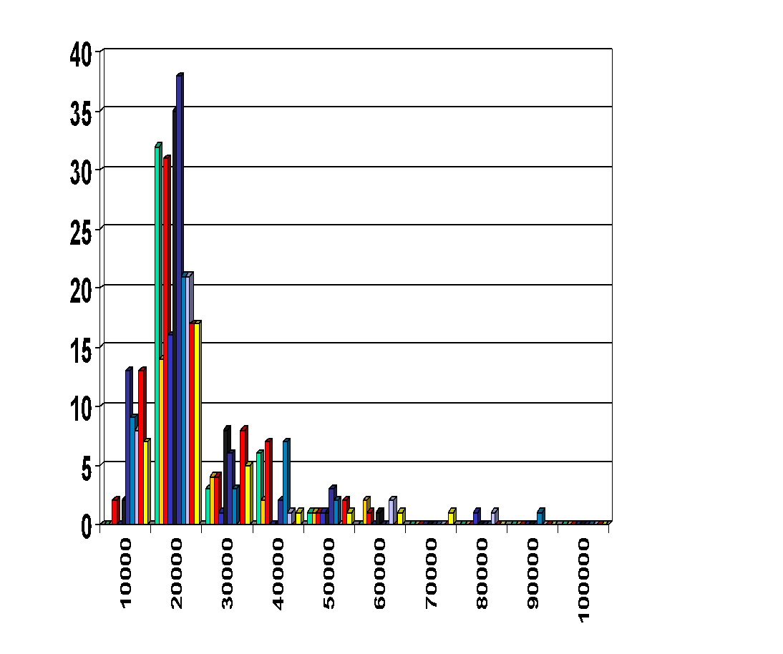
Histogram Analysis
Divide data into buckets and store average (sum) for each bucket
Partitioning rules:
  Equal-width: equal bucket range
  Equal-frequency (or equal-depth)
42
Notes:
42
Removed 09/09/10: V-optimal: with the least histogram variance (weighted sum of the original values that each bucket represents)

Slide 43
Clustering
Partition data set into clusters based on similarity, and store cluster representation (e.g., centroid and diameter) only
Can be very effective if data is clustered but not if data is “smeared”
Can have hierarchical clustering and be stored in multi-dimensional index tree structures
There are many choices of clustering definitions and clustering algorithms
Cluster analysis will be studied in depth in Chapter 10
43
Notes:
43

Slide 44
Sampling
Sampling: obtaining a small sample s to represent the whole data set N
Allow a mining algorithm to run in complexity that is potentially sub-linear to the size of the data
Key principle: Choose a representative subset of the data
  Simple random sampling may have very poor performance in the presence of skew
  Develop adaptive sampling methods, e.g., stratified sampling:
Note: Sampling may not reduce database I/Os (page at a time)
44
Notes:
44

Slide 45
Types of Sampling
Simple random sampling
  There is an equal probability of selecting any particular item
Sampling without replacement
  Once an object is selected, it is removed from the population
Sampling with replacement
  A selected object is not removed from the population
Stratified sampling:
  Partition the data set, and draw samples from each partition (proportionally, i.e., approximately the same percentage of the data)
  Used in conjunction with skewed data
45
Notes:
45

Slide 46
Sampling: With or without Replacement
SRSWOR
(simple random
sample without
replacement)
SRSWR
Raw Data
46
Notes:
46

Slide 47
Sampling: Cluster or Stratified Sampling
Raw Data
Cluster/Stratified Sample
47
Notes:
47

Slide 48
Data Cube Aggregation
The lowest level of a data cube (base cuboid)
  The aggregated data for an individual entity of interest
  E.g., a customer in a phone calling data warehouse
Multiple levels of aggregation in data cubes
  Further reduce the size of data to deal with
Reference appropriate levels
  Use the smallest representation which is enough to solve the task
Queries regarding aggregated information should be answered using data cube, when possible
48
Notes:
48

Slide 49
Data Reduction 3: Data Compression
String compression
  There are extensive theories and well-tuned algorithms
  Typically lossless, but only limited manipulation is possible without expansion
Audio/video compression
  Typically lossy compression, with progressive refinement
  Sometimes small fragments of signal can be reconstructed without reconstructing the whole
Time sequence is not audio
  Typically short and vary slowly with time
Dimensionality and numerosity reduction may also be considered as forms of data compression
49
Notes:
49
PCA and Wavelet are forms of data compression also.

Slide 50
Data Compression
Original Data
Compressed
Data
lossless
Original Data
Approximated
lossy
50
Notes:
50

Slide 51
Chapter 3: Data Preprocessing
Data Preprocessing: An Overview
  Data Quality
  Major Tasks in Data Preprocessing
Data Cleaning
Data Integration
Data Reduction
Data Transformation and Data Discretization
Summary
51
Notes:
51

Slide 52
Data Transformation
A function that maps the entire set of values of a given attribute to a new set of replacement values s.t. each old value can be identified with one of the new values
Methods
  Smoothing: Remove noise from data
  Attribute/feature construction
    New attributes constructed from the given ones
  Aggregation: Summarization, data cube construction
  Normalization: Scaled to fall within a smaller, specified range
    min-max normalization
    z-score normalization
    normalization by decimal scaling
  Discretization: Concept hierarchy climbing
52
Notes:
52

Slide 53
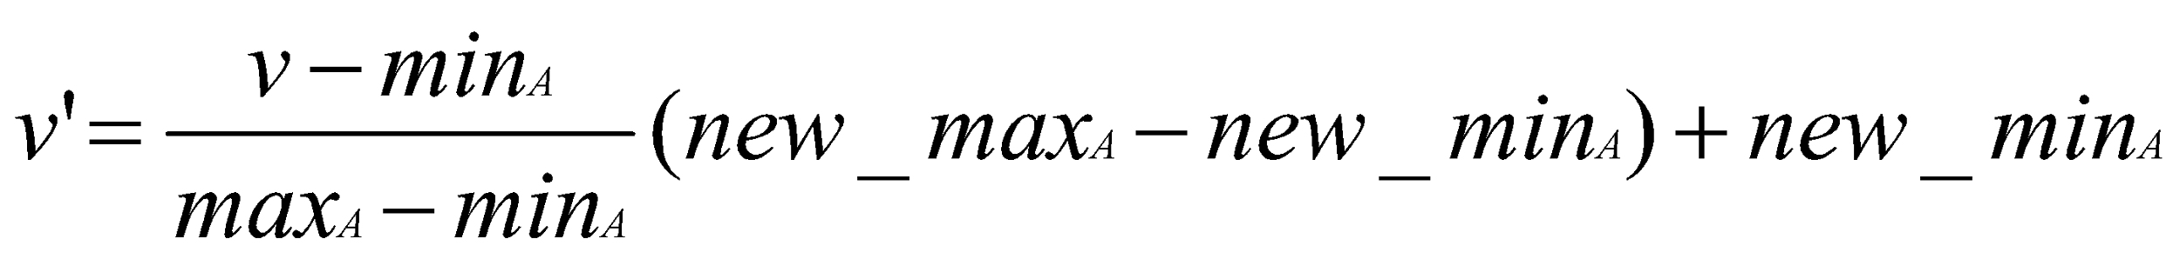
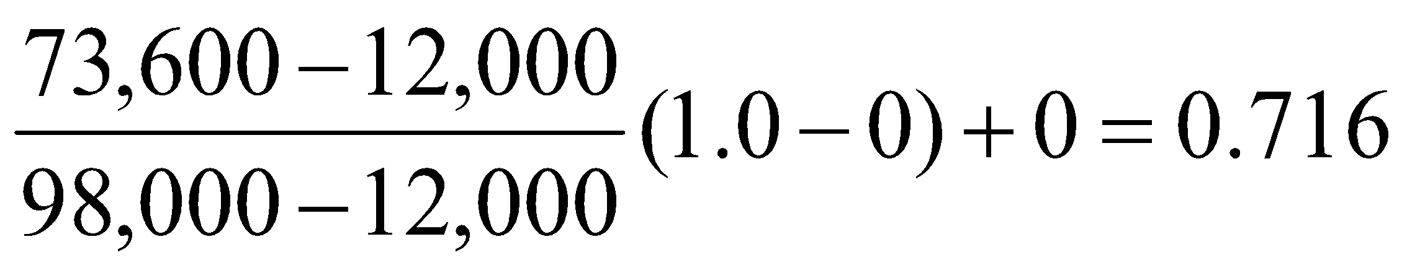

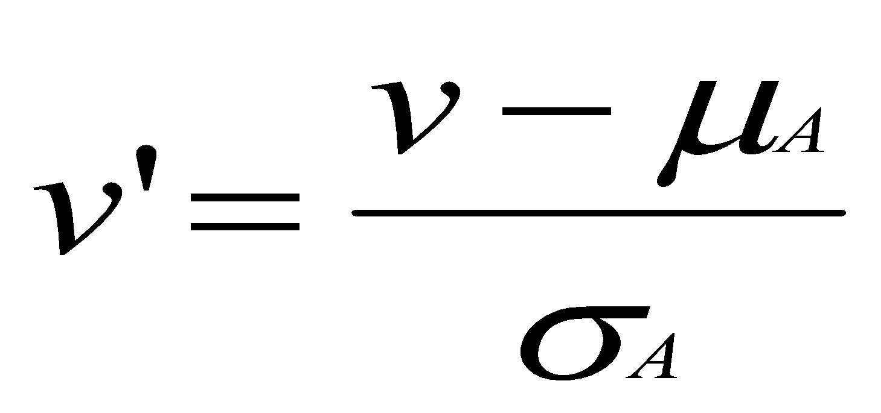
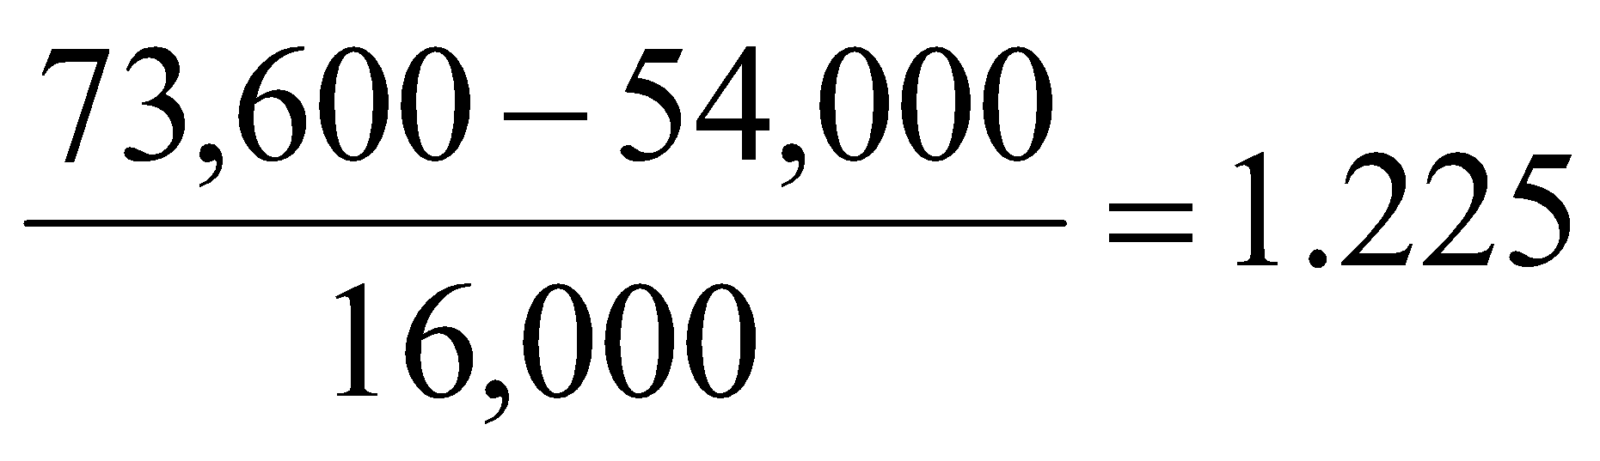
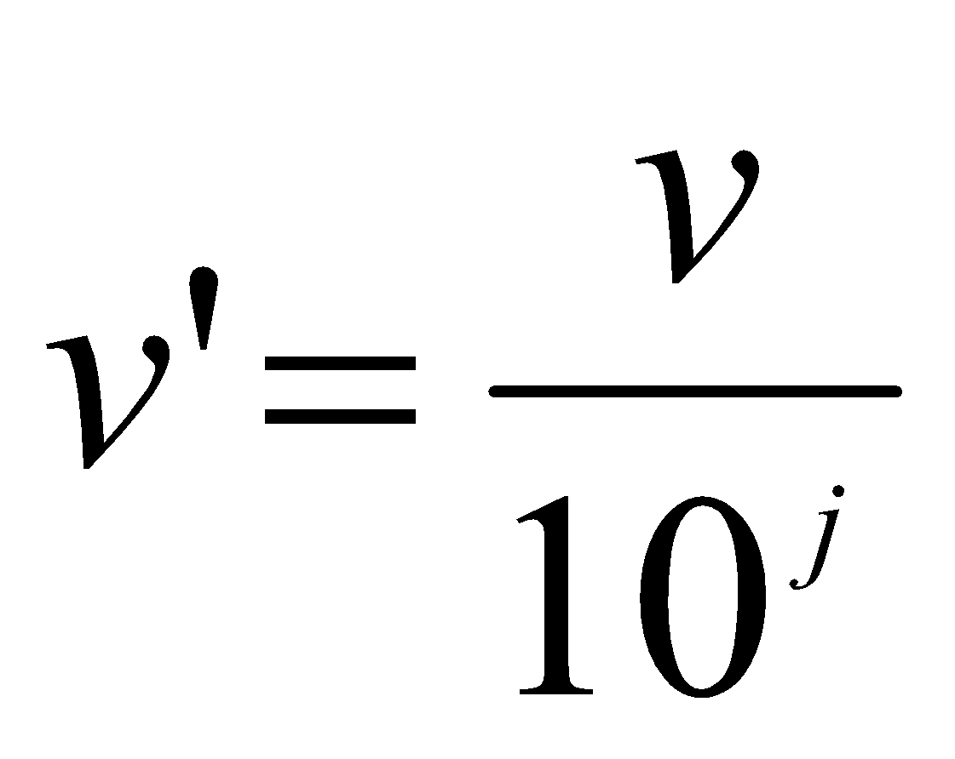
Normalization
Min-max normalization: to [new_min_{A}, new_max_{A}]
  Ex. Let income range $12,000 to $98,000 normalized to [0.0, 1.0]. Then $73,000 is mapped to
Z-score normalization (μ: mean, σ: standard deviation):
  Ex. Let μ = 54,000, σ = 16,000. Then
Normalization by decimal scaling
Where j is the smallest integer such that Max(|ν’|) < 1
53
Notes:
53

Slide 54
Discretization
Three types of attributes
  Nominal—values from an unordered set, e.g., color, profession
  Ordinal—values from an ordered set, e.g., military or academic rank
  Numeric—real numbers, e.g., integer or real numbers
Discretization: Divide the range of a continuous attribute into intervals
  Interval labels can then be used to replace actual data values
  Reduce data size by discretization
  Supervised vs. unsupervised
  Split (top-down) vs. merge (bottom-up)
  Discretization can be performed recursively on an attribute
  Prepare for further analysis, e.g., classification
54
Notes:
54
08.09.12 MK: Slide moved here from Ch. 3. Added examples.

Slide 55
Data Discretization Methods
Typical methods: All the methods can be applied recursively
  Binning
    Top-down split, unsupervised
  Histogram analysis
    Top-down split, unsupervised
  Clustering analysis (unsupervised, top-down split or bottom-up merge)
  Decision-tree analysis (supervised, top-down split)
  Correlation (e.g., χ²) analysis (unsupervised, bottom-up merge)
55
Notes:
55

Slide 56
Simple Discretization: Binning
Equal-width (distance) partitioning
  Divides the range into N intervals of equal size: uniform grid
  if A and B are the lowest and highest values of the attribute, the width of intervals will be: W = (B –A)/N.
  The most straightforward, but outliers may dominate presentation
  Skewed data is not handled well
Equal-depth (frequency) partitioning
  Divides the range into N intervals, each containing approximately same number of samples
  Good data scaling
  Managing categorical attributes can be tricky
56
Notes:
56

Slide 57
Binning Methods for Data Smoothing
Sorted data for price (in dollars): 4, 8, 9, 15, 21, 21, 24, 25, 26, 28, 29, 34
* Partition into equal-frequency (equi-depth) bins:
- Bin 1: 4, 8, 9, 15
- Bin 2: 21, 21, 24, 25
- Bin 3: 26, 28, 29, 34
* Smoothing by bin means:
- Bin 1: 9, 9, 9, 9
- Bin 2: 23, 23, 23, 23
- Bin 3: 29, 29, 29, 29
* Smoothing by bin boundaries:
- Bin 1: 4, 4, 4, 15
- Bin 2: 21, 21, 25, 25
- Bin 3: 26, 26, 26, 34
57
Notes:
57

Slide 58
Discretization by Classification & Correlation Analysis
Classification (e.g., decision tree analysis)
  Supervised: Given class labels, e.g., cancerous vs. benign
  Using entropy to determine split point (discretization point)
  Top-down, recursive split
  Details to be covered in Chapter “Classification”
Correlation analysis (e.g., Chi-merge: χ²-based discretization)
  Supervised: use class information
  Bottom-up merge: find the best neighboring intervals (those having similar distributions of classes, i.e., low χ² values) to merge
  Merge performed recursively, until a predefined stopping condition
58
Notes:
58

Slide 59
Concept Hierarchy Generation
Concept hierarchy organizes concepts (i.e., attribute values) hierarchically and is usually associated with each dimension in a data warehouse
Concept hierarchies facilitate drilling and rolling in data warehouses to view data in multiple granularity
Concept hierarchy formation: Recursively reduce the data by collecting and replacing low level concepts (such as numeric values for age) by higher level concepts (such as youth, adult, or senior)
Concept hierarchies can be explicitly specified by domain experts and/or data warehouse designers
Concept hierarchy can be automatically formed for both numeric and nominal data—For numeric data, use discretization methods shown
59
Notes:
59

