Slide 1
Data Mining: Data
Lecture Notes for Chapter 2
Introduction to Data Mining
by
Tan, Steinbach, Kumar

Slide 2
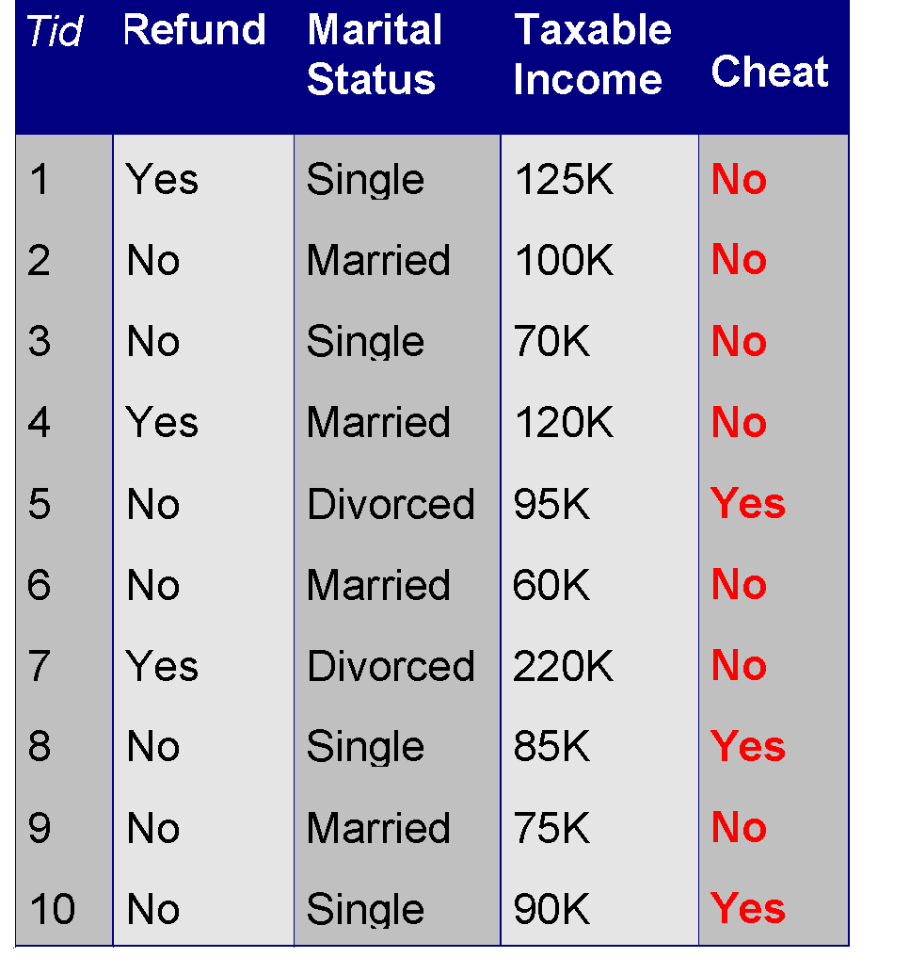
What is Data?
Collection of data objects and their attributes
An attribute is a property or characteristic of an object
Examples: eye color of a person, temperature, etc.
Attribute is also known as variable, field, characteristic, or feature
A collection of attributes describe an object
Object is also known as record, point, case, sample, entity, or instance
Attributes
Objects

Slide 3
Attribute Values
Attribute values are numbers or symbols assigned to an attribute
Distinction between attributes and attribute values
Same attribute can be mapped to different attribute values
Example: height can be measured in feet or meters
Different attributes can be mapped to the same set of values
Example: Attribute values for ID and age are integers
But properties of attribute values can be different
ID has no limit but age has a maximum and minimum value

Slide 4
Types of Attributes
There are different types of attributes
Nominal
Examples: ID numbers, eye color, zip codes
Ordinal
Examples: rankings (e.g., taste of potato chips on a scale from 1-10), grades, height in {tall, medium, short}
Interval
Examples: calendar dates, temperatures in Celsius or Fahrenheit.
Ratio
Examples: temperature in Kelvin, length, time, counts

Slide 5
Properties of Attribute Values
The type of an attribute depends on which of the following properties it possesses:
Distinctness: = ≠
Order: < >
Addition: + -
Multiplication: * /
Nominal attribute: distinctness
Ordinal attribute: distinctness & order
Interval attribute: distinctness, order & addition
Ratio attribute: all 4 properties

Slide 6
Attribute Type
Description
Examples
Operations
Nominal
The values of a nominal attribute are just different names, i.e., nominal attributes provide only enough information to distinguish one object from another. (=, ≠)
zip codes, employee ID numbers, eye color, sex: {male, female}
mode, entropy, contingency correlation, χ² test
Ordinal
The values of an ordinal attribute provide enough information to order objects. (<, >)
hardness of minerals, {good, better, best}, grades, street numbers
median, percentiles, rank correlation, run tests, sign tests
Interval
For interval attributes, the differences between values are meaningful, i.e., a unit of measurement exists. (+, - )
calendar dates, temperature in Celsius or Fahrenheit
mean, standard deviation, Pearson's correlation, t and F tests
Ratio
For ratio variables, both differences and ratios are meaningful. (*, /)
temperature in Kelvin, monetary quantities, counts, age, mass, length, electrical current
geometric mean, harmonic mean, percent variation

Slide 7
Attribute Level
Transformation
Comments
Nominal
Any permutation of values
If all employee ID numbers were reassigned, would it make any difference?
Ordinal
An order preserving change of values, i.e., new_value = f(old_value) where f is a monotonic function.
An attribute encompassing the notion of good, better best can be represented equally well by the values {1, 2, 3} or by { 0.5, 1, 10}.
Interval
new_value =a * old_value + b where a and b are constants
Thus, the Fahrenheit and Celsius temperature scales differ in terms of where their zero value is and the size of a unit (degree).
Ratio
new_value = a * old_value
Length can be measured in meters or feet.

Slide 8
Discrete and Continuous Attributes
Discrete Attribute
Has only a finite or countably infinite set of values
Examples: zip codes, counts, or the set of words in a collection of documents
Often represented as integer variables.
Note: binary attributes are a special case of discrete attributes
Continuous Attribute
Has real numbers as attribute values
Examples: temperature, height, or weight.
Practically, real values can only be measured and represented using a finite number of digits.
Continuous attributes are typically represented as floating-point variables.

Slide 9
Types of data sets
Record
Data Matrix
Document Data
Transaction Data
Graph
World Wide Web
Molecular Structures
Ordered
Spatial Data
Temporal Data
Sequential Data
Genetic Sequence Data

Slide 10
Important Characteristics of Structured Data
Dimensionality
Curse of Dimensionality
Sparsity
Only presence counts
Resolution
Patterns depend on the scale

Slide 11
Record Data
Data that consists of a collection of records, each of which consists of a fixed set of attributes

Slide 12
Data Matrix
If data objects have the same fixed set of numeric attributes, then the data objects can be thought of as points in a multi-dimensional space, where each dimension represents a distinct attribute
Such data set can be represented by an m by n matrix, where there are m rows, one for each object, and n columns, one for each attribute

Slide 13
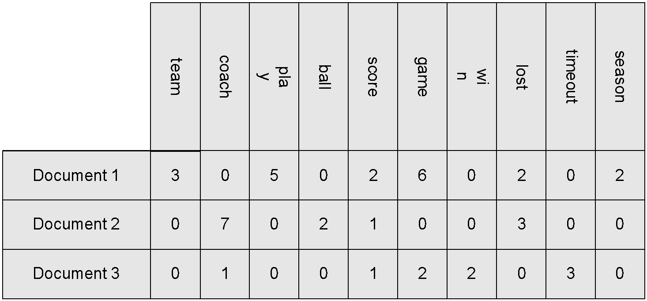
Document Data
Each document becomes a `term' vector,
each term is a component (attribute) of the vector,
the value of each component is the number of times the corresponding term occurs in the document.

Slide 14
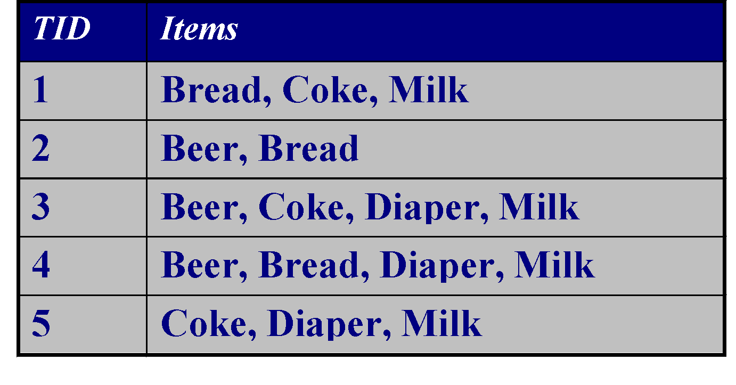
Transaction Data
A special type of record data, where
each record (transaction) involves a set of items.
For example, consider a grocery store. The set of products purchased by a customer during one shopping trip constitute a transaction, while the individual products that were purchased are the items.

Slide 15
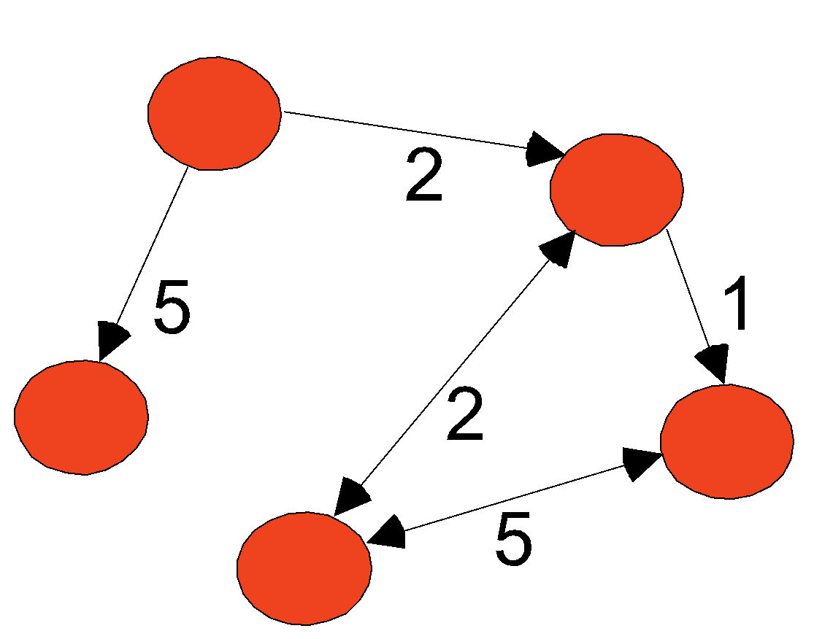
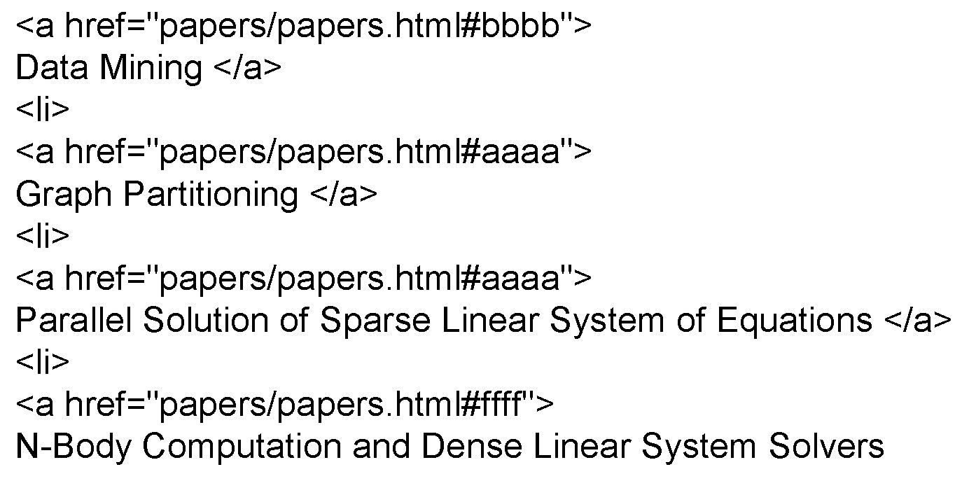
Graph Data
Examples: Generic graph and HTML Links

Slide 16
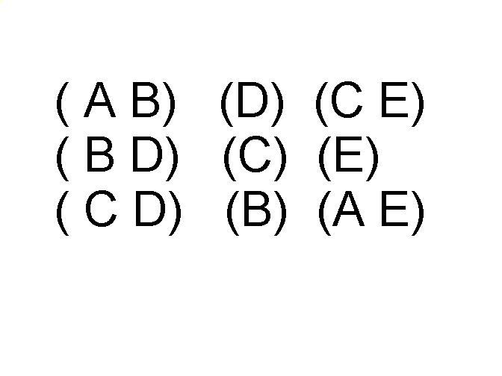
Ordered Data
Sequences of transactions
Items/Events
An element of the sequence

Slide 17
Data Quality
What kinds of data quality problems?
How can we detect problems with the data?
What can we do about these problems?
Examples of data quality problems:
Noise and outliers
missing values
duplicate data

Slide 18
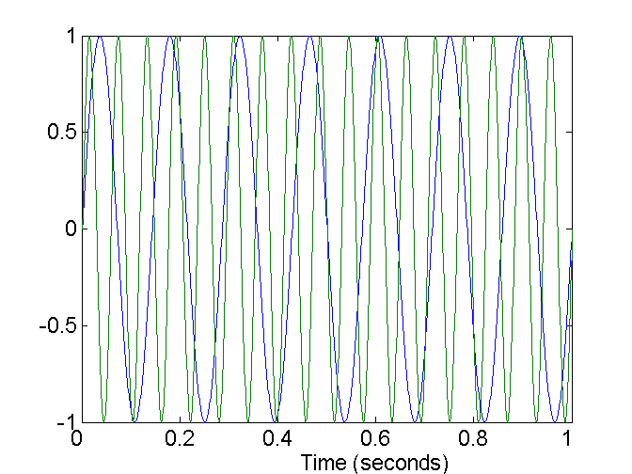
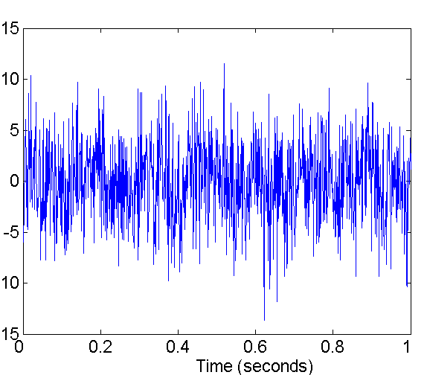
Noise
Noise refers to modification of original values
Examples: distortion of a person’s voice when talking on a poor phone and “snow” on television screen
Two Sine Waves
Two Sine Waves + Noise

Slide 19
Outliers
Outliers are data objects with characteristics that are considerably different than most of the other data objects in the data set

Slide 20
Missing Values
Reasons for missing values
Information is not collected (e.g., people decline to give their age and weight)
Attributes may not be applicable to all cases (e.g., annual income is not applicable to children)
Handling missing values
Eliminate Data Objects
Estimate Missing Values
Ignore the Missing Value During Analysis
Replace with all possible values (weighted by their probabilities)

Slide 21
Duplicate Data
Data set may include data objects that are duplicates, or almost duplicates of one another
Major issue when merging data from heterogeous sources
Examples:
Same person with multiple email addresses
Data cleaning
Process of dealing with duplicate data issues

