Slide 1
Data Mining:
Concepts and Techniques
(3rd ed.)
— Chapter 10 —
Jiawei Han, Micheline Kamber, and Jian Pei
University of Illinois at Urbana-Champaign &
Simon Fraser University
©2013 Han, Kamber & Pei. All rights reserved.
1
Notes:
1

Slide 2
Chapter 10. Cluster Analysis: Basic Concepts and Methods
Cluster Analysis: Basic Concepts
Partitioning Methods
Hierarchical Methods
Density-Based Methods
Grid-Based Methods
Evaluation of Clustering
Summary
2
2
Notes:
2

Slide 3
What is Cluster Analysis?
Cluster: A collection of data objects
  similar (or related) to one another within the same group
  dissimilar (or unrelated) to the objects in other groups
Cluster analysis (or clustering, data segmentation, …)
  Finding similarities between data according to the characteristics found in the data and grouping similar data objects into clusters
Unsupervised learning: no predefined classes (i.e., learning by observations vs. learning by examples: supervised)
Typical applications
  As a stand-alone tool to get insight into data distribution
  As a preprocessing step for other algorithms
3
Notes:
3

Slide 4
Applications of Cluster Analysis
Data reduction
  Summarization: Preprocessing for regression, PCA, classification, and association analysis
  Compression: Image processing: vector quantization
Hypothesis generation and testing
Prediction based on groups
  Cluster & find characteristics/patterns for each group
Finding K-nearest Neighbors
  Localizing search to one or a small number of clusters
Outlier detection: Outliers are often viewed as those “far away” from any cluster
4

Slide 5
Clustering: Application Examples
Biology: taxonomy of living things: kingdom, phylum, class, order, family, genus and species
Information retrieval: document clustering
Land use: Identification of areas of similar land use in an earth observation database
Marketing: Help marketers discover distinct groups in their customer bases, and then use this knowledge to develop targeted marketing programs
City-planning: Identifying groups of houses according to their house type, value, and geographical location
Earth-quake studies: Observed earth quake epicenters should be clustered along continent faults
Climate: understanding earth climate, find patterns of atmospheric and ocean
Economic Science: market research
5
Notes:
5

Slide 6
Basic Steps to Develop a Clustering Task
Feature selection
  Select info concerning the task of interest
  Minimal information redundancy
Proximity measure
  Similarity of two feature vectors
Clustering criterion
  Expressed via a cost function or some rules
Clustering algorithms
  Choice of algorithms
Validation of the results
  Validation test (also, clustering tendency test)
Interpretation of the results
  Integration with applications
6

Slide 7
Quality: What Is Good Clustering?
A good clustering method will produce high quality clusters
  high intra-class similarity: cohesive within clusters
  low inter-class similarity: distinctive between clusters
The quality of a clustering method depends on
  the similarity measure used by the method
  its implementation, and
  Its ability to discover some or all of the hidden patterns
7
Notes:
7

Slide 8
Measure the Quality of Clustering
Dissimilarity/Similarity metric
  Similarity is expressed in terms of a distance function, typically metric: d(i, j)
  The definitions of distance functions are usually rather different for interval-scaled, boolean, categorical, ordinal ratio, and vector variables
  Weights should be associated with different variables based on applications and data semantics
Quality of clustering:
  There is usually a separate “quality” function that measures the “goodness” of a cluster.
  It is hard to define “similar enough” or “good enough”
    The answer is typically highly subjective
8
Notes:
8

Slide 9
Considerations for Cluster Analysis
Partitioning criteria
  Single level vs. hierarchical partitioning (often, multi-level hierarchical partitioning is desirable)
Separation of clusters
  Exclusive (e.g., one customer belongs to only one region) vs. non-exclusive (e.g., one document may belong to more than one class)
Similarity measure
  Distance-based (e.g., Euclidian, road network, vector) vs. connectivity-based (e.g., density or contiguity)
Clustering space
  Full space (often when low dimensional) vs. subspaces (often in high-dimensional clustering)
9

Slide 10
Requirements and Challenges
Scalability
  Clustering all the data instead of only on samples
Ability to deal with different types of attributes
  Numerical, binary, categorical, ordinal, linked, and mixture of these
Constraint-based clustering
    User may give inputs on constraints
    Use domain knowledge to determine input parameters
Interpretability and usability
Others
  Discovery of clusters with arbitrary shape
  Ability to deal with noisy data
  Incremental clustering and insensitivity to input order
  High dimensionality
10

Slide 11
Major Clustering Approaches (I)
Partitioning approach:
  Construct various partitions and then evaluate them by some criterion, e.g., minimizing the sum of square errors
  Typical methods: k-means, k-medoids, CLARANS
Hierarchical approach:
  Create a hierarchical decomposition of the set of data (or objects) using some criterion
  Typical methods: Diana, Agnes, BIRCH, CAMELEON
Density-based approach:
  Based on connectivity and density functions
  Typical methods: DBSACN, OPTICS, DenClue
Grid-based approach:
  based on a multiple-level granularity structure
  Typical methods: STING, WaveCluster, CLIQUE
11
Notes:
11

Slide 12
Major Clustering Approaches (II)
Model-based:
  A model is hypothesized for each of the clusters and tries to find the best fit of that model to each other
  Typical methods: EM, SOM, COBWEB
Frequent pattern-based:
  Based on the analysis of frequent patterns
  Typical methods: p-Cluster
User-guided or constraint-based:
  Clustering by considering user-specified or application-specific constraints
  Typical methods: COD (obstacles), constrained clustering
Link-based clustering:
  Objects are often linked together in various ways
  Massive links can be used to cluster objects: SimRank, LinkClus
12
Notes:
12

Slide 13
Chapter 10. Cluster Analysis: Basic Concepts and Methods
Cluster Analysis: Basic Concepts
Partitioning Methods
Hierarchical Methods
Density-Based Methods
Grid-Based Methods
Evaluation of Clustering
Summary
13
13
Notes:
13

Slide 14
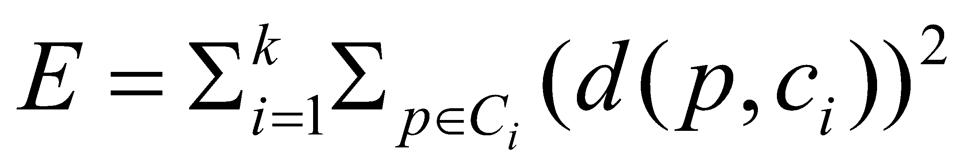
Partitioning Algorithms: Basic Concept
Partitioning method: Partitioning a database D of n objects into a set of k clusters, such that the sum of squared distances is minimized (where c_{i} is the centroid or medoid of cluster C_{i})
Given k, find a partition of k clusters that optimizes the chosen partitioning criterion
  Global optimal: exhaustively enumerate all partitions
  Heuristic methods: k-means and k-medoids algorithms
  k-means (MacQueen’67, Lloyd’57/’82): Each cluster is represented by the center of the cluster
  k-medoids or PAM (Partition around medoids) (Kaufman & Rousseeuw’87): Each cluster is represented by one of the objects in the cluster
14
Notes:
14

Slide 15
The K-Means Clustering Method
Given k, the k-means algorithm is implemented in four steps:
  Partition objects into k nonempty subsets
  Compute seed points as the centroids of the clusters of the current partitioning (the centroid is the center, i.e., mean point, of the cluster)
  Assign each object to the cluster with the nearest seed point
  Go back to Step 2, stop when the assignment does not change
15
Notes:
15

Slide 16
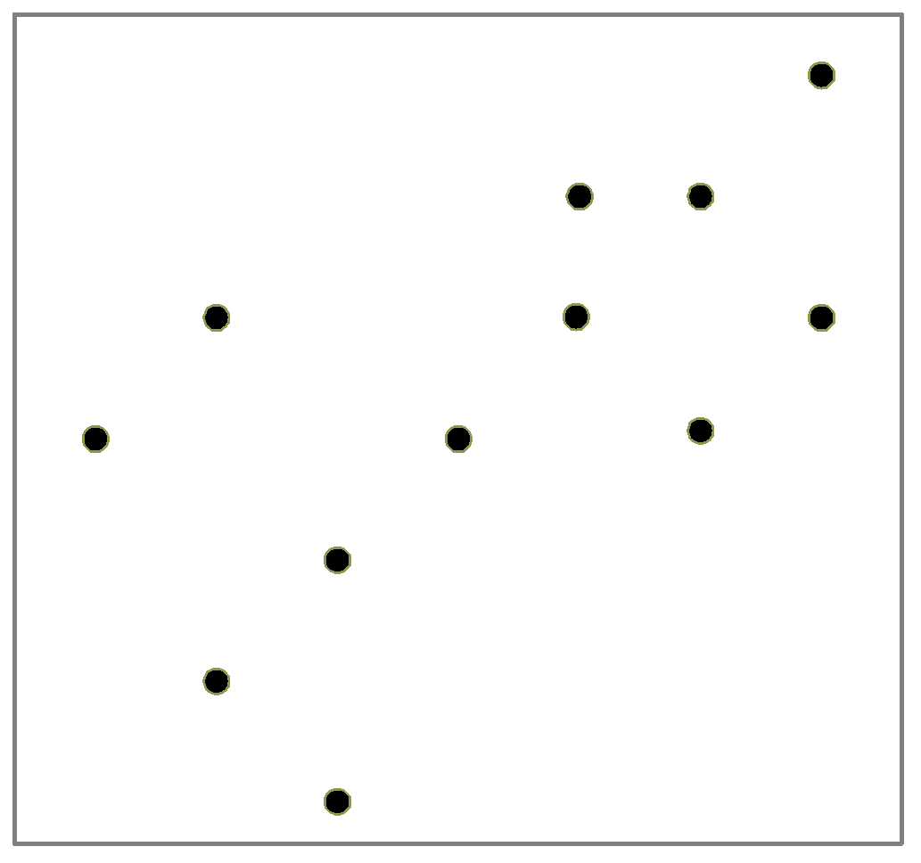
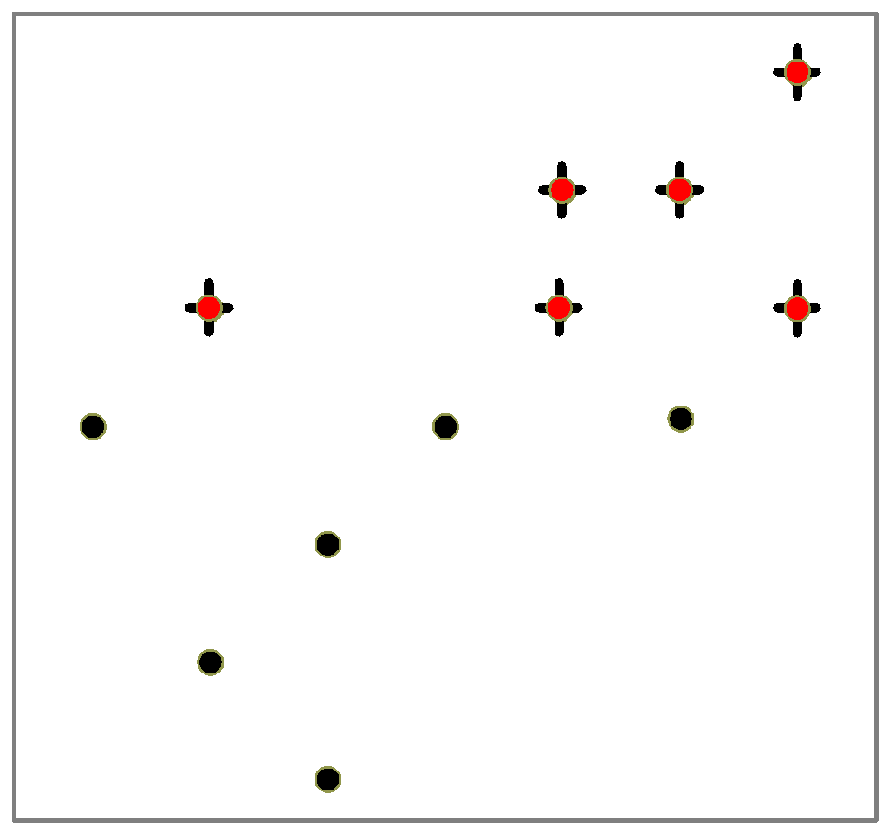
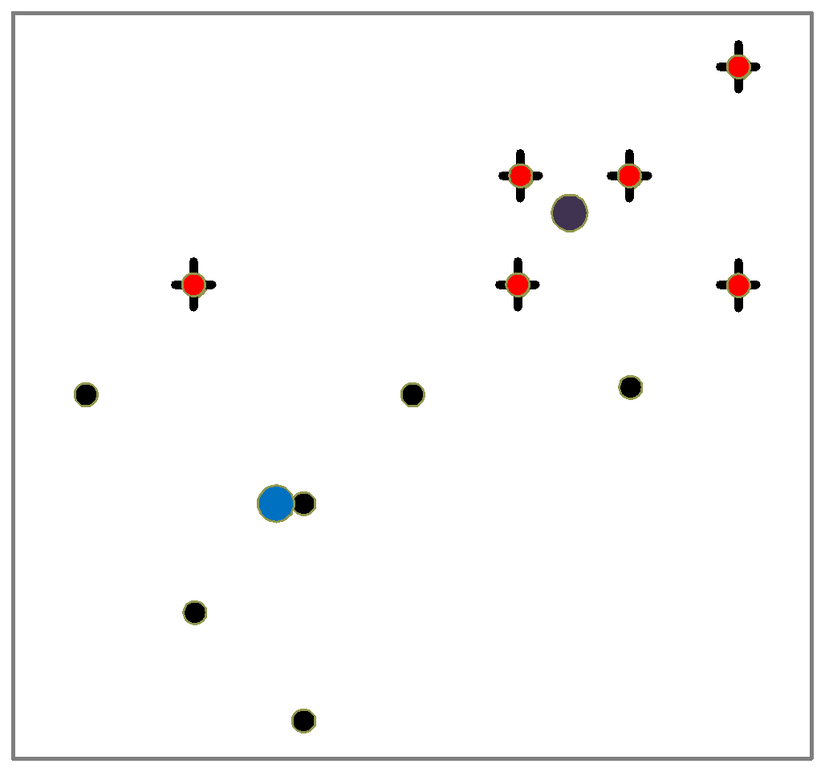
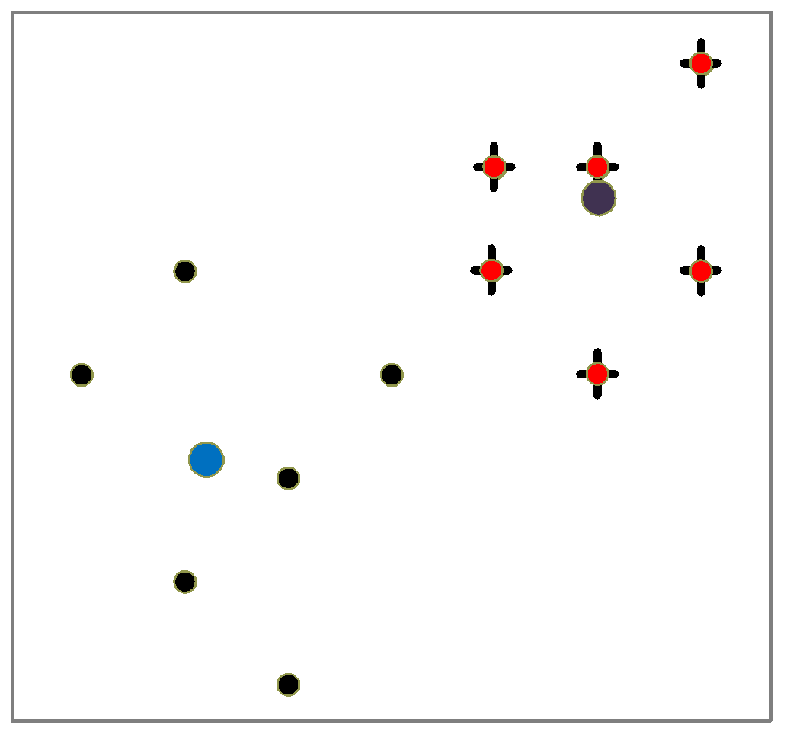
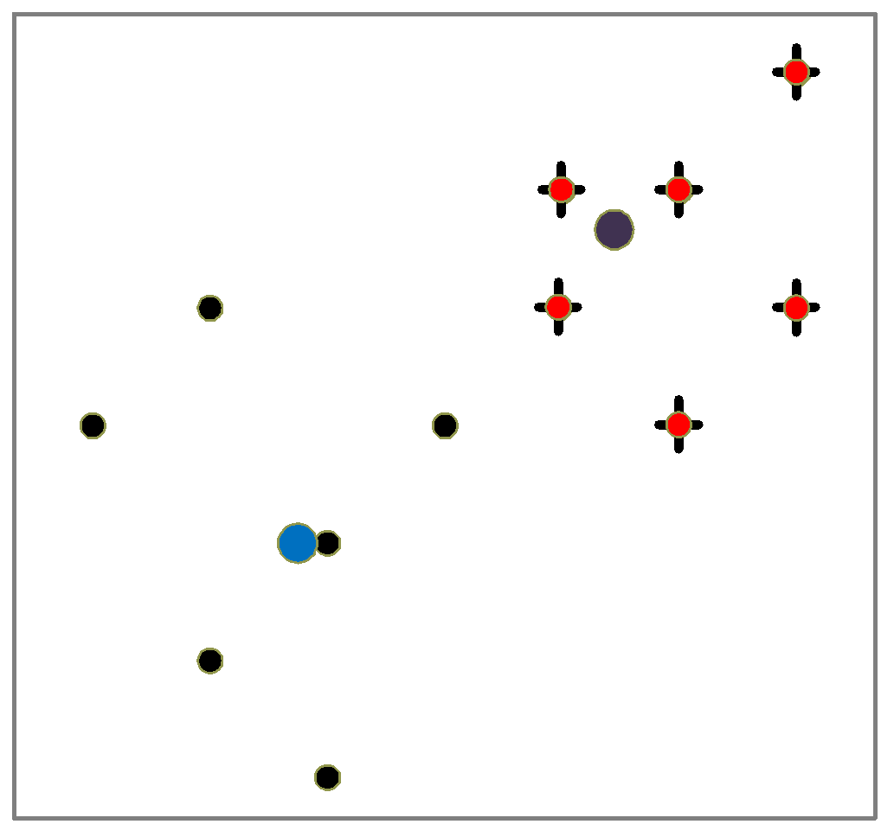
An Example of K-Means Clustering
K=2
Arbitrarily partition objects into k groups
Update the cluster centroids
The initial data set
Loop if needed
Reassign objects
Partition objects into k nonempty subsets
Repeat
  Compute centroid (i.e., mean point) for each partition
  Assign each object to the cluster of its nearest centroid
Until no change
Update the cluster centroids
16
Notes:
16

Slide 17
Comments on the K-Means Method
Strength: Efficient: O(tkn), where n is # objects, k is # clusters, and t is # iterations. Normally, k, t << n.
    Comparing: PAM: O(k(n-k)² ), CLARA: O(ks² + k(n-k))
Comment: Often terminates at a local optimal
Weakness
  Applicable only to objects in a continuous n-dimensional space
    Using the k-modes method for categorical data
    In comparison, k-medoids can be applied to a wide range of data
  Need to specify k, the number of clusters, in advance (there are ways to automatically determine the best k (see Hastie et al., 2009)
  Sensitive to noisy data and outliers
  Not suitable to discover clusters with non-convex shapes
17
Notes:
17

Slide 18
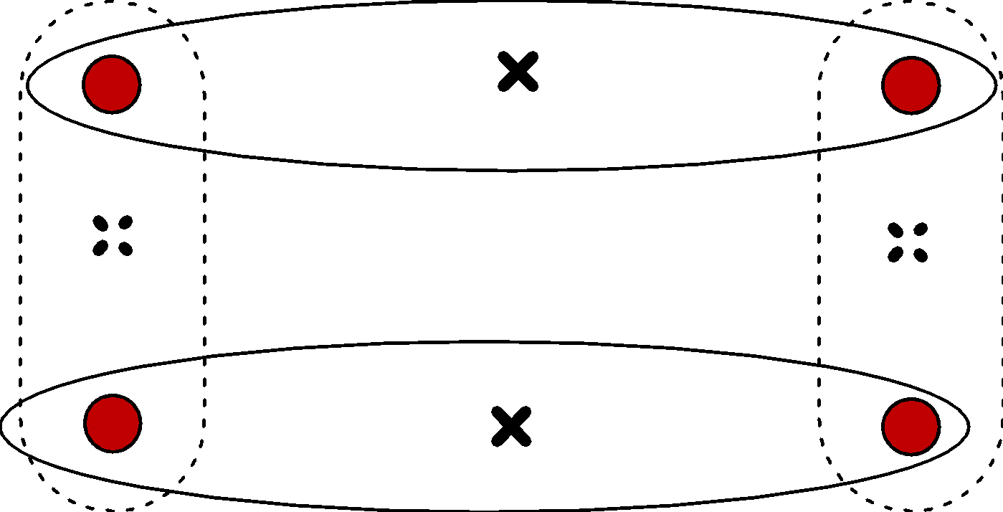
Variations of the K-Means Method
Most of the variants of the k-means which differ in
  Selection of the initial k means
  Dissimilarity calculations
  Strategies to calculate cluster means
Handling categorical data: k-modes
  Replacing means of clusters with modes
  Using new dissimilarity measures to deal with categorical objects
  Using a frequency-based method to update modes of clusters
  A mixture of categorical and numerical data: k-prototype method
18
Notes:
18

Slide 19
What Is the Problem of the K-Means Method?
The k-means algorithm is sensitive to outliers !
  Since an object with an extremely large value may substantially distort the distribution of the data
K-Medoids: Instead of taking the mean value of the object in a cluster as a reference point, medoids can be used, which is the most centrally located object in a cluster
10
10
9
9
8
8
7
7
6
6
5
5
4
4
3
3
2
2
1
1
0
0
1
2
3
4
5
6
7
8
9
10
0
0
1
2
3
4
5
6
7
8
9
10
19
Notes:
19

Slide 20
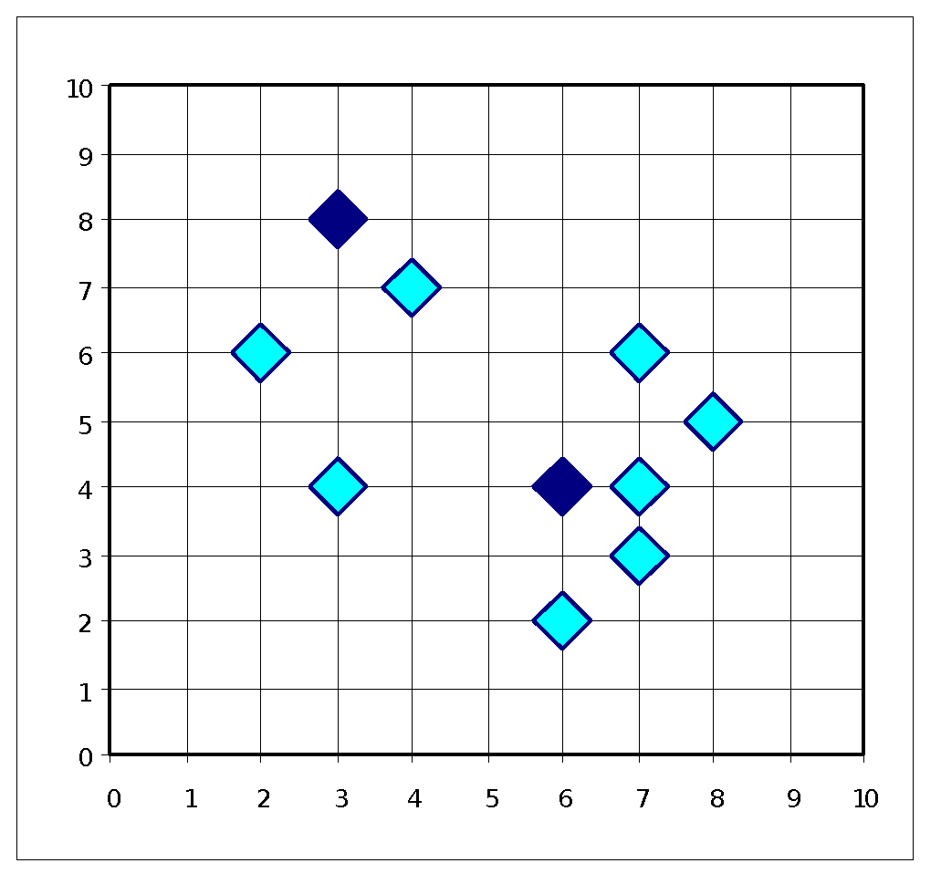
PAM: A Typical K-Medoids Algorithm
Total Cost = 20
10
9
8
Arbitrary choose k object as initial medoids
Assign each remaining object to nearest medoids
7
6
5
4
3
2
1
0
0
1
2
3
4
5
6
7
8
9
10
K=2
Randomly select a nonmedoid object,O_{ramdom}
Total Cost = 26
Do loop
Until no change
10
10
9
Compute total cost of swapping
9
Swapping O and O_{ramdom}
If quality is improved.
8
8
7
7
6
6
5
5
4
4
3
3
2
2
1
1
0
0
1
2
3
4
5
6
7
8
9
10
0
0
1
2
3
4
5
6
7
8
9
10
20
Notes:
20

Slide 21
Chapter 10. Cluster Analysis: Basic Concepts and Methods
Cluster Analysis: Basic Concepts
Partitioning Methods
Hierarchical Methods
Density-Based Methods
Grid-Based Methods
Evaluation of Clustering
Summary
21
21
Notes:
21

Slide 22
Hierarchical Clustering
Use distance matrix as clustering criteria. This method does not require the number of clusters k as an input, but needs a termination condition
Step 0
Step 1
Step 2
Step 3
Step 4
agglomerative
(AGNES)
a
a b
b
a b c d e
c
c d e
d
d e
e
divisive
(DIANA)
Step 4
Step 3
Step 2
Step 1
Step 0
22
Notes:
22

Slide 23
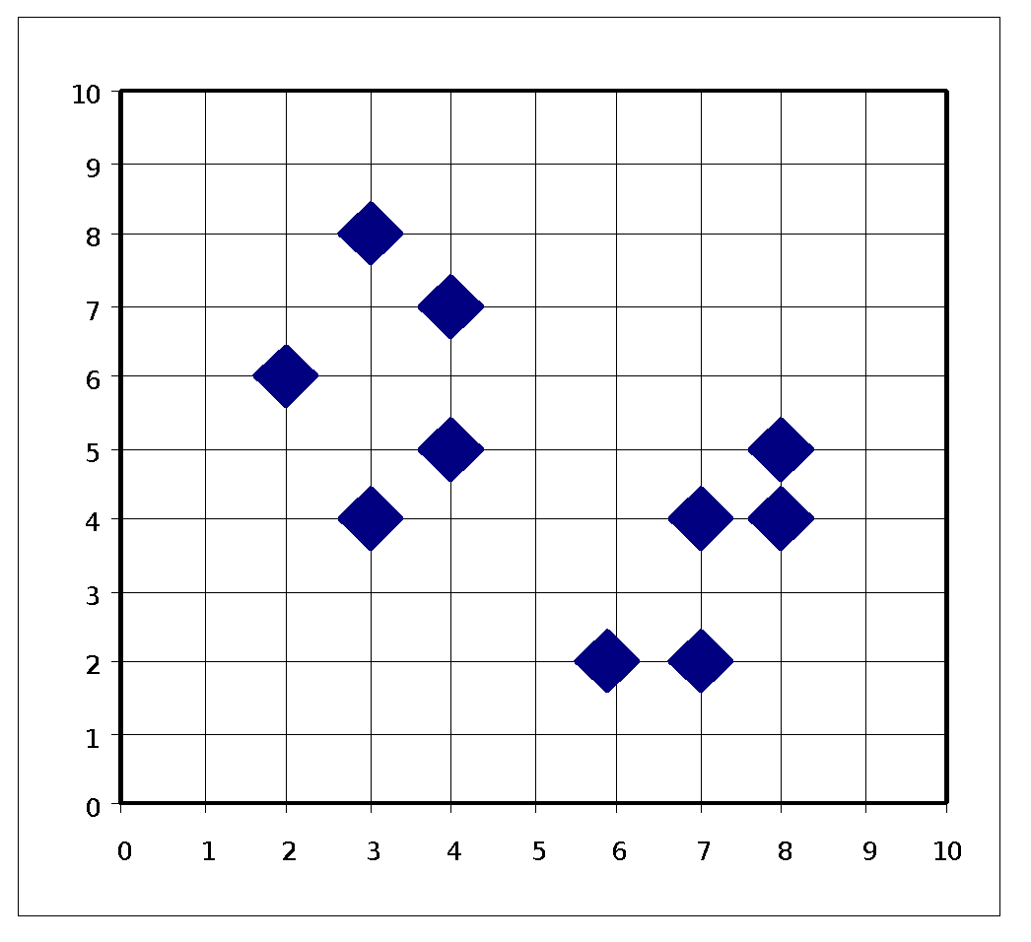
AGNES (Agglomerative Nesting)
Introduced in Kaufmann and Rousseeuw (1990)
Implemented in statistical packages, e.g., Splus
Use the single-link method and the dissimilarity matrix
Merge nodes that have the least dissimilarity
Go on in a non-descending fashion
Eventually all nodes belong to the same cluster
23
Notes:
23

Slide 24
Dendrogram: Shows How Clusters are Merged
  Decompose data objects into a several levels of nested partitioning (tree of clusters), called a dendrogram
  A clustering of the data objects is obtained by cutting the dendrogram at the desired level, then each connected component forms a cluster
24
Notes:
24

Slide 25
DIANA (Divisive Analysis)
Introduced in Kaufmann and Rousseeuw (1990)
Implemented in statistical analysis packages, e.g., Splus
Inverse order of AGNES
Eventually each node forms a cluster on its own
25
Notes:
25

Slide 26
Distance between Clusters
X
X
Single link: smallest distance between an element in one cluster and an element in the other, i.e., dist(K_{i}, K_{j}) = min(t_{ip}, t_{jq})
Complete link: largest distance between an element in one cluster and an element in the other, i.e., dist(K_{i}, K_{j}) = max(t_{ip}, t_{jq})
Average: avg distance between an element in one cluster and an element in the other, i.e., dist(K_{i}, K_{j}) = avg(t_{ip}, t_{jq})
Centroid: distance between the centroids of two clusters, i.e., dist(K_{i}, K_{j}) = dist(C_{i}, C_{j})
Medoid: distance between the medoids of two clusters, i.e., dist(K_{i}, K_{j}) = dist(M_{i}, M_{j})
  Medoid: a chosen, centrally located object in the cluster
26
Notes:
26

Slide 27
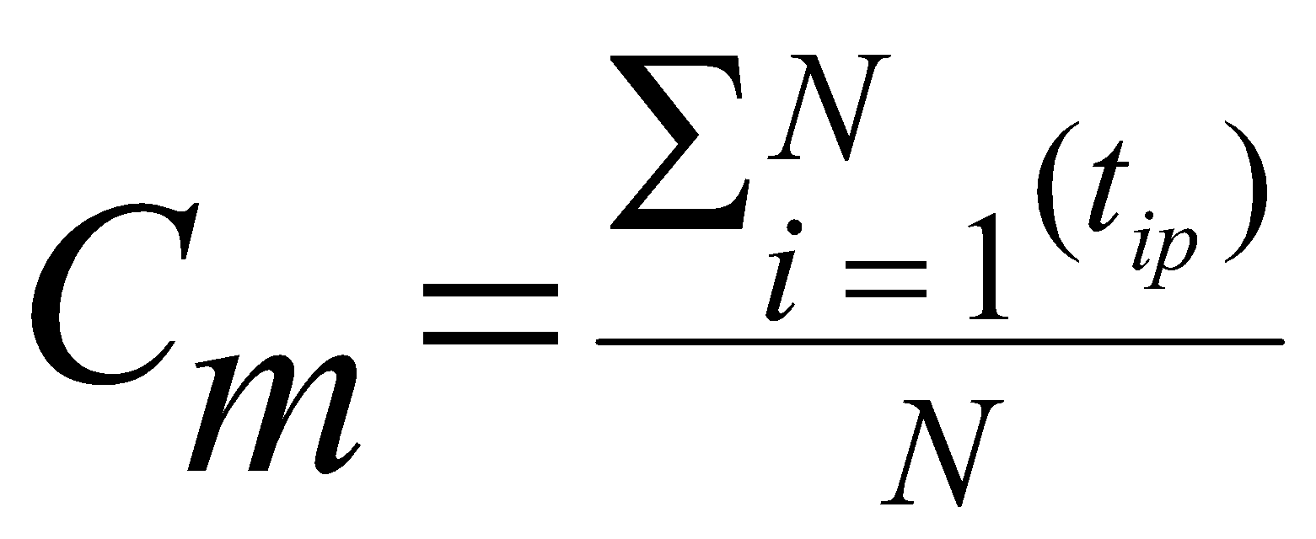
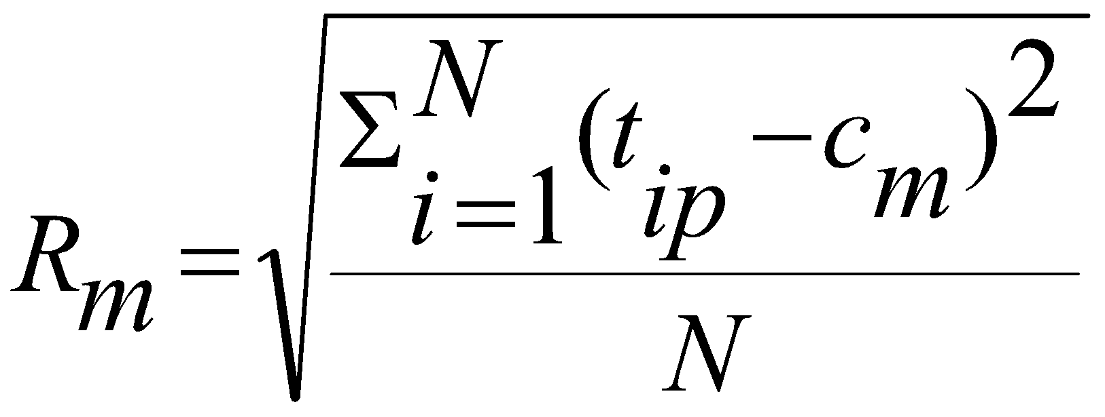
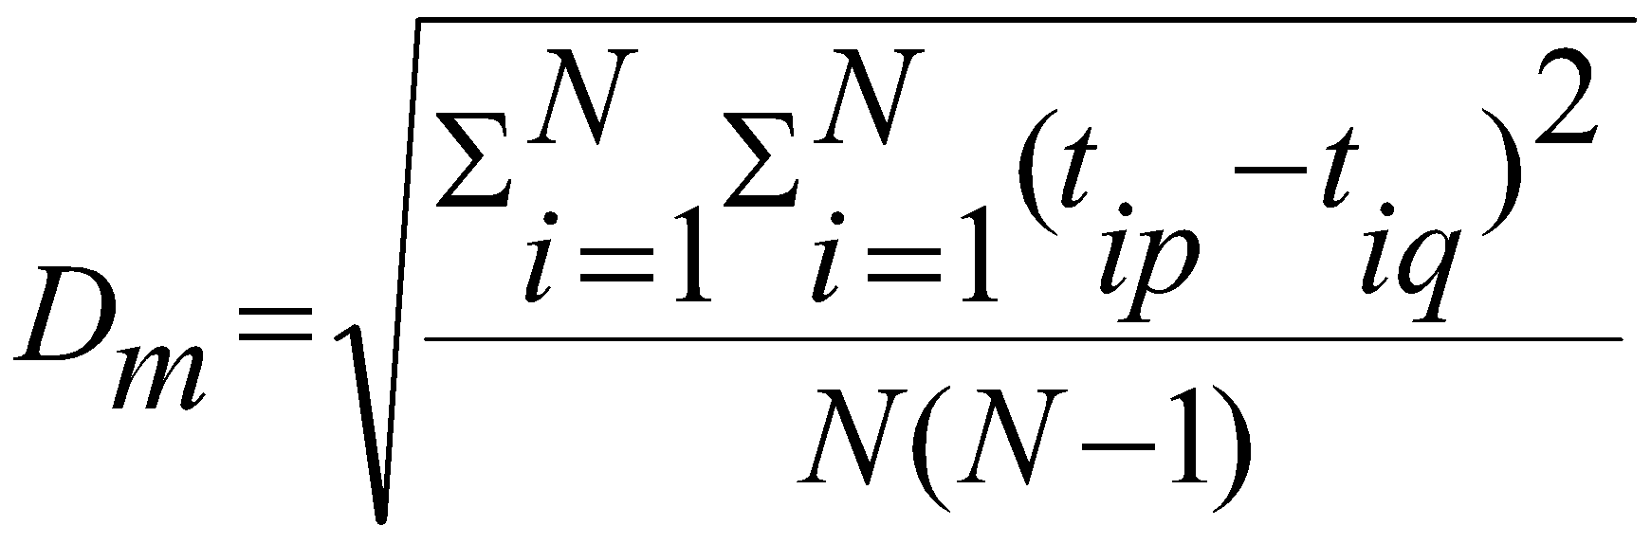
Centroid, Radius and Diameter of a Cluster (for numerical data sets)
X
Centroid: the “middle” of a cluster
Radius: square root of average distance from any point of the cluster to its centroid
Diameter: square root of average mean squared distance between all pairs of points in the cluster
27
Notes:
27

Slide 28
Chapter 10. Cluster Analysis: Basic Concepts and Methods
Cluster Analysis: Basic Concepts
Partitioning Methods
Hierarchical Methods
Density-Based Methods
Grid-Based Methods
Evaluation of Clustering
Summary
28
28
Notes:
28

Slide 29
Density-Based Clustering Methods
Clustering based on density (local cluster criterion), such as density-connected points
Major features:
  Discover clusters of arbitrary shape
  Handle noise
  One scan
  Need density parameters as termination condition
Several interesting studies:
  DBSCAN: Ester, et al. (KDD’96)
  OPTICS: Ankerst, et al (SIGMOD’99).
  DENCLUE: Hinneburg & D. Keim (KDD’98)
  CLIQUE: Agrawal, et al. (SIGMOD’98) (more grid-based)
29
Notes:
29

Slide 30
Density-Based Clustering: Basic Concepts
Two parameters:
  Eps: Maximum radius of the neighbourhood
  MinPts: Minimum number of points in an Eps-neighbourhood of that point
N_{Eps}(q): {p belongs to D | dist(p,q) ≤ Eps}
Directly density-reachable: A point p is directly density-reachable from a point q w.r.t. Eps, MinPts if
  p belongs to N_{Eps}(q)
  core point condition:
  |N_{Eps} (q)| ≥ MinPts
p
MinPts = 5
Eps = 1 cm
q
30
Notes:
30

Slide 31
Density-Reachable and Density-Connected
Density-reachable:
  A point p is density-reachable from a point q w.r.t. Eps, MinPts if there is a chain of points p₁, …, p_{n}, p₁ = q, p_{n} = p such that p_{i+1} is directly density-reachable from p_{i}
Density-connected
  A point p is density-connected to a point q w.r.t. Eps, MinPts if there is a point o such that both, p and q are density-reachable from o w.r.t. Eps and MinPts
p
p₁
q
p
q
o
31
Notes:
31

Slide 32
DBSCAN: Density-Based Spatial Clustering of Applications with Noise
Relies on a density-based notion of cluster: A cluster is defined as a maximal set of density-connected points
Discovers clusters of arbitrary shape in spatial databases with noise
Outlier
Border
Eps = 1cm
MinPts = 5
Core
32
Notes:
32

Slide 33
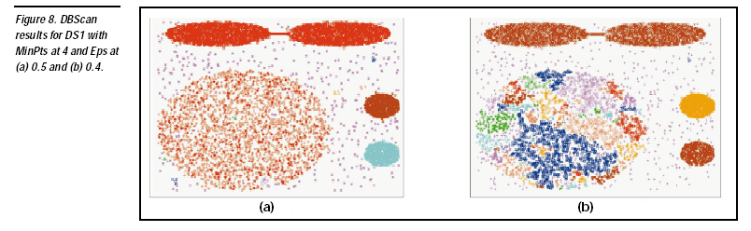

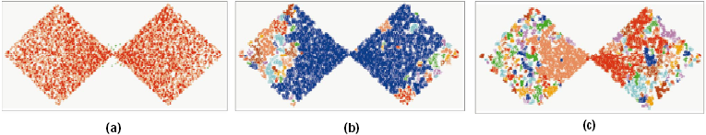
DBSCAN: Sensitive to Parameters
DBSCAN online Demo:
http://webdocs.cs.ualberta.ca/~yaling/Cluster/Applet/Code/Cluster.html
33
Notes:
33

Slide 34
OPTICS: A Cluster-Ordering Method (1999)
OPTICS: Ordering Points To Identify the Clustering Structure
  Ankerst, Breunig, Kriegel, and Sander (SIGMOD’99)
  Produces a special order of the database wrt its density-based clustering structure
  This cluster-ordering contains info equiv to the density-based clusterings corresponding to a broad range of parameter settings
  Good for both automatic and interactive cluster analysis, including finding intrinsic clustering structure
  Can be represented graphically or using visualization techniques
34
Notes:
34

Slide 35
Chapter 10. Cluster Analysis: Basic Concepts and Methods
Cluster Analysis: Basic Concepts
Partitioning Methods
Hierarchical Methods
Density-Based Methods
Grid-Based Methods
Evaluation of Clustering
Summary
35
35
Notes:
35

Slide 36
Grid-Based Clustering Method
Using multi-resolution grid data structure
Several interesting methods
  STING (a STatistical INformation Grid approach) by Wang, Yang and Muntz (1997)
  CLIQUE: Agrawal, et al. (SIGMOD’98)
    Both grid-based and subspace clustering
  WaveCluster by Sheikholeslami, Chatterjee, and Zhang (VLDB’98)
    A multi-resolution clustering approach using wavelet method
36
Notes:
36

Slide 37
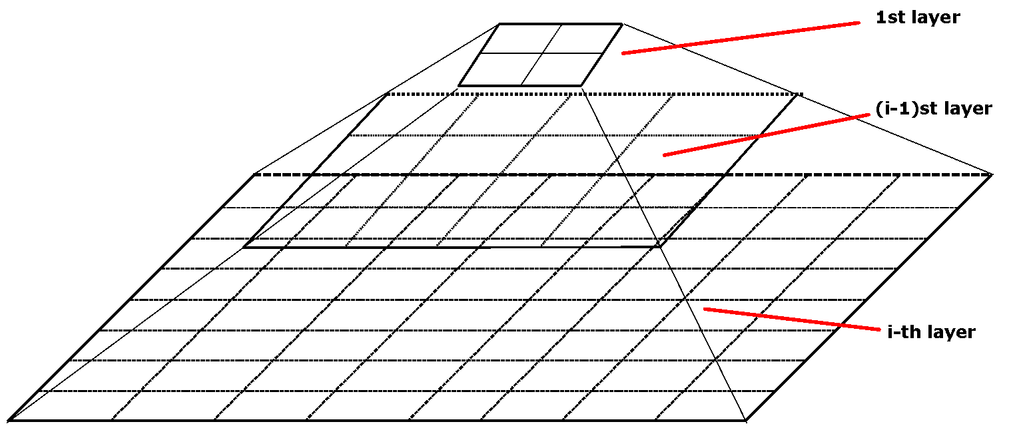
STING: A Statistical Information Grid Approach
Wang, Yang and Muntz (VLDB’97)
The spatial area is divided into rectangular cells
There are several levels of cells corresponding to different levels of resolution
37
Notes:
37

Slide 38
The STING Clustering Method
Each cell at a high level is partitioned into a number of smaller cells in the next lower level
Statistical info of each cell is calculated and stored beforehand and is used to answer queries
Parameters of higher level cells can be easily calculated from parameters of lower level cell
  count, mean, s, min, max
  type of distribution—normal, uniform, etc.
Use a top-down approach to answer spatial data queries
Start from a pre-selected layer—typically with a small number of cells
For each cell in the current level compute the confidence interval
38
Notes:
38

Slide 39
STING Algorithm and Its Analysis
Remove the irrelevant cells from further consideration
When finish examining the current layer, proceed to the next lower level
Repeat this process until the bottom layer is reached
Advantages:
  Query-independent, easy to parallelize, incremental update
  O(K), where K is the number of grid cells at the lowest level
Disadvantages:
  All the cluster boundaries are either horizontal or vertical, and no diagonal boundary is detected
39
Notes:
39

Slide 40
CLIQUE (Clustering In QUEst)
Agrawal, Gehrke, Gunopulos, Raghavan (SIGMOD’98)
Automatically identifying subspaces of a high dimensional data space that allow better clustering than original space
CLIQUE can be considered as both density-based and grid-based
  It partitions each dimension into the same number of equal length interval
  It partitions an m-dimensional data space into non-overlapping rectangular units
  A unit is dense if the fraction of total data points contained in the unit exceeds the input model parameter
  A cluster is a maximal set of connected dense units within a subspace
40
Notes:
40

Slide 41
CLIQUE: The Major Steps
Partition the data space and find the number of points that lie inside each cell of the partition.
Identify the subspaces that contain clusters using the Apriori principle
Identify clusters
  Determine dense units in all subspaces of interests
  Determine connected dense units in all subspaces of interests.
Generate minimal description for the clusters
  Determine maximal regions that cover a cluster of connected dense units for each cluster
  Determination of minimal cover for each cluster
41
Notes:
41

Slide 42
Chapter 10. Cluster Analysis: Basic Concepts and Methods
Cluster Analysis: Basic Concepts
Partitioning Methods
Hierarchical Methods
Density-Based Methods
Grid-Based Methods
Evaluation of Clustering
Summary
42
42
Notes:
42

Slide 43
Determine the Number of Clusters
Empirical method
  # of clusters: k ≈√n/2 for a dataset of n points, e.g., n = 200, k = 10
Elbow method
  Use the turning point in the curve of sum of within cluster variance w.r.t the # of clusters
Cross validation method
  Divide a given data set into m parts
  Use m – 1 parts to obtain a clustering model
  Use the remaining part to test the quality of the clustering
    E.g., For each point in the test set, find the closest centroid, and use the sum of squared distance between all points in the test set and the closest centroids to measure how well the model fits the test set
  For any k > 0, repeat it m times, compare the overall quality measure w.r.t. different k’s, and find # of clusters that fits the data the best
43

Slide 44
Measuring Clustering Quality
3 kinds of measures: External, internal and relative
External: supervised, employ criteria not inherent to the dataset
  Compare a clustering against prior or expert-specified knowledge (i.e., the ground truth) using certain clustering quality measure
Internal: unsupervised, criteria derived from data itself
  Evaluate the goodness of a clustering by considering how well the clusters are separated, and how compact the clusters are, e.g., Silhouette coefficient
Relative: directly compare different clusterings, usually those obtained via different parameter settings for the same algorithm
44

Slide 45
Some Commonly Used External Measures
Matching-based measures
  Purity, maximum matching, F-measure
Entropy-Based Measures
  Conditional entropy, normalized mutual information (NMI), variation of information
Pair-wise measures
  Four possibilities: True positive (TP), FN, FP, TN
  Jaccard coefficient, Rand statistic, Fowlkes-Mallow measure
Correlation measures
  Discretized Huber static, normalized discretized Huber static
Ground truth partitioning T₁
T₂
Cluster C₁
Cluster C₂
45

