Slide 1
Chapter 16
Chapter 16 Advanced Management Topics
Advanced Management Topics
Network Management: Principles and Practice
© Mani Subramanian and N. Usha Rani 2010
*
Notes:
*
Chapter16

Slide 2
Objectives
Chapter 16 Advanced Management Topics
Next generation NM requirements
ITU-T
IETF
Status of current NM technology
ISO Model: FCAPS
Product requirements
Limitations of SNMP management
Early Web-based development
Web interface and Web management
WBEM
WIMA
CORBA-based NM technology
XML-based NM technology
Comparison of NM technologies
Recent NM-related standards
Network Management: Principles and Practice
© Mani Subramanian and N. Usha Rani 2010
*

Slide 3
Need for New Management Technologies
Chapter 16 Advanced Management Topics
Since late ’80s
Networks have evolved
Management needs have changed
Management technologies have evolved
Mismatch in speed of evolution of networks and management requirements vis a vis management technology
Notes
Network Management: Principles and Practice
© Mani Subramanian and N. Usha Rani 2010
*

Slide 4
Evolution of Networks
Chapter 16 Advanced Management Topics
In the mid-late ’80s
Devices simple, resources constrained
Capabilities were limited
Today
Increased functional complexity
Increased complexity in configuration
Increased intelligence and programmability of devices
Networks that provide a wide range of services
NGNs: Packet-based networks for all services
Providing unfettered access for users to networks and to competing service providers for services of their choice
Notes
Network Management: Principles and Practice
© Mani Subramanian and N. Usha Rani 2010
*

Slide 5
NGN Requirements
Chapter 16 Advanced Management Topics
Original Requirement | New Requirements
End-to-end transparency | Packet inspection, NAT
Peer-to-peer | NATs/firewalls/servers
Connectionless | MPLS
Best effort | Real-time demands, bandwidth demands
User back-off | QoS guarantees
Network empowerment | User empowerment
No flow state | Flow state
Trust | Hackers everywhere
Static addresses | DHCP, mobility
Fairness | QoS
Terminal-to-host | Mass public residential services, multiterminal, multi QoS
Flat network | Access and core domains
Simple protocol layering | Protocol maze
Research/Defence use | Commercialization, competition, consumer choice
NGN…Next Generation Networks
Network Management: Principles and Practice
© Mani Subramanian and N. Usha Rani 2010
*

Slide 6
Changes in Operator Needs
Chapter 16 Advanced Management Topics
Management of large backbone networks requires powerful configuration management
Move from device management approach to system management
Service-centric view of network
VoIP (residential and business), multimedia streaming, IP TV, fast data connectivity, triple play
Increased speed of service delivery
Automation of business processes
Notes
Network Management: Principles and Practice
© Mani Subramanian and N. Usha Rani 2010
*

Slide 7
Configuration Management Needs
Chapter 16 Advanced Management Topics
Need for concurrent configuration changes to several network devices
Download bulk configuration changes on many devices
Schedule configuration operations on devices at particular times
Roll back support
Coordinated activation of downloaded configurations
Notes
Network Management: Principles and Practice
© Mani Subramanian and N. Usha Rani 2010
*

Slide 8
Consequences for Management
Chapter 16 Advanced Management Topics
Rethinking management principles – Integration of independent developments
Management support for delivering quality service
Changes resulting from “user” focus as opposed to “network” focus
Importance of developing standardized management software for easy maintenance and extensibility
Notes
Network Management: Principles and Practice
© Mani Subramanian and N. Usha Rani 2010
*

Slide 9
Traditional Approaches - Datacomm
Chapter 16 Advanced Management Topics
SNMP based
Aim was to have simple small footprint protocol
Kept self contained and independent of other network services
Catered to fault, performance monitoring, and simple configuration management
Soon after release, shortcomings were exposed
SNMPv2: Get-Bulk, Inform, SMIv2
SNMPv3: security
Notes
Network Management: Principles and Practice
© Mani Subramanian and N. Usha Rani 2010
*

Slide 10
Drawbacks of SNMP
Chapter 16 Advanced Management Topics
Inadequate information modeling – simple data structures and protocol operations
Object based rather than object oriented
No inheritance – so no information re-use
Inadequate primitive for bulk information retrieval
UDP transport restricts size of data sent
Limited configuration management support
Low level semantics
Notes
Network Management: Principles and Practice
© Mani Subramanian and N. Usha Rani 2010
*

Slide 11
OSI NM
Chapter 16 Advanced Management Topics
Designed as successor to SNMPOSI-NM
Comprehensive management technology addressing datacom and telecom arena
CMIP/CMISE support many primitives
Information access is powerful
Supports bulk and selective retrieval
Connection-oriented transport included
Found to be complex and technologically too advanced for deployment in late ‘80s
Notes
Network Management: Principles and Practice
© Mani Subramanian and N. Usha Rani 2010
*

Slide 12
Overcoming SNMP Shortcomings
Chapter 16 Advanced Management Topics
Evolutionary efforts were made to address shortcomings
Improving SMI
Improving SNMP protocol
Enhancing configuration management
Notes
Network Management: Principles and Practice
© Mani Subramanian and N. Usha Rani 2010
*

Slide 13
Improving SMI
Chapter 16 Advanced Management Topics
Internet Research Task Force (IRTF) and Network Management Research Group (NMRG) developed SMIng
Allows arbitrarily nested data structures
Facilitates re-usability of complex data structures
Extensible mechanisms
IETF was to develop a standards track for above in 2000
Phase 1: requirements drawn up
Phase 2: two strong proposals emerged
Efforts to merge these failed, in 2003 group was wound up
Notes
Network Management: Principles and Practice
© Mani Subramanian and N. Usha Rani 2010
*

Slide 14
SNMP Protocol Improvement
Chapter 16 Advanced Management Topics
Attempt to improve protocol shortcomings
Efforts to reduce overhead due to OID redundancy
Compression
Suppression of redundant OID fragments
Effect bulk transfer at MIB level instead of OID
Use of TCP as transport protocol
Did not meet with success because of industry reluctance to accept new technology
Notes
Network Management: Principles and Practice
© Mani Subramanian and N. Usha Rani 2010
*

Slide 15
Configuration Management
Chapter 16 Advanced Management Topics
COPS PR Common Open Policy Service– Policy Provisioning) for improving Configuration Management capability
Resource Allocation Protocol (RAP)–WG for policy-based configuration and provisioning
Specification language: Structure of Policy Provisioning Information (SPPI)
TCP is transport protocol
Intends to make configuration changes based on PBMS
Did not meet with market acceptance
Notes
Network Management: Principles and Practice
© Mani Subramanian and N. Usha Rani 2010
*

Slide 16
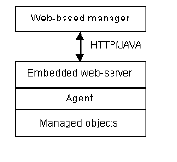
Web-based Management
Chapter 16 Advanced Management Topics
Notes
Early approaches:
Embedded Web server in device
Browser can connect to the URL of the device and html pages with management information
Provides graphical displays of management information
Improved configuration facility, detailed device management
Drawbacks
More an EMS-like approach – no end-to- end view
High level management functions such as map-based view, root cause analysis, trend analysis not supported
Network Management: Principles and Practice
© Mani Subramanian and N. Usha Rani 2010
*

Slide 17
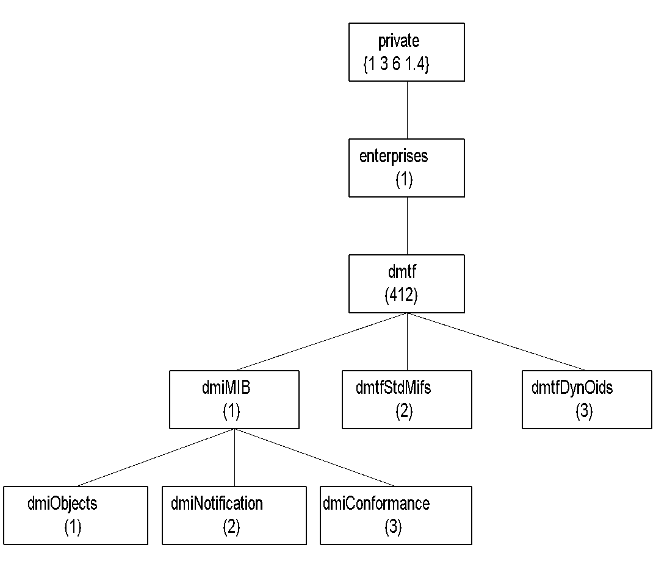
DMI MIB
Chapter 16 Advanced Management Topics
Figure 16.2 Desktop Interface MIB
Notes
Desktop Interface Management (DMI ) standard specified by Desktop Interface Management (DMTF)
DMTF task expanded to specify Web-based enterprise management (WBEM)
MIF specified using ASN.1 syntax
Can be managed by an SNMP manager
Network Management: Principles and Practice
© Mani Subramanian and N. Usha Rani 2010
*

Slide 18
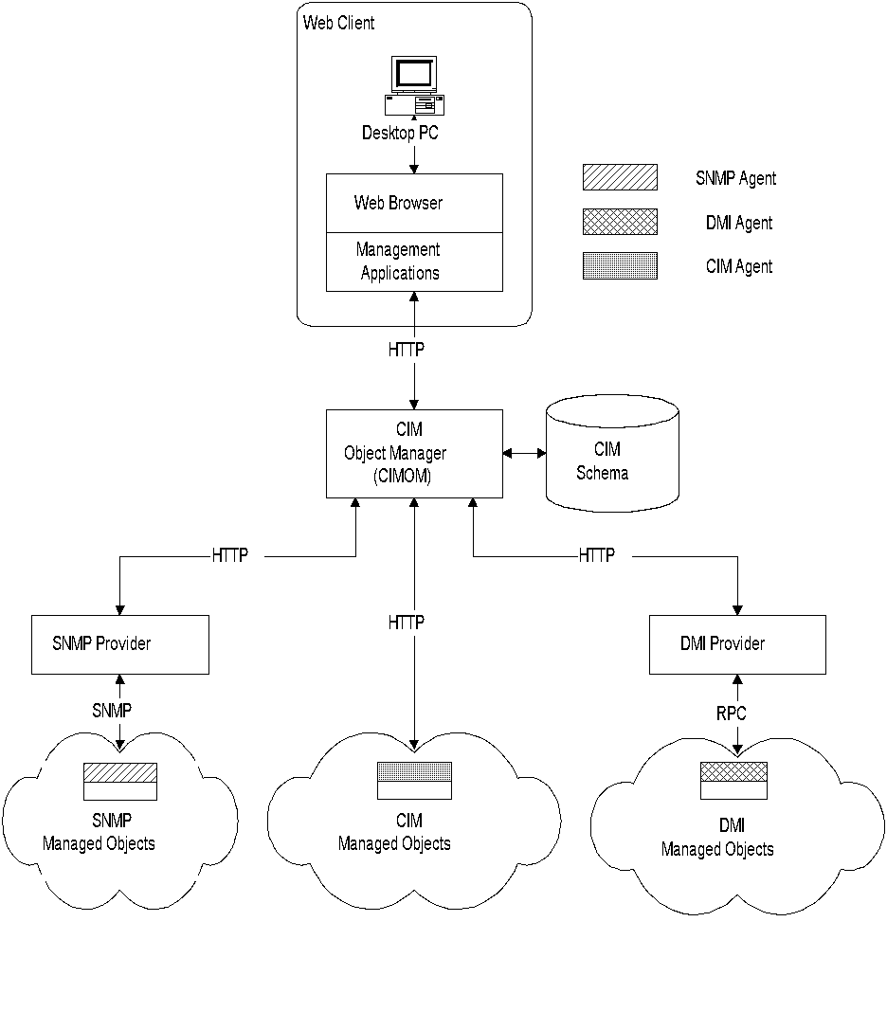
WBEM Architecture
Chapter 16 Advanced Management Topics
Figure 16.3 WBEM Architecture
Notes
WBEM based on Common Information Module, developed by Microsoft
CIM is information-modeling framework intended to accommodate all protocols and frameworks
Object oriented
Five components:
Web client
CIM object manager (CIMOM)
CIM schema
Management protocol
Managed objects with specific protocol
Network Management: Principles and Practice
© Mani Subramanian and N. Usha Rani 2010
*

Slide 19
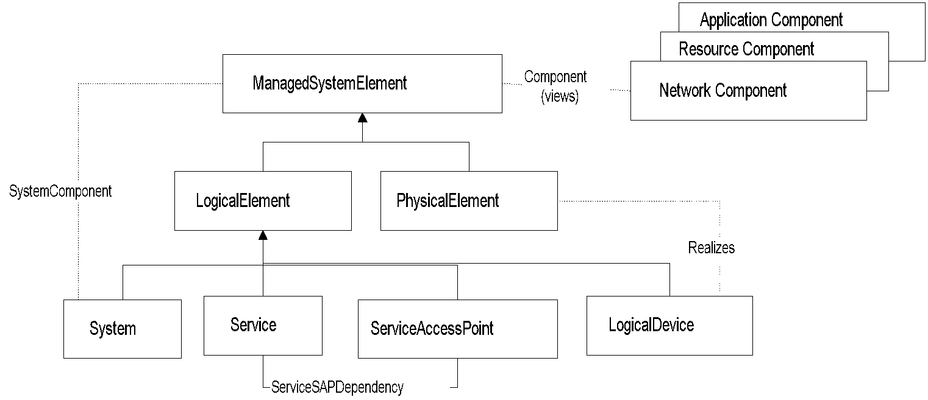
Simplified WBEM CIM Core Model
Chapter 16 Advanced Management Topics
Figure 16.4 Simplified WBEM CIM Core Model
Notes
Managed system element is a group of components
System an aggregate of Managed System Elements
Subclasses of system element are:
PhysicalElement (e.g., interface card) and
LogicalElement (IP address)
Service access point is management, measurement, and configuration of a service
Network Management: Principles and Practice
© Mani Subramanian and N. Usha Rani 2010
*

Slide 20
WIMA
Chapter 16 Advanced Management Topics
Web-based interface management architecture
A push-based management for repetitive tasks
Pull-based for occasional on-demand tasks
Reduces management bandwidth
Uses SNMP MIB and organization model
Compression adds further benefit
Some functions moved from manager to agent
Notes
Network Management: Principles and Practice
© Mani Subramanian and N. Usha Rani 2010
*

Slide 21
WIMA Communication Model
Chapter 16 Advanced Management Topics
Communication model
HTTP based instead of SNMP based
Transport protocol is TCP instead of UDP
Compression to save bandwidth
Unlimited number of MIB variables per push cycle
BER encoding of data replaced by MIME (Multipurpose Internet Mail Extensions) parts + {strings, serialized Java objects, XML, etc.}
Natural table retrievals
Notes
Network Management: Principles and Practice
© Mani Subramanian and N. Usha Rani 2010
*

Slide 22
MIME-based Push
Chapter 16 Advanced Management Topics
HTTP offers no native support for bidirectional persistent connections
Before HTTP sends a Response, it must have received a Request – no unsolicited messages
Solution
Initiate the data transfer from the HTTP client, and send an infinitely long response from the HTTP server, with separators embedded in the payload of the response
Use the multipart type of MIME (Multipurpose Internet Mail Extensions)
Notes
Network Management: Principles and Practice
© Mani Subramanian and N. Usha Rani 2010
*

Slide 23
MIME-based Push (cont.)
Chapter 16 Advanced Management Topics
At every push cycle, the agent sends a new MIME part including a number of {OID, value} pairs
MIME separator delimits two consecutive push cycles
Encode only one notification per MIME part
MIME parts transferring MIB data are compressed with gzip
Notes
Network Management: Principles and Practice
© Mani Subramanian and N. Usha Rani 2010
*

Slide 24
CORBA-based Network Management
Chapter 16 Advanced Management Topics
Client-server model
Fully object-oriented approach
Targets programmatic interface between manager and agent
Distributed application with objects interacting via services exposed by their interfaces
Meant for interworking of networked applications developed on different platforms
Notes
Network Management: Principles and Practice
© Mani Subramanian and N. Usha Rani 2010
*

Slide 25
CORBA-based Management
Chapter 16 Advanced Management Topics
CORBA (OMG’s proposal) is the real-world approach
Object Request Broker (ORB) provides underlying platform
ORB provides access, location, failure, resource transparency
Specifies an RPC over TCP/IP – Internet Inter-ORB Protocol (IIOP)
Interoperable References (IOR) of interfaces through naming or trading service
Interface Definition Language (IDL) for specifying interfaces
CORBA inherently supports some basic NM needs
Efficient data retrieval – bulk and selective
Notifications with filtering
Transaction support
Notes
Network Management: Principles and Practice
© Mani Subramanian and N. Usha Rani 2010
*

Slide 26
CORBA-based Management (cont.)
Chapter 16 Advanced Management Topics
Information model – fully object oriented with inheritance
Interfaces to objects defined via Interface Definition Language (IDL)
Interfaces can be specialized through inheritance
Multiple inheritance, polymorphism supported
Internet Inter-ORB Protocol (IIOP) provides reliable transport over TCP/IP
Grouping and retrieval of attributes
Lists
Iterator interface
Notes
Network Management: Principles and Practice
© Mani Subramanian and N. Usha Rani 2010
*

Slide 27
Early Work
Chapter 16 Advanced Management Topics
TMF and OMG set up Joint Inter Domain Management (JIDM) WG
Aim was to provide static mapping of GDMO attributes to IDLs
This approach has drawbacks
One remote call per attribute is costly
Scalability issue because of large number of connections
Solution to this
Rather than syntactic translation from GDMO to IDLs, follow semantic approach
Group commonly accessed attributes of object
Notes
Network Management: Principles and Practice
© Mani Subramanian and N. Usha Rani 2010
*

Slide 28
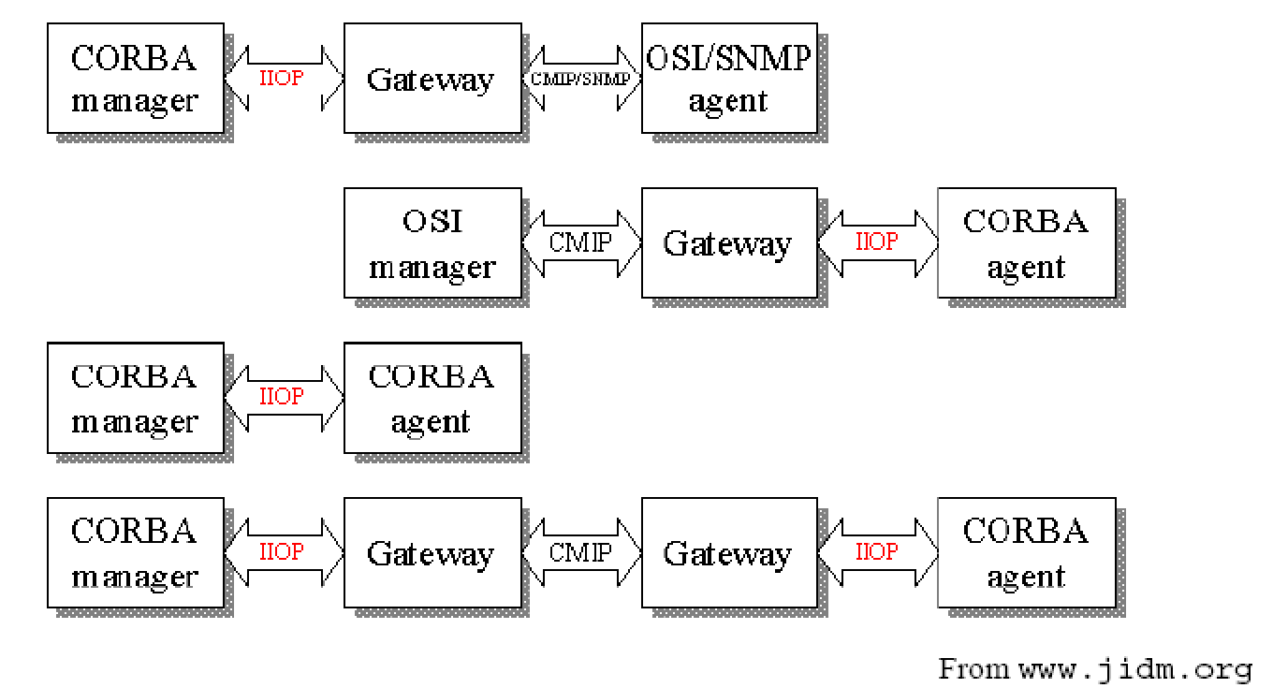
JIDM Scenarios
Chapter 16 Advanced Management Topics
Notes
Network Management: Principles and Practice
© Mani Subramanian and N. Usha Rani 2010
*

Slide 29
Access and Distribution
Chapter 16 Advanced Management Topics
Access => access and communication between MOs and management applications
Both request response and notifications supported by CORBA
A request looks like an API call, response is the return value
IIOP over TCP/IP
CORBA objects are specified and accessed separately
Contrast to MO cluster administered by an agent in traditional manager/agent paradigm
Notes
Network Management: Principles and Practice
© Mani Subramanian and N. Usha Rani 2010
*

Slide 30
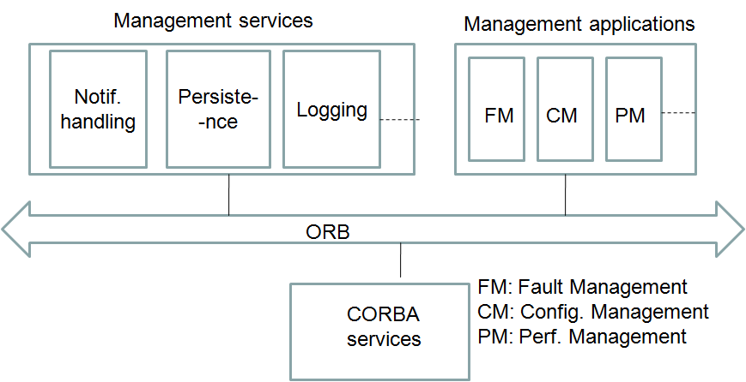
Architecture of CORBA-based NMS
Chapter 16 Advanced Management Topics
Figure 16.7 CORBA-Based Manager Architecture
Notes
Network Management: Principles and Practice
© Mani Subramanian and N. Usha Rani 2010
*

Slide 31
Scalability, Flexibility, Security
Chapter 16 Advanced Management Topics
Event-driven management supported
Lower bandwidth utilization by management traffic
Lends itself naturally to hierarchical management
Broad level of security services
APIs specified for authentication, protection against replay, message confidentiality, access control, auditing, authorization
Notes
Network Management: Principles and Practice
© Mani Subramanian and N. Usha Rani 2010
*

Slide 32
CORBA Issues
Chapter 16 Advanced Management Topics
No support for bulk or selective transfer
One remote invocation per attribute
Scalability
Large number of dynamic objects may cause memory issues
Commonly accessed attributes grouped together
Dynamic entities such as connections are not modeled as separate objects
Same problems exist with Web services…. And more!!
Notes
Network Management: Principles and Practice
© Mani Subramanian and N. Usha Rani 2010
*

Slide 33
MTNM
Chapter 16 Advanced Management Topics
Multi-Technology Network Management
Defines the information exchange between NMS and EMS
Enables management of datacom and telecom
TeleManagement Forum (TMF) initiative: set of documents specify the standard
Business agreement for the exchange of management information: TMF 513
MTNM Information Model: TMF 608
Interface Model: TMF 814
Uses CORBA as transport
Set of CORBA IDLs published
Uses Naming and Notification Service of CORBA
Notes
Network Management: Principles and Practice
© Mani Subramanian and N. Usha Rani 2010
*

Slide 34
TMF 814 Basics
Chapter 16 Advanced Management Topics
The standard recommends that a number of key objects in the network be exposed via this interface.
Objects are modeled based on the layered concepts and layer decomposition laid out in ITU G.805.
An object model that is based on these concepts is assumed to be used by the EMS.
A number of object managers that have services to obtain data about the objects in the network are defined.
Notes
Network Management: Principles and Practice
© Mani Subramanian and N. Usha Rani 2010
*

Slide 35
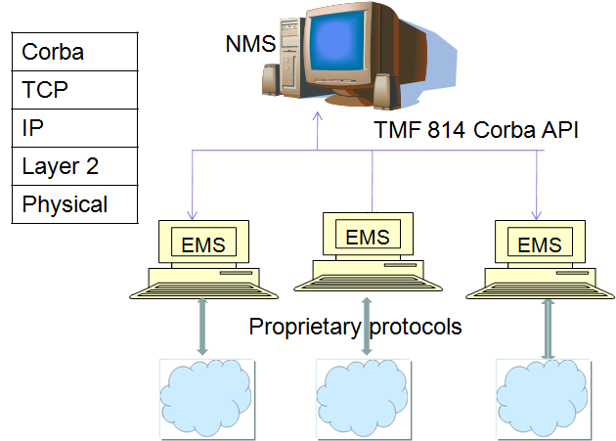
TMF 814-based Management
Chapter 16 Advanced Management Topics
Figure 16.9 TMF 814-Based NMS and EMSs
Notes
Network Management: Principles and Practice
© Mani Subramanian and N. Usha Rani 2010
*

Slide 36
XML-based Management
Chapter 16 Advanced Management Topics
Distributed system approach
Complete, precise specifications of protocols imperative to a distributed system
Such standards exist
Databases are queried using SQL
Clients use ODBC/JDBC compliant APIs
Remote object access is via standard RPC mechanisms or CORBA
However, these standards were developed independently of each other
Do not build on each other or use common basic concepts
XML differs in this respect
Notes
Network Management: Principles and Practice
© Mani Subramanian and N. Usha Rani 2010
*

Slide 37
Use of XML in Management
Chapter 16 Advanced Management Topics
The Desktop Management Task Force (DMTF) Web Based Enterprise Management (WBEM) have already used XML in Service and Application management.
A newer concept is the use of XML/Web Services for network management.
Notes
Network Management: Principles and Practice
© Mani Subramanian and N. Usha Rani 2010
*

Slide 38
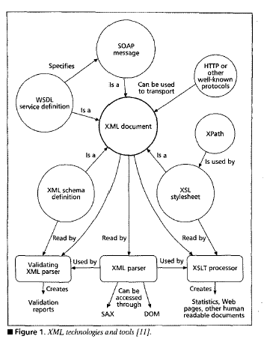
XML as Core Building Block
Chapter 16 Advanced Management Topics
Notes
Figure 16.10 Interrelation between XML and Associated Technologies
Notes
XML is core building block upon which related technologies are being developed
Network Management: Principles and Practice
© Mani Subramanian and N. Usha Rani 2010
*

Slide 39
Advantages of Use of XML
Chapter 16 Advanced Management Topics
Ease of use
Highly structured – arbitrary hierarchies can be represented
Reduced cost of development and maintenance
Powerful management transactions
Unifying system and service management
Extensible mechanism
Notes
Network Management: Principles and Practice
© Mani Subramanian and N. Usha Rani 2010
*

Slide 40
XML in Network Management
Chapter 16 Advanced Management Topics
XML documents provide a structured way to represent management data
Widely deployed protocols such as TCP and HTTP can be used to ship data
There are standard APIs (DOM and SAX) to access the data
Items within documents can be accessed using Xpath expressions
XSLT can be used to process data
Data can be structured as XML schemas
Notes
Network Management: Principles and Practice
© Mani Subramanian and N. Usha Rani 2010
*

Slide 41
XML-based Management
Chapter 16 Advanced Management Topics
Information model
XML document, XML schemas, DTD
Communication model
XML/HTTP/TCP
Xpath to identify management information
Notifications using HTTP post from agent
Notes
Network Management: Principles and Practice
© Mani Subramanian and N. Usha Rani 2010
*

Slide 42
XML-based Device Management
Chapter 16 Advanced Management Topics
Use SNMP manager and SNMP agent, XML only at the UI
XML-based manager (XBM) and SNMP-based agent
SNMP-based manager and XML agent
XML-based manager and XML-based agent
Notes
Network Management: Principles and Practice
© Mani Subramanian and N. Usha Rani 2010
*

Slide 43
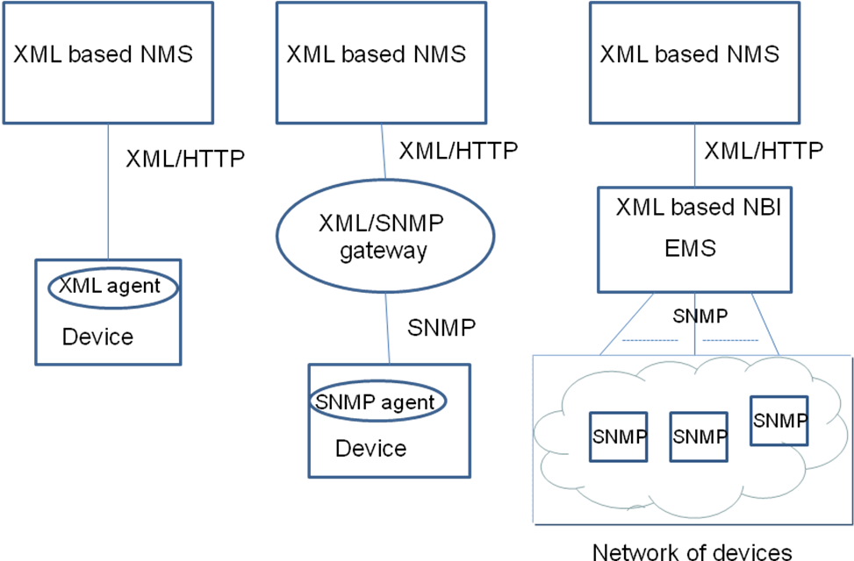
XML for IP Device Management
Chapter 16 Advanced Management Topics
Figure 16.12 Three Specific XML-Based Architectures
Notes
Network Management: Principles and Practice
© Mani Subramanian and N. Usha Rani 2010
*

Slide 44
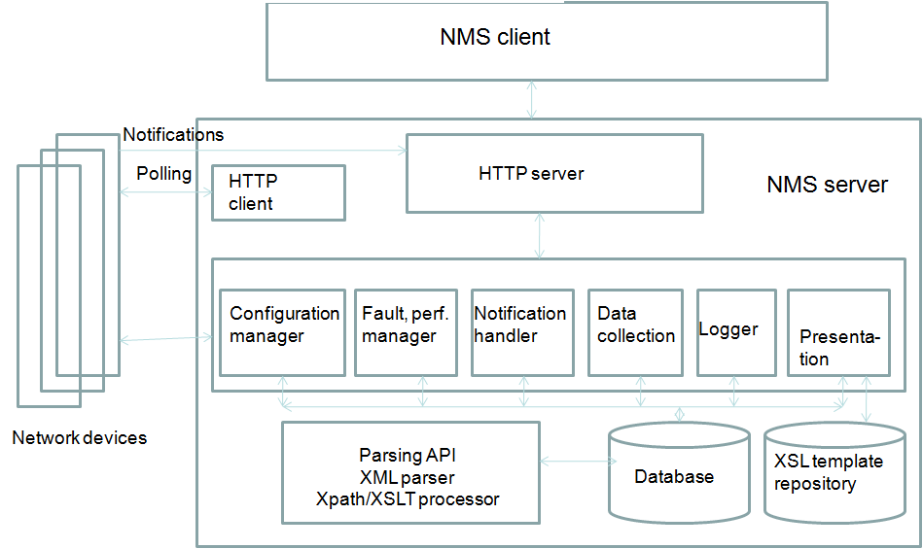
XML-based Manager
Chapter 16 Advanced Management Topics
Figure 16.13 Generalized XML-Based NM Architecture
Notes
Network Management: Principles and Practice
© Mani Subramanian and N. Usha Rani 2010
*

Slide 45
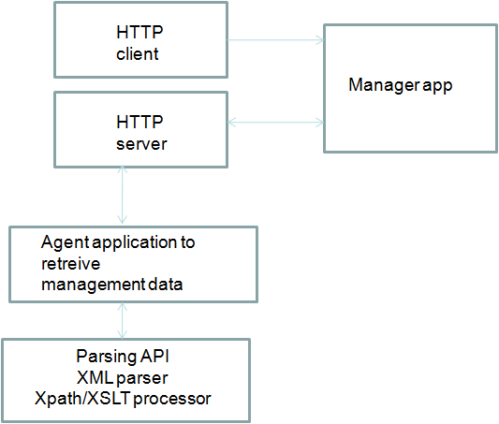
XML-based Agent
Chapter 16 Advanced Management Topics
Notes
Figure 16.15 XML-Based Agent Architecture
Notes
Network Management: Principles and Practice
© Mani Subramanian and N. Usha Rani 2010
*

Slide 46
Summing up Web-based Management
Chapter 16 Advanced Management Topics
Reduced cost of development and maintenance of management solutions
More expressive and powerful transactions
Extensible approach
Better security and transaction support
Performance is an issue, bandwidth is an issue
Notes
Network Management: Principles and Practice
© Mani Subramanian and N. Usha Rani 2010
*

Slide 47
Web Services
Chapter 16 Advanced Management Topics
XML-based framework for building distributed applications
Basic Web services platform is XML + HTTP
Being considered for management
More from perspective of a Service Oriented Architecture for integrating applications than from device management perspective
Notes
Network Management: Principles and Practice
© Mani Subramanian and N. Usha Rani 2010
*

Slide 48
Comparison of Management Protocols
Chapter 16 Advanced Management Topics
Feature | OSI | SNMP | Corba | XML
Information model | ASN.1/GDMO fully object -oriented, powerful, comprehensive but very complicated. | SMI/MIBs are basic, simple, but not object oriented, less powerful. | CORBA IDLs specify a fully object-oriented model, less powerful than ASN1/GDMO | XML or WSDL documents - powerful, very expressive, flexible.
Organization model | Manager-agent paradigm using CMISE as the protocol | Manager-agent paradigm using SNMP as the protocol | Client-server model with programmatic interface between server and client | Message -based architecture with XML SOAP-based messages between server and client
Communication model | CMISE over OSI protocol stack | SNMP over UDP | CORBA RPC over TCP, IIOP | Usually HTTP over TCP
Service location | N/A | N/A | Inter-ORB-reference (IOR) | Universal Resource Identifier (URI)
Naming, directory | N/A | N/A | Naming service, interface repository | UDDI
Management operations | Comprehen-sive, powerful, support for notifications with filtering and scoping. | Basic, very few operations, notifications (traps) supported. | Powerful, notifications with filtering, somewhat less comprehensive than OSI. | Support exists
Network Management: Principles and Practice
© Mani Subramanian and N. Usha Rani 2010
*

Slide 49
Comparison of Management Protocols (cont.)
Chapter 16 Advanced Management Topics
Feature | OSI | SNMP | Corba | XML
Support for configuration management | Average | Not satisfactory | Good | Very powerful support
Scalability, flexibility | Scalable | Scalable. Useful for retrieval of small quantities of data from large number of elements rather than bulk data from fewer numbers. | Can pose scalability issues at the element management level | Can pose scalability issues at the element management level
Maturity | Mature and time tested | Mature and time tested | Mature. Has been in use since mid-1990s | Relatively new vendors support since around 2000.
Performance | Satisfac-tory and very efficient for fine grained operations. | Performs well especially for retrieval of atomic data. Very efficient for fine grained operations. | Satisfactory. Not very efficient for fine grained operations. More efficient when multiple objects retrieved with a single method call. | Poses problems for bandwidth usage, response times and CPU usage at the NE
Security | SNMP v3 |  | CORBA security service | HTTP/SSL, XML signature
Network Management: Principles and Practice
© Mani Subramanian and N. Usha Rani 2010
*

Slide 50
Recent Trends
Chapter 16 Advanced Management Topics
For efficient service delivery, end-to-end automation of certain processes essential.
eTOM map specifies these
Software architecture of individual applications must cater to seamless integration.
Service Oriented Architecture holds the promise of meeting this requirement.
MTOSI and OASIS are two standards getting established in this regard.
Notes
Network Management: Principles and Practice
© Mani Subramanian and N. Usha Rani 2010
*

Slide 51
MTOSI
Chapter 16 Advanced Management Topics
Multi Technology Operations Systems Interface
Standard that provides an integration framework for different applications in Service Provider’s Operations Centre
Processes referred to as Operations Systems or OS
Management functional areas of an NMS (FCAPS)
Root Cause Analysis, Service Impact Analysis, SLA monitoring, etc.
The objective of MTOSI is to extend MTNM using XML/Web services interface
Results in integration of the different OS components using SOA and NGOSS design principles
Initial focus of MTOSI was to develop an OS- to-OS interface that covers the NMS/EMS
interface as a special case
Notes
Network Management: Principles and Practice
© Mani Subramanian and N. Usha Rani 2010
*

Slide 52
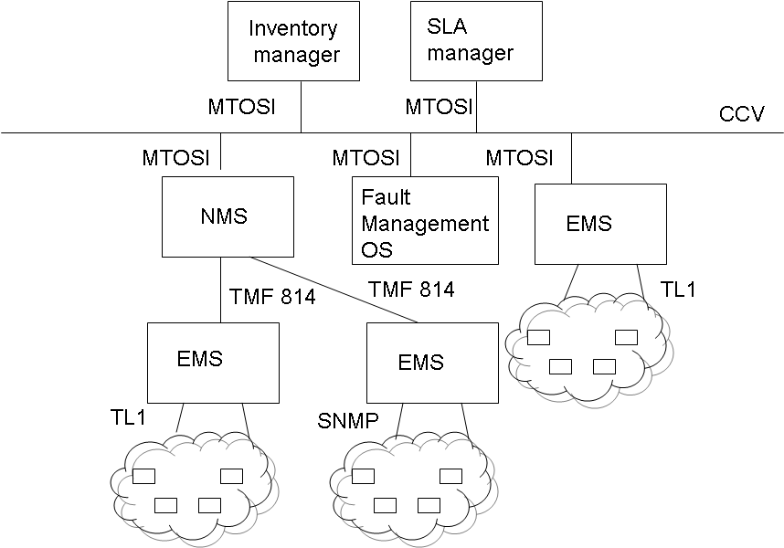
MTOSI-based Architecture
Chapter 16 Advanced Management Topics
Notes
Figure 16.17 MTOSI Architecture
Network Management: Principles and Practice
© Mani Subramanian and N. Usha Rani 2010
*

Slide 53
OASIS
Chapter 16 Advanced Management Topics
“Organization for the Advancement of Structured Information Standards (OASIS) is a not-for-profit consortium that drives the development, convergence, and adoption of open standards for the global information society.”
Notes
Network Management: Principles and Practice
© Mani Subramanian and N. Usha Rani 2010
*

Slide 54
OASIS Standards
Chapter 16 Advanced Management Topics
Web Services Distributed Management (WSDM) [WSD] committee defined the architecture and technology to manage distributed resources using Web services
Standard particularly applicable to systems management
The two applicable standards are Management Using Web Services (MUWS) and Management Of Web Services (MOWS).
Notes
Network Management: Principles and Practice
© Mani Subramanian and N. Usha Rani 2010
*

Slide 55
MUWS
Chapter 16 Advanced Management Topics
Addresses the use of Web services as the foundation of a systems management framework
Includes the use of Web services for interaction between the managed resources and management applications
Wire-level specification of how to describe the manageability of a resource using WSDL documents
Capability for discovery of manageable resources and their manageability capabilities.
Notes
Network Management: Principles and Practice
© Mani Subramanian and N. Usha Rani 2010
*

Slide 56
MOWS
Chapter 16 Advanced Management Topics
Includes management-specific attributes to expose properties such as lifecycle state and performance of Web services.
Management operations to monitor/control a Web service itself are specified.
Notes
Network Management: Principles and Practice
© Mani Subramanian and N. Usha Rani 2010
*

Slide 57
Summary
Chapter 16 Advanced Management Topics
Service Provider’s NOC has several loosely coupled applications interacting with managed resources and with each other.
Network facing interface is low-level, efficient, and fast.
Application communication via event-driven bus architecture required rather than a request- response model.
Web services-based management approach appropriate
MTOSI, in the telecom IT environment , and WSDM for systems management meet the needs.
Notes
Network Management: Principles and Practice
© Mani Subramanian and N. Usha Rani 2010
*

