Slide 1
S 11-32
76-?
Chapter 13
Broadband Network Management:
Wired and Optical Access Networks
Chapter 13 Broadband Network Management: Wired and Optical Access Networks
Network Management: Principles and Practice
© Mani Subramanian 2010
*
Notes:
Chapter 13
*

Slide 2
Objectives
Chapter 13 Broadband Network Management: Wired and Optical Access Networks
(Wired) Broadband access networks
  Cable or HFC (hybrid fiber cable) network
  ADSL (asymmetrical digital subscriber line)
  network
  PON (passive optical network)
Cable access network
  Popular in North American continents
  “Triple play” service can be provided
  DOCSIS (data over cable system interface
  specifications) standards
ADSL
  Predominant throughout the rest of the world
  Uses conventional telephone local loop medium
  Broadband voice and data services
  Adopts IETF and DSL forum standards
  VDSL2 for performance improvement of
  broadband service
PON
  PON deployment configurations
  Ethernet-based PON, EPON
  EPON protocol architecture
  EPON management
  EPON MIBs
Network Management: Principles and Practice
© Mani Subramanian 2010
*

Slide 3
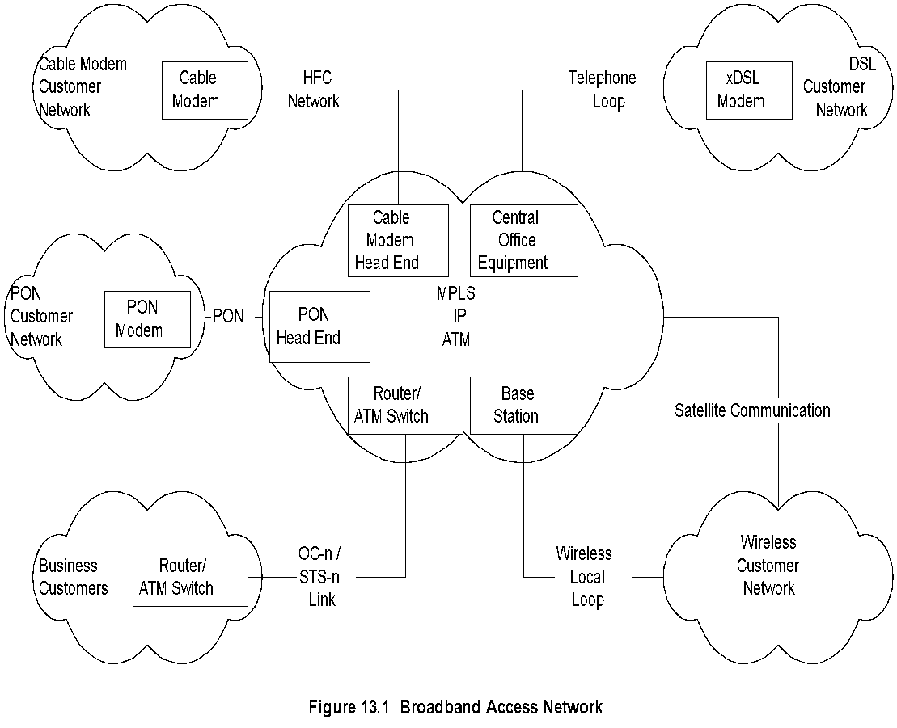
Broadband Access Networks
Chapter 13 Broadband Network Management: Wired and Optical Access Networks
  Notes
Access network between WAN and home network
Four access network technologies
OC-n an extension of WAN for enterprise
Network Management: Principles and Practice
© Mani Subramanian 2010
*

Slide 4
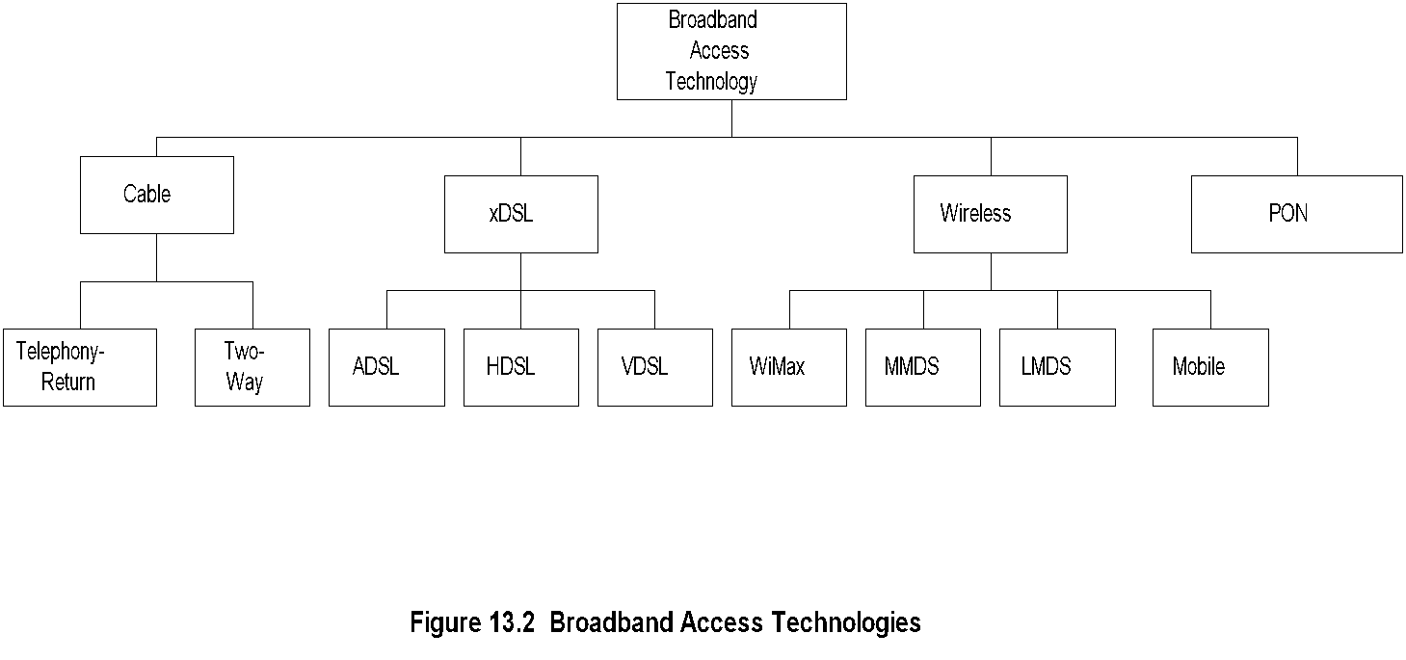
Broadband Access Technologies
Chapter 13 Broadband Network Management: Wired and Optical Access Networks
  Notes
Cable popular in North America
ADSL more extensively deployed elsewhere in the world
Wireless:
  Fixed: MMDS, LMDS, and WiMax
  Mobile: CDMA, GPRS
PON on fiber medium
Network Management: Principles and Practice
© Mani Subramanian 2010
*

Slide 5
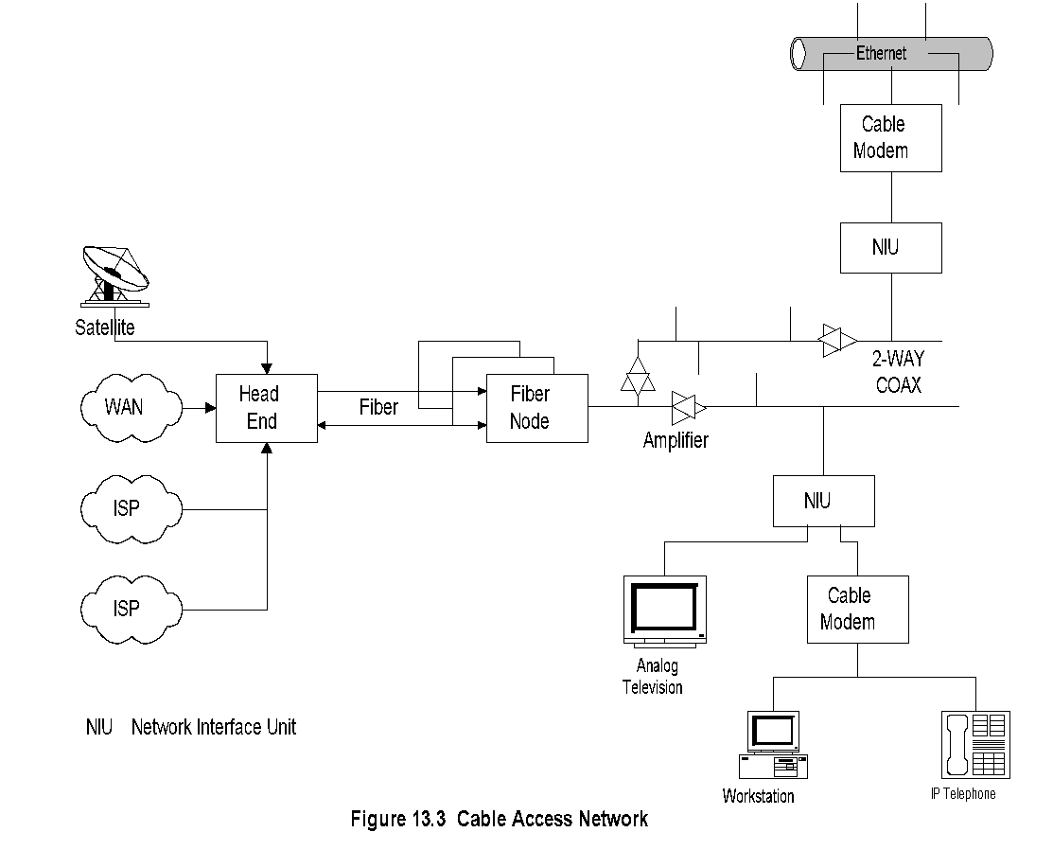
Cable Access Network
Chapter 13 Broadband Network Management: Wired and Optical Access Networks
  Notes
Head end:
  Signals from multiple sources multiplexed
  Frequency conversion for local signal
Traffic Flow:
  Downstream: Head end to NIU
  Upstream: NIU to head end
Network interface device (NID) / unit (NIU):
Demarcation point between customer network and
service provider networks
Cable modem: RF Ethernet, voice-over-IP,
and video
Network Management: Principles and Practice
© Mani Subramanian 2010
*
Notes:
Chapter 13
*

Slide 6
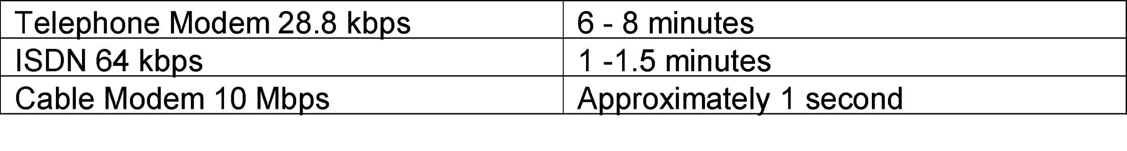
Comparative Speeds
Chapter 13 Broadband Network Management: Wired and Optical Access Networks
Table13.1 Comparative Data Transmission Speeds
  Notes
Network Management: Principles and Practice
© Mani Subramanian 2010
*

Slide 7
Cable Access Network Technology
Chapter 13 Broadband Network Management: Wired and Optical Access Networks
Broadband 2-way cable access network
Asymmetric bandwidth allocation for 2-way
communication
Transmission Mode
  Downstream: TDM broadcast mode
  Upstream: TDMA / S-CDMA
RF spread-spectrum that carries multiple
signals over HFC
RF spectrum allocation to carry multimedia
services - voice, video, and data
  Notes
Network Management: Principles and Practice
© Mani Subramanian 2010
*

Slide 8
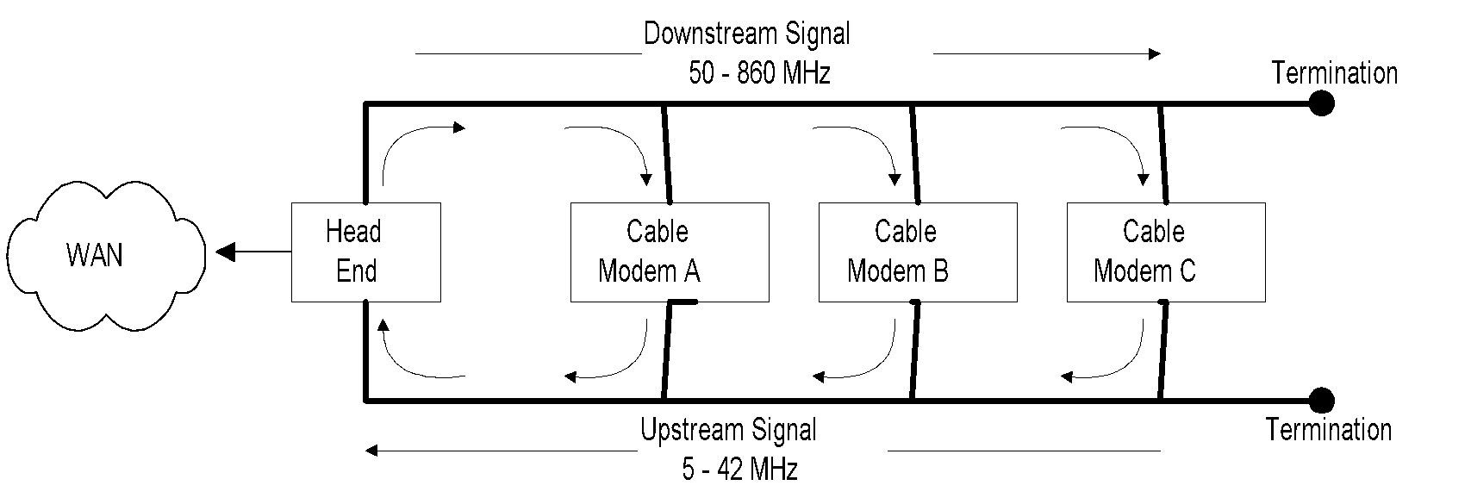
Cable Access Network
Chapter 13 Broadband Network Management: Wired and Optical Access Networks
Figure 13.4 Two-way Transmission in a Coaxial Cable
  Notes
Single physical medium, 2 logical data streams
Downstream 6 MHz (North American) / 8 MHz
(Europe, Asia) channels
Upstream Variable speed channels 160 kbps to
5.2 Mbps
Downstream TDM broadcast mode
Upstream TDMA in DOCSIS 1.0 and 1.1
Upstream S-CDMA in DOCSIS 2.0
Network Management: Principles and Practice
© Mani Subramanian 2010
*

Slide 9
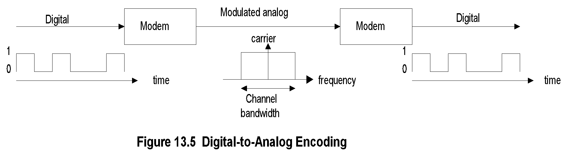
Digital-to-Analog Encoding
Chapter 13 Broadband Network Management: Wired and Optical Access Networks
Carrier
Carrier
  Notes
bit rate
symbol (baud) rate
number of levels n = 2^{k};
k..number of bits per symbol
bit rate = symbol rate x k
Network Management: Principles and Practice
© Mani Subramanian 2010
*

Slide 10
Modulation Schemes
Chapter 13 Broadband Network Management: Wired and Optical Access Networks
Basic modulation techniques
  ASK (Amplitude Shift Keying)
  FSK (Frequency Shift Keying)
  PSK (Phase Shift Keying)
Cable technology uses
  QPSK (Quadrature Phase Shift Keying)
  QAM (Quadrature Amplitude Modulation)
  Notes
Quadrature phase shift keying
  Four levels ( 00, 01, 10, 11)
  Relatively insensitive to noise
  Used for low-band upstream
  8 MHz channel: 8x2=16 Mbps
Quadrature amplitude modulation (not 4-levels)
  Combination of AM and PM
  16-QAM = 8 PM x 2 AM or 4 PM x 4 AM
  Used for higher-band downstream
  8 MHz channel 8x4=32 Mbps
Network Management: Principles and Practice
© Mani Subramanian 2010
*

Slide 11
Cable Modem
Chapter 13 Broadband Network Management: Wired and Optical Access Networks
Table 13.2 Cable Modem Speeds
Version | DOCSIS |  | EuroDOCSIS
 | Downstream Mbit/s | Upstream Mbit/s | Downstream Mbit/s | Upstream Mbit/s
1.x | 42.88 (38) | 10.24 (9) Mbit/s | 55.62 (50) | 10.24 (9)
2.0 | 42.88 (38) | 30.72 (27) | 55.62 (50) | 30.72 (27)
3.0 4 channel | +171.52 (+152) | +122.88 (+108) | +222.48 (+200) | +122.88 (+108)
3.0 8 channel | +343.04 (+304) | +122.88 (+108) | +444.96 (+400) | +122.88 (+108)
  Notes
HFC uses tree topology
Downstream in broadcast mode
Upstream transmission by cable modem
coordinated by head end
Data-over-cable service specifications (DOCSIS)
for cable modem ensures interoperability
One-way cable modem uses telco-return
Network Management: Principles and Practice
© Mani Subramanian 2010
*

Slide 12
Functions of Cable Modem
Termination System
Chapter 13 Broadband Network Management: Wired and Optical Access Networks
Equipment at the head end
All cable modems terminated on the head end
Gateway to the external network
Multiplexes and demultiplexes signals
Frequency converts upstream to downstream
signals
Can be configured either as a bridge or router
  Notes
Network Management: Principles and Practice
© Mani Subramanian 2010
*

Slide 13
HFC Plant
Chapter 13 Broadband Network Management: Wired and Optical Access Networks
Multiple fiber pairs run from head end to fiber node;
each pair carries 2 one-way signals
Head end converts all (telephony, digital video,
data, and analog video) signals to optical carrier
to transmit on the fiber
Houses are connected from fiber node via
coaxial cables
Coaxial cable is in tree topology and carries
2-way signal
Amplifiers on the coaxial cable have 2-way
amplifiers that amplify the signals in both directions
Drop from coaxial cable to NID (also called NIU)
- called “Tap-to-TV” in CATV
  Notes
Network Management: Principles and Practice
© Mani Subramanian 2010
*

Slide 14
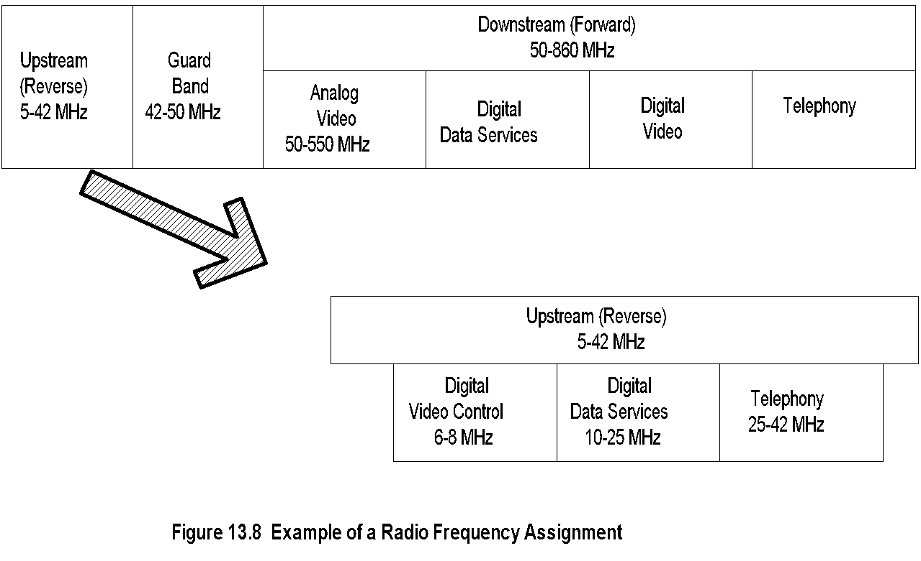
RF Spectrum
Chapter 13 Broadband Network Management: Wired and Optical Access Networks
  Notes
Network Management: Principles and Practice
© Mani Subramanian 2010
*

Slide 15
Data-over-Cable Standards
Chapter 13 Broadband Network Management: Wired and Optical Access Networks
Standards driven by CableLabs
Two sets of standards to achieve interoperability
  DOCSIS (Data-Over-Cable Interface
  Specifications)
    DOCSIS 1.0
    DOCSIS 1.1
    DOCISS 2.0
    DOCISS 3.0
  IETF RFCs on MIBs
CableLabs Projects
  Notes
Open Cable: Specifies customer device,
Hardware and software
Packet Cable: Interoperable specifications for
multimode real-time devices
Cable Home: Interface specifications for
extending DOCSIS services to home
Network Management: Principles and Practice
© Mani Subramanian 2010
*

Slide 16
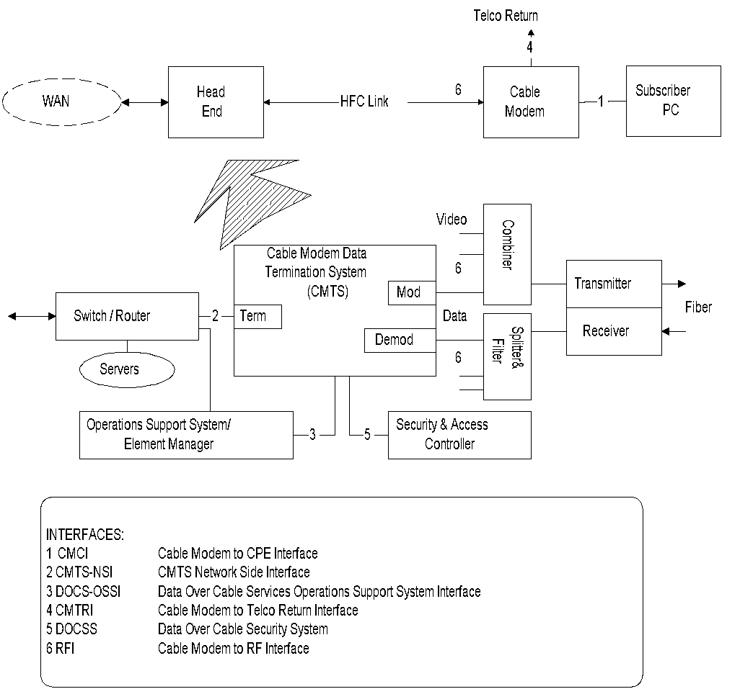
DOCS Reference Architecture
Chapter 13 Broadband Network Management: Wired and Optical Access Networks
Source: CableLabs
Figure 13.9 Data-Over-Cable System Reference Architecture
  Notes
The architecture shows two-way (HFC link)
and one-way (HFC link & telco return).
Network Management: Principles and Practice
© Mani Subramanian 2010
*

Slide 17
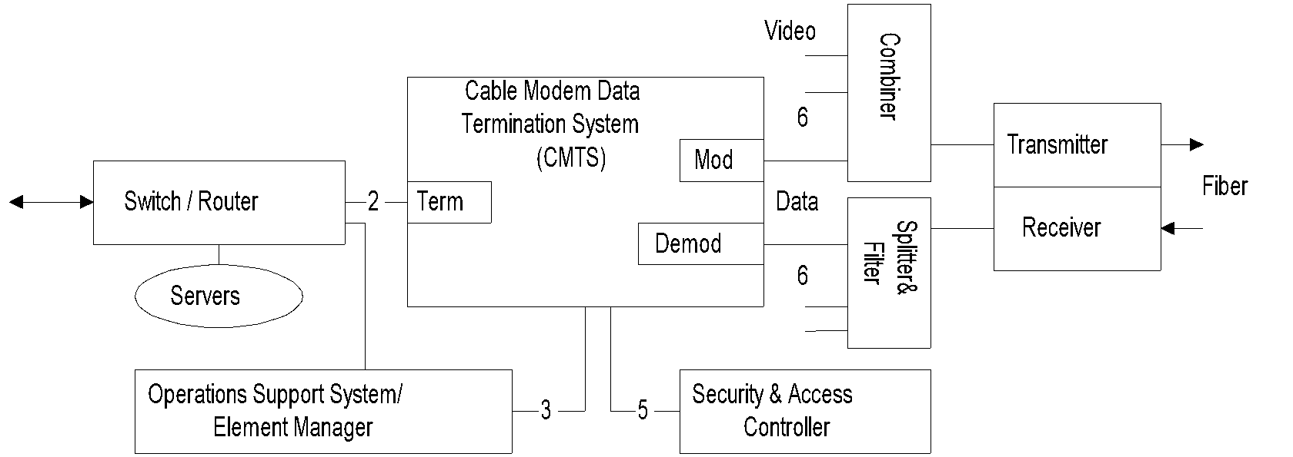
CMTS Components
Chapter 13 Broadband Network Management: Wired and Optical Access Networks
  Notes
Switch / router routes the traffic between cable
modems and to the external network. It interfaces
to CMTS via the terminator (term).
Modulator (mod) and demodulator (demod)
transform digital data from and to analog format.
Combiner and splitter and filter perform the
complementary functions of mux’ing and demux’ing.
Transmitter converts the RF signals to optical carrier;
receiver down-converts the optical signal.
Servers handle the applications and databases.
Security is managed by the security and access
controller.
OSS and element manager perform network and
service management.
Network Management: Principles and Practice
© Mani Subramanian 2010
*

Slide 18
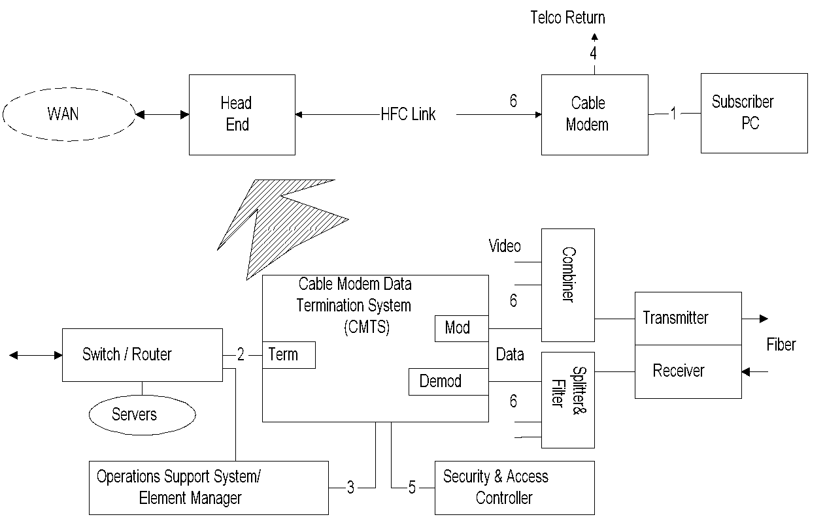
DOCS Interfaces
Chapter 13 Broadband Network Management: Wired and Optical Access Networks
  Notes
Three groups of interfaces:
  Data interfaces
    Cable modem to CPE (1)
    CMTS-NSI (2)
  Operations support systems and telco-return
    OSS (3)
    Telco-return (4)
  RF and security
    DOCS security system (5)
    RF interface (6)
Network Management: Principles and Practice
© Mani Subramanian 2010
*

Slide 19
HFC Management: Challenges
Chapter 13 Broadband Network Management: Wired and Optical Access Networks
More complex than either computer network or
telecommunication network
Involves both physical and data layers
Multiple physical facilities
Legacy cable system
Multimedia service
RF spectrum management
Service and business management important
for MSOs and customer
Shared media impacts security and bandwidth
Security and privacy of home network
  Notes
Network Management: Principles and Practice
© Mani Subramanian 2010
*

Slide 20
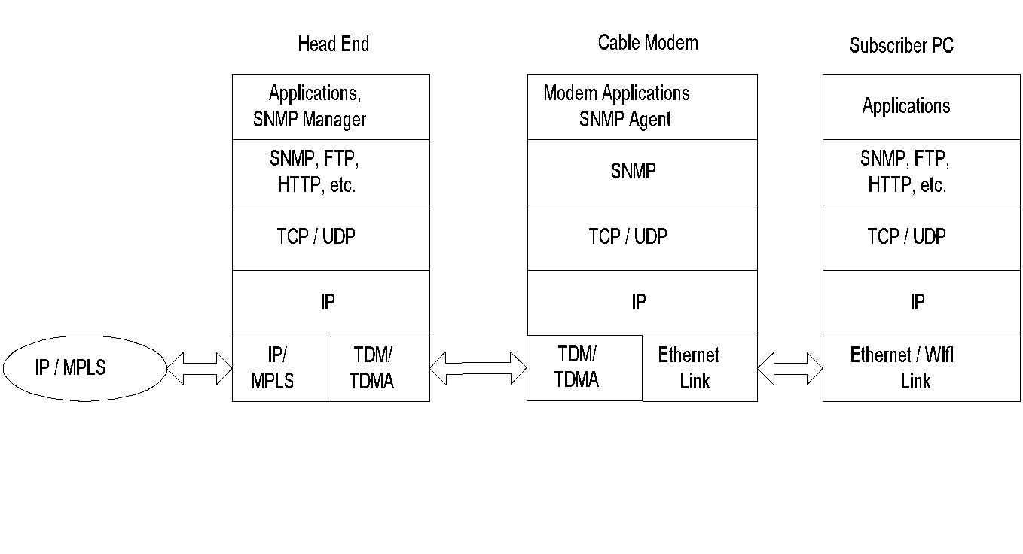
HFC Protocol Architecture
Chapter 13 Broadband Network Management: Wired and Optical Access Networks
Figure 13.10 Protocol-Layer Architecture in a Cable Access Network System
  Notes
Head end has both NM applications and manager
Cable modems have SNMP agents
NMS can be regionalized; then, head ends could
behave as RMONs
Network Management: Principles and Practice
© Mani Subramanian 2010
*

Slide 21
HFC / CM Management
Chapter 13 Broadband Network Management: Wired and Optical Access Networks
Cable modem management
CMTS management
HFC link management
RF spectrum management
  Notes
Network Management: Principles and Practice
© Mani Subramanian 2010
*

Slide 22
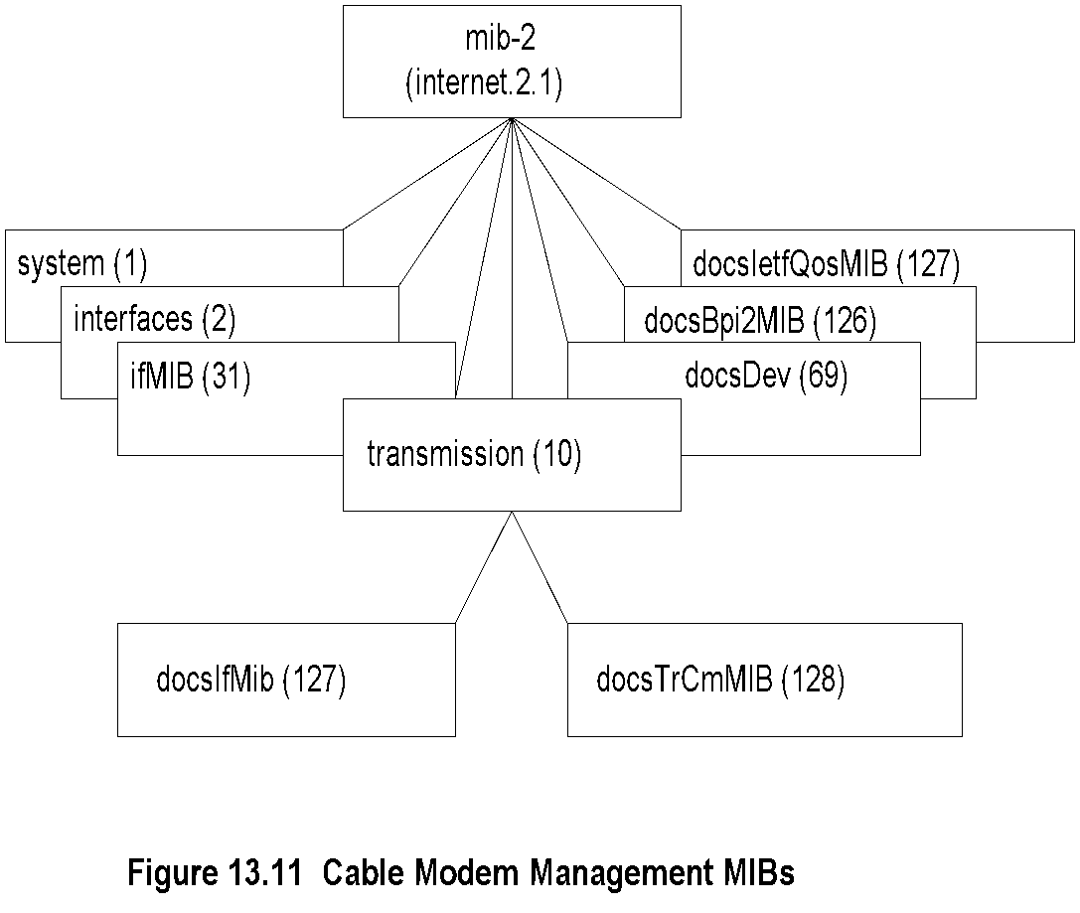
CM Management MIBs
Chapter 13 Broadband Network Management: Wired and Optical Access Networks
  Notes
Three categories of MIBs
  Standard MIBs:
    system, interfaces, ifMIB
  CM and CMTS interfaces
    docIfMIB .. RF Interfaces in CM and CMTS,
    base line privacy and QoS
    docsTrCmMIB .. telephony-return interface
  CM and CMTS objects
    docsDev MIB
Network Management: Principles and Practice
© Mani Subramanian 2010
*

Slide 23
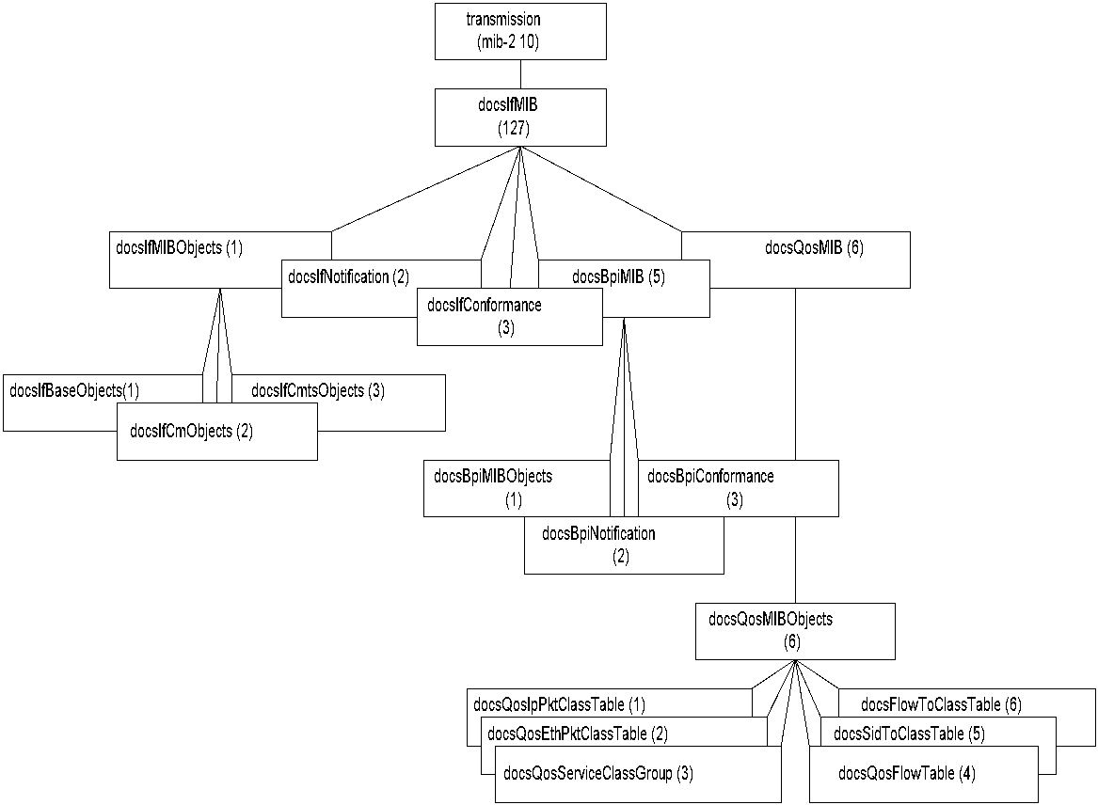
DOCS Interface MIB
Chapter 13 Broadband Network Management: Wired and Optical Access Networks
Figure 13.12 DOCS Interface MIB
  Notes
docsIfMIB supplements standard SNMP interfaces MIB
Covers:
  CM and CMTS objects docsIfMIBObjects
  Baseline privacy MIB docsBpiMIB: Security &
  Privacy
  QoS MIB docsQosMIB: CM and CMTS QoS
Network Management: Principles and Practice
© Mani Subramanian 2010
*

Slide 24
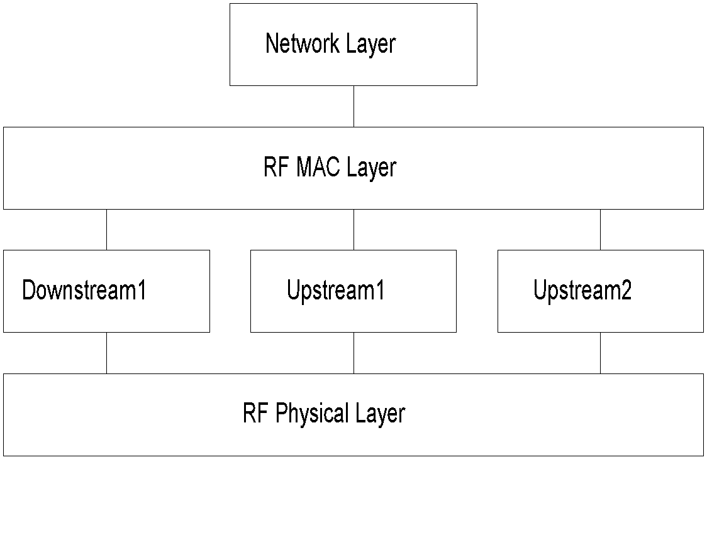
RF MAC Interface
Chapter 13 Broadband Network Management: Wired and Optical Access Networks
Figure 13.13 RF MAC Interface
  Notes
Multiple RF channels upstream and downstream
Layered structure
Specified using RFC 2873 ifMIB
ifType
  docsCable MAC layer 127
  docsCable downstream 128
  docs upstream 129
Network Management: Principles and Practice
© Mani Subramanian 2010
*

Slide 25
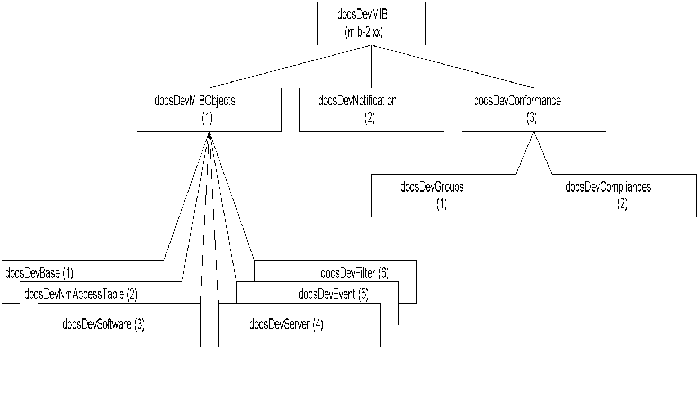
DOCS Cable Device MIB
Chapter 13 Broadband Network Management: Wired and Optical Access Networks
Figure 13.14 DOCS Cable Device MIB
  Notes
Network Management: Principles and Practice
© Mani Subramanian 2010
*

Slide 26
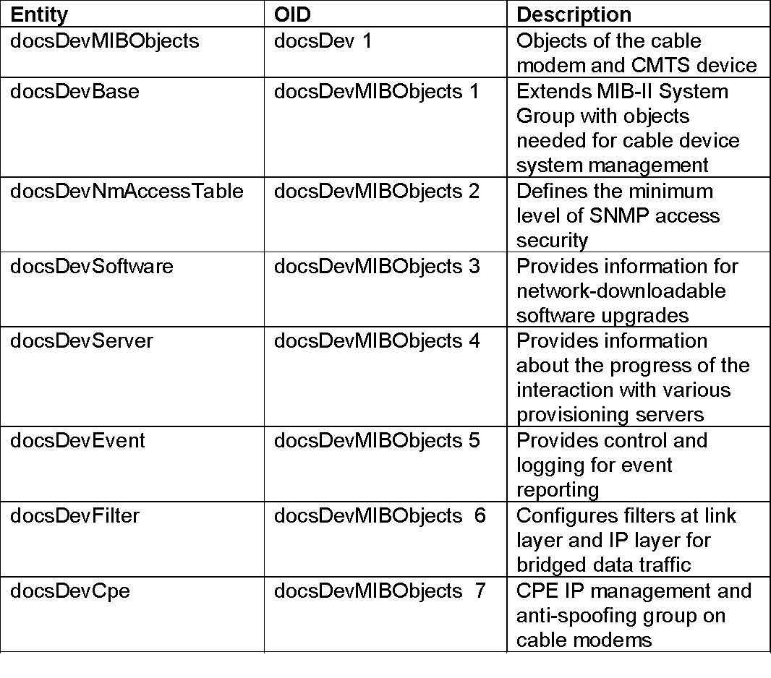
DOCS Cable Device MIB
Chapter 13 Broadband Network Management: Wired and Optical Access Networks
Table 13.6 DOCS Cable Device MIB
  Notes
Network Management: Principles and Practice
© Mani Subramanian 2010
*

Slide 27
Link and Spectrum Management
Chapter 13 Broadband Network Management: Wired and Optical Access Networks
HFC Link Management
  Signal strength critical
  Requires continuous monitoring of amplifiers
  using transponders (CheetahNet)
  Legacy system requires proxy server
RF Spectrum Management
  Allocation of spectrum for services -
  upstream and downstream
  Frequency agility management
  Notes
Network Management: Principles and Practice
© Mani Subramanian 2010
*

Slide 28
DOCSIS 1.0 / 1.1
Chapter 13 Broadband Network Management: Wired and Optical Access Networks
Key differences between DOCSIS 1.0 and 1.1
  Quality of Service – 8 levels
  Dynamic Services
  Fragmentation of upstream packet per CM
  basis
  Concatenation of packets
  Payload Header Suppression of repeated
  header
  IP Multicast using IGMP
  CM Authentication
  SNMPv3 security
  View-based access control and management
  (VACM)
  CM Account Management
  Fault Management
  Secure Software
  Notes
Network Management: Principles and Practice
© Mani Subramanian 2010
*

Slide 29
DOCSIS 2.0 and 3.0
Chapter 13 Broadband Network Management: Wired and Optical Access Networks
DOCSIS 2.0
  Enhancements on improving the performance of
  upstream traffic
  Efficient modulation techniques using two protocols:
    Synchronous CDMA (code division multiple access)
    Asynchronous TDMA (time division multiple access)
DOCSIS 3.0
  Introduction of IPv6 management
  Enhanced OSS interface
  Accounting management – Usage-based billing:
    SAMIS (Subscriber Account Management
    Interface Specification)
  IP Multicast
  Channel bonding
  Notes
Network Management: Principles and Practice
© Mani Subramanian 2010
*

Slide 30
DOCSIS Documentation
(Management Related)
Chapter 13 Broadband Network Management: Wired and Optical Access Networks
SP-CMCI-I10-050408 | Cable Modem to Customer Premises equipment Interface (CMCI) Specification
SP-CMTRI-I01-970804 | Cable Modem Telephony return Interface Specification
CM-SP-L2VPN-I08-080522 SP-CMTS-NSI-I01-960702 | Cable Modem Termination System - network side Interface specification
SP-RFIv1-I01-990311 CM-SP-DRFI-I06-080215 | RF Interface Specification
CM-SP-BPI+-I12-050812 | Baseline Privacy Interface Specification
CM-SP-OSSIv1.1-C01-050907 CM-SP-OSSIv2.0-I09-050812 CM-SP-M-OSSI-I07-071206 CM-SP-OSSIv3.0-I07-080522 | OSS Interface Specifications
RFC 4639 | Cable Device MIB
RFC 4547 | Event Notification MIB
RFC 4546 | RF Interface MIB
RFC 3083 RFC 4131 | Baseline Privacy MIB
draft-ietf-ipcdn-qos-mib-07.txt RFC 4323 | Quality of Service MIB
draft-ietf-ipcdn-tri-mib-00.txt, July 30, 1998 | Telephony-return interface MIB for Cable Modems and CMTS
RFC 4036 | CMTS for Subscriber Management
Network Management: Principles and Practice
© Mani Subramanian 2010
*

Slide 31
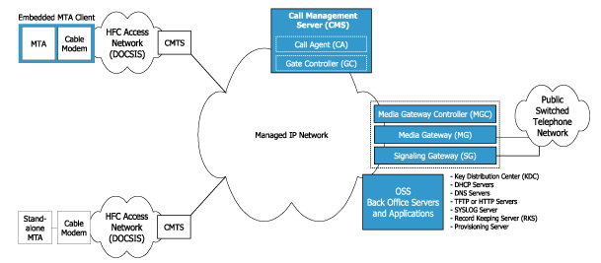
Packet Cable VoIP
Chapter 13 Broadband Network Management: Wired and Optical Access Networks
  Notes
Packet Cable defines a platform to deliver IP
services over DOCSIS
Network Management: Principles and Practice
© Mani Subramanian 2010
*

Slide 32
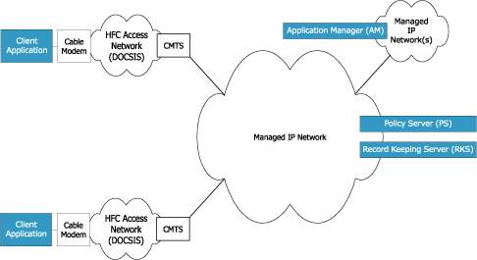
Packet Cable Multimedia
Chapter 13 Broadband Network Management: Wired and Optical Access Networks
  Notes
Platform for multimedia over DOCSIS access network
Application manager requests QoS on behalf of clients
Policy managers authorize and commit QoS requests
Network Management: Principles and Practice
© Mani Subramanian 2010
*

Slide 33
Digital Subscriber Line Access Networks
Chapter 13 Broadband Network Management: Wired and Optical Access Networks
Network Management: Principles and Practice
© Mani Subramanian 2010
*

Slide 34
DSL Access Technology
Chapter 13 Broadband Network Management: Wired and Optical Access Networks
Why is DSL attractive?
Shannon limit of data rate is 30,000 bps
(3-KHz, 30 dB S/N channel)
Digital transmission over loop (DSL) improves
data rate
  8-15 Mbps downstream
  0.8-1.5 Mbps upstream
  Limit on distance: max to 18,000 feet
  Notes
Network Management: Principles and Practice
© Mani Subramanian 2010
*

Slide 35
DSL Limitations
Chapter 13 Broadband Network Management: Wired and Optical Access Networks
Loop conditions with no direct copper to the house
Loaded coils in loop (used to increase analog
distance) cannot carry digital signal
Modern subdivisions have fiber to the neighborhood
or curb with digital mux
Operating company inventory dated (administrative
issue)
  Notes
Network Management: Principles and Practice
© Mani Subramanian 2010
*

Slide 36
xDSL Technologies
Chapter 13 Broadband Network Management: Wired and Optical Access Networks
Table 13.8 DSL Technologies
Name | Meaning | Max Data Rate* | Mode | Cable | Applications
ADSL / ADSL2 / ADSL2+ | Asymmetric Digital Subscriber Line | 7/12/24 Mbps 0.8/1/1 Mbps | Down Up | 1-pair | Most common type
SHDSL | Symmetric High data rate DSL | 5.6 Mbps | Duplex Duplex | 2-pair | Business Connections
VDSL 1 Km | Very high data rate Digital Subscriber Line | 55 Mbps 15 Mbps | Down Up | 2-pair | Triple Play (No QoS)
VDSL2- Long Reach 3 Km | Very high data rate Digital Subscriber Line | 55 Mbps 30 Mbps | Down Up | 2-pair | Triple Play
VDSL Short Reach 500 m | Very high data rate Digital Subscriber Line | 100 Mbps 100 Mbps | Down Up | 2-pair | Triple Play
* Max Data Rate as per Broadband Forum
  Notes
Network Management: Principles and Practice
© Mani Subramanian 2010
*

Slide 37
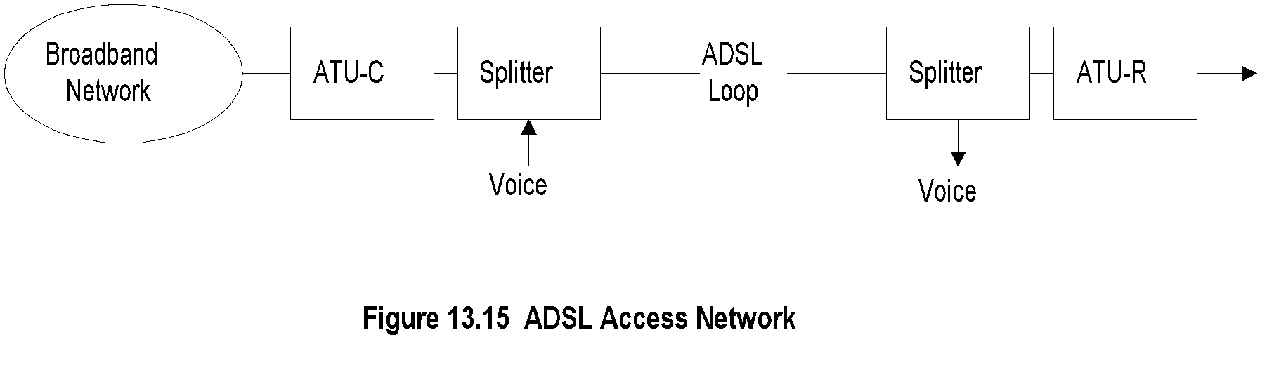
ADSL Network
Chapter 13 Broadband Network Management: Wired and Optical Access Networks
  Notes
ADSL .. Asymmetric Digital Subscriber Line
ATU-C ADSL transmission unit - central office
ATU-R ADSL transmission unit - remote/residence
Splitter separates voice and data
Network Management: Principles and Practice
© Mani Subramanian 2010
*

Slide 38
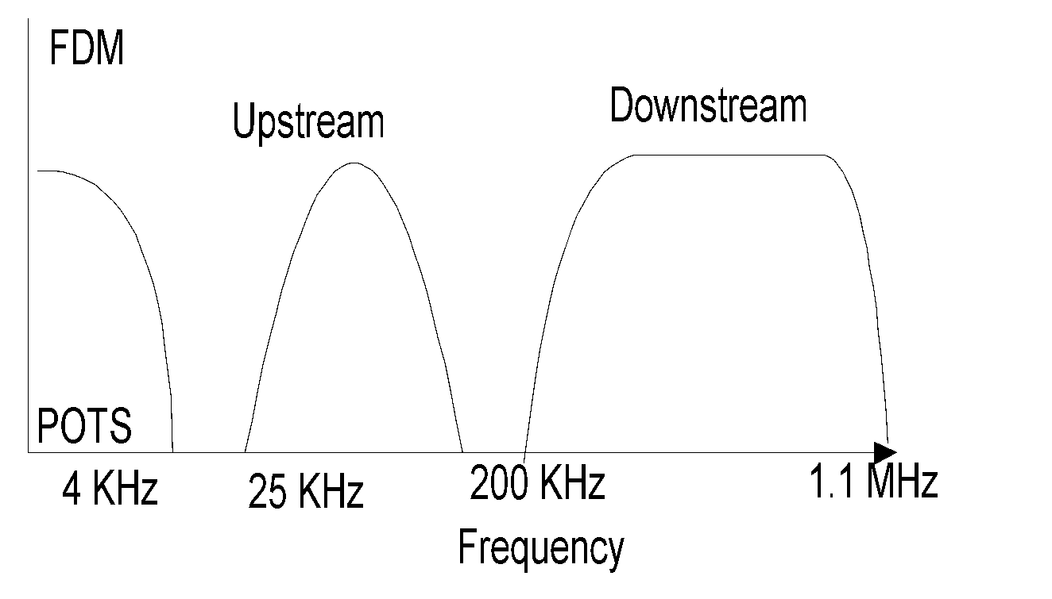
ADSL Spectrum Allocation with Guard Band
Chapter 13 Broadband Network Management: Wired and Optical Access Networks
Figure 13.16 ADSL Spectrum Allocationd (FDM)
  Notes
POTS .. Plain old telephone service
Network Management: Principles and Practice
© Mani Subramanian 2010
*

Slide 39
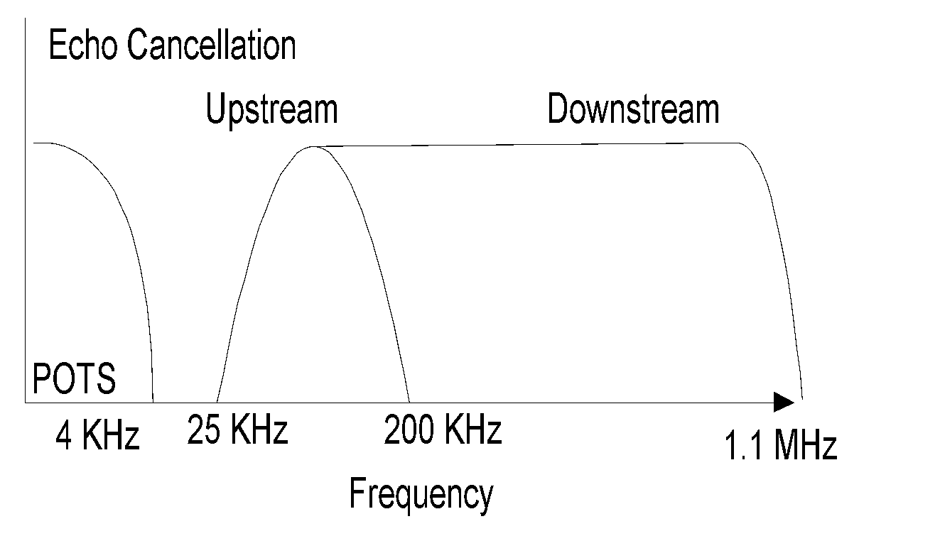
ADSL Spectrum Allocation with Echo Cancellation
Chapter 13 Broadband Network Management: Wired and Optical Access Networks
Figure 13.16 ADSL Spectrum Allocation (Echo Cancellation)
  Notes
Echo cancellation separates upstream and
downstream signals
Increases (low-frequency) upstream bandwidth
Network Management: Principles and Practice
© Mani Subramanian 2010
*

Slide 40
Modulation Schemes
Chapter 13 Broadband Network Management: Wired and Optical Access Networks
Carrierless amplitude phase (CAP) modulation
Discrete MultiTone modulation (DMT): 4kHz tones
Both CAP and DMT are QAM-based
DMT outperforms CAP
  Higher downstream throughput > 4 times
  Higher upstream throughput > 10
  Rate adaptive
  Ongoing active monitoring
  Maximum loop variation coverage
  Standard and hence interoperability
  Notes
Network Management: Principles and Practice
© Mani Subramanian 2010
*

Slide 41
DSL / Broadband Forum
Chapter 13 Broadband Network Management: Wired and Optical Access Networks
ADSL (now Broadband) Forum is an
industry consortium formed to
  Achieve interoperability
  Accelerate DSL implementation
  Address end-to-end system operation
  Security
  Management
3 sets of complementary standards adopted
  ITU-T standards
    G.992.x
    G.997.x
    T1-413 (ANSI)
  Forum Standards
    Technical reports TR-xxx
  IETF standards
    RFC xxxx
  Notes
Network Management: Principles and Practice
© Mani Subramanian 2010
*

Slide 42
Selected Documentation from DSL / Broadband Forum
Chapter 13 Broadband Network Management: Wired and Optical Access Networks
Table 13.9 ADSL Management Documents
TR-001 | ADSL Forum System Reference Model | May 1996
TR-005 | ADSL Network Element Mgmt | March 1998
TR-015 | CAP Line Code Specific MIB | February 1999
TR-024 | DMT Line Code Specific MIB | June 1999
TR-027 | SNMP-based ADSL LINE MIB | September 1999
TR-028 | CMIP Specification for ADSL Network Element Mgmt | May 1999
TR-066 | ADSL Network Element Mgmt (Update to TR-005) | March 2004
TR-090 | Protocol Independent Object Model for Managing Next Generation ADSL Technologies | December 2004
TR-113 | MCM Specific Managed Objects in VDSL Network Element | December 2005
TR-128 | Addendum to TR-090 | September 2006
  Notes
Network Management: Principles and Practice
© Mani Subramanian 2010
*

Slide 43

VDSL Network
Chapter 13 Broadband Network Management: Wired and Optical Access Networks
Figure 13.17 VDSL Access Network
  Notes
Used in FTTN configuration
Asymmetric band allocation (similar to ADSL)
Fiber carries multiple channels to ONU
Channels demultiplexed at ONU and carried to
customer premises on multiple twisted pairs
Shorter distance of multiple twisted pairs
Higher data rate - 55.2 Mbps downstream and
2.3 Mbps upstream
Network Management: Principles and Practice
© Mani Subramanian 2010
*

Slide 44
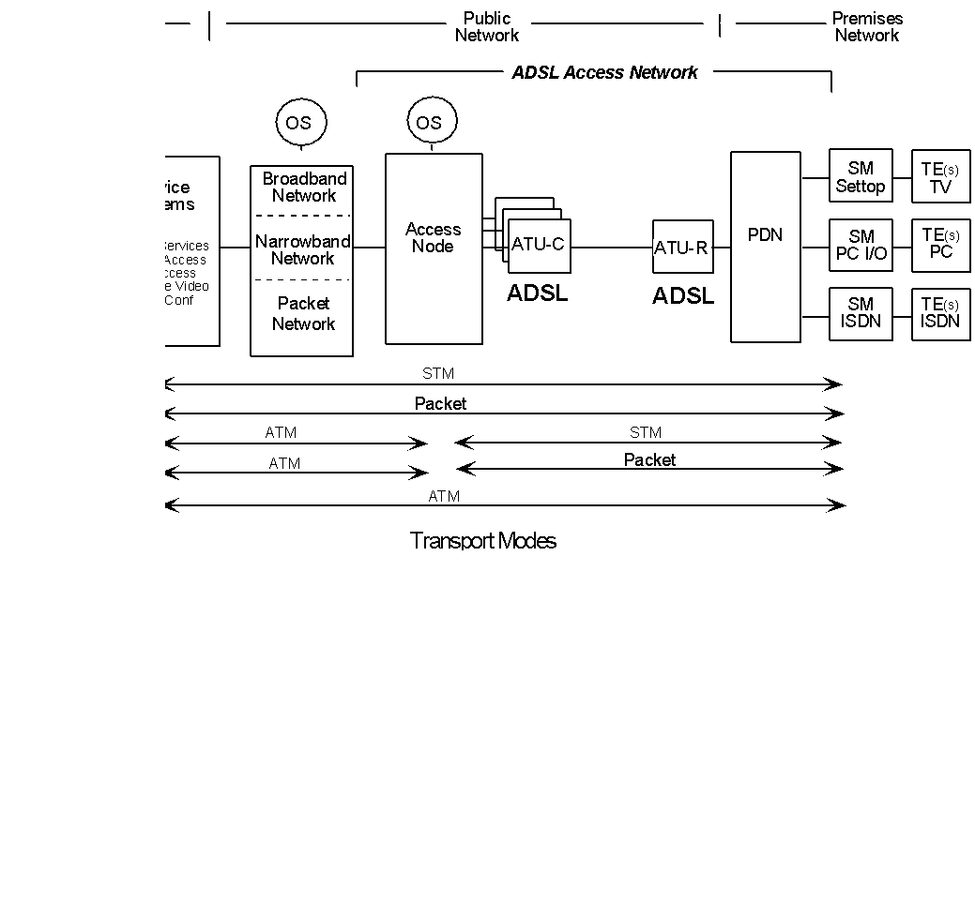
ADSL Network
Chapter 13 Broadband Network Management: Wired and Optical Access Networks
  Notes
Network Management: Principles and Practice
© Mani Subramanian 2010
*

Slide 45
Transport Modes
Chapter 13 Broadband Network Management: Wired and Optical Access Networks
Synchronous transport mode (STM)
  Bit synchronous transmission (T1/E1)
End-to-end packet mode
  Used for SOHO (IP packets)
ATM / STM
  ATM WAN (Public network) and
  STM access network
ATM / Packet
  ATM WAN and packet access network (IP)
End-to-end ATM
  Notes
Network Management: Principles and Practice
© Mani Subramanian 2010
*

Slide 46
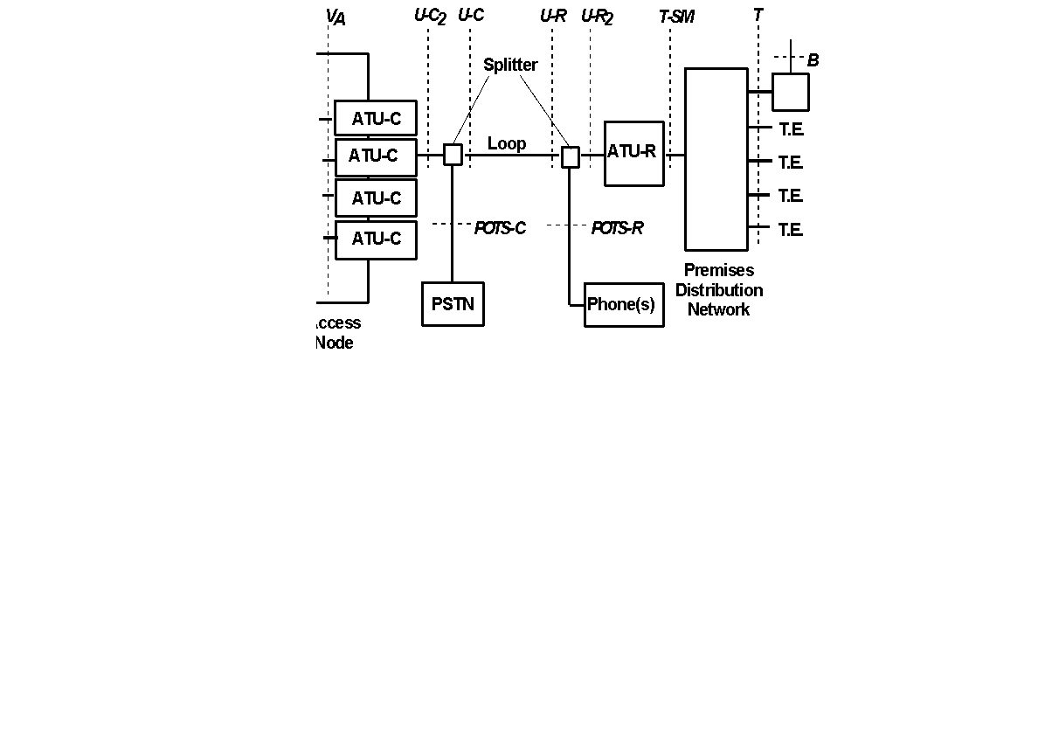
ADSL System Reference Model
Chapter 13 Broadband Network Management: Wired and Optical Access Networks
  Notes
(ADSL Forum)
Network Management: Principles and Practice
© Mani Subramanian 2010
*

Slide 47
Interfaces
Chapter 13 Broadband Network Management: Wired and Optical Access Networks
An interface can have multiple physical connections
V interface
  V_{C} interface between access node and
  external network and interfaces
U interfaces - off the splitters; Will be eliminated with
ADSL-Lite
POTS interfaces – low-pass filter interfaces for POTS
T and B are customer premises network interfaces
  T between PDN and service modules
  B auxiliary data input (e.g., satellite feed)
  Notes
Network Management: Principles and Practice
© Mani Subramanian 2010
*

Slide 48
ADSL Channeling Schemes
Chapter 13 Broadband Network Management: Wired and Optical Access Networks
ATU-C
ATU-R
Downstream bearer channels
Duplex bearer channels
ATU-C
ATU-R
Fast channel
Interleaved channel
Figure 13.20 ADSL Channeling
  Notes
Transport bearer channels
  Seven AS downstream channels
  - multiples (1-, 2-, 3- or 4-) T1 rate of 1.536 Mbps
  Three LS duplex channels
  - 160, 384, and 576 Kbps
Buffering scheme
  Fast channel: uses fast buffers for real-time data
  Interleaved channel: used for non-real-time data
  Both fast and interleaved channels carried on the
  same physical channel
Network Management: Principles and Practice
© Mani Subramanian 2010
*

Slide 49
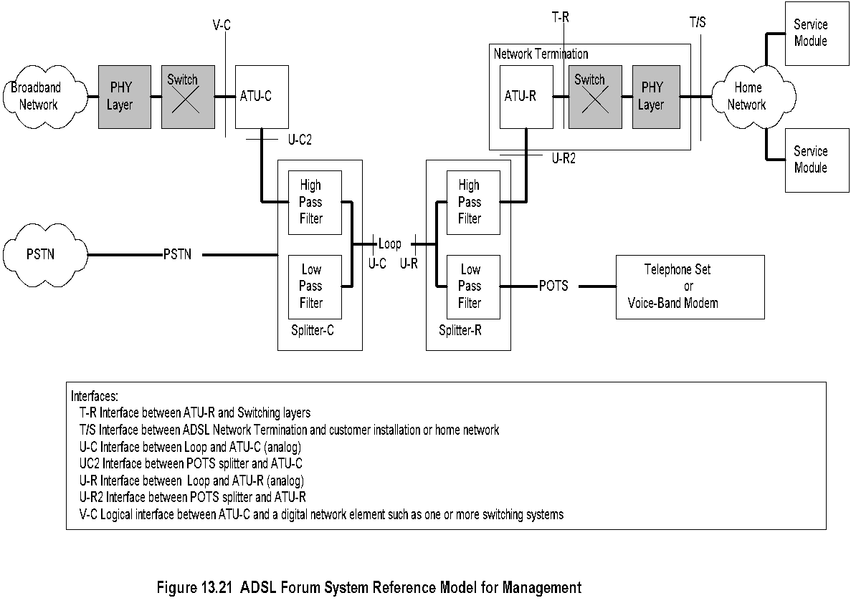
Management Reference Model
Chapter 13 Broadband Network Management: Wired and Optical Access Networks
  Notes
Network Management: Principles and Practice
© Mani Subramanian 2010
*

Slide 50
Management Elements
Chapter 13 Broadband Network Management: Wired and Optical Access Networks
Management of elements done across V-interface:
  Management communications protocol
  across V-interface
  Management communications protocol
  across U-interfaces
  Parameters and operations across ATU-C
  Parameters and operations across ATU-R
  ATU-R side of the T interface
  Notes
Note addition of physical layer and switching
in the management architecture representation
Management of physical layer involves:
  Physical channel
  Fast channel
  Interleaved channel
Management of type of line encoding
  DMT
  CAP
Network Management: Principles and Practice
© Mani Subramanian 2010
*

Slide 51
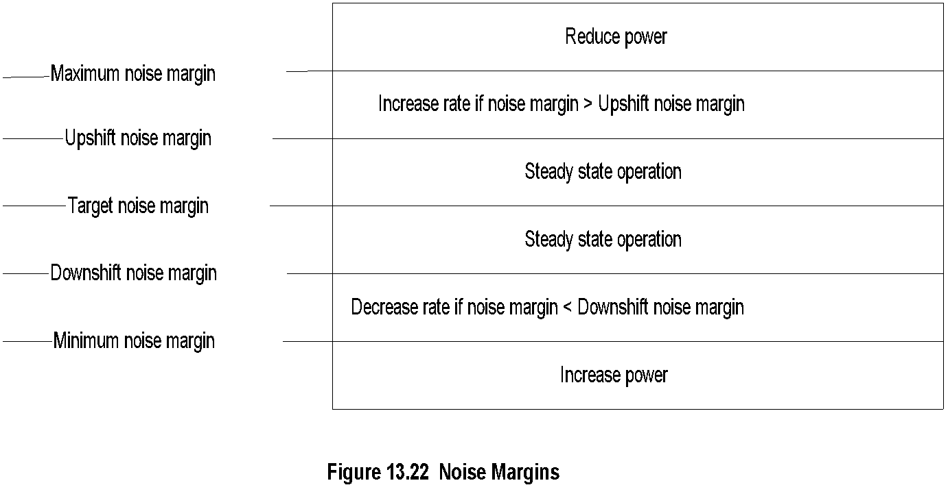
Signal Power and Data Rate Management
Chapter 13 Broadband Network Management: Wired and Optical Access Networks
  Notes
Five levels of noise margin
Signal power controlled by noise margin
Data rate: Increase or decrease based on
threshold margins
Data rate adaptation modes: Manual (1),
automatic at start-up (2), and dynamic (3)
Network Management: Principles and Practice
© Mani Subramanian 2010
*

Slide 52
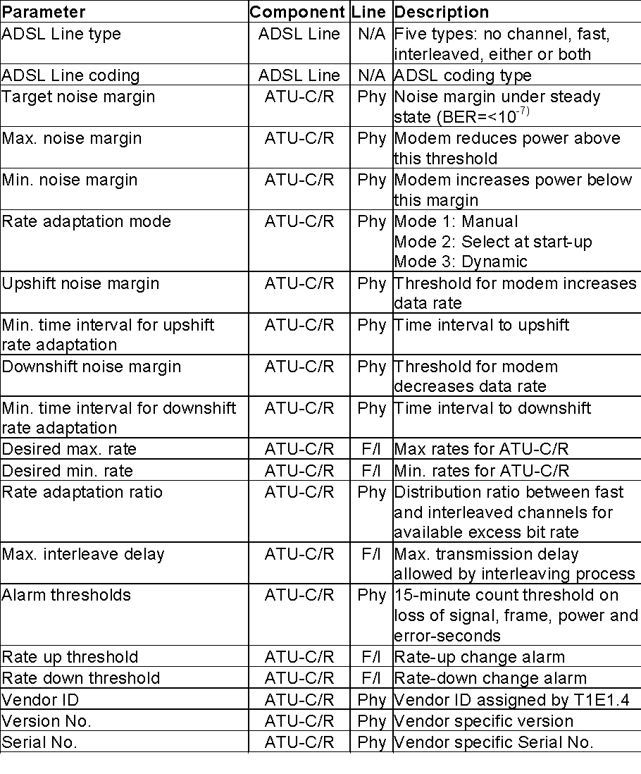
Configuration Mgmt Parameters
Chapter 13 Broadband Network Management: Wired and Optical Access Networks
Table 13.10 ADSL Configuration Management Parameters
Network Management: Principles and Practice
© Mani Subramanian 2010
*

Slide 53
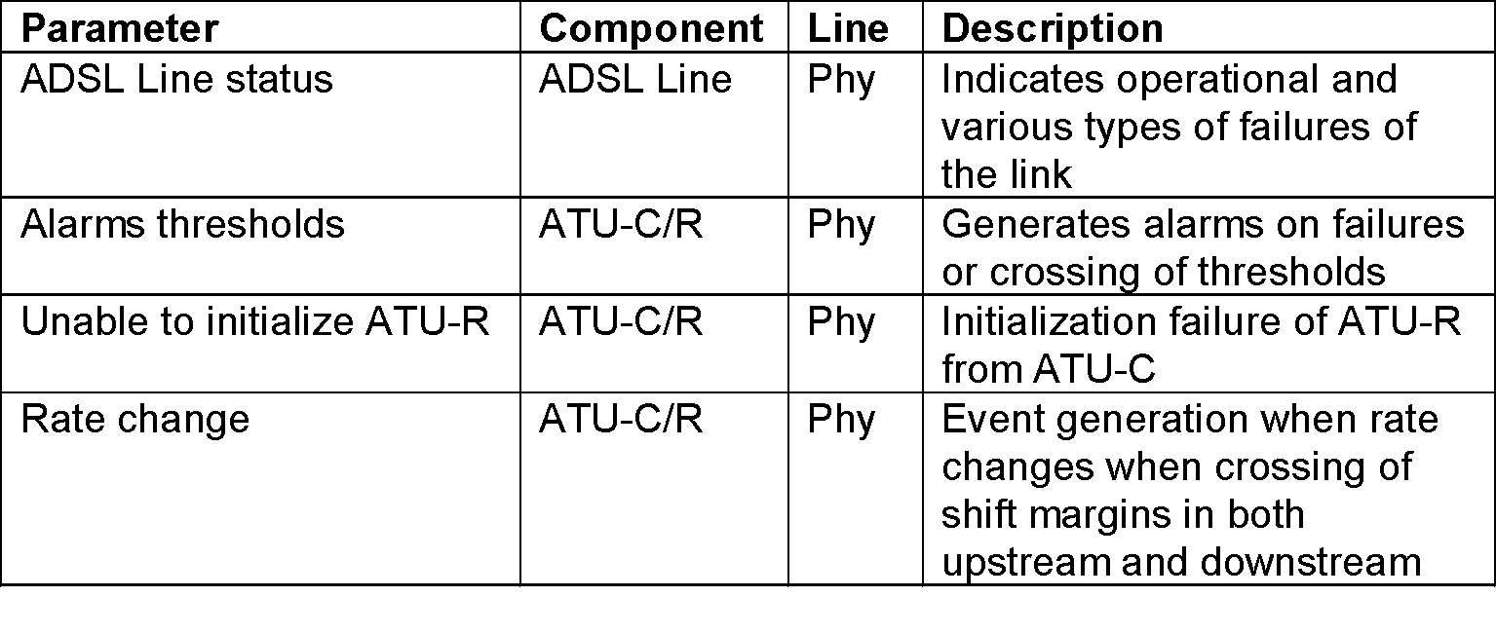
Fault Management
Chapter 13 Broadband Network Management: Wired and Optical Access Networks
Table 13.11 ADSL Fault Management Parameters
  Notes
Failure indication of physical channel by NMS
Failure indication of logical channels
Failure indication of ATU-C/R
Self-test of ATU-C/R as per T1.413
Noise margin threshold alarms
Rate change due to noise margin
Network Management: Principles and Practice
© Mani Subramanian 2010
*

Slide 54
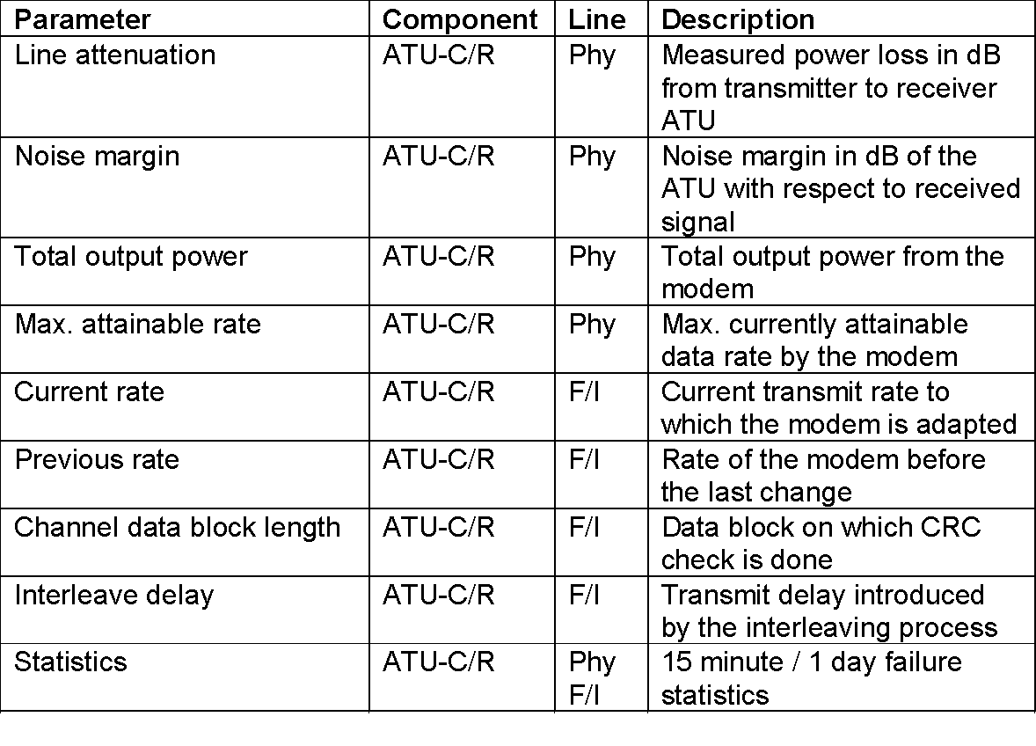
Performance Management
Chapter 13 Broadband Network Management: Wired and Optical Access Networks
Table 13.12 ADSL Performance Management Parameters
  Notes
Line attenuation
Noise margin
Output power
Data rate
Data integrity check
Interleave channel delay
Error statistics
Network Management: Principles and Practice
© Mani Subramanian 2010
*

Slide 55
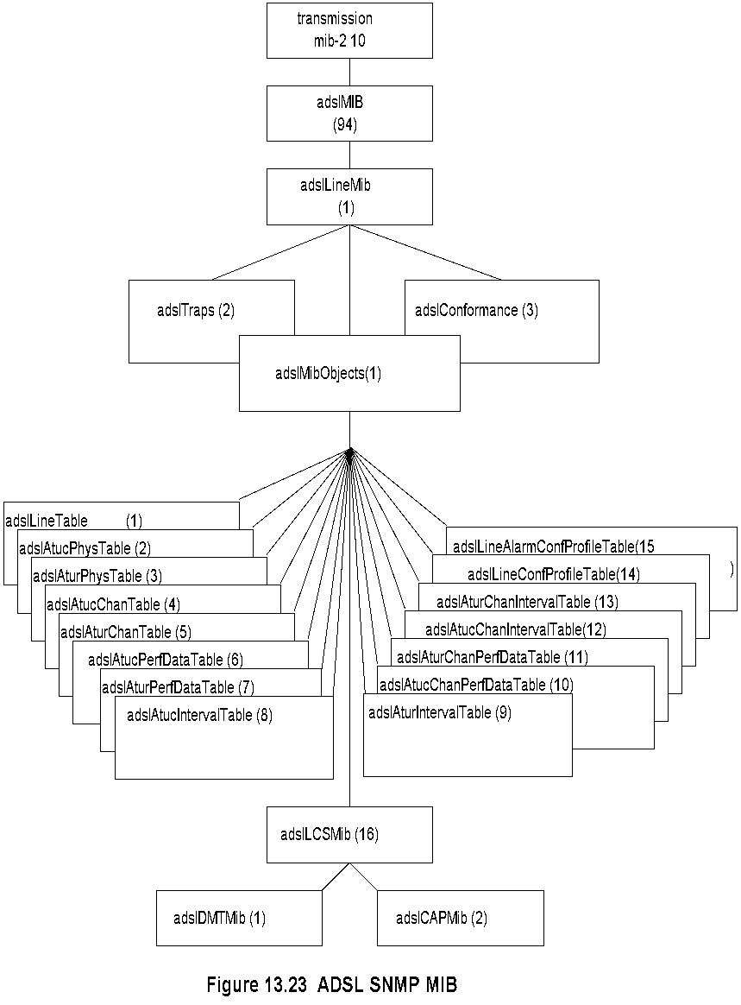
ADSL SNMP MIB
Chapter 13 Broadband Network Management: Wired and Optical Access Networks
Network Management: Principles and Practice
© Mani Subramanian 2010
*

Slide 56
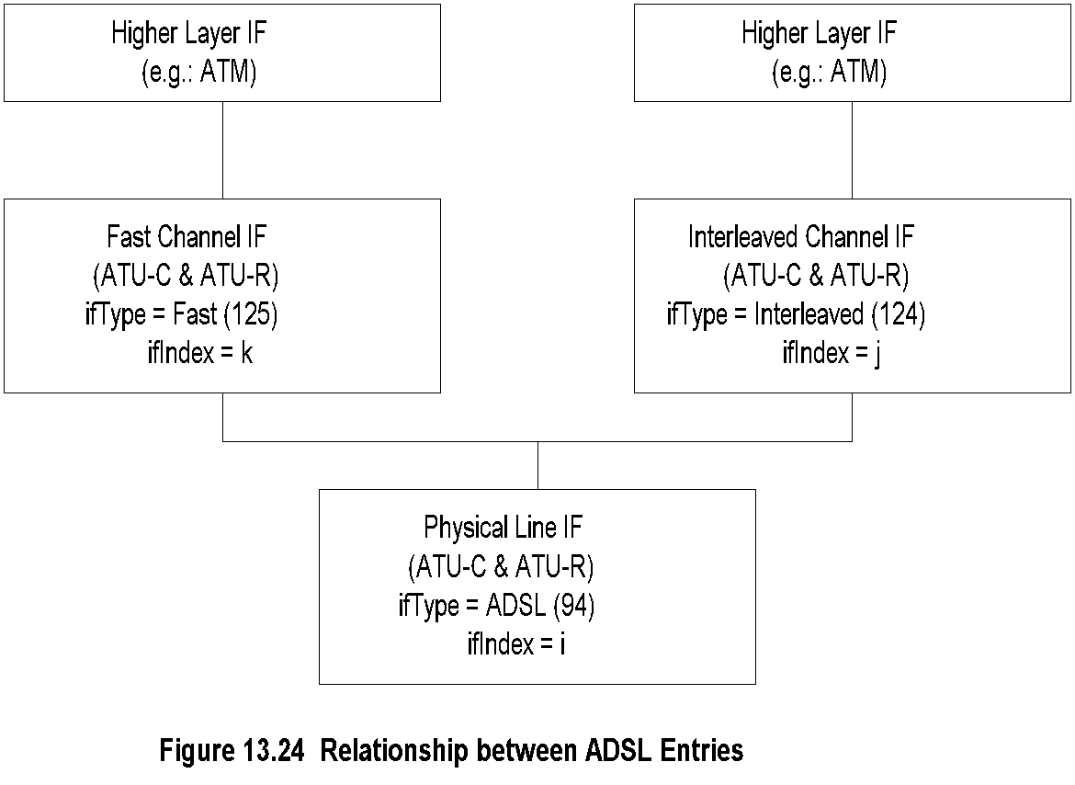
Proposed IF Types
Chapter 13 Broadband Network Management: Wired and Optical Access Networks
  Notes
Sublayers handled by ifMIB
ifStackTable {ifMib.ifMIBObjects 2} (RFC 1573)
Propose ifTypes
adslPhysIf ::= {transmission 94}
adslInterIf ::= {transmission 124}
adslFastIf ::= {transmission 125}
Network Management: Principles and Practice
© Mani Subramanian 2010
*

Slide 57
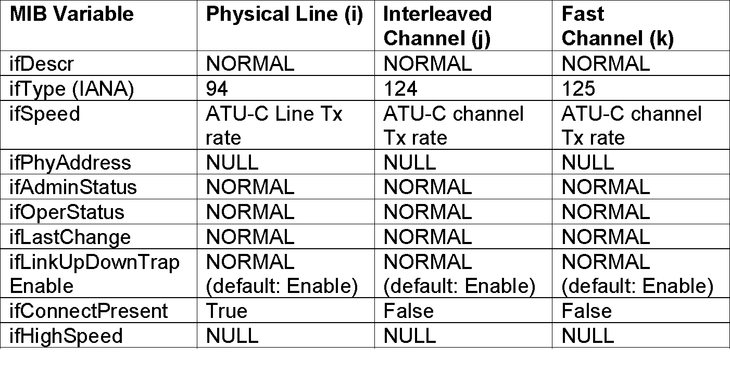
ADSL Interfaces Table
Chapter 13 Broadband Network Management: Wired and Optical Access Networks
Table 13.13 Use of Interfaces Table for ADSL
Table 13.14 ADSL Operational Profile for ifType File
  ADSL Operational Configuration
Line type | Physical | Fast Channel | Interleaved Channel
Number of Channels (1) | Yes |  | Yes
Fast only (2) | Yes | Yes
Interleave only (3) | Yes |  | Yes
Fast or Interleaved (4) | Yes | Yes | Yes
Fast and Interleaved (5) | Yes | Yes | Yes
Network Management: Principles and Practice
© Mani Subramanian 2010
*

Slide 58
ADSL Profiles Management
Chapter 13 Broadband Network Management: Wired and Optical Access Networks
Configuration profile
Performance profile
Alarm profile
Traps
  Generic
  Loss of frame
  Loss of signal
  Loss of power
  Error-second threshold
  Data rate change
  Loss of link
  ATU-C initialization failure
  Notes
Network Management: Principles and Practice
© Mani Subramanian 2010
*

Slide 59
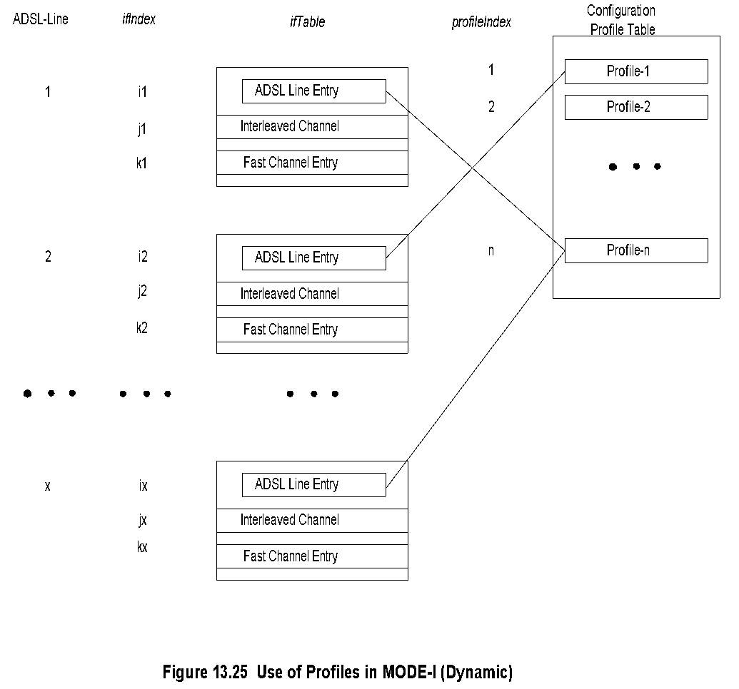
Configuration Profile:
Mode I - Dynamic
Chapter 13 Broadband Network Management: Wired and Optical Access Networks
Network Management: Principles and Practice
© Mani Subramanian 2010
*

Slide 60
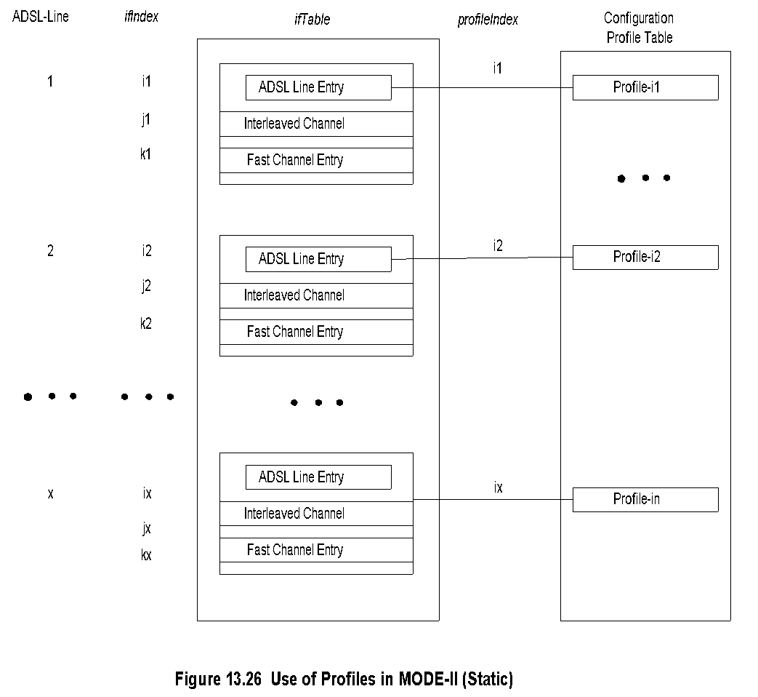
Configuration Profile:
Mode II - Static
Chapter 13 Broadband Network Management: Wired and Optical Access Networks
Network Management: Principles and Practice
© Mani Subramanian 2010
*

Slide 61
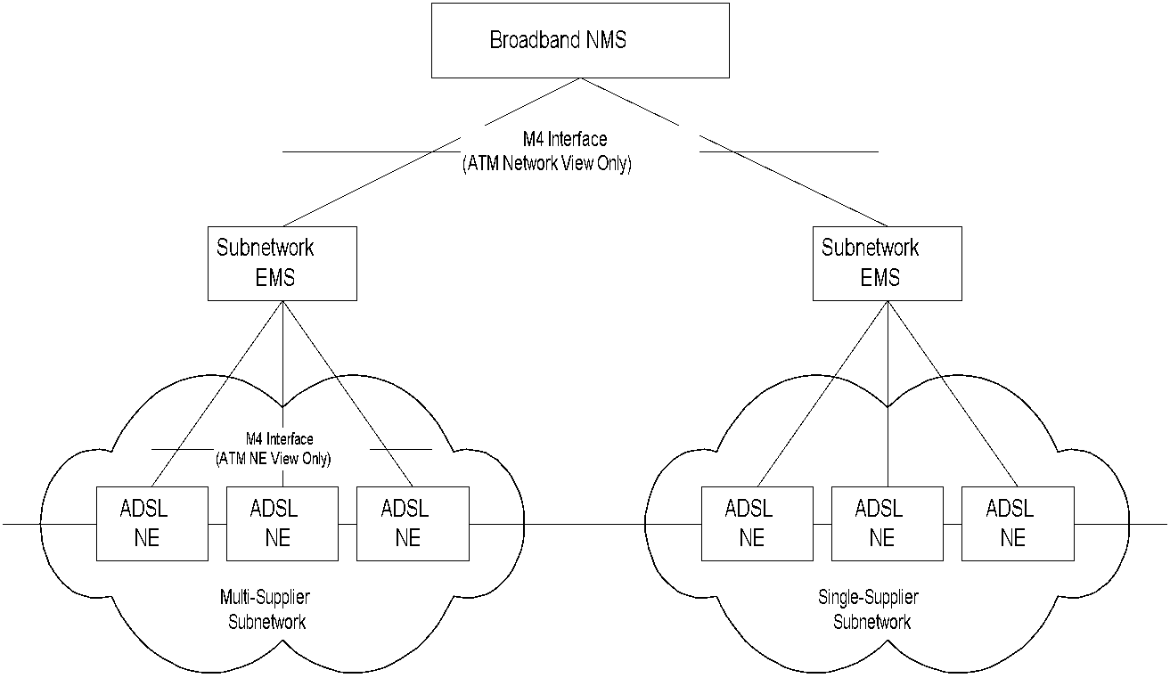
ADSL EMS-NMS Management
Chapter 13 Broadband Network Management: Wired and Optical Access Networks
  Notes
TMN- and ATM-based model
M4 is ATM Forum defined interface between
public NMS and public network
Network Management: Principles and Practice
© Mani Subramanian 2010
*

Slide 62
ADSL2 and ADSL2+
Chapter 13 Broadband Network Management: Wired and Optical Access Networks
Rate and reach Improvements
ADSL Speed Downstream/Upstream 1/.256 Mbps
ADSL2 Standard G.992.3 July 2002
ADSL2 Lite Standard G.992.4 July 2002
  Speed Downstream/Upstream 12/1 Mbps
ADSL2+ Standard G.992.5 January 2003
  Speed Downstream/Upstream 24/2 Mbps
Other Major Enhancements
  Diagnostics
  Power enhancements
  Rate adaptation
  Bonding for higher data rates
  Channelization and Channelized Voice-over
  DSL (CVoDSL)
Additional Benefits
  Improved interoperability
  Fast startup
  All-Digital Mode
  Support of packet-based services
Network Management: Principles and Practice
© Mani Subramanian 2010
*

Slide 63
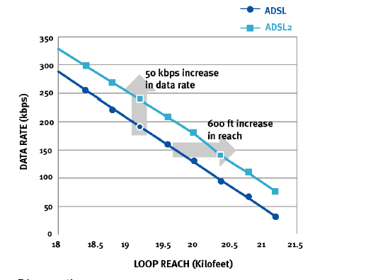
ADSL2 Rate and Reach
Chapter 13 Broadband Network Management: Wired and Optical Access Networks
  Notes
Data rate increase of 50 kbps or increase of
600 feet reach achieved
Programmable overhead
  ADSL 32 kbps
  ADSL2 4-32 kbps
Higher coding gain from Reed-Solomon (RS) code
Network Management: Principles and Practice
© Mani Subramanian 2010
*

Slide 64
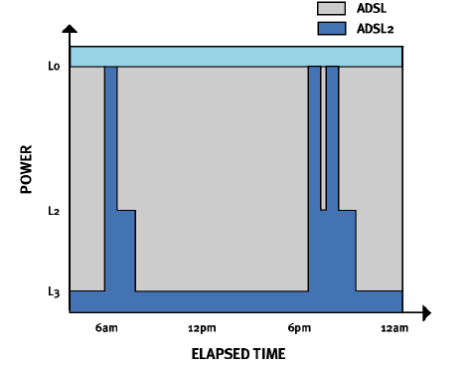
ADSL2 Power Enhancement
Chapter 13 Broadband Network Management: Wired and Optical Access Networks
  Notes
Savings in ATU-C and ATU-R
L0 Full power
L2 Normal power
L3 Sleep mode (user not on line)
Network Management: Principles and Practice
© Mani Subramanian 2010
*

Slide 65

Seamless Rate Adaptation
Chapter 13 Broadband Network Management: Wired and Optical Access Networks
  Notes
Telephone cable in bundle of 25 or more
Next and Fext can cause connection drop
SRA (Seamless Rate Adaptation) decouples
modulation and framing layers
Network Management: Principles and Practice
© Mani Subramanian 2010
*

Slide 66
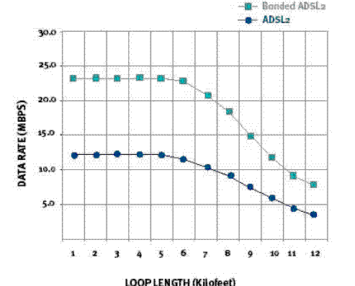
Bonding for Higher Data Rates
Chapter 13 Broadband Network Management: Wired and Optical Access Networks
  Notes
Bonds two or more UTP using ATM IMA (Inverse
Multiplexing for ATM)
New sublayer between PHY and ATM
Network Management: Principles and Practice
© Mani Subramanian 2010
*

Slide 67
Other ADSL2 Enhancements
Chapter 13 Broadband Network Management: Wired and Optical Access Networks
Diagnostics by use of enhanced transreceivers
  Line noise
  Loop attenuation
  SNR (Signal-to-Noise ratio)
Improved interoperability due to initialization of
state machine
Fast startup
Transmission of ADSL data in the voice bandwidth
Ethernet over ADSL2
  Notes
Network Management: Principles and Practice
© Mani Subramanian 2010
*

Slide 68
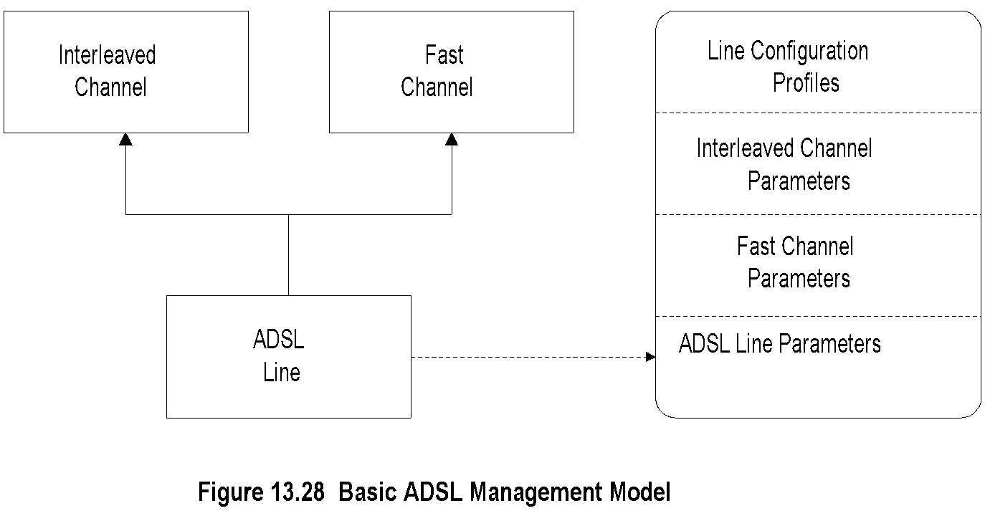
Basic ADSL Management Model
Chapter 13 Broadband Network Management: Wired and Optical Access Networks
  Notes
Supports a simple and fixed channel
  Fast channel
  Interleaved channel or
  Both
Network Management: Principles and Practice
© Mani Subramanian 2010
*

Slide 69
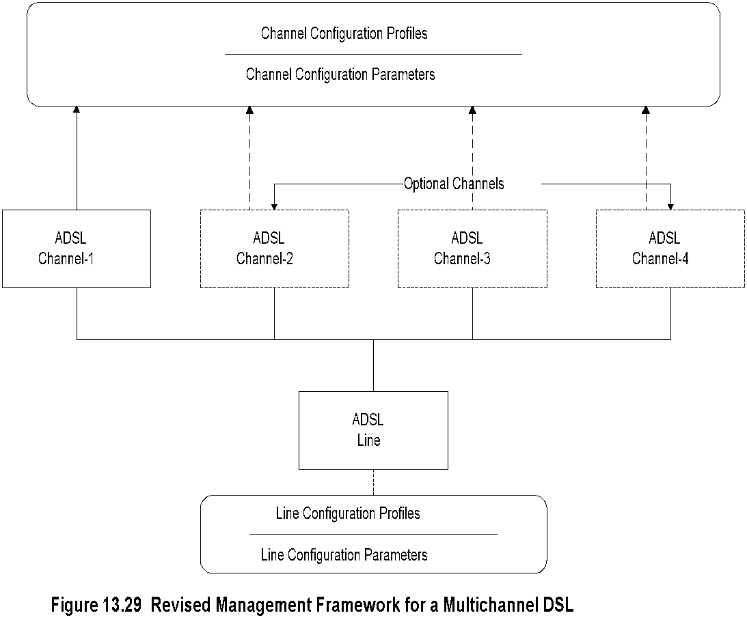
Multichannel DSL Management
Chapter 13 Broadband Network Management: Wired and Optical Access Networks
  Notes
Decouple channel parameters from line parameters
Up to four generic channels
Flexible configuration
Many combinations of parameters to manage
Network Management: Principles and Practice
© Mani Subramanian 2010
*

Slide 70
Passive Optical Network
Chapter 13 Broadband Network Management: Wired and Optical Access Networks
Network Management: Principles and Practice
© Mani Subramanian 2010
*

Slide 71
Passive Optical Network
Chapter 13 Broadband Network Management: Wired and Optical Access Networks
Fiber Medium
No active elements in the transmission medium
Passive elements in the fiber medium
  Beam splitter – Lossy
  Wavelength Division Multiplexer (WDM)
  Notes
Network Management: Principles and Practice
© Mani Subramanian 2010
*

Slide 72
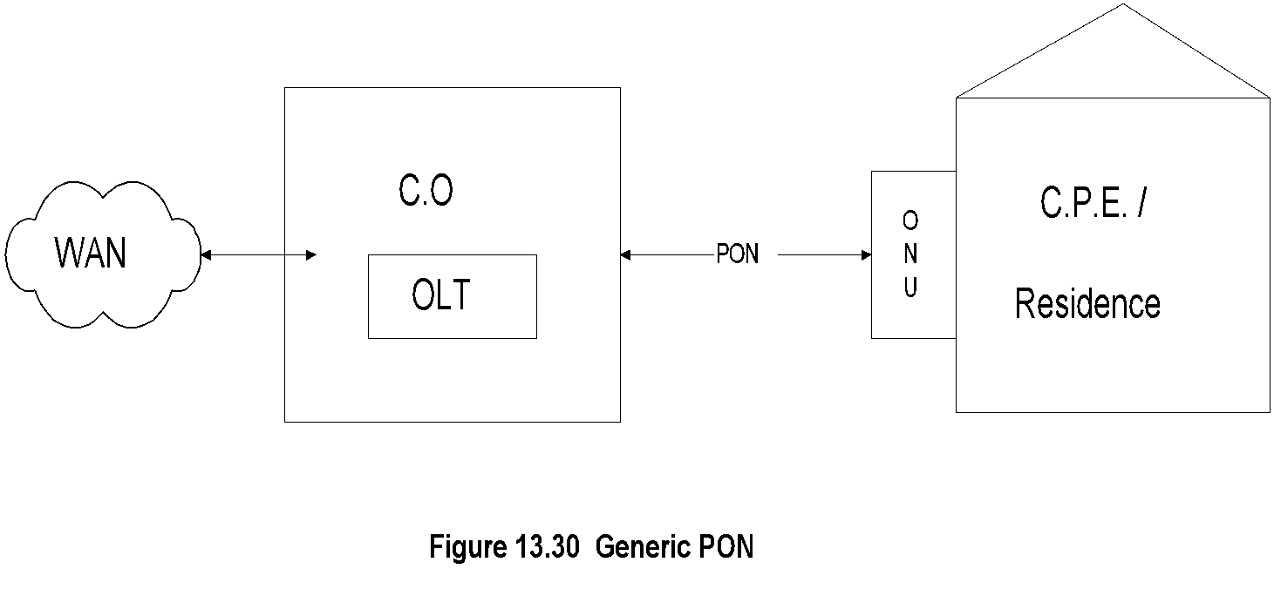
Generic PON Architecture
Chapter 13 Broadband Network Management: Wired and Optical Access Networks
  Notes
Optical Line Termination (OLT) in central office
Optical Network Unit (ONU) in customer residence
Shared or dedicated optical path
1-way and 2-way transmission using separate physical
or optical wavelength (λ) path
Dedicated fiber (λ) vs. shared medium multiple (λ)
3 deployment configurations
  Dedicated fiber
  EPON
  WDM
Network Management: Principles and Practice
© Mani Subramanian 2010
*

Slide 73
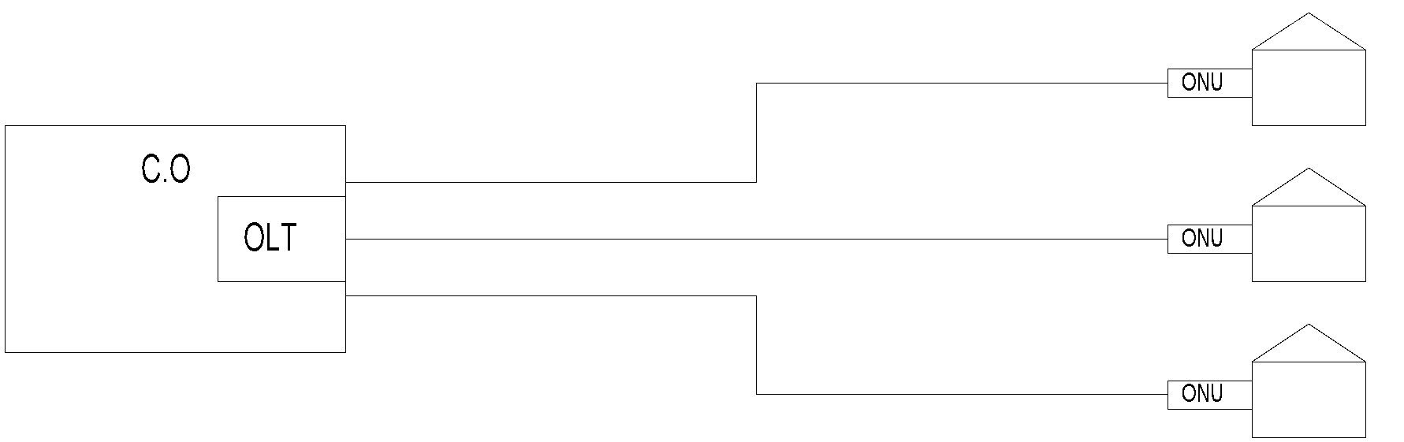
PON Configurations:
Dedicated Fiber
Chapter 13 Broadband Network Management: Wired and Optical Access Networks
Figure 13.31(a) PON Configuration (Point-to Point PON)
  Notes
Dedicated fiber from OLT to each ONU
ONU function similar to ONU in cable access network
One-way in each fiber / Dual wavelength fiber for 2-way
Expensive configuration
Network Management: Principles and Practice
© Mani Subramanian 2010
*

Slide 74
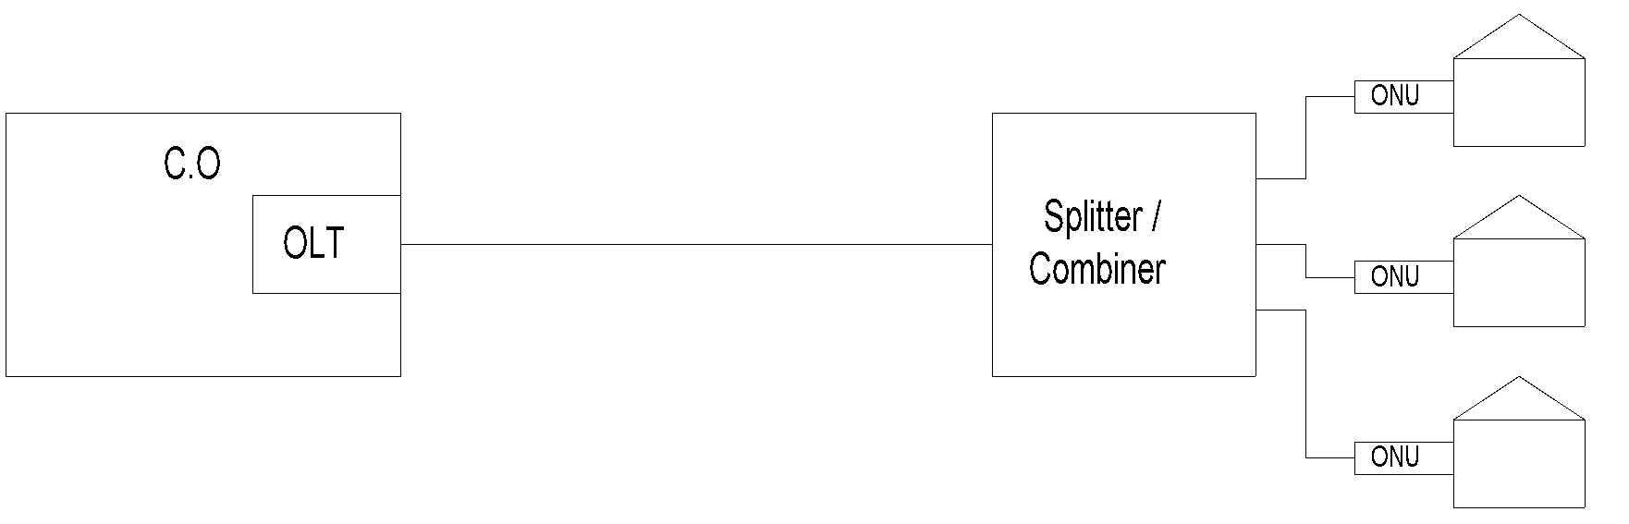
PON Configuration: EPON
Chapter 13 Broadband Network Management: Wired and Optical Access Networks
Figure 13.31(b) PON Configuration (EPON)
  Notes
Shared optical fiber from OLT to power splitter / combiner
Twisted pair or Cat-x cable from splitter / combiner to
ONU
Modified Ethernet MAC protocol for EFM (Ethernet First
Mile)
Downstream TDM and upstream TDMA
MIB specified only for EPON
Network Management: Principles and Practice
© Mani Subramanian 2010
*

Slide 75
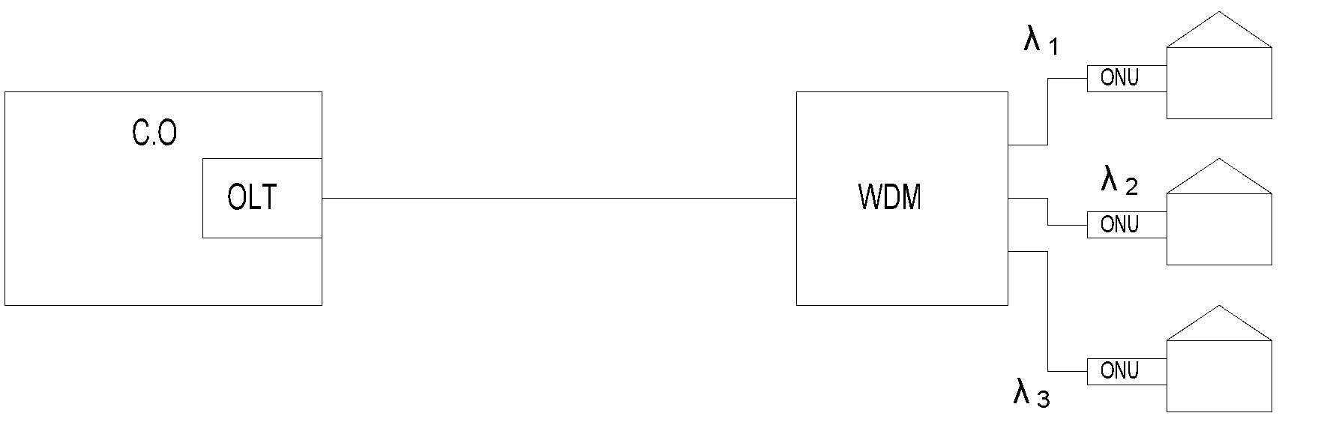
PON Configuration: WPON
Chapter 13 Broadband Network Management: Wired and Optical Access Networks
Figure 13.31(c) PON Configuration (WPON)
  Notes
Shared single fiber from OLT to WDM
Multiple (λ), one to each ONU
DWDM (Dense WDM) special case of WDM
Network Management: Principles and Practice
© Mani Subramanian 2010
*

Slide 76
EPON MAC Protocol
Chapter 13 Broadband Network Management: Wired and Optical Access Networks
Point-to-Multipoint architecture
OLT with n virtual ports communicates with n ONUs
Communication established through virtual tunneling
Different from IP/SNMP used for traditional 802.3 ->
802.3ah
Some management capabilities are embedded in
Ethernet layer
802.3ah defines both physical and MAC layer
Modified gigabit Ethernet protocol
PON link based on shared optical fiber with optical
splitter dividing the subscribers
Multipoint control protocol embedded in MAC layer
to control EPON subscribers
Emulation layer creates virtual private path to each ONU
FEC error correction
802.1d – modified bridge – in the MAC layer sets up
peer-to-peer communication between OLT and ONU
Management layer embedded in MAC layer for OAM
  Notes
Network Management: Principles and Practice
© Mani Subramanian 2010
*

Slide 77
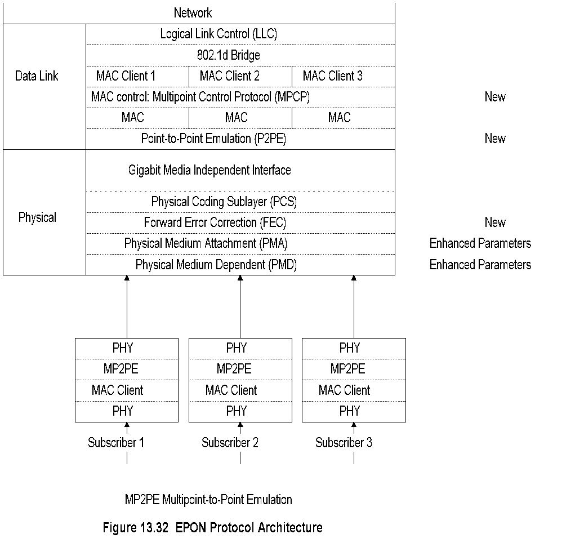
EPON Protocol Architecture
Chapter 13 Broadband Network Management: Wired and Optical Access Networks
  Notes
Network Management: Principles and Practice
© Mani Subramanian 2010
*

Slide 78
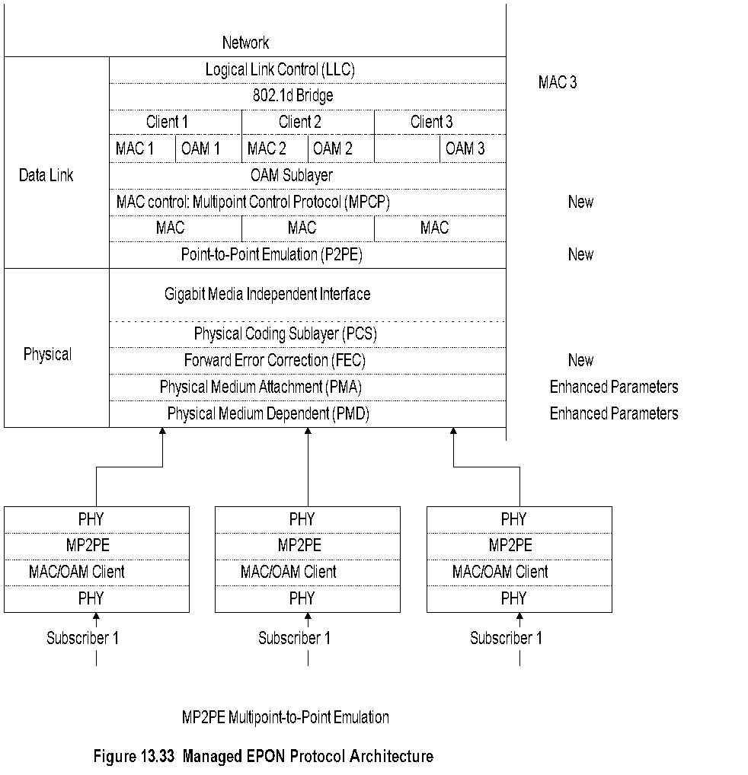
Managed EPON Protocol Architecture
Chapter 13 Broadband Network Management: Wired and Optical Access Networks
Network Management: Principles and Practice
© Mani Subramanian 2010
*

Slide 79
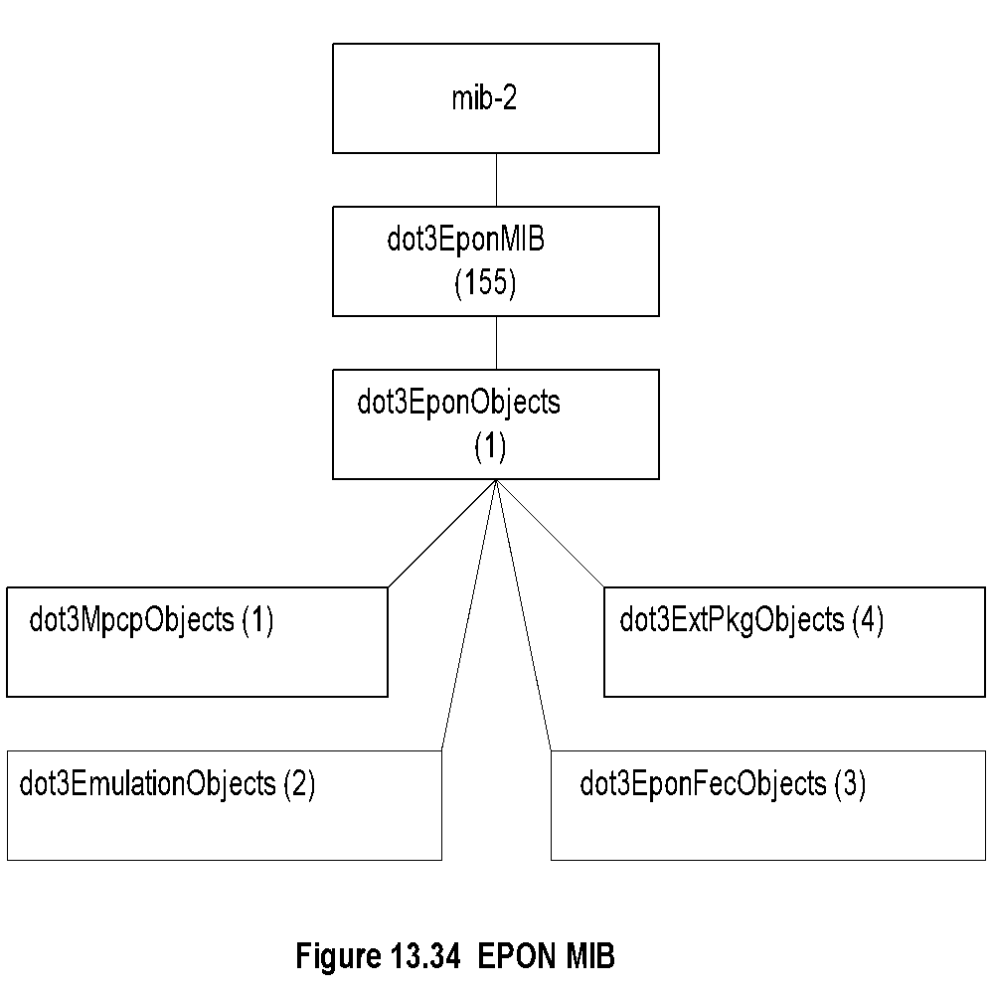
EPON MIB
Chapter 13 Broadband Network Management: Wired and Optical Access Networks
  Notes
Network Management: Principles and Practice
© Mani Subramanian 2010
*

Slide 80
EPON Group
Chapter 13 Broadband Network Management: Wired and Optical Access Networks
Table 13.16 EPON Group
Entity | OID | Description (brief)
dot3EponMIB | Mib-2 155 | EPON MAC
dot3EponObjects | dot3EponMIB 1 | EPON MIB objects
dot3MpcpObjects | dot3EponMIB 1 | 802.3ah MPCP attributes
dot3EmulationObjects | dot3EponMIB 2 | Point-to-point OMP emulation attributes
dot3EponFecObjects | dot3EponMIB 3 | EPON FEC attributes
dot3ExtPkgObjects | dot3EponMIB 4 | Configuration and status attributes of Extended EPON
  Notes
Network Management: Principles and Practice
© Mani Subramanian 2010
*

Slide 81
ONU Interface MIB Example
Chapter 13 Broadband Network Management: Wired and Optical Access Networks
Table 13.17 ONU Interface MIB Example
Interface MIB Object | Optical Interface Value | ONU Interface Value
ifIndex | 1 | 100
ifDescr | “Interface Description” | “Interface Description”
ifType | ethernetCsmacd (6) 1000base-Px | ethernetCsmacd (6) 1000base-Px
ifMtu | MTU size (1522) | MTU size (1522)
ifSpeed | 1000000000 | 1000000000
ifPhysAddress | ONU_MAC_Address | ONU_MAC_Address
  Notes
Network Management: Principles and Practice
© Mani Subramanian 2010
*

Slide 82
OLT Interface MIB Example
Table 13.16 OLT Interface MIB Example
Table 13.16 OLT Interface MIB Example
Interface MIB Object | Optical Interface Value | ONU Interface Value | ONU Interface Value | ONU Broadcast Interface Value
ifIndex | 2 | 200001 | 200002 | 265535
ifDescr | “Interface Description” | “Interface Description” | “Interface Description” | “Interface Description”
ifType | ethernetCsmacd (6) 1000base-Px | ethernetCsmacd (6) 1000base-Px | ethernetCsmacd (6) 1000base-Px | ethernetCsmacd (6) 1000base-Px
ifMtu | MTU size (1522) | MTU size (1522) | MTU size (1522) | MTU size (1522)
ifSpeed | 1000000000 | 1000000000 | 1000000000 | 1000000000
ifPhysAddress | OLT_MAC_Address | OLT_MAC_Address | OLT_MAC_Address | OLT_MAC_Address
Interface MIB Object | Optical Interface Value | ONU Interface Value | ONU Interface Value | ONU Broadcast Interface Value
ifIndex | 2 | 200001 | 200002 | 265535
ifDescr | “Interface Description” | “Interface Description” | “Interface Description” | “Interface Description”
ifType | ethernetCsmacd (6) 1000base-Px | ethernetCsmacd (6) 1000base-Px | ethernetCsmacd (6) 1000base-Px | ethernetCsmacd (6) 1000base-Px
ifMtu | MTU size (1522) | MTU size (1522) | MTU size (1522) | MTU size (1522)
ifSpeed | 1000000000 | 1000000000 | 1000000000 | 1000000000
ifPhysAddress | OLT_MAC_Address | OLT_MAC_Address | OLT_MAC_Address | OLT_MAC_Address
Chapter 13 Broadband Network Management: Wired and Optical Access Networks
Table 13.18 ONU Interface MIB Example
Interface MIB Object | Optical Interface Value | ONU Interface Value | ONU Interface Value | ONU Broadcast Interface Value
ifIndex | 2 | 200001 | 200002 | 265535
ifDescr | “Interface Description” | “Interface Description” | “Interface Description” | “Interface Description”
ifType | ethernetCsmacd (6) 1000base-Px | ethernetCsmacd (6) 1000base-Px | ethernetCsmacd (6) 1000base-Px | ethernetCsmacd (6) 1000base-Px
ifMtu | MTU size (1522) | MTU size (1522) | MTU size (1522) | MTU size (1522)
ifSpeed | 1000000000 | 1000000000 | 1000000000 | 1000000000
ifPhysAddress | OLT_MAC_Address | OLT_MAC_Address | OLT_MAC_Address | OLT_MAC_Address
  Notes
Network Management: Principles and Practice
© Mani Subramanian 2010
*

