Slide 1
Chapter 10
Chapter 10 Telecommunications Management Network
Telecommunications Management Network
Network Management: Principles and Practice
© Mani Subramanian 2010
*

Slide 2
Objectives
Chapter 10 Telecommunications Management Network
Telecommunications Management Network, TMN
Concept of Operations Support System, OSS
TMN conceptual model includes:
Customers
Service providers
Network
Operations support systems, OSSs
System operators
TMN standards and documentation
TMN architecture
Functional
Physical
Informational
TMN service management architecture
Network element
Element management
Network management
Service management
Business management
TMN service management
Operations, Administration, Maintenance, Provisioning; OAMP
TMN implementation methodologies
OMNIPoint
eTOM
Network Management: Principles and Practice
© Mani Subramanian 2010
*

Slide 3
Chapter 10 Telecommunications Management Network
TMN
Necessity for interoperability basis for TMN
Need for management of more than just the network components
Networks / subnetworks need to be managed
Services - internal and external need management
Business management needs to be addressed
TMN joint effort by ITU-T and ISO
Notes
Network Management: Principles and Practice
© Mani Subramanian 2010
*

Slide 4
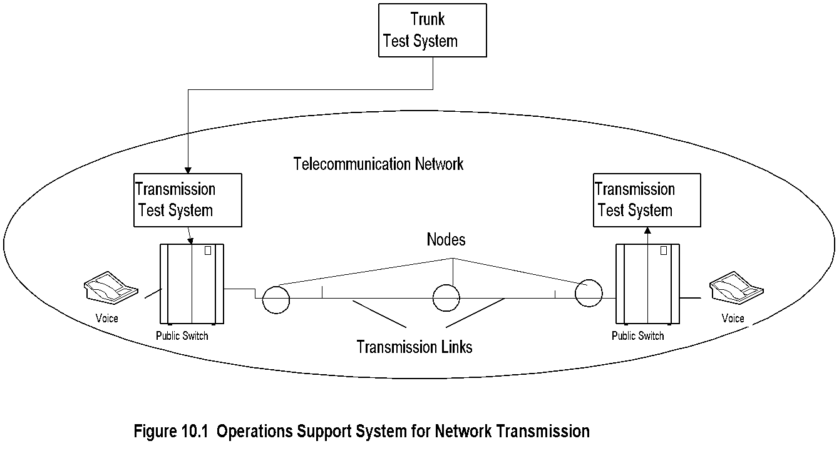
Chapter 10 Telecommunications Management Network
OS: Trunk Testing System
Notes
Trunk is a logical connection between two switching nodes
Periodic measurement of loss and S/N of all trunks
Failing threshold set for QoS; failing trunks removed out of service before the customer complains
Network Management: Principles and Practice
© Mani Subramanian 2010
*

Slide 5
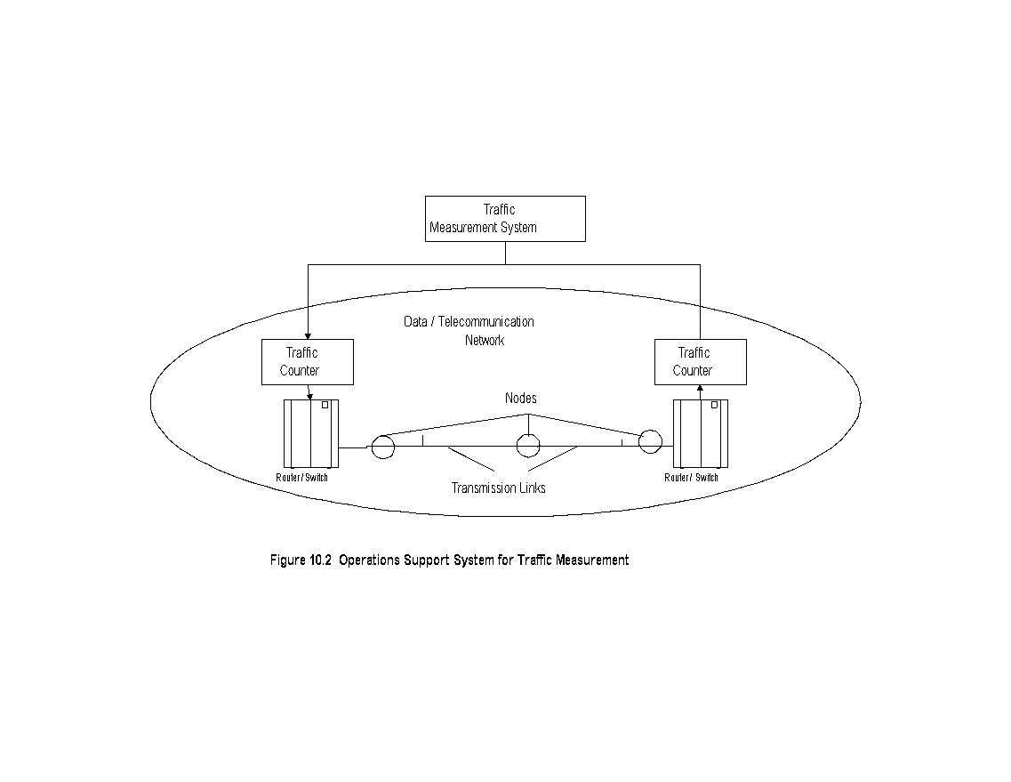
Chapter 10 Telecommunications Management Network
OS: Telephone Switch Traffic
Notes
Traffic monitored at switch appearance
Call-blocking statistics obtained
Traffic and call-blocking statistics provide data for planning
Importance of Operations, Administration, Mainte- nance, and Provisioning
Network Management: Principles and Practice
© Mani Subramanian 2010
*

Slide 6
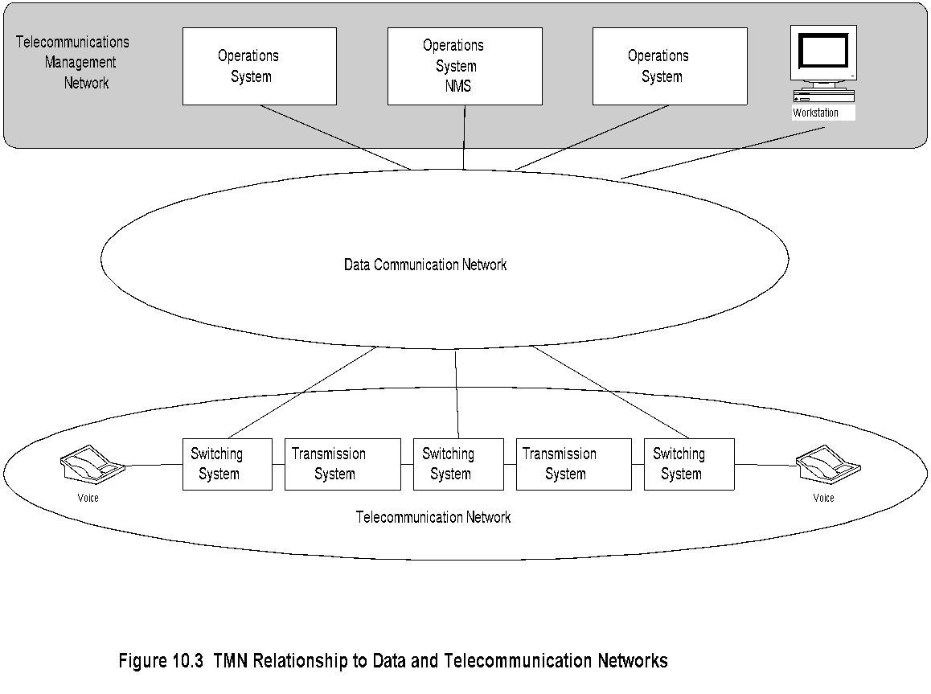
Chapter 10 Telecommunications Management Network
TMN Conceptual Model
Notes
Network Management: Principles and Practice
© Mani Subramanian 2010
*

Slide 7
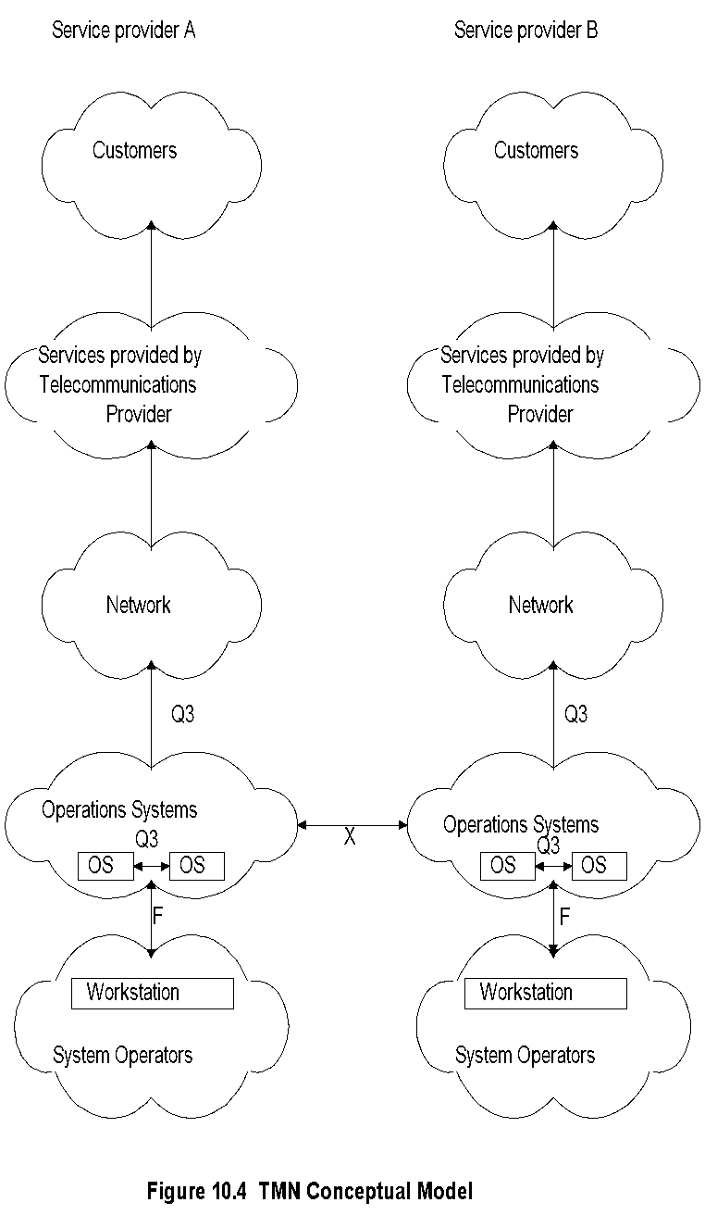
Chapter 10 Telecommunications Management Network
TMN Conceptual Model (cont.)
Notes
Components
Interfaces
Network Management: Principles and Practice
© Mani Subramanian 2010
*

Slide 8
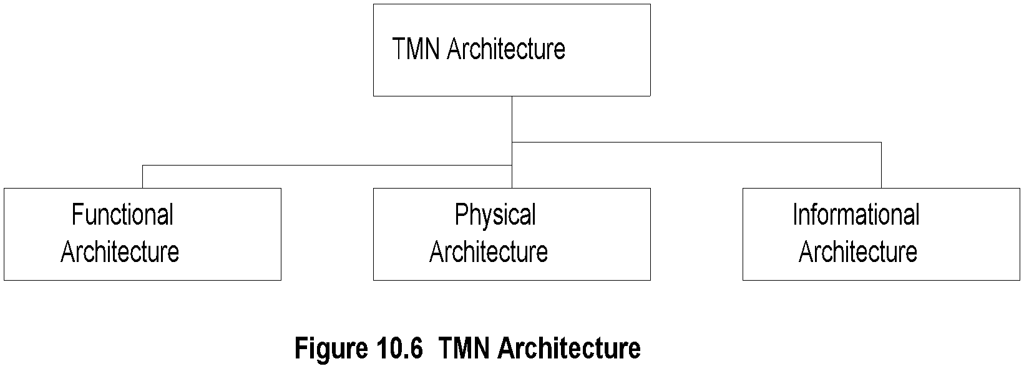
Chapter 10 Telecommunications Management Network
TMN Architecture
Notes
Functional architecture:
Functional modules or blocks
Reference points between modules
Physical architecture:
Physical blocks
Physical interfaces between the blocks
Informational architecture:
Information exchange between entities
Object oriented
Network Management: Principles and Practice
© Mani Subramanian 2010
*

Slide 9
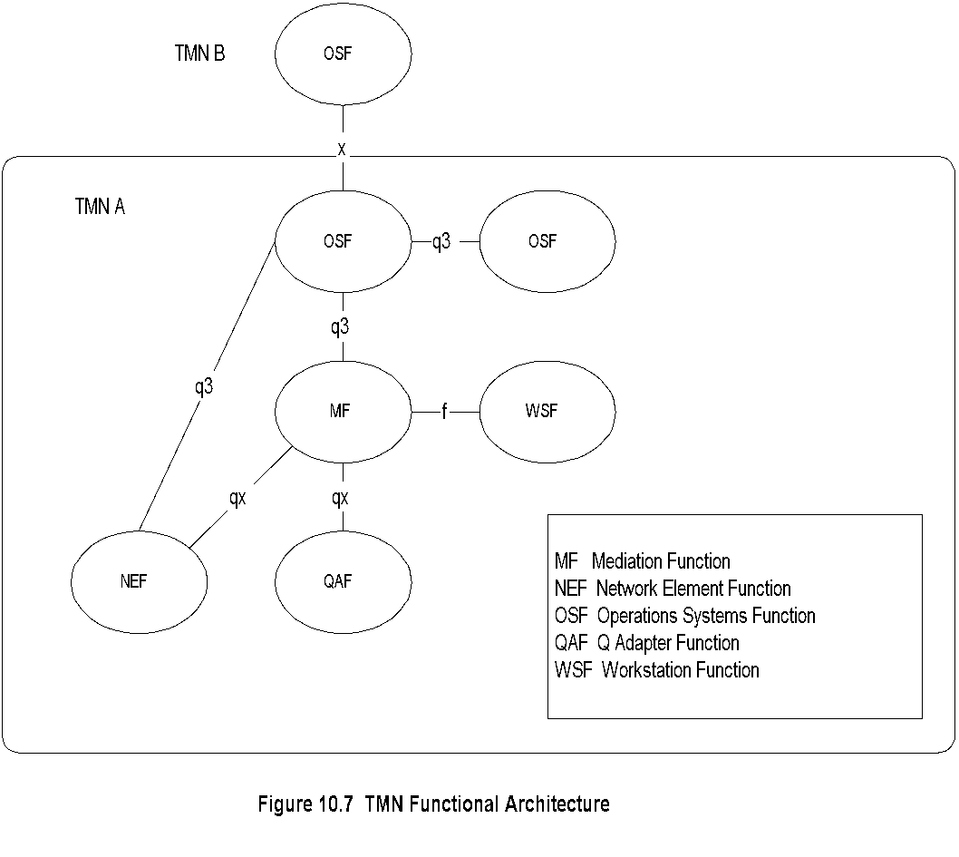
Chapter 10 Telecommunications Management Network
Functional Architecture
Notes
OSF: Functions performed by Operations systems: e.g., NMS, testing, accounting, trouble tracking
NEF: Functions needed to support network elements; network elements themselves are not part of TMN: e.g., NM agent, MIB, collision rate
Network Management: Principles and Practice
© Mani Subramanian 2010
*

Slide 10
Chapter 10 Telecommunications Management Network
Functional Architecture (cont.)
Notes
MF: Operations on the information between network elements; e.g., filtering, protocol conversion
MF can be shared between multiple OSSs; e.g., RMON
WSF:Human-TMN activities interface; e.g., GUI
QAF: Adapter function to accommodate non-TMN entities; e.g., proxy server, SNMP-to-CMIP
Network Management: Principles and Practice
© Mani Subramanian 2010
*

Slide 11
Chapter 10 Telecommunications Management Network
TMN Reference Point
Notes
Function blocks connected by conceptual interfaces, called reference point
Designated by lower case letters (upper case letter for physical interfaces)
x: Interface between operations systems that belong to different domains; e.g., interface between two NMSs belonging to two different domains
q3: Interface between two OSFs in the same domain
qx: Interface between mediation function such as RMON and agent in the network element
f: Interface to the workstation
Network Management: Principles and Practice
© Mani Subramanian 2010
*

Slide 12
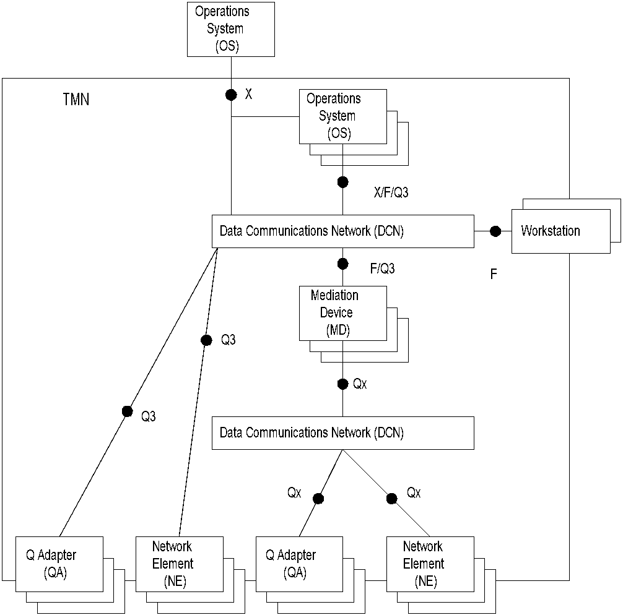
Chapter 10 Telecommunications Management Network
Physical Architecture
Figure 10.9 TMN Physical Architecture
Notes
Network Management: Principles and Practice
© Mani Subramanian 2010
*

Slide 13
Chapter 10 Telecommunications Management Network
Information Architecture
Notes
Network Management: Principles and Practice
© Mani Subramanian 2010
*

Slide 14
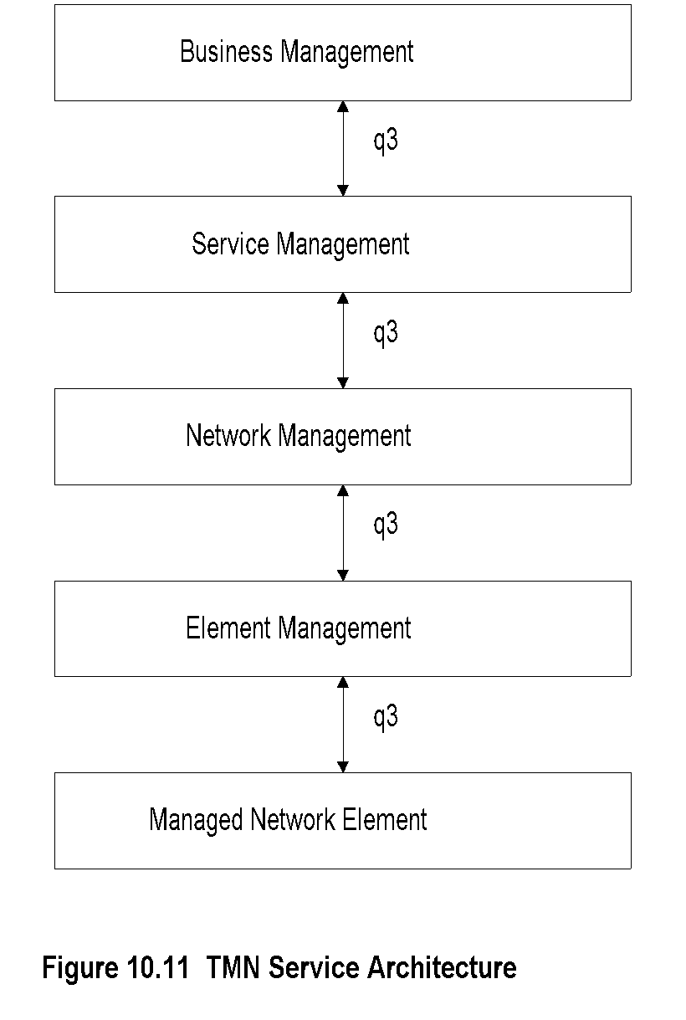
Chapter 10 Telecommunications Management Network
Service Architecture الرسمة
Notes
Network Management: Principles and Practice
© Mani Subramanian 2010
*

Slide 15
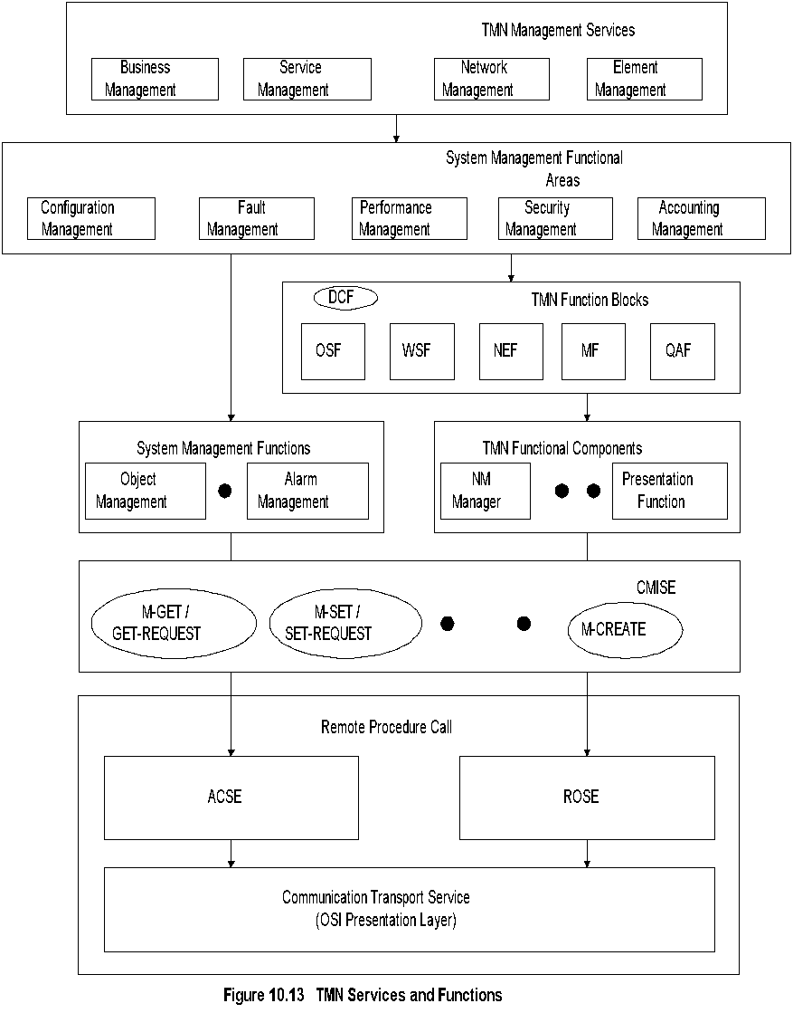
Chapter 10 Telecommunications Management Network
TMN Services & Functions
Notes
Network Management: Principles and Practice
© Mani Subramanian 2010
*

Slide 16
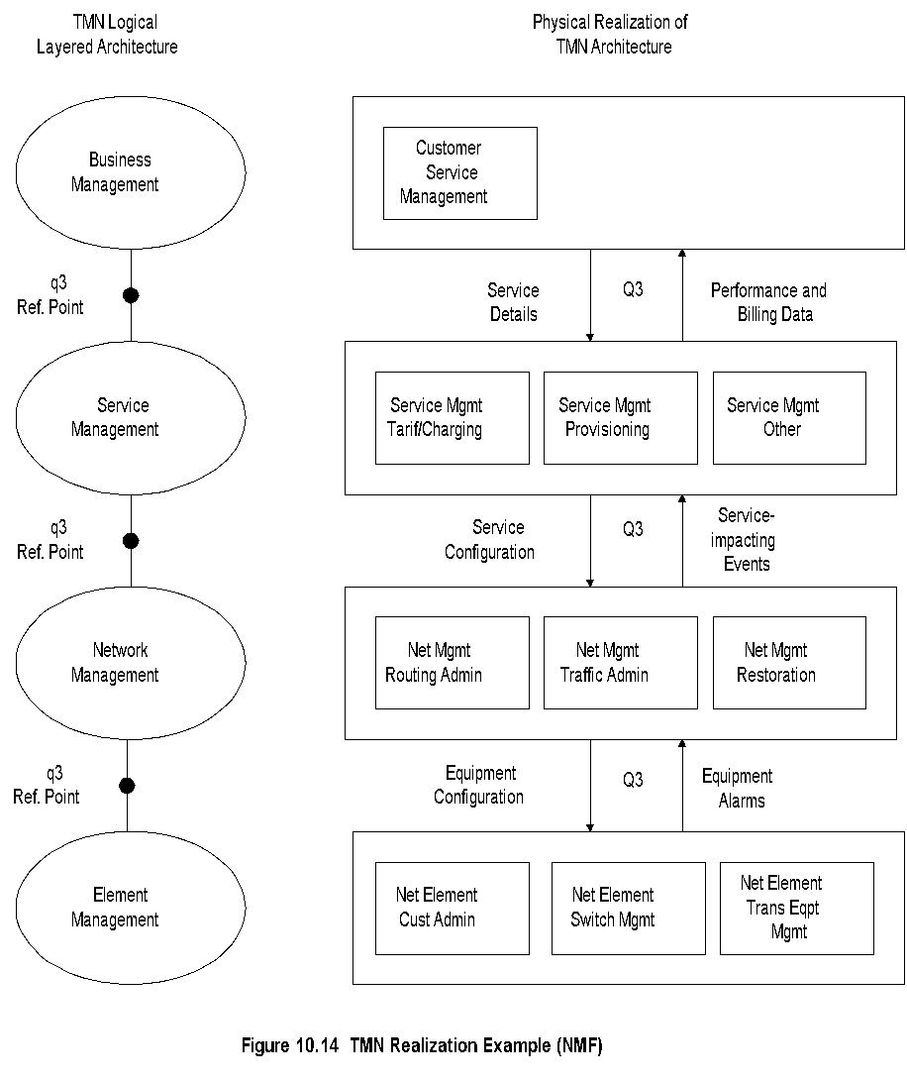
Chapter 10 Telecommunications Management Network
Example (NMF)
Network Management: Principles and Practice
© Mani Subramanian 2010
*

Slide 17
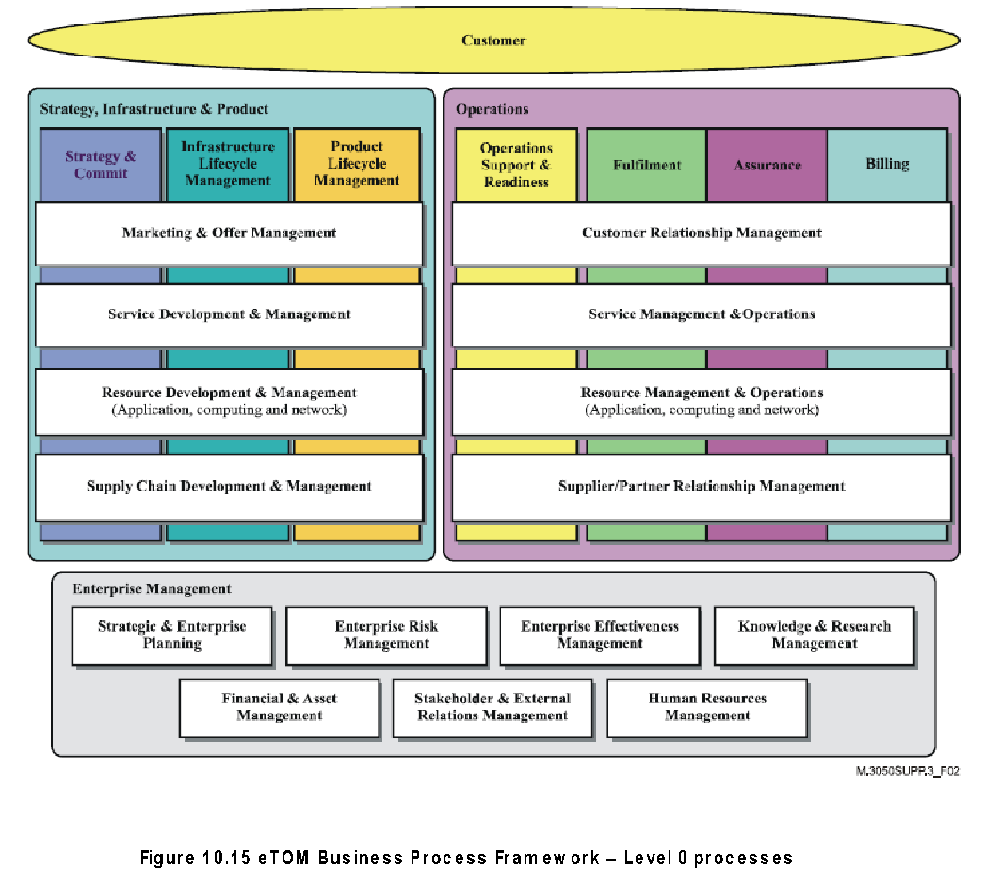
شرح الكلامeTOM
Chapter 10 Telecommunications Management Network
Notes
TM Forum top-down implementation approach of TMN (ITU-T)
eTOM (enhanced Telecom Operations)
Framework to automate delivery of “information, communication, and entertainment services”
Addresses business processes end-to-end
Multiple levels (0, 1, 2,and 3) based on details
Network Management: Principles and Practice
© Mani Subramanian 2010
*

Slide 18
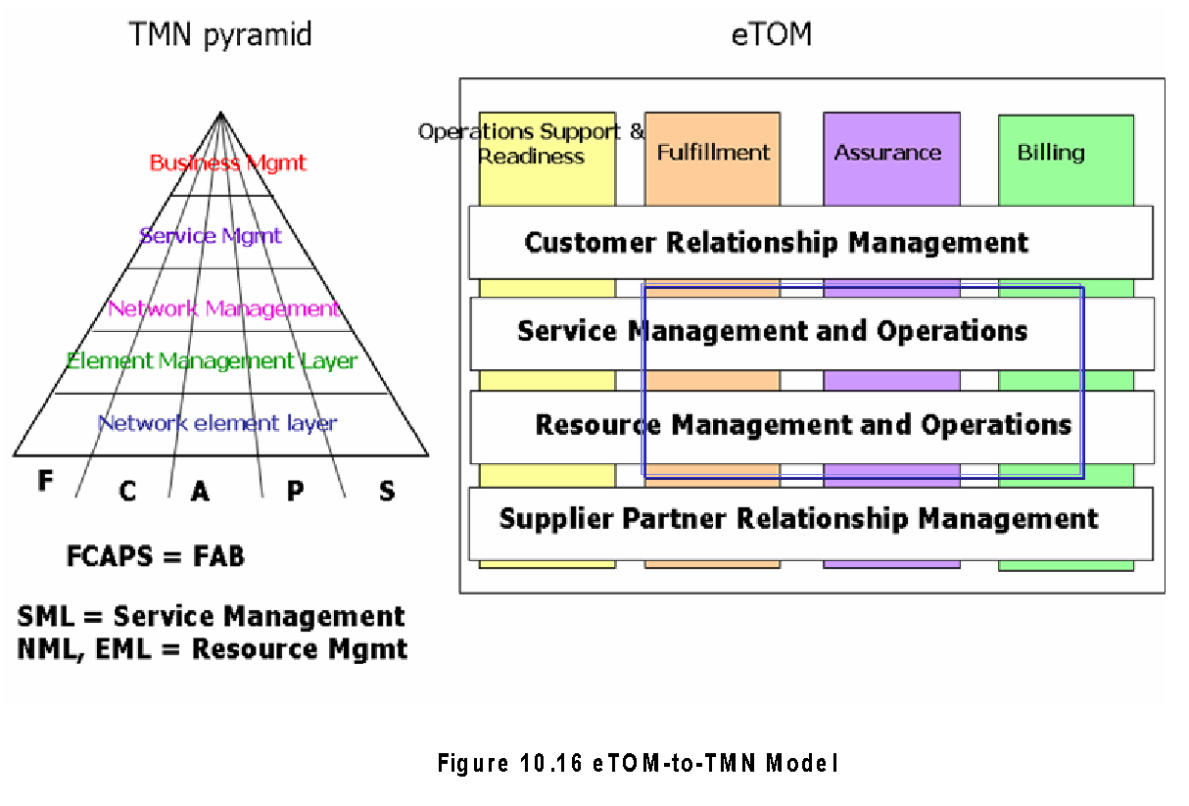
TMN & eTOM
Chapter 10 Telecommunications Management Network
Notes
eTOM-to-TMN mapping of functions
Fulfillment Configuration
Assurance Fault Performance
Billing Accounting
Eqivalent NMS application functions in both TMN and eTOM
Network Management: Principles and Practice
© Mani Subramanian 2010
*

Slide 19
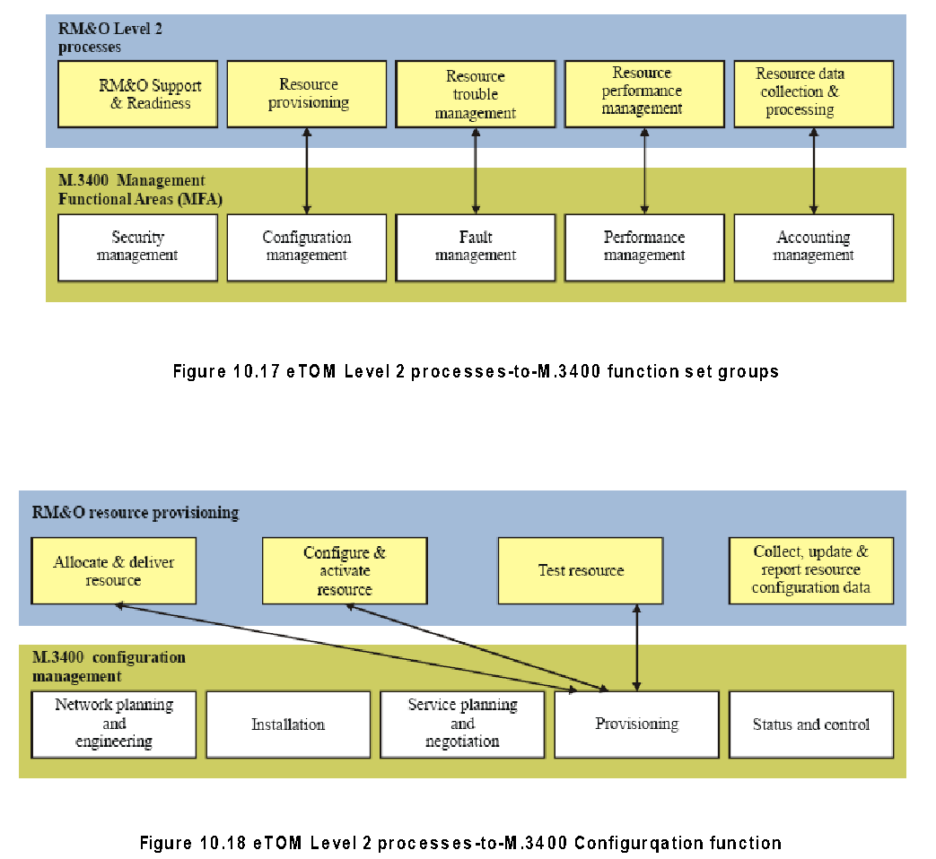
eTOM-to-TMN M.3400 (Level 2) Processes
Chapter 10 Telecommunications Management Network
Notes
Network Management: Principles and Practice
© Mani Subramanian 2010
*

