Slide 1
Chapter 2 Review of Information Network and Technology
Chapter 2 Review of Information Network and Technology
Network Management: Principles and Practice
© Mani Subramanian 2010
*
Notes:
*

Slide 2
Objectives
Chapter 2 Review of Information Network and Technology
Network components and technologies to be managed
Network Topologies: LAN and WAN
Wired LAN topology: Bus, Ring, Star, and Hybrid Hub
Wireless LAN
WAN topology: Mesh and Tree
Fixed and mobile wireless networks
Fiber networks
Ethernet LAN:
Physical media and MAC protocol
10 and 100 Mbps; 1 and 10 Gbps Ethernet LAN
Switched and Duplex Ethernet LANs
Virtual LAN
Token-ring LAN
FDDI
Network components
Bridges
Routers
Gateways
Circuit switching and packet switching
Transmission technology
Transmission media: Wired and Wireless
Transmission modes
Multiplexing: TDM and WDM
SONET and SDH
Multimedia networks and services
Network Management: Principles and Practice
© Mani Subramanian 2010
*
Notes:
*

Slide 3
Technology and Management
Chapter 2 Review of Information Network and Technology
What are the technologies that need to managed?
Challenges of technological progress on network management
Notes
Network Management: Principles and Practice
© Mani Subramanian 2010
*

Slide 4
Information Network Technology
Chapter 2 Review of Information Network and Technology
Network components
Links
Nodes
Topology: How they’re configured
LANs
Wireless LAN
WANs
Bridges
Routers and Gateways
Switches
Transmission Media
Transmission Modes
ISDN
Broadband networks and services
Notes
Network Management: Principles and Practice
© Mani Subramanian 2010
*

Slide 5
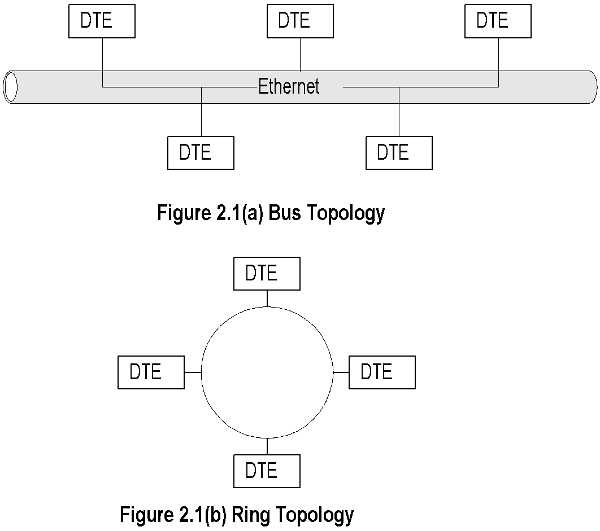
Basic LAN Topologies
Chapter 2 Review of Information Network and Technology
Notes
Bus Topology
Used in Ethernet LAN family
Common shared medium
Randomized access (CSMA/CD)
Easy to implement
Lower utilization under heavy traffic 30%-40%
Single culprit could effect the entire LAN
Network Management: Principles and Practice
© Mani Subramanian 2010
*

Slide 6
Basic LAN Topologies (cont.)
Chapter 2 Review of Information Network and Technology
Notes
Ring Topology
Used in token ring and FDDI
Shared medium
Deterministic access
Master DTE has control
High utilization >90%
Also used in MAN
Network Management: Principles and Practice
© Mani Subramanian 2010
*

Slide 7
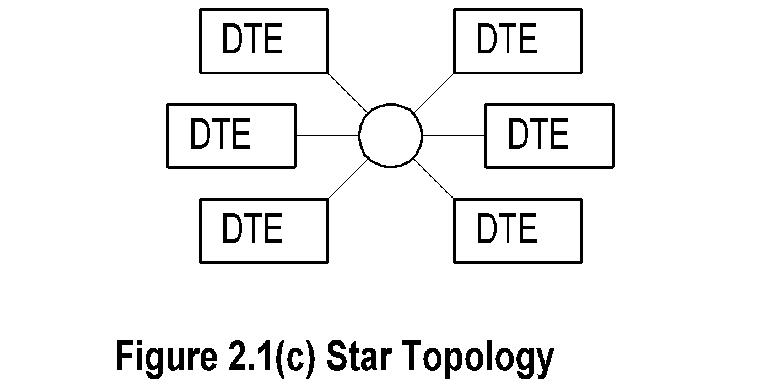
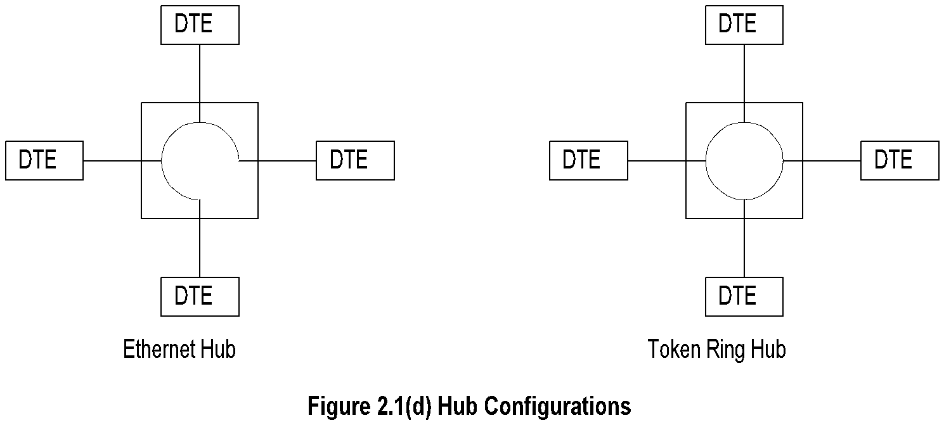
Star & Hybrid LAN Topologies
Chapter 2 Review of Information Network and Technology
Notes
Star topology used with bus and ring topology
Hub is “LAN in a box”
What does the electronic LAN inside the box look like?
Why has hub become so popular?
Network Management: Principles and Practice
© Mani Subramanian 2010
*

Slide 8
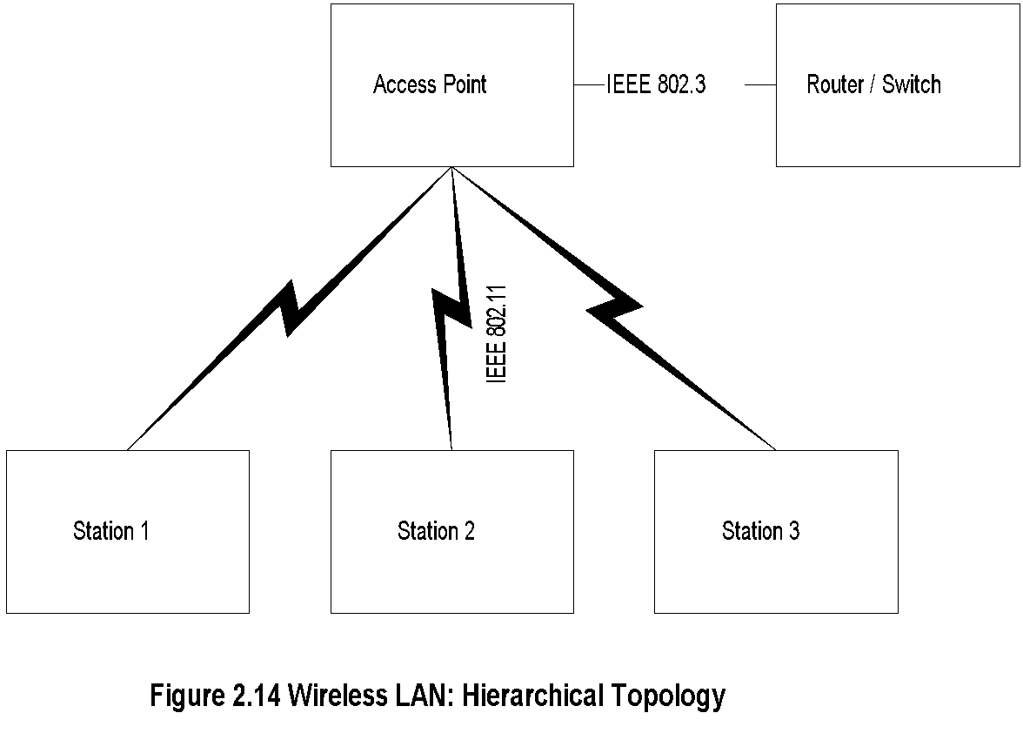
Wireless LAN
Chapter 2 Review of Information Network and Technology
Notes
Hierarchical
Ad Hoc
Network Management: Principles and Practice
© Mani Subramanian 2010
*

Slide 9
IEEE 802.11 Standards and Amendments
Chapter 2 Review of Information Network and Technology
802.11a | 54 Mbps data rate 5.15 MHz to 5.35 and 5.4 MHz to 5.825 MHz
802.11b | 11 Mbps data rate at 2.4 GHz
802.11e | Addresses QoS issues
802.11f | Addresses multivendor AP interoperability
802.11g | Higher data rate extension to 54 Mbps in the 2.4 GHz
802.11h | Dynamic frequency selection and transmit power control for operation of 5 GHz products
802.11i | Addresses security issues
802.11j | Addresses channelization in Japan’s 4.9 GHz band
802.11k | Enables medium and network resources more efficiently
802.11n | Addition of multiple-input multiple-output (MIMO); WiFi certification
Network Management: Principles and Practice
© Mani Subramanian 2010
*

Slide 10
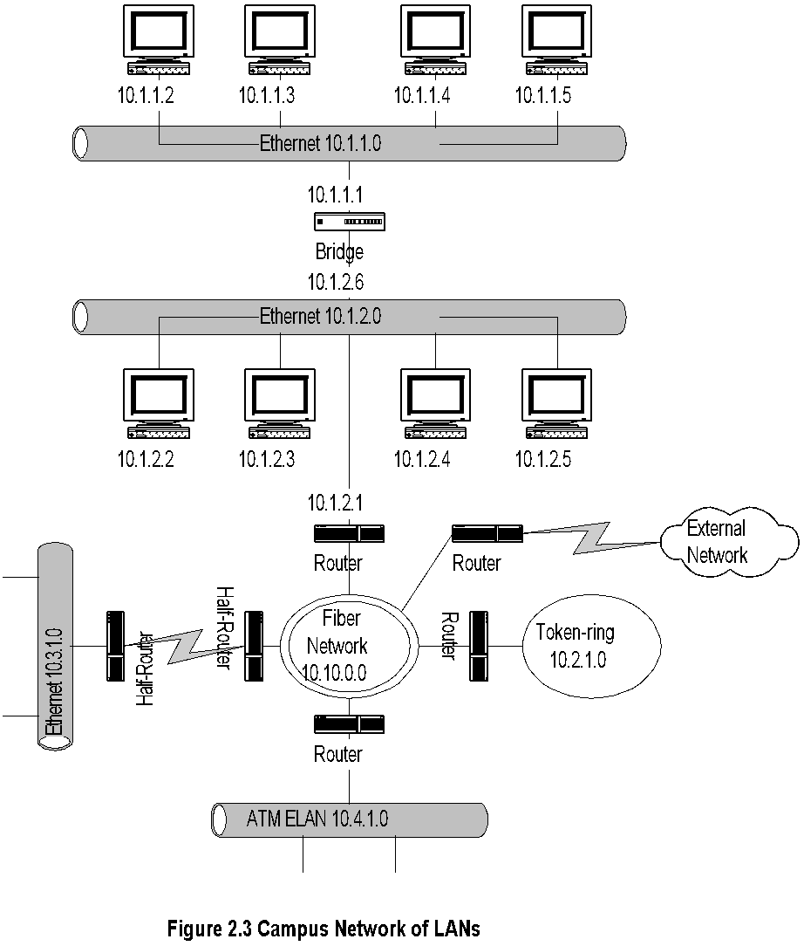
Campus Network
Chapter 2 Review of Information Network and Technology
Notes
Fiber Network could be Gigabit LAN or MAN
Network Management: Principles and Practice
© Mani Subramanian 2010
*

Slide 11
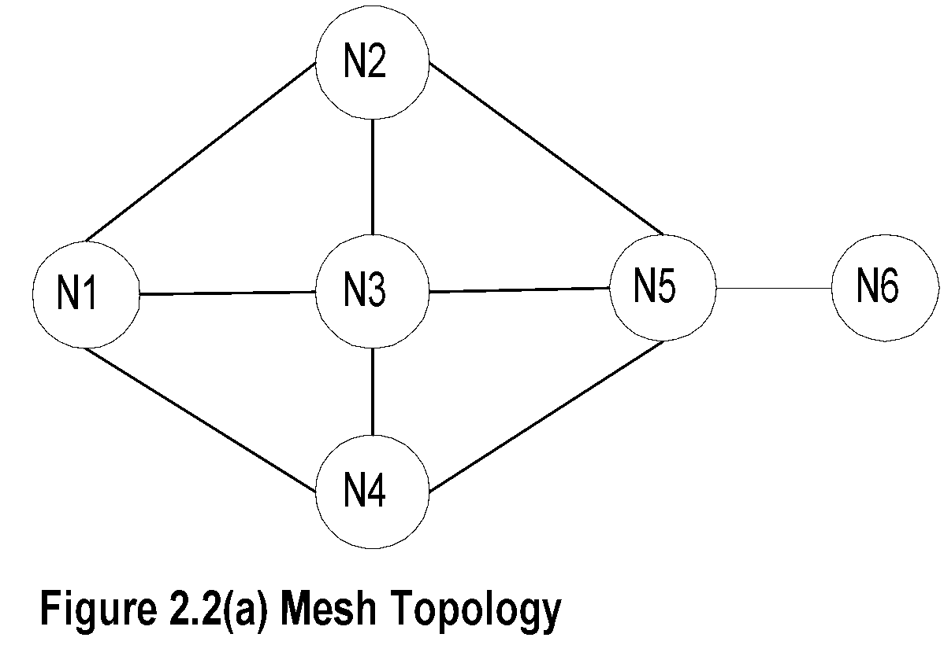
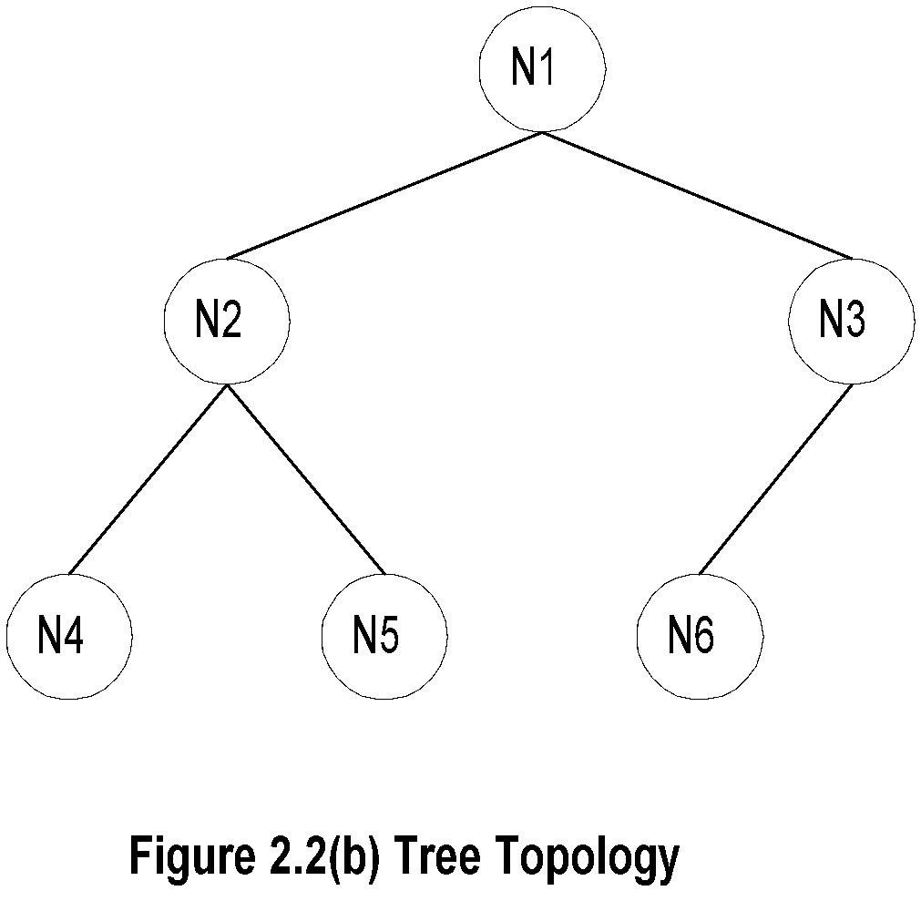
Chapter 2 Review of Information Network and Technology
WAN Topologies
Notes
Mesh topology
Implemented in network layer level
Multiple paths between nodes
Flat topology
Redundancy
Load balancing
Shortest path
Tree topology
Used with Ethernet bridges
Hierarchical
Efficient for small networks and special purpose networks
Ring Topology
SONET / SDH
MAN
Broadband feeder network
Network Management: Principles and Practice
© Mani Subramanian 2010
*

Slide 12
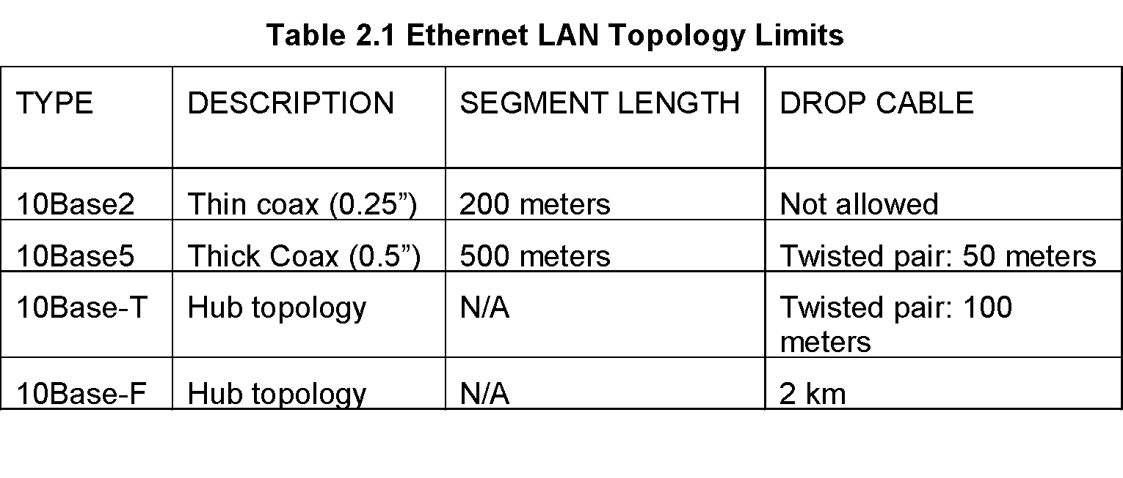
Chapter 2 Review of Information Network and Technology
Ethernet
Notes
IEEE 802.3 standard
10 Mbps data rate
Collision - analogy of hollow pipe
Principle of operation; CSMA/CD
Segment length and drop cable length
Minimum size of packet 64 bytes
Maximum size of packet 1500 bytes
Hub configuration
Network Management: Principles and Practice
© Mani Subramanian 2010
*

Slide 13
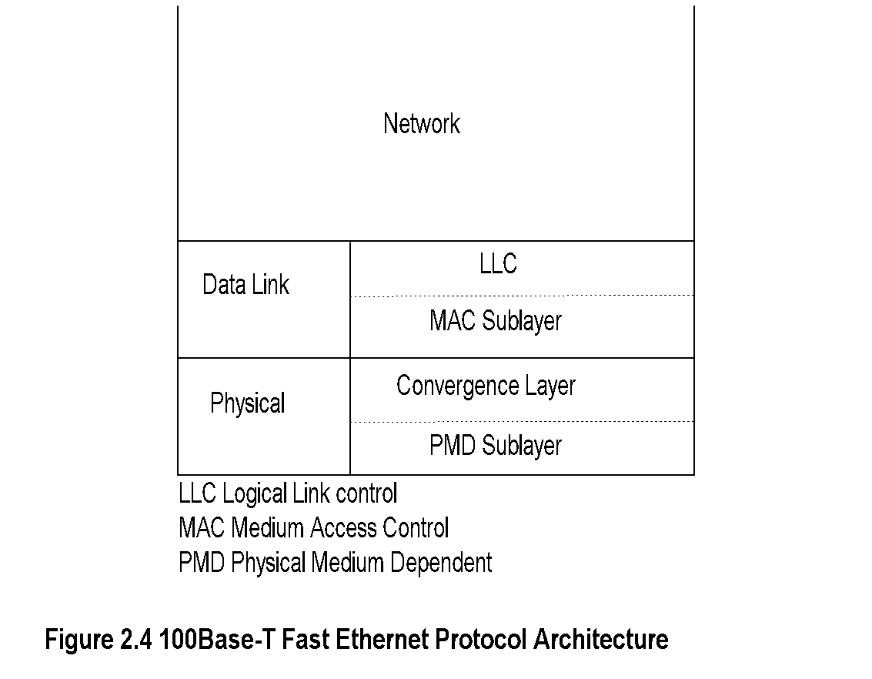
Chapter 2 Review of Information Network and Technology
Fast Ethernet
Notes
Rationale
Max drop length 100m => Max round-trip time 1/10 of Ethernet; hence 10 times data rate
Standard 100Base-T4
Compatibility with 10BaseT
Cat 5e (Max 100 m, 100 MHz)
Cat 6 (Max 100 m, 250 MHz)
100Base FX optical fiber (Max 10 km single and 400 m multimode)
Network Management: Principles and Practice
© Mani Subramanian 2010
*

Slide 14
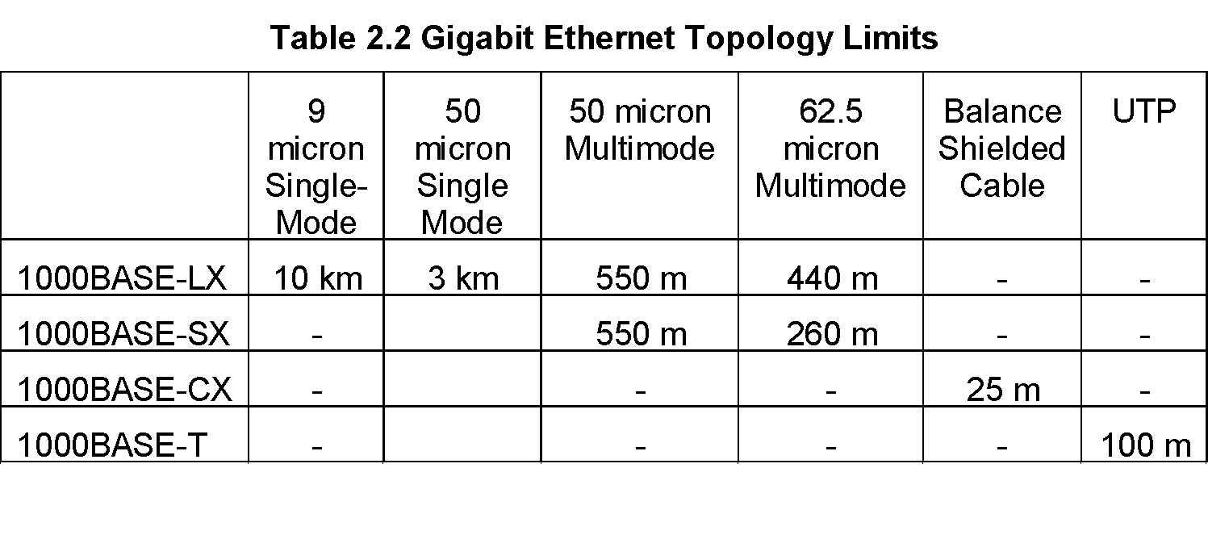
Chapter 2 Review of Information Network and Technology
Gigbit Ethernet
Notes
Packet size 512 bytes, slot size 4.096 microseconds
Minimum frame size 64 bytes for backward compatibility; Slot filled with carrier extension
Packet bursts with no idle time between frames increases efficiency
Network Management: Principles and Practice
© Mani Subramanian 2010
*

Slide 15
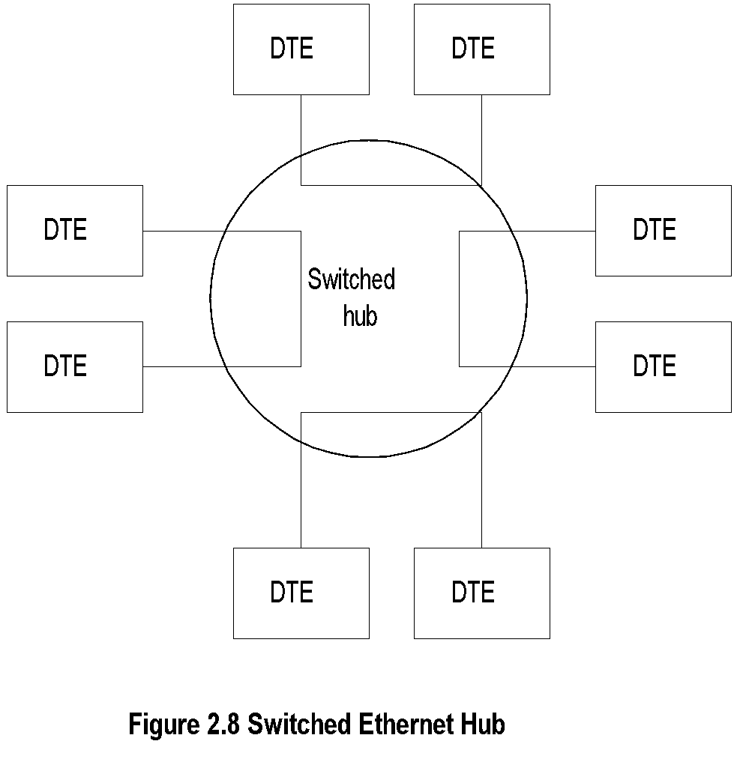
Chapter 2 Review of Information Network and Technology
Switched Ethernet
Notes
Maximum throughput increased ~N/2 in N-port hub
Snooping capability lost for management
Network Management: Principles and Practice
© Mani Subramanian 2010
*

Slide 16
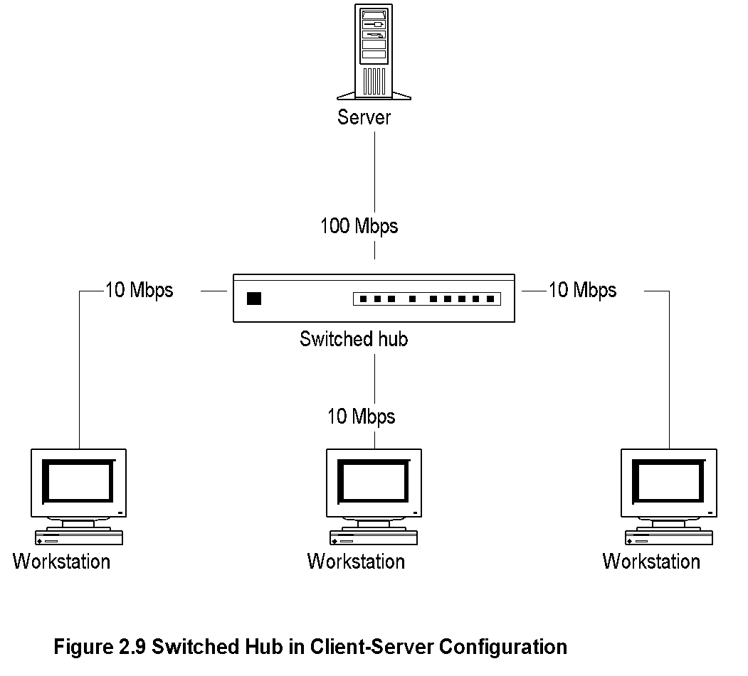
Chapter 2 Review of Information Network and Technology
Client-Server Configuration using
Switched Hub
Notes
Network Management: Principles and Practice
© Mani Subramanian 2010
*

Slide 17
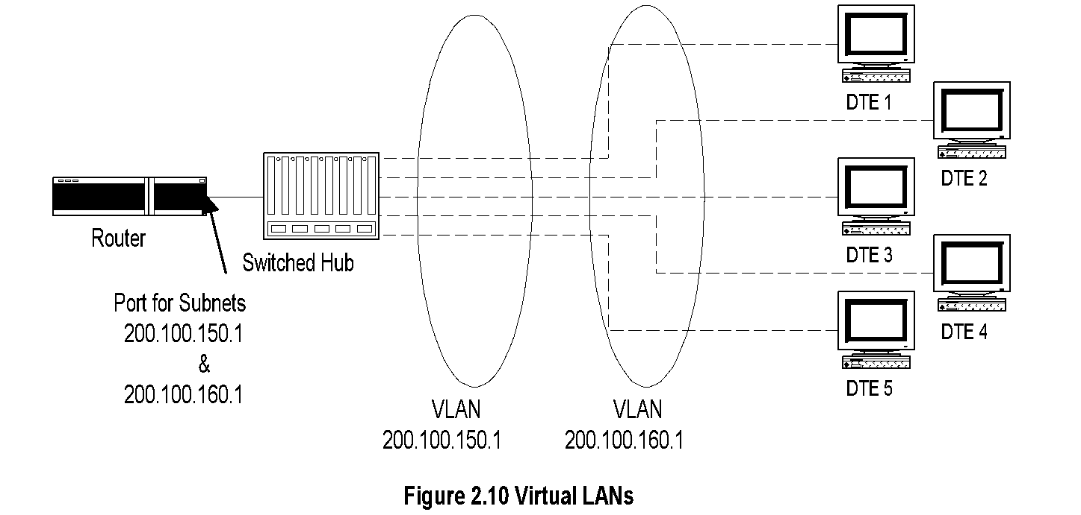
Chapter 2 Review of Information Network and Technology
Virtual LAN
Notes
Switched hub enables establishing virtual LANs
Permits switching stations between LANs without physical moving of equipment
Remote VLAN via switch offered by service providers
Network Management: Principles and Practice
© Mani Subramanian 2010
*

Slide 18
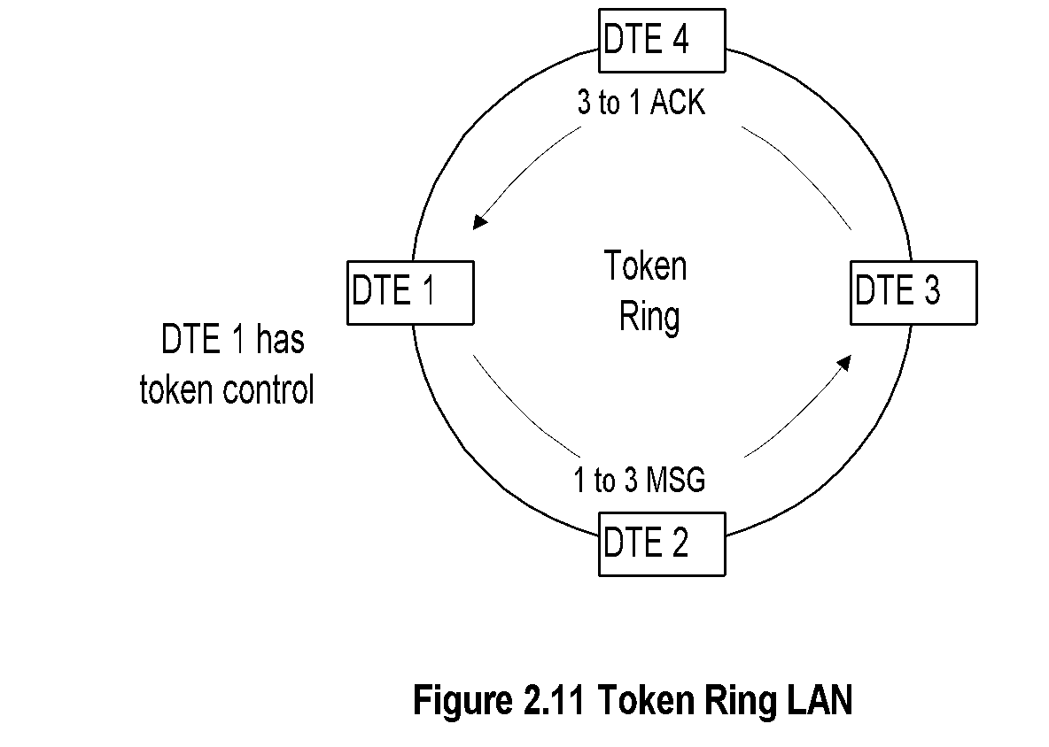
Chapter 2 Review of Information Network and Technology
Token Ring
Notes
Adopted by IBM
IEEE 802.5 standard
Data rates of 4 Mbps and 16 Mbps
Single- and dual-ring LANs
Network Management: Principles and Practice
© Mani Subramanian 2010
*

Slide 19
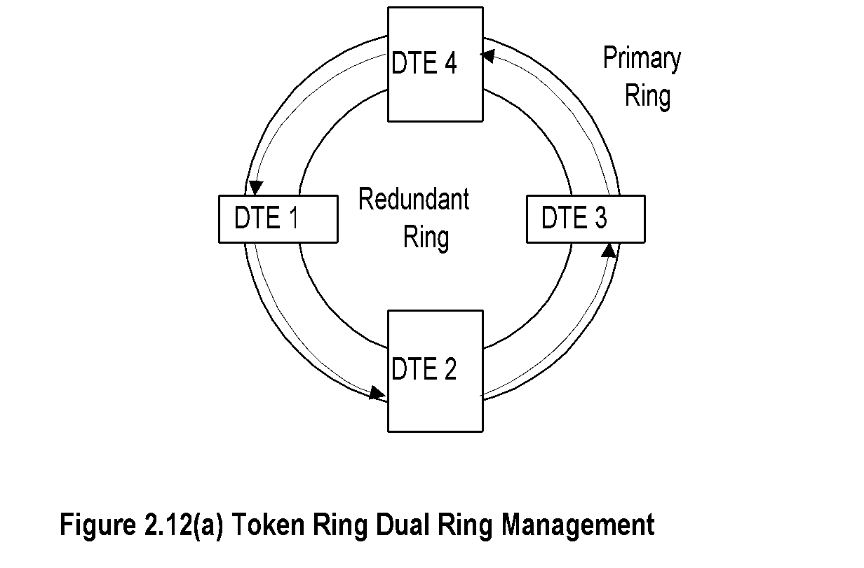
Chapter 2 Review of Information Network and Technology
Dual Ring Token Ring LAN
Notes
Network Management: Principles and Practice
© Mani Subramanian 2010
*

Slide 20
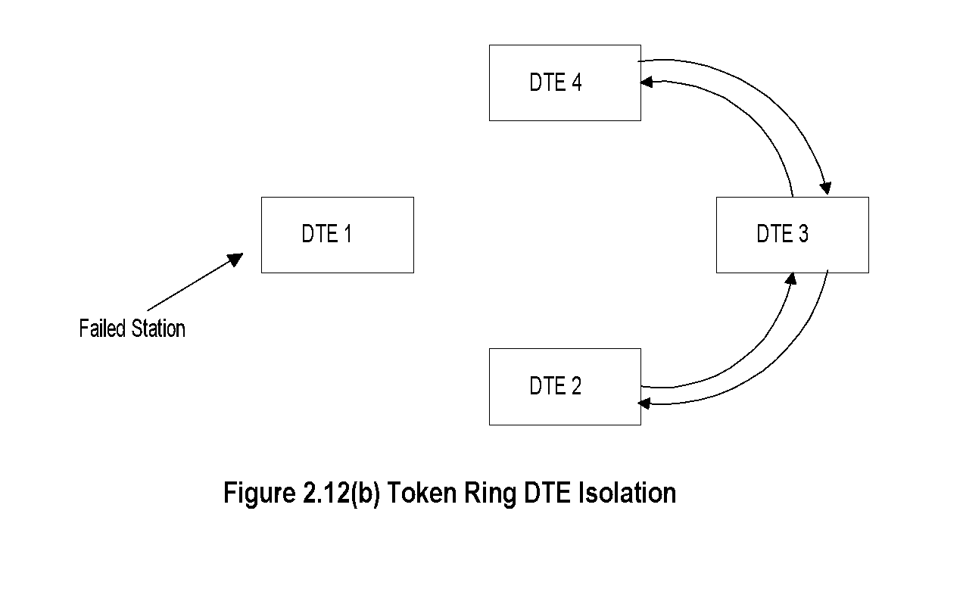
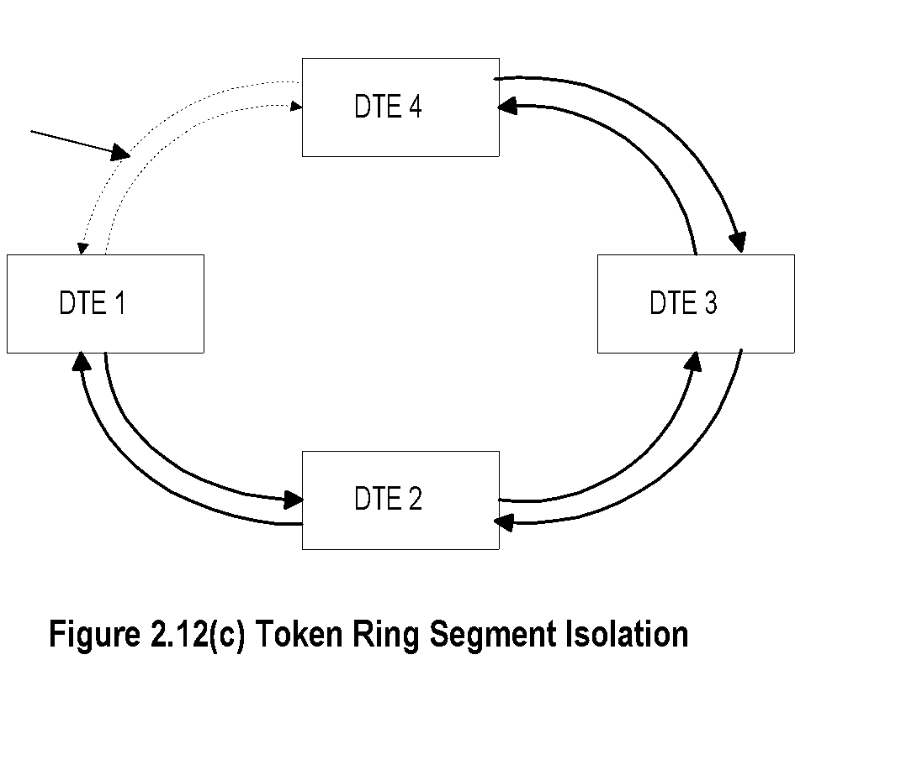
Chapter 2 Review of Information Network and Technology
Failure Recovery in TR LAN
Notes
Station failure recovery
Link failure recovery
Network Management: Principles and Practice
© Mani Subramanian 2010
*

Slide 21
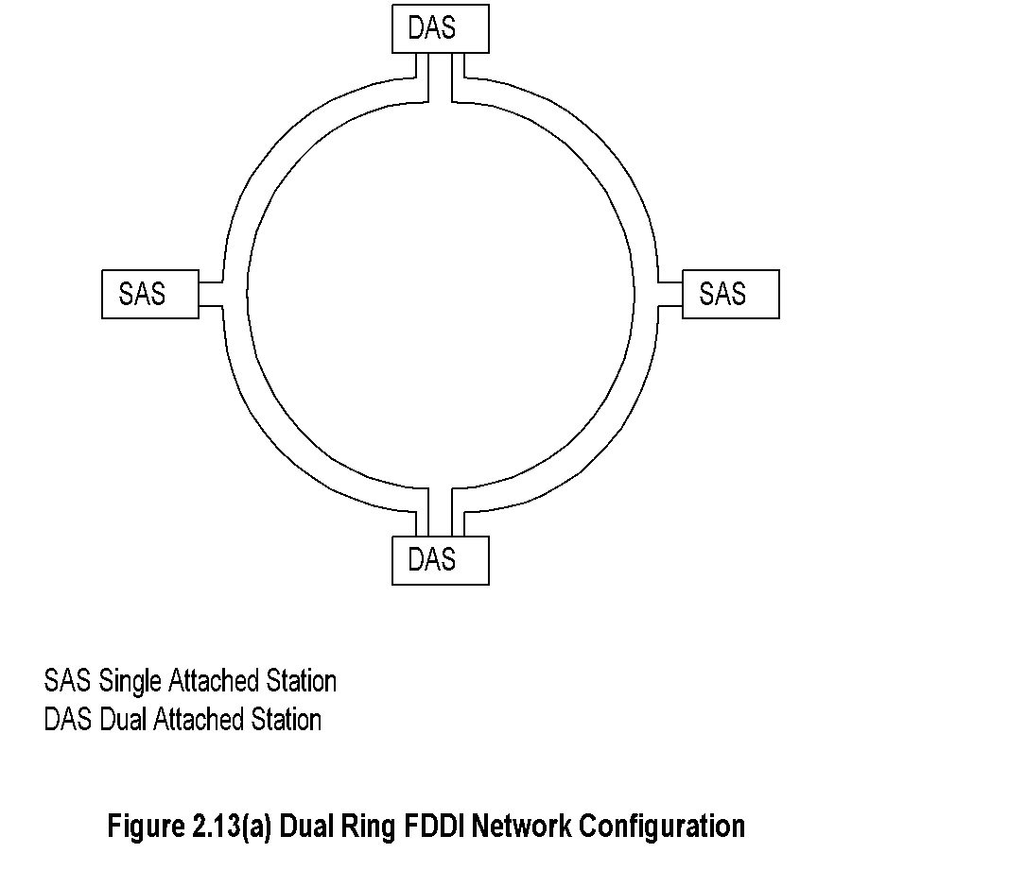
Chapter 2 Review of Information Network and Technology
FDDI
Notes
Uses fiber optics medium
Modified token-ring protocol
Data rate 100 Mbps
Segment length 100 km
500 stations in the ring with max separation of 2 km
Single- and dual-attached stations
Dual-attached stations load share the two rings
Network Management: Principles and Practice
© Mani Subramanian 2010
*

Slide 22
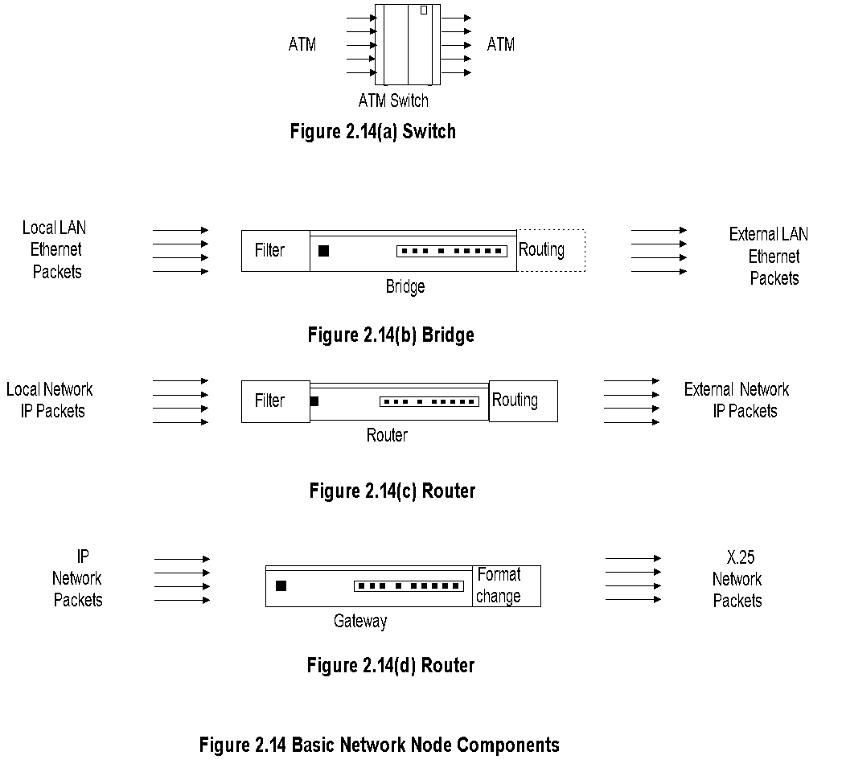
Chapter 2 Review of Information Network and Technology
Basic Network Nodes
Notes
Network Management: Principles and Practice
© Mani Subramanian 2010
*

Slide 23
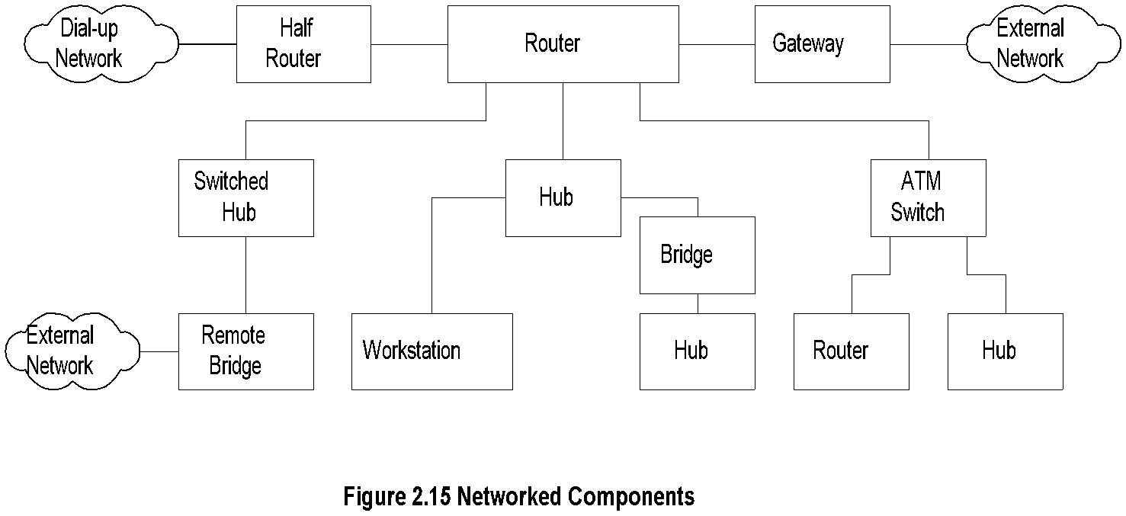
Chapter 2 Review of Information Network and Technology
Network Node Components
Notes
Hubs
Bridges
Remote bridges
Routers
Gateways
Half bridge / half router
Switches
Transport devices (ADM, SDH)
Broadband access components
Residential distribution devices
Network Management: Principles and Practice
© Mani Subramanian 2010
*

Slide 24
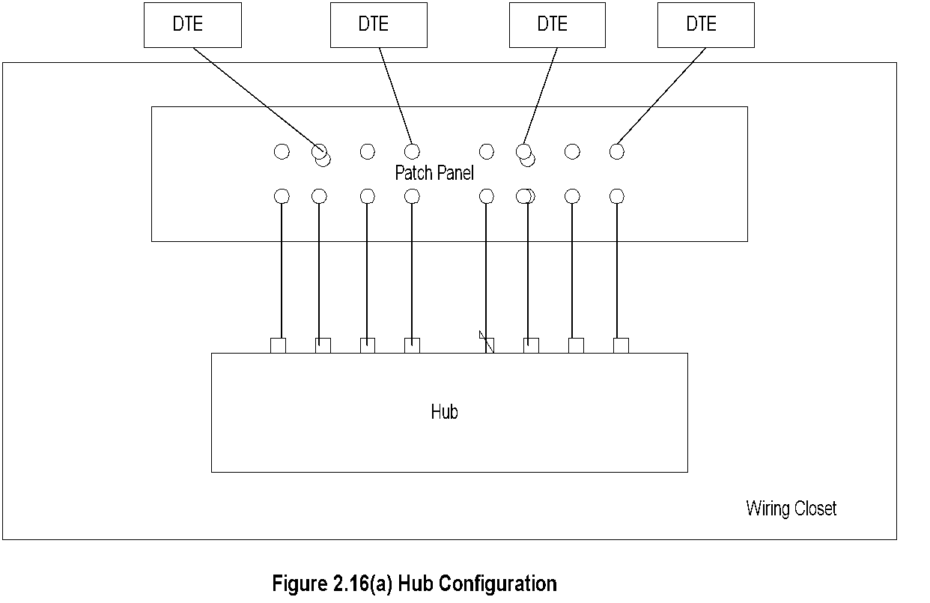
Chapter 2 Review of Information Network and Technology
Hubs
Notes
Hub is a platform
Function dependent on what is housed
LAN
Switched LAN
Bridge
Network Management: Principles and Practice
© Mani Subramanian 2010
*

Slide 25
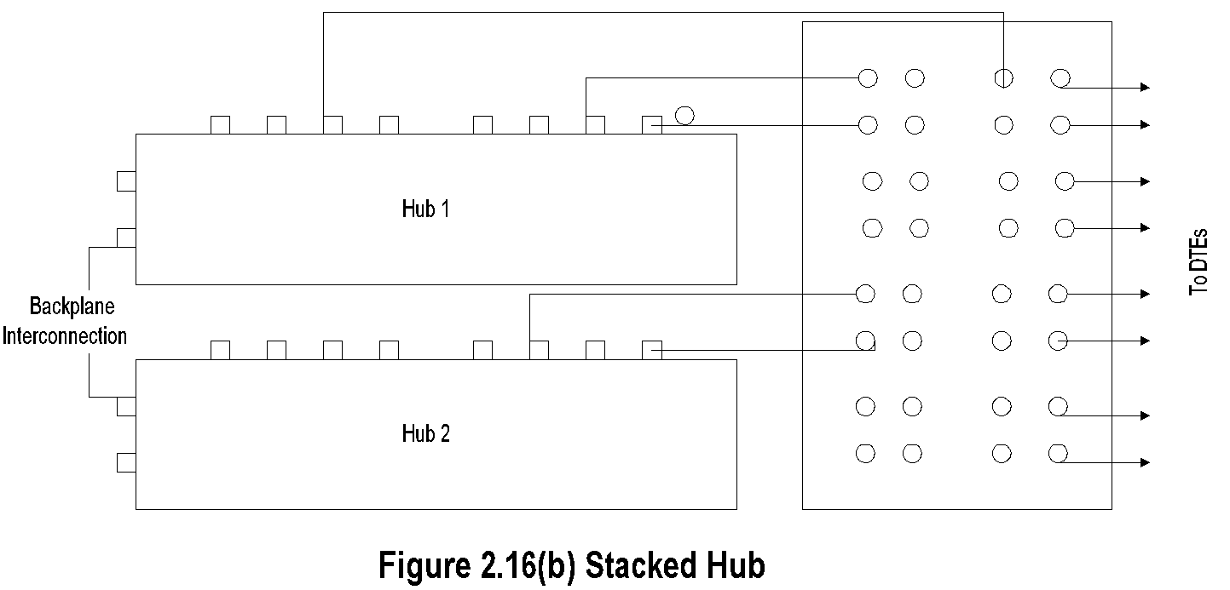
Chapter 2 Review of Information Network and Technology
Stacked Hubs
Notes
Hub ports can be scaled up using stacked hubs
Stacked hub
Extend back plane
Connected as daisy chain
Network Management: Principles and Practice
© Mani Subramanian 2010
*

Slide 26
Chapter 2 Review of Information Network and Technology
Bridges
Bridge
Local Bridge
Remote Bridge
Simple
Multiport
Multiport
Multi-protocol
Notes
Bridges two nodes at data link control layer
Ethernet: tree topology, transparent bridge
Token ring:mesh topology, source routing bridge
Remote bridge uses WAN interface cards; same protocol used at both ends
Ethernet bridge is a learning bridge
Network Management: Principles and Practice
© Mani Subramanian 2010
*

Slide 27
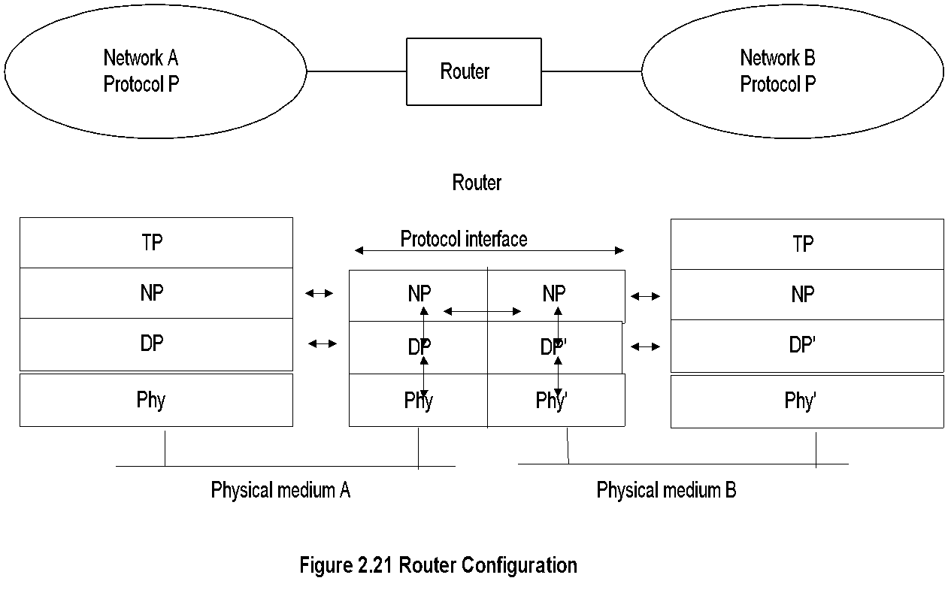
Chapter 2 Review of Information Network and Technology
Routers
Notes
Routers operate at network layer
Routes packets between nodes of similar network protocols
Routing table used to route packets
DLC and Physical layers could be different under the same common network layer protocol
Network Management: Principles and Practice
© Mani Subramanian 2010
*

Slide 28
Chapter 2 Review of Information Network and Technology
Gateway
Notes
Gateway is router connecting two networks with dissimilar network protocols.
Gateway does the protocol conversion at the network layer.
Protocol converter does the conversion at the application layer.
Network Management: Principles and Practice
© Mani Subramanian 2010
*

Slide 29
Chapter 2 Review of Information Network and Technology
Tunneling
Joe’s Mobile
Loc: Seattle
Home LAN
NY
Tunneling
Foreign
Agent
Sally
L.A
Notes
Tunneling is transmission of packets (via multiprotocol routers) by encapsulation.
In Figure 2.24, packets are encapsulated and transmitted through X.25 network in a serial mode.
In the mobile environment, Joe and his home agent in NY communicate Joe’s Seattle location to the foreign agent. His communication with Sally in LA is tunneled.
Network Management: Principles and Practice
© Mani Subramanian 2010
*

Slide 30
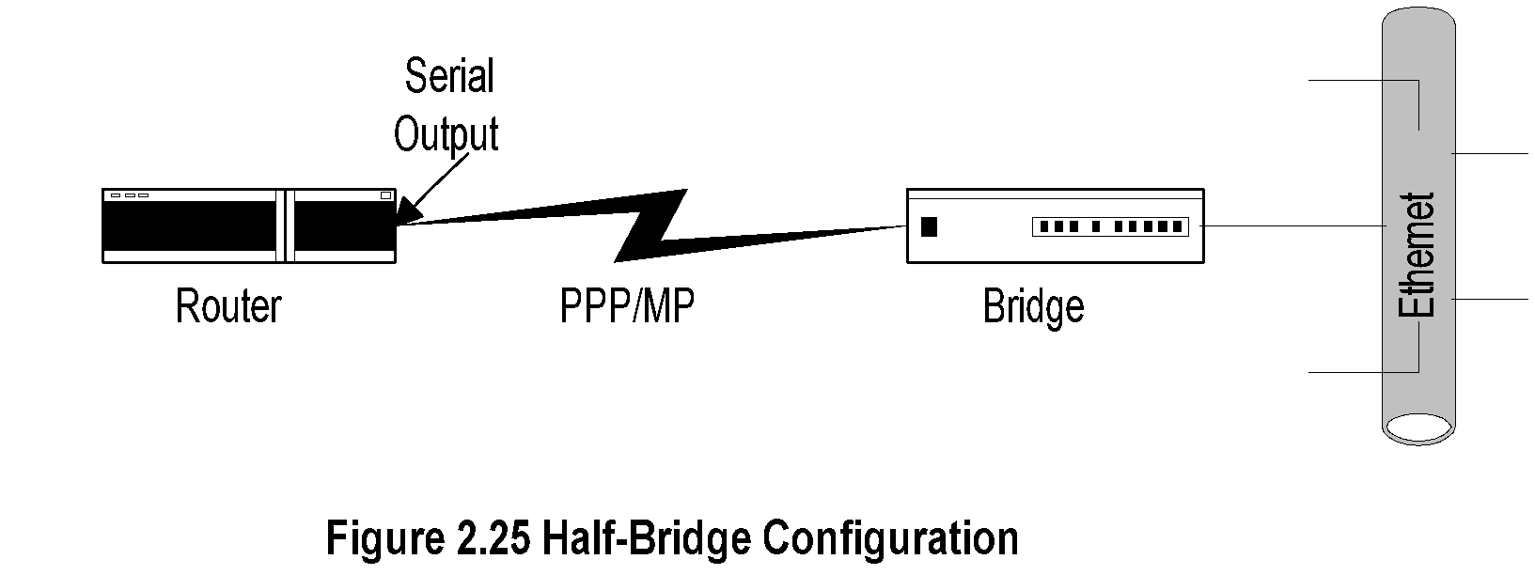
Chapter 2 Review of Information Network and Technology
Half-Bridge
Notes
Half-bridge (also referred to as half-router) is point-to-point communication
Uses PPP protocol
Helps low-end users to communicate with ISP on dial-up link saving the expense of dedicated link
Router encapsulates packets in PPP frames and puts serial outputs to the bridge, and vice-versa
Network Management: Principles and Practice
© Mani Subramanian 2010
*

Slide 31
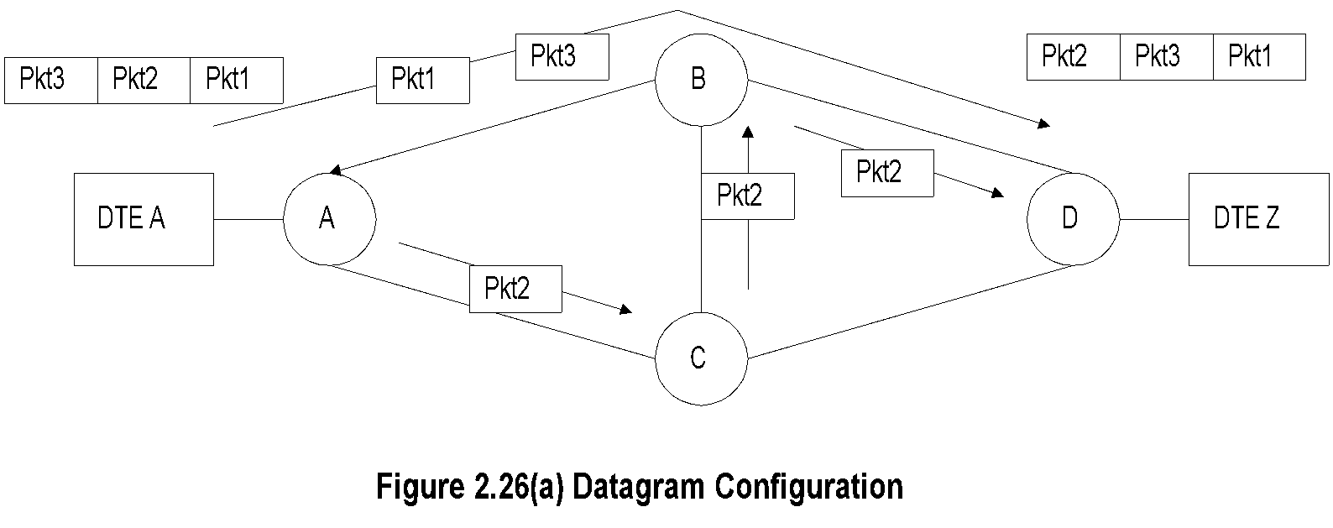
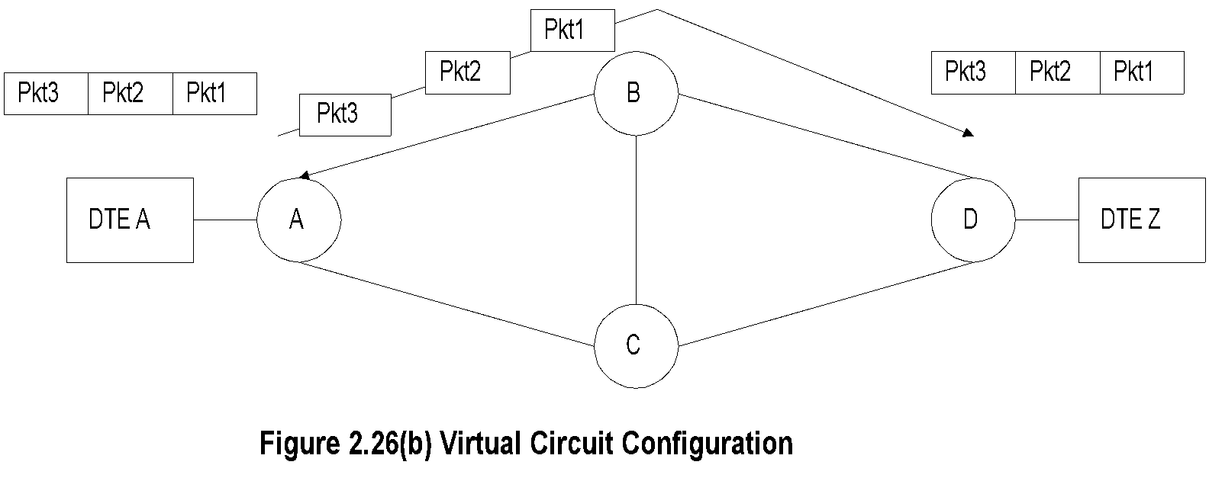
Chapter 2 Review of Information Network and Technology
Switched Networks
Notes
Switches are embedded in bridges and routers
Switched network used in WAN
Two types of switched networks
Circuit-switched
Packet-switched
Datagram service
Virtual circuit
Network Management: Principles and Practice
© Mani Subramanian 2010
*

Slide 32
Chapter 2 Review of Information Network and Technology
Transmission Technology
Transmission Technology
Medium
Mode
Wired
Wireless
Digital
Analog
LAN
WAN
LAN Mobile Satellite
Notes
Physical transport media
UTP
Coax
Fiber
Terrestrial wireless
Satellite transmission
Network Management: Principles and Practice
© Mani Subramanian 2010
*

Slide 33
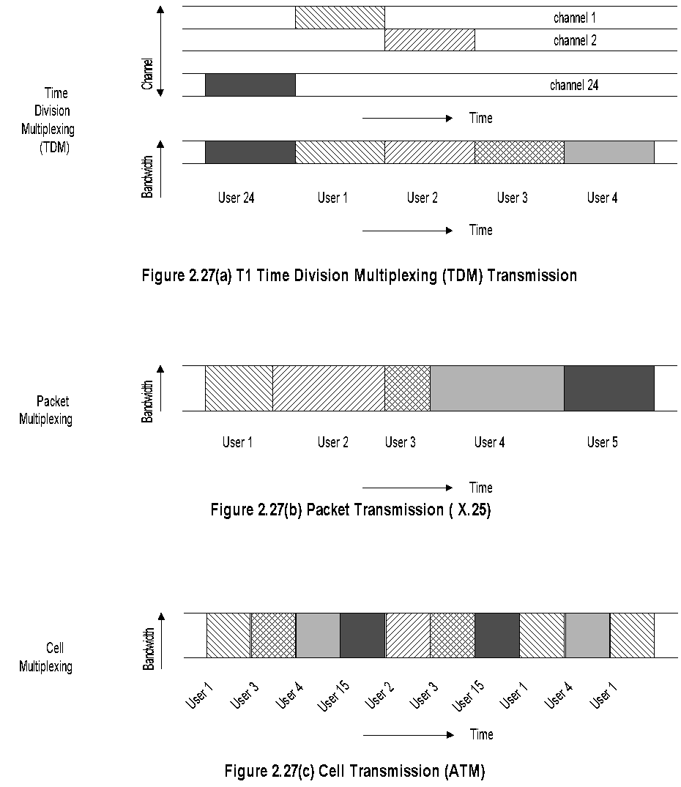
Chapter 2 Review of Information Network and Technology
Transmission Modes
Notes
Network Management: Principles and Practice
© Mani Subramanian 2010
*

Slide 34
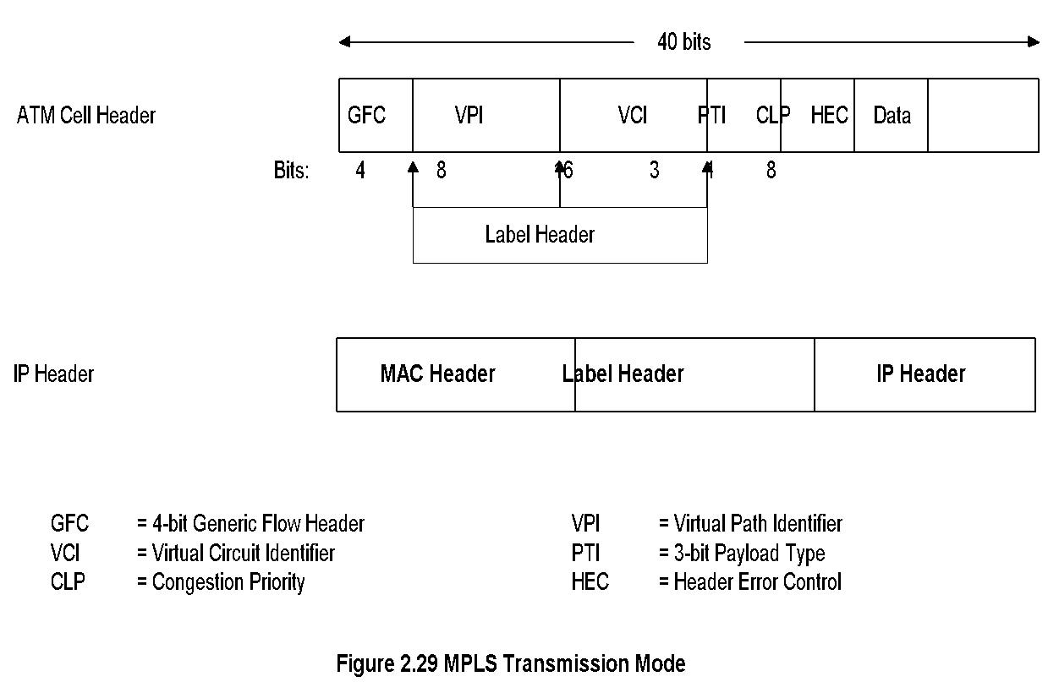
MPLS Transmission Mode
Chapter 2 Review of Information Network and Technology
Notes
Multiprotocol Label Switching
Combines
Richness of IP
Performance of ATM
Label inserted between 2nd and 3rd layers
Compatible with IP and ATM
Network Management: Principles and Practice
© Mani Subramanian 2010
*

Slide 35
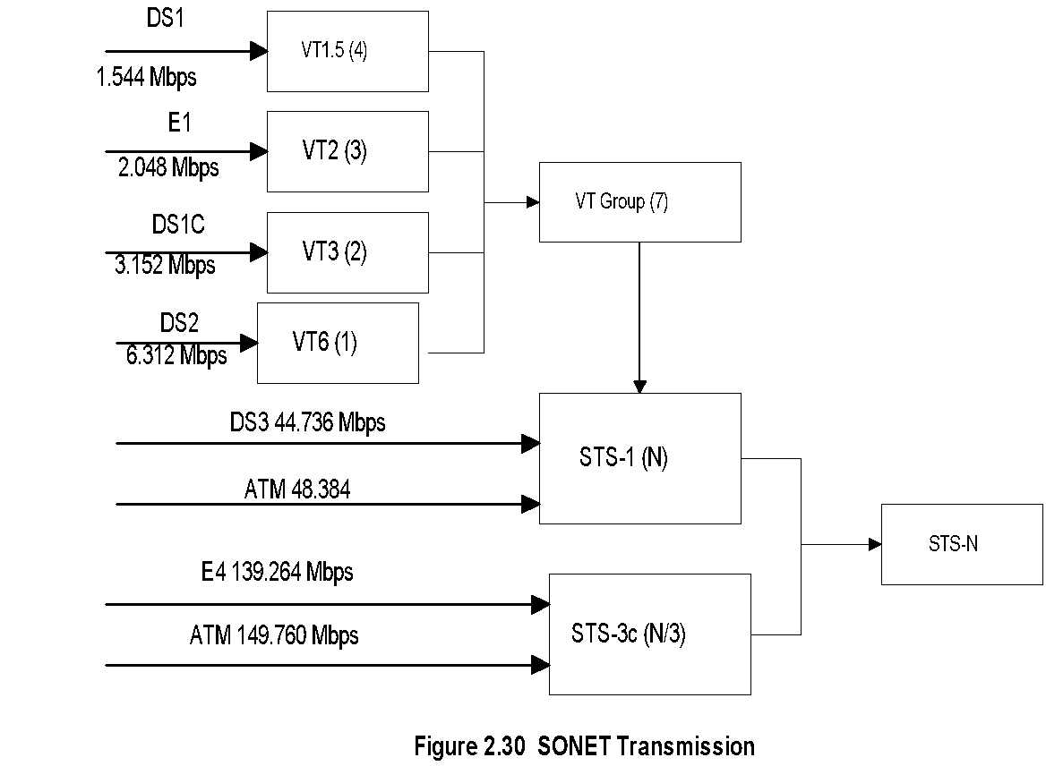
SONET Transmission
Chapter 2 Review of Information Network and Technology
Notes
Synchronous Optical Network (SONET) based on Synchronous Digital Hierarchy (SDH)
Incompatible T1 and E1 made into universally compatible digital network
Uses fiber optics carrying large bandwidth
Basic digital bandwidth STS-1 of 51.84 Mbps
Hierarchy based on STM-N (Synchronous Transmission Mode): STM-1, STM-4, etc.
Network Management: Principles and Practice
© Mani Subramanian 2010
*

Slide 36
Synchronous Digital Hierarchy
Chapter 2 Review of Information Network and Technology
SONET Signal | SDH Signal | Bit Rate (Mbps)
STS-1 |  | 51.84
STS-3 | STM-1 | 155.52
STS-12 | STM-4 | 622.08
STS-24 |  | 1244.16
STS-48 | STM-16 | 2488.32
STS-192 | STM-64 | 9953.28
STS-768 | STM-256 | 39,814.32
Notes
Network Management: Principles and Practice
© Mani Subramanian 2010
*

Slide 37
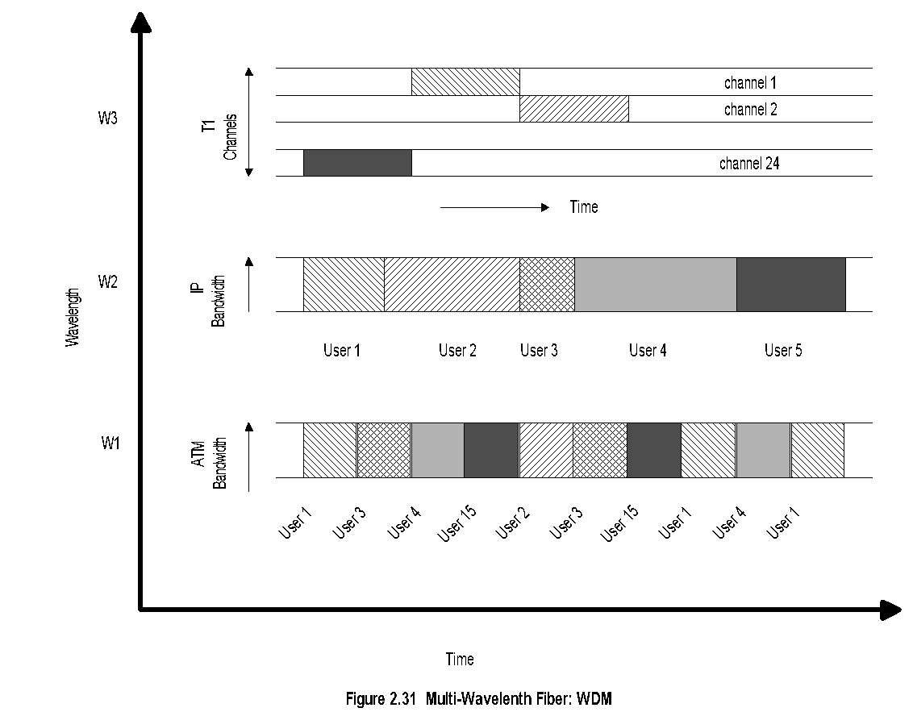
DWDM
Chapter 2 Review of Information Network and Technology
Notes
(Dense) Wavelength Division Multiplexing
Similar to FDM at lower frequecies
Multiple wavelength carrier can be configured for multiple protocol transmision.
Network Management: Principles and Practice
© Mani Subramanian 2010
*

Slide 38
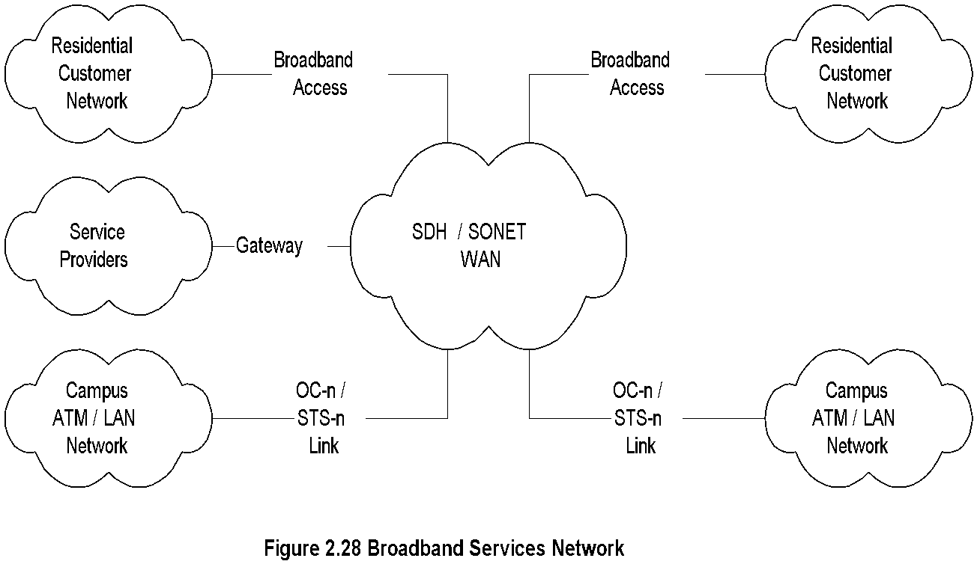
Chapter 2 Review of Information Network and Technology
Broadband Services
Notes
Integrated services: Voice, video, and data
Narrow band ISDN (Integrated Services Digital Net.)
Basic rate:2B + D (B channel 64 kbps and D channel 16 kbps
Primary rate: 23B + D channels
Broadband (ISDN) Services uses ATM technology
SONET (Synchronous Optical Network) or SDH (Synchronous Digital Hierarchy)
Data rate OC-n
OC-1 51.84 Mbps
OC-3 155.52 Mbps
Access technologies:
Cable
ADSL (Asymmetric Digital Subscriber Line)
Fixed Wireless
Mobile cellular wireless
Network Management: Principles and Practice
© Mani Subramanian 2010
*

