Slide 1
Chapter 3
Basic Foundations:
Standards, Models, and Language

Slide 2
Introduction
Standards
Standards organizations
Protocol standards of transport layers
Protocol standards of management (application) layer
Management Models
Language

Slide 3
Table 3.1 Network Management Standards

Slide 4
OSI Architecture and Model

Slide 5
OSI Architecture and Model (cont.)
Organization
Network management components
Functions of components
Relationships
Information
Structure of management information (SMI)
Syntax and semantics
Management information base (MIB)
Organization of management information
Object-oriented
Communication
Transfer syntax with bidirectional messages
Transfer structure (PDU)
Functions
Application functions
Configure components
Monitor components
Measure performance
Secure information
Usage accounting

Slide 6
SNMP Architecture and Model
Organization
Same as OSI model
Information
Same as OSI, but scalar
Communication
Messages less complex than OSI and unidirectional
Transfer structure (PDU)
Functions
Application functions
Fault management
Configuration management
Account management
Performance management
Security management

Slide 7
TMN (Telecommunications Management Network) Architecture
Addresses management of telecommunication networks
Based on OSI model
Superstructure on OSI network
Addresses network, service, and business management

Slide 8
Organizational Model
Manager
Sends requests to agents
Monitors alarms
Houses applications
Provides user interface
Agent
Gathers information from objects
Configures parameters of objects
Responds to managers’ requests
Generates alarms and sends them to managers
Managed object
Network element that is managed
Houses management agent
All objects are not managed / manageable

Slide 9
Two-Tier Model
Agent built into network element Example: Managed hub, managed router
An agent can manage multiple elements Example: Switched hub, ATM switch
MDB is a physical database
Unmanaged objects are network elements that are not managed - both physical (unmanaged hub) and logical (passive elements)

Slide 10
Three-Tier Model
Middle layer plays the dual role
Agent to the top-level manager
Manager to the managed objects
Example of middle level: Remote monitoring agent (RMON)

Slide 11
Manager of Managers
Agent NMS manages the domain
MoM presents integrated view of domains
Domain may be geographical, administrative, vendor-specific products, etc.

Slide 12
Peer NMSs
Dual role of both NMSs
Network management system acts as peers
Dumbbell architecture discussed in Chapter 1
Notice that the manager and agent functions are processes and not systems

Slide 13
Information Model: Analogy
Figure in a book uniquely identified by
ISBN, Chapter, and Figure number in that hierarchical order
ID: {ISBN, chapter, figure}
The three elements above define the syntax
Semantics is the meaning of the three entities according to Webster’s dictionary
The information comprises syntax and semantics about an object

Slide 14
Structure of Management Information (SMI)
SMI defines for a managed object
Syntax
Semantics
Plus additional information such as status
Example sysDescr: { system 1 } Syntax: OCTET STRING Definition: "A textual description of the entity. " Access: read-only Status: mandatory

Slide 15
Management Information Base (MIB)
Information base contains information about objects
Organized by grouping of related objects
Defines relationship between objects
It is NOT a physical database. It is a virtual database that is compiled into management module

Slide 16
Information Base View: An Analogy
Fulton County library system has many branches
Each branch has a set of books
The books in each branch is a different set
The information base of the county has the view (catalog) of all books
The information base of each branch has the catalog of books that belong to that branch. That is, each branch has its view (catalog) of the information base
Let us apply this to MIB view

Slide 17
MIB View and Access of an Object
A managed object has many attributes - its information base
There are several operations that can be performed on the objects
A user (manager) can view and perform only certain operations on the object by invoking the management agent
The view of the object attributes that the agent perceives is the MIB view
The operation that a user can perform is the MIB access

Slide 18
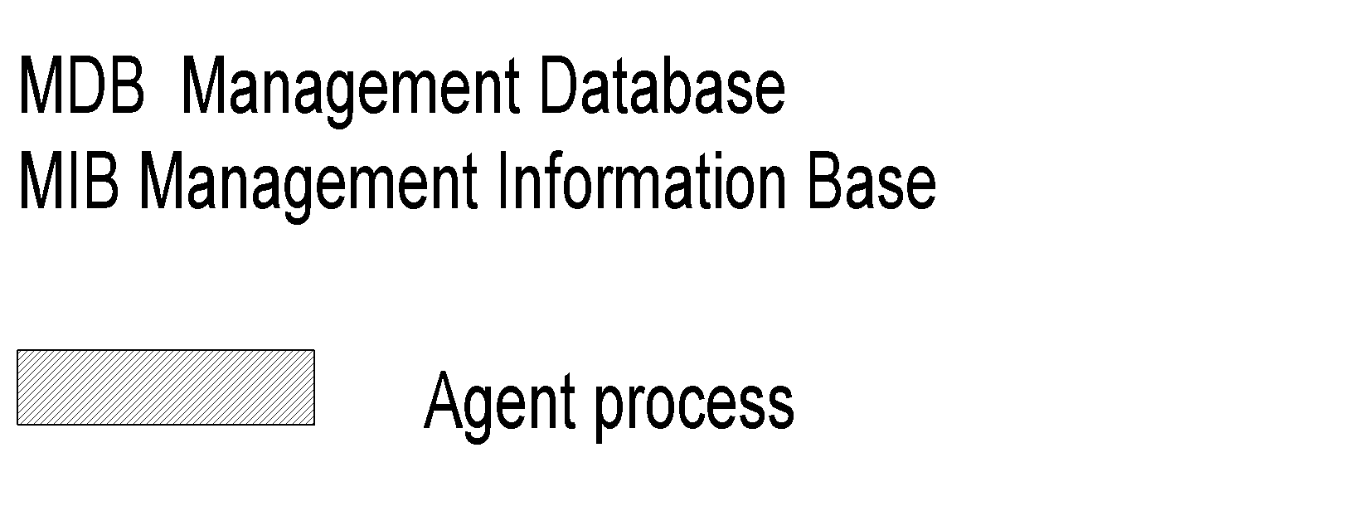
Management Data Base / Information Base
Distinction between MDB and MIB
MDB physical database; e.g., Oracle, Sybase
MIB virtual database; schema compiled into management software.
An NMS can automatically discover a managed object, such as a hub, when added to the network
The NMS can identify the new object as hub only after the MIB schema of the hub is compiled into NMS software.

Slide 19
Managed Object
Managed objects can be
Network elements (hardware, system)
Hubs, bridges, routers, transmission facilities
Software (non-physical)
Programs, algorithms
Administrative information
Contact person, name of group of objects (IP group)

Slide 20
Management Information Tree

Slide 21
OSI Management Information Tree
iso International Standards Organization itu International Telecommunications Union dod Department of Defense
Designation:
iso 1
org 1.3
dod 1.3.6
internet 1.3.6.1

Slide 22
Object Type and Instance
Type
Name
Syntax
Definition
Status
Access
Instance
Note:
Example of a circle
“circle” is syntax
Semantics is definition from dictionary “A plane figure bounded by a singl curved line, every point of which is of equal distance from the center of the figure.”
Analogy of nursery school

Slide 23
Managed Object: Internet Perspective
object ID unique ID
and descriptor and name for the object
syntax used to model the object
access access privilege to a managed object
status implementation requirements
definition textual description of the semantics of object type

Slide 24
Managed Object: OSI Perspective
object class managed object
attributes attributes visible at its boundary
operations operations which may be applied to it
behavior behavior exhibited by it in response to operation
notifications notifications emitted by the object

Slide 25
Packet Counter Example

Slide 26
Internet vs. OSI Managed Object
Scalar object in Internet vs. Object-oriented approach in OSI
OSI characteristics of operations, behavior, and notification are part of communication model in Internet: get/set and response/alarm
Internet syntax is absorbed as part of OSI attributes
Internet access is part of OSI security model
Internet status is part of OSI conformance application
OSI permits creation and deletion of objects; Internet does not: Enhancement in SNMPv2

Slide 27
Mgmt. Communication Model
In Internet requests/responses, in OSI operations
In Internet traps and notifications (SNMPv2), in OSI notifications

Slide 28
Transfer Protocols
Internet is based on SNMP; OSI is based on CMIP
OSI uses CMISE (Common Management Information Service Element) application with CMIP
OSI specifies both c-o and connectionless transport protocol; SNMPv2 extended to c-o, but rarely used

Slide 29
Abstract Syntax Notation One
ASN.1 is more than a syntax; it’s a language
Addresses both syntax and semantics
Two types of syntax
Abstract syntax: set of rules that specify data type and structure for information storage
Transfer syntax: set of rules for communicating information between systems
Makes application layer protocols independent of lower layer protocols
Can generate machine-readable code: Basic Encoding Rules (BER) is used in management modules

Slide 30
Backus-Nauer Form (BNF)
Definition:
<name> ::= <definition>
Rules:
<digit> ::= 0|1|2|3|4|5|6|7|8|9
<number> ::= <number> | <digit> <number>
<op> ::= +|-|x|/
<SAE> ::= <number>|<SAE>|<SAE><op><SAE>
Example:
9 is primitive 9
19 is construct of 1 and 9
619 is construct of 6 and 19
Note:
BNF is used for ASN.1 constructs
Constructs developed from primitives
The above example illustrates how numbers are constructed from the primitive <digit>
Simple Arithmetic Expression entity (<SAE>) is constructed from the primitives <digit> and <op>

Slide 31
Simple Arithmetic Expression
<SAE> ::= <number> | <SAE><op><number>
Example: 26 = 13 x 2
Constructs and primitives

Slide 32
Type and Value
Assignments
<BooleanType> ::= BOOLEAN
<BooleanValue> ::= TRUE | FALSE
ASN.1 module is a group of assignments person-name Person-Name::=
{
first "John",
middle “T",
last "Smith"
}

Slide 33
Data Type: Example 1
Note:
Module name starts with capital letters
Data types:
Primitives: NULL, GraphicString
Constructs
Alternatives : CHOICE
List maker: SET, SEQUENCE
Repetition: SET OF, SEQUENCE OF:
Difference between SET and SEQUENCE

Slide 34
Data Type: Example 2
Note:
SEQUENCE OF SEQUENCE makes
table of rows

Slide 35
ASN.1 Symbols
Symbol Meaning
::= Defined as
| or, alternative, options of a list
- Signed number
-- Following the symbol are comments
{} Start and end of a list
[] Start and end of a tag
() Start and end of subtype
.. Range

Slide 36
Keyword Examples
CHOICE
SET
SEQUENCE
OF
NULL
Note:
Keywords are in all UPPERCASE letters

Slide 37
ASN.1 Data Type Conventions

Slide 38
Data Type: Structure & Tag
Structure defines how data type is built
Tag uniquely identifies the data type

Slide 39
Structure
Simple
PageNumber ::= INTEGER
ChapterNumber ::= INTEGER
Structure / Construct
BookPageNumber ::= SEQUENCE {ChapterNumber, Separator, PageNumber Example: {1-1, 2-3, 3-39}
Tagged
Derived from another type; given a new ID
In Fig. 3-14, INTEGER is either universal or application specific
Other types:
CHOICE, ANY
Note:
BookPages ::= SEQUENCE OF { BookPageNumber} or BookPages ::= SEQUENCE OF
{
SEQUENCE
{ChapterNumber, Separator, PageNumber}
}

Slide 40
Tag
Tag uniquely identifies a data type
Comprises class and tag number
Class:
Universal - always true
Application - only in the application used
Context-specific - specific context in application
Private - used extensively by commercial vendors
Note:
Example: BOOLEAN Universal 1 INTEGER Universal 2 research Application [1] (Figure 3.13)
product-based Context-specific under research [0]

Slide 41
Enumerated Integer
Note:
ENUMERATED is a special case of INTEGER
Example: RainbowColors(5) is orange

Slide 42
ASN.1 Module Example

Slide 44
Object Name
Note:
internet OBJECT IDENTIFIER ::= {ISO(1) ORG(3) DOD(6) INTERNET(1)}

Slide 45
TLV Encoding
TLV Type, length, and value are components of the structure

Slide 46
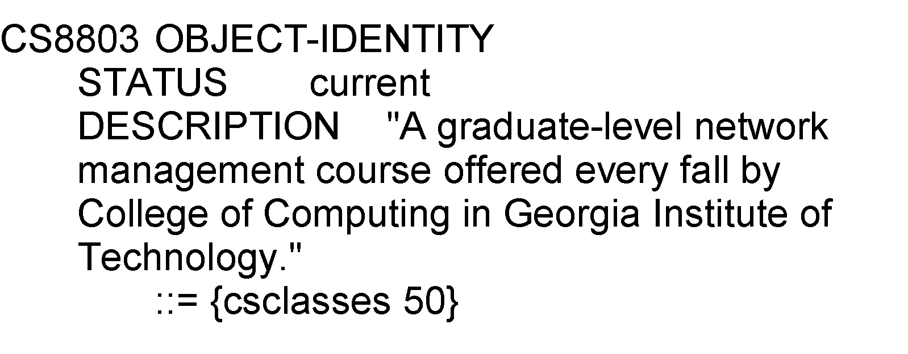
Macro
Example:
Note: Macro is used to create new data types

Slide 47
Functional Model

Slide 48
Functional Model-Cont.
Configuration management
Set and change network configuration component parameters
Set up alarm thresholds
Fault management
Detection and isolation of failures in network
Trouble ticket administration
Performance management
Monitor performance of network
Security management
Authentication
Authorization
Encryption
Accounting management
Functional accounting of network usage
Nisreen AlGhadban 120015789

