Slide 1
Chapter 5 SNMPv1 Network Management: Communication and Functional Models
Chapter 5
SNMPv1 Network Management:
Communication and Functional Models
Network Management: Principles and Practice
© Mani Subramanian 2010
*

Slide 2
Objectives
Chapter 5 SNMPv1 Network Management: Communication and Functional Models
Communication model: Administrative and messages
Administrative structure
Community-based model
Access policy
MIB view
Message PDU
SNMP protocol specifications
SNMP operations
SNMP MIB
SNMP functional model
Network Management: Principles and Practice
© Mani Subramanian 2010
*

Slide 3
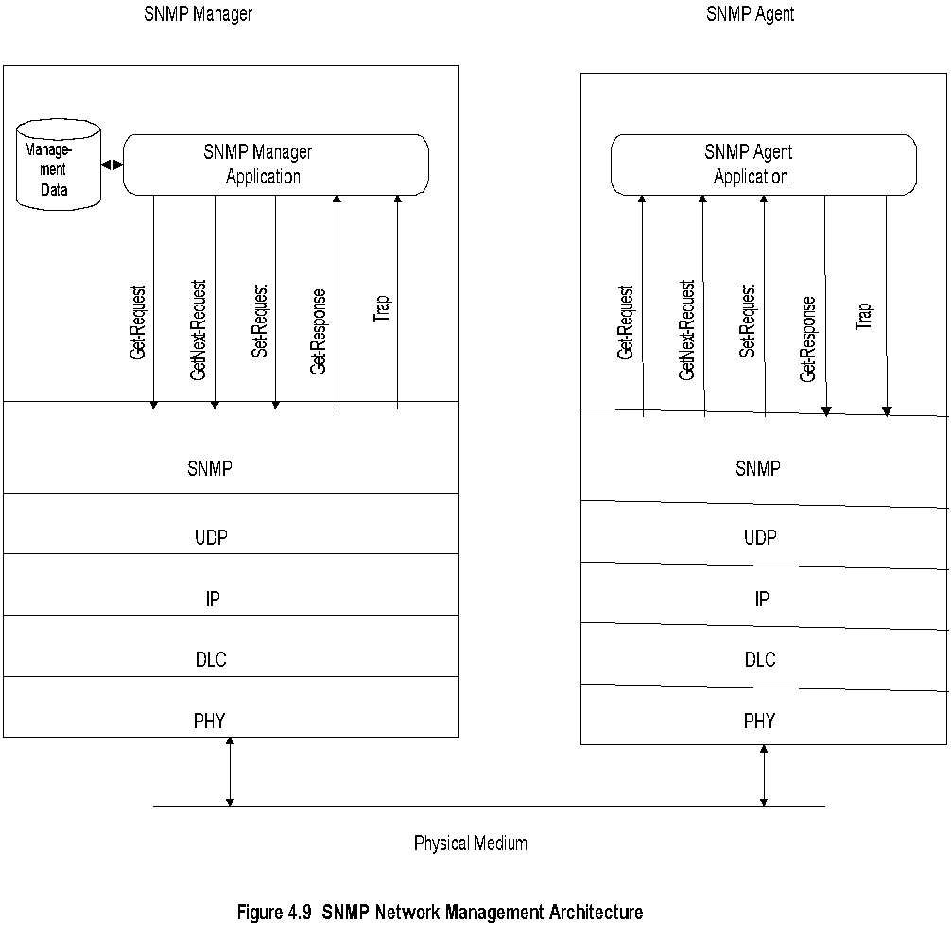
Chapter 5 SNMPv1 Network Management: Communication and Functional Models
SNMP Architecture
Notes
Truly simple network management protocol
Five messages, 3 from manager and 2 from agent
Network Management: Principles and Practice
© Mani Subramanian 2010
*

Slide 4
Chapter 5 SNMPv1 Network Management: Communication and Functional Models
SNMP Messages
Get-Request
Get-Next-Request
Set-Request
Get-Response
Trap
Generic trap
Specific trap
Time stamp
Notes
Generic trap
coldStart
warmStart
linkDown
linkUp
authenticationfailure
egpNeighborLoss
enterpriseSpecific
Specific trap
For special measurements such as statistics
Time stamp: Time since last initialization
Network Management: Principles and Practice
© Mani Subramanian 2010
*

Slide 5
Chapter 5 SNMPv1 Network Management: Communication and Functional Models
Administrative Model
Based on community profile and policy
SNMP Entities:
SNMP application entities - Reside in management stations and network elements - Manager and agent
SNMP protocol entities - Communication processes (PDU handlers) - Peer processes that support application entities
Notes
Network Management: Principles and Practice
© Mani Subramanian 2010
*

Slide 6
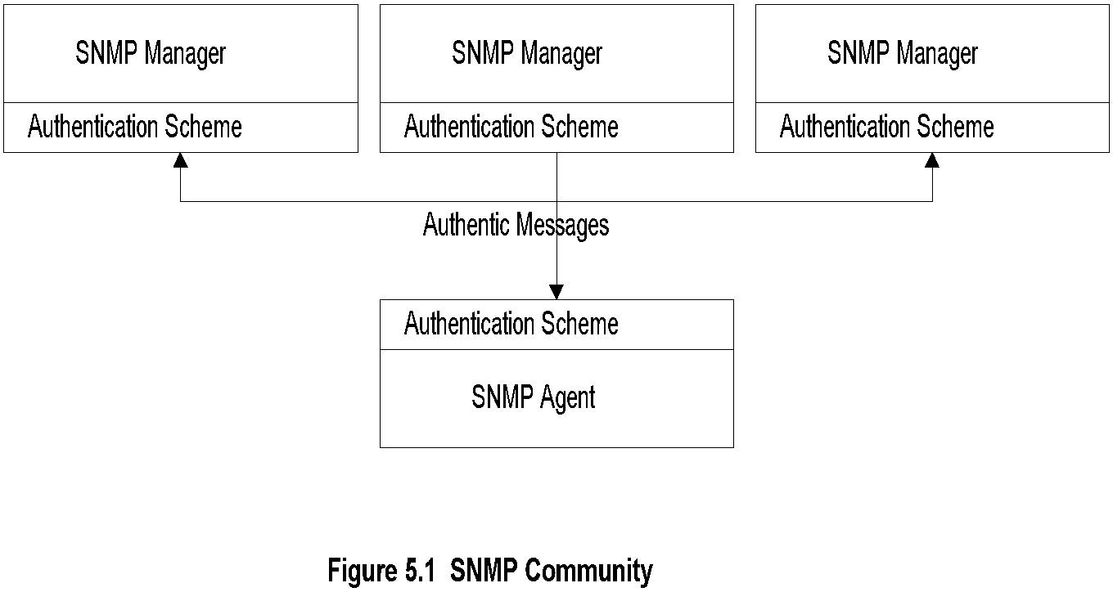
Chapter 5 SNMPv1 Network Management: Communication and Functional Models
SNMP Community
Notes
Security in SNMPv1 is community based
Authentication scheme in manager and agent
Community: Pairing of two application entities
Community name: String of octets
Two applications in the same community communicate with each other
Application could have multiple community names
Communication is not secured in SNMPv1 - no encryption
Network Management: Principles and Practice
© Mani Subramanian 2010
*

Slide 7
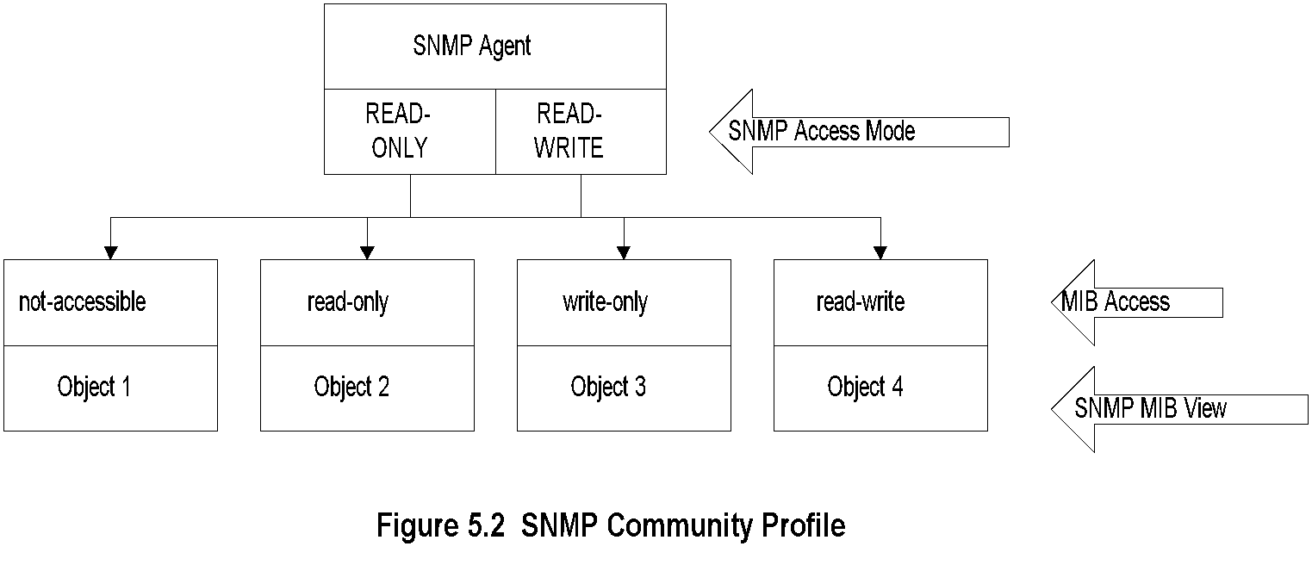
Chapter 5 SNMPv1 Network Management: Communication and Functional Models
Community Profile
Notes
MIB view
An agent is programmed to view only a subset of managed objects of a network element
Access mode
Each community name is assigned an access mode: read-only and read-write
Community profile: MIB view + SNMP access mode
Operations on an object determined by community profile and the access mode of the object
Total of four access privileges
Some objects, such as table and table entry are non-accessible
Network Management: Principles and Practice
© Mani Subramanian 2010
*

Slide 8
Chapter 5 SNMPv1 Network Management: Communication and Functional Models
Administrative Model
Administrative model is SNMP access policy
SNMP community paired with SNMP community profile is SNMP access policy
Notes
Parameters:
Community / communities
Agent / Agents
Manager / Managers
Network Management: Principles and Practice
© Mani Subramanian 2010
*

Slide 9
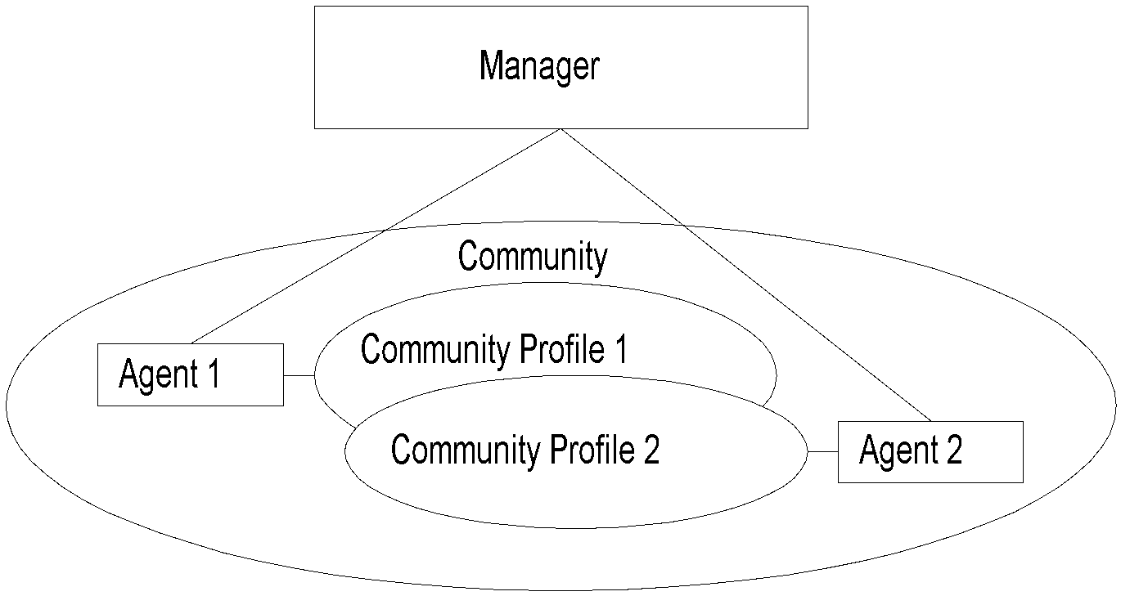
Chapter 5 SNMPv1 Network Management: Communication and Functional Models
Access Policy
Notes
Manager manages Community 1 and 2 network components via Agents 1 and 2
Agent 1 has only view of Community Profile 1, e.g., Cisco components
Agent 2 has only view of Community Profile 2, e.g., 3Com components
Manager has total view of both Cisco and 3Com components
Network Management: Principles and Practice
© Mani Subramanian 2010
*

Slide 10
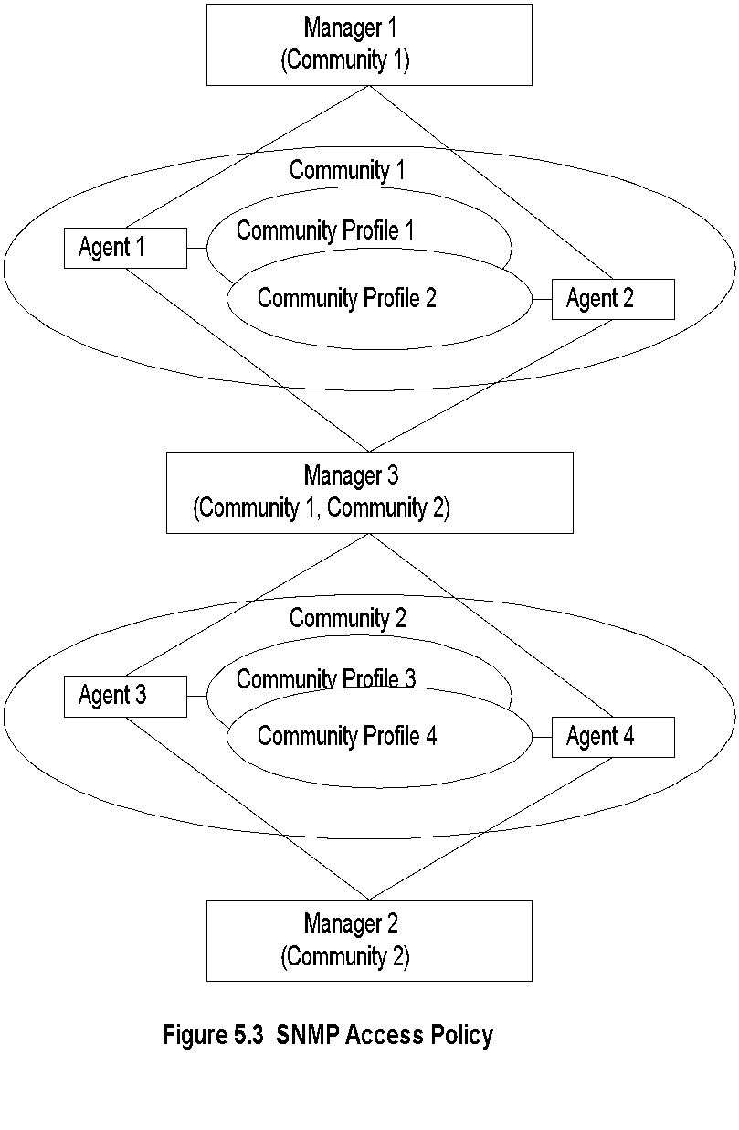
Chapter 5 SNMPv1 Network Management: Communication and Functional Models
Generalized Administrative Model
Notes
Manager 1 manages community 1, manager 2 community 2, and manager 3 (MoM) both communities 1 and 2
Network Management: Principles and Practice
© Mani Subramanian 2010
*

Slide 11
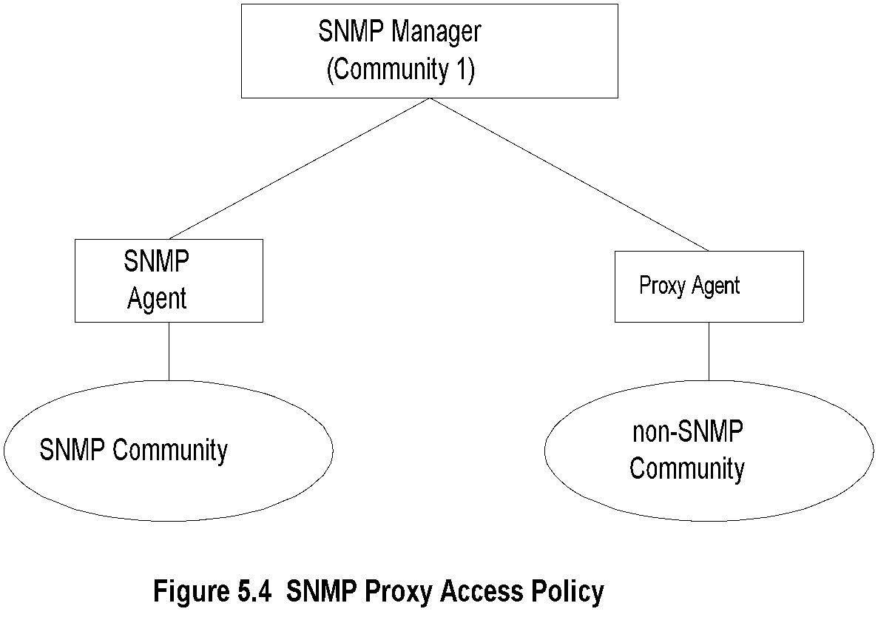
Chapter 5 SNMPv1 Network Management: Communication and Functional Models
Proxy Access Policy
Notes
Proxy agent enables non-SNMP community elements to be managed by an SNMP manager.
An SNMP MIB is created to handle the non-SNMP objects.
Network Management: Principles and Practice
© Mani Subramanian 2010
*

Slide 12
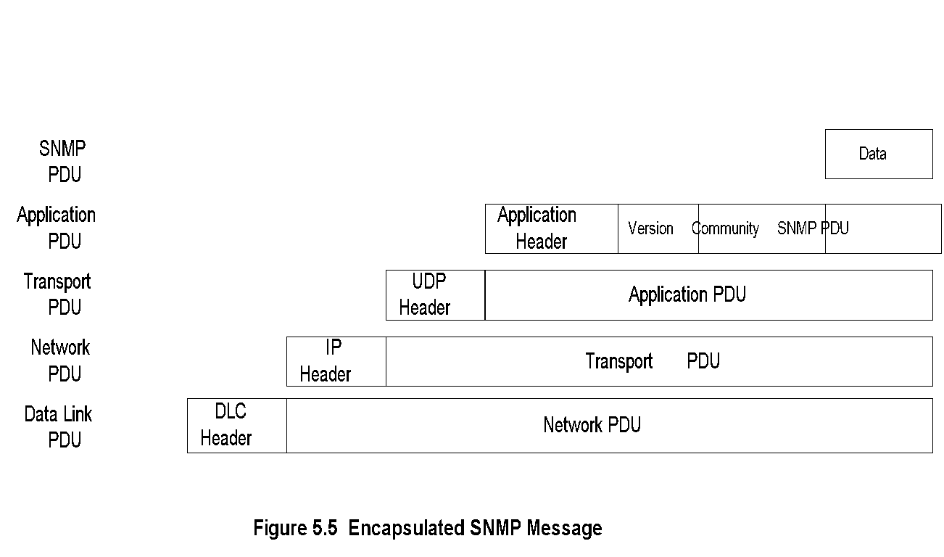
Chapter 5 SNMPv1 Network Management: Communication and Functional Models
Protocol Entities
Notes
Protocol entities support application entities
Communication between remote peer processes
Message consists of:
Version identifier
Community name
Protocol Data Unit
Message encapsulated and transmitted
Network Management: Principles and Practice
© Mani Subramanian 2010
*

Slide 13
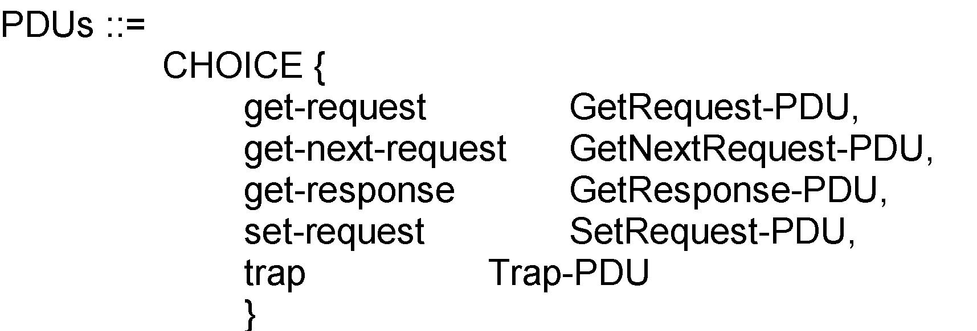
Chapter 5 SNMPv1 Network Management: Communication and Functional Models
Get and Set PDU
Notes
VarBindList: multiple instances of VarBind pairs
PDU Types: enumerated INTEGER
Network Management: Principles and Practice
© Mani Subramanian 2010
*

Slide 14
Chapter 5 SNMPv1 Network Management: Communication and Functional Models
Error in Response
Error Index: No. of VarBind that the first error occurred
Notes
Network Management: Principles and Practice
© Mani Subramanian 2010
*

Slide 15
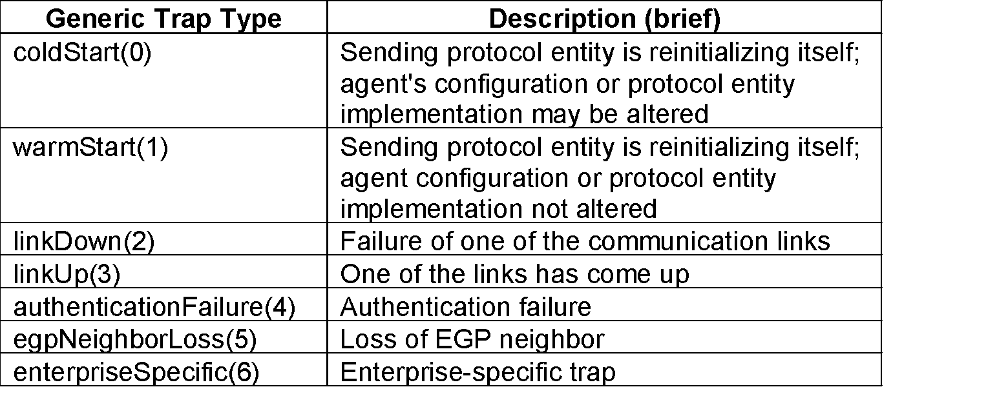
Chapter 5 SNMPv1 Network Management: Communication and Functional Models
Trap PDU
Figure 5.8 Get and Set Type PDUs
Table 5.1 Generic Traps
Notes
Enterprise and agent address pertain to the system generating the trap
Seven generic traps specified by enumerated INTEGER
Specific trap is a trap not covered by enterprise specific trap
Timestamp indicates elapsed time since last re- initialization
Network Management: Principles and Practice
© Mani Subramanian 2010
*

Slide 16
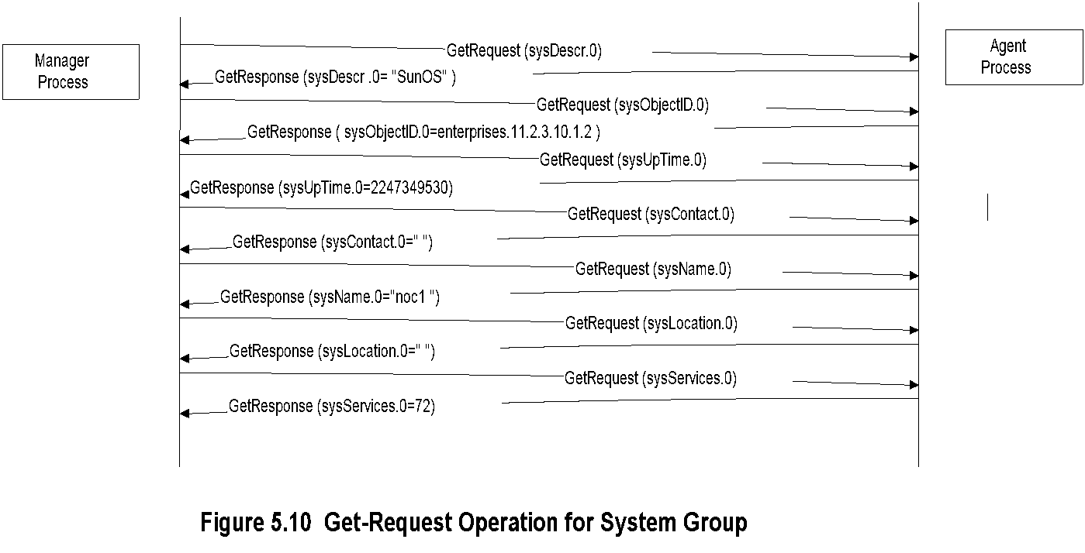
Chapter 5 SNMPv1 Network Management: Communication and Functional Models
SNMP Operations
Notes
Network Management: Principles and Practice
© Mani Subramanian 2010
*

Slide 17
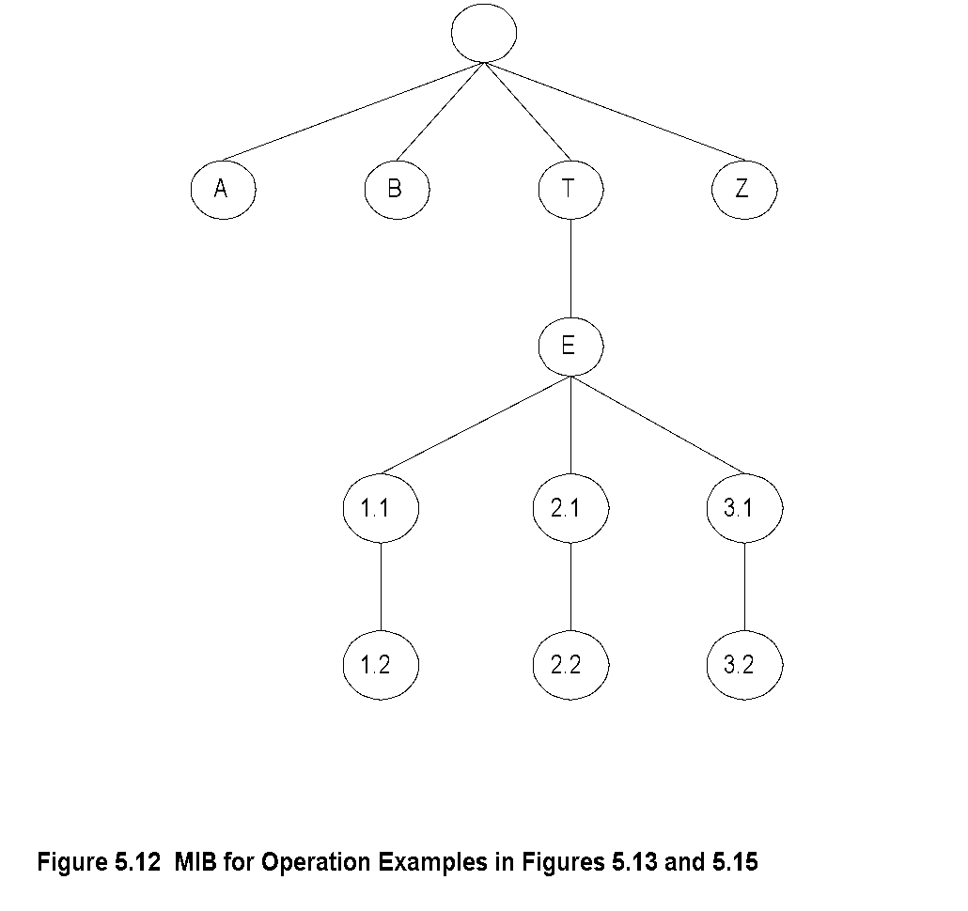
Chapter 5 SNMPv1 Network Management: Communication and Functional Models
MIB for Get-Next-Request
Notes
Network Management: Principles and Practice
© Mani Subramanian 2010
*

Slide 18
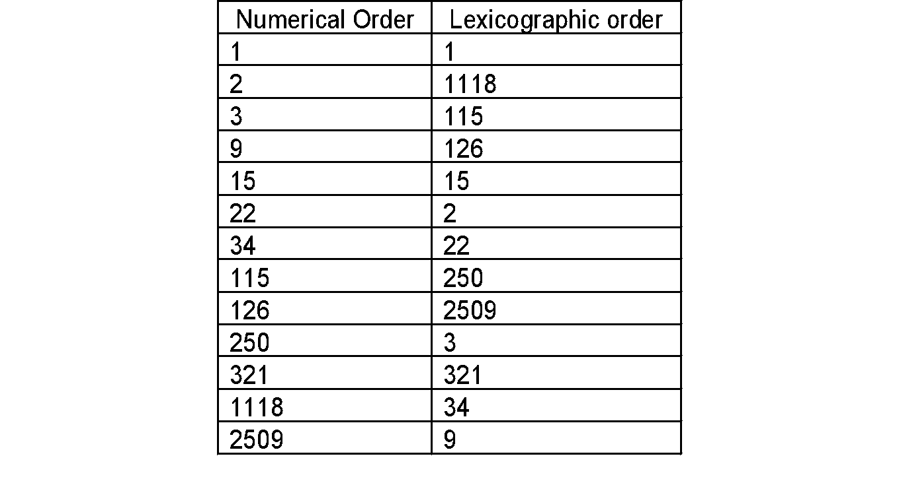
Chapter 5 SNMPv1 Network Management: Communication and Functional Models
Lexicographic Order
Table 5.2 Lexicographic-Order Number Example
Notes
Procedure for ordering:
Start with leftmost digit as first position
Before increasing the order in the first position, select the lowest digit in the second position
Continue the process till the lowest digit in the last position is captured
Increase the order in the last position until all the digits in the last position are captured
Move back to the last but one position and repeat the process
Continue advancing to the first position until all the numbers are ordered
Tree structure for the above process
Network Management: Principles and Practice
© Mani Subramanian 2010
*

Slide 19
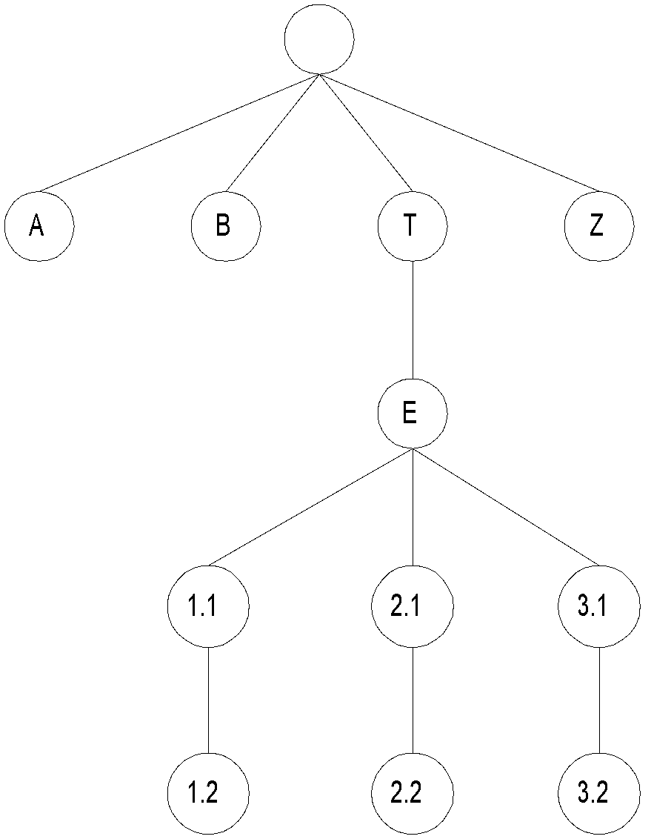
Chapter 5 SNMPv1 Network Management: Communication and Functional Models
MIB Lexicographic Order
Figure 5.12 MIB for Operation Examples in Figures 5.13 and 5.15
Notes
A 3.1
B 3.2
T Z
E
1.1
1.2
2.1
2.2
Network Management: Principles and Practice
© Mani Subramanian 2010
*

Slide 20
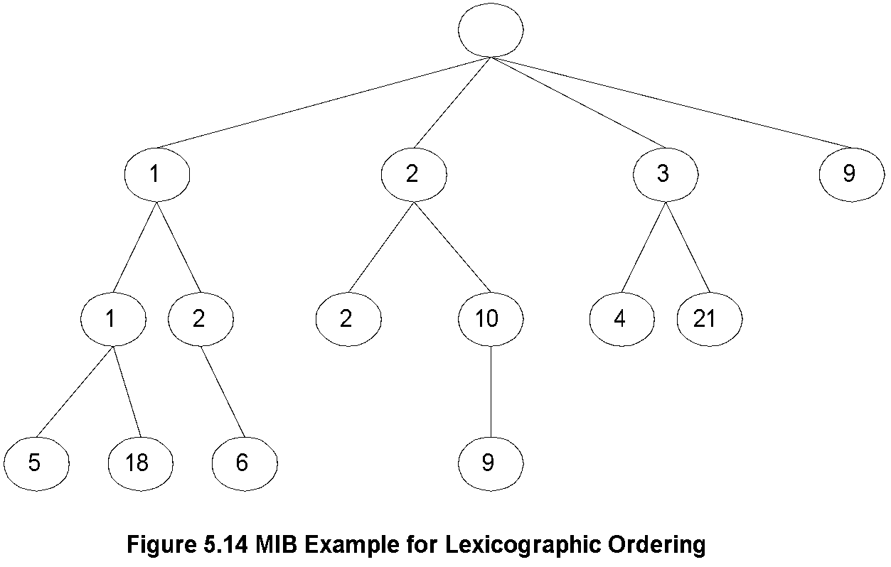
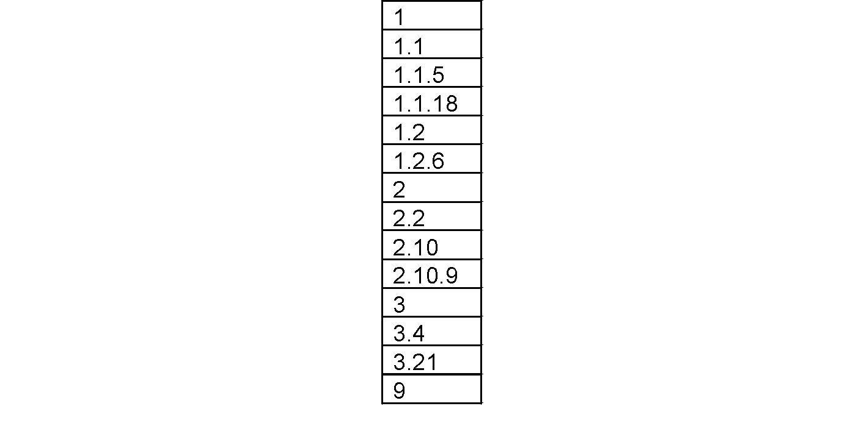
Chapter 5 SNMPv1 Network Management: Communication and Functional Models
A More Complex MIB Example
Notes
Network Management: Principles and Practice
© Mani Subramanian 2010
*

Slide 21
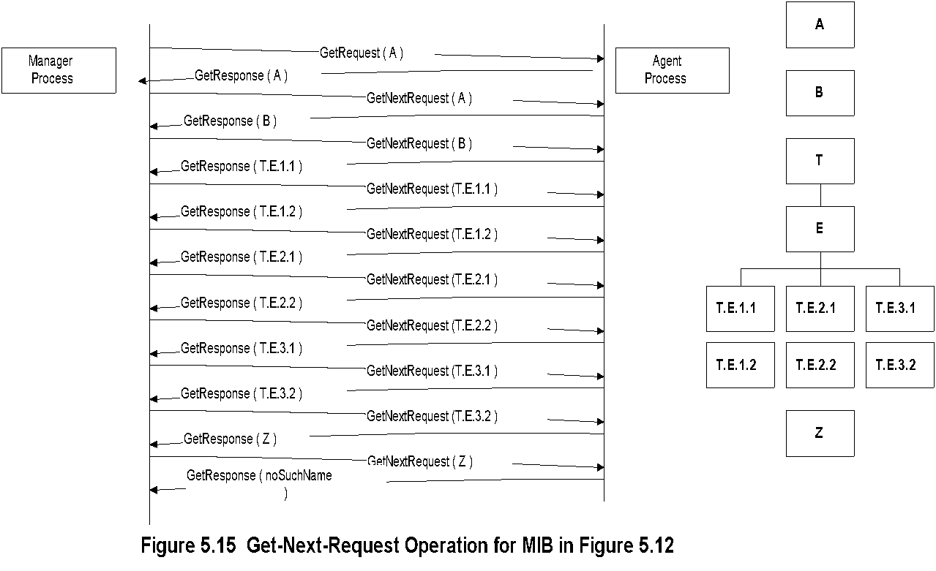
Chapter 5 SNMPv1 Network Management: Communication and Functional Models
Get-Next-Request Operation
Notes
Network Management: Principles and Practice
© Mani Subramanian 2010
*

Slide 22
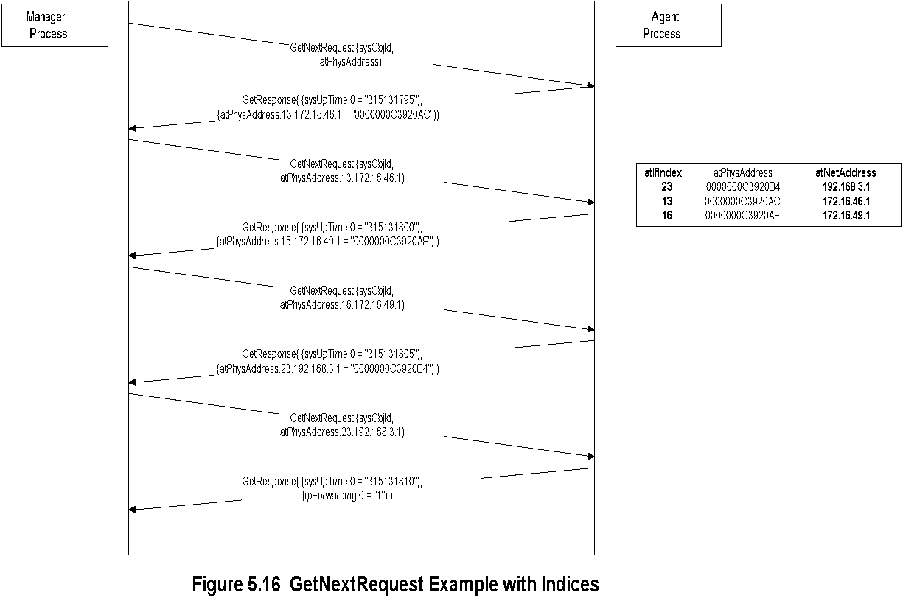
Chapter 5 SNMPv1 Network Management: Communication and Functional Models
Get-Next-Request Operation
Notes
Network Management: Principles and Practice
© Mani Subramanian 2010
*

Slide 23
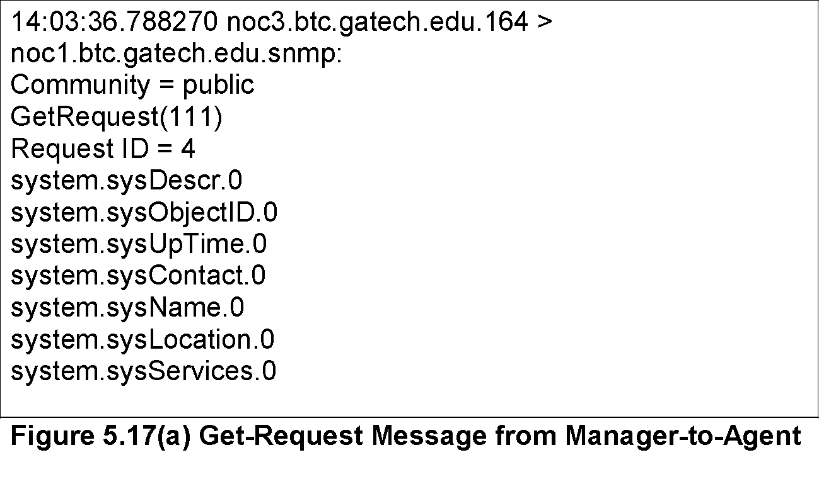
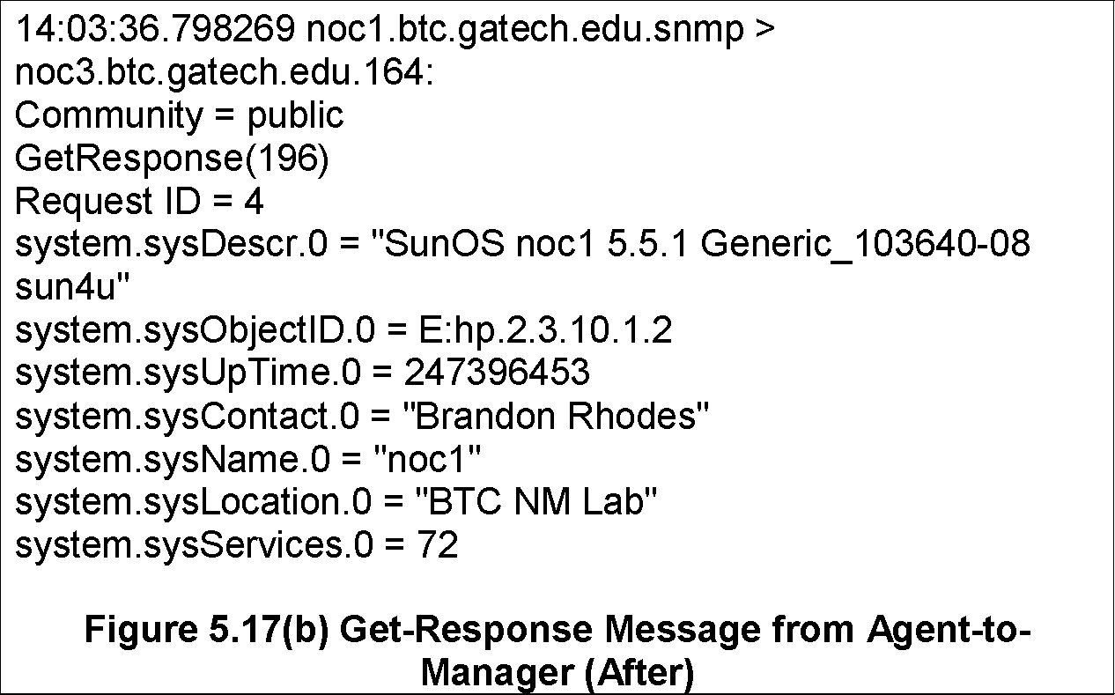
Chapter 5 SNMPv1 Network Management: Communication and Functional Models
Sniffer Data
Network Management: Principles and Practice
© Mani Subramanian 2010
*

Slide 24
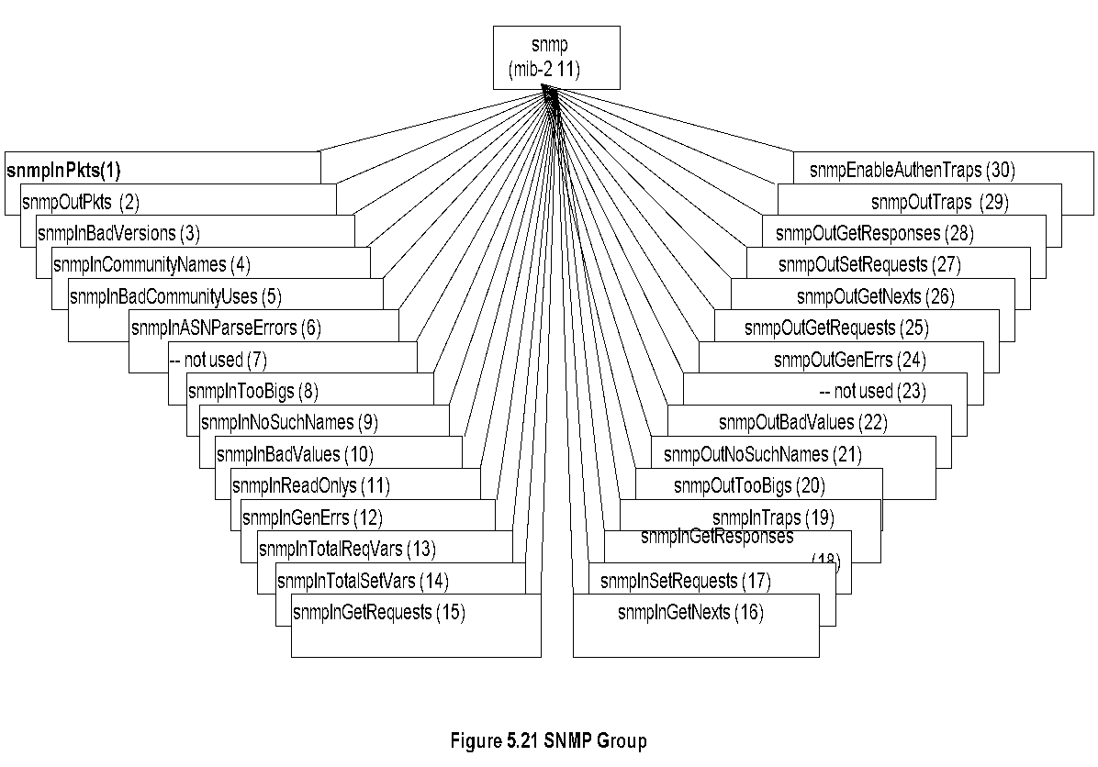
Chapter 5 SNMPv1 Network Management: Communication and Functional Models
SNMP MIB
Notes
SNMPv1 MIB has too many objects that are not used
SNMPv2 obsoleted a large number of them
Note: Most of the MIB objects were not used and hence deprecated in SNMPv2
Network Management: Principles and Practice
© Mani Subramanian 2010
*

