Slide 1
Web Technologies
IT230
Dr Mohamed Habib

Slide 2
Objectives
Write PHP code to perform a specific task.
Resolve problems in a PHP program.
Write PHP functions to perform specific tasks.
Chapter 2: PHP 5 Basic Language Chapter 3: PHP 5 OO Language

Slide 3
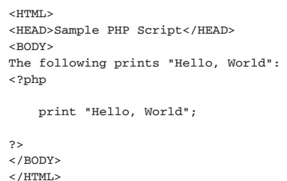
PHP 5 Basic Language
HTML EMBEDDING

Slide 4
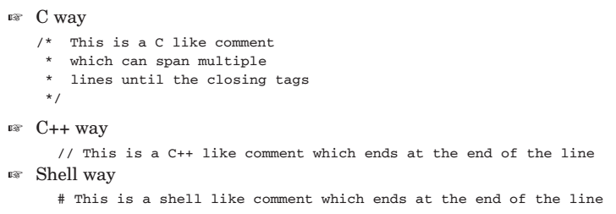
PHP 5 Basic Language
Comments

Slide 5
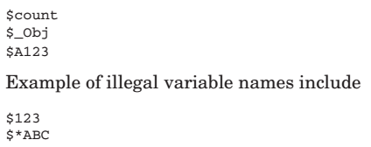
PHP 5 Basic Language
Variables

Slide 6
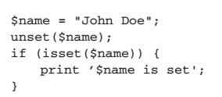
PHP 5 Basic Language
Managing Variables

Slide 7
PHP 5 Basic Language
Managing Variables

Slide 8
PHP 5 Basic Language
SuperGlobals

Slide 9
PHP 5 Basic Language
Basic Data Types
Integer
Floating Point
Strings
Booleans
Null

Slide 10
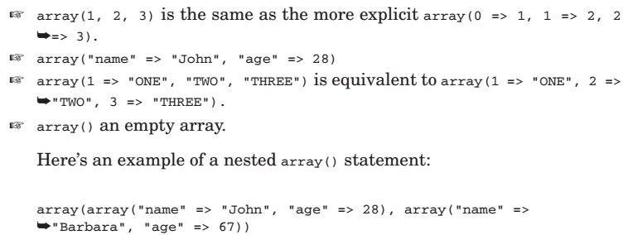
PHP 5 Basic Language
Arrays

Slide 11
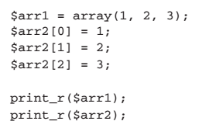
PHP 5 Basic Language

Slide 12
PHP 5 Basic Language
Reading array values

Slide 13
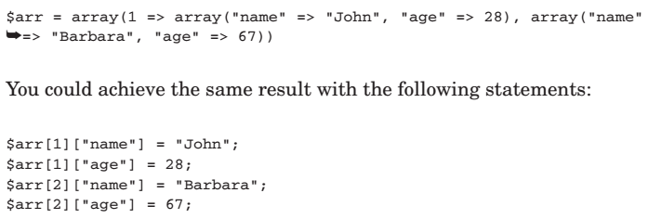
PHP 5 Basic Language
Accessing Nested Arrays

Slide 14
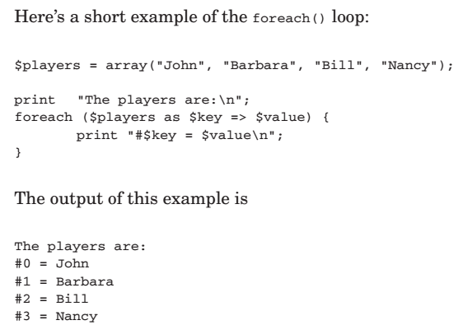
PHP 5 Basic Language
Traversing Arrays Using foreach

Slide 15
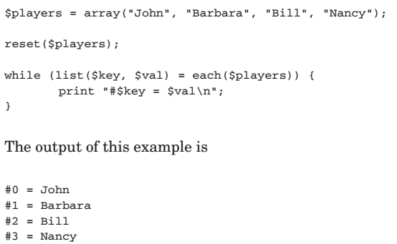
PHP 5 Basic Language
Traversing Arrays Using list() and each()

Slide 16
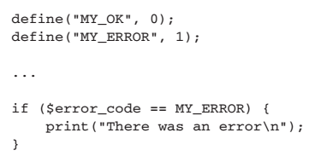
PHP 5 Basic Language
Constants

Slide 17
PHP 5 Basic Language
Operators
Numerical Operators
Assignment Operators
Comparison Operators
Logical Operators
Bitwise Operators
Negation Operators
Increment/Decrement Operators
The Cast Operators
The Silence Operator

Slide 18
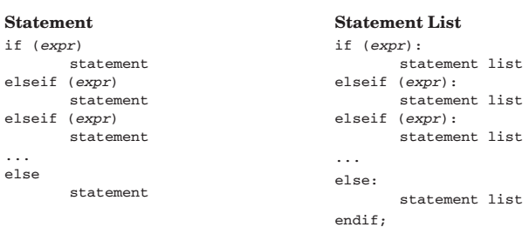
PHP 5 Basic Language
CONTROL STRUCTURES

Slide 19
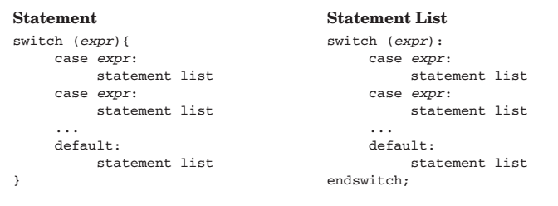
PHP 5 Basic Language
CONTROL STRUCTURES

Slide 20
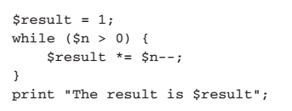
PHP 5 Basic Language
Loop Control Structures

Slide 21
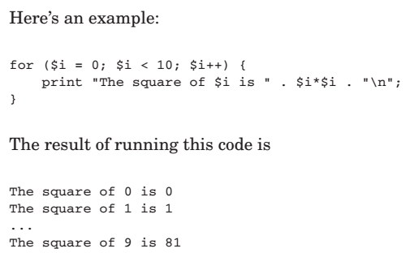
PHP 5 Basic Language
Loop Control Structures

Slide 22
PHP 5 Basic Language
Code Inclusion Control Structures

Slide 23
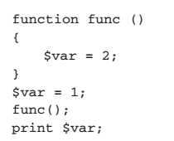
PHP 5 Basic Language
FUNCTIONS

Slide 24
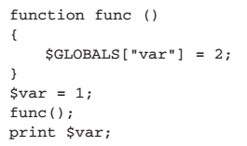
PHP 5 Basic Language
FUNCTIONS

Slide 25
PHP 5 Basic Language

Slide 26
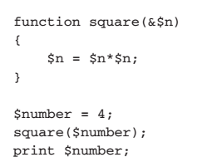
PHP 5 Basic Language
Declaring Function Parameters
By-Value Parameters
By-Reference Parameters

Slide 27
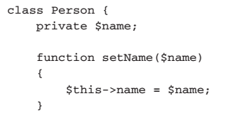
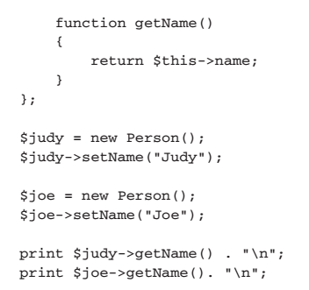
PHP 5 OO Language
Write a Class

Slide 28
PHP 5 OO Language

Slide 29
IT230 – Week 12
Thanks,

