Slide 1

Web Technologies
IT230
Dr Mohamed Habib

Slide 2
Objectives
Implement a database in Java.
Implement database access with JDBC.
Use a connector to persist objects in a relational database

Slide 3
JDBC
JDBC provides a standard library for accessing relational databases.
By using the JDBC API, you can access a wide variety of SQL databases with exactly the same Java syntax. It is important to note that although the JDBC API standardizes the approach for:
- connecting to databases
the syntax for sending queries
committing transactions
the data structure representing the result
JDBC does not attempt to standardize the SQL syntax. So, you can use any SQL extensions your database vendor supports. However, since most queries follow standard SQL syntax, using JDBC lets you change database hosts, ports, and even database vendors with minimal changes to your code.

Slide 4
JDBC
Seven Steps for Database Access
  Load the JDBC driver
  Define the connection URL
  Establish the connection
  Create a Statement object
  Execute a query or update
  Process the result set
  Close the statement and connection

Slide 5
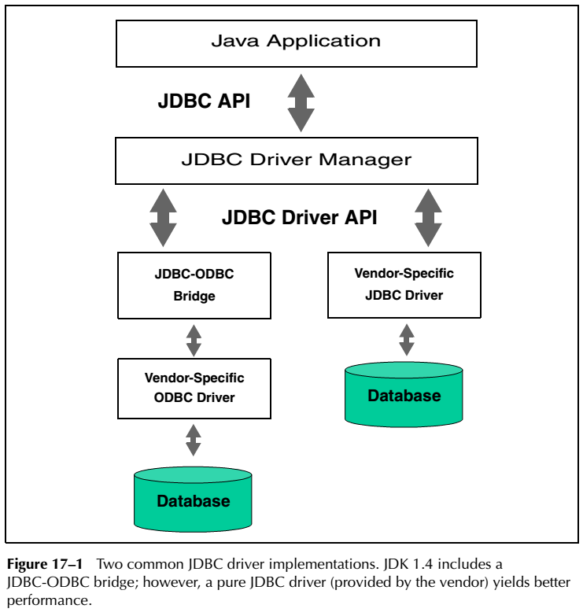
JDBC

Slide 6
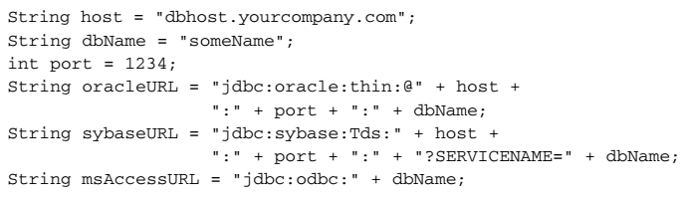
Define the Connection URL

Slide 7
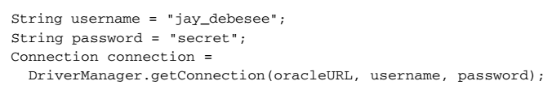
Establish the Connection

Slide 8
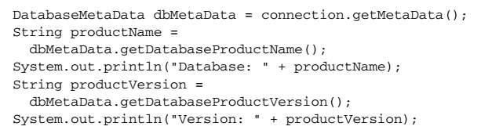
Get MetaData

Slide 9
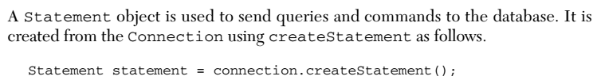
Create a Statement Object

Slide 10
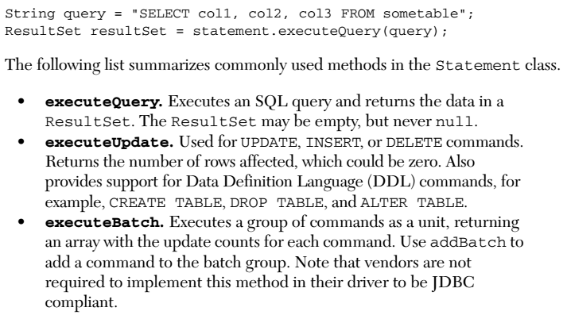
Execute a Query or Update

Slide 11
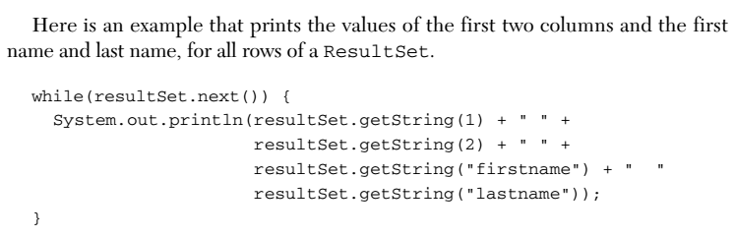
Process the Results

Slide 12
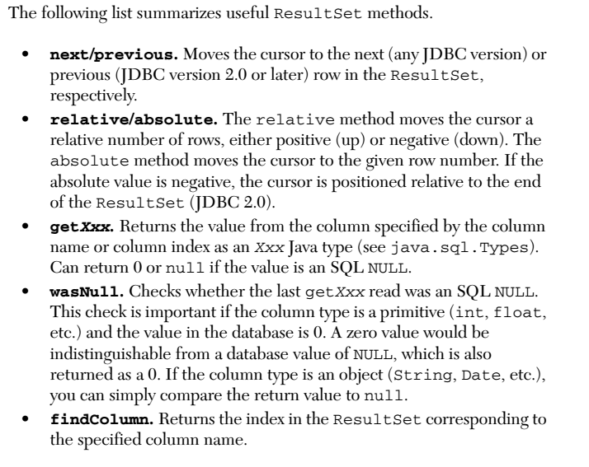
Process the Results

Slide 13

Process the Results

Slide 14

Close the Connection

Slide 15
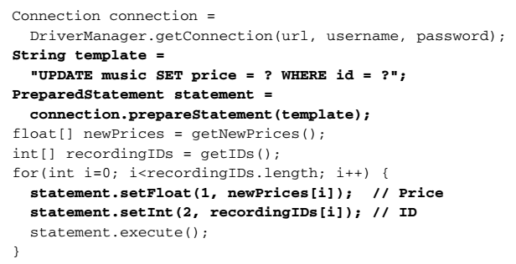
Using Prepared Statements

Slide 16
Adv. Of Prepared Statements
Be cautious though: a prepared statement does not always execute faster than an ordinary SQL statement. The performance improvement can depend on the particular SQL command you are executing. For a more detailed analysis of the performance for prepared statements in Oracle.
However, performance is not the only advantage of a prepared statement. Security is another advantage. We recommend that you always use a prepared statement or stored procedure to update database values when accepting input from a user through an HTML form. This approach is strongly recommended over the approach of building an SQL statement by concatenating strings from the user input values.

Slide 17
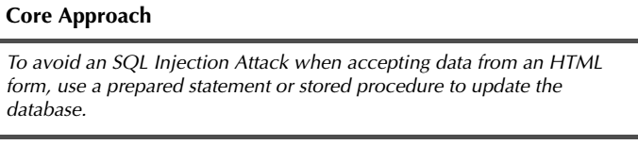
Adv. Of Prepared Statements

Slide 18
Creating Callable Statements
With a CallableStatement, you can execute a stored procedure or function in a
database. For example, in an Oracle database, you can write a procedure or function in PL/SQL and store it in the database along with the tables. Then, you can create a connection to the database and execute the stored procedure or function through a CallableStatement.

Slide 19
Adv. Of Callable Statements
A stored procedure has many advantages. For instance, syntax errors are caught at compile time instead of at runtime; the database procedure may run much faster than a regular SQL query; and the programmer only needs to know about the input and output parameters, not the table structure. In addition, coding of the stored procedure may be simpler in the database language than in the Java programming language because access to native database capabilities (sequences, triggers, multiple cursors) is possible.

Slide 20
DisAdv. Of Callable Statements
One disadvantage of a stored procedure is that you may need to learn a new database-specific language (note, however, that Oracle8i Database and later support
stored procedures written in the Java programming language).
A second disadvantage is that the business logic of the stored procedure executes on the database server instead of on the client machine or Web server.

Slide 21
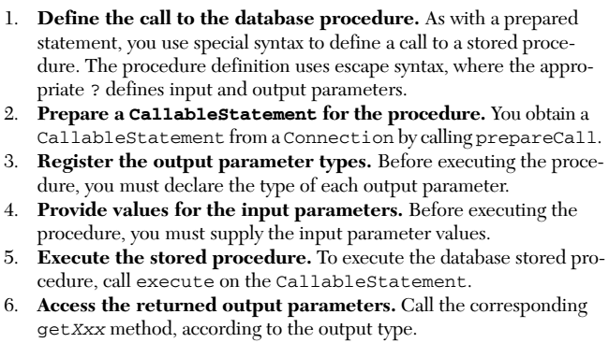
Creating Callable Statements

Slide 22
Using Database Transactions
When a database is updated, by default the changes are permanently written (or
committed) to the database. However, this default behavior can be programmatically turned off. If autocommitting is turned off and a problem occurs with the updates, then each change to the database can be backed out (or rolled back to the original values). If the updates execute successfully, then the changes can later be
permanently committed to the database. This approach is known as transaction management.

Slide 23
Using Database Transactions
The default for a database connection is autocommit; that is, each executed statement is automatically committed to the database. Thus, for transaction management you first need to turn off autocommit for the connection by calling setAutoCommit(false) .

Slide 24
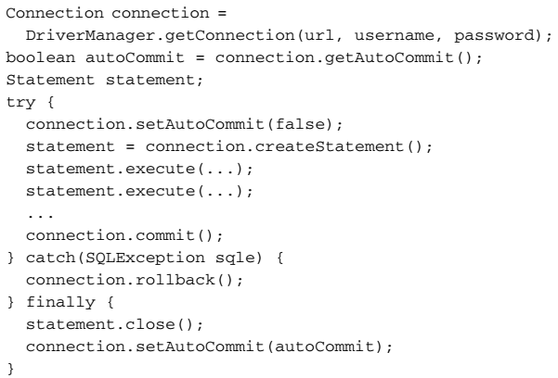
Using Database Transactions

Slide 25
Using Database Transactions
Here, the statement for obtaining a connection from the DriverManager is outside the try/catch block. That way, rollback is not called unless a connection is successfully obtained. However, the getConnection method can still throw an
SQLException and must be thrown by the enclosing method or be caught in a separate try/catch block.

Slide 26
Chapter 18
CONFIGURING MS ACCESS, MYSQL, AND ORACLE9I
Only for practical work

Slide 27
IT230 – Week 11
Thanks,

