Slide 1

Web Technologies
IT230
Dr.SANGHEETHAA S

Slide 2
Objectives
Chapter 6: Databases with PHP 5
Chapter 5: Error Handling

Slide 3
Databases with PHP 5
MYSQL
MySQL Strengths and Weaknesses
  Strength: Great Market Penetration
  Strength: Easy to Get Started
  Strength: Open-Source License for Most Users
  Strength: Fast

Slide 4
Databases with PHP 5
MYSQL
MySQL Strengths and Weaknesses
  Weakness: Commercial License for Commercial Redistribution
  Strength: Reasonable Scalability

Slide 5
Databases with PHP 5
PHP Interface
The mysqli PHP extension was written from the ground up to support the new features of the MySQL 4.1 and 5.0 Client API. The improvements from the old mysql extension include the following:

Slide 6
Databases with PHP 5
Connections

Slide 7
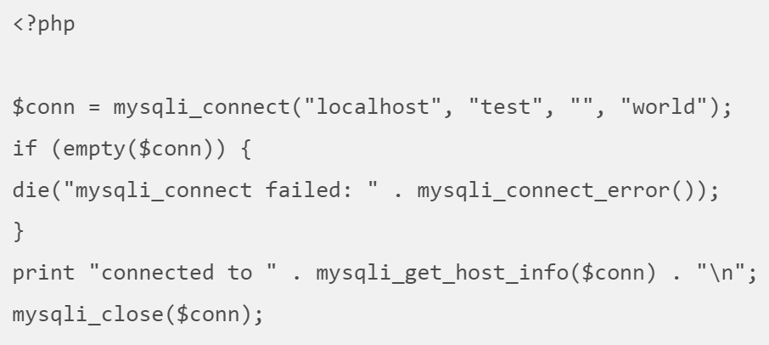
Example
Here, the mysqli_connect() function connects to "localhost" with the user name "test", an empty password, and selects the "world" database as the default database. If the connect fails,mysqli_connect() returns FALSE, and mysqli_connect_error() returns a message saying why it could not connect.

Slide 8
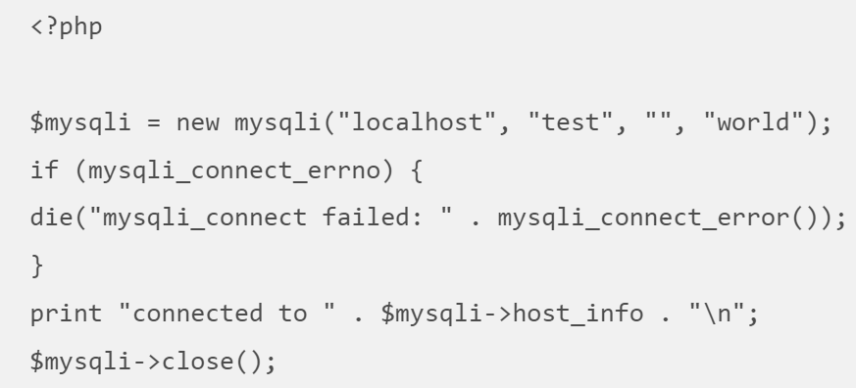
Example
When using the object-oriented interface, you can also specify your connection parameters by passing them to the constructor of the mysqli object:

Slide 9
Databases with PHP 5
Buffered Versus Unbuffered Queries
Buffered queries will retrieve the query results and store them in memory on the client side, and subsequent calls to get rows will simply spool through local memory.
Buffered queries have the advantage that you can seek in them, which means that you can move the “current row” pointer around in the result set freely because it is all in the client. Their disadvantage is that extra memory is required to store the result set, which could be very large, and that the PHP function used to run the query does not return until all the results have been retrieved.

Slide 10
Databases with PHP 5
Buffered Versus Unbuffered Queries
Unbuffered queries , on the other hand, limit you to a strict sequential access of the results but do not require any extra memory for storing the entire result set. You can start fetching and processing or displaying rows as soon as the MySQL server starts returning them. When using an unbuffered result set, you have to retrieve all rows with mysqli_fetch_row or close the result set with mysqli_free_result before sending any other command to the server.

Slide 11
Databases with PHP 5
Queries

Slide 12
Databases with PHP 5
Queries

Slide 13
After the query has been executed, memory on the client side is allocated to retrieve the complete result set. To use unbuffered resultset, you have to specify the optional parameter MYSQLI_USE_RESULT:
<?php
$conn = mysqli_connect("localhost", "test", "", "world");
$result = $conn->query("SELECT Name FROM City", MYSQLI_USE_RESULT);
while ($row = $result->fetch_row())
{
print $row[0] . "<br>\n";
}
$result->free();
$conn->close();

Slide 14
Databases with PHP 5
Fetching Modes

Slide 15
<?php
$con=mysqli_connect("localhost","my_user","my_password","my_db");
// Check connection
if (mysqli_connect_errno())
{
echo "Failed to connect to MySQL: " . mysqli_connect_error();
}
$sql="SELECT Lastname,Age FROM Persons ORDER BY Lastname";
$result=mysqli_query($con,$sql);
// Associative array
$row=mysqli_fetch_assoc($result);
printf ("%s (%s)\n",$row["Lastname"],$row["Age"]);
// Free result set
mysqli_free_result($result);
mysqli_close($con);
?>

Slide 16
<?php
$con=mysqli_connect("localhost","my_user","my_password","my_db");
// Check connection
if (mysqli_connect_errno())
{
echo "Failed to connect to MySQL: " . mysqli_connect_error();
}
$sql="SELECT Lastname,Age FROM Persons ORDER BY Lastname";
if ($result=mysqli_query($con,$sql))
{
while ($obj=mysqli_fetch_object($result))
{
printf("%s (%s)\n",$obj->Lastname,$obj->Age);
}
// Free result set
mysqli_free_result($result);
}
mysqli_close($con);
?>

Slide 17
Databases with PHP 5
Prepared Statements
  Binding Variables

Slide 18
Databases with PHP 5
Prepared Statements
  Binding Variables

Slide 19
Databases with PHP 5
Prepared Statements
  Binding Variables

Slide 20
Databases with PHP 5
Prepared Statements
  Binding Variables

Slide 21
Error Handling
TYPES OF ERRORS
  Programming Errors
    Syntax/Parse Errors
This example contains an XML tag where PHP expects to find code. Running this results in an error:
Parse error: parse error in test.php on line 4

Slide 22
Error Handling
TYPES OF ERRORS
  Programming Errors
    Eval
All syntax or parse errors are caught during compilation, except errors in code executed with eval(). In the case of eval, the code is compiled during the execution of the script.
Hello!
Parse error: parse error in /home/ssb/test.php(4) : eval()'d code on line 1

Slide 23
Error Handling
TYPES OF ERRORS
  Programming Errors
    Include / Require

Slide 24
Error Handling
TYPES OF ERRORS
  Programming Errors
    Include / Require

Slide 25
Error Handling
TYPES OF ERRORS
  Undefined Symbols
    Variables and Constants
var_dump — Dumps information about a variable
The output is
Notice: Undefined variable: undefined_variable in test.php on line 3 NULL
Notice: Use of undefined constant UNDEFINED_CONSTANT - assumed 'UNDEFINED_CONSTANT' in test.php on line 4 string(18) "UNDEFINED_CONSTANT"
Still alive!

Slide 26
Error Handling
TYPES OF ERRORS
  Undefined Symbols
    Array Indexes
If the page serving this script is requested without any GET parameters, it displays a notice: test.php(3) : Notice - Undefined index: name

Slide 27
Error Handling
TYPES OF ERRORS
  Undefined Symbols
    Functions and Classes
Fatal error: Call to undefined function: undefined_this_function_is() in test.php on line 4
Yoda says: Fatal error: Class 'undefined_class' not found in test.php on line 4

Slide 28
Error Handling
TYPES OF ERRORS
  Undefined Symbols
    Logical Errors
Another type of programming error is a logical error , errors that are in the structure and logic of the code rather than just the syntax. The best ways to find logical errors is testing combined with code reviews.

Slide 29
Error Handling
TYPES OF ERRORS
  Portability Errors
    Operating System Differences
    PHP Configuration Differences
    SAPI (Server APIs) Differences

Slide 30
Error Handling
TYPES OF ERRORS
  Runtime Errors
  PHP Errors
    E_ERROR: This is a fatal, unrecoverable error. Examples are out-of-memory errors, uncaught exceptions, or class redeclarations
    E_WARNING: This is the most common type of error. It normally signals that something you tried doing went wrong. Typical examples are missing function parameters, a database you could not connect to, or division by zero.

Slide 31
Error Handling
TYPES OF ERRORS
  PHP Errors
Error Reporting Several php.ini configuration settings control which errors should be displayed and how..

Slide 32
The mysqli_real_connect() function opens a new connection to the MySQL server.
The mysqli_real_connect() function differs from mysqli_connect() in the following ways:
mysqli_real_connect() requires a valid object created by mysqli_init()
mysqli_real_connect() can be used with mysqli_options() to set different options for the connection
mysqli_real_connect() has a flag parameter

Slide 33
IT230 – Week 14
Thanks,

