Slide 1
Chapter 4
Client-Side Programming: the JavaScript Language
WEB TECHNOLOGIES
A COMPUTER SCIENCE PERSPECTIVE
JEFFREY C. JACKSON
Run on the client’s machine not on the server

Slide 2
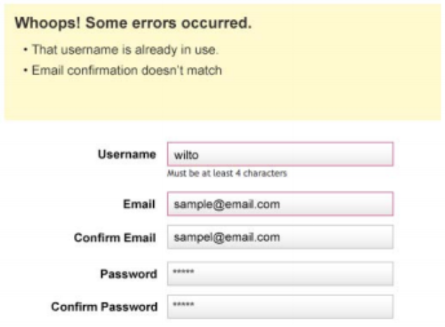
JavaScript Introduction
If you’ve ever attempted to register for a website, entered a username, and immediately received feedback that the username you’ve entered is already taken by someone else.

Slide 3
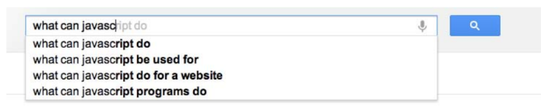
JavaScript Introduction
Suggest the complete term a user might be entering in a search box as he types. You can see this in action on Google.com

Slide 4
JavaScript Introduction
Let’s write a “Hello World!” JavaScript program
Problem: the JavaScript language itself has no input/output statements(!)
Solution: Most browsers provide standard I/O methods
  alert: pops up alert box containing text
  prompt: pops up window where user can enter text

Slide 5
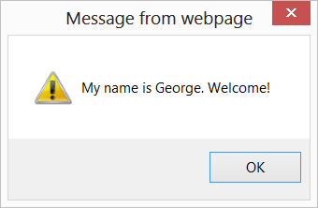
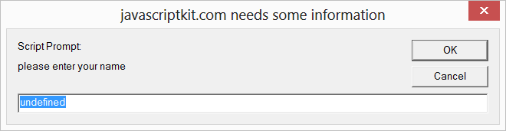
JavaScript Introduction

Slide 6

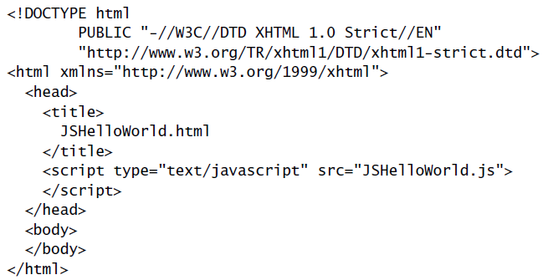
JavaScript Introduction
File JSHelloWorld.js:
HTML document executing this code:
- External Script
<script> element used
to load and execute
JavaScript code

Slide 7
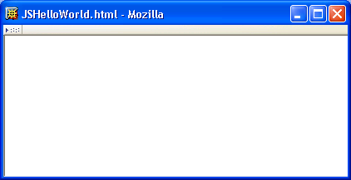
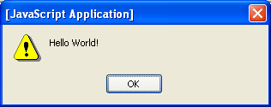
JavaScript Introduction
Web page and alert box generated by JSHelloWorld.html document and JSHelloWorld.js code:

Slide 8

JavaScript Introduction: Adding JS to a Page
Adding JS to your page:
  Embedded Script:
  External Script:

Slide 9
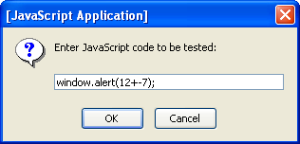
JavaScript Introduction
Prompt window example:
1
2

Slide 10
JavaScript Properties
Note that JavaScript code did not need to be compiled
  JavaScript is an interpreted language
  Portion of browser software that reads and executes JavaScript is an interpreter
Interpreted vs. compiled languages:
  Advantage: simplicity
  Disadvantage: efficiency

Slide 11
JavaScript Properties
JavaScript is a scripting language: designed to be executed within a larger software environment
JavaScript can be run within a variety of environments:
  Web browsers (our focus in next chapter)
  Web servers
  Application containers (general-purpose programming)

Slide 12
JavaScript Properties
All data in JavaScript is an object or a property of an object
Types of JavaScript objects
  Native: provided by scripting engine
    If automatically constructed before program execution, known as a built-in object
  Host: provided by host environment
    alert and prompt are host objects

Slide 13
Developing JavaScript Software
Writing JavaScript code
  Any text editor (e.g., Notepad, Emacs)
  Specialized software (e.g., MS Visual InterDev)
Executing JavaScript
  Load into browser (need HTML document)
  Browser detects syntax and run-time errors
    Mozilla: JavaScript console lists errors
    IE6: Exclamation icon and pop-up window

Slide 14
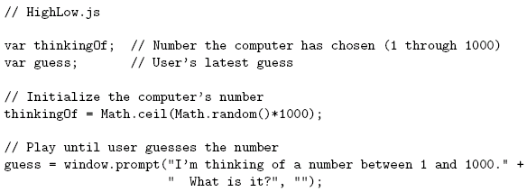
Basic JavaScript Syntax
Notice that there is no main() function/method

Slide 15
Basic JavaScript Syntax
Comments like Java/C++ (/* */ also allowed)
Comments
// This is a comment. It is similar to comments in C++ /* * This is a multiline comment in JavaScript * It is very similar to comments in C Programming */

Slide 16
Basic JavaScript Syntax
Variable declarations:
Not required
Data type not specified

Slide 17
Basic JavaScript Syntax
Semi-colons are usually
not required, but always
allowed at statement end

Slide 18
Basic JavaScript Syntax
Arithmetic operators same as Java/C++

Slide 19
Basic JavaScript Syntax
String concatenation operator
as well as addition

Slide 20
Basic JavaScript Syntax
Arguments can be any expressions
Argument lists are comma-separated

Slide 21
Basic JavaScript Syntax
Object dot notation for method calls as in Java/C++

Slide 22
Basic JavaScript Syntax
Many control constructs and use of
{ } identical to Java/C++

Slide 23
Basic JavaScript Syntax
Most relational operators syntactically
same as Java/C++

Slide 24
Basic JavaScript Syntax
Automatic type conversion:
guess is String,
thinkingOf is Number

Slide 25
Variables and Data Types
Type of a variable is dynamic: depends on the type of data it contains
JavaScript has six data types:
  Number
  String
  Boolean (values true and false)
  Object
  Null (only value of this type is null)
  Undefined (value of newly created variable)
Primitive data types: all but Object

Slide 26
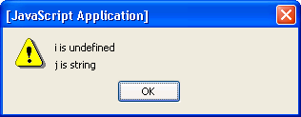
Variables and Data Types
typeof operator returns string related to data type
  Syntax: typeof expression
Example:

Slide 27
Variables and Data Types
Common automatic type conversions:
  Compare String and Number: String value converted to Number
  Condition of if or while converted to Boolean
  Array accessor (e.g., 3 in records[3]) converted to String

Slide 28
Variables and Data Types
Syntax rules for names (identifiers):
  Must begin with letter or underscore ( _ )
  Must contain only letters, underscores, and digits (or certain other characters)
  Must not be a reserved word
Remember: JavaScript is case-sensitive, and so are those variable names.

Slide 29

Variables and Data Types
A variable will automatically be created if a value is assigned to an undeclared identifier:
Recommendation: declare all variables
  Facilitates maintenance
  Avoids certain exceptions
var is not
required

Slide 30
JavaScript Statements
Expression statement: any statement that consists entirely of an expression
  Expression: code that represents a value
Block statement: one or more statements enclosed in { } braces
Keyword statement: statement beginning with a keyword, e.g., var or if

Slide 31
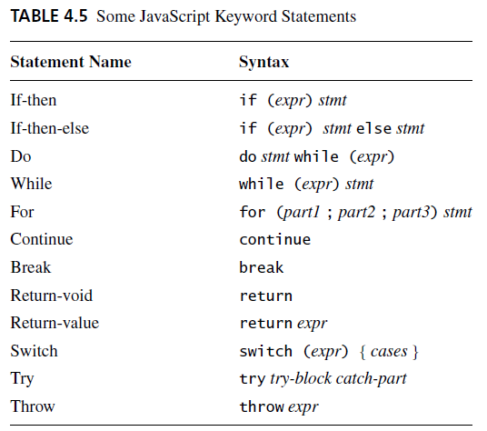
JavaScript Statements
var syntax:
Java-like keyword statements:
Comma-separated declaration list with
optional initializers

Slide 32
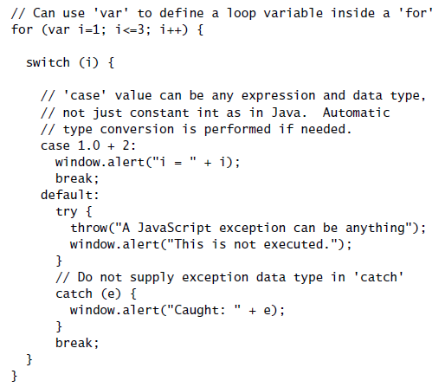
JavaScript Statements
JavaScript
keyword
statements
are very similar
to Java with
small exceptions

Slide 33
JavaScript Operators
Operators are used to create compound expressions from simpler expressions
Operators can be classified according to the number of operands involved:
  Unary: one operand (e.g., typeof i)
    Prefix or postfix (e.g., ++i or i++ )
  Binary: two operands (e.g., x + y)
  Ternary: three operands (conditional operator)

Slide 34
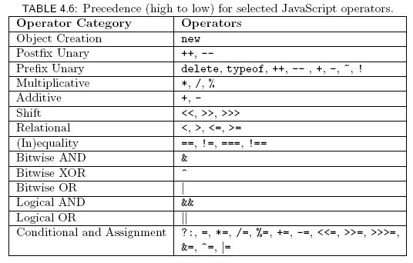
JavaScript Operators

Slide 35
JavaScript Operators:
Automatic Type Conversion
Binary operators +, -, *, /, % convert both operands to Number
  Exception: If one of operands of + is String then the other is converted to String
Relational operators <, >, <=, >= convert both operands to Number
  Exception: If both operands are String, no conversion is performed and lexicographic string comparison is performed

Slide 36
JavaScript Operators:
Automatic Type Conversion
Operators ==, != convert both operands to Number
  Exception: If both operands are String, no conversion is performed (lex. comparison)
  Exception: values of Undefined and Null are equal(!)
  Exception: instance of Date built-in “class” is converted to String (and host object conversion is implementation dependent)
  Exception: two Objects are equal only if they are references to the same object

Slide 37
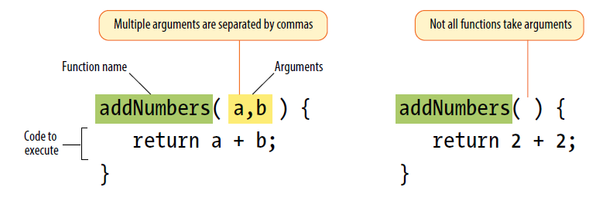
JavaScript Functions
Function declaration syntax

Slide 38
JavaScript Functions
Function declaration syntax
Identifier representing
function’s name
Declaration always begins with keyword
function, no return type
Formal parameter list
One or more statements representing
function body

Slide 39
JavaScript Functions
Function call syntax
Function call is an expression, can
be used on right-hand side of assignments,
as expression statement, etc.

Slide 40
JavaScript Functions
Function call semantics details:
  Arguments:
    May be expressions:
    Object’s effectively passed by reference (more later)
  Formal parameters:
    May be assigned values, argument is not affected
Number mismatch between argument list and formal parameter list:
  More arguments: excess ignored
  Fewer arguments: remaining parameters are Undefined

Slide 41
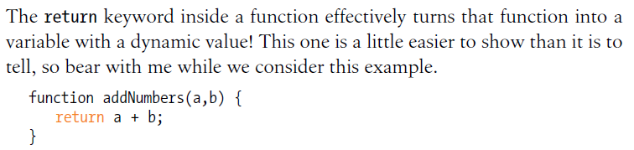
JavaScript Functions
  Return value:
    If last statement executed is not return-value, then returned value is of type Undefined

Slide 42
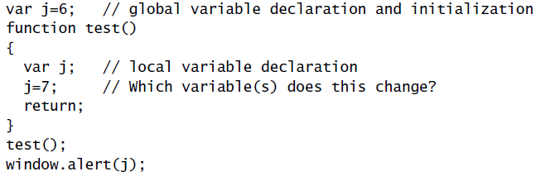
JavaScript Functions
Local vs. global variables
Global variable: declared outside any function
Local
variable
declared
within
a function

Slide 43
JavaScript Functions
Local vs. global variables
Local
declaration
shadows
corresponding
global
declaration
Output is 6

Slide 44
JavaScript Functions
Local vs. global variables
In browsers,
global
variables
(and functions)
are stored as properties
of the window built-in object.
Output is 7

Slide 45
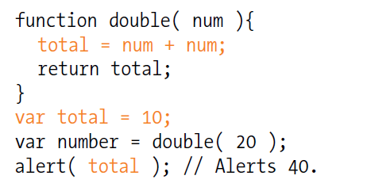
JavaScript Functions
Local vs. global variables

Slide 46
JavaScript Functions
Explicit type conversion supplied by built-in functions
  Boolean(), String(), Number()
  Each takes a single argument, returns value representing argument converted according to type-conversion rules given earlier

Slide 47
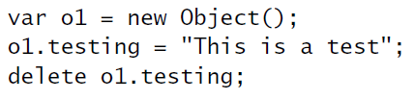
Object Introduction
There are no classes in JavaScript
Instead, properties can be created and deleted dynamically
Create an object o1
Create property testing
Delete testing property

Slide 48

Object Creation
Objects are created using new expression
A constructor is a function
  When called via new expression, a new empty Object is created and passed to the constructor along with the argument values
  Constructor performs initialization on object
    Can add properties and methods to object
    Can add object to an inheritance hierarchy
Constructor and argument list

Slide 49
Object Creation
The Object() built-in constructor
  Does not add any properties or methods directly to the object
  Adds object to hierarchy that defines default toString() and valueOf() methods (used for conversions to String and Number, resp.)

Slide 50
Property Creation
Assignment to a non-existent (even if inherited) property name creates the property:
Object initializer notation can be used to create an object (using Object() constructor) and one or more properties in a single statement:

Slide 51
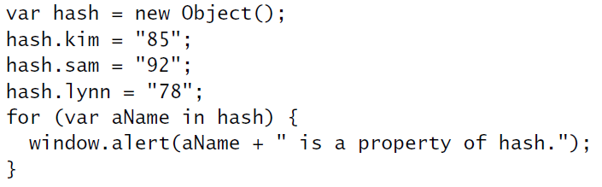
Enumerating Properties
Special form of for statement used to iterate through all properties of an object:
Produces three
alert boxes;
order of names
is implementation-dependent.

Slide 52
Accessing Property Values
The JavaScript object dot notation is actually shorthand for a more general associative array notation in which Strings are array indices:
Expressions can supply property names:
Converted to String
if necessary

Slide 53
Object Values
Value of Object is reference to object:
o1
o2
o2 is another
name for o1
Hello

Slide 54
Object Values
Value of Object is reference to object:
o1
o2
o1 is
changed
Hello World!

Slide 55
Object Values
Value of Object is reference to object:
o1
o2
Hello World!
Output is Hello World!

Slide 56
Object Methods
JavaScript functions are stored as values of type Object
A function declaration creates a function value and stores it in a variable (property of window) having the same name as the function
A method is an object property for which the value is a function

Slide 57
Object Methods
Creates global variable named leaf with function value

Slide 58
Object Methods
Creates isLeaf() method that is
defined by leaf() function

Slide 59

JavaScript Arrays
The Array built-in object can be used to construct objects with special properties and that inherit various methods
Array Constructor
No arguments
ary1
length (0)
Properties
Inherited
methods
toString()
sort()
shift()
…

Slide 60
JavaScript Arrays
The Array built-in object can be used to construct objects with special properties and that inherit various methods
ary2
length (3)
“0” (4)
“1” (true)
“2” (“OK”)
Accessing array elements:
ary2[1]
ary2[“1”]
ary2.1
Elements
of array
Must follow identifier
syntax rules
toString()
…

Slide 61


JavaScript Arrays
The Array constructor is indirectly called if an array initializer is used
Array initializiers can be used to create multidimensional arrays
ttt[1][2]

Slide 62
JavaScript Arrays
Changing the number of elements:
Creates a new element dynamically,
increases value of length
ary2
length (4)
“0” (4)
“1” (true)
“2” (“OK”)
“3” (-12.6)
toString()
…

Slide 63
JavaScript Arrays
Changing the number of elements:
Decreasing length can delete elements
ary2
length (2)
“0” (4)
“1” (true)
toString()
…

Slide 64
JavaScript Arrays
Value of length is not necessarily the same as the actual number of elements
var ary4 = new Array(200);
Calling constructor with single argument
sets length, does not create elements
ary4
length (200)
toString()
sort()
shift()
…

Slide 65
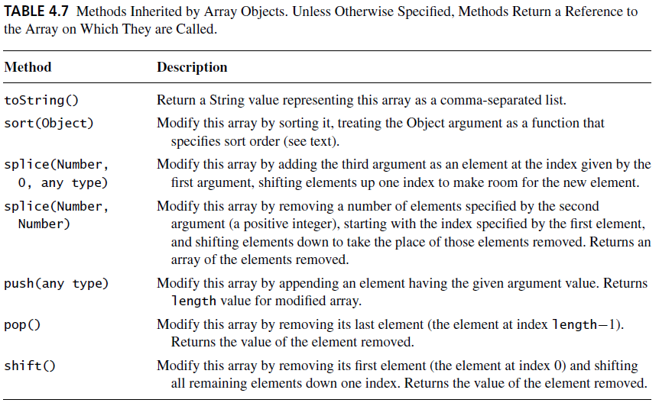
JavaScript Arrays

Slide 66
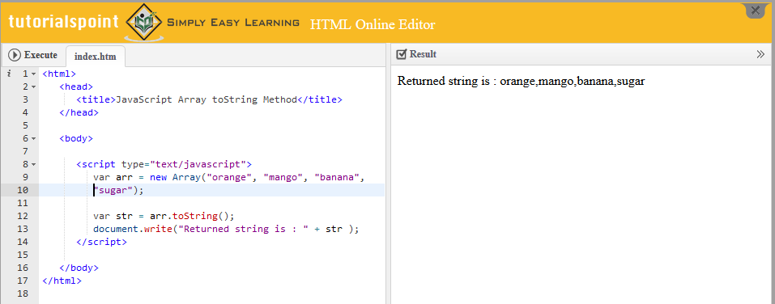
JavaScript Arrays
toString()

Slide 67
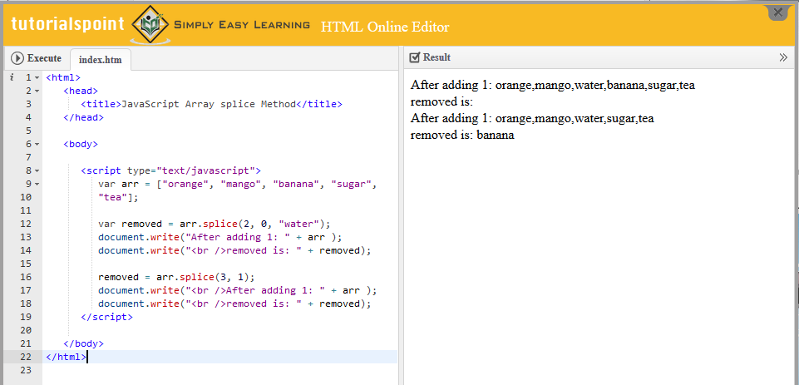
JavaScript Arrays
splice()

Slide 68
JavaScript Arrays
Add element with value 2.5 at
index 2, shift existing elements

Slide 69
JavaScript Arrays
Remove 3 elements starting
at index 5

Slide 70
Built-in Objects
The global object
  Named window in browsers
  Has properties representing all global variables
  Other built-in objects are also properties of the global object
    Ex: initial value of window.Array is Array object
  Has some other useful properties
    Ex: window.Infinity represents Number value

Slide 71
Built-in Objects
The global object and variable resolution:
This is why we can refer to built-in objects (Object, Array, etc.) without prefixing with window.
i = 42;
What does i refer to?
Search for local variable or formal parameter
named i
If none found, see if global object (window)
has property named i

Slide 72
Built-in Objects
String(), Boolean(), and Number() built-in functions can be called as constructors, created “wrapped” Objects:
Instances inherit valueOf() method that returns wrapped value of specified type:
Output is “number”

Slide 73
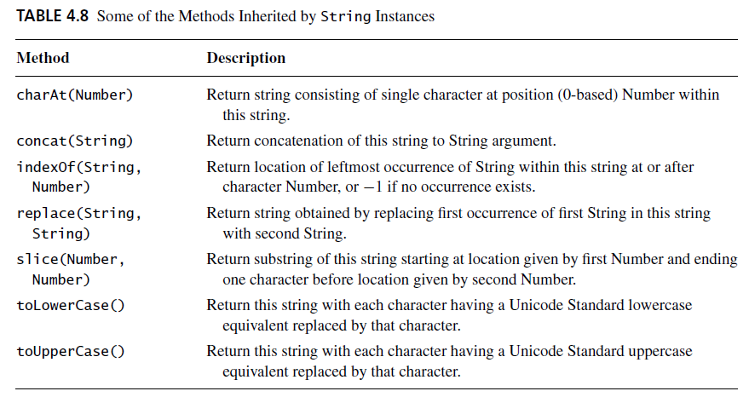
Built-in Objects

Slide 74
Built-in Objects
The Date() built-in constructor can be used to create Date instances that represent the current date and time
Often used to display local date and/or time in Web pages
Other methods: toLocaleDateString() , toLocaleTimeString(), etc.
var now = new Date();
window.alert(“Current date and time: “
+ now.toLocaleString());

Slide 75
Built-in Objects
Math object has methods for performing standard mathematical calculations:
Also has properties with approximate values for standard mathematical quantities, e.g., e ( Math.E ) and π (Math.PI)

