Slide 1
Chapter 7: Entity-Relationship Model
Notes:
*

Slide 2
Chapter 7: Entity-Relationship Model
Design Process
Modeling
Constraints
E-R Diagram
Design Issues
Weak Entity Sets
Extended E-R Features
Design of the Bank Database
Reduction to Relation Schemas
Database Design
UML
Notes:
*

Slide 3
Modeling
A database can be modeled as:
  a collection of entities,
  relationship among entities.
An entity is an object that exists and is distinguishable from other objects.
  Example: specific person, company, event, plant
Entities have attributes
  Example: people have names and addresses
An entity set is a set of entities of the same type that share the same properties.
  Example: set of all persons, companies, trees, holidays
Notes:
*

Slide 4
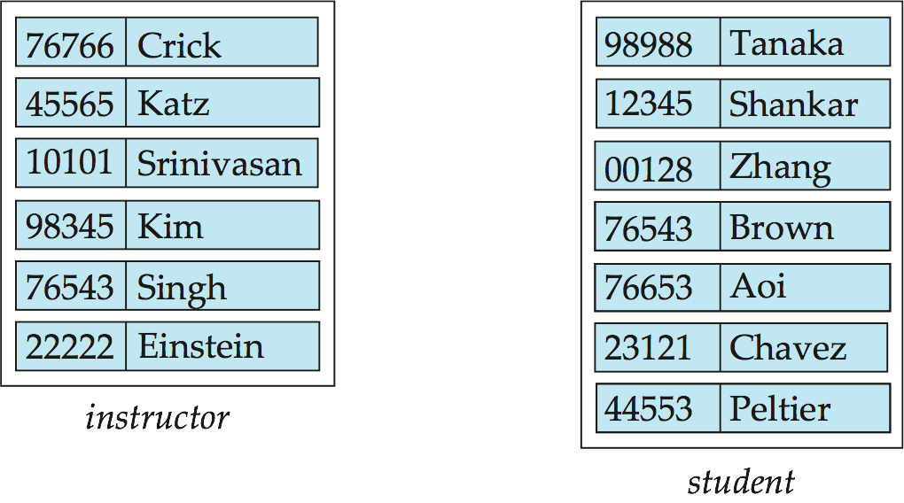
Entity Sets instructor and student
instructor_ID instructor_name student-ID student_name
Notes:
*

Slide 5
Relationship Sets
A relationship is an association among several entities
Example:
44553 (Peltier) advisor 22222 (Einstein) student entity relationship set instructor entity
A relationship set is a mathematical relation among n ≥ 2 entities, each taken from entity sets
{(e₁, e₂, … e_{n}) | e₁ ∈ E₁, e₂ ∈ E₂, …, e_{n} ∈ E_{n}}
where (e₁, e₂, …, e_{n}) is a relationship
  Example:
  (44553,22222) ∈ advisor
Notes:
*

Slide 6
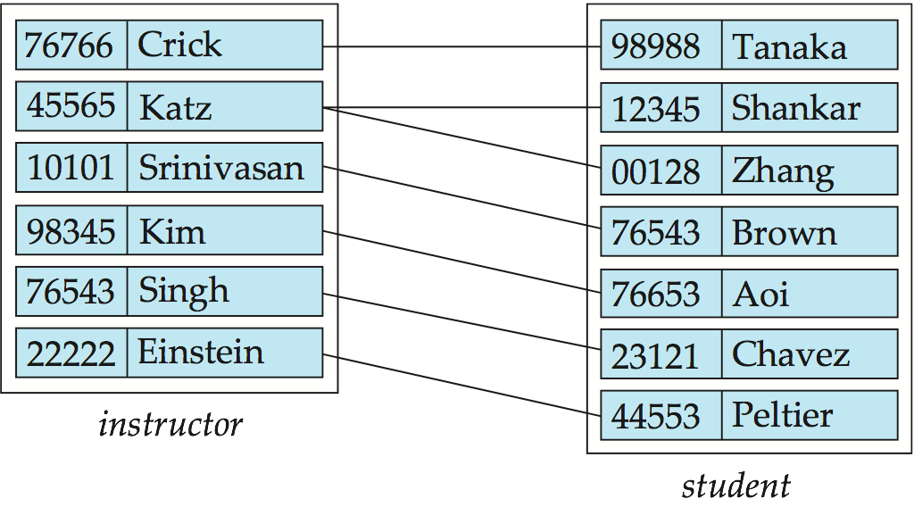
Relationship Set advisor
Notes:
*

Slide 7
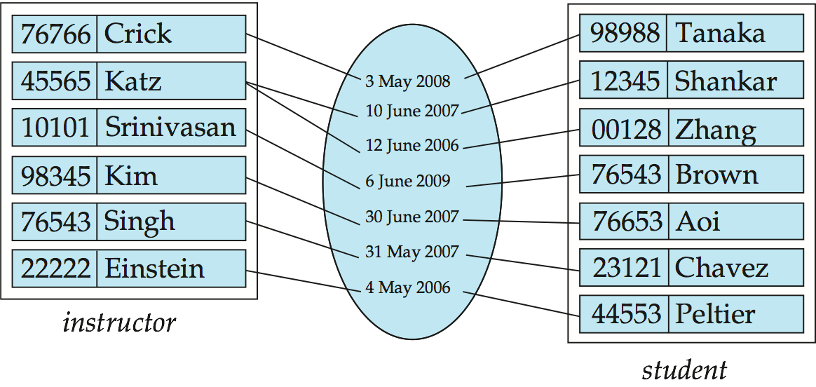
Relationship Sets (Cont.)
An attribute can also be property of a relationship set.
For instance, the advisor relationship set between entity sets instructor and student may have the attribute date which tracks when the student started being associated with the advisor
Notes:
*

Slide 8
Degree of a Relationship Set
binary relationship
  involve two entity sets (or degree two).
  most relationship sets in a database system are binary.
Relationships between more than two entity sets are rare. Most relationships are binary. (More on this later.)
  Example: students work on research projects under the guidance of an instructor.
  relationship proj_guide is a ternary relationship between instructor, student, and project
Notes:
*

Slide 9
Attributes
An entity is represented by a set of attributes, that is descriptive properties possessed by all members of an entity set.
  Example:
  instructor = (ID, name, street, city, salary )
  course= (course_id, title, credits)
Domain – the set of permitted values for each attribute
Attribute types:
  Simple and composite attributes.
  Single-valued and multivalued attributes
    Example: multivalued attribute: phone_numbers
  Derived attributes
    Can be computed from other attributes
    Example: age, given date_of_birth
Notes:
*

Slide 10
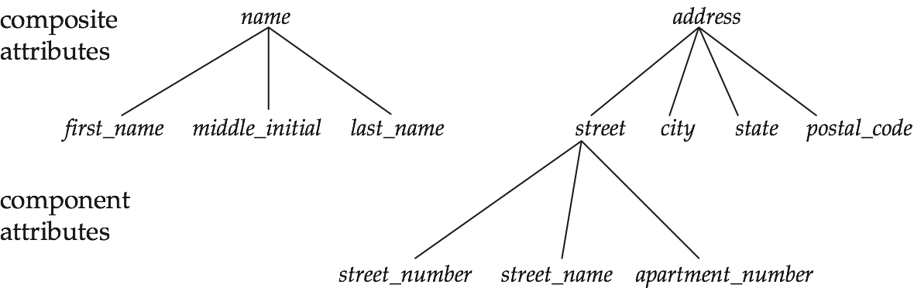
Composite Attributes
Notes:
*

Slide 11
Mapping Cardinality Constraints
Express the number of entities to which another entity can be associated via a relationship set.
Most useful in describing binary relationship sets.
For a binary relationship set the mapping cardinality must be one of the following types:
  One to one
  One to many
  Many to one
  Many to many
Notes:
*

Slide 12
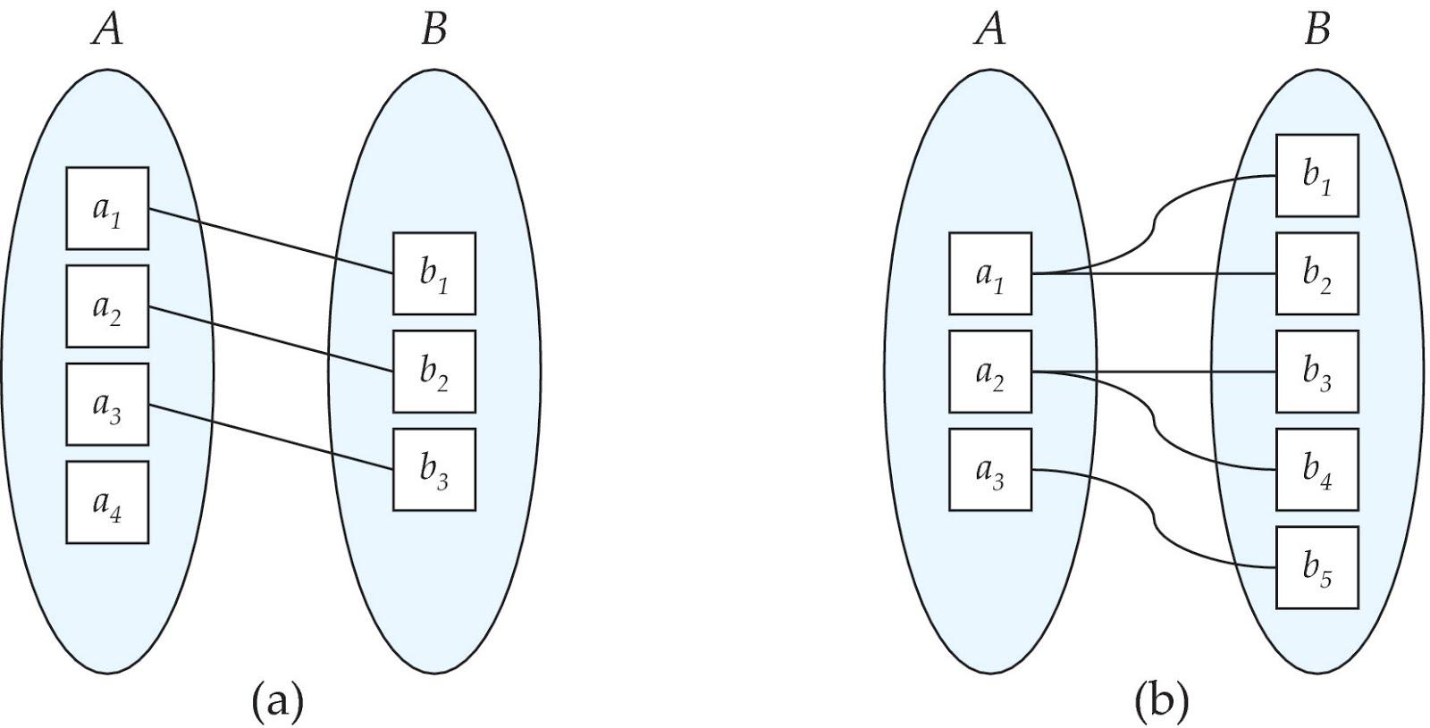
Mapping Cardinalities
One to one
One to many
Note: Some elements in A and B may not be mapped to any
elements in the other set
Notes:
*

Slide 13
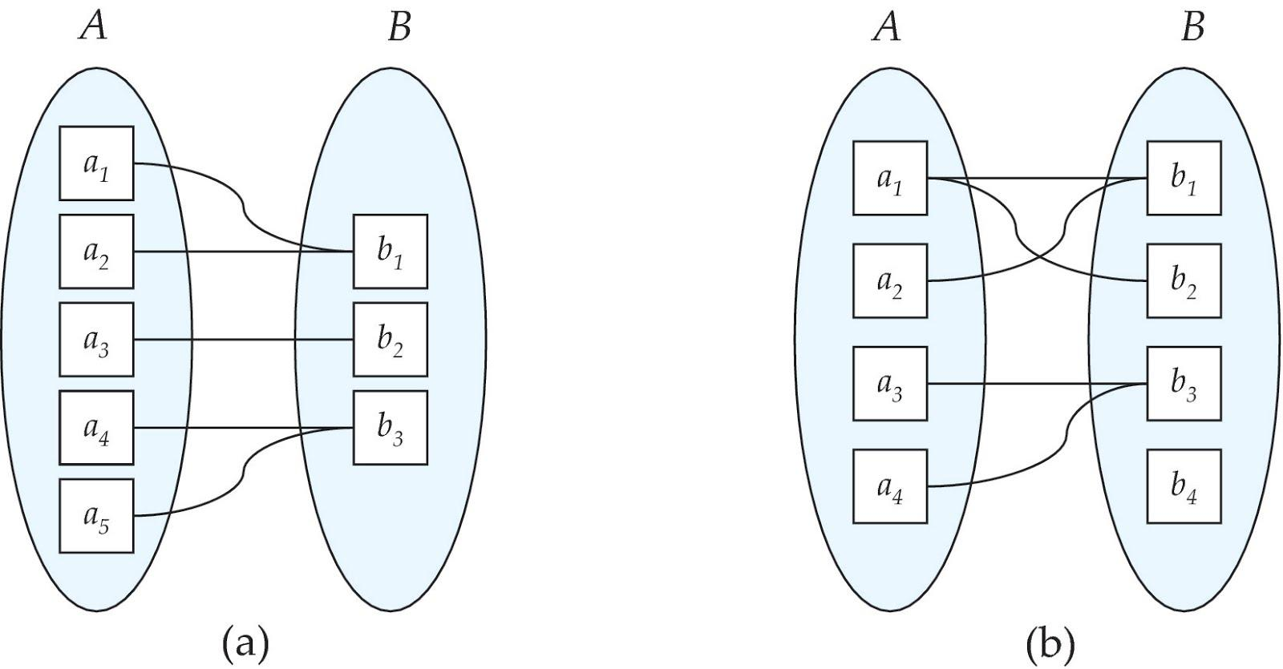
Mapping Cardinalities
Many to one
Many to many
Note: Some elements in A and B may not be mapped to any
elements in the other set
Notes:
*

Slide 14
Keys
A super key of an entity set is a set of one or more attributes whose values uniquely determine each entity.
A candidate key of an entity set is a minimal super key
  ID is candidate key of instructor
  course_id is candidate key of course
Although several candidate keys may exist, one of the candidate keys is selected to be the primary key.
Notes:
*

Slide 15
Keys for Relationship Sets
The combination of primary keys of the participating entity sets forms a super key of a relationship set.
  (s_id, i_id) is the super key of advisor
  NOTE: this means a pair of entity sets can have at most one relationship in a particular relationship set.
    Example: if we wish to track multiple meeting dates between a student and her advisor, we cannot assume a relationship for each meeting. We can use a multivalued attribute though
Must consider the mapping cardinality of the relationship set when deciding what are the candidate keys
Need to consider semantics of relationship set in selecting the primary key in case of more than one candidate key
Notes:
*

Slide 16
Redundant Attributes
Suppose we have entity sets
  instructor, with attributes including dept_name
  department
  and a relationship
  inst_dept relating instructor and department
Attribute dept_name in entity instructor is redundant since there is an explicit relationship inst_dept which relates instructors to departments
  The attribute replicates information present in the relationship, and should be removed from instructor
  BUT: when converting back to tables, in some cases the attribute gets reintroduced, as we will see.
Notes:
*

Slide 17
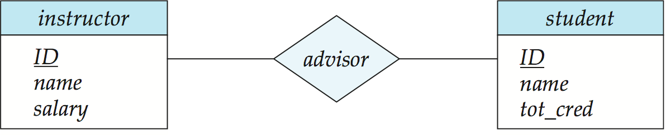
E-R Diagrams
Rectangles represent entity sets.
Diamonds represent relationship sets.
Attributes listed inside entity rectangle
Underline indicates primary key attributes
Notes:
*

Slide 18
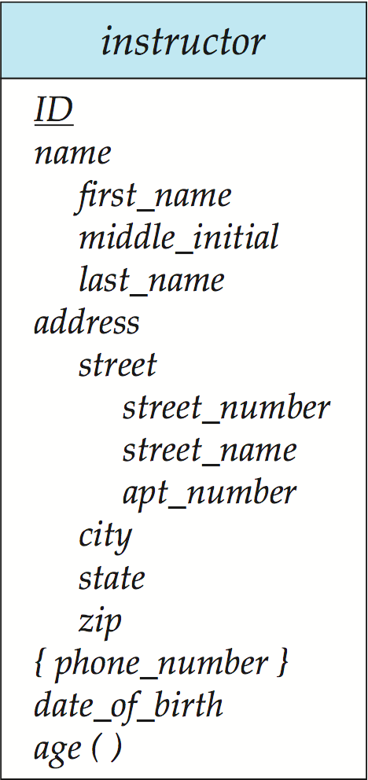
Entity With Composite, Multivalued, and Derived Attributes
Notes:
*

Slide 19
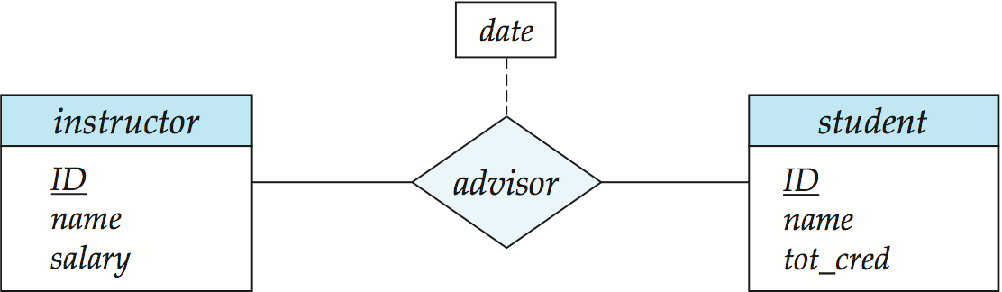
Relationship Sets with Attributes
Notes:
*

Slide 20
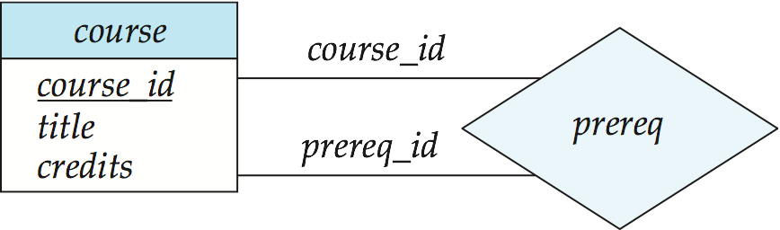
Roles
Entity sets of a relationship need not be distinct
  Each occurrence of an entity set plays a “role” in the relationship
The labels “course_id” and “prereq_id” are called roles.
Notes:
*

Slide 21
Cardinality Constraints
We express cardinality constraints by drawing either a directed line (→), signifying “one,” or an undirected line (—), signifying “many,” between the relationship set and the entity set.
One-to-one relationship:
  A student is associated with at most one instructor via the relationship advisor
  A student is associated with at most one department via stud_dept
Notes:
*

Slide 22
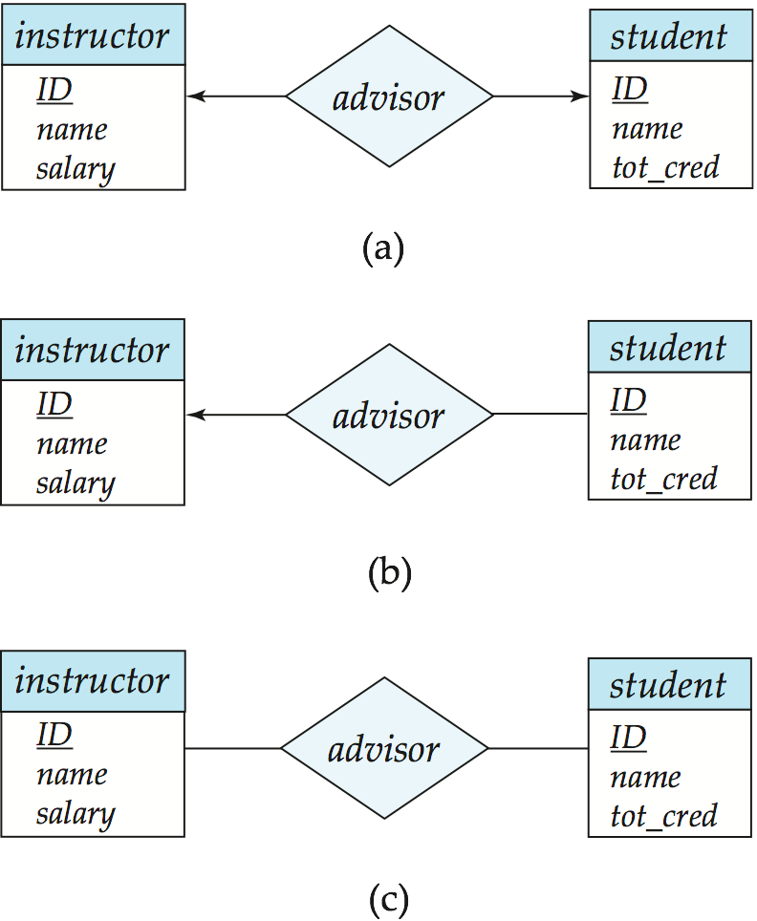
One-to-One Relationship
one-to-one relationship between an instructor and a student
  an instructor is associated with at most one student via advisor
  and a student is associated with at most one instructor via advisor
Notes:
*

Slide 23
One-to-Many Relationship
one-to-many relationship between an instructor and a student
  an instructor is associated with several (including 0) students via advisor
  a student is associated with at most one instructor via advisor,
Notes:
*

Slide 24
Many-to-One Relationships
In a many-to-one relationship between an instructor and a student,
  an instructor is associated with at most one student via advisor,
  and a student is associated with several (including 0) instructors via advisor
Notes:
*

Slide 25
Many-to-Many Relationship
An instructor is associated with several (possibly 0) students via advisor
A student is associated with several (possibly 0) instructors via advisor
Notes:
*

Slide 26
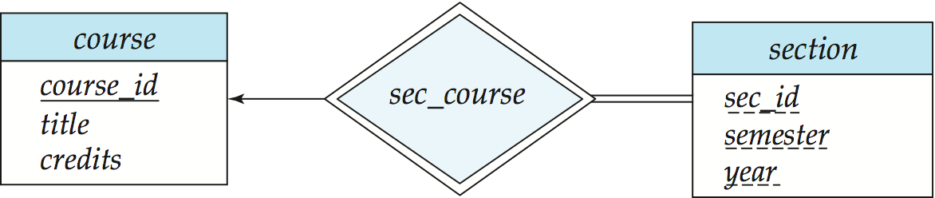
Participation of an Entity Set in a Relationship Set
Total participation (indicated by double line): every entity in the entity set participates in at least one relationship in the relationship set
  E.g., participation of section in sec_course is total
    every section must have an associated course
Partial participation: some entities may not participate in any relationship in the relationship set
  Example: participation of instructor in advisor is partial
Notes:
*

Slide 27
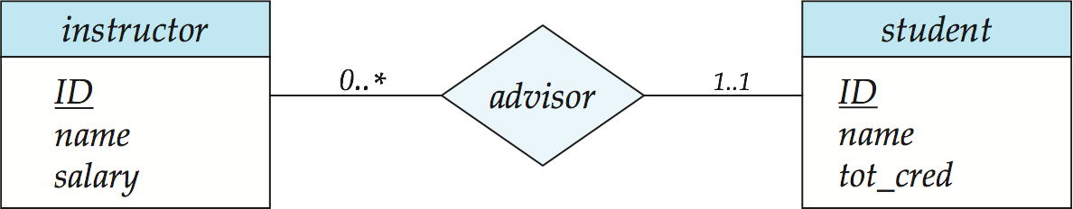
Alternative Notation for Cardinality Limits
Cardinality limits can also express participation constraints
Notes:
*

Slide 28
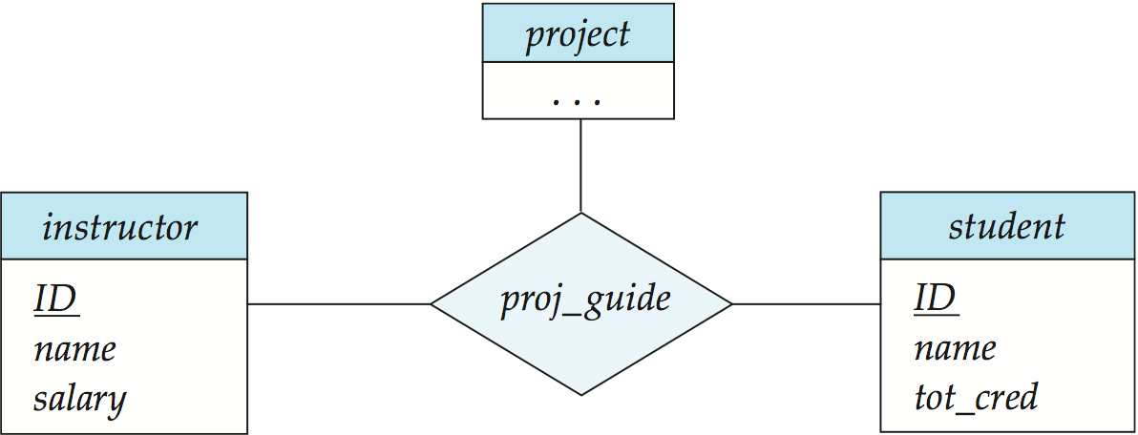
E-R Diagram with a Ternary Relationship
Notes:
*

Slide 29
Cardinality Constraints on Ternary Relationship
We allow at most one arrow out of a ternary (or greater degree) relationship to indicate a cardinality constraint
E.g., an arrow from proj_guide to instructor indicates each student has at most one guide for a project
If there is more than one arrow, there are two ways of defining the meaning.
  E.g., a ternary relationship R between A, B and C with arrows to B and C could mean
  1. each A entity is associated with a unique entity from B and C or
  2. each pair of entities from (A, B) is associated with a unique C entity, and each pair (A, C) is associated with a unique B
  Each alternative has been used in different formalisms
  To avoid confusion we outlaw more than one arrow
Notes:
*

Slide 30
How about doing an ER design interactively on the board?
Suggest an application to be modeled.
Notes:
*

Slide 31
Weak Entity Sets
An entity set that does not have a primary key is referred to as a weak entity set.
The existence of a weak entity set depends on the existence of a identifying entity set
  It must relate to the identifying entity set via a total, one-to-many relationship set from the identifying to the weak entity set
  Identifying relationship depicted using a double diamond
The discriminator (or partial key) of a weak entity set is the set of attributes that distinguishes among all the entities of a weak entity set.
The primary key of a weak entity set is formed by the primary key of the strong entity set on which the weak entity set is existence dependent, plus the weak entity set’s discriminator.
Notes:
*

Slide 32
Weak Entity Sets (Cont.)
We underline the discriminator of a weak entity set with a dashed line.
We put the identifying relationship of a weak entity in a double diamond.
Primary key for section – (course_id, sec_id, semester, year)
Notes:
*

Slide 33
Weak Entity Sets (Cont.)
Note: the primary key of the strong entity set is not explicitly stored with the weak entity set, since it is implicit in the identifying relationship.
If course_id were explicitly stored, section could be made a strong entity, but then the relationship between section and course would be duplicated by an implicit relationship defined by the attribute course_id common to course and section
Notes:
*

Slide 34
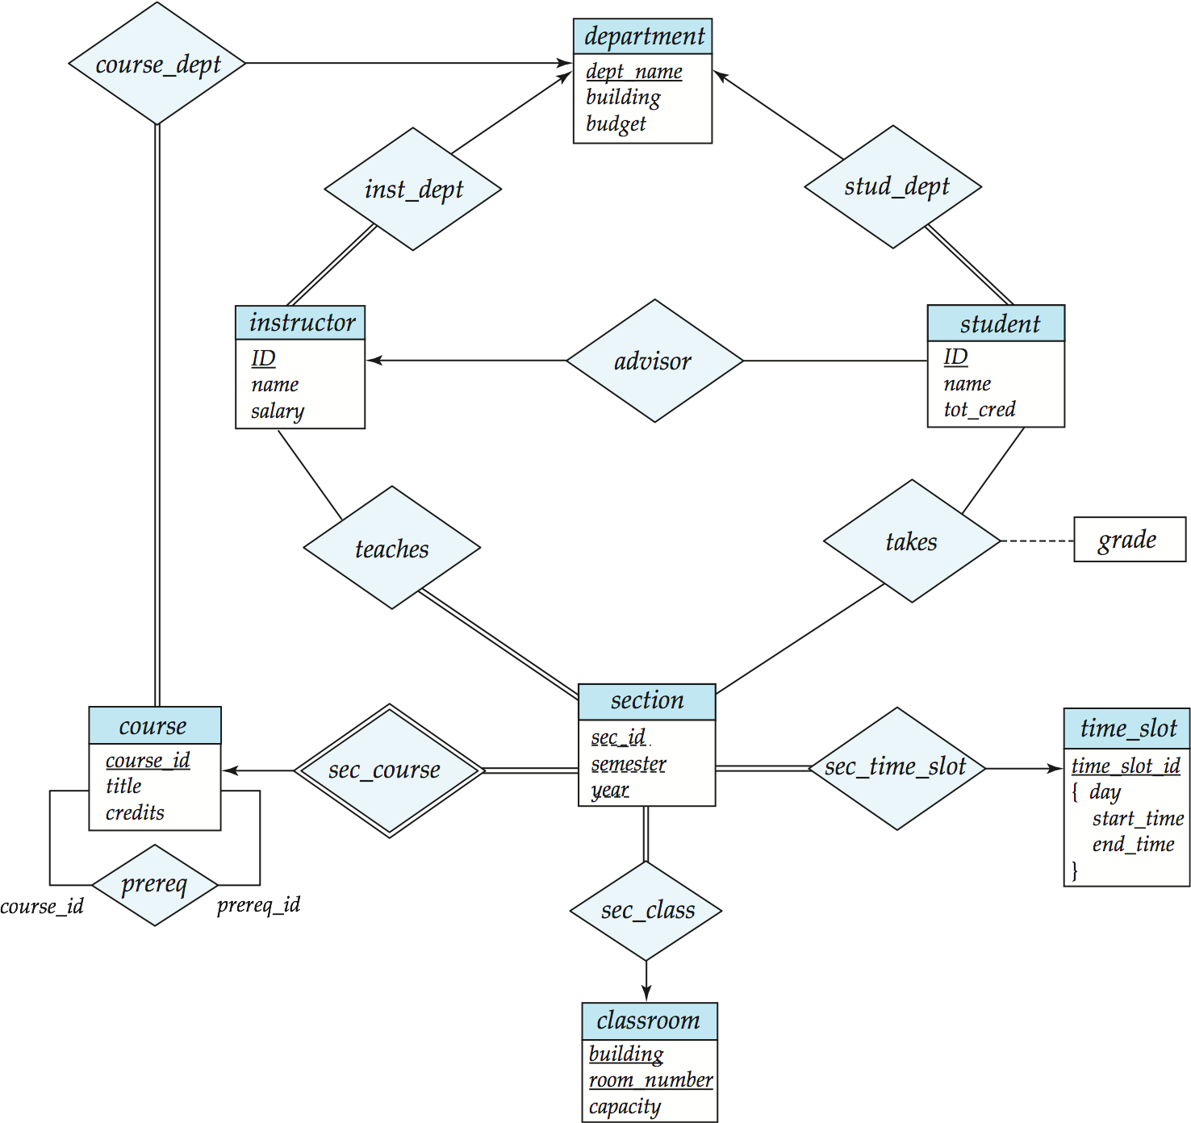
E-R Diagram for a University Enterprise
Notes:
*

Slide 35
Reduction to Relational Schemas

Slide 36
Reduction to Relation Schemas
Entity sets and relationship sets can be expressed uniformly as relation schemas that represent the contents of the database.
A database which conforms to an E-R diagram can be represented by a collection of schemas.
For each entity set and relationship set there is a unique schema that is assigned the name of the corresponding entity set or relationship set.
Each schema has a number of columns (generally corresponding to attributes), which have unique names.
Notes:
*

Slide 37
Representing Entity Sets With Simple Attributes
A strong entity set reduces to a schema with the same attributesstudent(ID, name, tot_cred)
A weak entity set becomes a table that includes a column for the primary key of the identifying strong entity set section ( course_id, sec_id, sem, year )
Notes:
*

Slide 38
Representing Relationship Sets
A many-to-many relationship set is represented as a schema with attributes for the primary keys of the two participating entity sets, and any descriptive attributes of the relationship set.
Example: schema for relationship set advisor
advisor = (s_id, i_id)
Notes:
*

Slide 39
Redundancy of Schemas
Many-to-one and one-to-many relationship sets that are total on the many-side can be represented by adding an extra attribute to the “many” side, containing the primary key of the “one” side
Example: Instead of creating a schema for relationship set inst_dept, add an attribute dept_name to the schema arising from entity set instructor
Notes:
*

Slide 40
Redundancy of Schemas (Cont.)
For one-to-one relationship sets, either side can be chosen to act as the “many” side
  That is, extra attribute can be added to either of the tables corresponding to the two entity sets
If participation is partial on the “many” side, replacing a schema by an extra attribute in the schema corresponding to the “many” side could result in null values
The schema corresponding to a relationship set linking a weak entity set to its identifying strong entity set is redundant.
  Example: The section schema already contains the attributes that would appear in the sec_course schema
Notes:
*

Slide 41
Composite and Multivalued Attributes
Composite attributes are flattened out by creating a separate attribute for each component attribute
  Example: given entity set instructor with composite attribute name with component attributes first_name and last_name the schema corresponding to the entity set has two attributes name_first_name and name_last_name
    Prefix omitted if there is no ambiguity
Ignoring multivalued attributes, extended instructor schema is
  instructor(ID,
  first_name, middle_initial, last_name,
  street_number, street_name,
  apt_number, city, state, zip_code,
  date_of_birth)
Notes:
*

Slide 42
Composite and Multivalued Attributes
A multivalued attribute M of an entity E is represented by a separate schema EM
  Schema EM has attributes corresponding to the primary key of E and an attribute corresponding to multivalued attribute M
  Example: Multivalued attribute phone_number of instructor is represented by a schema:
  inst_phone= ( ID, phone_number)
  Each value of the multivalued attribute maps to a separate tuple of the relation on schema EM
    For example, an instructor entity with primary key 22222 and phone numbers 456-7890 and 123-4567 maps to two tuples:
    (22222, 456-7890) and (22222, 123-4567)
Notes:
*

Slide 43
Multivalued Attributes (Cont.)
Special case:entity time_slot has only one attribute other than the primary-key attribute, and that attribute is multivalued
  Optimization: Don’t create the relation corresponding to the entity, just create the one corresponding to the multivalued attribute
  time_slot(time_slot_id, day, start_time, end_time)
  Caveat: time_slot attribute of section (from sec_time_slot) cannot be a foreign key due to this optimization
Notes:
*

Slide 44
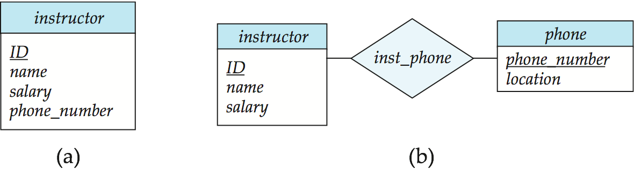
Design Issues
Use of entity sets vs. attributes
Use of phone as an entity allows extra information about phone numbers (plus multiple phone numbers)
Notes:
*

Slide 45
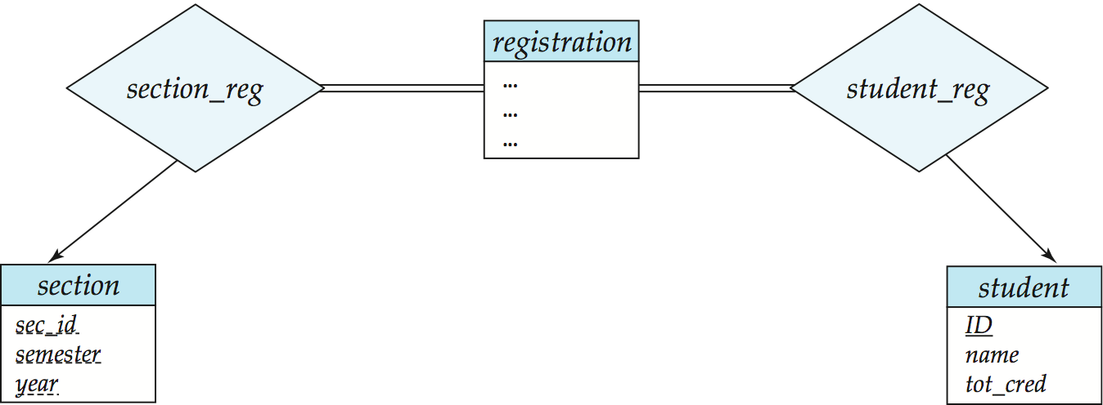
Design Issues
Use of entity sets vs. relationship setsPossible guideline is to designate a relationship set to describe an action that occurs between entities
Notes:
*

Slide 46
Design Issues
Binary versus n-ary relationship setsAlthough it is possible to replace any nonbinary (n-ary, for n > 2) relationship set by a number of distinct binary relationship sets, a n-ary relationship set shows more clearly that several entities participate in a single relationship.
Placement of relationship attributes
e.g., attribute date as attribute of advisor or as attribute of student
Notes:
*

Slide 47
Binary Vs. Non-Binary Relationships
Some relationships that appear to be non-binary may be better represented using binary relationships
  E.g., A ternary relationship parents, relating a child to his/her father and mother, is best replaced by two binary relationships, father and mother
    Using two binary relationships allows partial information (e.g., only mother being know)
  But there are some relationships that are naturally non-binary
    Example: proj_guide
Notes:
*

Slide 48
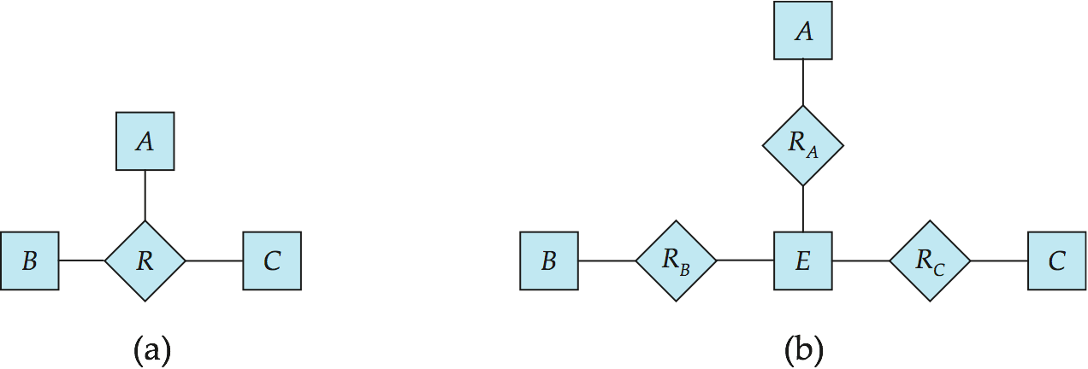
Converting Non-Binary Relationships to Binary Form
In general, any non-binary relationship can be represented using binary relationships by creating an artificial entity set.
  Replace R between entity sets A, B and C by an entity set E, and three relationship sets:
1. R_{A}, relating E and A 2. R_{B}, relating E and B
3. R_{C}, relating E and C
  Create a special identifying attribute for E
  Add any attributes of R to E
  For each relationship (a_{i} , b_{i} , c_{i}) in R, create
1. a new entity e_{i} in the entity set E 2. add (e_{i} , a_{i} ) to R_{A}
3. add (e_{i} , b_{i} ) to R_{B} 4. add (e_{i} , c_{i} ) to R_{C}
Notes:
*

Slide 49
Converting Non-Binary Relationships (Cont.)
Also need to translate constraints
  Translating all constraints may not be possible
  There may be instances in the translated schema that
  cannot correspond to any instance of R
    Exercise: add constraints to the relationships R_{A}, R_{B} and R_{C} to ensure that a newly created entity corresponds to exactly one entity in each of entity sets A, B and C
  We can avoid creating an identifying attribute by making E a weak entity set (described shortly) identified by the three relationship sets
Notes:
*

Slide 50
Extended ER Features

Slide 51
Extended E-R Features: Specialization
Top-down design process; we designate subgroupings within an entity set that are distinctive from other entities in the set.
These subgroupings become lower-level entity sets that have attributes or participate in relationships that do not apply to the higher-level entity set.
Depicted by a triangle component labeled ISA (E.g., instructor “is a” person).
Attribute inheritance – a lower-level entity set inherits all the attributes and relationship participation of the higher-level entity set to which it is linked.
Notes:
*

Slide 52
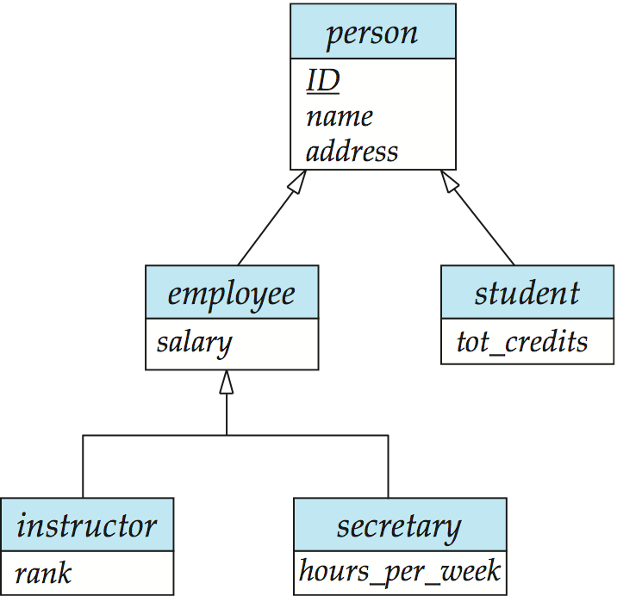
Specialization Example
Notes:
*

Slide 53
Extended ER Features: Generalization
A bottom-up design process – combine a number of entity sets that share the same features into a higher-level entity set.
Specialization and generalization are simple inversions of each other; they are represented in an E-R diagram in the same way.
The terms specialization and generalization are used interchangeably.
Notes:
*

Slide 54
Specialization and Generalization (Cont.)
Can have multiple specializations of an entity set based on different features.
E.g., permanent_employee vs. temporary_employee, in addition to instructor vs. secretary
Each particular employee would be
  a member of one of permanent_employee or temporary_employee,
  and also a member of one of instructor, secretary
The ISA relationship also referred to as superclass - subclass relationship
Notes:
*

Slide 55
Design Constraints on a Specialization/Generalization
Constraint on which entities can be members of a given lower-level entity set.
  condition-defined
    Example: all customers over 65 years are members of senior-citizen entity set; senior-citizen ISA person.
  user-defined
Constraint on whether or not entities may belong to more than one lower-level entity set within a single generalization.
  Disjoint
    an entity can belong to only one lower-level entity set
    Noted in E-R diagram by having multiple lower-level entity sets link to the same triangle
  Overlapping
    an entity can belong to more than one lower-level entity set
Notes:
*

Slide 56
Design Constraints on a Specialization/Generalization (Cont.)
Completeness constraint -- specifies whether or not an entity in the higher-level entity set must belong to at least one of the lower-level entity sets within a generalization.
  total: an entity must belong to one of the lower-level entity sets
  partial: an entity need not belong to one of the lower-level entity sets
Notes:
*

Slide 57
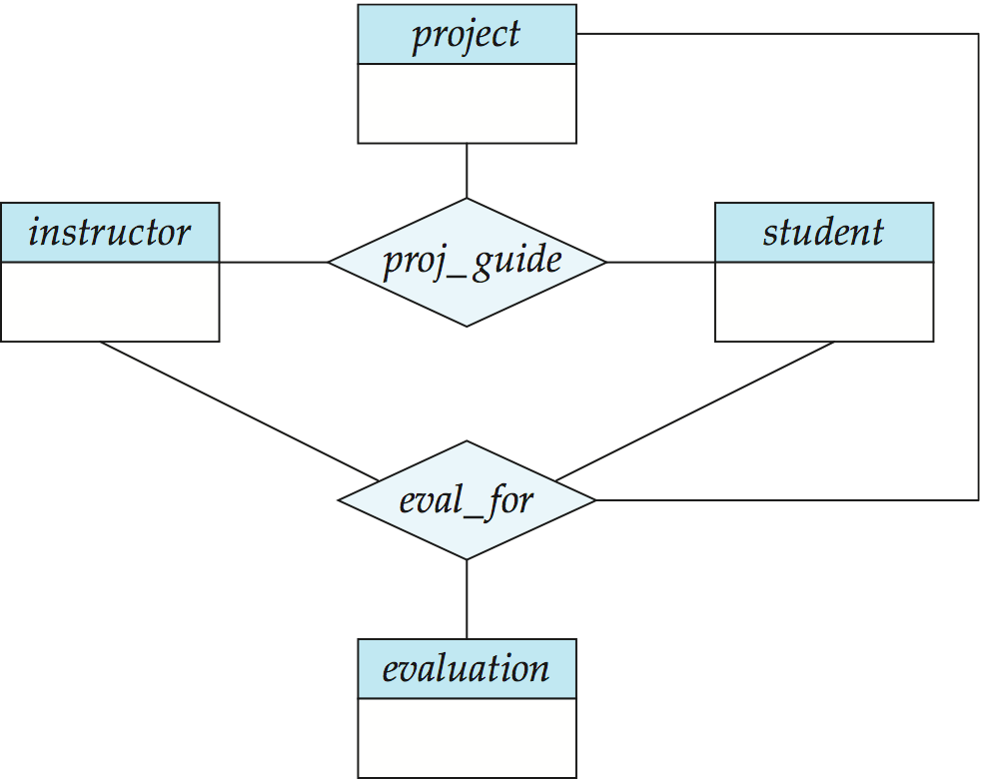
Aggregation
Consider the ternary relationship proj_guide, which we saw earlier
Suppose we want to record evaluations of a student by a guide on a project
Notes:
*

Slide 58
Aggregation (Cont.)
Relationship sets eval_for and proj_guide represent overlapping information
  Every eval_for relationship corresponds to a proj_guide relationship
  However, some proj_guide relationships may not correspond to any eval_for relationships
    So we can’t discard the proj_guide relationship
Eliminate this redundancy via aggregation
  Treat relationship as an abstract entity
  Allows relationships between relationships
  Abstraction of relationship into new entity
Notes:
*

Slide 59
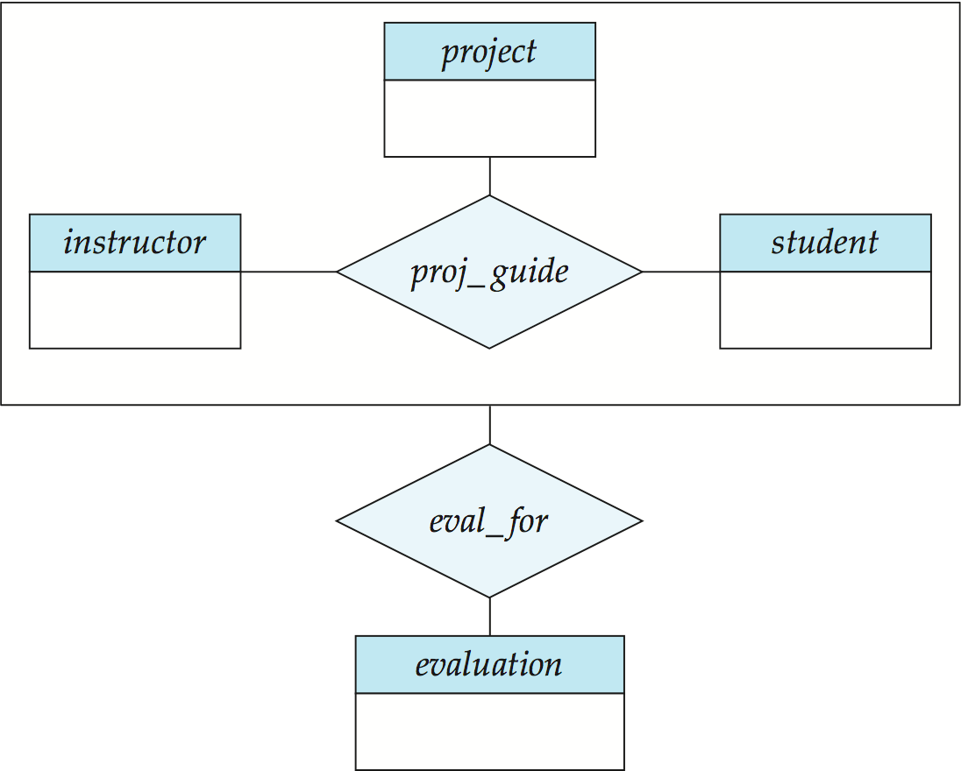
Aggregation (Cont.)
Without introducing redundancy, the following diagram represents:
  A student is guided by a particular instructor on a particular project
  A student, instructor, project combination may have an associated evaluation
Notes:
*

Slide 60
Representing Specialization via Schemas
Method 1:
  Form a schema for the higher-level entity
  Form a schema for each lower-level entity set, include primary key of higher-level entity set and local attributes schema attributes
  person ID, name, street, city
  student ID, tot_cred
  employee ID, salary
  Drawback: getting information about, an employee requires accessing two relations, the one corresponding to the low-level schema and the one corresponding to the high-level schema
Notes:
*

Slide 61
Representing Specialization as Schemas (Cont.)
Method 2:
  Form a schema for each entity set with all local and inherited attributes
  schema attributes
  person ID, name, street, city
  student ID, name, street, city, tot_cred
  employee ID, name, street, city, salary
  If specialization is total, the schema for the generalized entity set (person) not required to store information
    Can be defined as a “view” relation containing union of specialization relations
    But explicit schema may still be needed for foreign key constraints
  Drawback: name, street and city may be stored redundantly for people who are both students and employees
Notes:
*

Slide 62
Schemas Corresponding to Aggregation
To represent aggregation, create a schema containing
  primary key of the aggregated relationship,
  the primary key of the associated entity set
  any descriptive attributes
Notes:
*

Slide 63
Schemas Corresponding to Aggregation (Cont.)
For example, to represent aggregation manages between relationship works_on and entity set manager, create a schema
eval_for (s_ID, project_id, i_ID, evaluation_id)
Schema proj_guide is redundant provided we are willing to store null values for attribute manager_name in relation on schema manages
Notes:
*

Slide 64
E-R Design Decisions
The use of an attribute or entity set to represent an object.
Whether a real-world concept is best expressed by an entity set or a relationship set.
The use of a ternary relationship versus a pair of binary relationships.
The use of a strong or weak entity set.
The use of specialization/generalization – contributes to modularity in the design.
The use of aggregation – can treat the aggregate entity set as a single unit without concern for the details of its internal structure.
Notes:
*

Slide 65
How about doing another ER design interactively on the board?
Notes:
*

Slide 66
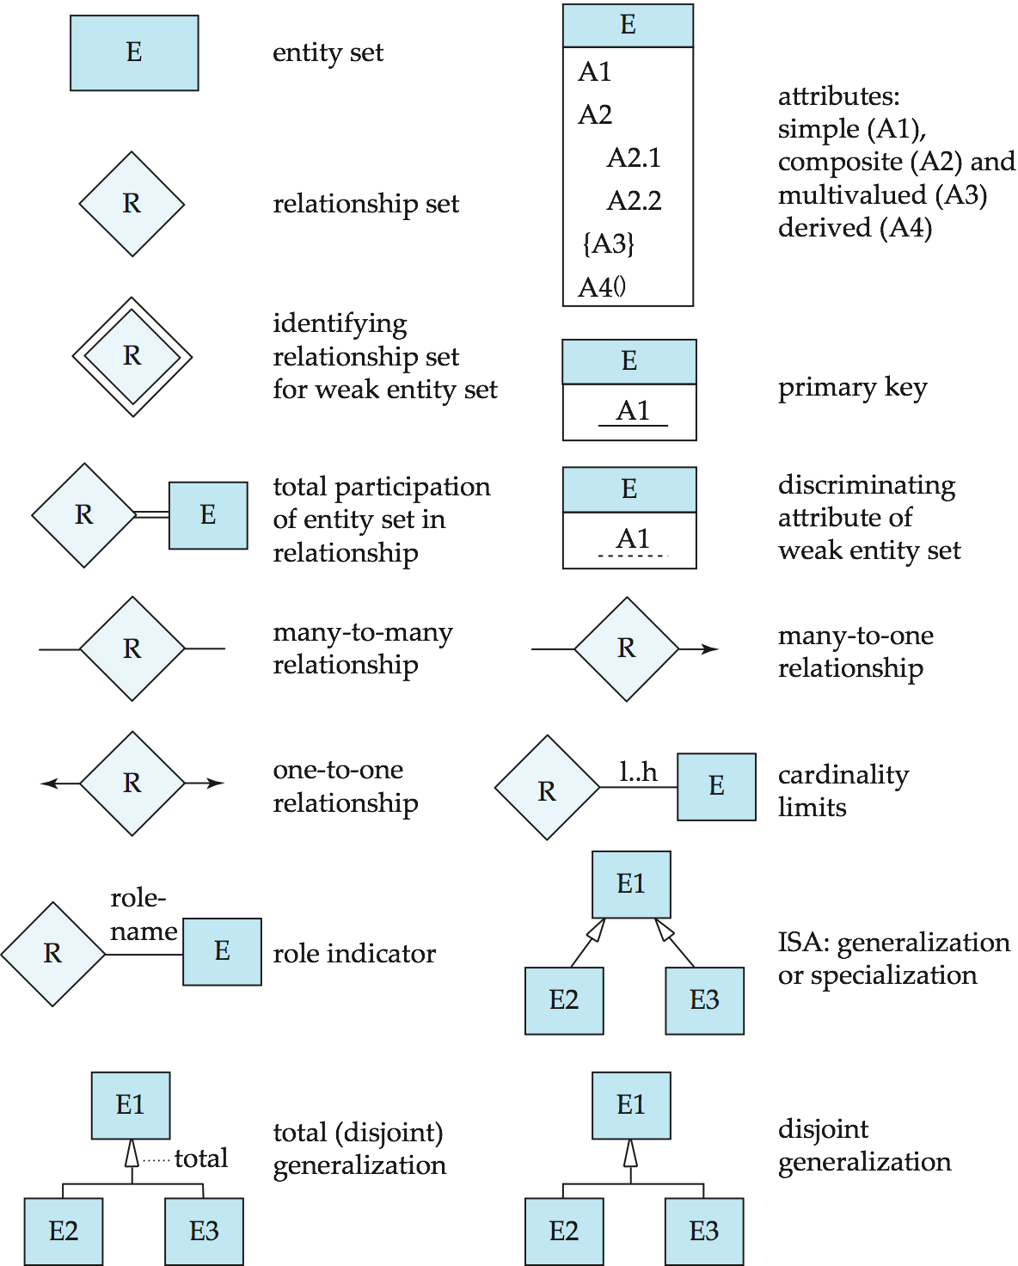
Summary of Symbols Used in E-R Notation
Notes:
*

Slide 67
Symbols Used in E-R Notation (Cont.)
Notes:
*

Slide 68
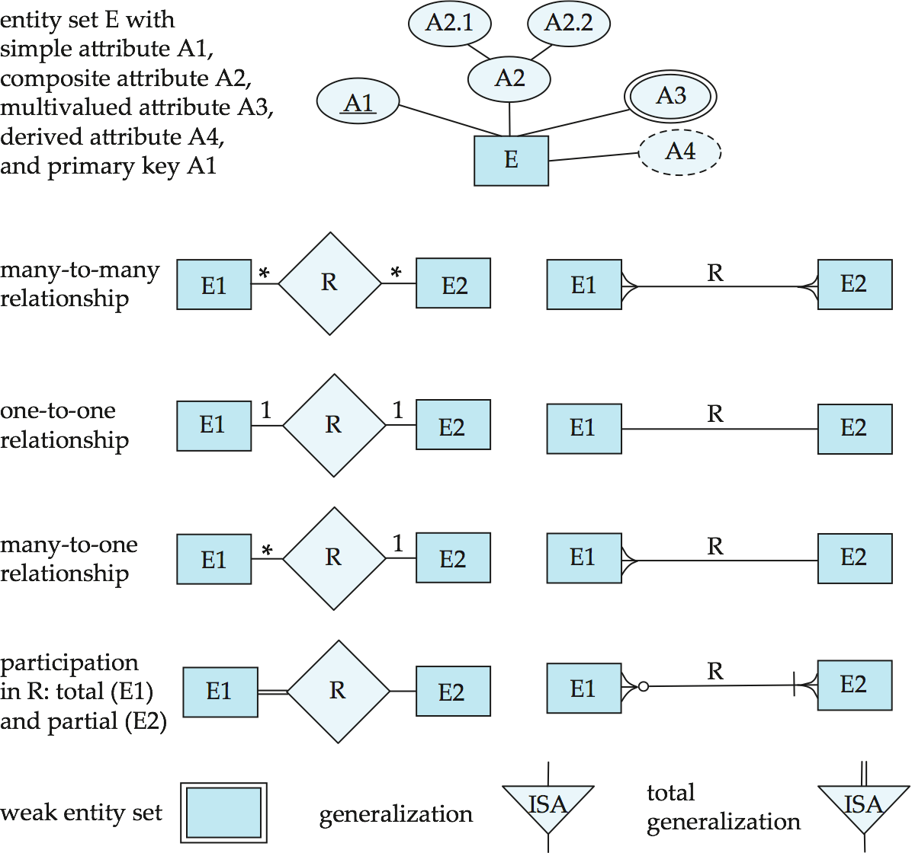
Alternative ER Notations
Chen, IDE1FX, …
Notes:
*

Slide 69
Alternative ER Notations
Chen IDE1FX (Crows feet notation)
Notes:
*

Slide 70
UML
UML: Unified Modeling Language
UML has many components to graphically model different aspects of an entire software system
UML Class Diagrams correspond to E-R Diagram, but several differences.
Notes:
*

Slide 71
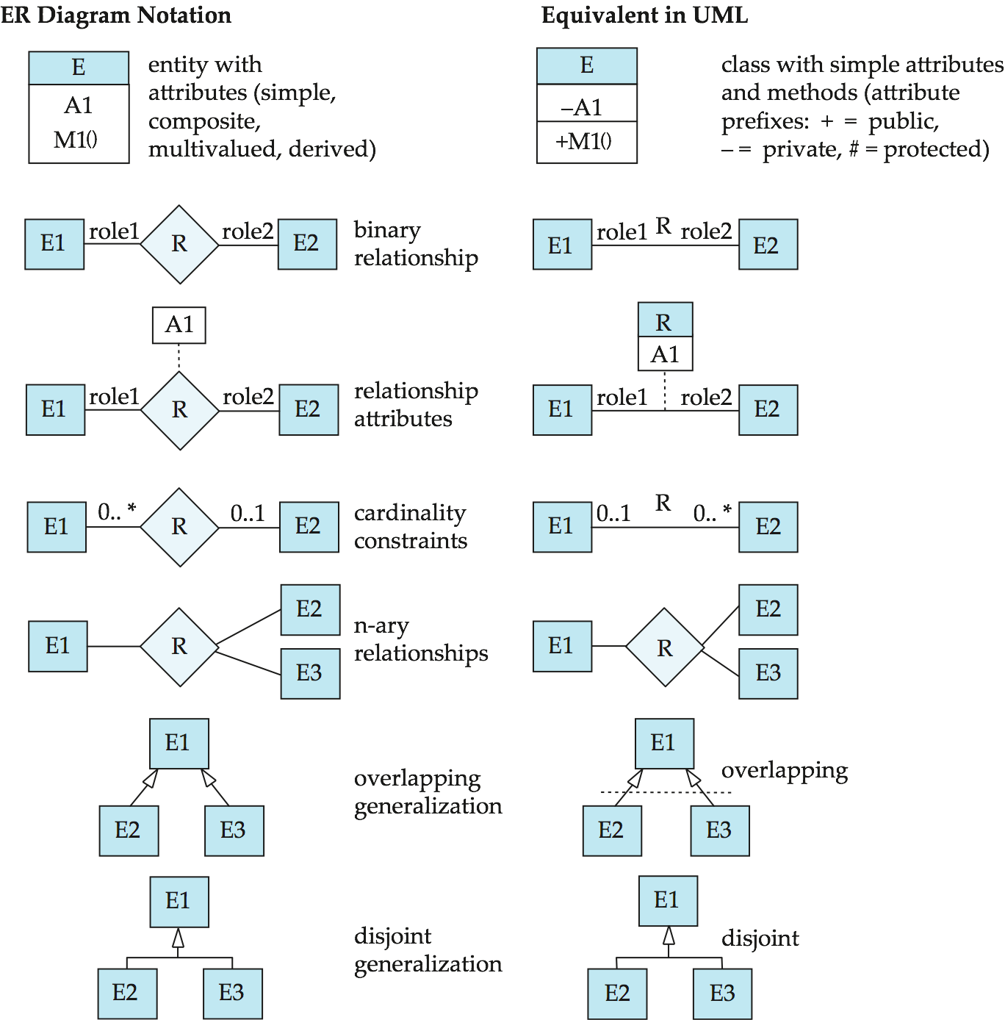
ER vs. UML Class Diagrams
*Note reversal of position in cardinality constraint depiction
Notes:
*

Slide 72
ER vs. UML Class Diagrams
ER Diagram Notation
Equivalent in UML
*Generalization can use merged or separate arrows independent
of disjoint/overlapping
Notes:
*

Slide 73
UML Class Diagrams (Cont.)
Binary relationship sets are represented in UML by just drawing a line connecting the entity sets. The relationship set name is written adjacent to the line.
The role played by an entity set in a relationship set may also be specified by writing the role name on the line, adjacent to the entity set.
The relationship set name may alternatively be written in a box, along with attributes of the relationship set, and the box is connected, using a dotted line, to the line depicting the relationship set.
Notes:
*

Slide 74
End of Chapter 7
Notes:
*

Slide 75
Figure 7.01
Notes:
*

Slide 76
Figure 7.02
Notes:
*

Slide 77
Figure 7.03
Notes:
*

Slide 78
Figure 7.04
Notes:
*

Slide 79
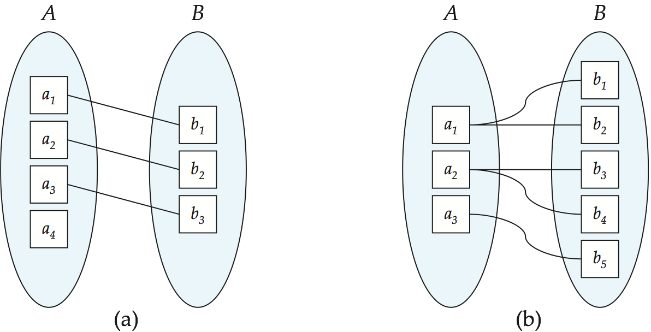
Figure 7.05
Notes:
*

Slide 80
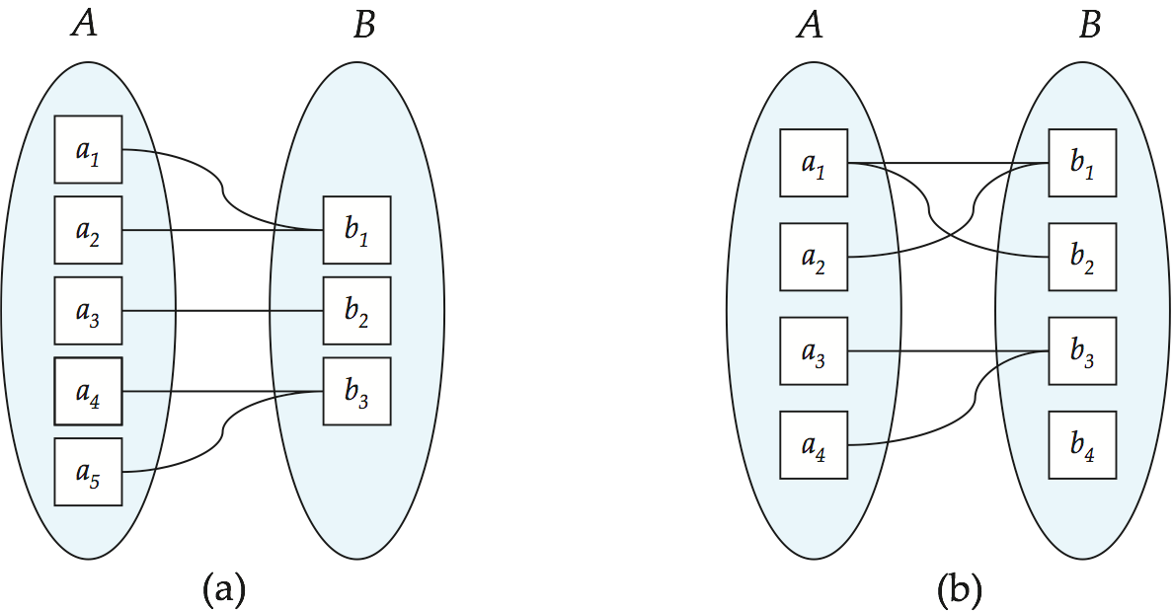
Figure 7.06
Notes:
*

Slide 81
Figure 7.07
Notes:
*

Slide 82
Figure 7.08
Notes:
*

Slide 83
Figure 7.09
Notes:
*

Slide 84
Figure 7.10
Notes:
*

Slide 85
Figure 7.11
Notes:
*

Slide 86
Figure 7.12
Notes:
*

Slide 87
Figure 7.13
Notes:
*

Slide 88
Figure 7.14
Notes:
*

Slide 89
Figure 7.15
Notes:
*

Slide 90
Figure 7.17
Notes:
*

Slide 91
Figure 7.18
Notes:
*

Slide 92
Figure 7.19
Notes:
*

Slide 93
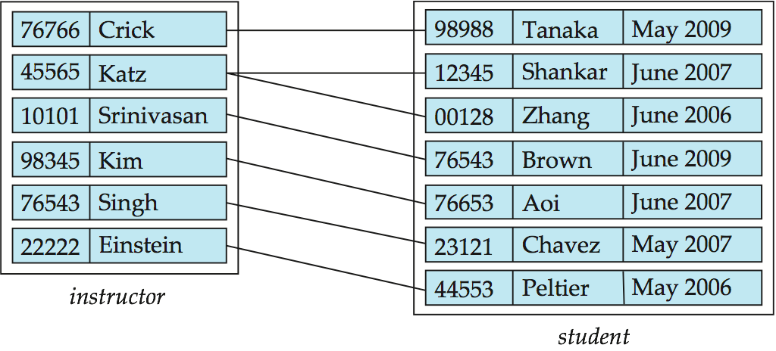
Figure 7.20
Notes:
*

Slide 94
Figure 7.21
Notes:
*

Slide 95
Figure 7.22
Notes:
*

Slide 96
Figure 7.23
Notes:
*

Slide 97
Figure 7.24
Notes:
*

Slide 98
Figure 7.25
Notes:
*

Slide 99
Figure 7.26
Notes:
*

Slide 100
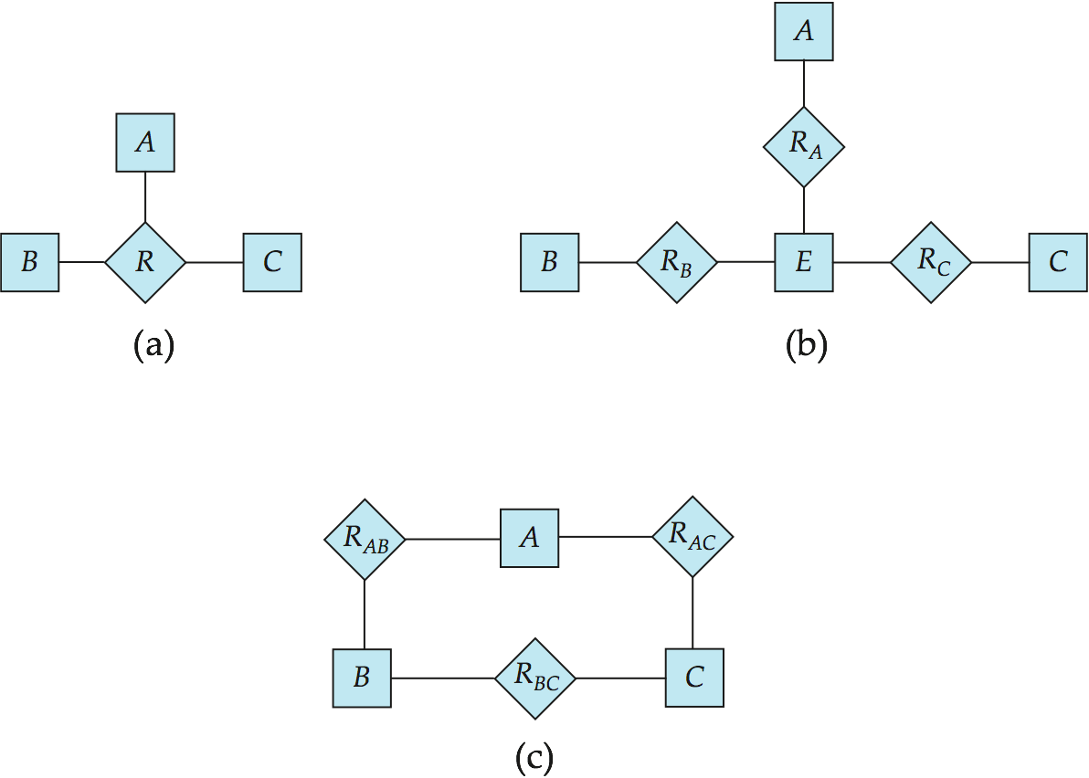
Figure 7.27
Notes:
*

Slide 101
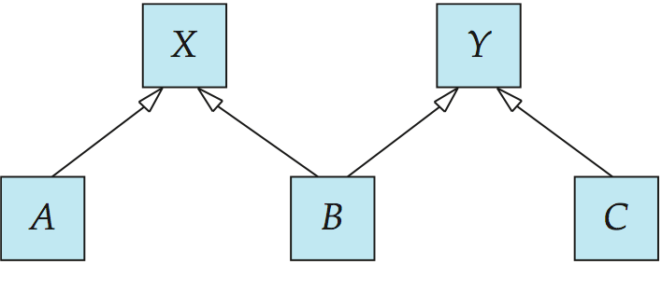
Figure 7.28
Notes:
*

Slide 102
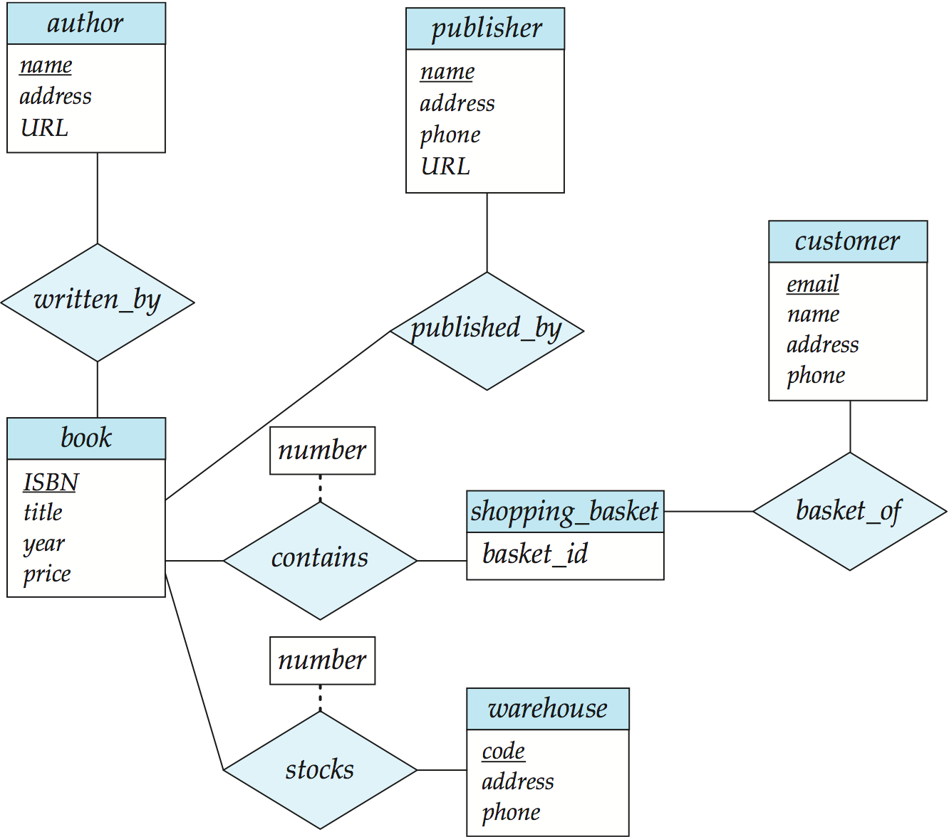
Figure 7.29
Notes:
*

