Slide 1
Chapter 1: Introduction
Notes:
*

Slide 2
Database Management System (DBMS)
DBMS contains information about a particular enterprise
  Collection of interrelated data
  Set of programs to access the data
  An environment that is both convenient and efficient to use
Database Applications:
  Banking: transactions
  Airlines: reservations, schedules
  Universities: registration, grades
  Sales: customers, products, purchases
  Online retailers: order tracking, customized recommendations
  Manufacturing: production, inventory, orders, supply chain
  Human resources: employee records, salaries, tax deductions
Databases can be very large.
Databases touch all aspects of our lives
Notes:
*

Slide 3
University Database Example
Application program examples
  Add new students, instructors, and courses
  Register students for courses, and generate class rosters
  Assign grades to students, compute grade point averages (GPA) and generate transcripts
In the early days, database applications were built directly on top of file systems
Notes:
*

Slide 4
Drawbacks of using file systems to store data
  Data redundancy and inconsistency
    Multiple file formats, duplication of information in different files
  Difficulty in accessing data
    Need to write a new program to carry out each new task
  Data isolation — multiple files and formats
  Integrity problems
    Integrity constraints (e.g., account balance > 0) become “buried” in program code rather than being stated explicitly
    Hard to add new constraints or change existing ones
Notes:
*

Slide 5
Drawbacks of using file systems to store data (Cont.)
  Atomicity of updates
    Failures may leave database in an inconsistent state with partial updates carried out
    Example: Transfer of funds from one account to another should either complete or not happen at all
  Concurrent access by multiple users
    Concurrent access needed for performance
    Uncontrolled concurrent accesses can lead to inconsistencies
      Example: Two people reading a balance (say 100) and updating it by withdrawing money (say 50 each) at the same time
  Security problems
    Hard to provide user access to some, but not all, data
Database systems offer solutions to all the above problems
Notes:
*

Slide 6
Levels of Abstraction
Physical level: describes how a record (e.g., customer) is stored.
Logical level: describes data stored in database, and the relationships among the data.
  type instructor = record
  ID : string;
  name : string;
  dept_name : string;
  salary : integer;
        end;
View level: application programs hide details of data types. Views can also hide information (such as an employee’s salary) for security purposes.
Notes:
*

Slide 7
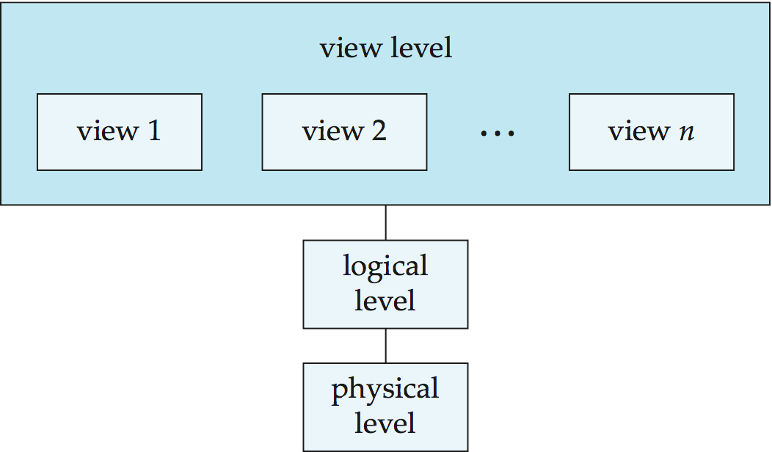
View of Data
An architecture for a database system
Notes:
*

Slide 8
Instances and Schemas
Similar to types and variables in programming languages
Schema – the logical structure of the database
  Example: The database consists of information about a set of customers and accounts and the relationship between them
  Analogous to type information of a variable in a program
  Physical schema: database design at the physical level
  Logical schema: database design at the logical level
Instance – the actual content of the database at a particular point in time
  Analogous to the value of a variable
Physical Data Independence – the ability to modify the physical schema without changing the logical schema
  Applications depend on the logical schema
  In general, the interfaces between the various levels and components should be well defined so that changes in some parts do not seriously influence others.
Notes:
*

Slide 9
Data Models
A collection of tools for describing
  Data
  Data relationships
  Data semantics
  Data constraints
Relational model
Entity-Relationship data model (mainly for database design)
Object-based data models (Object-oriented and Object-relational)
Semistructured data model (XML)
Other older models:
  Network model
  Hierarchical model
Notes:
*

Slide 10
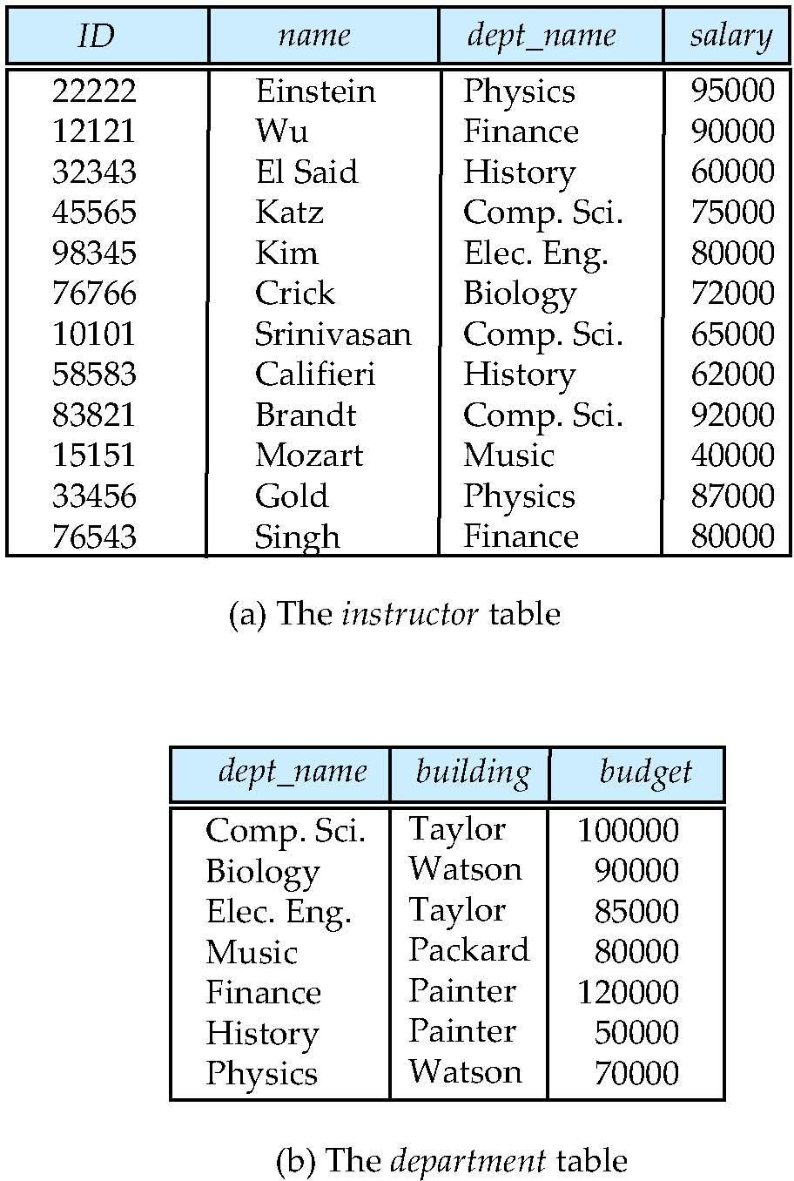
Relational Model
Relational model (Chapter 2)
Example of tabular data in the relational model
Columns
Rows
Notes:
*

Slide 11
A Sample Relational Database
Notes:
*

Slide 12
Data Manipulation Language (DML)
Language for accessing and manipulating the data organized by the appropriate data model
  DML also known as query language
Two classes of languages
  Procedural – user specifies what data is required and how to get those data
  Declarative (nonprocedural) – user specifies what data is required without specifying how to get those data
SQL is the most widely used query language
Notes:
*

Slide 13
Data Definition Language (DDL)
Specification notation for defining the database schema
  Example: create table instructor (
  ID char(5),
  name varchar(20),
  dept_name varchar(20),
  salary numeric(8,2))
DDL compiler generates a set of table templates stored in a data dictionary
Data dictionary contains metadata (i.e., data about data)
  Database schema
  Integrity constraints
    Primary key (ID uniquely identifies instructors)
    Referential integrity (references constraint in SQL)
      e.g. dept_name value in any instructor tuple must appear in department relation
  Authorization
Notes:
*

Slide 14
SQL
SQL: widely used non-procedural language
  Example: Find the name of the instructor with ID 22222
  select name
  from instructor
  where instructor.ID = ‘22222’
  Example: Find the ID and building of instructors in the Physics dept.
  select instructor.ID, department.buildingfrom instructor, departmentwhere instructor.dept_name = department.dept_name and
  department.dept_name = ‘Physics’
Application programs generally access databases through one of
  Language extensions to allow embedded SQL
  Application program interface (e.g., ODBC/JDBC) which allow SQL queries to be sent to a database
Chapters 3, 4 and 5
Notes:
*

Slide 15
Database Design
The process of designing the general structure of the database:
Logical Design – Deciding on the database schema. Database design requires that we find a “good” collection of relation schemas.
  Business decision – What attributes should we record in the database?
  Computer Science decision – What relation schemas should we have and how should the attributes be distributed among the various relation schemas?
Physical Design – Deciding on the physical layout of the database
Notes:
*

Slide 16
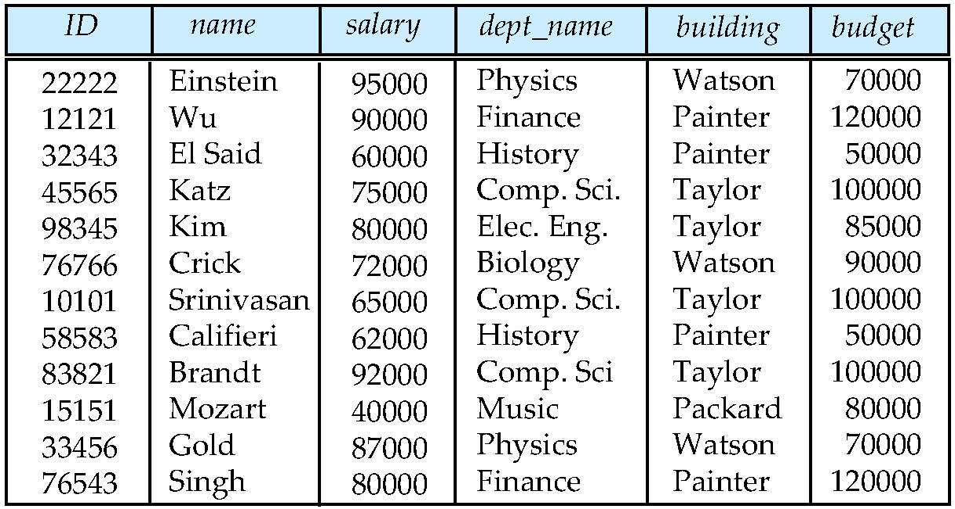
Database Design?
Is there any problem with this design?
Notes:
*

Slide 17
Design Approaches
Normalization Theory (Chapter 8)
  Formalize what designs are bad, and test for them
Entity Relationship Model (Chapter 7)
  Models an enterprise as a collection of entities and relationships
    Entity: a “thing” or “object” in the enterprise that is distinguishable from other objects
      Described by a set of attributes
    Relationship: an association among several entities
  Represented diagrammatically by an entity-relationship diagram:
Notes:
*

Slide 18
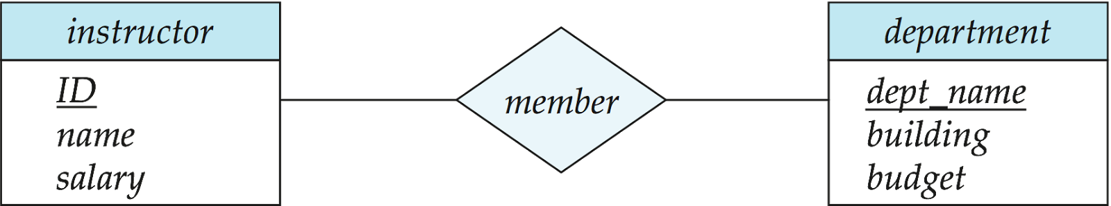
The Entity-Relationship Model
Models an enterprise as a collection of entities and relationships
  Entity: a “thing” or “object” in the enterprise that is distinguishable from other objects
    Described by a set of attributes
  Relationship: an association among several entities
Represented diagrammatically by an entity-relationship diagram:
What happened to dept_name of instructor and student?
Notes:
*

Slide 19
Object-Relational Data Models
Relational model: flat, “atomic” values
Object Relational Data Models
  Extend the relational data model by including object orientation and constructs to deal with added data types.
  Allow attributes of tuples to have complex types, including non-atomic values such as nested relations.
  Preserve relational foundations, in particular the declarative access to data, while extending modeling power.
  Provide upward compatibility with existing relational languages.
Notes:
*

Slide 20
XML: Extensible Markup Language
Defined by the WWW Consortium (W3C)
Originally intended as a document markup language not a database language
The ability to specify new tags, and to create nested tag structures made XML a great way to exchange data, not just documents
XML has become the basis for all new generation data interchange formats.
A wide variety of tools is available for parsing, browsing and querying XML documents/data
Notes:
*

Slide 21
Storage Management
Storage manager is a program module that provides the interface between the low-level data stored in the database and the application programs and queries submitted to the system.
The storage manager is responsible to the following tasks:
  Interaction with the file manager
  Efficient storing, retrieving and updating of data
Issues:
  Storage access
  File organization
  Indexing and hashing
Notes:
*

Slide 22
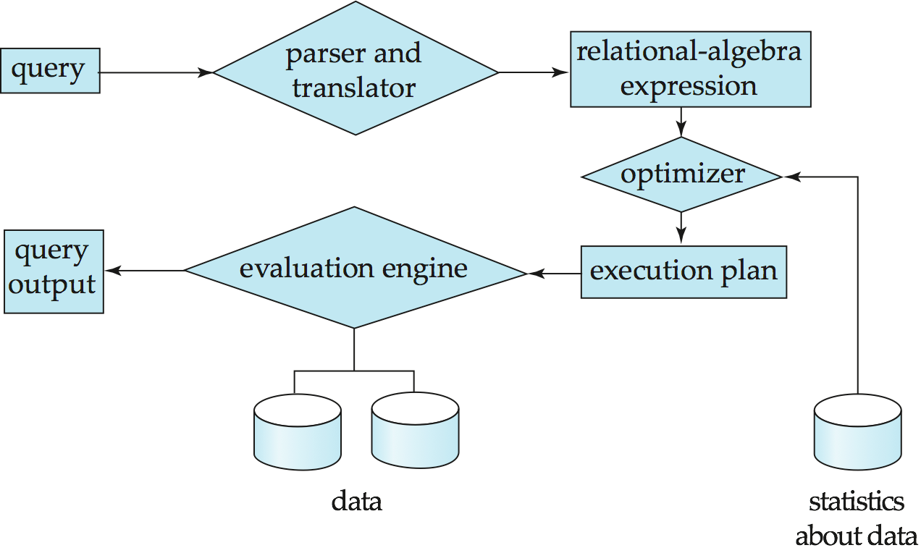
Query Processing
1. Parsing and translation
2. Optimization
3. Evaluation
Notes:
*

Slide 23
Query Processing (Cont.)
Alternative ways of evaluating a given query
  Equivalent expressions
  Different algorithms for each operation
Cost difference between a good and a bad way of evaluating a query can be enormous
Need to estimate the cost of operations
  Depends critically on statistical information about relations which the database must maintain
  Need to estimate statistics for intermediate results to compute cost of complex expressions
Notes:
*

Slide 24
Transaction Management
What if the system fails?
What if more than one user is concurrently updating the same data?
A transaction is a collection of operations that performs a single logical function in a database application
Transaction-management component ensures that the database remains in a consistent (correct) state despite system failures (e.g., power failures and operating system crashes) and transaction failures.
Concurrency-control manager controls the interaction among the concurrent transactions, to ensure the consistency of the database.
Notes:
*

Slide 25
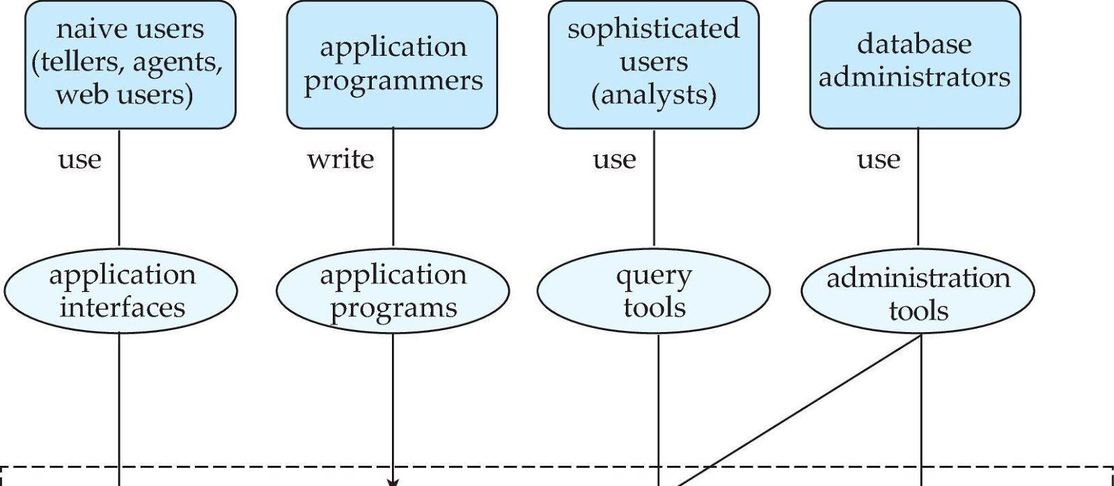
Database Users and Administrators
Database
Notes:
*

Slide 26
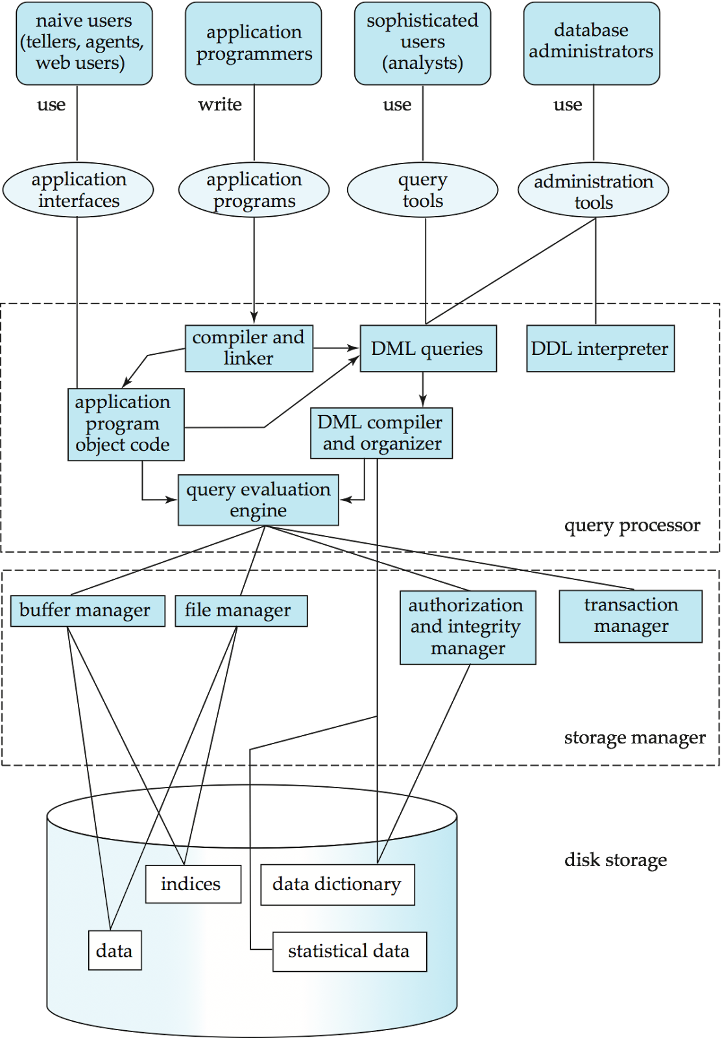
Database System Internals
Notes:
*

Slide 27
Database Architecture
The architecture of a database systems is greatly influenced by
the underlying computer system on which the database is running:
Centralized
Client-server
Parallel (multi-processor)
Distributed
Notes:
*

Slide 28
History of Database Systems
1950s and early 1960s:
  Data processing using magnetic tapes for storage
    Tapes provided only sequential access
  Punched cards for input
Late 1960s and 1970s:
  Hard disks allowed direct access to data
  Network and hierarchical data models in widespread use
  Ted Codd defines the relational data model
    Would win the ACM Turing Award for this work
    IBM Research begins System R prototype
    UC Berkeley begins Ingres prototype
  High-performance (for the era) transaction processing
Notes:
*

Slide 29
History (cont.)
1980s:
  Research relational prototypes evolve into commercial systems
    SQL becomes industrial standard
  Parallel and distributed database systems
  Object-oriented database systems
1990s:
  Large decision support and data-mining applications
  Large multi-terabyte data warehouses
  Emergence of Web commerce
Early 2000s:
  XML and XQuery standards
  Automated database administration
Later 2000s:
  Giant data storage systems
    Google BigTable, Yahoo PNuts, Amazon, ..
Notes:
*

Slide 30
End of Chapter 1
Notes:
*

Slide 31

Figure 1.02
Notes:
*

Slide 32
Figure 1.04
Notes:
*

Slide 33
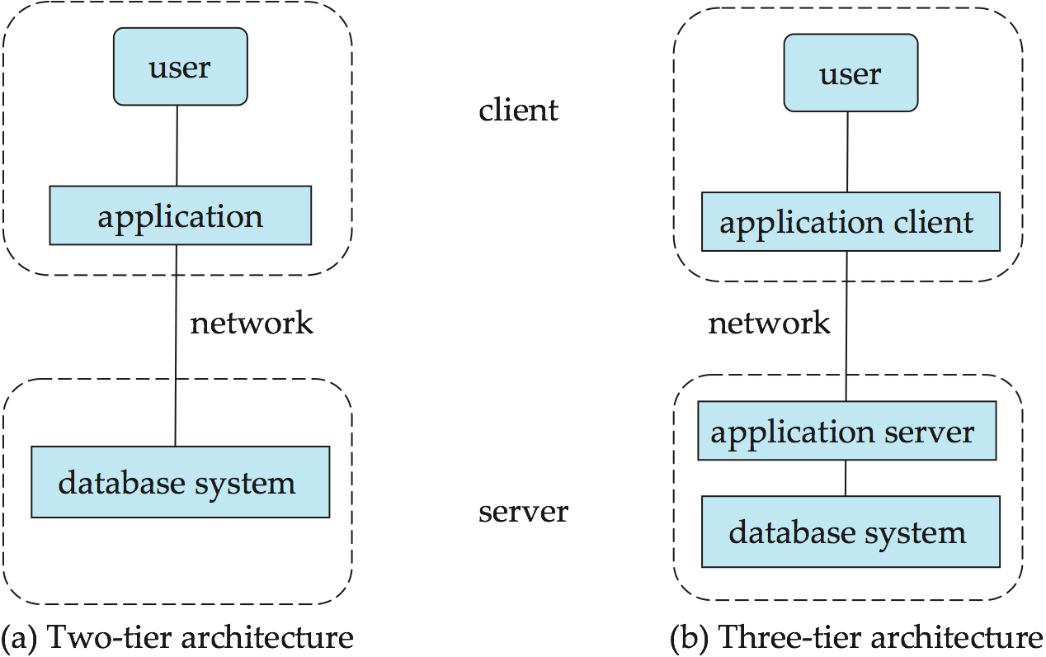
Figure 1.06
Notes:
*

