Slide 1
Systems Analysis and Design
Alan Dennis, Barbara Haley Wixom, and Roberta Roth
John Wiley & Sons, Inc.
Slides by Candace S. Garrod
Red Rocks Community College
PowerPoint Presentation for Dennis, Wixom, & Roth Systems Analysis and Design, 4th Edition
Copyright 2009 © John Wiley & Sons, Inc. All rights reserved.
11-1

Slide 2
Data Storage Design
Chapter 11
PowerPoint Presentation for Dennis, Wixom, & Roth Systems Analysis and Design, 4th Edition
Copyright 2009 © John Wiley & Sons, Inc. All rights reserved.
11 - *
Notes:
*

Slide 3
Key Definitions
The data storage function manages how data is stored and handled by programs that run the system
Goals of data storage design
  Efficient data retrieval (good response time)
  Access to the information users need
11 - *
PowerPoint Presentation for Dennis, Wixom, & Roth Systems Analysis and Design, 4th Edition
Copyright 2009 © John Wiley & Sons, Inc. All rights reserved.

Slide 4
DATA STORAGE FORMATS
PowerPoint Presentation for Dennis, Wixom, & Roth Systems Analysis and Design, 4th Edition
Copyright 2009 © John Wiley & Sons, Inc. All rights reserved.
11 - *
Notes:
*

Slide 5
Types of Data Storage Formats
Files: electronic lists of data optimized to perform a particular transaction
Database: a collection of groupings of information the relate to each other in some way.
A Database Management System (DBMS) is software that creates and manipulates databases.
11 - *
PowerPoint Presentation for Dennis, Wixom, & Roth Systems Analysis and Design, 4th Edition
Copyright 2009 © John Wiley & Sons, Inc. All rights reserved.

Slide 6
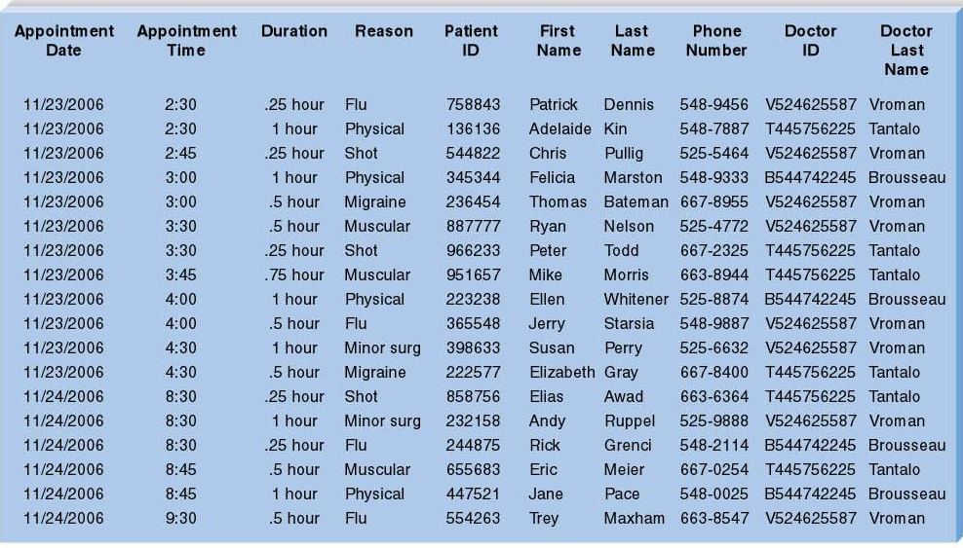
Appointment File
PowerPoint Presentation for Dennis, Wixom, & Roth Systems Analysis and Design, 4thEdition
Copyright 2009 © John Wiley & Sons, Inc. All rights reserved.
11 - *

Slide 7
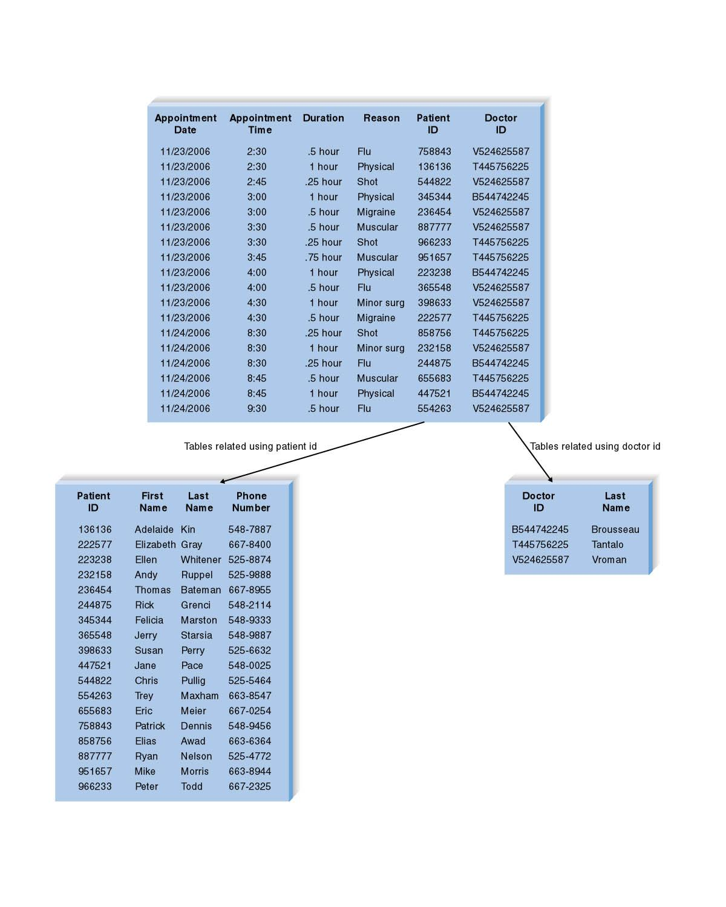
Appointment Database
PowerPoint Presentation for Dennis, Wixom, & Roth Systems Analysis and Design, 4th Edition
Copyright 2006 © John Wiley & Sons, Inc. All rights reserved.
11 - *

Slide 8
File Attributes
Files contain information formatted for a particular transaction
Typically organized sequentially
Pointers used to associate records with other records
Linked Lists are files with records linked together using pointers
11 - *
PowerPoint Presentation for Dennis, Wixom, & Roth Systems Analysis and Design, 4thEdition
Copyright 2009 © John Wiley & Sons, Inc. All rights reserved.

Slide 9
File Types
Master files – store core, important information
Look-up files – store static values
Transaction files – store information that updates a master file
Audit files – record before and after versions of data
History (archive) files – store past information
11 - *
PowerPoint Presentation for Dennis, Wixom, & Roth Systems Analysis and Design, 4th Edition
Copyright 2009 © John Wiley & Sons, Inc. All rights reserved.

Slide 10
Database Types
Legacy database
  Hierarchical (depict parent-child relationships using inverted trees)
  Network (depict nonhierarchical associations using pointers)
Relational database
Object database
Multidimensional database
11 - *
PowerPoint Presentation for Dennis, Wixom, & Roth Systems Analysis and Design, 4th Edition
Copyright 2009 © John Wiley & Sons, Inc. All rights reserved.

Slide 11
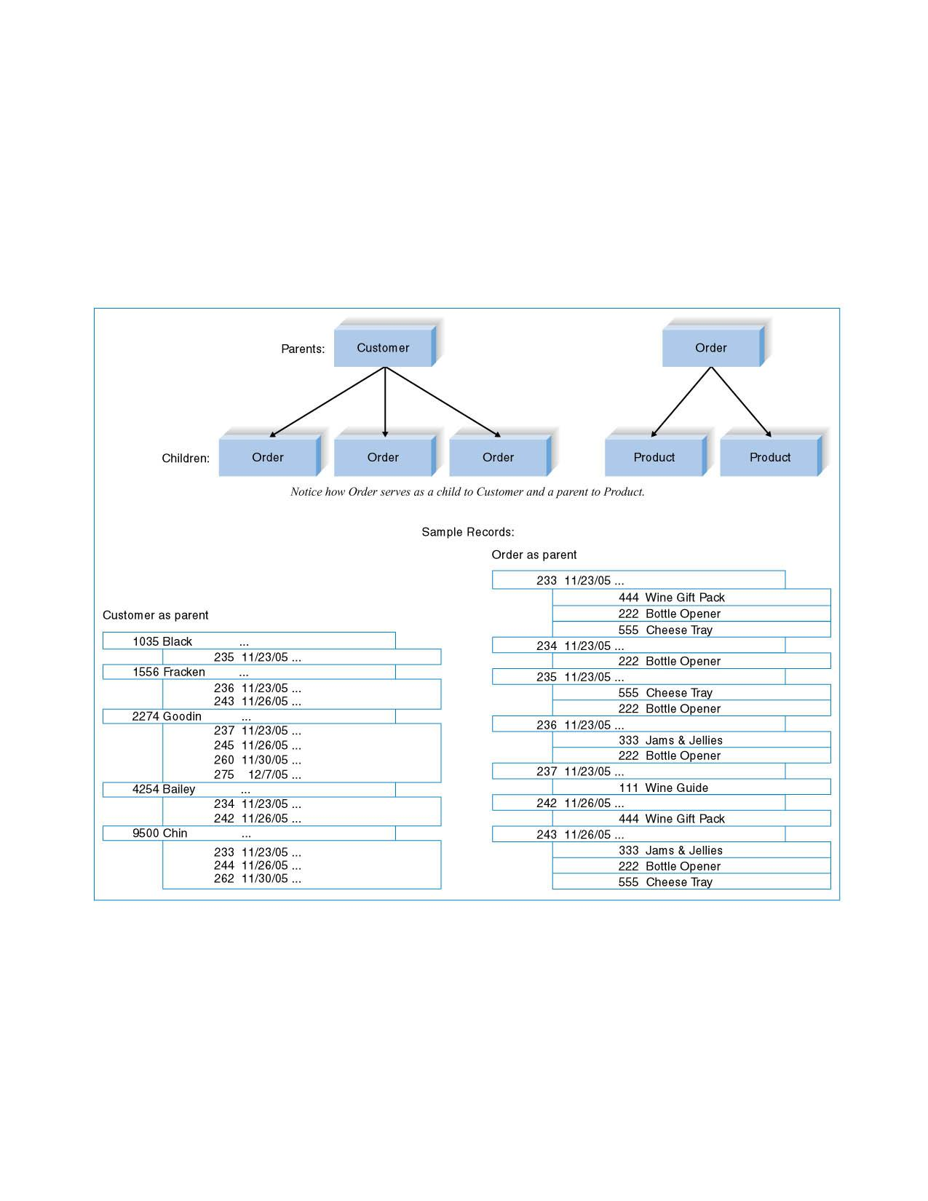
Hierarchical Database Example
11 - *
PowerPoint Presentation for Dennis, Wixom, & Roth Systems Analysis and Design, 4th Edition
Copyright 2009 © John Wiley & Sons, Inc. All rights reserved.

Slide 12
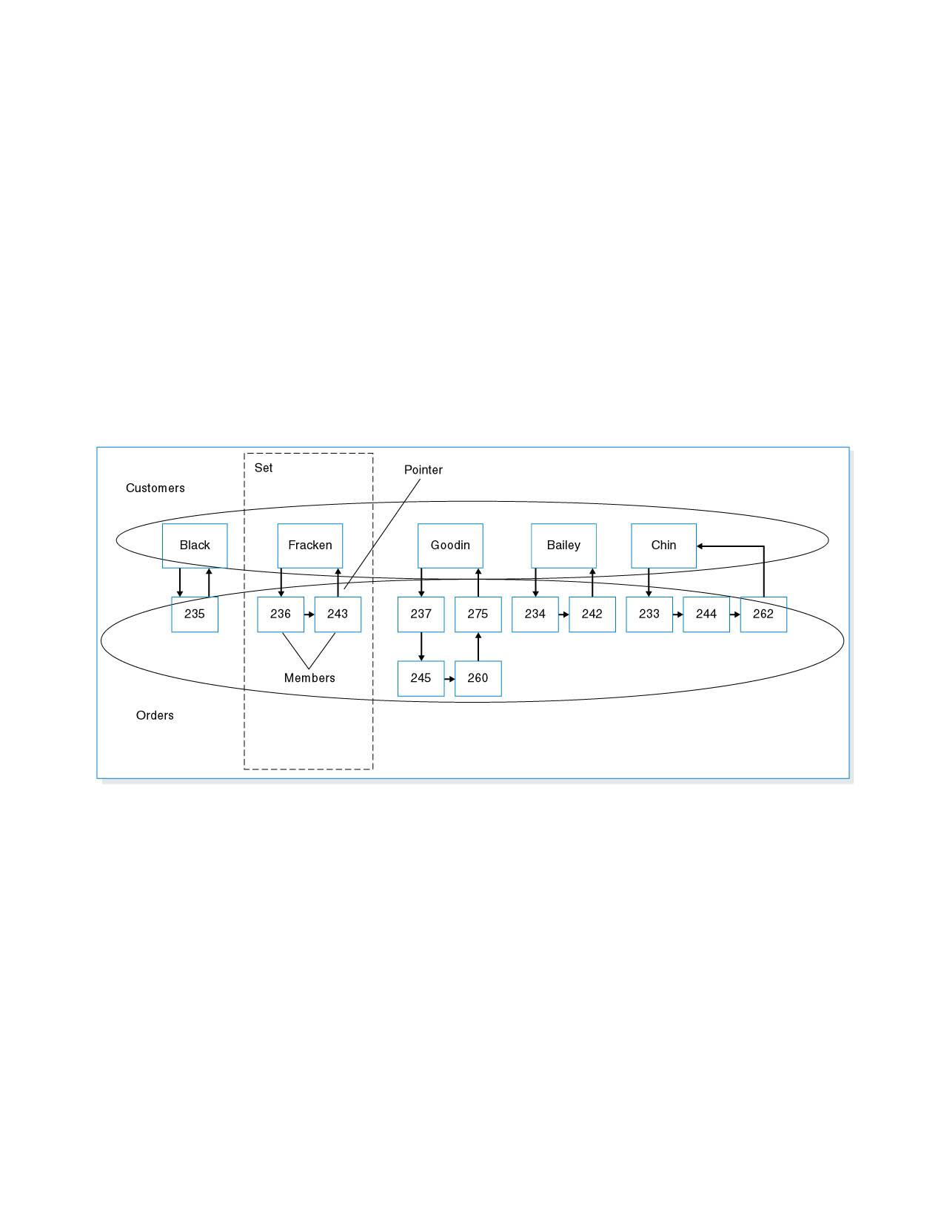
Network Database Example
11 - *
PowerPoint Presentation for Dennis, Wixom, & Roth Systems Analysis and Design, 4th Edition
Copyright 2009 © John Wiley & Sons, Inc. All rights reserved.

Slide 13
Relational Database Concepts
Popular; easy for developers to use
Primary and foreign keys used to identify and link tables
Referential integrity ensures correct and valid table synchronization
Structured Query Language (SQL)- standard language for accessing data
11 - *
PowerPoint Presentation for Dennis, Wixom, & Roth Systems Analysis and Design, 4th Edition
Copyright 2009 © John Wiley & Sons, Inc. All rights reserved.

Slide 14
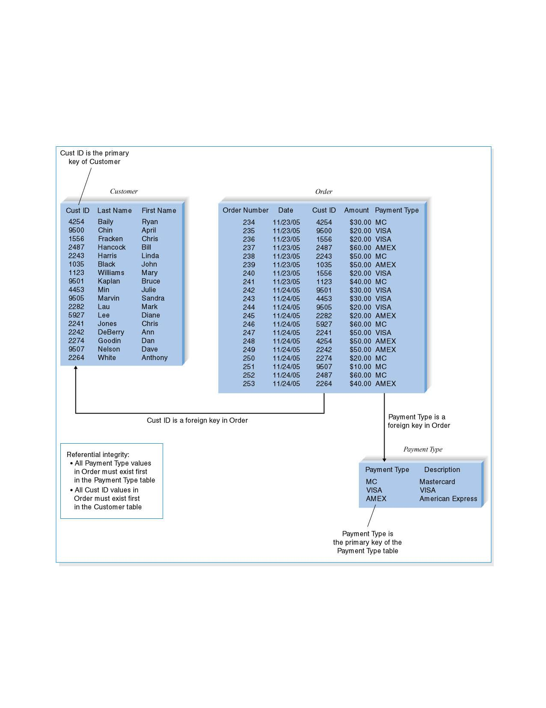
Relational Database Example
11 - *
PowerPoint Presentation for Dennis, Wixom, & Roth Systems Analysis and Design, 4th Edition
Copyright 2009 © John Wiley & Sons, Inc. All rights reserved.

Slide 15
Object Database Concepts
Built around objects consisting of both data and processes
Objects are encapsulated (self-contained)
Object classes – major object categories
OODBMS – used primarily for applications with multimedia or complex data
Hybrid OODBMS – both object and relational features
11 - *
PowerPoint Presentation for Dennis, Wixom, & Roth Systems Analysis and Design, 4th Edition
Copyright 2009 © John Wiley & Sons, Inc. All rights reserved.

Slide 16
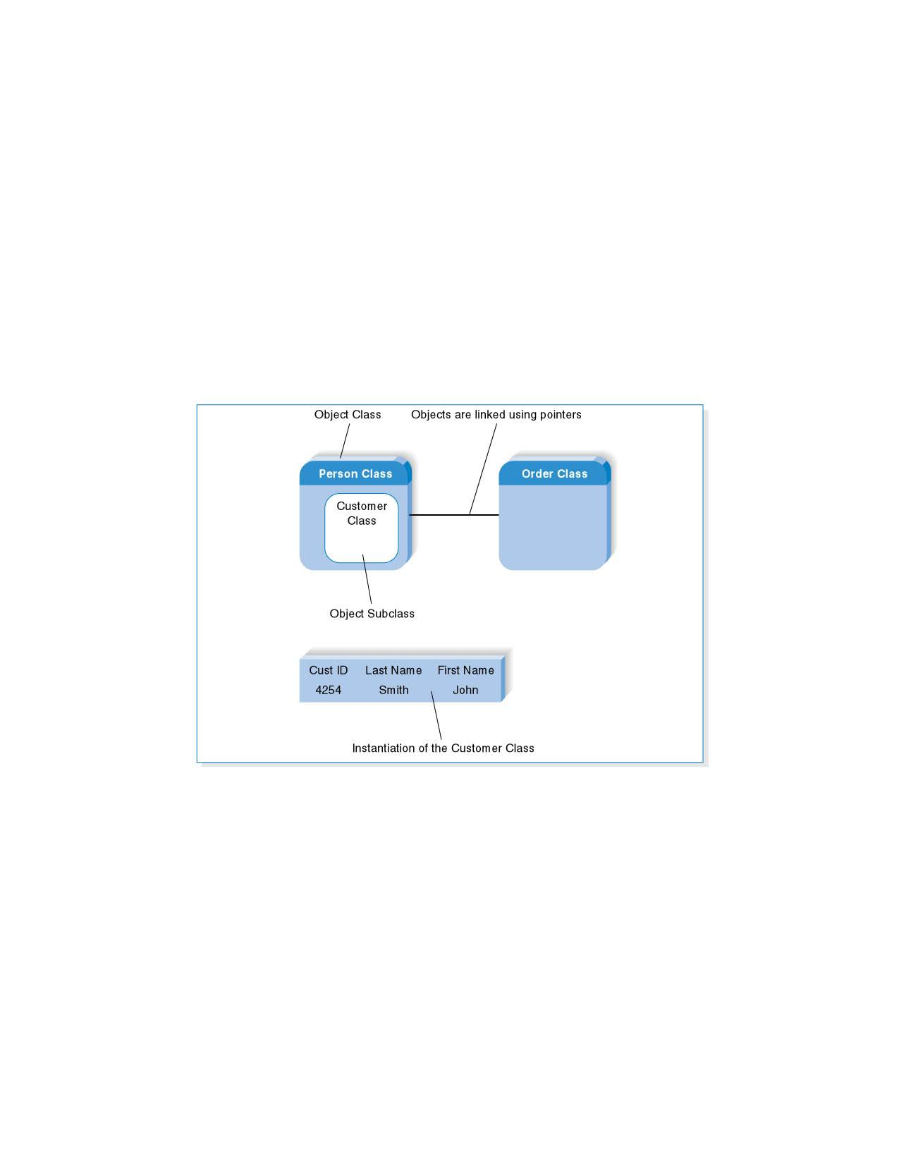
Object Database Example
11 - *
PowerPoint Presentation for Dennis, Wixom, & Roth Systems Analysis and Design, 4th Edition
Copyright 2009 © John Wiley & Sons, Inc. All rights reserved.

Slide 17
Multidimensional Database Concepts
Stores data for easy aggregation and manipulation across many dimensions
Used for data warehouses and data marts
Summary data is pre-calculated and stored for fast access
11 - *
PowerPoint Presentation for Dennis, Wixom, & Roth Systems Analysis and Design, 4th Edition
Copyright 2009 © John Wiley & Sons, Inc. All rights reserved.

Slide 18
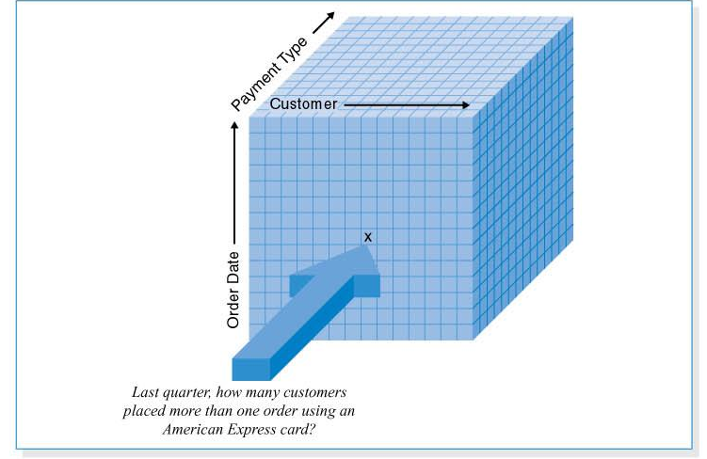
Multidimensional Database Example
11 - *
PowerPoint Presentation for Dennis, Wixom, & Roth Systems Analysis and Design, 4th Edition
Copyright 2009 © John Wiley & Sons, Inc. All rights reserved.

Slide 19
SELECTING A STORAGE FORMAT
11 - *
PowerPoint Presentation for Dennis, Wixom, & Roth Systems Analysis and Design, 4th Edition
Copyright 2009 © John Wiley & Sons, Inc. All rights reserved.
Notes:
*

Slide 20
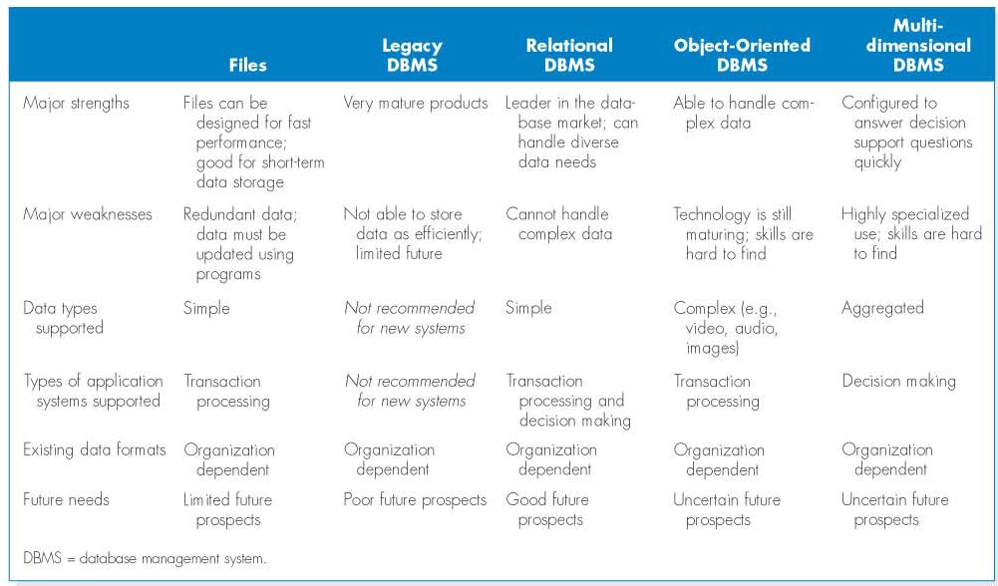
Comparing Data Storage Formats
11 - *
PowerPoint Presentation for Dennis, Wixom, & Roth Systems Analysis and Design, 4th Edition
Copyright 2009 © John Wiley & Sons, Inc. All rights reserved.

Slide 21
Selecting a Storage Format (continued)
Type of Application System: the best choices for these systems usually are relational databases and multidimensional databases as the formats can be configured
Existing Storage Formats: Data storage format should be selected primarily on the basis of the kind of data and application system being developed.
11 - *
PowerPoint Presentation for Dennis, Wixom, & Roth Systems Analysis and Design, 4th Edition
Copyright 2009 © John Wiley & Sons, Inc. All rights reserved.

Slide 22
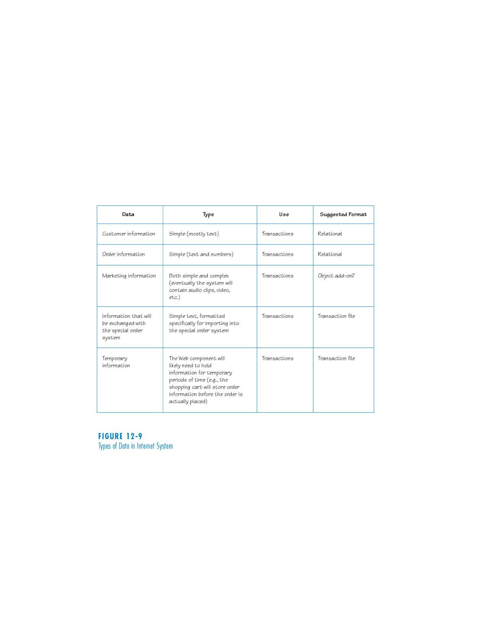
Types of Data in Internet Systems
11 - *
PowerPoint Presentation for Dennis, Wixom, & Roth Systems Analysis and Design, 4th Edition
Copyright 2009 © John Wiley & Sons, Inc. All rights reserved.

Slide 23
MOVING FROM LOGICAL TO PHYSICAL DATA MODELS
11 - *
PowerPoint Presentation for Dennis, Wixom, & Roth Systems Analysis and Design, 4th Edition
Copyright 2009 © John Wiley & Sons, Inc. All rights reserved.

Slide 24
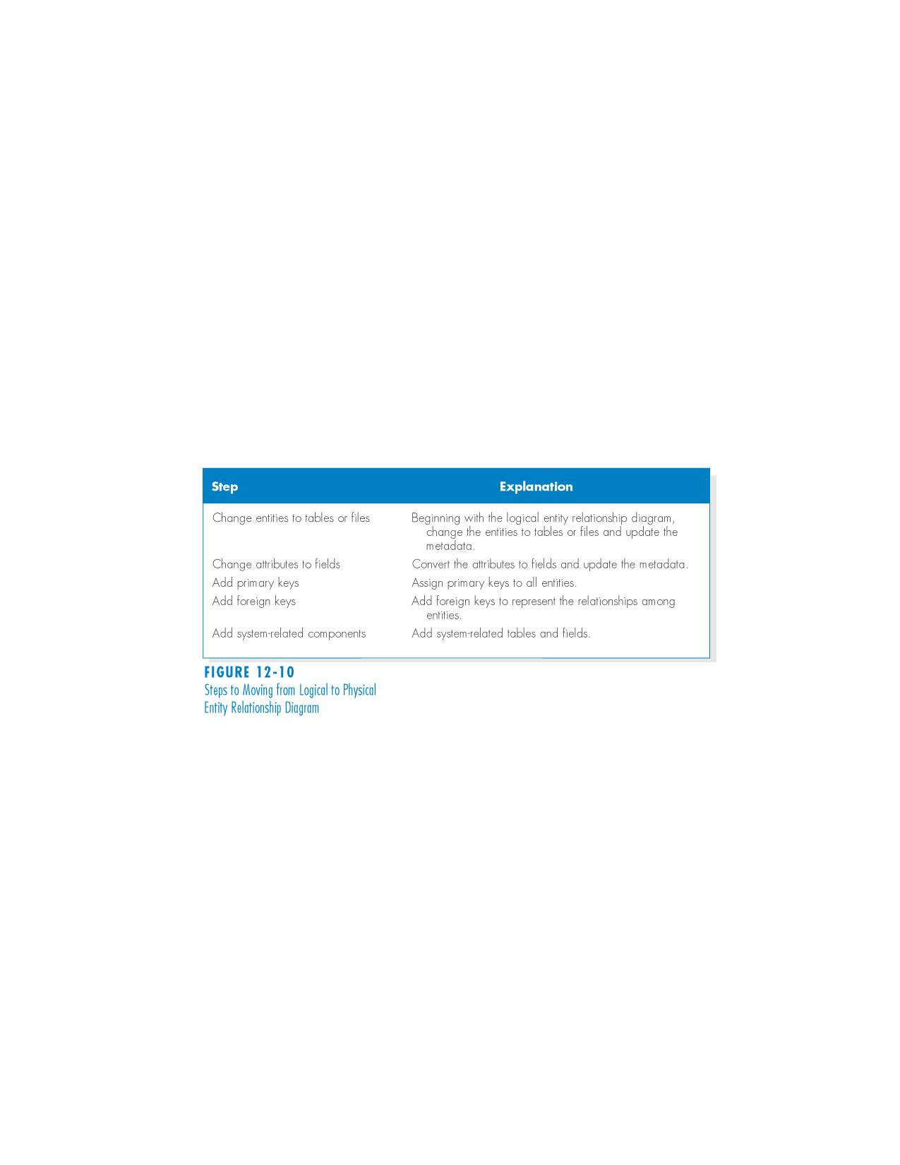
The Physical Entity Relationship Diagram: Five Steps
11 - *
PowerPoint Presentation for Dennis, Wixom, & Roth Systems Analysis and Design, 4th Edition
Copyright 2009 © John Wiley & Sons, Inc. All rights reserved.

Slide 25
Five Step Process
Step 1: Change Entities to Tables or Files
Step 2: Change Attributes to Fields
Step 3: Add Primary Keys
Step 4: Add Foreign Keys
Step 5: Add System-Related Components
11 - *
PowerPoint Presentation for Dennis, Wixom, & Roth Systems Analysis and Design, 4th Edition
Copyright 2009 © John Wiley & Sons, Inc. All rights reserved.

Slide 26
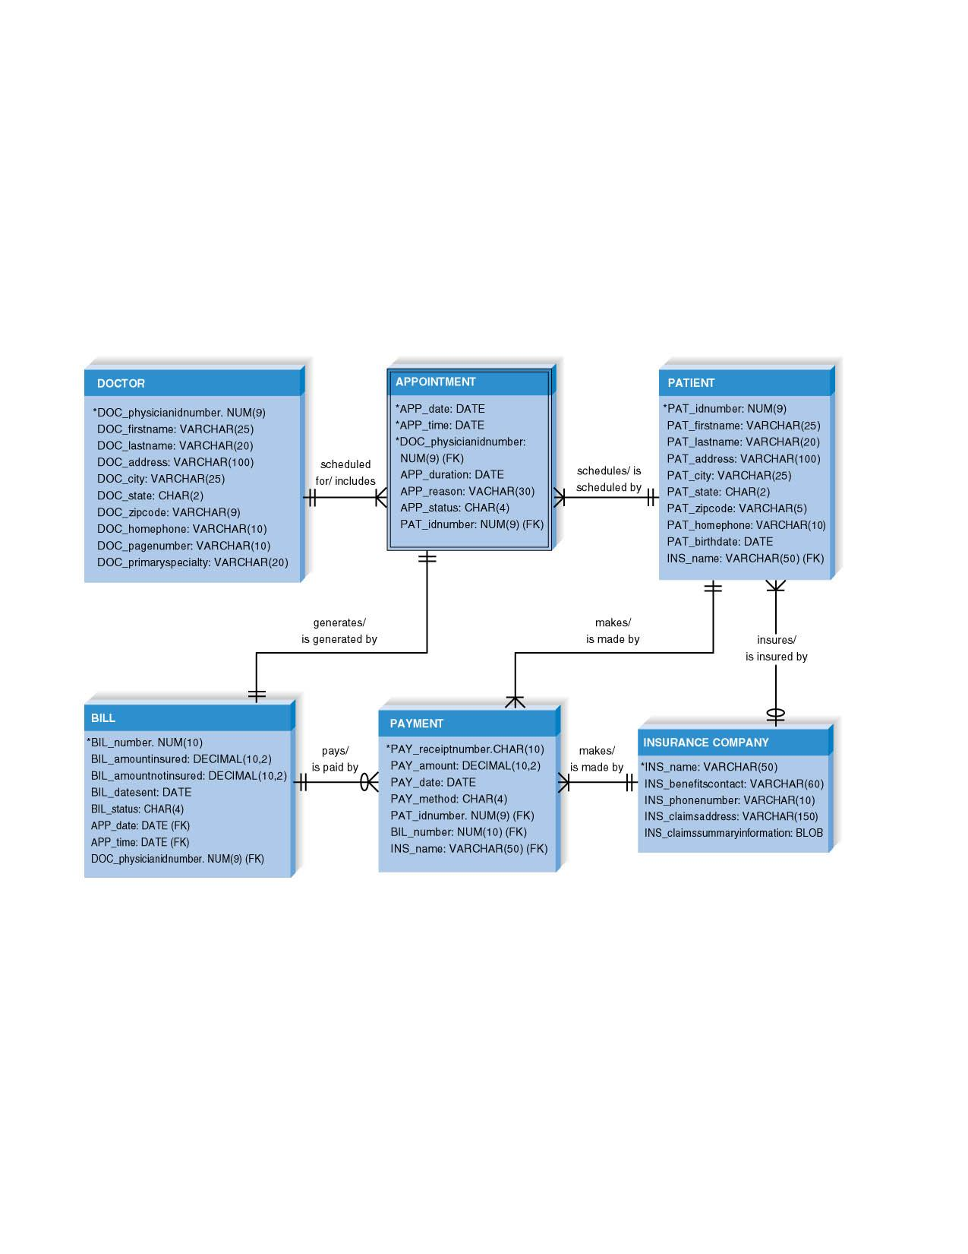
Doctor’s Office System Physical ERD
11 - *
PowerPoint Presentation for Dennis, Wixom, & Roth Systems Analysis and Design, 4th Edition
Copyright 2009 © John Wiley & Sons, Inc. All rights reserved.

Slide 27
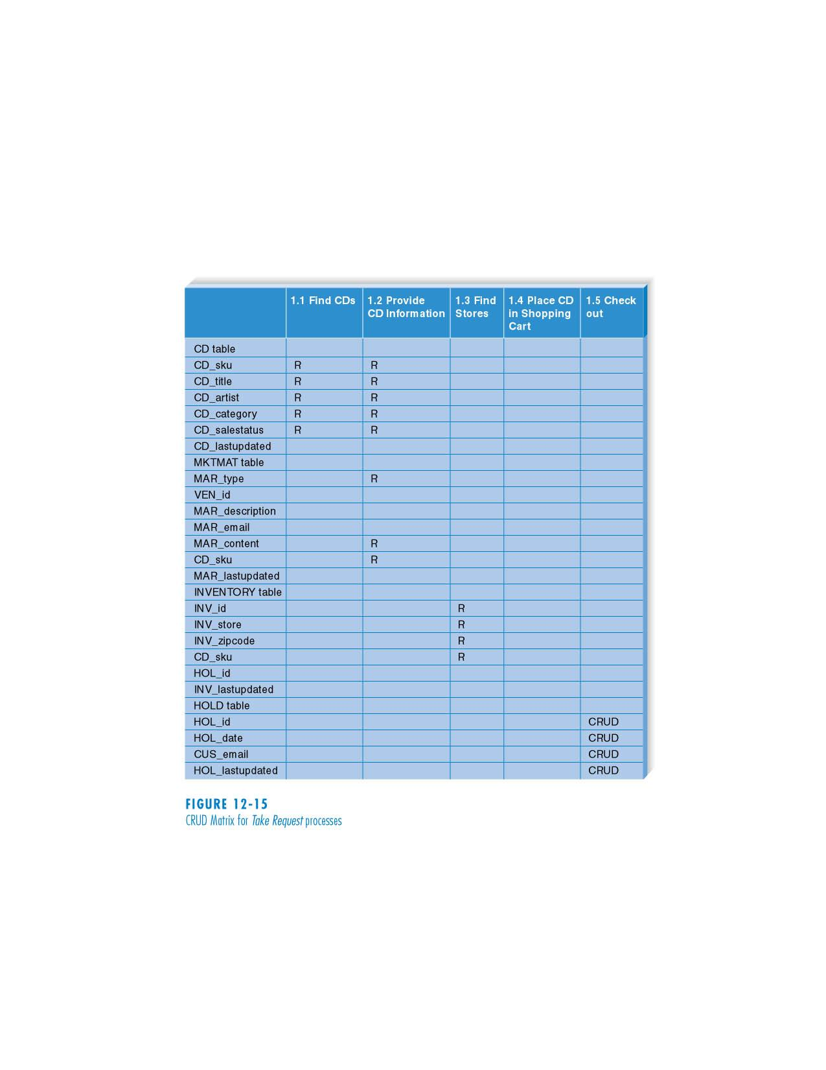
CRUD Matrix for Take Request Processes
11 - *
PowerPoint Presentation for Dennis, Wixom, & Roth Systems Analysis and Design, 4th Edition
Copyright 2009 © John Wiley & Sons, Inc. All rights reserved.

Slide 28
OPTIMIZING DATA STORAGE
11 - *
PowerPoint Presentation for Dennis, Wixom, & Roth Systems Analysis and Design, 4th Edition
Copyright 2009 © John Wiley & Sons, Inc. All rights reserved.

Slide 29
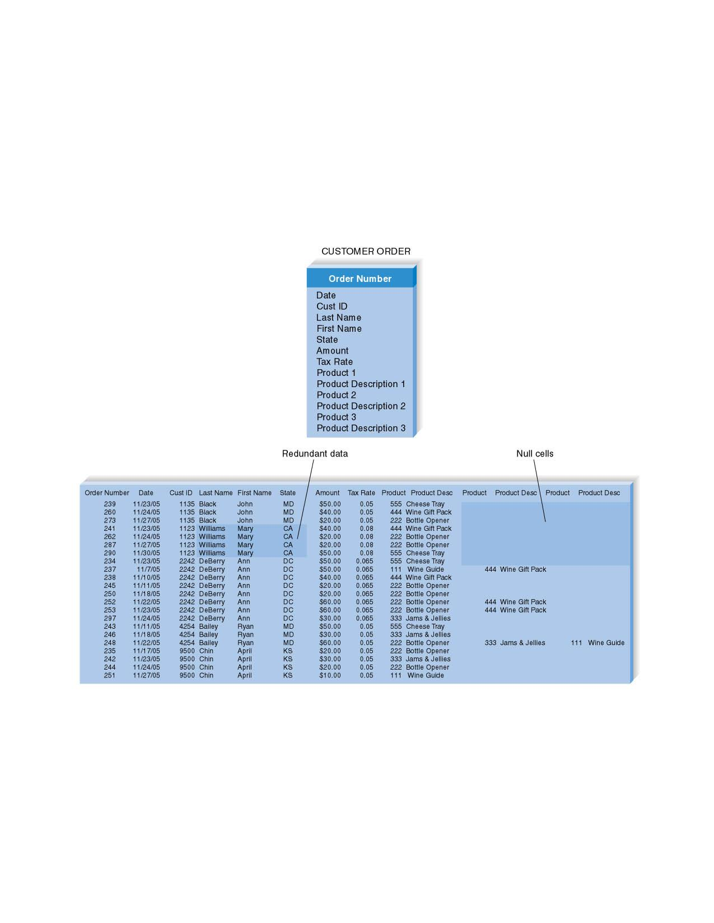
Optimizing Storage Efficiency
11 - *
PowerPoint Presentation for Dennis, Wixom, & Roth Systems Analysis and Design, 4th Edition
Copyright 2009 © John Wiley & Sons, Inc. All rights reserved.

Slide 30
Optimizing Access Speed
After you have optimized your data model design for data storage efficiency, the end result is data that is spread out across a number of tables
There are several techniques that the project team can use to try to speed up access to data:
  Denormalization
  Clustering
  Indexing
  Estimating the size of data for hardware planning purposes
11 - *
PowerPoint Presentation for Dennis, Wixom, & Roth Systems Analysis and Design, 4th Edition
Copyright 2009 © John Wiley & Sons, Inc. All rights reserved.

Slide 31
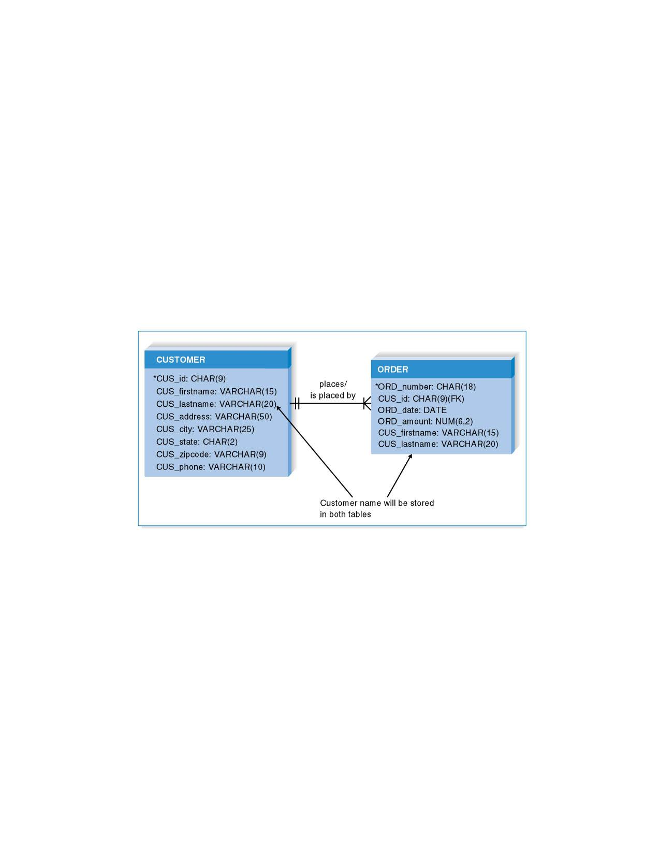
Denormalized Data Model
11 - *
PowerPoint Presentation for Dennis, Wixom, & Roth Systems Analysis and Design, 4th Edition
Copyright 2009 © John Wiley & Sons, Inc. All rights reserved.

Slide 32
Clustering
Reduce the number of times storage must be accessed by physically placing like records close together.
  Intrafile clustering – similar records in a table are stored together
  Interfile clustering – combine records from more that one table that are typically retrieved together
11 - *
PowerPoint Presentation for Dennis, Wixom, & Roth Systems Analysis and Design, 4th Edition
Copyright 2009 © John Wiley & Sons, Inc. All rights reserved.

Slide 33
Indexing
A minitable that contains values from one or more fields in a table and the location of the values within the table
Similar to the index of a book.
11 - *
PowerPoint Presentation for Dennis, Wixom, & Roth Systems Analysis and Design, 4th Edition
Copyright 2009 © John Wiley & Sons, Inc. All rights reserved.

Slide 34
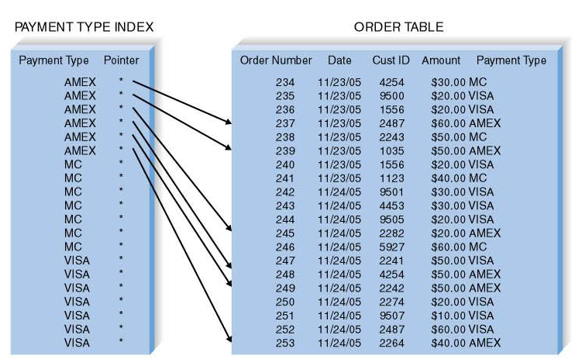
Payment Type Index
11 - *
PowerPoint Presentation for Dennis, Wixom, & Roth Systems Analysis and Design, 4th Edition
Copyright 2009 © John Wiley & Sons, Inc. All rights reserved.

Slide 35
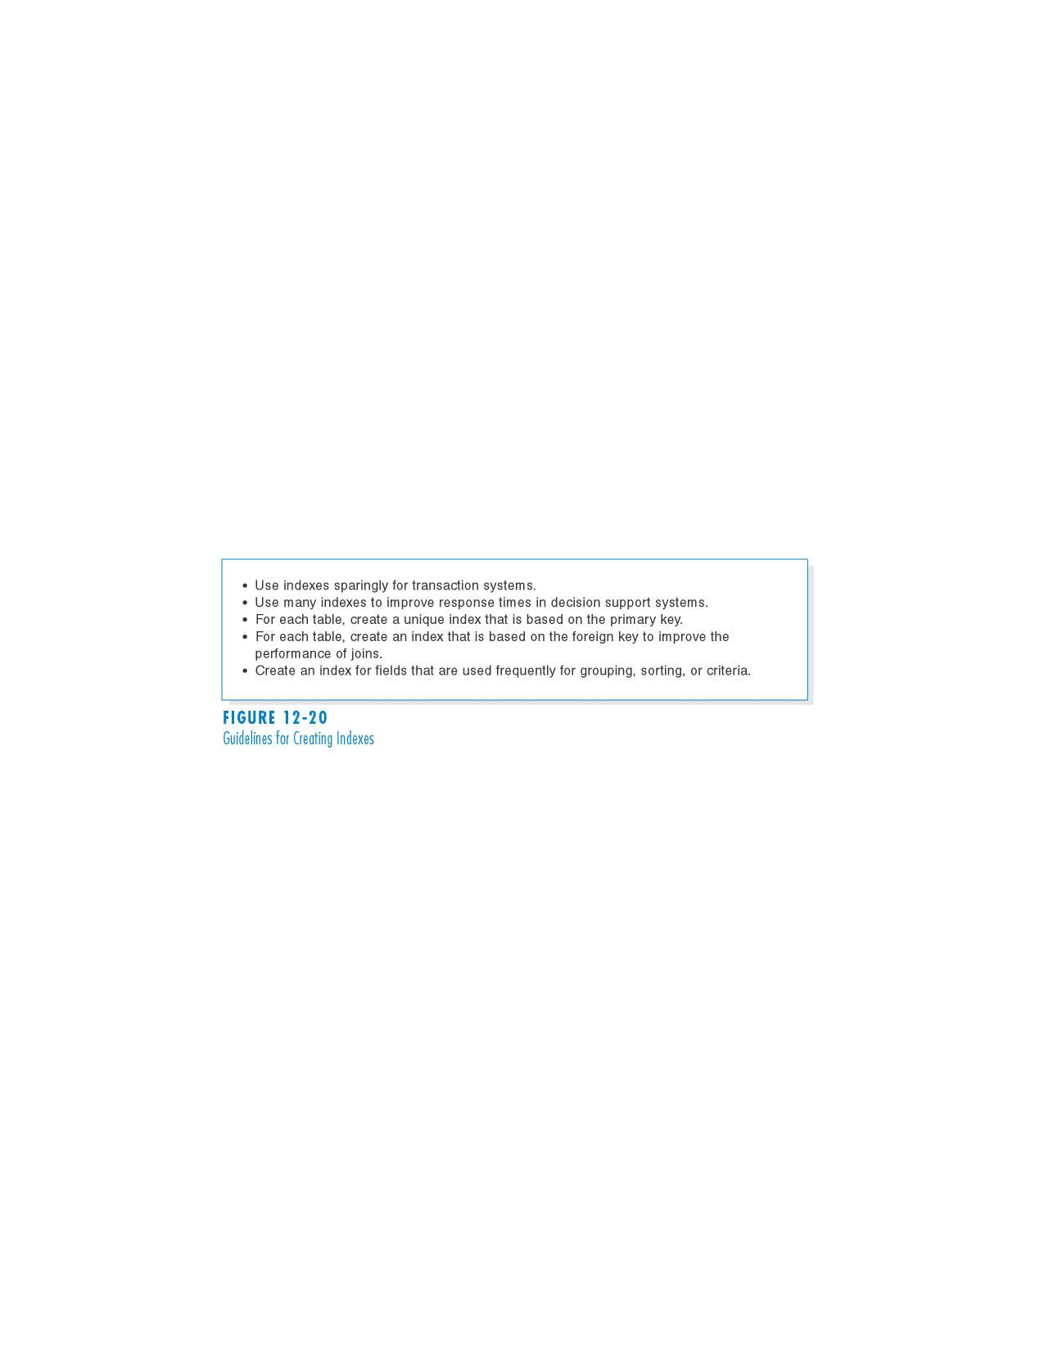
Guidelines for Creating Indexes
11 - *
PowerPoint Presentation for Dennis, Wixom, & Roth Systems Analysis and Design, 4th Edition
Copyright 2009 © John Wiley & Sons, Inc. All rights reserved.

Slide 36
Estimating Storage Size
Raw data – sum of the average widths of all fields in a table.
Calculate overhead requirements based on DBMS vendor recommendations
Estimate initial number of records
Estimate growth rate of records
11 - *
PowerPoint Presentation for Dennis, Wixom, & Roth Systems Analysis and Design, 4th Edition
Copyright 2009 © John Wiley & Sons, Inc. All rights reserved.

Slide 37
Volumetrics – Estimating Data Storage Size
Raw data – sum of the average widths of all fields in a table.
Calculate overhead requirements based on DBMS vendor recommendations
Estimate initial number of records
Estimate growth rate of records
11 - *
PowerPoint Presentation for Dennis, Wixom, & Roth Systems Analysis and Design, 4th Edition
Copyright 2009 © John Wiley & Sons, Inc. All rights reserved.

Slide 38
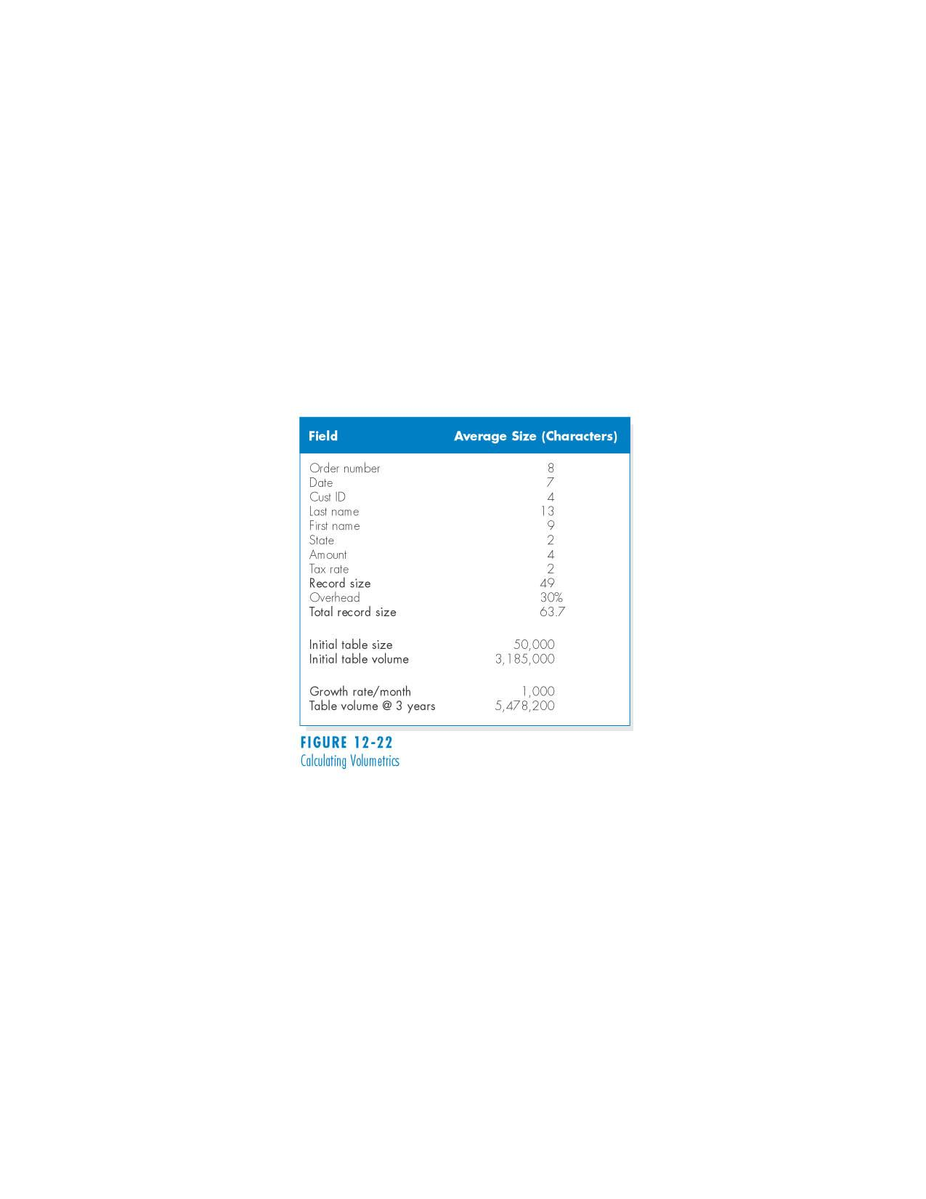
Calculating Volumetrics
11 - *
PowerPoint Presentation for Dennis, Wixom, & Roth Systems Analysis and Design, 4th Edition
Copyright 2009 © John Wiley & Sons, Inc. All rights reserved.

Slide 39
Summary
Files are electronic lists of data generally of five types: master, look-up, transaction, audit, and history.
A database is a collection of groupings of information and a DBMS is software that creates and manipulates these.
There are a number of methods for optimizing data access speed and data storage efficiency, though the designers may have to make tradeoffs between these goals.
Physical ERDs contain references to how data will be stored in a file or database table.
11 - *
PowerPoint Presentation for Dennis, Wixom, & Roth Systems Analysis and Design, 4th Edition
Copyright 2009 © John Wiley & Sons, Inc. All rights reserved.

Slide 40
Copyright © 2009
John Wiley & Sons, Inc.
All rights reserved. Reproduction or translation of this work beyond that permitted in Section 117 of the 1976 United States Copyright Act without the express written permission of the copyright owner is unlawful.
Request for further information should be addressed to the Permissions Department, John Wiley & Sons, Inc.
The purchaser may make back-up copies for his/her own use only and not for redistribution or resale.
The Publisher assumes no responsibility for errors, omissions, or damages, caused by the use of these programs or from the use of the information contained herein.
11 - *
PowerPoint Presentation for Dennis, Wixom, & Roth Systems Analysis and Design, 4th Edition
Copyright 2009 © John Wiley & Sons, Inc. All rights reserved.
Notes:
*

