Slide 1
Systems Analysis and Design
Alan Dennis, Barbara Haley Wixom, and Roberta Roth
John Wiley & Sons, Inc.
Slides by Candace S. Garrod
Red Rocks Community College

Slide 2
Program Design
Chapter 10

Slide 3
Key Definitions
Program design - creating instructions for the programmers
The top-down, modular approach - begin with the “big picture” and gradually add detail
Program design document – all structure charts and specifications needed by programmers to implement the system

Slide 4
MOVING FROM LOGICAL TO PHYSICAL PROCESS MODELS
Analysis phase – focus on logical processes and data flows
Design phase – create physical process models showing “how” the final system will work
Physical process models convey the “system view” of the new system

Slide 5
The Physical Data Flow Diagram
The physical DFD contains the same components as the logical DFD, and the same rules apply
There are five steps to perform to make the transition to the physical DFD

Slide 6
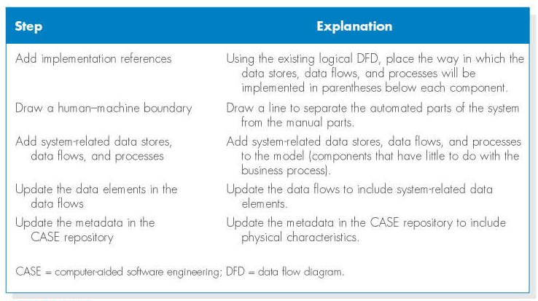
Steps to Create the Physical Data Flow Diagram

Slide 7
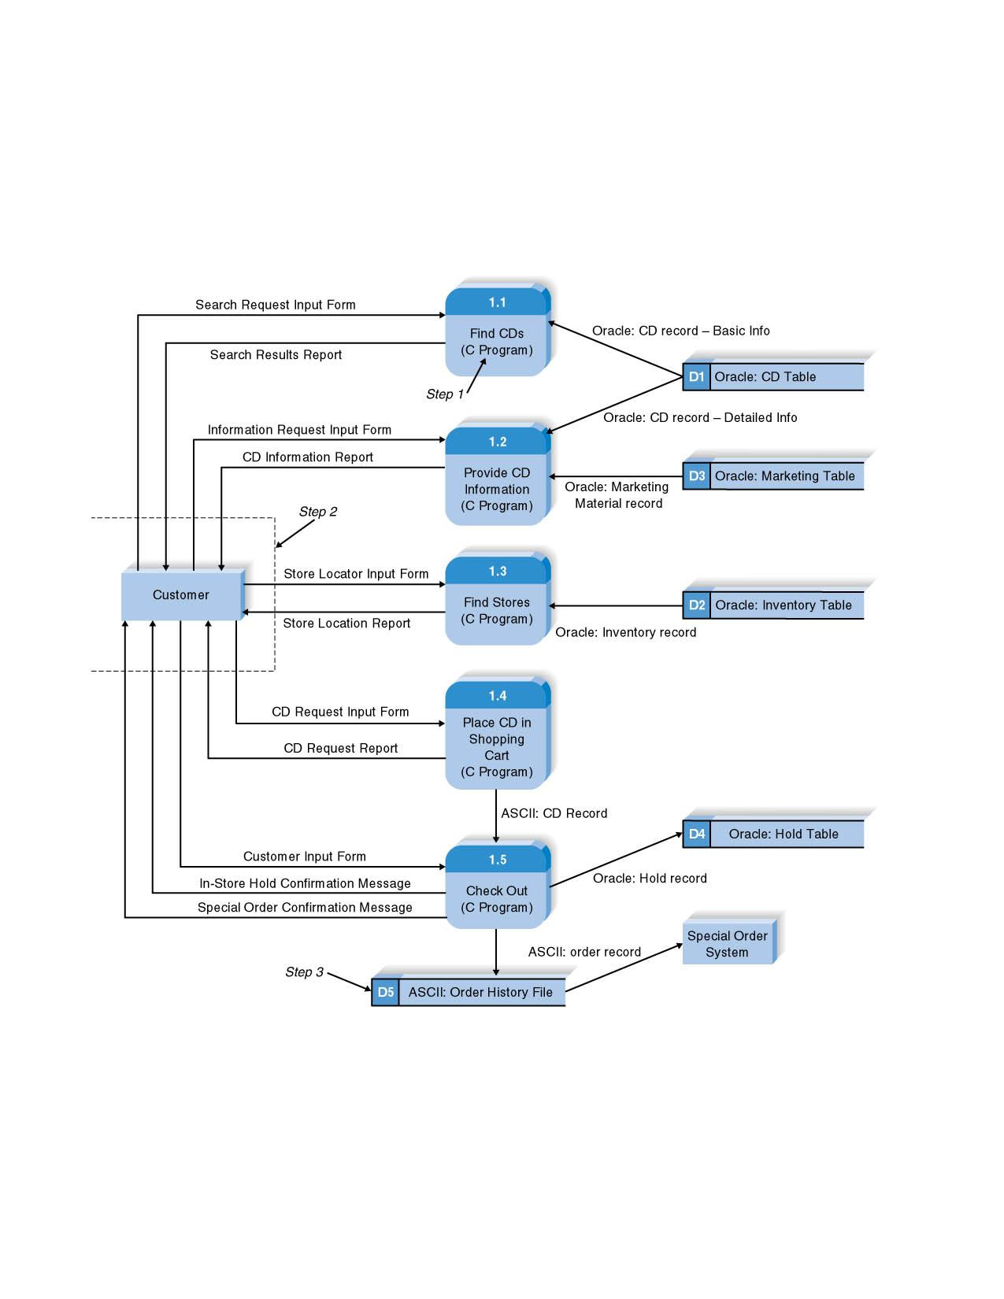
The Physical Data Flow Diagram (The How)

Slide 8
DESIGNING PROGRAMS

Slide 9
Designing Programs
Resist temptation to write code to quickly
System quality is enhanced with top-down, modular design
Program design document is the final deliverable for this task

Slide 10

Using a Top-Down Modular Approach

Slide 11
STRUCTURE CHART

Slide 12
The Structure Chart
Important program design technique
Shows all components of code in a hierarchical format
  Sequence
  Selection
  Iteration

Slide 13
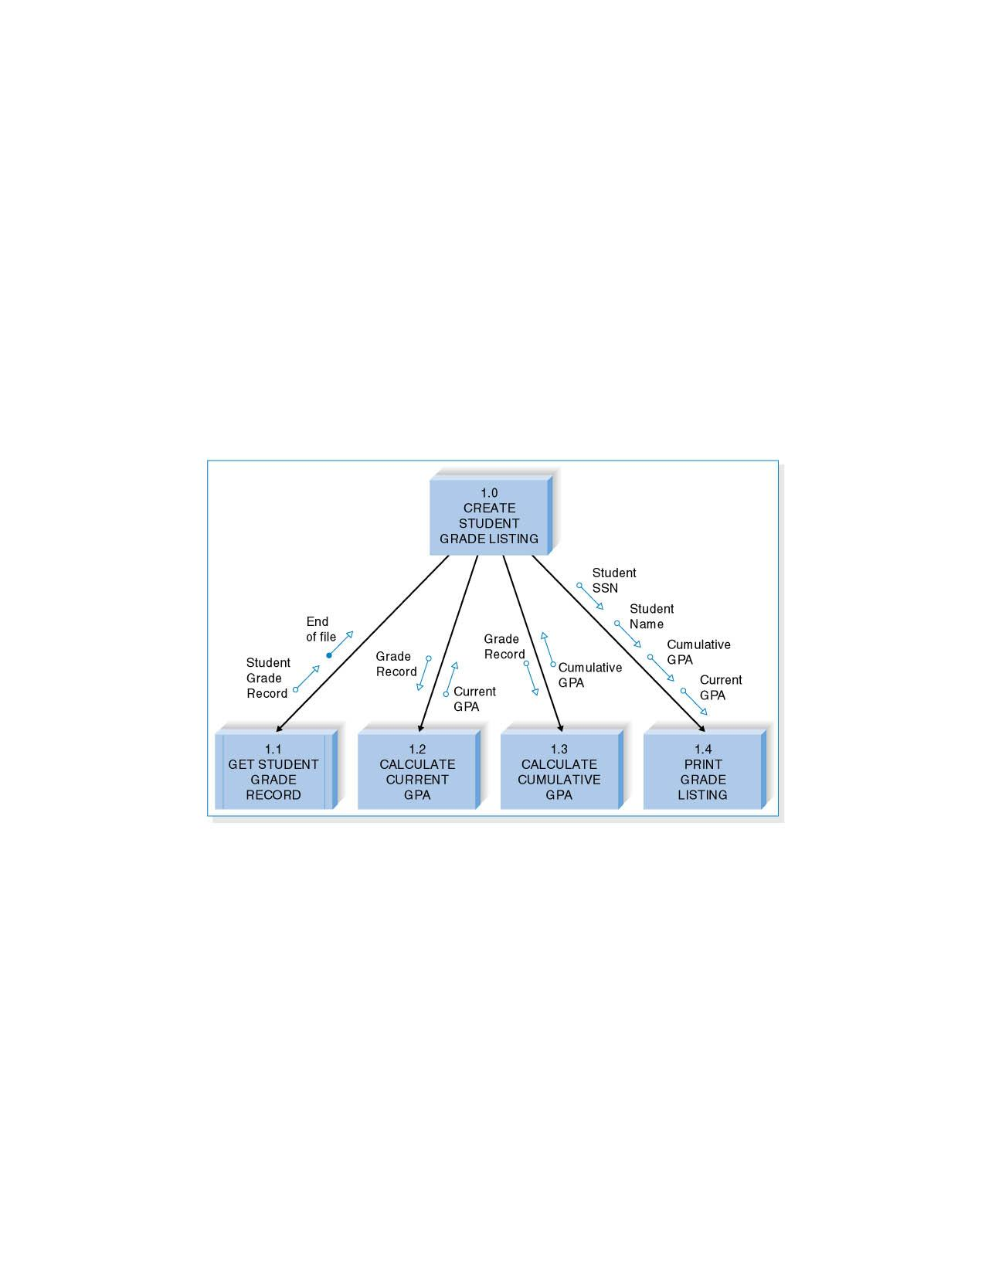
Structure Chart Example

Slide 14
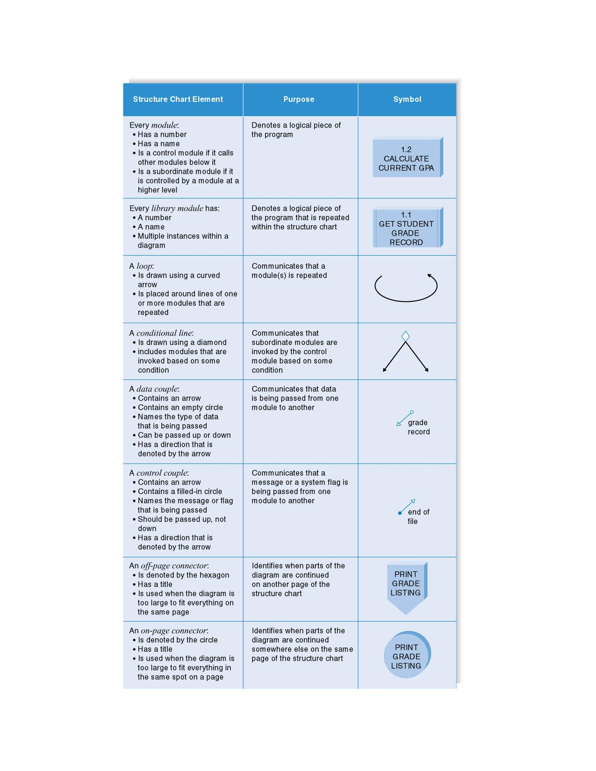
Structure Chart Elements

Slide 15
Building the Structure Chart
Processes in the DFD tend to represent one module on the structure chart
  Afferent processes – provide inputs to system
  Central processes – perform critical system operations
  Efferent processes – handle system outputs
The DFD leveling can correspond to the structure chart hierarchy

Slide 16
Types of Structure Charts
Transaction structure – control module calls subordinate modules, each of which handles a particular transaction
  Many afferent processes
  Few efferent processes
  Higher up levels of structure chart
  Using inputs to create a new output

Slide 17
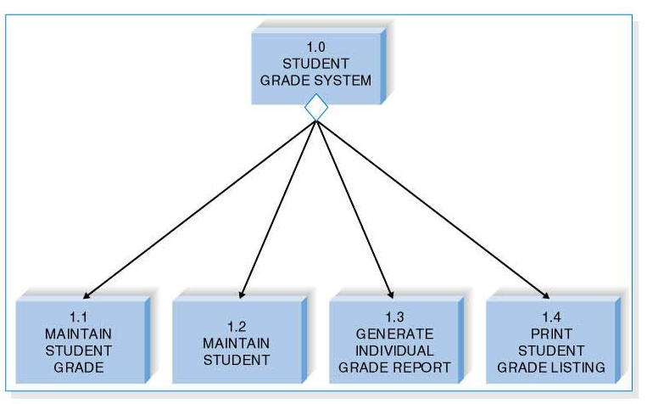
Transaction Structure

Slide 18
Transform Structure
This structure has a control module that calls several subordinate modules in sequence after which something “happens.”
These modules are related because together they form a process that transforms some input into an output.

Slide 19
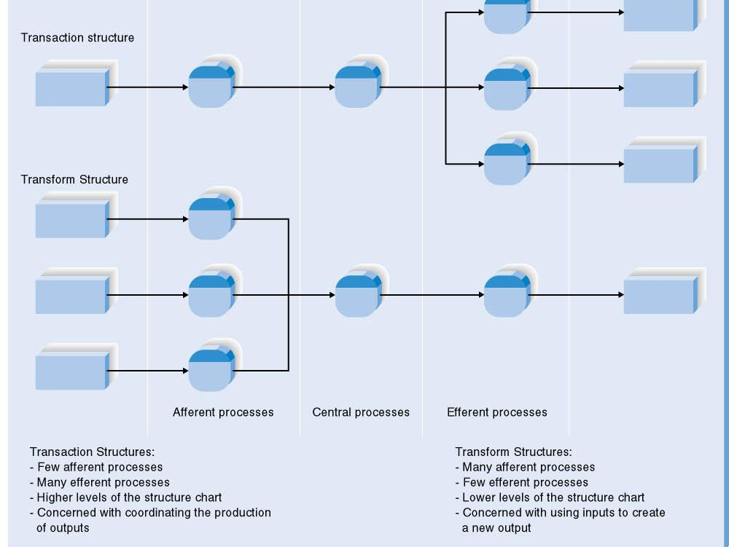
Transform versus Transaction Structures

Slide 20
Steps in Building the Structure Chart
1. Identify top level modules and decompose them into lower levels
2. Add control connections
3. Add couples
4. Review and revise again and again until complete

Slide 21
Design Guidelines
High quality structure charts result in programs that are modular, reusable and easy to implement.
Measures include:
  Cohesion
  Coupling
  Appropriate levels of fan-in and fan-out

Slide 22
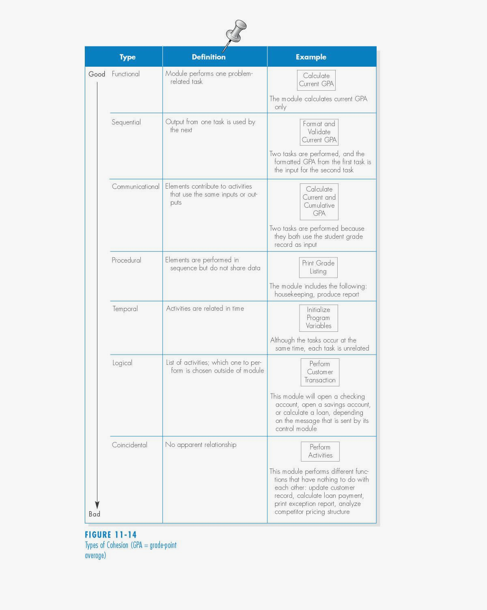
Types of Cohesion (GPA = grade point average)

Slide 23
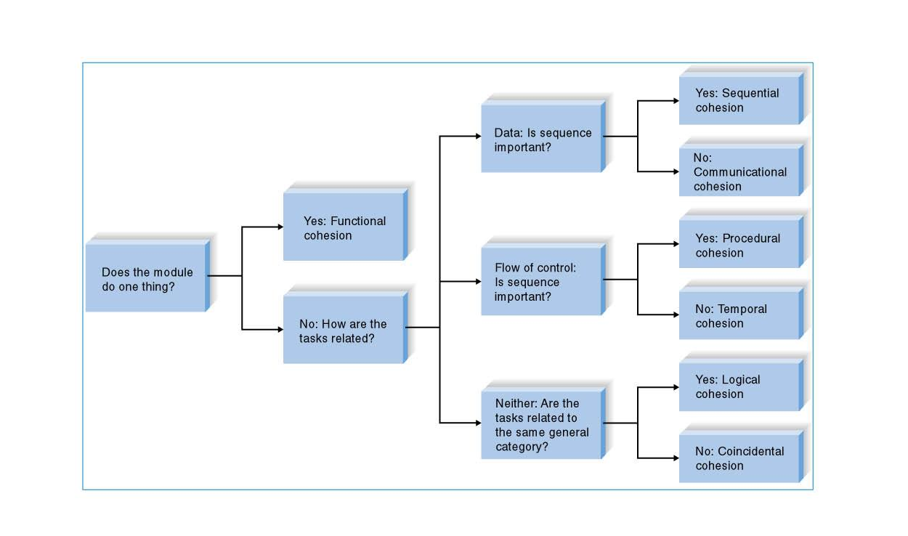
Cohesion Decision Tree
(Adopted From Page-Jones, 1980)

Slide 24
Factoring
Process of dealing with “low” cohesion
Separates tasks into different modules
Reduces use of control flags

Slide 25
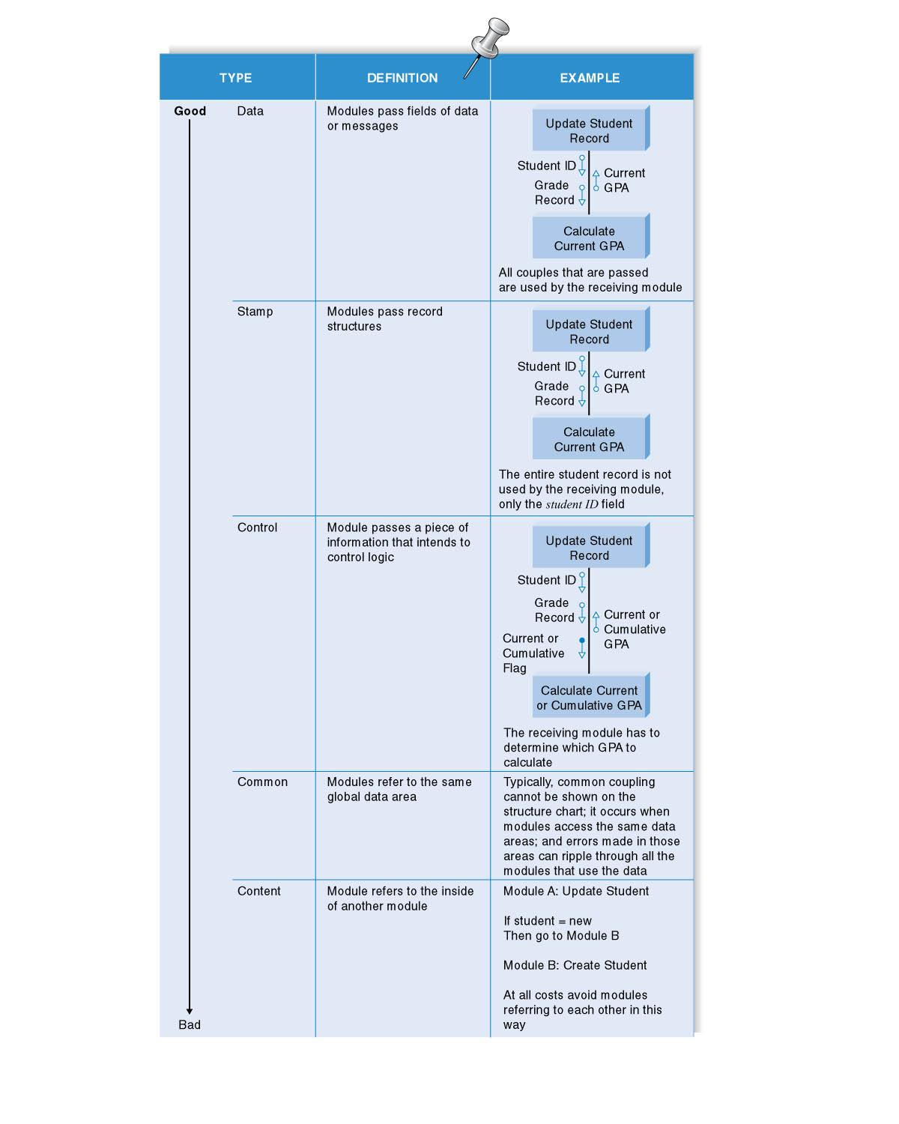
Types of Coupling

Slide 26
Your Turn
What, if anything, happens to coupling when you create modules that are more cohesive?
What, if anything happens to the cohesiveness of modules when you lower the coupling among them?

Slide 27
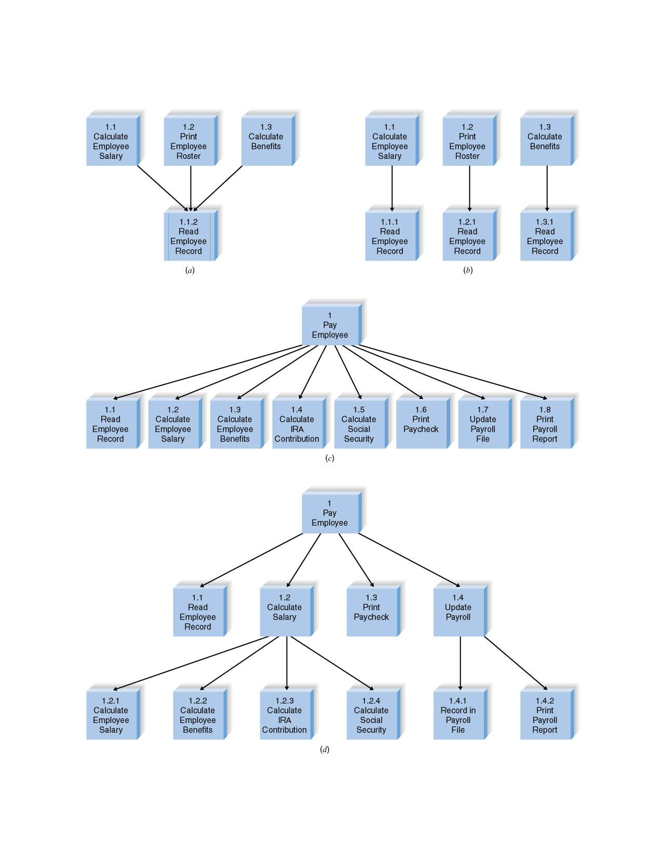
Examples of Fan-in and Fan-out
1.2
Print
Employee
Roster

Slide 28
Quality Checklist
1. Library modules have been created where ever possible
2. The diagram has a high fan-in structure
3. Control modules have no more than 7 subordinates
4. Each module performs only one function (high cohesion)
5. Modules sparingly share information (loose coupling)
6. Data couples that are passed are actually used by the accepting module
7. Control couples are passed from “low to high”
8. Each module has a reasonable amount of code associated with it

Slide 29
PROGRAM SPECIFICATION

Slide 30
Program Specifications Content
No standard approach
Include program information
Note events that trigger actions
List inputs and outputs
Include pseudocode
Present additional notes and comments

Slide 31
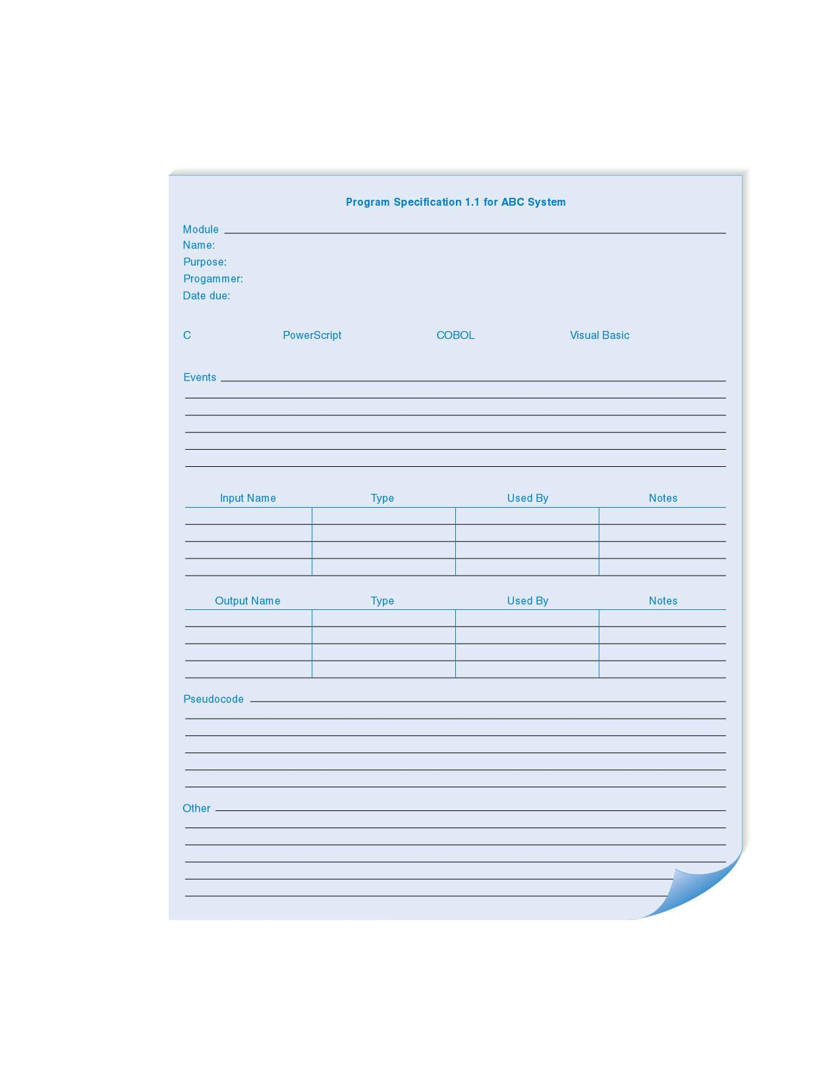
Program Specification Form

Slide 32

Pseudocode Example

Slide 33
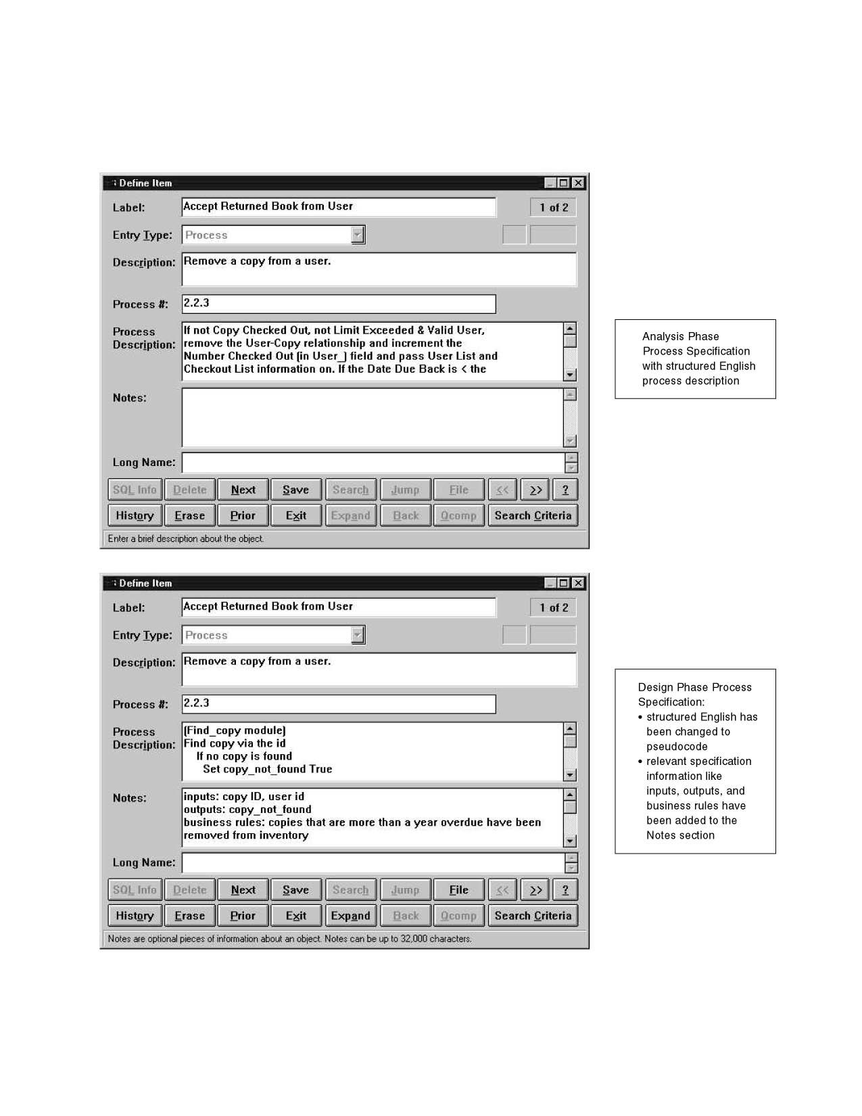
Process Description – Analysis and Design

Slide 34
Summary
The structure chart shows all of the functional components needed in the program at a high level. Components of the structure chart show sequence, selection, and iteration
Follow design guidelines regarding cohesion, coupling, and fan-in/fan-out.
Prepare detailed specifications to programmers including pseudocode to show important programming structures.

Slide 35
Copyright © 2009
John Wiley & Sons, Inc.
All rights reserved. Reproduction or translation of this work beyond that permitted in Section 117 of the 1976 United States Copyright Act without the express written permission of the copyright owner is unlawful.
Request for further information should be addressed to the Permissions Department, John Wiley & Sons, Inc.
The purchaser may make back-up copies for his/her own use only and not for redistribution or resale.
The Publisher assumes no responsibility for errors, omissions, or damages, caused by the use of these programs or from the use of the information contained herein.

