Slide 1
Systems Analysis and Design Third Edition
Alan Dennis, Barbara Haley Wixom, and Roberta Roth John Wiley & Sons, Inc.
Slides by Candace S. Garrod
Red Rocks Community College

Slide 2
Use Case Analysis
Chapter 4

Slide 3
Key Ideas
Use cases are a text-based method of describing and documenting complex processes
Use cases add detail to the requirements outlined in the requirement definition
Systems analysts work with users to develop use cases
Systems analysts develop process and data models later based on the use cases

Slide 4
Use Cases

Slide 5
Roles of Use Cases
A use case is a set of activities that produce some output result
Describes how the system reacts to an event that triggers the system
Trigger -- event that causes the use case to be executed
Event-driven modeling – everything in the system is a response to some triggering event

Slide 6
Role of Use Cases
All possible responses to the event are documented
Use cases are helpful when the situation is complicated

Slide 7
Elements of a Use Case
Basic information
Name, number and brief description
Trigger – event that causes the use case to being
External trigger – some from outside the system
Temporal triggers – time-based occurrences
Viewpoint of the use cases should be consistent
Major inputs and outputs
Sources and destinations
Goal is to be all inclusive
Details
Steps performed and the data inputs and outputs

Slide 8
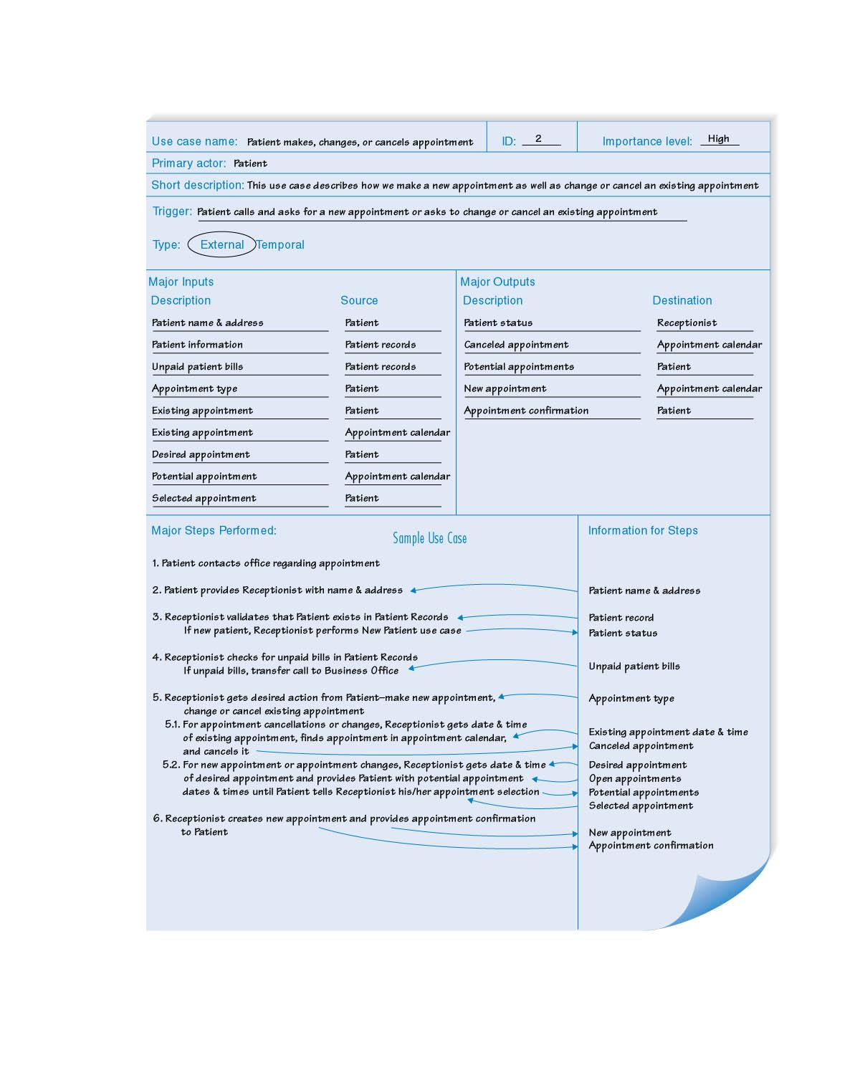
Sample Use Case

Slide 9
Building Use Cases

Slide 10
Process of Developing Use Cases
Identify the major use cases
Identify the major steps within each use case
Identify elements within steps
Confirm the use case
Cycle through the above steps iteratively

Slide 11
Step 1: Identify the major use cases
Activities
Typical Questions Asked
Start a use case form for each use case
If more than nine, group into packages
Ask who, what, and where about the tasks and their inputs and outputs:
What are the major tasks performed?
What triggers this task? What tells you to perform this task?
What information/forms/reports do you need to perform this task?
Who gives you these information/forms/reports?
What information/forms/reports does this produce and where do they go?

Slide 12
Sample List of Events-Actions Based on Requirements Definition

Slide 13
Step 2: Identify the major steps within each use case
Activities
Typical Questions Asked
For each use case, fill in the major steps needed to process the inputs and produce the outputs
Ask how about each use case:
How do you produce this report?
How do you change the information on the report?
How do you process forms?
What tools do you use to do this step (e.g., on paper, by email, by phone)?

Slide 14
Step 3: Identify elements within steps
Activities
Typical Questions Asked
For each step, identify its triggers and its inputs and outputs
Ask how about each step
How does the person know when to perform this step?
What forms/reports/data does this step produce?
What forms/reports/data does this step need?
What happens when this form/report/data is not available?

Slide 15
Step 4: Confirm the use case
Activities
Typical Questions Asked
For each use case, validate that it is correct and complete
Ask the user to execute the process using the written steps in the use case – that is, have the user role-play the use case

Slide 16
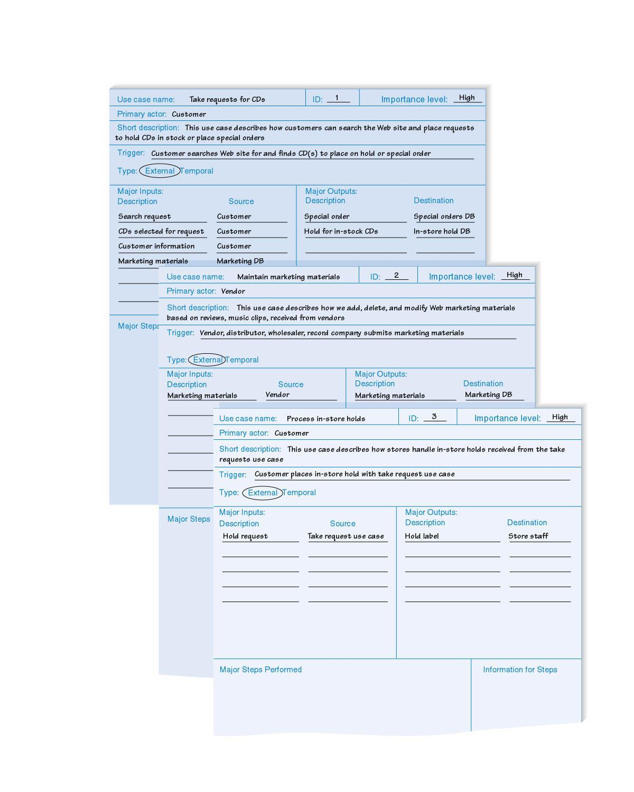
CD SELECTIONS

Slide 17
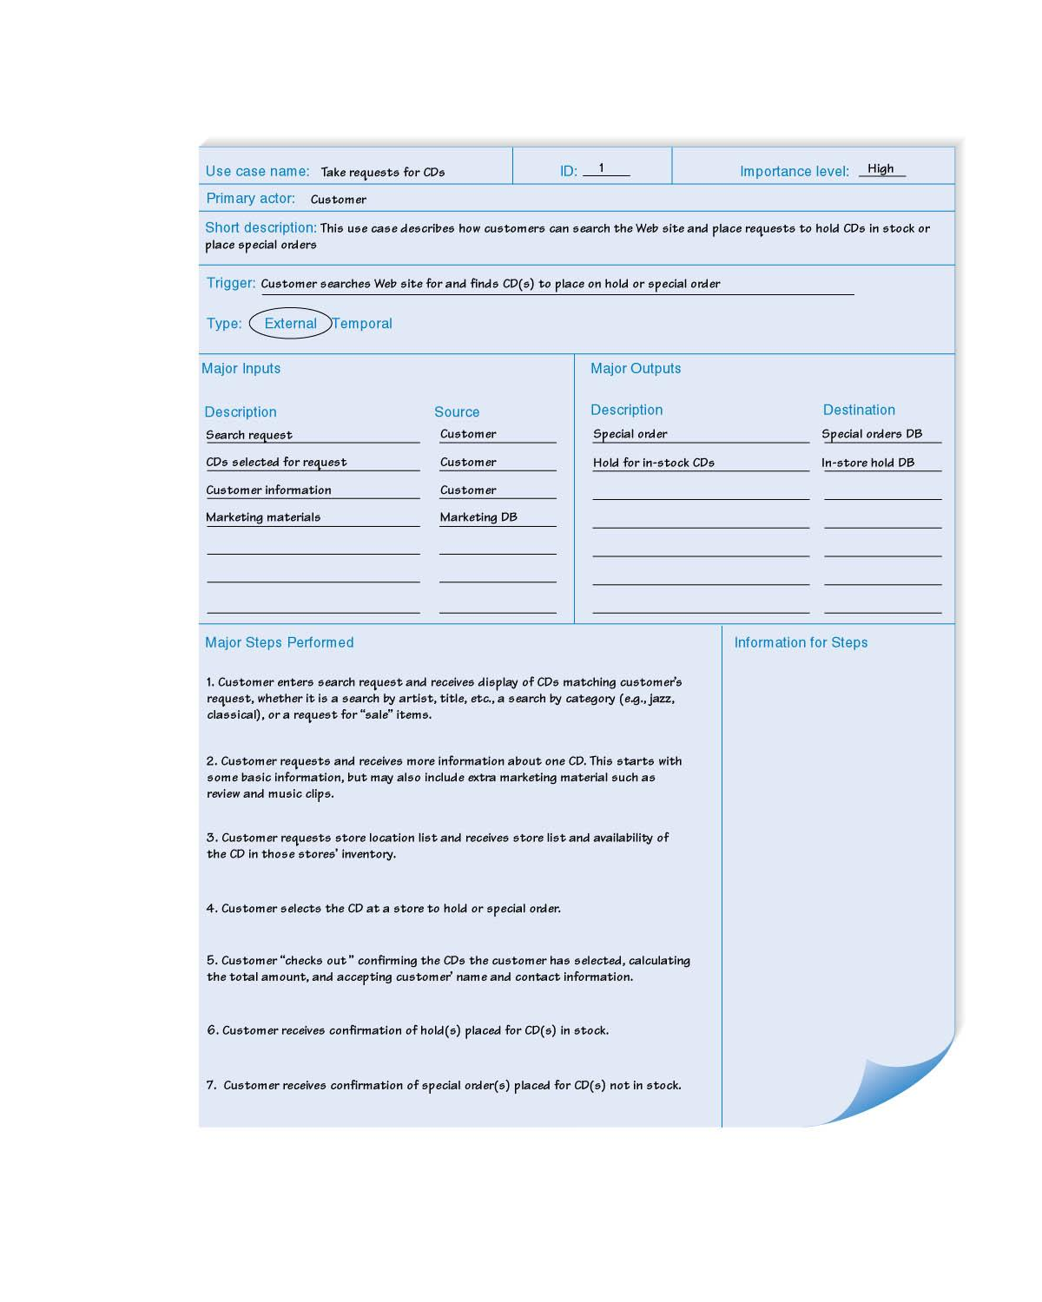
CD SELECTIONS

Slide 18
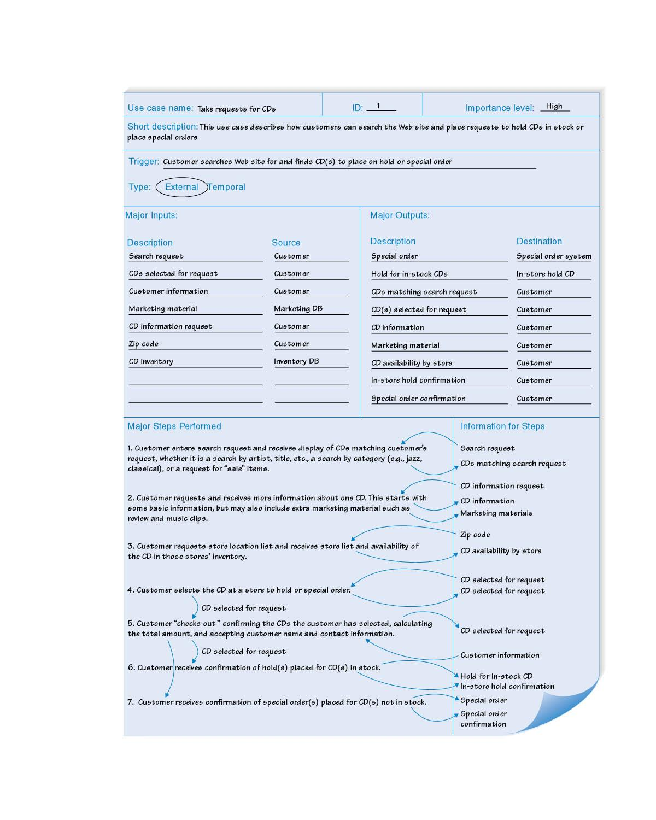
CD SELECTIONS

Slide 19
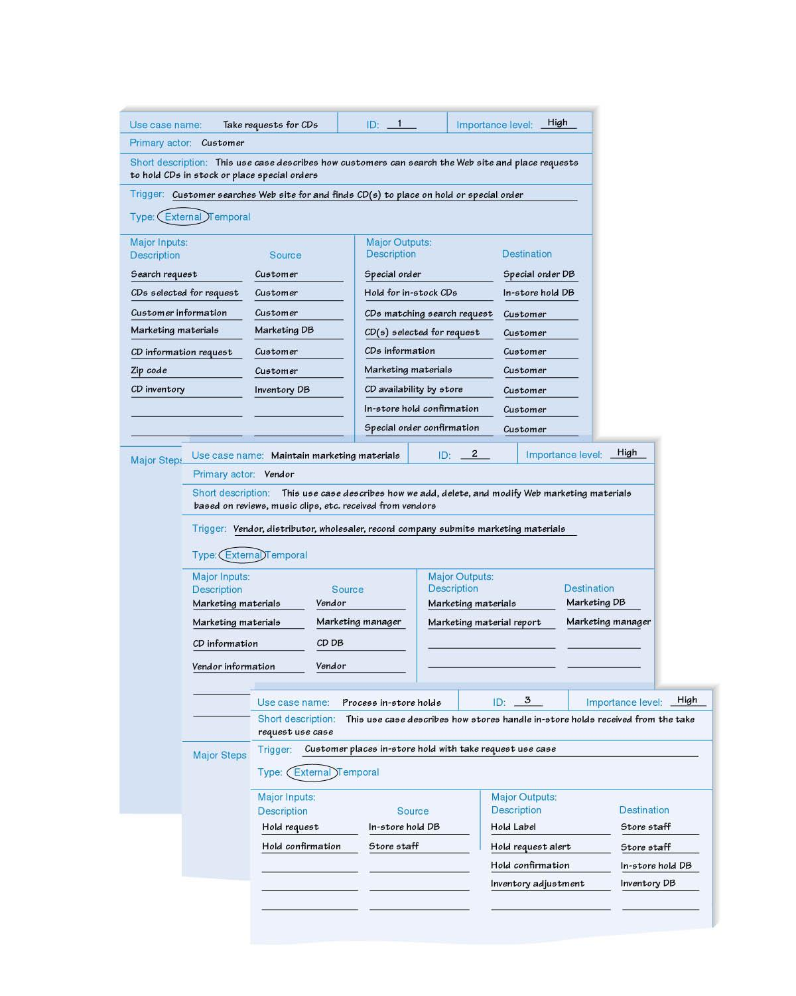
CD SELECTIONS

Slide 20
Summary
Use cases contain all the information needed for process modeling, but are easier for users to comprehend
Use cases are created in an iterative cycle of steps until they are considered accurate and complete

Slide 21
Copyright © 2009 John Wiley & Sons, Inc.
All rights reserved. Reproduction or translation of this work beyond that permitted in Section 117 of the 1976 United States Copyright Act without the express written permission of the copyright owner is unlawful.
Request for further information should be addressed to the Permissions Department, John Wiley & Sons, Inc.
The purchaser may make back-up copies for his/her own use only and not for redistribution or resale.
The Publisher assumes no responsibility for errors, omissions, or damages, caused by the use of these programs or from the use of the information contained herein.

