Slide 1
Chapter Eleven
Managing Individual
Differences & Behavior:
Supervising People as People
McGraw-Hill/Irwin
Copyright © 2013 by The McGraw-Hill Companies, Inc. All rights reserved.

Slide 2
Major Questions You Should Be Able to Answer
11.1 In the hiring process, do employers care about one’s personality and individual traits?
11.2 How do the hidden aspects of individuals-their values and attitudes-affect employee behavior?
11.3 What are the distortions of perception that can cloud one’s judgment?

Slide 3
Major Questions You Should Be Able to Answer
11.4 Is it important for managers to pay attention to employee attitudes?
11.5 What trends in workplace diversity should managers be aware of?
11.6 What causes workplace stress, and how can it be reduced?

Slide 4

Personality & Individual Behavior
Personality
  the stable psychological traits and behavioral attributes that give a person his or her identity

Slide 5
The Big Five Personality Dimensions
Extroversion
  how outgoing, talkative, sociable, and assertive a person is
Agreeableness
  how trusting, good-natured, cooperative, and soft-hearted one is
Conscientiousness
  how dependable, responsible, achievement-oriented, and persistent one is

Slide 6
The Big Five Personality Dimensions
Emotional stability
  how relaxed, secure, and unworried one is
Openness to experience
  how intellectual, imaginative, curious, and broad-minded one is

Slide 7
Question?
Susan loves going to parties, where she talks to everyone there. Susan is probably high in:
Emotional stability
Conscientiousness
Extroversion
Agreeableness
Notes:
The correct answer is “C” - extroversion
Page: 338
Multimedia Lecture Support Package to Accompany Basic Marketing
Lecture Script 6-*

Slide 8
Do Personality Tests Work for the Workplace?
Extroversion has been associated with success for managers and salespeople
Conscientiousness has been found to have the strongest positive correlation with job performance and training performance

Slide 9
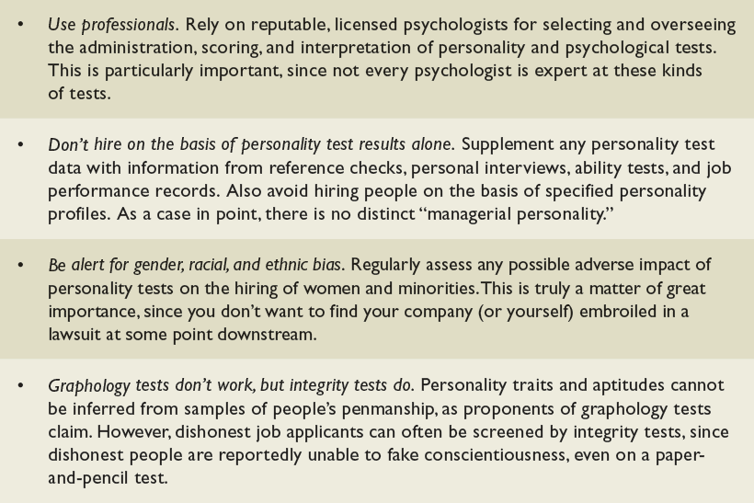
Cautions About Using Personality Testing in the Workplace
Table 11.1

Slide 10

Proactive Personality
Proactive personality
  someone who is more apt to take initiative and persevere to influence the environment

Slide 11
Five Traits Important in Organizations
Locus of control
  indicates how much people believe they control their fate through their own efforts
  internal, external
Expect different degrees of structure and compliance for each type
Employ different reward systems for each type
Notes:
*

Slide 12
Five Traits Important in Organizations
Self-efficacy
  belief in one’s ability to do a task
  learned helplessness
Self-esteem
  the extent to which people like or dislike themselves, their overall self-evaluation
Notes:
Learned helplessness, the debilitating lack of faith in one’s ability to control one’s environment
*

Slide 13
Five Traits Important in Organizations
Self-monitoring
  the extent to which people are able to observe their own behavior and adapt it to external situations
Emotional intelligence
  ability to cope, empathize with others, and be self-motivated

Slide 14
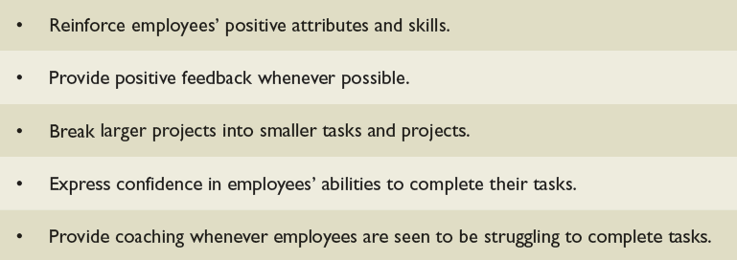
Some Ways That Managers Can Boost Employee Self-Esteem
Table 11.2

Slide 15
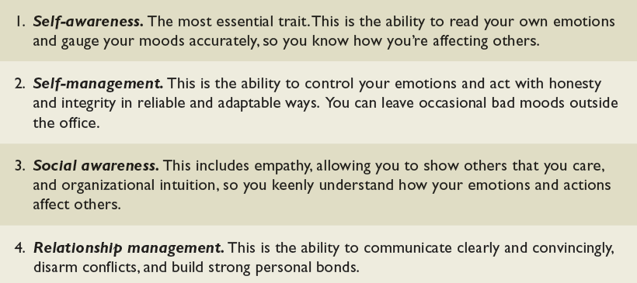
The Traits of Emotional Intelligence
Table 11.3
Notes:
Sources: Adapted from D. Goleman, R. Boyatzis, and A. McKee, “Primal Leadership: The Hidden Driver of Great
Performance,” Harvard Business Review, December 2001, p. 49; and Primal Leadership: Realizing the Power of
Emotional Intelligence, Boston: Harvard Business School Press, 2002, p. 39.
*

Slide 16
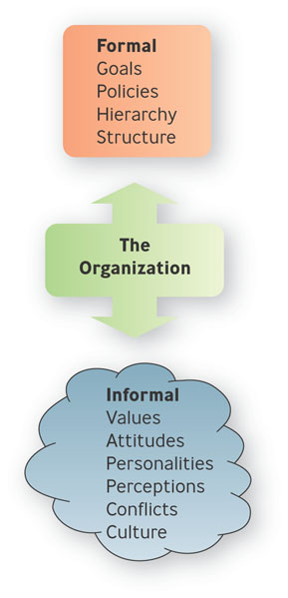
Organizational Behavior
Organizational Behavior
  tries to help managers not only explain workplace behavior but also to predict it, so that they can better lead and motivate
  their employees to perform
  productively
  individual, group behavior

Slide 17
Values and Attitudes
Values
  abstract ideals that guide one’s thinking and behavior across all situations
Attitude
  a learned predisposition toward a given object

Slide 18
Three Components of Attitudes
Affective
  consists of feelings or emotions one has about a situation
Cognitive
  beliefs and knowledge one has about a situation
Behavioral
  refers to how one intends or expects to behave toward a situation

Slide 19
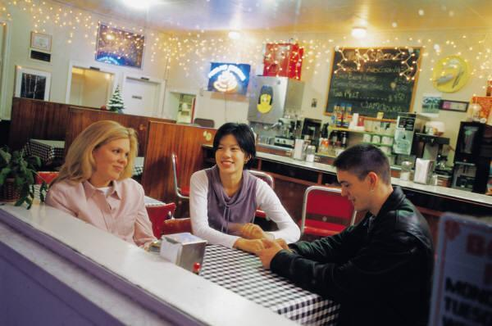
Question?
The statement, “I am never going to eat at this restaurant again,” reflects the ___________ component of an attitude.
Behavioral
Decisional
Cognitive
Affective
Notes:
The correct answer is “A” – behavioral.
Page: 345
Multimedia Lecture Support Package to Accompany Basic Marketing
Lecture Script 6-*

Slide 20
Attitudes
Cognitive dissonance
  the psychological discomfort a person experiences between his or her cognitive attitude and incompatible behavior
  Importance, control, rewards

Slide 21
Ways to Reduce Cognitive Dissonance
Change attitude or behavior
Belittle importance of the inconsistent behavior
Find consonant elements that outweigh dissonant ones

Slide 22
Example: Thinking Beyond Profit to Create Value for Society
IBM celebrated its 100th anniversary in June 2011 by offering a global service day, with 300,000 IBM employees signing up to perform 2.6 million hours of service to the world
In West Africa Procter & Gamble set up Pampers mobile clinics

Slide 23

Perception
Perception
  process of interpreting and understanding one’s environment

Slide 24
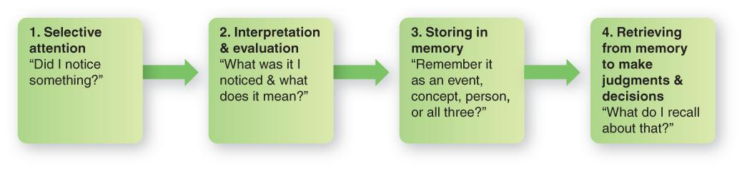
The Four Steps in the
Perceptual Process
Figure 11.2

Slide 25
Distortions in Perception
Stereotyping
  tendency to attribute to an individual the characteristics one believes are typical of the group to which that individual belongs
  sex-role, age, race/ethnicity
Halo effect
  forming an impression of an individual based on a single trait

Slide 26
Question?
John is interviewing Bambi for a job opening at his accounting firm. He notices that she has several tattoos visible on both arms. He does not believe that people with tattoos can be good accountants. John is engaged in ____________.
Counseling
Stereotyping
Behavioral interviewing
Situational interviewing
Notes:
The correct answer is “B” – stereotyping. See previous slide.
Multimedia Lecture Support Package to Accompany Basic Marketing
Lecture Script 6-*

Slide 27
Distortions in Perception
Recency effect
  Tendency to remember recent information better than earlier information
Causal attributions
  activity of inferring causes for observed behaviors
  fundamental, self-serving bias
Notes:
Two tendencies that distort an individual’s interpretation of behavior are fundamental attribution bias (occurs when people attribute another person’s behavior to his or her personal characteristics rather than situational factors) and self-serving bias (occurs when people take more personal responsibility for success than for failure)
Multimedia Lecture Support Package to Accompany Basic Marketing
Lecture Script 6-*

Slide 28
Example: Are Attractive Men & Women Paid More than Ordinary People
Being good looking seems to be strongly associated with self-confidence
Employers showed higher estimates for beautiful people’s productivity
Good-looking people are good communicators

Slide 29
Self-Fulfilling Prophecy
Self-Fulfilling prophecy
  the phenomenon in which people’s expectations of themselves or others lead them to behave in ways that make those expectations come true
  also called the Pygmalion effect

Slide 30
Work-Related Attitudes
Employee engagement
  an individual’s involvement, satisfaction, and enthusiasm for work
Job satisfaction
  extent to which you feel positively or negatively about various aspects of your work
Notes:
Job involvement
extent to which you identify or are personally involved with your job
*

Slide 31
Work-Related Attitudes
Organizational commitment
  reflects the extent to which an employee identifies with an organization and is committed to its goals
  Strong positive relationship between organizational commitment and job satisfaction

Slide 32
Important Workplace Behaviors
Performance and productivity
Absenteeism and turnover
Organizational citizenship behaviors
Counterproductive work behaviors
Notes:
Organizational citizenship behaviors are those employee behaviors that are not directly part of employees’ job descriptions—that
exceed their work-role requirements.
Counterproductive work behaviors (CWB), types of behavior that harm employees and the organization as a whole
*

Slide 33
Question?
Herman spends his lunch hour drinking beer in his car in the parking lot. This is an example of a(n) _____________.
Evaluating behavior
Discerning behavior
Counterproductive work behavior
Destructive work behavior
Notes:
The correct answer is “C” - Counterproductive work behavior. See previous slide. Counterproductive work behavior
Multimedia Lecture Support Package to Accompany Basic Marketing
Lecture Script 6-*

Slide 34
The New Diversified Workforce
Diversity
  represents all the ways people are unlike and alike—the differences and similarities in age, gender, race, religion, ethnicity, sexual orientation, capabilities, and socioeconomic background

Slide 35
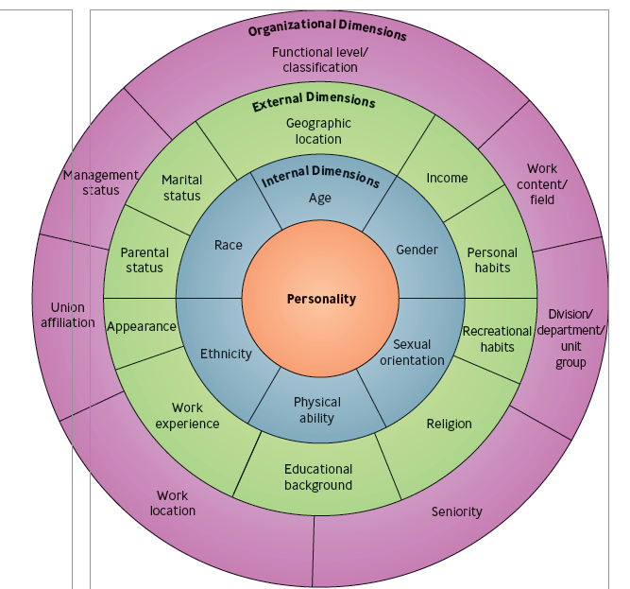
The Diversity Wheel
Figure 11.3

Slide 36
The Diversity Wheel
Internal dimensions
  those human differences that exert a powerful, sustained effect throughout every stage of our lives
  gender, age, ethnicity, race, sexual orientation, physical abilities

Slide 37
The Diversity Wheel
External dimensions
  consist of the personal characteristics that people acquire, discard, or modify throughout their lives
  educational background, marital status, parental status, religion, income, geographic location, work experience, recreational habits, appearance, personal habits.

Slide 38
Trends in Workforce Diversity
Age: More Older People in the Workforce
Gender: More Women Working
Race & Ethnicity: More People of Color in the Workforce
Sexual Orientation: Gays & Lesbians Become More Visible
People with Differing Physical & Mental Abilities
Educational Levels: Mismatches Between Education & Workforce Needs

Slide 39
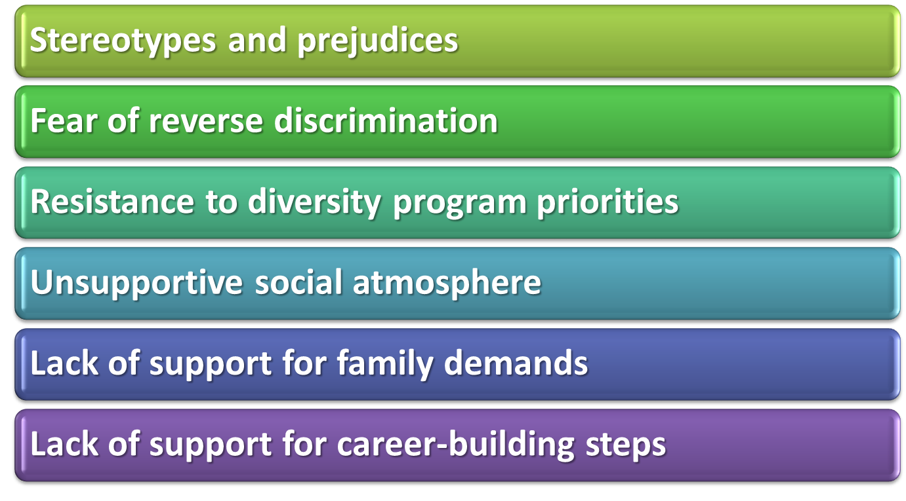
Barriers to Diversity
Notes:
Ethnocentrism is the belief that one’s native country, culture, language, abilities, or behavior is superior to those of another culture.
*

Slide 40

What is Stress?
Stress
  the tension people feel when they are facing or enduring extraordinary demands, constraints, or opportunities and are uncertain about their ability to handle
  them effectively

Slide 41
Sources of Job-Related Stress
Demands created by individual differences,
Individual task demands
Individual role demands
Group demands,
Organizational demands
Nonwork demands.

Slide 42
Question?
Your boss expects you to stay late to cover the workload of a coworker who is out sick, but you are supposed to help your mother with some work on her house tonight. You are suffering from:
Role overload
Role conflict
Role ambiguity
Burnout
Notes:
The correct answer is “B” – role conflict
Page: 365
Multimedia Lecture Support Package to Accompany Basic Marketing
Lecture Script 6-*

Slide 43
Symptom of Stress
Physiological
  backaches, headaches, sweaty palms, nausea
Psychological
  boredom, irritability, nervousness, anger, anxiety, depression
Behavioral
  sleeplessness, changes in eating habits, increased smoking/alcohol/drug abuse

Slide 44

Consequences of Stress
Burnout
  state of emotional, mental, and even physical exhaustion

Slide 45
Reducing Stressors in Organizations
Roll out employee assistance programs
Recommend a holistic wellness approach
Create a supportive environment
Make jobs interesting
Make career counseling available

