Slide 1
Chapter Five
Planning:
The Foundation of Successful Management
McGraw-Hill/Irwin
Copyright © 2013 by The McGraw-Hill Companies, Inc. All rights reserved.

Slide 2
Major Questions You Should Be Able to Answer
5.1 How do I tend to deal with uncertainty, and how can planning help?
5.2 What are mission and vision statements and what are three types of planning and goals?
5.3 What are SMART goals and MBO, and how can they be implemented?
5.4 How does the planning/control cycle help keep a manager’s plans headed in the right direction?

Slide 3
Planning & Uncertainty
Planning
  coping with uncertainty by formulating future courses of action to achieved specified results
  setting goals and deciding how to achieve them

Slide 4
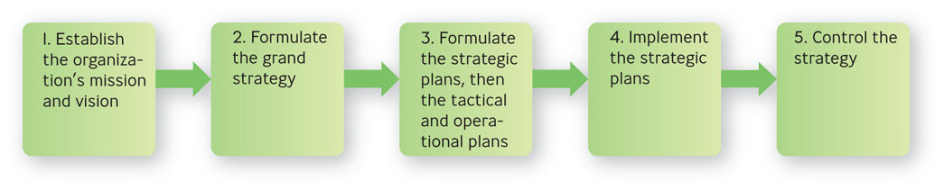
Planning & Strategic Management
Figure 5.1

Slide 5
Why Not Plan?
Planning requires you to set aside the time to do it
You may have to make some decisions without a lot of time to plan

Slide 6
How Planning Helps You
Helps you check on your progress
Helps you coordinate activities
Helps you think ahead
Helps you cope with uncertainty

Slide 7
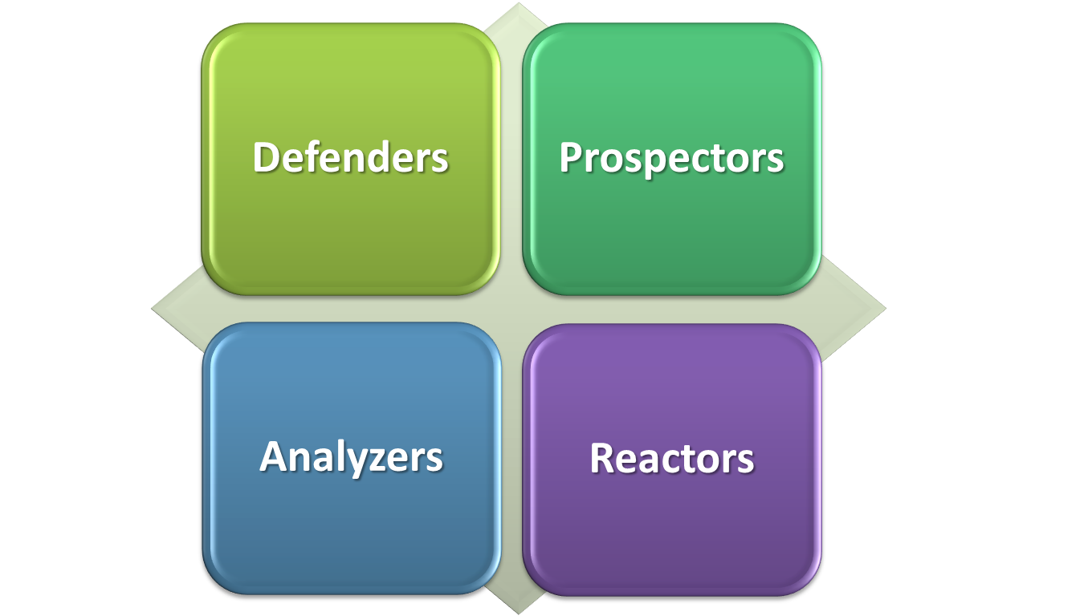
Four Basic Strategy Types

Slide 8

Four Basic Strategy Types
Defenders
  expert at producing and selling narrowly defined products
Notes:
Defenders
“Let’s stick with what we do best, avoid other involvements
experts at producing and selling narrowly defined products
Multimedia Lecture Support Package to Accompany Basic Marketing
Lecture Script 6-*

Slide 9
Four Basic Strategy Types
Prospectors
  focus on developing new products and in seeking out new markets, rather than waiting for things to happen
Notes:
Prospectors
“Let’s create our own opportunities, not wait for them to happen”
focus on developing new products and in seeking out new markets, rather than waiting for things to happen
*

Slide 10
Four Basic Strategy Types
Analyzers
  let other organizations take the risks of product development and marketing and then imitate what seems to work best
Notes:
Analyzers – “Let others take the risks of innovating, & we’ll imitate what works best”
Multimedia Lecture Support Package to Accompany Basic Marketing
Lecture Script 6-*

Slide 11

Four Basic Strategy Types
Reactors
  make adjustments only when finally forced to by environmental pressures
Notes:
Reactors – “Let’s wait until there’s a crisis, then we’ll react”
*

Slide 12
Question?
Fredhandbag Photography scans it environment regularly. However, it does not tend to seek opportunities outside its present markets. This company would most likely be a (n):
Reactor
Prospector
Analyzer
Defender
Notes:
The correct answer is “D” - defender
p. 134
Multimedia Lecture Support Package to Accompany Basic Marketing
Lecture Script 6-*

Slide 13
The Adaptive Cycle
Adaptive Cycle
  businesses are continuously cycling through decisions about three kinds of business problems: (1) entrepreneurial, (2) engineering, and (3) administrative
Notes:
Entrepreneurial – selecting and making adjustments of products and markets
Engineering – producing and delivering the products
Administrative – establishing roles, relationships, and organizational processes
Multimedia Lecture Support Package to Accompany Basic Marketing
Lecture Script 6-*

Slide 14
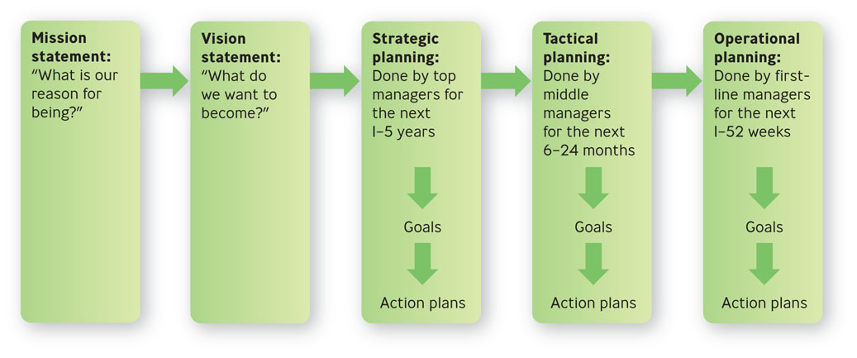
Making Plans
Figure 5.2

Slide 15
Mission & Vision Statements
Mission statement
  expresses the purpose of the organization
Vision statement
  long-term goal describing “what” an organization wants to become
  clear sense of the future and the actions needed to get there

Slide 16

Example: Nest Fresh Eggs
“NestFresh strives to provide you and your family with a more sustainable, humane alternative to conventional eggs, which are produced in caged facilities. We insist on producing cage free and organic eggs to create awareness about the need for humane treatment of egg laying hens and the importance of environmental responsibility.”
Notes:
http://nestfresh.com/ourstory.aspx
*

Slide 17
Three Types of Planning for Three Levels of Management
Strategic planning
  determine what the organization’s long-term goals should be for the next 1-5 years with the resources they expect to have available

Slide 18
Question?
Danny is participating with other managers in a discussion about what his organization's goals should be for the next decade. He is participating in:
Strategic planning
Operational planning
Tactical planning
Controlling
Notes:
The correct answer is “A”
Page: 138 LO: 2 Difficulty: Hard
Rationale: He is participating in long-term planning, a part of strategic planning.
AACSB: 6 BT: Application
Multimedia Lecture Support Package to Accompany Basic Marketing
Lecture Script 6-*

Slide 19
Three Types of Planning for Three Levels of Management
Tactical planning
  determine what contributions their departments or similar work units can make during the next 6-24 months

Slide 20

Three Types of Planning for Three Levels of Management
Operational planning
  determine how to accomplish specific tasks with available resources within the next 1-52 weeks

Slide 21
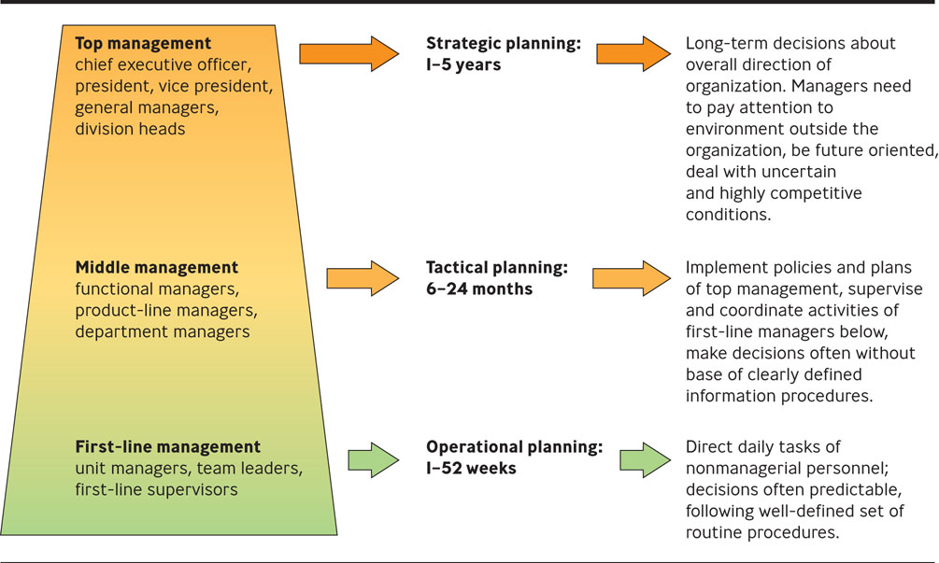
Three Levels of Management, Three Types of Planning
Figure 5.3

Slide 22
Goals, Action Plans & Operating Plans
Goals
  specific commitment to achieve a measurable result within a stated period of time
  also known as an objective
  strategic, tactical, operational

Slide 23
Goals
Strategic goals
  set by and for top management and focus on objectives for the organization as a whole.
Tactical goals
  set by and for middle managers and focus on the actions needed to achieve strategic goals.

Slide 24
Goals
Operational goals
  set by and for first-line managers and are concerned with short-term matters associated with realizing tactical goals.

Slide 25
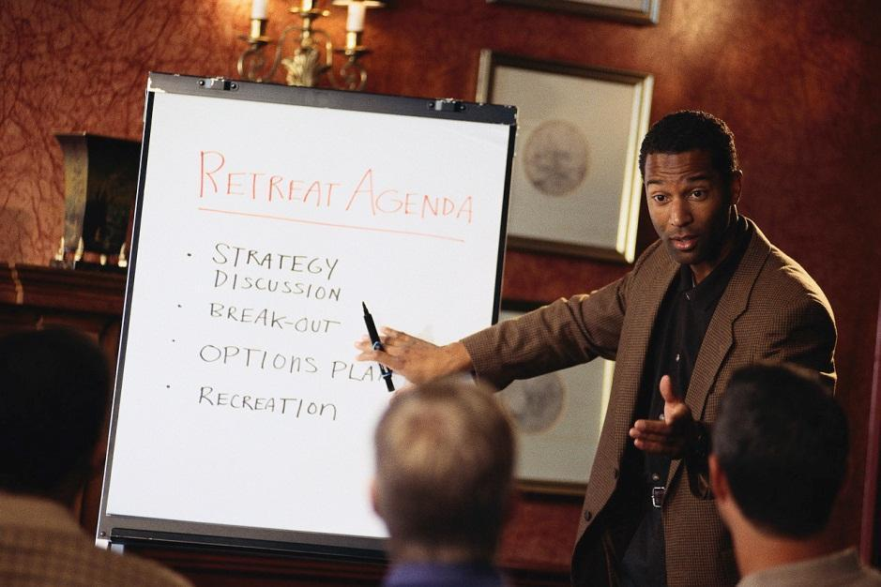
Goals, Action Plans & Operating Plans
Action plan
  defines the course of action needed to achieve the stated goal

Slide 26
Goals, Action Plans & Operating Plans
Operating plan
  designed for a 1-year period
  defines how you conduct your business based on the action plan
  identifies clear targets such as revenue, cash flow, and market share

Slide 27
Standing Plans: Policies, Procedures, & Rules
Standing plans
  plans developed for activities that occur repeatedly over a period of time
  consist of policies, procedures, and rules.

Slide 28
Standing Plans: Policies, Procedures, & Rules
Policy
  outlines the general response to a designated problem or situation
Procedure
  outlines the response to a particular problem or circumstances
Rule
  designates specific required action

Slide 29
Single-Use Plans:
Programs & Projects
Single-use plans
  plans developed for activities that are not likely to be repeated in the future

Slide 30
Single-Use Plans: Programs & Projects
Program
  encompasses a range of projects or activities
Project
  plan of less scope and complexity than a program

Slide 31
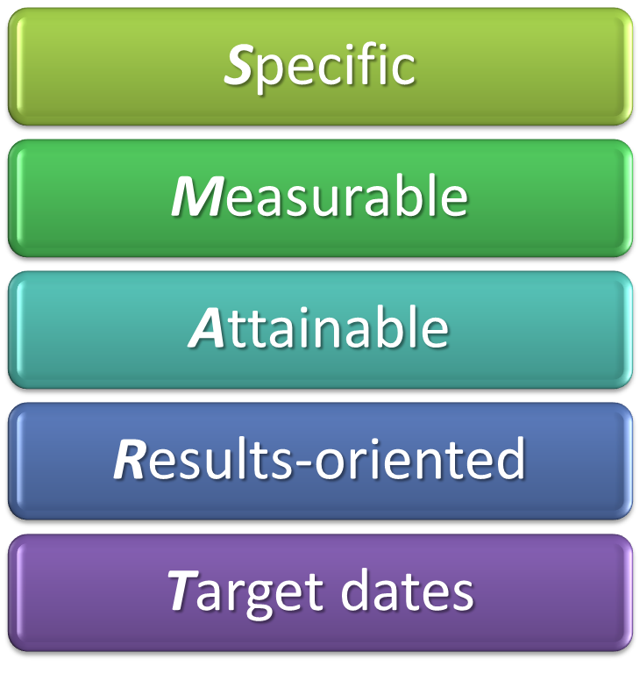
SMART Goals
Notes:
• Specific: Goals should be stated in specific rather than vague terms. The
goal that “As many planes as possible should arrive on time” is too general.
The goal that “Ninety percent of planes should arrive within 15 minutes
of the scheduled arrival time” is specific.
• Measurable: Whenever possible, goals should be measurable, or quantifiable
(as in “90% of planes should arrive within 15 minutes . . .”). That is,
there should be some way to measure the degree to which a goal has been
reached.
Of course, some goals—such as those concerned with improving
quality—are not precisely quantifiable. In that case, something on the
order of “Improve the quality of customer relations by instituting 10 follow-up
telephone calls every week” will do. You can certainly quantify how
many follow-up phone calls were made.
• Attainable: Goals should be challenging, of course, but above all they
should be realistic and attainable. It may be best to set goals that are quite
ambitious so as to challenge people to meet high standards. Always, however,
the goals should be achievable within the scope of the time, equipment,
and financial support available. (See Figure 5.4 . )
If too easy (as in “half the flights should arrive on time”), goals
won’t impel people to make much effort. If impossible (“all flights must
arrive on time, regardless of weather”), employees won’t even bother
trying. Or they will try and continually fail, which will end up hurting
morale.
• Results-oriented: Only a few goals should be chosen—say, five for any
work unit. And they should be results-oriented —they should support the
organization’s vision.
In writing out the goals, start with the word “To” and follow it
with action-oriented verbs—“complete,” “acquire,” “increase” (“to decrease
by 10% the time to get passengers settled in their seats before
departure”).
Some verbs should not be used in your goal statement because they
imply activities—the tactics used to accomplish goals (such as having baggage
handlers waiting). For example, you should not use “to develop,” “to
conduct,” “to implement.”
• Target dates: Goals should specify the target dates or deadline dates when
they are to be attained. For example, it’s unrealistic to expect an airline to
improve its on-time arrivals by 10% overnight. However, you could set a
target date—3 to 6 months away, say—by which this goal is to be achieved.
That allows enough time for lower-level managers and employees to
revamp their systems and work habits and gives them a clear time frame
in which they know what they are expected to do.
*

Slide 32
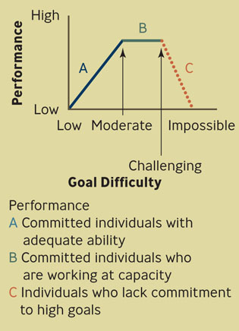
Relationship Between Goal Difficulty and Performance
Figure 5.4

Slide 33
What Is MBO?
Jointly set objectives
Develop action plan
Periodically review performance
Give performance appraisal and rewards, if any

Slide 34
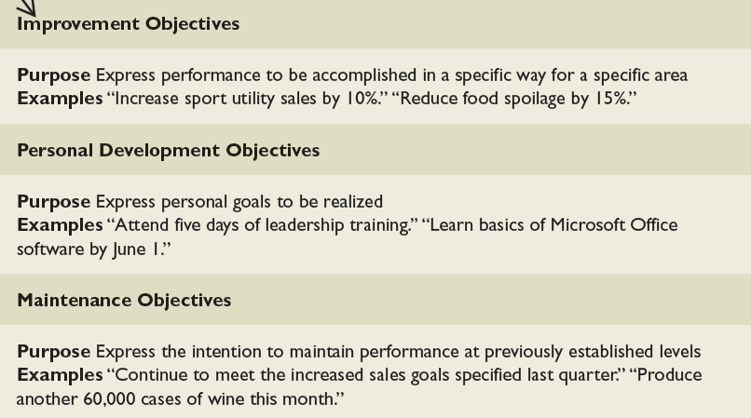
Three Types of Objectives Used in MBO
Table 5.2

Slide 35
Cascading Objectives: MBO from the Top Down
Top management must be committed
It must be applied organization-wide
Objectives must “cascade”
Notes:
Objectives are structured in a unified hierarchy, becoming more specific at lower levels of the organization.
Multimedia Lecture Support Package to Accompany Basic Marketing
Lecture Script 6-*

Slide 36
Example: Wal-Mart Setting Objectives for Change
In 2008 Walmart CEO, Lee Scott, laid out new environmental, health, and ethical goals
Walmart would continue to promote energy-saving in more products
Walmart would apply cost-cutting skills to helping other companies deliver health care for its employees

Slide 37
Question?
Melissa wants her employee, Ralph, to turn in his monthly sales report by the 5th of every month. This meets the ____________ requirement of SMART goals.
Specific
Measurable
Attainable
Target dates
Notes:
The correct answer is “D” – Target dates.
Multimedia Lecture Support Package to Accompany Basic Marketing
Lecture Script 6-*

Slide 38
The Planning/Control Cycle
Make the plan
Carry out the plan
Control the direction by comparing results with the plan
Control the direction by taking corrective action in two ways
  Correcting deviations
  Improving future plans

Slide 39
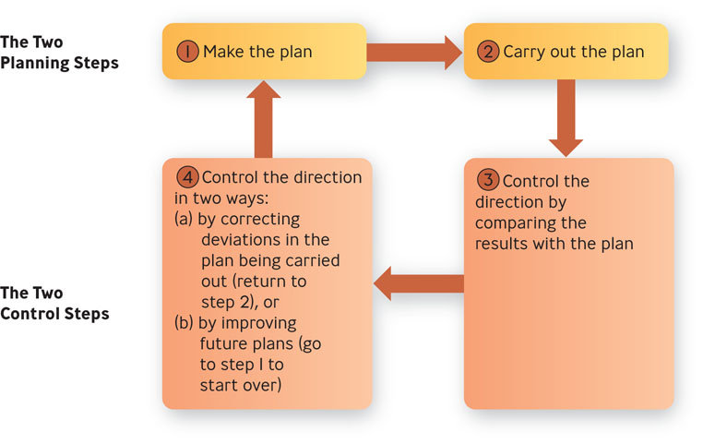
The Planning/Control Cycle
Figure 5.5

Slide 40
Question?
Apple has fired employees who have leaked news about unannounced products. Which step of the Planning/Control is this?
Make the plan
Carry out the plan
Take corrective action
Document the plan
Notes:
The correct answer is “C” – take corrective action.
Multimedia Lecture Support Package to Accompany Basic Marketing
Lecture Script 6-*

