Slide 1
Chapter Three
The Manager’s Changing
Work Environment & Ethical
Responsibilities:
Doing the Right Thing
McGraw-Hill/Irwin
Copyright © 2013 by The McGraw-Hill Companies, Inc. All rights reserved.

Slide 2
Major Questions You Should Be Able to Answer
3.1 Who are the stakeholders important to me inside the organization?
3.2 Who are the stakeholders important to me outside the organization?
3.3 What does the successful manager need to know about ethics and values?
3.4 Is being socially responsible really necessary
3.5 How can I trust a company is doing the right thing?

Slide 3
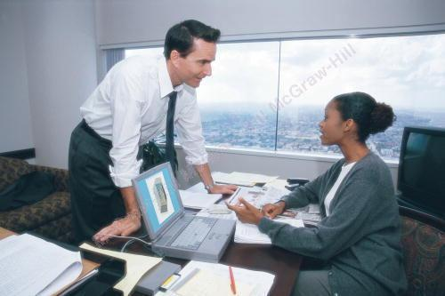
The Community of Stakeholders Inside the Organization
Stakeholders
  the people whose interests are affected by an organization’s activities
  Internal, external

Slide 4
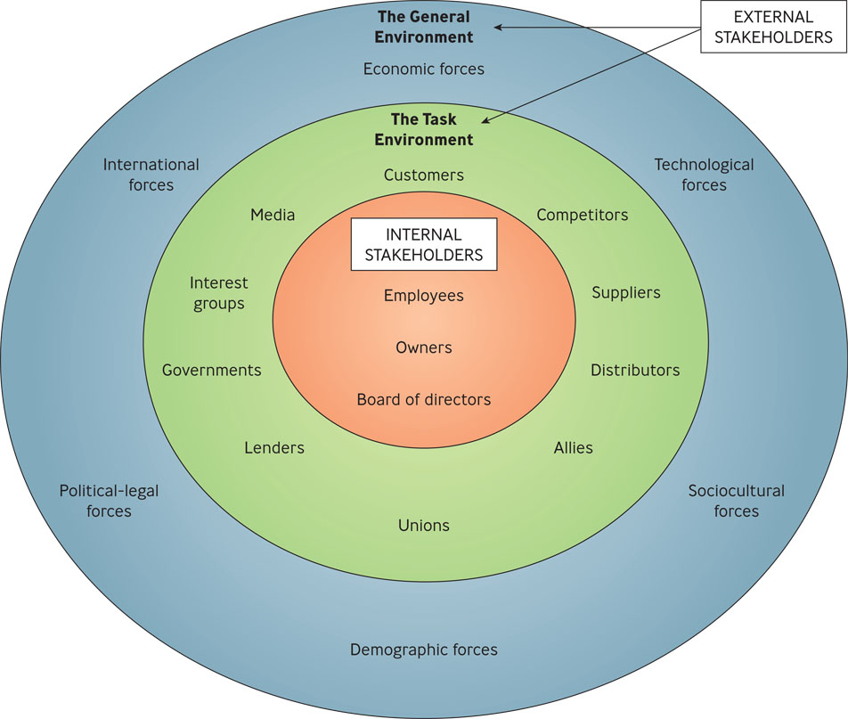
The Organization’s Environment
Figure 3.1

Slide 5
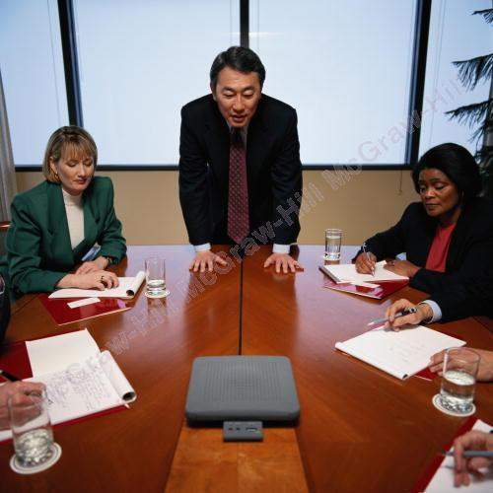
The Community of Stakeholders Inside the Organization
Internal stakeholders
  consist of employees, owners, and the board of directors

Slide 6
The Community of Stakeholders Inside the Organization
Owners
  consist of all those who can claim the organization as their legal property
Board of directors
  members elected by the stockholders to see that the company is being run according o their interests

Slide 7
Question?
Two drug companies agree to work together to pool their research and development funds to develop a new drug for arthritis. In doing so, these two organizations have:
Formed a union
Formed a strategic alliance
Analyzed their internal environment
Influenced the mass media
Notes:
Answer: B Page: 72
Difficulty: Hard
Rationale: These organizations have joined together to achieve an advantage that neither could perform as well alone.
AACSB: 6, 13 BT: Comprehension
Multimedia Lecture Support Package to Accompany Basic Marketing
Lecture Script 6-*

Slide 8
The Community of Stakeholders Inside the Organization
External stakeholders
  people or groups in the organization’s external environment that are affected by it
  Task, general environment

Slide 9
The Task Environment
Customers
  those who pay to use an organization’s goods or services
Competitors
  people or organizations that compete for customers or services

Slide 10

The Task Environment
Suppliers
  A person or organization that provides raw materials, services, equipment, labor or energy to other organizations

Slide 11

Example: Amazon.com and the Customer Experience
Jeff Bezos, founder and CEO of Amazon.com is obsessed with customer service
Believes that company’s success is driven by the customer experience
In 2011 the company’s revenue increased 41%

Slide 12
The Task Environment
Distributor
  a person or organization that helps another organization sell its goods and services to customers

Slide 13

The Task Environment
Strategic allies
  describes the relationship of two organizations who join forces to achieve advantages neither can perform as well alone

Slide 14
The Task Environment
Employee Organizations: Unions & Associations
Local Communities
Financial Institutions
Notes:
clawbacks — rescinding the tax breaks when firms don’t deliver promised jobs
*

Slide 15
The Task Environment
Government regulators
  regulatory agencies that establish ground rules under which organizations may operate

Slide 16
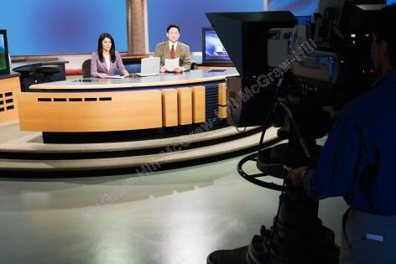
The Task Environment
Special interest groups
  groups whose members try to influence specific issues
Mass Media

Slide 17
Question?
ChemTech International is being picketed by a group of people who live by their biggest plant. The group is concerned about ChemTech’s disposal of waste products into nearby waterways. In this instance, ChemTech is dealing with the _____ part of its _______ environment.
special-interest groups; task
local communities; task
sociocultural; general
sociocultural; task
Notes:
Answer: B
Difficulty: Hard
Rationale: Local communities are most likely to be concerned about this issue, and provide problems for managers to deal with on a daily basis.
AACSB: 2, 6, 7, 10 BT: Application
Multimedia Lecture Support Package to Accompany Basic Marketing
Lecture Script 6-*

Slide 18
The General Environment
Economic forces
  consist of the general economic conditions and trends – unemployment, inflation, interest rates, economic growth – that may affect an organization’s performance

Slide 19

The General Environment
Technological forces
  new developments in methods for transforming resources into goods and services

Slide 20
The General Environment
Sociocultural forces
  Influences and trends originating in a country’s, a society’s, or a culture’s human relationships and values that may affect an organization

Slide 21
The General Environment
Demographic forces
  influences on an organization arising from changes in the characteristics of a population, such as age, gender, or ethnic origin

Slide 22
The General Environment
Political-Legal forces
  changes in the way politics shape laws and laws shape the opportunities for and threats to an organization

Slide 23
The General Environment
International forces
  changes in the economic, political, legal, and technological global system that may affect an organization

Slide 24
Example: What Does a Company Owe Its Community?
NCR is moving its headquarters from Dayton, OH to Atlanta, GA
NCR had been headquartered in Dayton since the company was founded in 1884
Georgia promised a lucrative incentive package
Dayton officials thought the long relationship between the two should count for something
Notes:
As mentioned, many communities offer companies inducements to relocate, often trading tax breaks in return
for the promise of jobs. But in cash-strapped times, cities that once bent over backward to lure companies are now
resorting to “clawbacks”—asserting their right to rescind the tax breaks when the firms fail to deliver. Target Corp.,
for instance, got tax abatements from DeKalb, Illinois, city, county, and other taxing bodies after promising at
least 500 jobs at a local distribution center. “So when the company came up 66 workers short in 2009,” says one
report, “Target got word its next tax bill would be jumping almost $600,000—more than half of which goes to the
local school district, where teachers and programs have been cut as coffers dried up.”
Multimedia Lecture Support Package to Accompany Basic Marketing
Lecture Script 6-*

Slide 25

The Ethical Responsibilities Required of You as a Manager
Ethical dilemma
  situation in which you have to decide whether to pursue a course of action that may benefit you or your organization but that is unethical
  or even illegal

Slide 26
Defining Ethics & Values
Ethics
  standards of right and wrong that influence behavior
Values
  relatively permanent and deeply held underlying beliefs and attitudes that help determine a person’s behavior

Slide 27
Values
Organizations may have two value systems that conflict:
The value system stressing financial performance versus
The value system stressing cohesion and solidarity in employee relationships

Slide 28
Question?
Fairness in hiring practices is an example of an organization's _______________.
Cost-benefit analysis
Morality
Competitive advantage
Long-term interests
Values.
Notes:
Answer: E - Values
Difficulty: Medium
Rationale: Values are the relatively permanent and deeply held underlying beliefs and attitudes that help determine a person's behavior, such as the belief that "Fairness means hiring according to ability, not family background.“
AACSB: Ethics
Bloom's: Understand
Multimedia Lecture Support Package to Accompany Basic Marketing
Lecture Script 6-*

Slide 29
Four Approaches to Deciding Ethical Dilemmas
Utilitarian
  guided by what will result in the greatest good for the greatest number of people
Individual
  guided by what will result in the individual’s best long term interest, which ultimately are in everyone’s self-interest

Slide 30
Four Approaches to Deciding Ethical Dilemmas (cont.)
Moral-rights
  guided by respect for the fundamental rights of human beings
Justice
  guided by respect for impartial standards of fairness and equity

Slide 31
Question?
Pat, a manager at State University, is deciding how to set up a procedure for registering on-line that gives students fair access to courses. Pat is engaged in the ________ approach.
utilitarian
individual
moral-rights
justice
Notes:
Answer: D
Difficulty: Moderate
AACSB: 6 BT: Knowledge
Multimedia Lecture Support Package to Accompany Basic Marketing
Lecture Script 6-*

Slide 32

White-Collar Crime, SarbOx, & Ethical Training
Sarbanes-Oxley of 2002
  Often shortened to SarbOx or SOX, established requirements for proper financial record keeping for public companies
  and penalties of as much
  as 25 years in prison for
  noncompliance
Notes:
SOX requires a company’s CEO and CFO to personally certify the organization’s financial reports,
prohibits them from taking personal loans and lines of credit, and makes them reimburse the organization
for bonuses and stock options when required by restatement of corporate profits. It also requires the company to
have established procedures and guidelines for audit committees.
Multimedia Lecture Support Package to Accompany Basic Marketing
Lecture Script 6-*

Slide 33
How Do People Learn Ethics? Kohlberg’s Theories
Level 1, preconventional – follows rules
Level 2, conventional – follows expectations of others
Level 3, postconventional – guided by internal values

Slide 34
How Organizations Can Promote Ethics
Creating of a strong ethical climate
Screening prospective employees
Instituting ethics codes and training programs
Rewarding ethical behavior: Protecting whistle-blowers

Slide 35
The Social Responsibilities Required of You as a Manager
Social responsibility
  manager’s duty to take actions that will benefit the interests of society as well as of the organization

Slide 36
The Social Responsibilities Required of You as a Manager
Corporate social responsibility
  notion that corporations are expected to go above and beyond following the law and making a profit

Slide 37
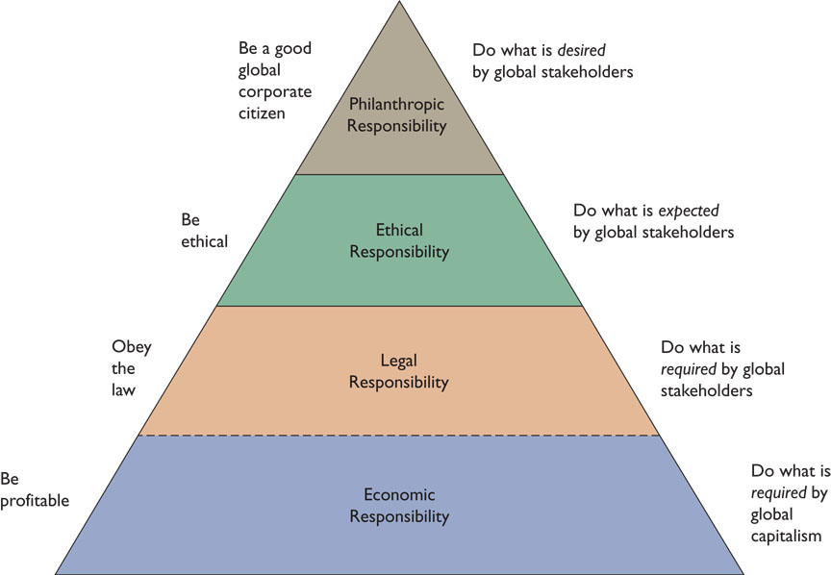
Carroll’s Global Corporate Social Responsibility Pyramid
Figure 3.2

Slide 38

Two Types of Social Responsibility
Philanthropy
  making charitable donations to benefit humankind

Slide 39
Corporate Governance
Corporate governance
  the system of governing a company so that the interests of corporate owners and other stakeholders are protected.

Slide 40
The Need for Independent Directors
More attention is being paid to strengthening corporate governance so that directors are clearly separated in their authority from the CEO

