Slide 1
Chapter 9
Requirements Modeling: Scenario-Based Methods
Slide Set to accompany Software Engineering: A Practitioner’s Approach, 8/e
by Roger S. Pressman and Bruce R. Maxim
Slides copyright © 1996, 2001, 2005, 2009, 2014 by Roger S. Pressman
For non-profit educational use only
May be reproduced ONLY for student use at the university level when used in conjunction with Software Engineering: A Practitioner's Approach, 8/e. Any other reproduction or use is prohibited without the express written permission of the author.
All copyright information MUST appear if these slides are posted on a website for student use.
These slides are designed to accompany Software Engineering: A Practitioner’s Approach, 8/e (McGraw-Hill, 2014). Slides copyright 2014 by Roger Pressman.
‹#›

Slide 2
Requirements Analysis
Requirements analysis
specifies software’s operational characteristics
indicates software's interface with other system elements
establishes constraints that software must meet
Requirements analysis allows the software engineer (called an analyst or modeler in this role) to:
elaborate on basic requirements established during earlier requirement engineering tasks
build models that depict user scenarios, functional activities, problem classes and their relationships, system and class behavior, and the flow of data as it is transformed.
These slides are designed to accompany Software Engineering: A Practitioner’s Approach, 8/e (McGraw-Hill, 2014). Slides copyright 2014 by Roger Pressman.
‹#›

Slide 3
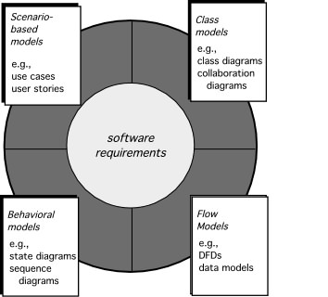
Elements of Requirements Analysis
These slides are designed to accompany Software Engineering: A Practitioner’s Approach, 8/e (McGraw-Hill, 2014). Slides copyright 2014 by Roger Pressman.
‹#›

Slide 4
Requirements Modeling
Scenario-based
system from the user’s point of view
Data
shows how data are transformed inside the system
Class-oriented
defines objects, attributes, and relationships
Flow-oriented
shows how data are transformed inside the system
Behavioral
show the impact of events on the system states
These slides are designed to accompany Software Engineering: A Practitioner’s Approach, 8/e (McGraw-Hill, 2014). Slides copyright 2014 by Roger Pressman.
‹#›

Slide 5
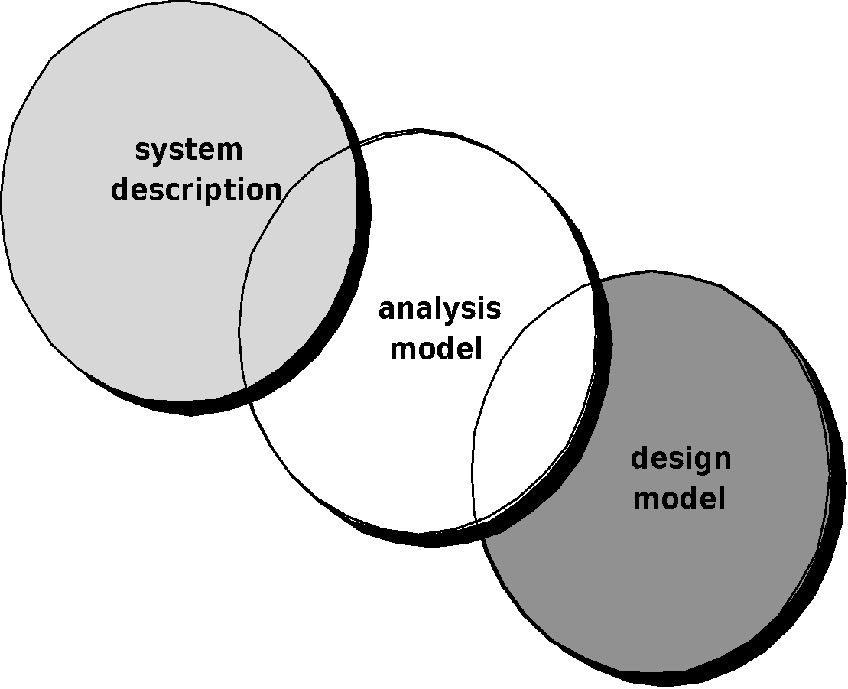
A Bridge
These slides are designed to accompany Software Engineering: A Practitioner’s Approach, 8/e (McGraw-Hill, 2014). Slides copyright 2014 by Roger Pressman.
‹#›

Slide 6
Rules of Thumb
The model should focus on requirements that are visible within the problem or business domain. The level of abstraction should be relatively high.
Each element of the analysis model should add to an overall understanding of software requirements and provide insight into the information domain, function and behavior of the system.
Delay consideration of infrastructure and other non-functional models until design.
Minimize coupling throughout the system.
Be certain that the analysis model provides value to all stakeholders.
Keep the model as simple as it can be.
These slides are designed to accompany Software Engineering: A Practitioner’s Approach, 8/e (McGraw-Hill, 2014). Slides copyright 2014 by Roger Pressman.
‹#›

Slide 7
Domain Analysis
Software domain analysis is the identification, analysis, and specification of common requirements from a specific application domain, typically for reuse on multiple projects within that application domain . . . [Object-oriented domain analysis is] the identification, analysis, and specification of common, reusable capabilities within a specific application domain, in terms of common objects, classes, subassemblies, and frameworks . . .
Donald Firesmith
These slides are designed to accompany Software Engineering: A Practitioner’s Approach, 8/e (McGraw-Hill, 2014). Slides copyright 2014 by Roger Pressman.
‹#›

Slide 8
Domain Analysis
Define the domain to be investigated.
Collect a representative sample of applications in the domain.
Analyze each application in the sample.
Develop an analysis model for the objects.
These slides are designed to accompany Software Engineering: A Practitioner’s Approach, 8/e (McGraw-Hill, 2014). Slides copyright 2014 by Roger Pressman.
‹#›

Slide 9
Scenario-Based Modeling
“[Use-cases] are simply an aid to defining what exists outside the system (actors) and what should be performed by the system (use-cases).” Ivar Jacobson
(1) What should we write about?
(2) How much should we write about it?
(3) How detailed should we make our description?
(4) How should we organize the description?
These slides are designed to accompany Software Engineering: A Practitioner’s Approach, 8/e (McGraw-Hill, 2014). Slides copyright 2014 by Roger Pressman.
‹#›

Slide 10
What to Write About?
Inception and elicitation—provide you with the information you’ll need to begin writing use cases.
Requirements gathering meetings, QFD, and other requirements engineering mechanisms are used to
identify stakeholders
define the scope of the problem
specify overall operational goals
establish priorities
outline all known functional requirements, and
describe the things (objects) that will be manipulated by the system.
To begin developing a set of use cases, list the functions or activities performed by a specific actor.
These slides are designed to accompany Software Engineering: A Practitioner’s Approach, 8/e (McGraw-Hill, 2014). Slides copyright 2014 by Roger Pressman.
‹#›

Slide 11
How Much to Write About?
As further conversations with the stakeholders progress, the requirements gathering team develops use cases for each of the functions noted.
In general, use cases are written first in an informal narrative fashion.
If more formality is required, the same use case is rewritten using a structured format similar to the one proposed.
These slides are designed to accompany Software Engineering: A Practitioner’s Approach, 8/e (McGraw-Hill, 2014). Slides copyright 2014 by Roger Pressman.
‹#›

Slide 12
Use-Cases
a scenario that describes a “thread of usage” for a system
actors represent roles people or devices play as the system functions
users can play a number of different roles for a given scenario
These slides are designed to accompany Software Engineering: A Practitioner’s Approach, 8/e (McGraw-Hill, 2014). Slides copyright 2014 by Roger Pressman.
‹#›

Slide 13
Developing a Use-Case
What are the main tasks or functions that are performed by the actor?
What system information will the the actor acquire, produce or change?
Will the actor have to inform the system about changes in the external environment?
What information does the actor desire from the system?
Does the actor wish to be informed about unexpected changes?
These slides are designed to accompany Software Engineering: A Practitioner’s Approach, 8/e (McGraw-Hill, 2014). Slides copyright 2014 by Roger Pressman.
‹#›

Slide 14
Reviewing a Use-Case
Use-cases are written first in narrative form and mapped to a template if formality is needed
Each primary scenario should be reviewed and refined to see if alternative interactions are possible
Can the actor take some other action at this point?
Is it possible that the actor will encounter an error condition at some point? If so, what?
Is it possible that the actor will encounter some other behavior at some point? If so, what?
These slides are designed to accompany Software Engineering: A Practitioner’s Approach, 8/e (McGraw-Hill, 2014). Slides copyright 2014 by Roger Pressman.
‹#›

Slide 15
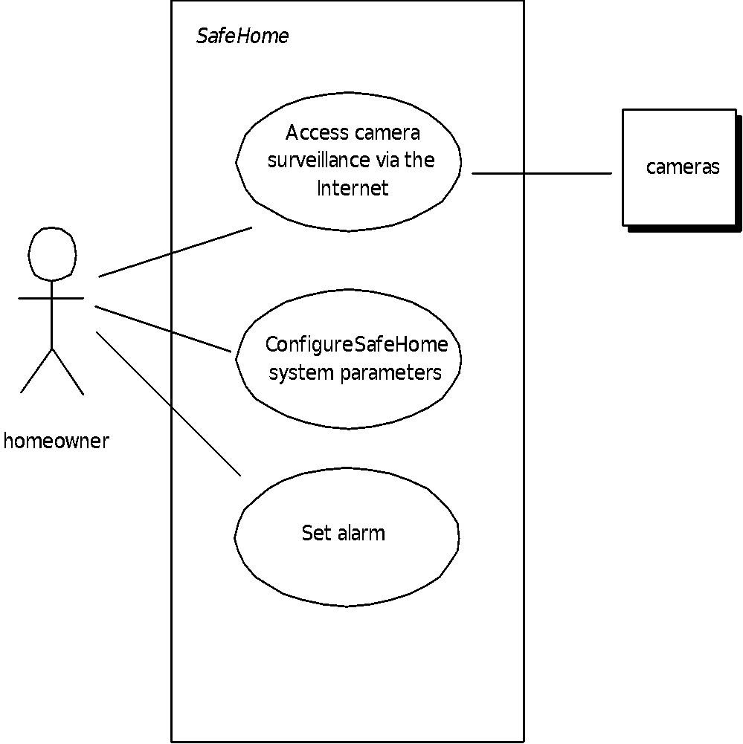
Use-Case Diagram
These slides are designed to accompany Software Engineering: A Practitioner’s Approach, 8/e (McGraw-Hill, 2014). Slides copyright 2014 by Roger Pressman.
‹#›

Slide 16
Exceptions
Describe situations (failures or user choices) that cause the system to exhibit unusual behavior
Brainstorming should be used to derive a reasonably complete set of exceptions for each use case
Are there cases where a validation function occurs for the use case?
Are there cases where a supporting function (actor) fails to respond appropriately?
Can poor system performance result in unexpected or improper use actions?
Handling exceptions may require the creation of additional use cases
These slides are designed to accompany Software Engineering: A Practitioner’s Approach, 8/e (McGraw-Hill, 2014). Slides copyright 2014 by Roger Pressman.
‹#›

Slide 17
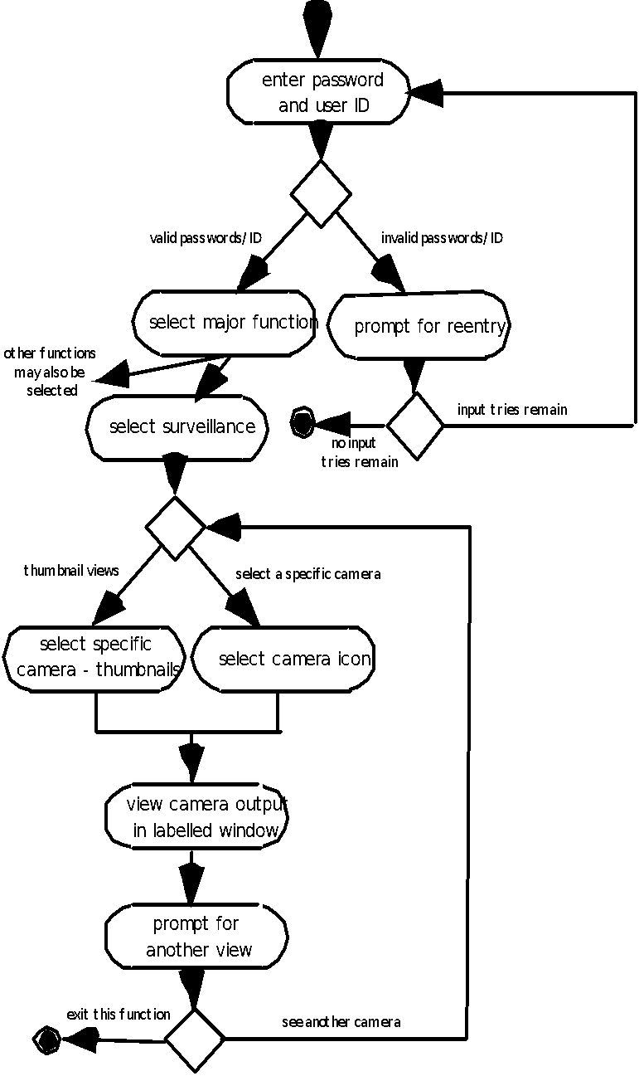
Activity Diagram
Supplements the use case by providing a graphical representation of the flow of interaction within a specific scenario
These slides are designed to accompany Software Engineering: A Practitioner’s Approach, 8/e (McGraw-Hill, 2014). Slides copyright 2014 by Roger Pressman.
‹#›

Slide 18
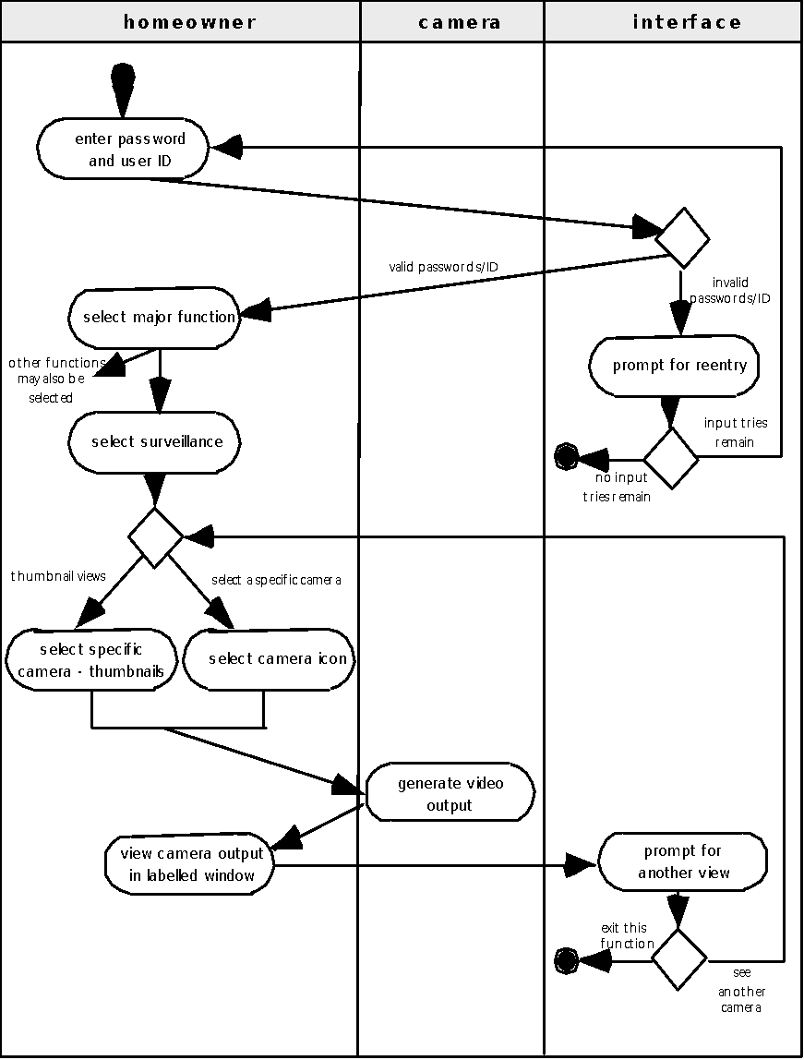
Swimlane Diagrams
Allows the modeler to represent the flow of activities described by the use-case and at the same time indicate which actor (if there are multiple actors involved in a specific use-case) or analysis class has responsibility for the action described by an activity rectangle
These slides are designed to accompany Software Engineering: A Practitioner’s Approach, 8/e (McGraw-Hill, 2014). Slides copyright 2014 by Roger Pressman.
‹#›

