Slide 1
Chapter 17
WebApp Design
Slide Set to accompany
Software Engineering: A Practitioner’s Approach, 8/e
by Roger S. Pressman and Bruce R. Maxim
Slides copyright © 1996, 2001, 2005, 2009, 2014 by Roger S. Pressman
For non-profit educational use only
May be reproduced ONLY for student use at the university level when used in conjunction with Software Engineering: A Practitioner's Approach, 8/e. Any other reproduction or use is prohibited without the express written permission of the author.
All copyright information MUST appear if these slides are posted on a website for student use.
These slides are designed to accompany Software Engineering: A Practitioner’s Approach, 8/e (McGraw-Hill, 2014) Slides copyright 2014 by Roger Pressman.
‹#›

Slide 2
Design & WebApps
“There are essentially two basic approaches to design: the artistic ideal of expressing yourself and the engineering ideal of solving a problem for a customer.”
Jakob Nielsen
When should we emphasize WebApp design?
  when content and function are complex
  when the size of the WebApp encompasses hundreds of content objects, functions, and analysis classes
  when the success of the WebApp will have a direct impact on the success of the business
These slides are designed to accompany Software Engineering: A Practitioner’s Approach, 8/e (McGraw-Hill, 2014) Slides copyright 2014 by Roger Pressman.
‹#›

Slide 3
Design & WebApp Quality
Security
  Rebuff external attacks
  Exclude unauthorized access
  Ensure the privacy of users/customers
Availability
  the measure of the percentage of time that a WebApp is available for use
Scalability
  Can the WebApp and the systems with which it is interfaced handle significant variation in user or transaction volume
Time to Market
These slides are designed to accompany Software Engineering: A Practitioner’s Approach, 8/e (McGraw-Hill, 2014) Slides copyright 2014 by Roger Pressman.
‹#›

Slide 4
Quality Dimensions for End-Users
Time
  How much has a Web site changed since the last upgrade?
  How do you highlight the parts that have changed?
Structural
  How well do all of the parts of the Web site hold together.
  Are all links inside and outside the Web site working?
  Do all of the images work?
  Are there parts of the Web site that are not connected?
Content
  Does the content of critical pages match what is supposed to be there?
  Do key phrases exist continually in highly-changeable pages?
  Do critical pages maintain quality content from version to version?
  What about dynamically generated HTML pages?
These slides are designed to accompany Software Engineering: A Practitioner’s Approach, 8/e (McGraw-Hill, 2014) Slides copyright 2014 by Roger Pressman.
‹#›

Slide 5
Quality Dimensions for End-Users
Accuracy and Consistency
  Are today's copies of the pages downloaded the same as yesterday's? Close enough?
  Is the data presented accurate enough? How do you know?
Response Time and Latency
  Does the Web site server respond to a browser request within certain parameters?
  In an E-commerce context, how is the end to end response time after a SUBMIT?
  Are there parts of a site that are so slow the user declines to continue working on it?
Performance
  Is the Browser-Web-Web site-Web-Browser connection quick enough?
  How does the performance vary by time of day, by load and usage?
  Is performance adequate for E-commerce applications?
These slides are designed to accompany Software Engineering: A Practitioner’s Approach, 8/e (McGraw-Hill, 2014) Slides copyright 2014 by Roger Pressman.
‹#›

Slide 6
WebApp Design Goals
Consistency
  Content should be constructed consistently
  Graphic design (aesthetics) should present a consistent look across all parts of the WebApp
  Architectural design should establish templates that lead to a consistent hypermedia structure
  Interface design should define consistent modes of interaction, navigation and content display
  Navigation mechanisms should be used consistently across all WebApp elements
These slides are designed to accompany Software Engineering: A Practitioner’s Approach, 8/e (McGraw-Hill, 2014) Slides copyright 2014 by Roger Pressman.
‹#›

Slide 7
WebApp Design Goals
Identity
  Establish an “identity” that is appropriate for the business purpose
Robustness
  The user expects robust content and functions that are relevant to the user’s needs
Navigability
  designed in a manner that is intuitive and predictable
Visual appeal
  the look and feel of content, interface layout, color coordination, the balance of text, graphics and other media, navigation mechanisms must appeal to end-users
Compatibility
  With all appropriate environments and configurations
These slides are designed to accompany Software Engineering: A Practitioner’s Approach, 8/e (McGraw-Hill, 2014) Slides copyright 2014 by Roger Pressman.
‹#›

Slide 8
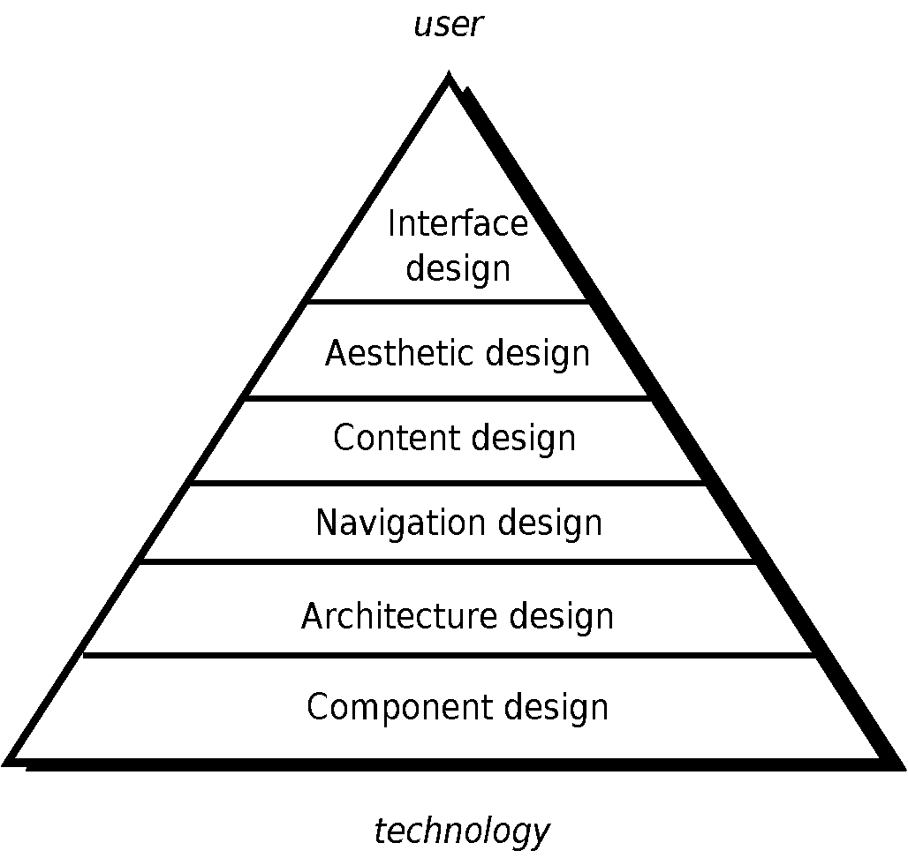
WebE Design Pyramid
These slides are designed to accompany Software Engineering: A Practitioner’s Approach, 8/e (McGraw-Hill, 2014) Slides copyright 2014 by Roger Pressman.
‹#›

Slide 9
WebApp Interface Design
Where am I? The interface should
  provide an indication of the WebApp that has been accessed
  inform the user of her location in the content hierarchy.
What can I do now? The interface should always help the user understand his current options
  what functions are available?
  what links are live?
  what content is relevant?
Where have I been, where am I going? The interface must facilitate navigation.
  Provide a “map” (implemented in a way that is easy to understand) of where the user has been and what paths may be taken to move elsewhere within the WebApp.
These slides are designed to accompany Software Engineering: A Practitioner’s Approach, 8/e (McGraw-Hill, 2014) Slides copyright 2014 by Roger Pressman.
‹#›

Slide 10
Effective WebApp Interfaces
Bruce Tognozzi [TOG01] suggests…
  Effective interfaces are visually apparent and forgiving, instilling in their users a sense of control. Users quickly see the breadth of their options, grasp how to achieve their goals, and do their work.
  Effective interfaces do not concern the user with the inner workings of the system. Work is carefully and continuously saved, with full option for the user to undo any activity at any time.
  Effective applications and services perform a maximum of work, while requiring a minimum of information from users.
These slides are designed to accompany Software Engineering: A Practitioner’s Approach, 8/e (McGraw-Hill, 2014) Slides copyright 2014 by Roger Pressman.
‹#›

Slide 11
Interface Design Principles-I
Anticipation—A WebApp should be designed so that it anticipates the use’s next move.
Communication—The interface should communicate the status of any activity initiated by the user
Consistency—The use of navigation controls, menus, icons, and aesthetics (e.g., color, shape, layout)
Controlled autonomy—The interface should facilitate user movement throughout the WebApp, but it should do so in a manner that enforces navigation conventions that have been established for the application.
Efficiency—The design of the WebApp and its interface should optimize the user’s work efficiency, not the efficiency of the Web engineer who designs and builds it or the client-server environment that executes it.
These slides are designed to accompany Software Engineering: A Practitioner’s Approach, 8/e (McGraw-Hill, 2014) Slides copyright 2014 by Roger Pressman.
‹#›

Slide 12
Interface Design Principles-II
Focus—The WebApp interface (and the content it presents) should stay focused on the user task(s) at hand.
Fitt’s Law—“The time to acquire a target is a function of the distance to and size of the target.”
Human interface objects—A vast library of reusable human interface objects has been developed for WebApps.
Latency reduction—The WebApp should use multi-tasking in a way that lets the user proceed with work as if the operation has been completed.
Learnability— A WebApp interface should be designed to minimize learning time, and once learned, to minimize relearning required when the WebApp is revisited.
These slides are designed to accompany Software Engineering: A Practitioner’s Approach, 8/e (McGraw-Hill, 2014) Slides copyright 2014 by Roger Pressman.
‹#›

Slide 13
Interface Design Principles-III
Maintain work product integrity—A work product (e.g., a form completed by the user, a user specified list) must be automatically saved so that it will not be lost if an error occurs.
Readability—All information presented through the interface should be readable by young and old.
Track state—When appropriate, the state of the user interaction should be tracked and stored so that a user can logoff and return later to pick up where she left off.
Visible navigation—A well-designed WebApp interface provides “the illusion that users are in the same place, with the work brought to them.”
These slides are designed to accompany Software Engineering: A Practitioner’s Approach, 8/e (McGraw-Hill, 2014) Slides copyright 2014 by Roger Pressman.
‹#›

Slide 14
Aesthetic Design
Don’t be afraid of white space.
Emphasize content.
Organize layout elements from top-left to bottom right.
Group navigation, content, and function geographically within the page.
Don’t extend your real estate with the scrolling bar.
Consider resolution and browser window size when designing layout.
These slides are designed to accompany Software Engineering: A Practitioner’s Approach, 8/e (McGraw-Hill, 2014) Slides copyright 2014 by Roger Pressman.
‹#›

Slide 15
Content Design
Develops a design representation for content objects
  For WebApps, a content object is more closely aligned with a data object for conventional software
Represents the mechanisms required to instantiate their relationships to one another.
  analogous to the relationship between analysis classes and design components described in Chapter 11
A content object has attributes that include content-specific information and implementation-specific attributes that are specified as part of design
These slides are designed to accompany Software Engineering: A Practitioner’s Approach, 8/e (McGraw-Hill, 2014) Slides copyright 2014 by Roger Pressman.
‹#›

Slide 16
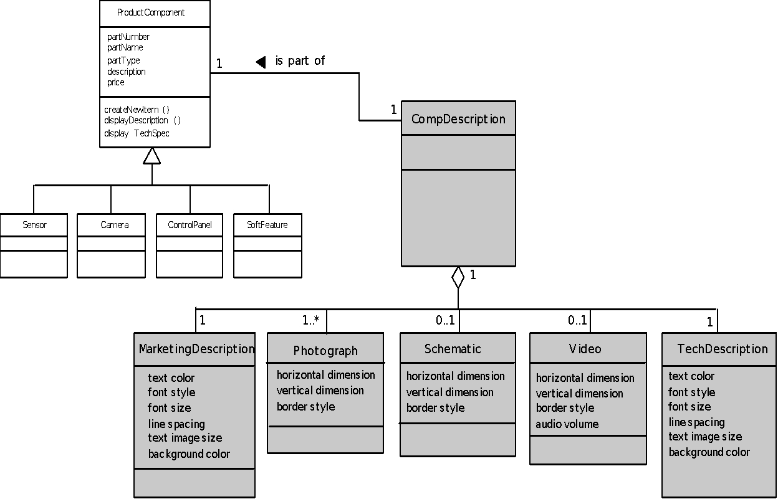
Design of Content Objects
These slides are designed to accompany Software Engineering: A Practitioner’s Approach, 8/e (McGraw-Hill, 2014) Slides copyright 2014 by Roger Pressman.
‹#›

Slide 17
Architecture Design
Content architecture focuses on the manner in which content objects (or composite objects such as Web pages) are structured for presentation and navigation.
  The term information architecture is also used to connote structures that lead to better organization, labeling, navigation, and searching of content objects.
WebApp architecture addresses the manner in which the application is structured to manage user interaction, handle internal processing tasks, effect navigation, and present content.
Architecture design is conducted in parallel with interface design, aesthetic design and content design.
These slides are designed to accompany Software Engineering: A Practitioner’s Approach, 8/e (McGraw-Hill, 2014) Slides copyright 2014 by Roger Pressman.
‹#›

Slide 18
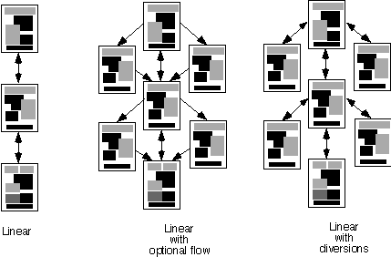
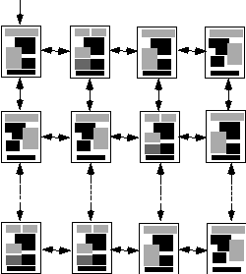
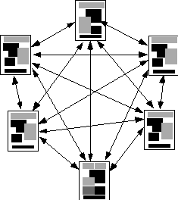
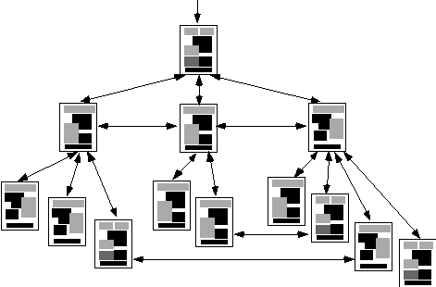
Content Architecture
Linear
structure
Grid
structure
Network
structure
Hierarchical
structure
These slides are designed to accompany Software Engineering: A Practitioner’s Approach, 8/e (McGraw-Hill, 2014) Slides copyright 2014 by Roger Pressman.
‹#›

Slide 19
MVC Architecture
The model contains all application specific content and processing logic, including
  all content objects
  access to external data/information sources,
  all processing functionality that are application specific
The view contains all interface specific functions and enables
  the presentation of content and processing logic
  access to external data/information sources,
  all processing functionality required by the end-user.
The controller manages access to the model and the view and coordinates the flow of data between them.
These slides are designed to accompany Software Engineering: A Practitioner’s Approach, 8/e (McGraw-Hill, 2014) Slides copyright 2014 by Roger Pressman.
‹#›

Slide 20
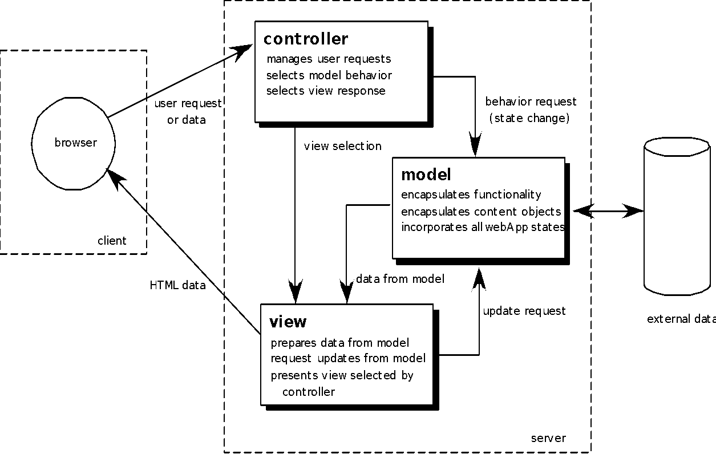
MVC Architecture
These slides are designed to accompany Software Engineering: A Practitioner’s Approach, 8/e (McGraw-Hill, 2014) Slides copyright 2014 by Roger Pressman.
‹#›

Slide 21
Navigation Design
Begins with a consideration of the user hierarchy and related use-cases
  Each actor may use the WebApp somewhat differently and therefore have different navigation requirements
As each user interacts with the WebApp, she encounters a series of navigation semantic units (NSUs)
  NSU—“a set of information and related navigation structures that collaborate in the fulfillment of a subset of related user requirements”
These slides are designed to accompany Software Engineering: A Practitioner’s Approach, 8/e (McGraw-Hill, 2014) Slides copyright 2014 by Roger Pressman.
‹#›

Slide 22
Navigation Semantic Units
Navigation semantic unit
  Ways of navigation (WoN)—represents the best navigation way or path for users with certain profiles to achieve their desired goal or sub-goal. Composed of …
    Navigation nodes (NN) connected by Navigation links
link₁₂
NN₂
link₂₄
NN₁
NN₄
NSU
link₁₃
NN₃
link₃₄
These slides are designed to accompany Software Engineering: A Practitioner’s Approach, 8/e (McGraw-Hill, 2014) Slides copyright 2014 by Roger Pressman.
‹#›

Slide 23
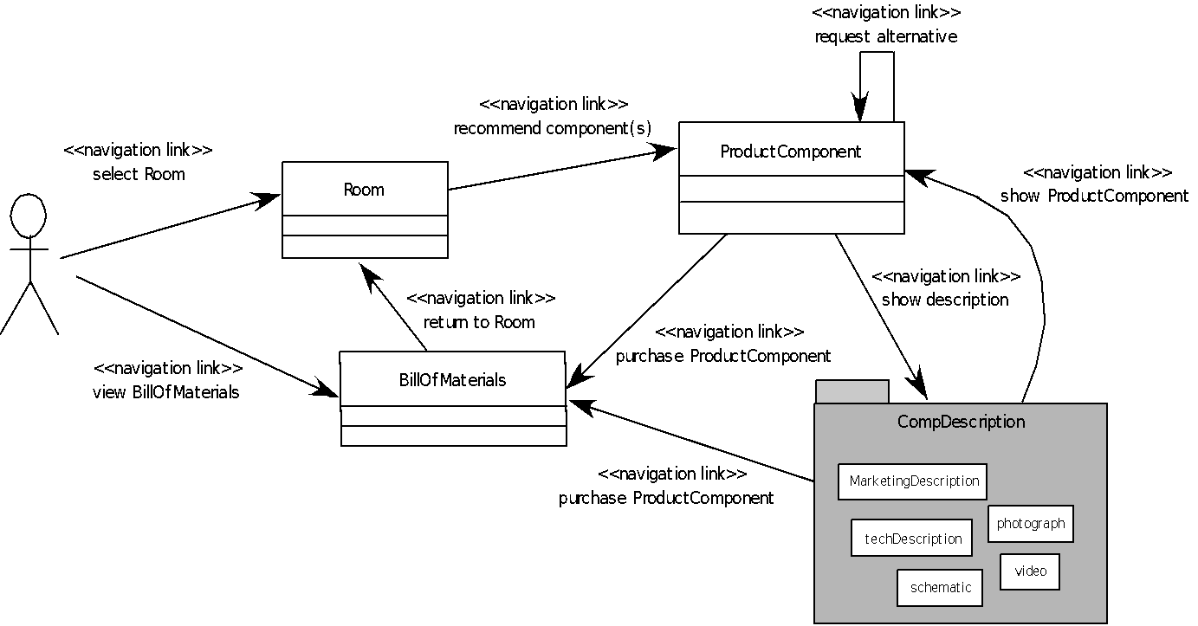
Creating an NSU
These slides are designed to accompany Software Engineering: A Practitioner’s Approach, 8/e (McGraw-Hill, 2014) Slides copyright 2014 by Roger Pressman.
‹#›

Slide 24
Navigation Syntax
Individual navigation link—text-based links, icons, buttons and switches, and graphical metaphors..
Horizontal navigation bar—lists major content or functional categories in a bar containing appropriate links. In general, between 4 and 7 categories are listed.
Vertical navigation column
  lists major content or functional categories
  lists virtually all major content objects within the WebApp.
Tabs—a metaphor that is nothing more than a variation of the navigation bar or column, representing content or functional categories as tab sheets that are selected when a link is required.
Site maps—provide an all-inclusive tab of contents for navigation to all content objects and functionality contained within the WebApp.
These slides are designed to accompany Software Engineering: A Practitioner’s Approach, 8/e (McGraw-Hill, 2014) Slides copyright 2014 by Roger Pressman.
‹#›

Slide 25
Component-Level Design
WebApp components implement the following functionality
  perform localized processing to generate content and navigation capability in a dynamic fashion
  provide computation or data processing capability that are appropriate for the WebApp’s business domain
  provide sophisticated database query and access
  establish data interfaces with external corporate systems.
These slides are designed to accompany Software Engineering: A Practitioner’s Approach, 8/e (McGraw-Hill, 2014) Slides copyright 2014 by Roger Pressman.
‹#›

Slide 26
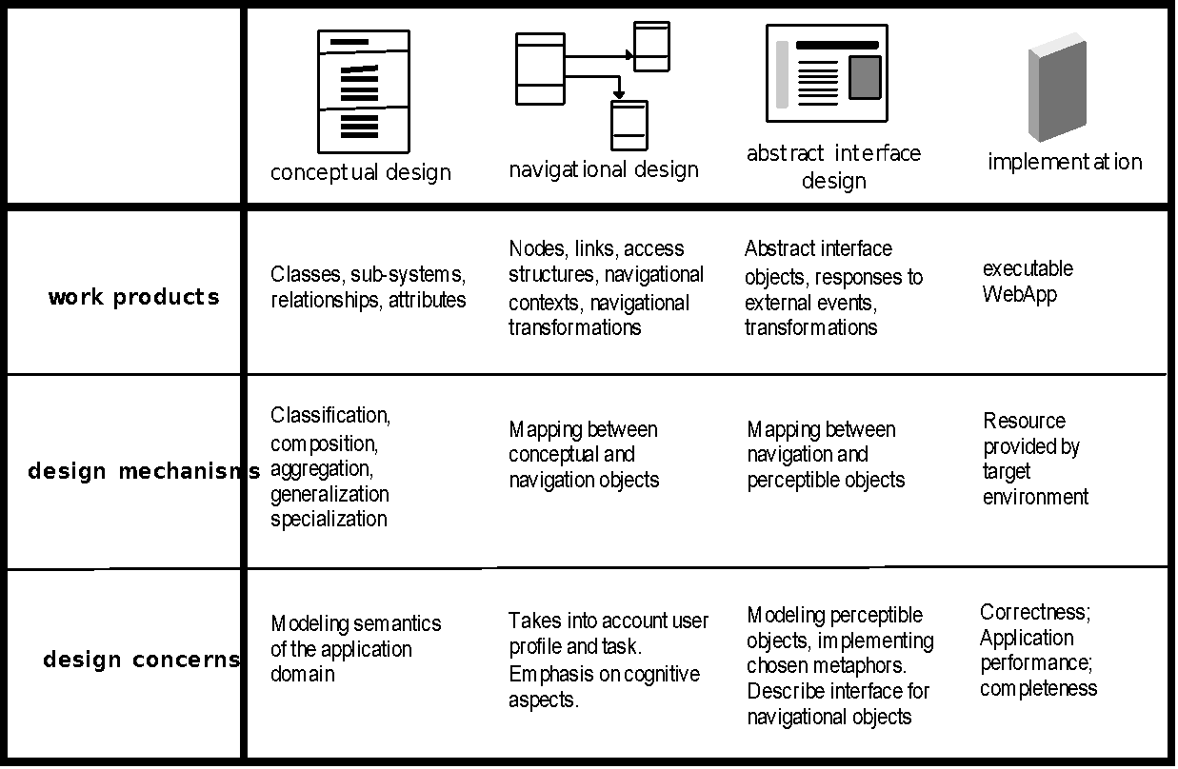
OOHDM
Object-Oriented Hypermedia Design Method (OOHDM)
These slides are designed to accompany Software Engineering: A Practitioner’s Approach, 8/e (McGraw-Hill, 2014) Slides copyright 2014 by Roger Pressman.
‹#›

Slide 27
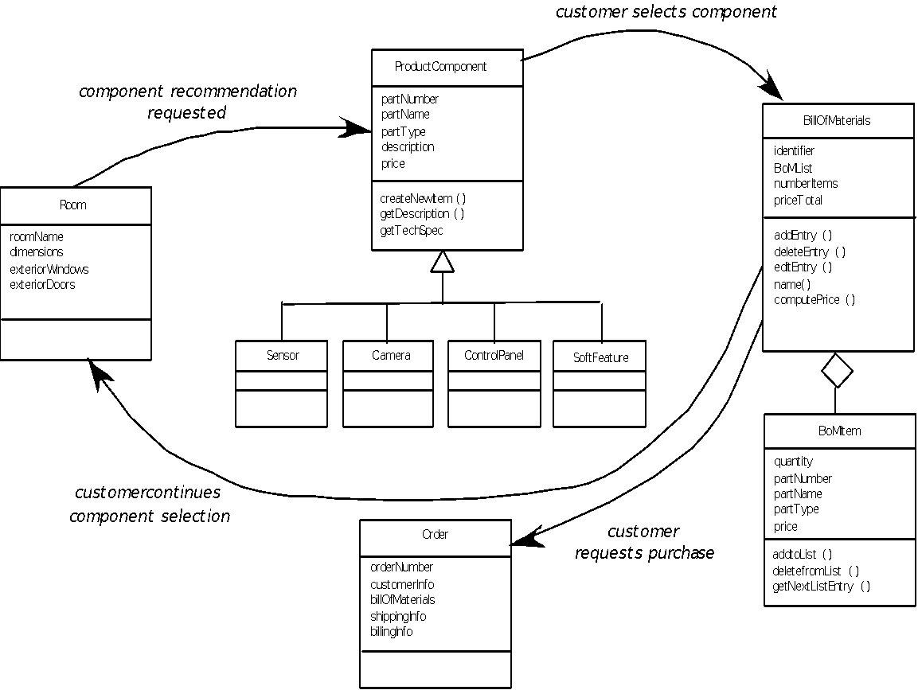
Conceptual Schema
These slides are designed to accompany Software Engineering: A Practitioner’s Approach, 8/e (McGraw-Hill, 2014) Slides copyright 2014 by Roger Pressman.
‹#›

