Slide 1
Chapter 14
Component-Level Design
Slide Set to accompany Software Engineering: A Practitioner’s Approach, 8/e
by Roger S. Pressman and Bruce R. Maxim
Slides copyright © 1996, 2001, 2005, 2009, 2014 by Roger S. Pressman
For non-profit educational use only
May be reproduced ONLY for student use at the university level when used in conjunction with Software Engineering: A Practitioner's Approach, 8/e. Any other reproduction or use is prohibited without the express written permission of the author.
All copyright information MUST appear if these slides are posted on a website for student use.
These slides are designed to accompany Software Engineering: A Practitioner’s Approach, 8/e (McGraw-Hill, 2014). Slides copyright 2014 by Roger Pressman.
‹#›

Slide 2
What is a Component?
OMG Unified Modeling Language Specification [OMG01] defines a component as
“… a modular, deployable, and replaceable part of a system that encapsulates implementation and exposes a set of interfaces.””
OO view: a component contains a set of collaborating classes
Conventional view: a component contains processing logic, the internal data structures that are required to implement the processing logic, and an interface that enables the component to be invoked and data to be passed to it.
These slides are designed to accompany Software Engineering: A Practitioner’s Approach, 8/e (McGraw-Hill, 2014). Slides copyright 2014 by Roger Pressman.
‹#›

Slide 3
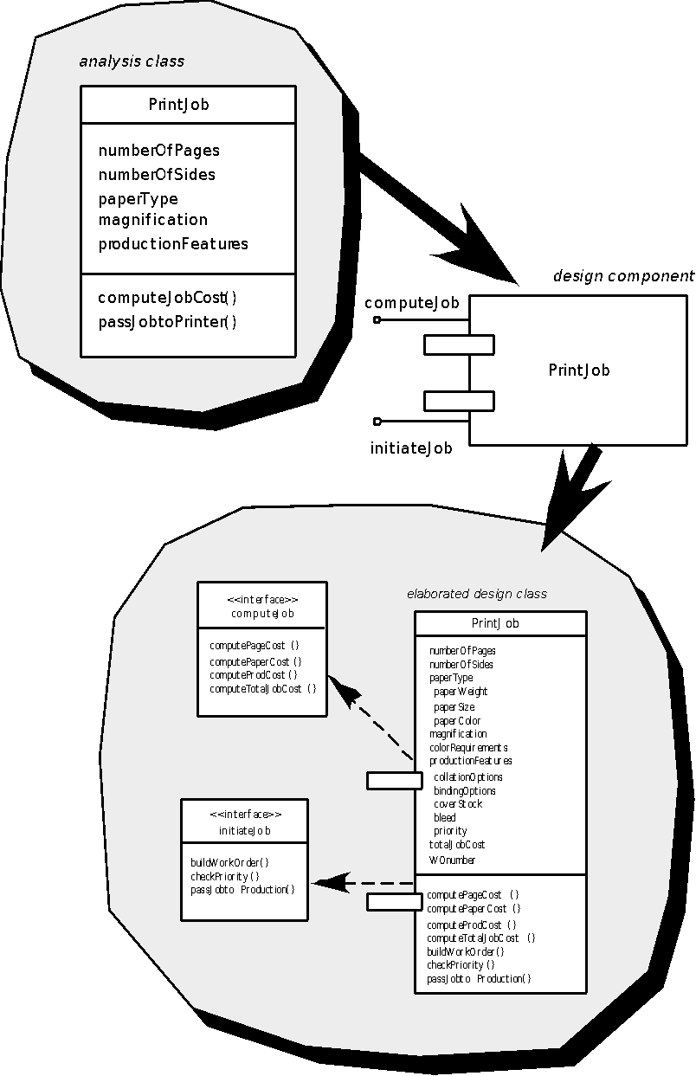
OO Component
These slides are designed to accompany Software Engineering: A Practitioner’s Approach, 8/e (McGraw-Hill, 2014). Slides copyright 2014 by Roger Pressman.
‹#›

Slide 4
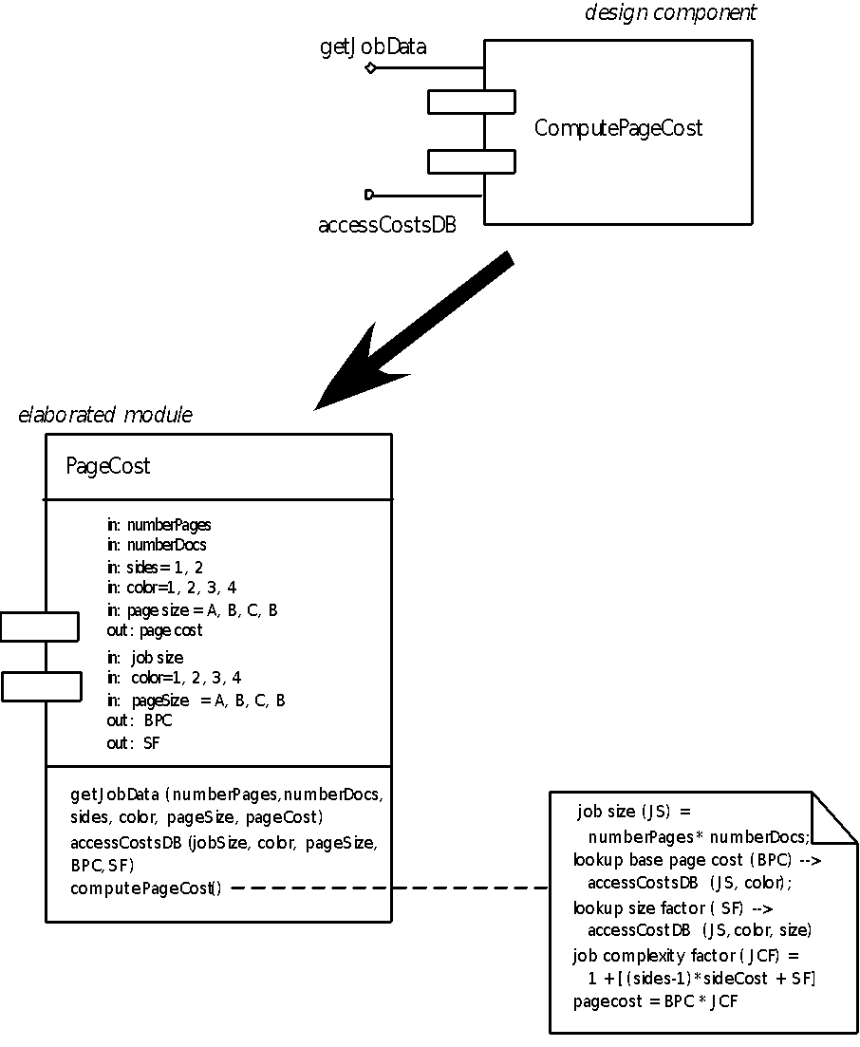
Conventional Component
These slides are designed to accompany Software Engineering: A Practitioner’s Approach, 8/e (McGraw-Hill, 2014). Slides copyright 2014 by Roger Pressman.
‹#›

Slide 5
Basic Design Principles
The Open-Closed Principle (OCP). “A module [component] should be open for extension but closed for modification.
The Liskov Substitution Principle (LSP). “Subclasses should be substitutable for their base classes.
Dependency Inversion Principle (DIP). “Depend on abstractions. Do not depend on concretions.”
The Interface Segregation Principle (ISP). “Many client-specific interfaces are better than one general purpose interface.
The Release Reuse Equivalency Principle (REP). “The granule of reuse is the granule of release.”
The Common Closure Principle (CCP). “Classes that change together belong together.”
The Common Reuse Principle (CRP). “Classes that aren’t reused together should not be grouped together.”
Source: Martin, R., “Design Principles and Design Patterns,” downloaded from http:www.objectmentor.com, 2000.
These slides are designed to accompany Software Engineering: A Practitioner’s Approach, 8/e (McGraw-Hill, 2014). Slides copyright 2014 by Roger Pressman.
‹#›

Slide 6
Design Guidelines
Components
Naming conventions should be established for components that are specified as part of the architectural model and then refined and elaborated as part of the component-level model
Interfaces
Interfaces provide important information about communication and collaboration (as well as helping us to achieve the OPC)
Dependencies and Inheritance
it is a good idea to model dependencies from left to right and inheritance from bottom (derived classes) to top (base classes).
These slides are designed to accompany Software Engineering: A Practitioner’s Approach, 8/e (McGraw-Hill, 2014). Slides copyright 2014 by Roger Pressman.
‹#›

Slide 7
Cohesion
Conventional view:
the “single-mindedness” of a module
OO view:
cohesion implies that a component or class encapsulates only attributes and operations that are closely related to one another and to the class or component itself
Levels of cohesion
Functional
Layer
Communicational
Sequential
Procedural
Temporal
utility
These slides are designed to accompany Software Engineering: A Practitioner’s Approach, 8/e (McGraw-Hill, 2014). Slides copyright 2014 by Roger Pressman.
‹#›

Slide 8
Coupling
Conventional view:
The degree to which a component is connected to other components and to the external world
OO view:
a qualitative measure of the degree to which classes are connected to one another
Level of coupling
Content
Common
Control
Stamp
Data
Routine call
Type use
Inclusion or import
External
These slides are designed to accompany Software Engineering: A Practitioner’s Approach, 8/e (McGraw-Hill, 2014). Slides copyright 2014 by Roger Pressman.
‹#›

Slide 9
Component Level Design-I
Step 1. Identify all design classes that correspond to the problem domain.
Step 2. Identify all design classes that correspond to the infrastructure domain.
Step 3. Elaborate all design classes that are not acquired as reusable components.
Step 3a. Specify message details when classes or component collaborate.
Step 3b. Identify appropriate interfaces for each component.
These slides are designed to accompany Software Engineering: A Practitioner’s Approach, 8/e (McGraw-Hill, 2014). Slides copyright 2014 by Roger Pressman.
‹#›

Slide 10
Component-Level Design-II
Step 3c. Elaborate attributes and define data types and data structures required to implement them.
Step 3d. Describe processing flow within each operation in detail.
Step 4. Describe persistent data sources (databases and files) and identify the classes required to manage them.
Step 5. Develop and elaborate behavioral representations for a class or component.
Step 6. Elaborate deployment diagrams to provide additional implementation detail.
Step 7. Factor every component-level design representation and always consider alternatives.
These slides are designed to accompany Software Engineering: A Practitioner’s Approach, 8/e (McGraw-Hill, 2014). Slides copyright 2014 by Roger Pressman.
‹#›

Slide 11
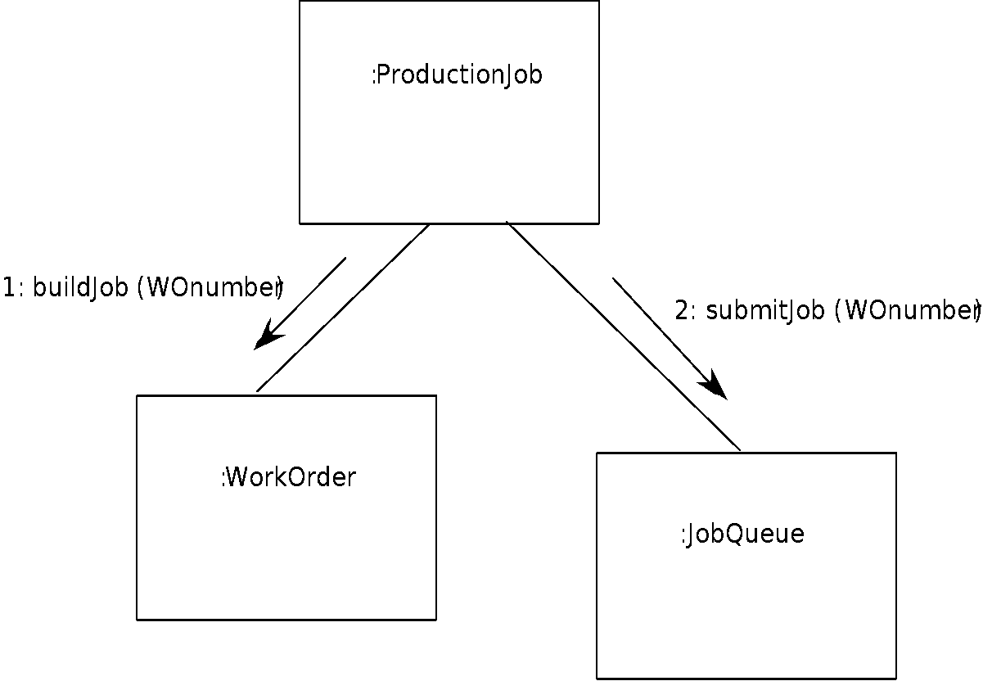
Collaboration Diagram
These slides are designed to accompany Software Engineering: A Practitioner’s Approach, 8/e (McGraw-Hill, 2014). Slides copyright 2014 by Roger Pressman.
‹#›

Slide 12
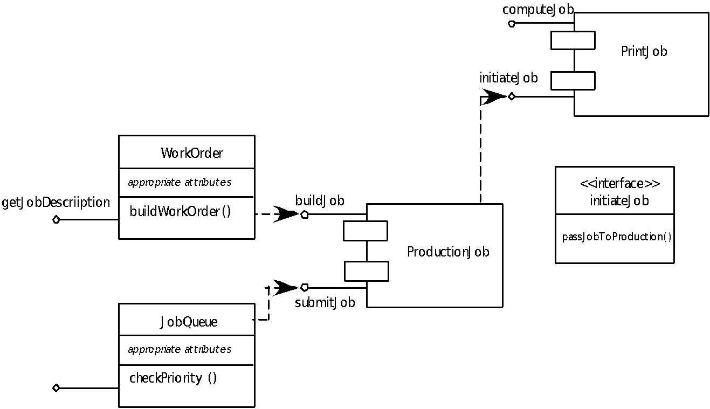
Refactoring
These slides are designed to accompany Software Engineering: A Practitioner’s Approach, 8/e (McGraw-Hill, 2014). Slides copyright 2014 by Roger Pressman.
‹#›

Slide 13
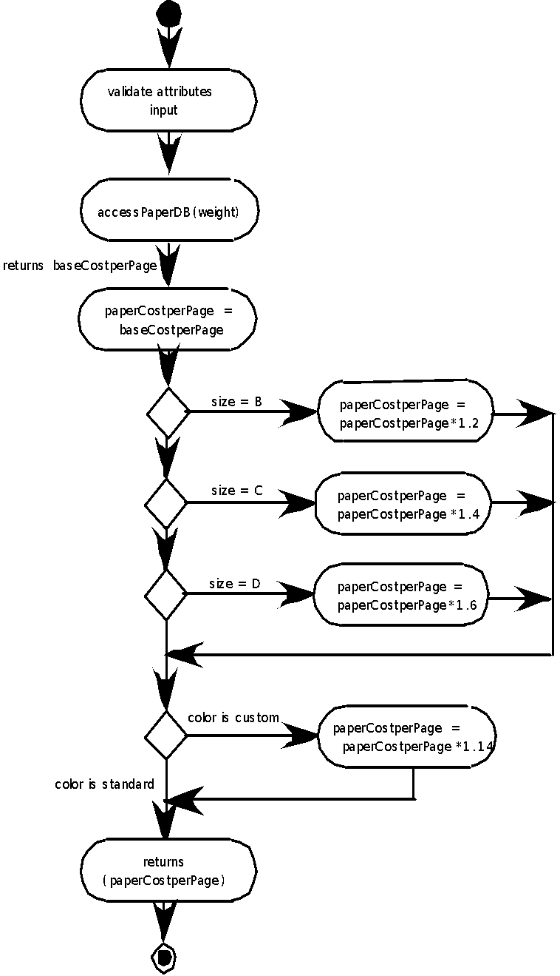
Activity Diagram
These slides are designed to accompany Software Engineering: A Practitioner’s Approach, 8/e (McGraw-Hill, 2014). Slides copyright 2014 by Roger Pressman.
‹#›

Slide 14
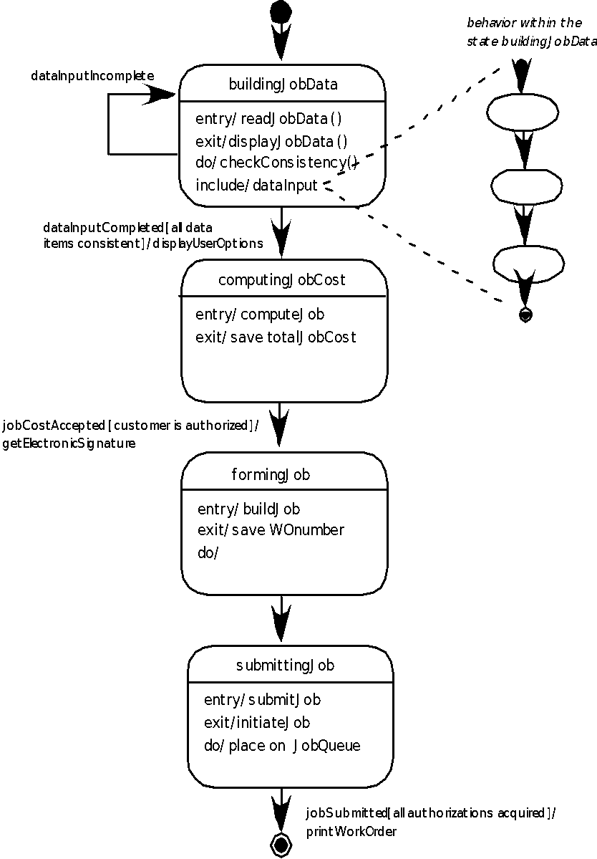
Statechart
These slides are designed to accompany Software Engineering: A Practitioner’s Approach, 8/e (McGraw-Hill, 2014). Slides copyright 2014 by Roger Pressman.
‹#›

Slide 15
Component Design for WebApps
WebApp component is
(1) a well-defined cohesive function that manipulates content or provides computational or data processing for an end-user, or
(2) a cohesive package of content and functionality that provides end-user with some required capability.
Therefore, component-level design for WebApps often incorporates elements of content design and functional design.
These slides are designed to accompany Software Engineering: A Practitioner’s Approach, 8/e (McGraw-Hill, 2014). Slides copyright 2014 by Roger Pressman.
‹#›

Slide 16
Content Design for WebApps
focuses on content objects and the manner in which they may be packaged for presentation to a WebApp end-user
consider a Web-based video surveillance capability within SafeHomeAssured.com
potential content components can be defined for the video surveillance capability:
(1) the content objects that represent the space layout (the floor plan) with additional icons representing the location of sensors and video cameras;
(2) the collection of thumbnail video captures (each an separate data object), and
(3) the streaming video window for a specific camera.
Each of these components can be separately named and manipulated as a package.
These slides are designed to accompany Software Engineering: A Practitioner’s Approach, 8/e (McGraw-Hill, 2014). Slides copyright 2014 by Roger Pressman.
‹#›

Slide 17
Functional Design for WebApps
Modern Web applications deliver increasingly sophisticated processing functions that:
(1) perform localized processing to generate content and navigation capability in a dynamic fashion;
(2) provide computation or data processing capability that is appropriate for the WebApp’s business domain;
(3) provide sophisticated database query and access, or
(4) establish data interfaces with external corporate systems.
To achieve these (and many other) capabilities, you will design and construct WebApp functional components that are identical in form to software components for conventional software.
These slides are designed to accompany Software Engineering: A Practitioner’s Approach, 8/e (McGraw-Hill, 2014). Slides copyright 2014 by Roger Pressman.
‹#›

Slide 18
Component Design for Mobile Apps
Thin web-based client
Interface layer only on device
Business and data layers implemented using web or cloud services
Rich client
All three layers (interface, business, data) implemented on device
Subject to mobile device limitations
These slides are designed to accompany Software Engineering: A Practitioner’s Approach, 8/e (McGraw-Hill, 2014). Slides copyright 2014 by Roger Pressman.
‹#›

Slide 19
Designing Conventional Components
The design of processing logic is governed by the basic principles of algorithm design and structured programming
The design of data structures is defined by the data model developed for the system
The design of interfaces is governed by the collaborations that a component must effect
These slides are designed to accompany Software Engineering: A Practitioner’s Approach, 8/e (McGraw-Hill, 2014). Slides copyright 2014 by Roger Pressman.
‹#›

Slide 20
Component-Based Development
When faced with the possibility of reuse, the software team asks:
Are commercial off-the-shelf (COTS) components available to implement the requirement?
Are internally-developed reusable components available to implement the requirement?
Are the interfaces for available components compatible within the architecture of the system to be built?
At the same time, they are faced with the following impediments to reuse ...
These slides are designed to accompany Software Engineering: A Practitioner’s Approach, 8/e (McGraw-Hill, 2014). Slides copyright 2014 by Roger Pressman.
‹#›

Slide 21
Impediments to Reuse
Few companies and organizations have anything that even slightly resembles a comprehensive software reusability plan.
Although an increasing number of software vendors currently sell tools or components that provide direct assistance for software reuse, the majority of software developers do not use them.
Relatively little training is available to help software engineers and managers understand and apply reuse.
Many software practitioners continue to believe that reuse is “more trouble than it’s worth.”
Many companies continue to encourage of software development methodologies which do not facilitate reuse
Few companies provide an incentives to produce reusable program components.
These slides are designed to accompany Software Engineering: A Practitioner’s Approach, 8/e (McGraw-Hill, 2014). Slides copyright 2014 by Roger Pressman.
‹#›

Slide 22
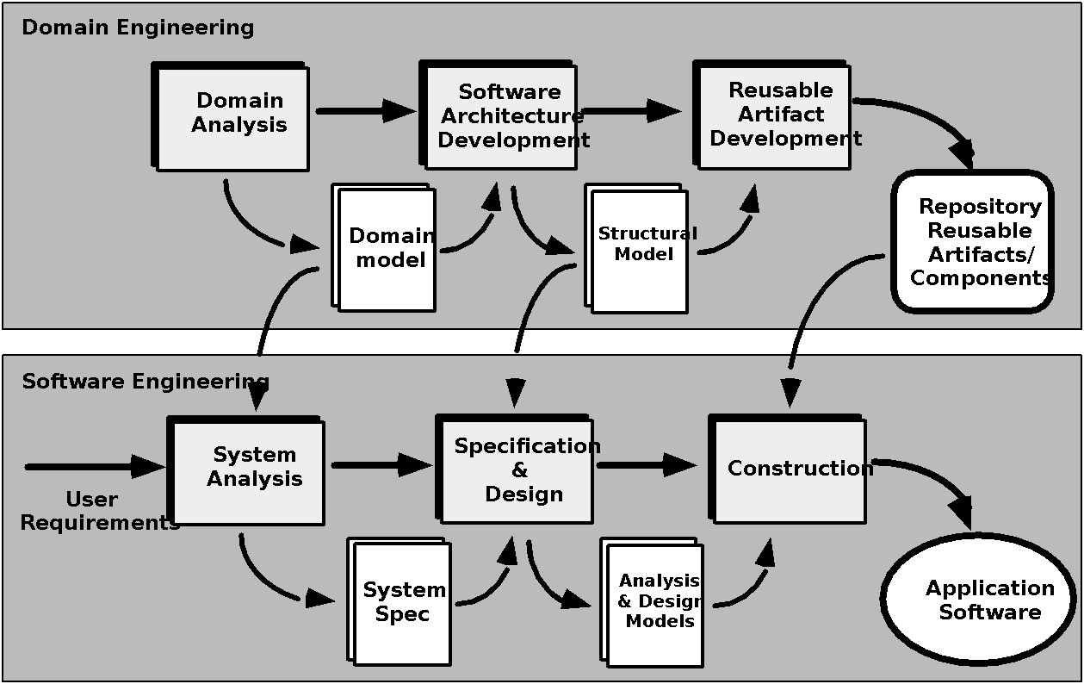
The CBSE Process
These slides are designed to accompany Software Engineering: A Practitioner’s Approach, 8/e (McGraw-Hill, 2014). Slides copyright 2014 by Roger Pressman.
‹#›

Slide 23
Domain Engineering
1. Define the domain to be investigated.
2. Categorize the items extracted from the domain.
3. Collect a representative sample of applications in the domain.
4. Analyze each application in the sample.
5. Develop an analysis model for the objects.
These slides are designed to accompany Software Engineering: A Practitioner’s Approach, 8/e (McGraw-Hill, 2014). Slides copyright 2014 by Roger Pressman.
‹#›

Slide 24
Identifying Reusable Components
• Is component functionality required on future implementations?
• How common is the component's function within the domain?
• Is there duplication of the component's function within the domain?
• Is the component hardware-dependent?
• Does the hardware remain unchanged between implementations?
• Can the hardware specifics be removed to another component?
• Is the design optimized enough for the next implementation?
• Can we parameterize a non-reusable component so that it becomes reusable?
• Is the component reusable in many implementations with only minor changes?
• Is reuse through modification feasible?
• Can a non-reusable component be decomposed to yield reusable components?
• How valid is component decomposition for reuse?
These slides are designed to accompany Software Engineering: A Practitioner’s Approach, 8/e (McGraw-Hill, 2014). Slides copyright 2014 by Roger Pressman.
‹#›

Slide 25
Component-Based SE
a library of components must be available
components should have a consistent structure
a standard should exist, e.g.,
OMG/CORBA
Microsoft COM
Sun JavaBeans
These slides are designed to accompany Software Engineering: A Practitioner’s Approach, 8/e (McGraw-Hill, 2014). Slides copyright 2014 by Roger Pressman.
‹#›

Slide 26
CBSE Activities
Component qualification
Component adaptation
Component composition
Component update
These slides are designed to accompany Software Engineering: A Practitioner’s Approach, 8/e (McGraw-Hill, 2014). Slides copyright 2014 by Roger Pressman.
‹#›

Slide 27
Qualification
Before a component can be used, you must consider:
• application programming interface (API)
• development and integration tools required by the component
• run-time requirements including resource usage (e.g., memory or storage), timing or speed, and network protocol
• service requirements including operating system interfaces and support from other components
• security features including access controls and authentication protocol
• embedded design assumptions including the use of specific numerical or non-numerical algorithms
• exception handling
These slides are designed to accompany Software Engineering: A Practitioner’s Approach, 8/e (McGraw-Hill, 2014). Slides copyright 2014 by Roger Pressman.
‹#›

Slide 28
Adaptation
The implication of “easy integration” is:
(1) that consistent methods of resource management have been implemented for all components in the library;
(2) that common activities such as data management exist for all components, and
(3) that interfaces within the architecture and with the external environment have been implemented in a consistent manner.
These slides are designed to accompany Software Engineering: A Practitioner’s Approach, 8/e (McGraw-Hill, 2014). Slides copyright 2014 by Roger Pressman.
‹#›

Slide 29
Composition
An infrastructure must be established to bind components together
Architectural ingredients for composition include:
Data exchange model
Automation
Structured storage
Underlying object model
These slides are designed to accompany Software Engineering: A Practitioner’s Approach, 8/e (McGraw-Hill, 2014). Slides copyright 2014 by Roger Pressman.
‹#›

Slide 30
OMG/ CORBA
The Object Management Group has published a common object request broker architecture (OMG/CORBA).
An object request broker (ORB) provides services that enable reusable components (objects) to communicate with other components, regardless of their location within a system.
Integration of CORBA components (without modification) within a system is assured if an interface definition language (IDL) interface is created for every component.
Objects within the client application request one or more services from the ORB server. Requests are made via an IDL or dynamically at run time.
An interface repository contains all necessary information about the service’s request and response formats.
These slides are designed to accompany Software Engineering: A Practitioner’s Approach, 8/e (McGraw-Hill, 2014). Slides copyright 2014 by Roger Pressman.
‹#›

Slide 31
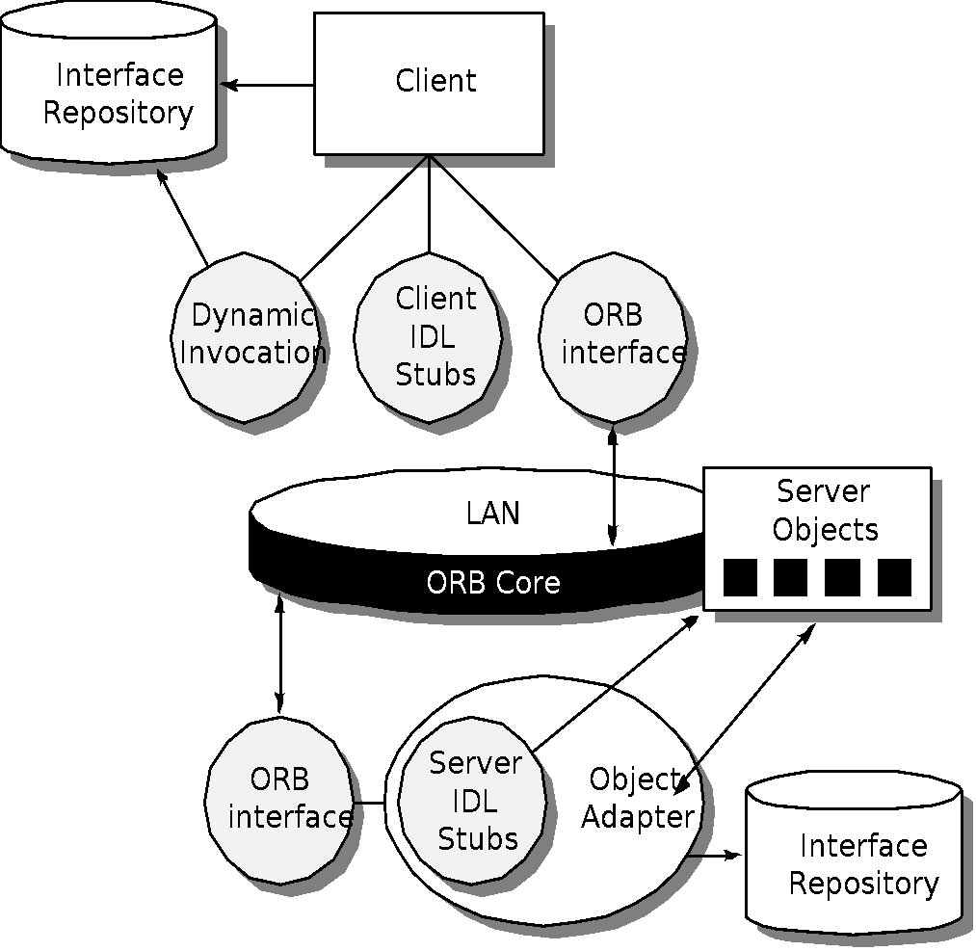
ORB Architecture
These slides are designed to accompany Software Engineering: A Practitioner’s Approach, 8/e (McGraw-Hill, 2014). Slides copyright 2014 by Roger Pressman.
‹#›

Slide 32
Microsoft COM
The component object model (COM) provides a specification for using components produced by various vendors within a single application running under the Windows operating system.
COM encompasses two elements:
COM interfaces (implemented as COM objects)
a set of mechanisms for registering and passing messages between COM interfaces.
These slides are designed to accompany Software Engineering: A Practitioner’s Approach, 8/e (McGraw-Hill, 2014). Slides copyright 2014 by Roger Pressman.
‹#›

Slide 33
Sun JavaBeans
The JavaBeans component system is a portable, platform independent CBSE infrastructure developed using the Java programming language.
The JavaBeans component system encompasses a set of tools, called the Bean Development Kit (BDK), that allows developers to
analyze how existing Beans (components) work
customize their behavior and appearance
establish mechanisms for coordination and communication
develop custom Beans for use in a specific application
test and evaluate Bean behavior.
These slides are designed to accompany Software Engineering: A Practitioner’s Approach, 8/e (McGraw-Hill, 2014). Slides copyright 2014 by Roger Pressman.
‹#›

Slide 34
Classification
Enumerated classification—components are described by defining a hierarchical structure in which classes and varying levels of subclasses of software components are defined
Faceted classification—a domain area is analyzed and a set of basic descriptive features are identified
Attribute-value classification—a set of attributes are defined for all components in a domain area
These slides are designed to accompany Software Engineering: A Practitioner’s Approach, 8/e (McGraw-Hill, 2014). Slides copyright 2014 by Roger Pressman.
‹#›

Slide 35
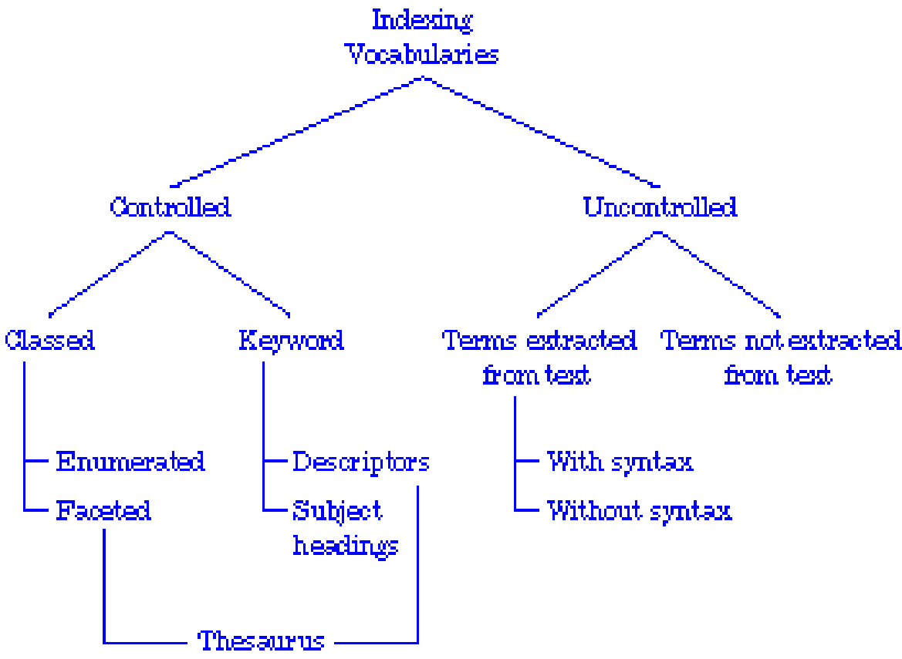
Indexing
These slides are designed to accompany Software Engineering: A Practitioner’s Approach, 8/e (McGraw-Hill, 2014). Slides copyright 2014 by Roger Pressman.
‹#›

Slide 36
The Reuse Environment
A component database capable of storing software components and the classification information necessary to retrieve them.
A library management system that provides access to the database.
A software component retrieval system (e.g., an object request broker) that enables a client application to retrieve components and services from the library server.
CBSE tools that support the integration of reused components into a new design or implementation.
These slides are designed to accompany Software Engineering: A Practitioner’s Approach, 8/e (McGraw-Hill, 2014). Slides copyright 2014 by Roger Pressman.
‹#›

