Slide 1
Chapter 10
Requirements Modeling: Class-Based Methods
Slide Set to accompany
Software Engineering: A Practitioner’s Approach, 8/e
by Roger S. Pressman
Slides copyright © 1996, 2001, 2005, 2009, 2014 by Roger S. Pressman
For non-profit educational use only
May be reproduced ONLY for student use at the university level when used in conjunction with Software Engineering: A Practitioner's Approach, 8/e. Any other reproduction or use is prohibited without the express written permission of the author.
All copyright information MUST appear if these slides are posted on a website for student use.
These slides are designed to accompany Software Engineering: A Practitioner’s Approach, 8/e (McGraw-Hill, 2014). Slides copyright 2014 by Roger Pressman.
‹#›

Slide 2
Requirements Modeling Strategies
One view of requirements modeling, called structured analysis, considers data and the processes that transform the data as separate entities.
  Data objects are modeled in a way that defines their attributes and relationships.
  Processes that manipulate data objects are modeled in a manner that shows how they transform data as data objects flow through the system.
A second approach to analysis modeled, called object-oriented analysis, focuses on
  the definition of classes and
  the manner in which they collaborate with one another to effect customer requirements.
These slides are designed to accompany Software Engineering: A Practitioner’s Approach, 8/e (McGraw-Hill 2014). Slides copyright 2014 by Roger Pressman.
‹#›

Slide 3
Class-Based Modeling
Class-based modeling represents:
  objects that the system will manipulate
  operations (also called methods or services) that will be applied to the objects to effect the manipulation
  relationships (some hierarchical) between the objects
  collaborations that occur between the classes that are defined.
The elements of a class-based model include classes and objects, attributes, operations, CRC models, collaboration diagrams and packages.
These slides are designed to accompany Software Engineering: A Practitioner’s Approach, 8/e (McGraw-Hill, 2014). Slides copyright 2014 by Roger Pressman.
‹#›

Slide 4
Identifying Analysis Classes
Examining the usage scenarios developed as part of the requirements model and perform a "grammatical parse" [Abb83]
  Classes are determined by underlining each noun or noun phrase and entering it into a simple table.
  Synonyms should be noted.
  If the class (noun) is required to implement a solution, then it is part of the solution space; otherwise, if a class is necessary only to describe a solution, it is part of the problem space.
But what should we look for once all of the nouns have been isolated?
These slides are designed to accompany Software Engineering: A Practitioner’s Approach, 8/e (McGraw-Hill, 2014). Slides copyright 2014 by Roger Pressman.
‹#›

Slide 5
Manifestations of Analysis Classes
Analysis classes manifest themselves in one of the following ways:
    External entities (e.g., other systems, devices, people) that produce or consume information
    Things (e.g, reports, displays, letters, signals) that are part of the information domain for the problem
    Occurrences or events (e.g., a property transfer or the completion of a series of robot movements) that occur within the context of system operation
    Roles (e.g., manager, engineer, salesperson) played by people who interact with the system
    Organizational units (e.g., division, group, team) that are relevant to an application
    Places (e.g., manufacturing floor or loading dock) that establish the context of the problem and the overall function
    Structures (e.g., sensors, four-wheeled vehicles, or computers) that define a class of objects or related classes of objects
These slides are designed to accompany Software Engineering: A Practitioner’s Approach, 8/e (McGraw-Hill, 2014). Slides copyright 2014 by Roger Pressman.
‹#›

Slide 6
Potential Classes
Retained information. The potential class will be useful during analysis only if information about it must be remembered so that the system can function.
Needed services. The potential class must have a set of identifiable operations that can change the value of its attributes in some way.
Multiple attributes. During requirement analysis, the focus should be on "major" information; a class with a single attribute may, in fact, be useful during design, but is probably better represented as an attribute of another class during the analysis activity.
Common attributes. A set of attributes can be defined for the potential class and these attributes apply to all instances of the class.
Common operations. A set of operations can be defined for the potential class and these operations apply to all instances of the class.
Essential requirements. External entities that appear in the problem space and produce or consume information essential to the operation of any solution for the system will almost always be defined as classes in the requirements model.
These slides are designed to accompany Software Engineering: A Practitioner’s Approach, 8/e (McGraw-Hill, 2014). Slides copyright 2014 by Roger Pressman.
‹#›

Slide 7
Defining Attributes
Attributes describe a class that has been selected for inclusion in the analysis model.
  build two different classes for professional baseball players
    For Playing Statistics software: name, position, batting average, fielding percentage, years played, and games played might be relevant
    For Pension Fund software: average salary, credit toward full vesting, pension plan options chosen, mailing address, and the like.
These slides are designed to accompany Software Engineering: A Practitioner’s Approach, 8/e (McGraw-Hill, 2014). Slides copyright 2014 by Roger Pressman.
‹#›

Slide 8
Defining Operations
Do a grammatical parse of a processing narrative and look at the verbs
Operations can be divided into four broad categories:
  (1) operations that manipulate data in some way (e.g., adding, deleting, reformatting, selecting)
  (2) operations that perform a computation
  (3) operations that inquire about the state of an object, and
  (4) operations that monitor an object for the occurrence of a controlling event.
These slides are designed to accompany Software Engineering: A Practitioner’s Approach, 8/e (McGraw-Hill, 2014). Slides copyright 2014 by Roger Pressman.
‹#›

Slide 9
CRC Models
Class-responsibility-collaborator (CRC) modeling [Wir90] provides a simple means for identifying and organizing the classes that are relevant to system or product requirements. Ambler [Amb95] describes CRC modeling in the following way:
  A CRC model is really a collection of standard index cards that represent classes. The cards are divided into three sections. Along the top of the card you write the name of the class. In the body of the card you list the class responsibilities on the left and the collaborators on the right.
These slides are designed to accompany Software Engineering: A Practitioner’s Approach, 8/e (McGraw-Hill, 2014). Slides copyright 2014 by Roger Pressman.
‹#›

Slide 10
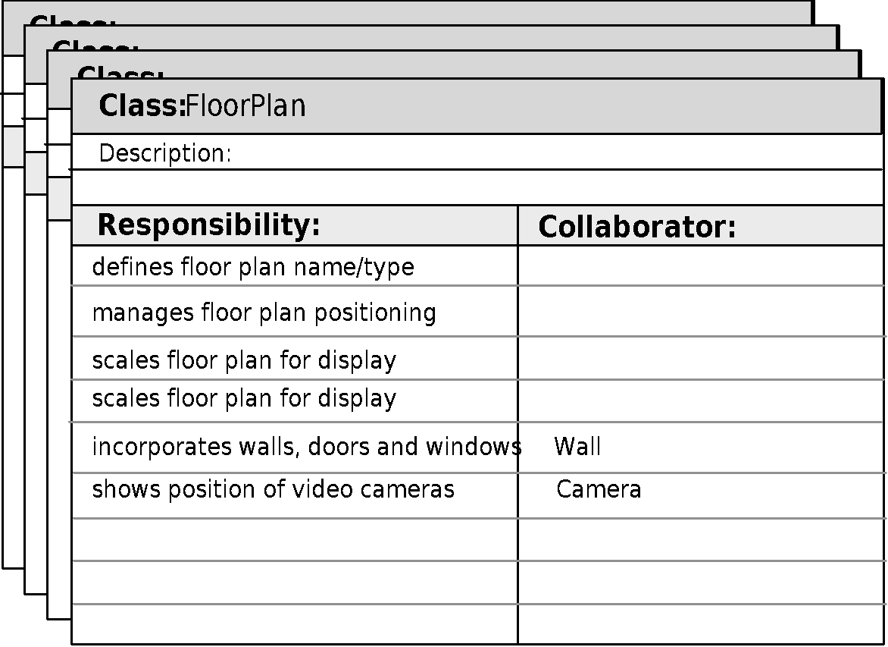
CRC Modeling
These slides are designed to accompany Software Engineering: A Practitioner’s Approach, 8/e (McGraw-Hill, 2014). Slides copyright 2014 by Roger Pressman.
‹#›

Slide 11
Class Types
Entity classes, also called model or business classes, are extracted directly from the statement of the problem (e.g., FloorPlan and Sensor).
Boundary classes are used to create the interface (e.g., interactive screen or printed reports) that the user sees and interacts with as the software is used.
Controller classes manage a “unit of work” [UML03] from start to finish. That is, controller classes can be designed to manage
  the creation or update of entity objects;
  the instantiation of boundary objects as they obtain information from entity objects;
  complex communication between sets of objects;
  validation of data communicated between objects or between the user and the application.
These slides are designed to accompany Software Engineering: A Practitioner’s Approach, 8/e (McGraw-Hill, 2014). Slides copyright 2014 by Roger Pressman.
‹#›

Slide 12
Responsibilities
System intelligence should be distributed across classes to best address the needs of the problem
Each responsibility should be stated as generally as possible
Information and the behavior related to it should reside within the same class
Information about one thing should be localized with a single class, not distributed across multiple classes.
Responsibilities should be shared among related classes, when appropriate.
These slides are designed to accompany Software Engineering: A Practitioner’s Approach, 8/e (McGraw-Hill, 2014). Slides copyright 2014 by Roger Pressman.
‹#›

Slide 13
Collaborations
Classes fulfill their responsibilities in one of two ways:
  A class can use its own operations to manipulate its own attributes, thereby fulfilling a particular responsibility, or
  a class can collaborate with other classes.
Collaborations identify relationships between classes
Collaborations are identified by determining whether a class can fulfill each responsibility itself
three different generic relationships between classes [WIR90]:
  the is-part-of relationship
  the has-knowledge-of relationship
  the depends-upon relationship
These slides are designed to accompany Software Engineering: A Practitioner’s Approach, 8/e (McGraw-Hill, 2014). Slides copyright 2014 by Roger Pressman.
‹#›

Slide 14
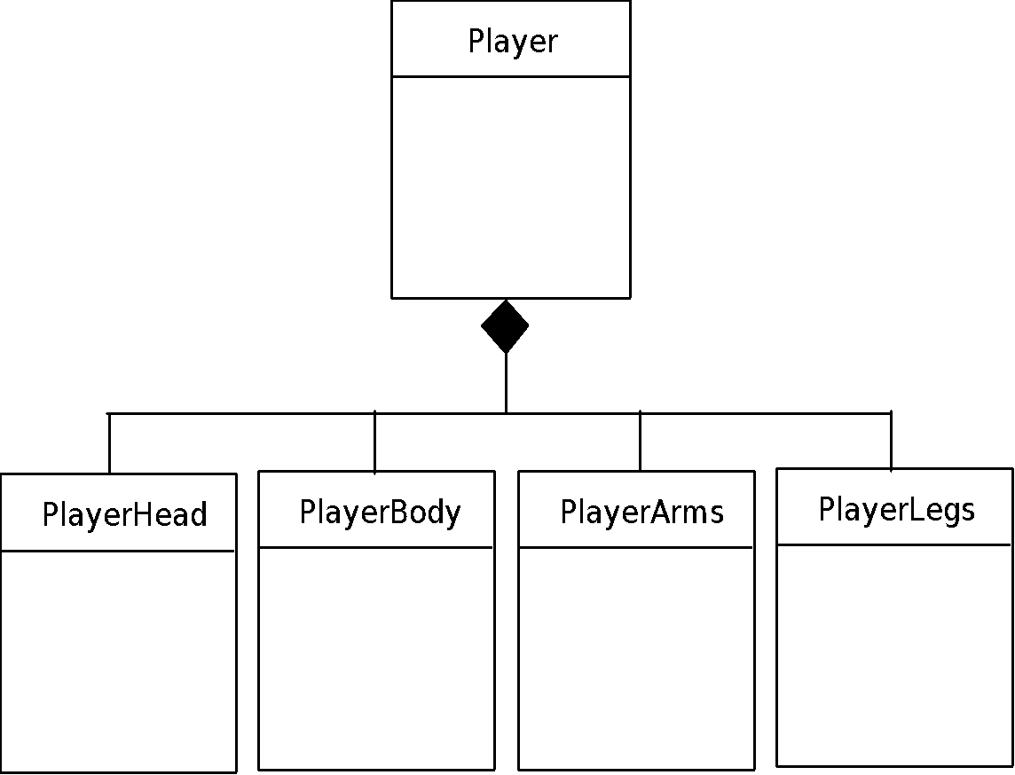
Composite Aggregate Class
These slides are designed to accompany Software Engineering: A Practitioner’s Approach, 8/e (McGraw-Hill, 2014). Slides copyright 2014 by Roger Pressman.
‹#›

Slide 15
Reviewing the CRC Model
All participants in the review (of the CRC model) are given a subset of the CRC model index cards.
  Cards that collaborate should be separated (i.e., no reviewer should have two cards that collaborate).
All use-case scenarios (and corresponding use-case diagrams) should be organized into categories.
The review leader reads the use-case deliberately.
  As the review leader comes to a named object, she passes a token to the person holding the corresponding class index card.
When the token is passed, the holder of the class card is asked to describe the responsibilities noted on the card.
  The group determines whether one (or more) of the responsibilities satisfies the use-case requirement.
If the responsibilities and collaborations noted on the index cards cannot accommodate the use-case, modifications are made to the cards.
  This may include the definition of new classes (and corresponding CRC index cards) or the specification of new or revised responsibilities or collaborations on existing cards.
These slides are designed to accompany Software Engineering: A Practitioner’s Approach, 8/e (McGraw-Hill, 2014). Slides copyright 2014 by Roger Pressman.
‹#›

Slide 16
Associations and Dependencies
Two analysis classes are often related to one another in some fashion
  In UML these relationships are called associations
  Associations can be refined by indicating multiplicity (the term cardinality is used in data modeling
In many instances, a client-server relationship exists between two analysis classes.
  In such cases, a client-class depends on the server-class in some way and a dependency relationship is established
These slides are designed to accompany Software Engineering: A Practitioner’s Approach, 8/e (McGraw-Hill, 2014). Slides copyright 2014 by Roger Pressman.
‹#›

Slide 17
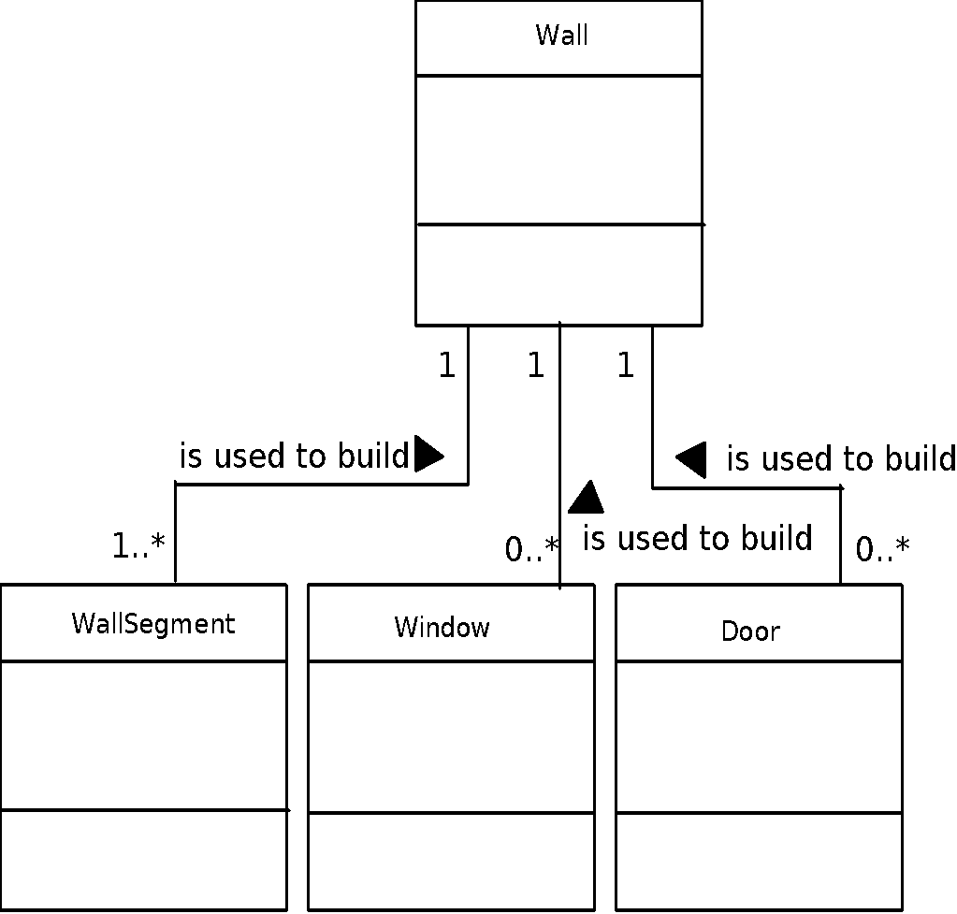
Multiplicity
These slides are designed to accompany Software Engineering: A Practitioner’s Approach, 8/e (McGraw-Hill, 2014). Slides copyright 2014 by Roger Pressman.
‹#›

Slide 18
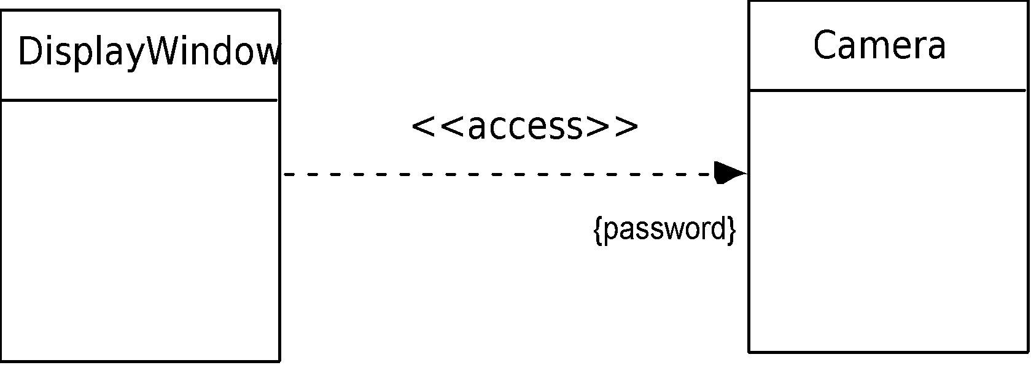
Dependencies
These slides are designed to accompany Software Engineering: A Practitioner’s Approach, 8/e (McGraw-Hill, 2014). Slides copyright 2014 by Roger Pressman.
‹#›

Slide 19
Analysis Packages
Various elements of the analysis model (e.g., use-cases, analysis classes) are categorized in a manner that packages them as a grouping
The plus sign preceding the analysis class name in each package indicates that the classes have public visibility and are therefore accessible from other packages.
Other symbols can precede an element within a package. A minus sign indicates that an element is hidden from all other packages and a # symbol indicates that an element is accessible only to packages contained within a given package.
These slides are designed to accompany Software Engineering: A Practitioner’s Approach, 8/e (McGraw-Hill, 2014). Slides copyright 2014 by Roger Pressman.
‹#›

Slide 20
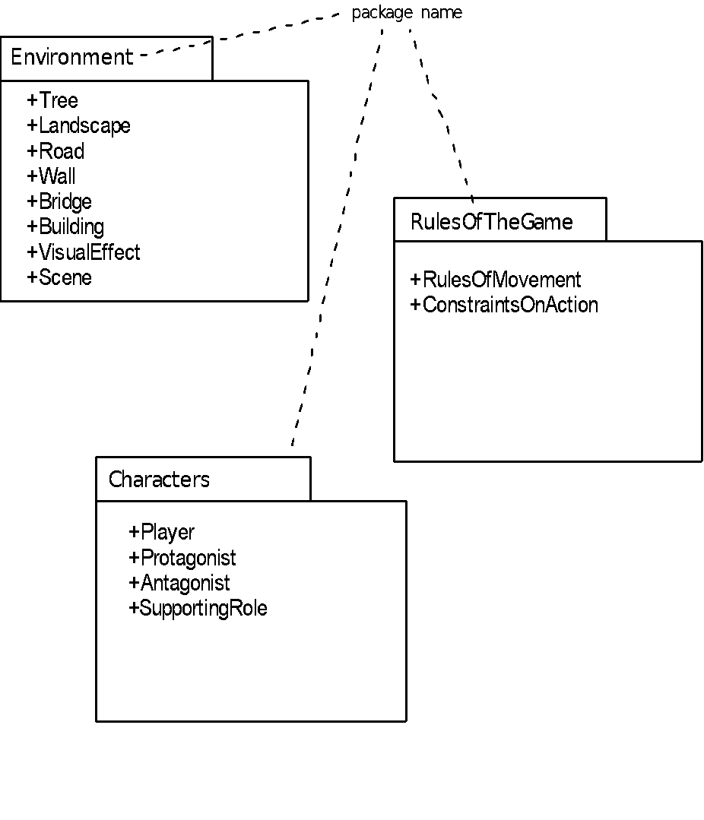
Analysis Packages
These slides are designed to accompany Software Engineering: A Practitioner’s Approach, 8/e (McGraw-Hill, 2014). Slides copyright 2014 by Roger Pressman.
‹#›

